Slide 1
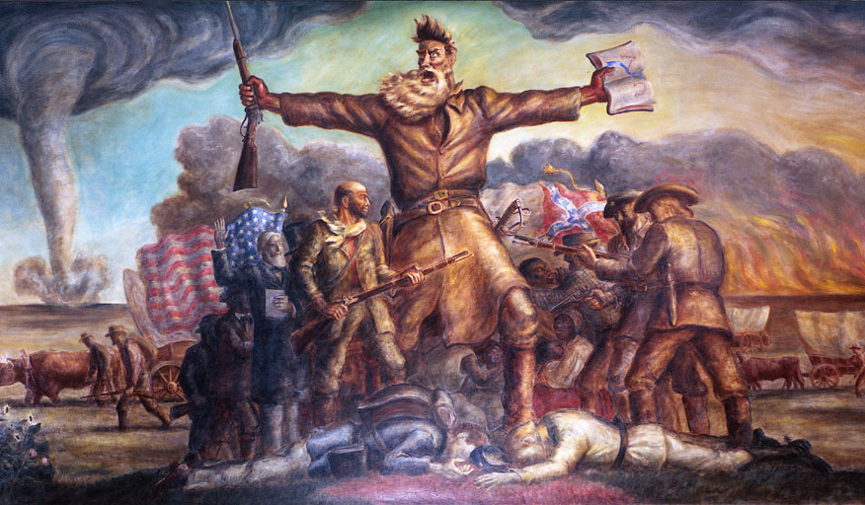
Renewing the Sectional Struggle: A Prelude to Disunion & War

Slide 2
Objectives
Trace the growing conflict over the issue of slavery in the western territories.
Analyze the importance of the Dred Scott decision.
Explain how the election of Abraham Lincoln in 1860 led to secession.

Slide 3
Terms and People
Wilmot Proviso – proposed, but rejected, 1846 bill that would have banned slavery in the territory won from Mexico in the Mexican-American War
Free-Soil Party – antislavery political party of the mid-1800s
Compromise of 1850 – political agreement that allowed California to be admitted as a free state by allowing popular sovereignty in the territories and enacting a stricter fugitive slave law; undid the Missouri Compromise

Slide 4
Terms and People (continued)
popular sovereignty – political policy that permitted the residents of federal territories to decide whether or not to allow slavery
Harriet Beecher Stowe – abolitionist author of Uncle Tom’s Cabin
Kansas-Nebraska Act – 1854 law that divided the Nebraska Territory into Kansas and Nebraska giving voters in each territory the right to decide whether or not to allow slavery
Notes:
4

Slide 5
Terms and People (continued)
Dred Scott v. Sandford – 1857 Supreme Court ruling that slaves were property, the federal government could not ban slavery in any territory, and the Missouri Compromise was unconstitutional
Abraham Lincoln – Republican who was elected President in 1860
John Brown – abolitionist executed for leading an 1859 attack on a federal arsenal in Harper’s Ferry, Virginia
secede – to withdraw formally from a membership in a group or an organization
Notes:
5

Slide 6
How did the issue of slavery divide the Union?
Regional differences in the U.S widened in the 1800s, with the North developing an industrial economy and the South depending on plantation agriculture and slavery.
In time, conflict over the issue of slavery led to the Civil War.

Slide 7
The question of slavery in the West became a major issue after the Mexican-American War.
The failed Wilmot Proviso would have prohibited slavery in the new territories, while allowing it to continue in the South.
In 1848, a new political party called the Free-Soil Party called for “free soil, free speech, free labor and free men.”

Slide 8
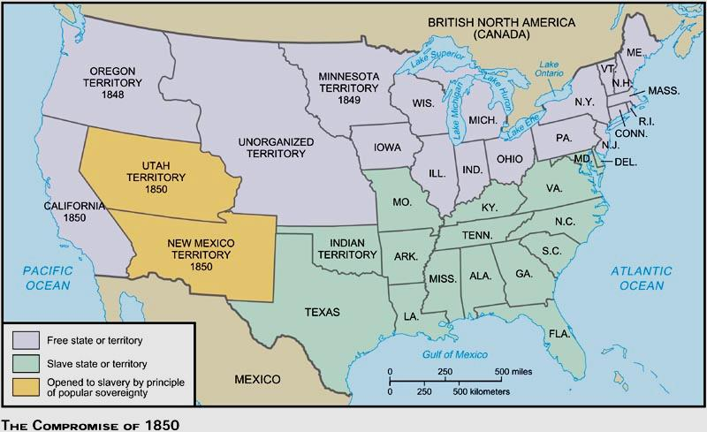
The Big Picture
The future of slavery became the key issue in the election of 1848 and the notion of popular sovereignty emerged, an idea many viewed as a possible solution to decades of debate..
A. The Sovereignty Solution to slavery & the Election of 1848

Slide 9
“The madmen of the North…have, we fear, cast the die and numbered the days of this glorious Union.”
-Richmond Enquirer, regarding Wilmot Proviso
1. Southerners sought to extend slavery into territories won from Mexico and Northerners clung to Wilmot Proviso

Slide 10
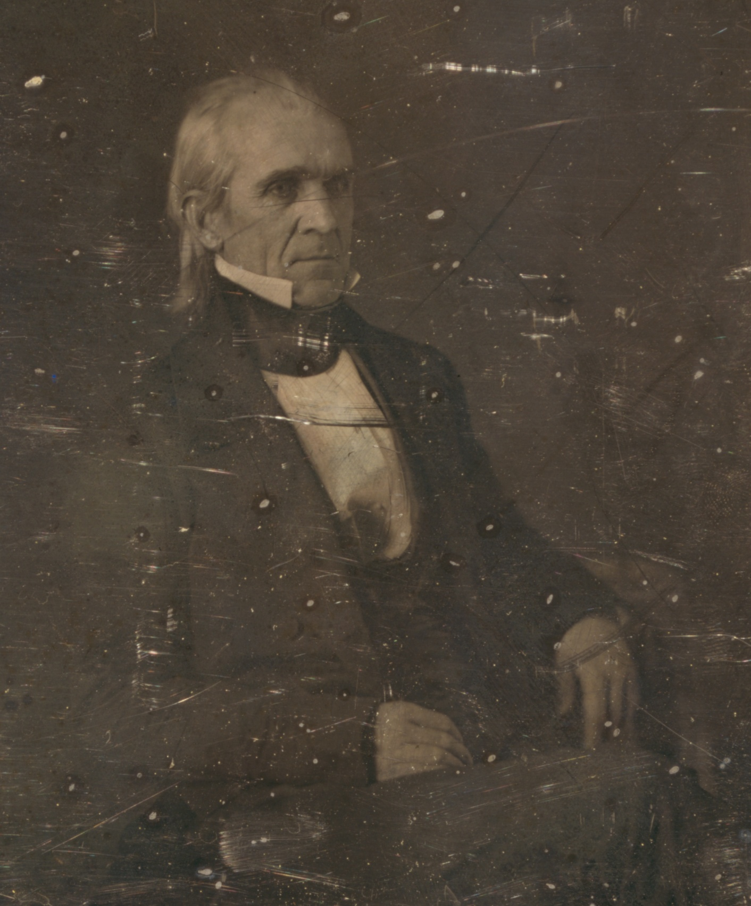
“Peace, plenty, and contentment reign throughout our borders, and our beloved country presents a sublime moral spectacle to the world.”
-James K. Polk
3. (1848) Polk didn’t seek a 2nd term (he accomplished his goals and had health issues)

Slide 11
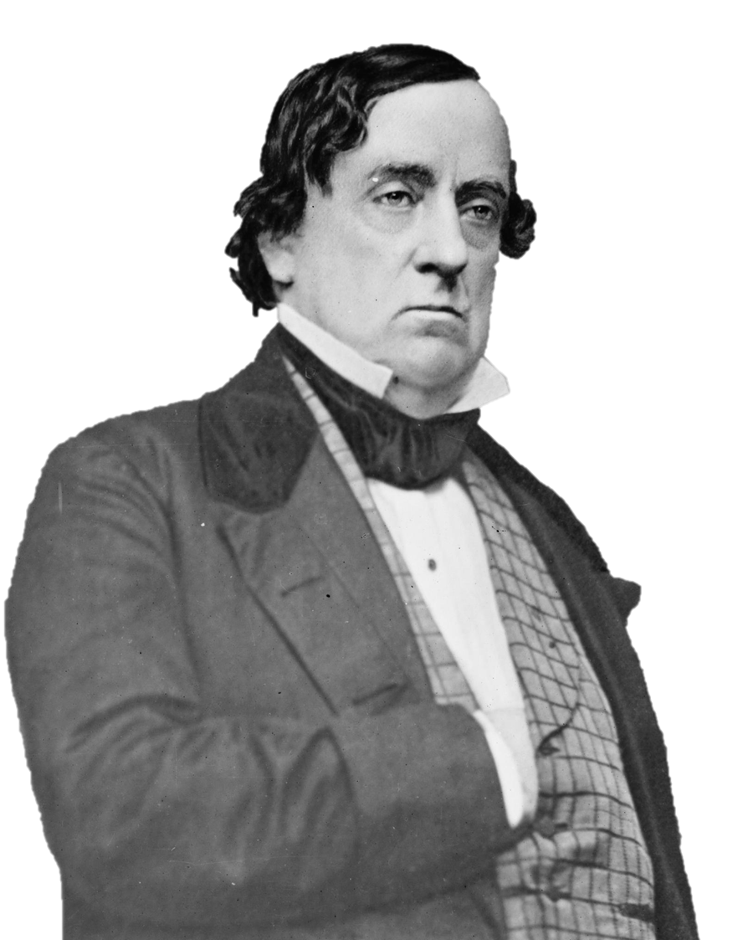
4. Democratic candidate was General Lewis Cass who suggested popular sovereignty could solve issue of the extension of slavery

Slide 12
5. Popular Sovereignty would allow the people of each territory to decide on slavery themselves (with no federal mandate)

Slide 13
6. Popular sovereignty was a compromise between North and South but self-determination could still lead to the spread of slavery

Slide 14
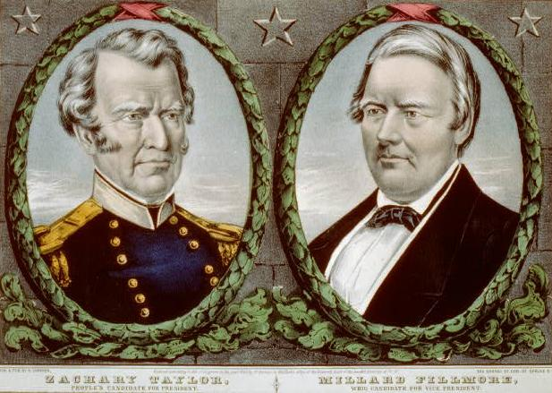
7. Whigs nominated General Zachary Taylor

Slide 15
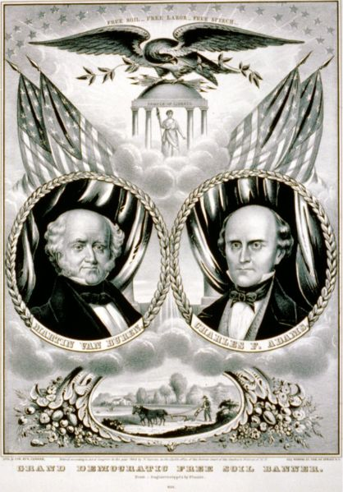
Free Soil! Free Speech! Free Labor! Free Men!
Slavery is an institution of “aristocratic men” and a danger to “the great mass of the people (because it)…threatens the general and equal distribution of our lands into convenient family farms.”
-Abijah Beckwith, free-solier
8. the Free Soil Party nominated Martin Van Buren and hoped to stop spread of slavery into the territories

Slide 16
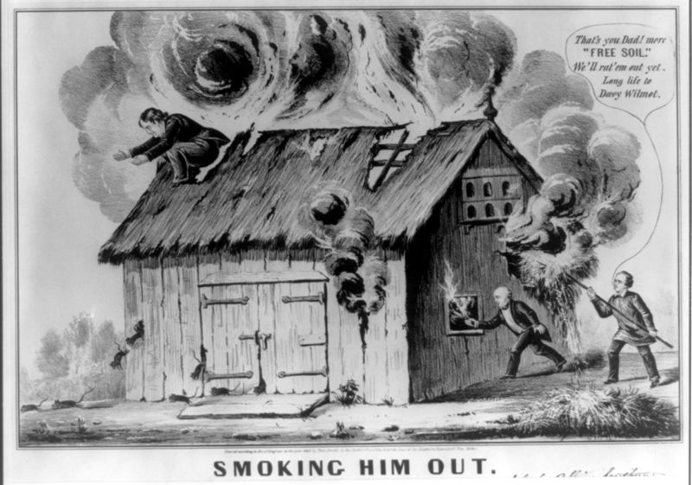
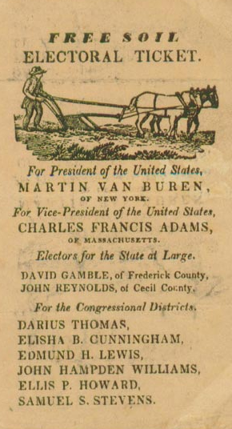
9. Free Soilers wanted federal aid for internal improvements and urged free government homesteads for settlers

Slide 17
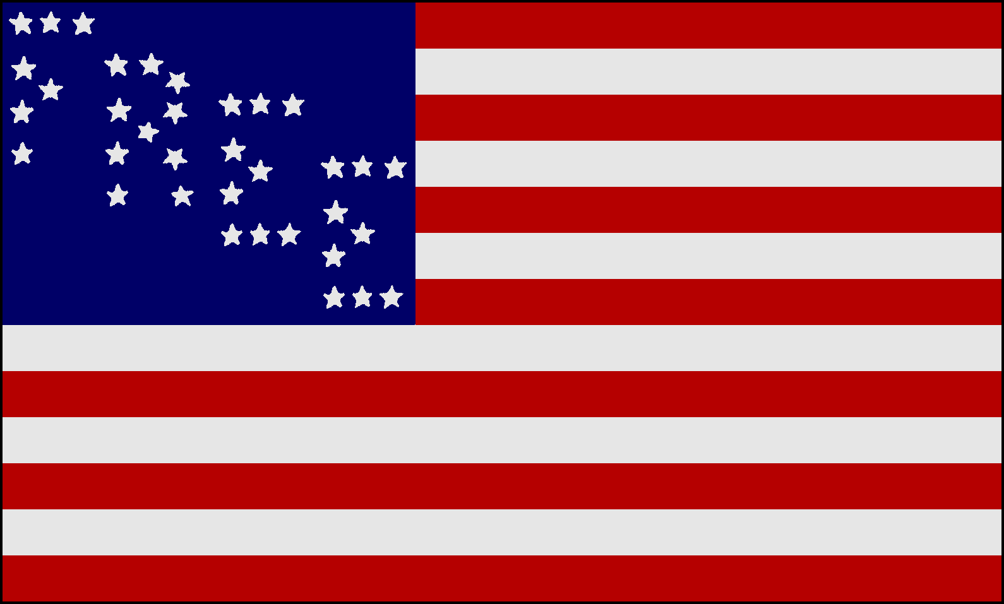
10. Free Soil Party attracted people angry over half-acquisition of Oregon, those opposed to blacks in territories and abolitionists

Slide 18
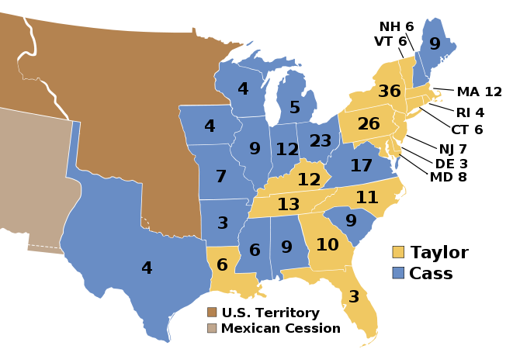
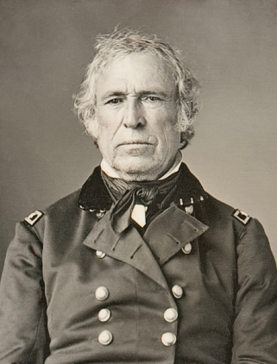
11. neither Whigs nor Democrats talked about slavery issue (Taylor narrowly won)

Slide 19
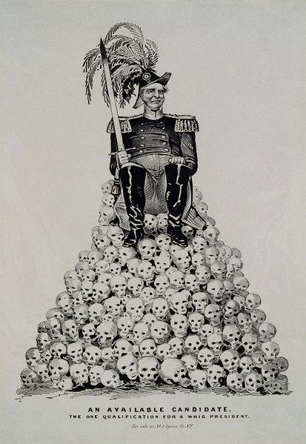
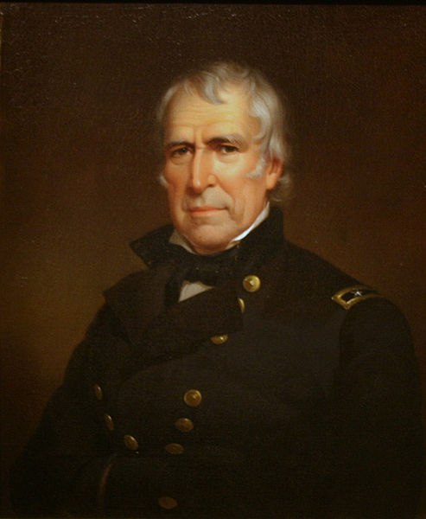
RANK—#29
Zachary Taylor
Presidency: 1849-1850
Birthplace: Virginia
Education: none
Party: Whig
Age Upon Taking Office: 64
Vice-President: Millard Fillmore
Height: 5’8”
Nicknames: “Old Rough & Ready”
Fun Fact:
Taylor wore clothes so tattered and torn that he was often mistaken as a farmer and he was the last US president who owned slaves.
Sound Bite: “Tell him to got to Hell.” (responding to Mexican general Santa Anna’s demand to surrender)

Slide 20
In 1850, California sought statehood, which threatened the balance between free and slave states in Congress.
The Compromise of 1850 allowed California to enter as a free state, while other new territories decided the issue of slavery through popular sovereignty.
The Fugitive Slave Act required citizens to help apprehend runaway slaves.
Notes:
20

Slide 21
The Big Picture
The various arrangements that constitute the Compromise of 1850 only temporarily delayed the final reckoning on the future of slavery.
B. The Compromise of 1850

Slide 22
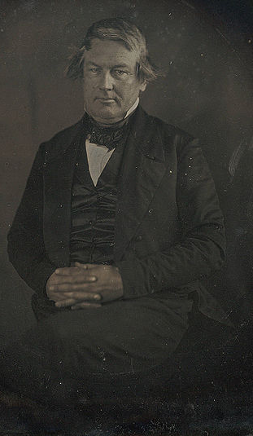
1. (1850) South was in a good position (Southern President, majority in the cabinet and Supreme Court, equality in the Senate)

Slide 23
2. with 15 states the South could veto any amendment to end slavery (the South remained worried though)

Slide 24
3. balance of 15 free and 15 slave states in danger with admission of CA

Slide 25
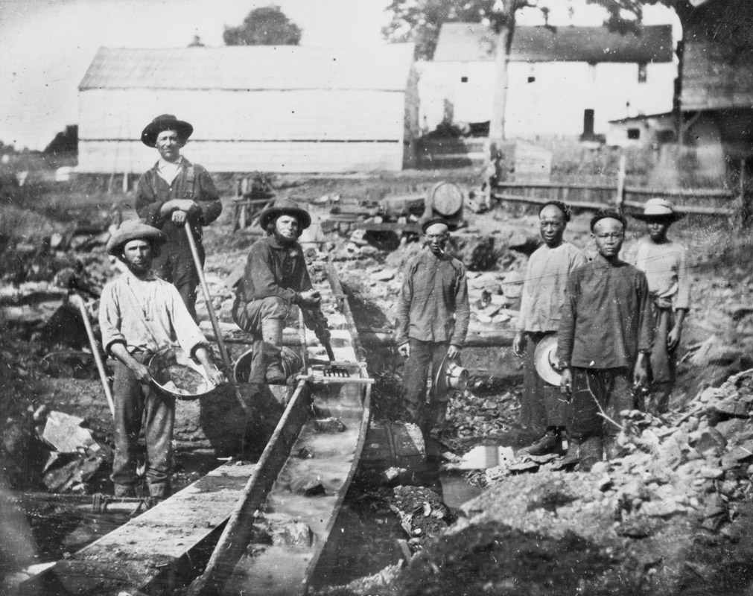
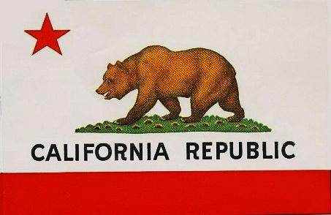
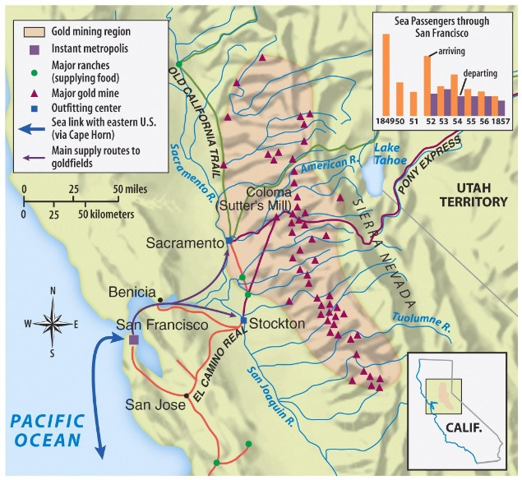
4. (1849) gold discovered in CA led to the famous gold rush (1000s moved there hoping to strike it rich)

Slide 26
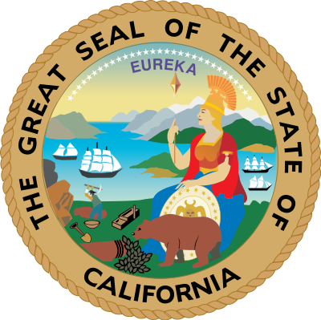
5. CA (encouraged by President Taylor) soon drafted a constitution & applied for statehood

Slide 27
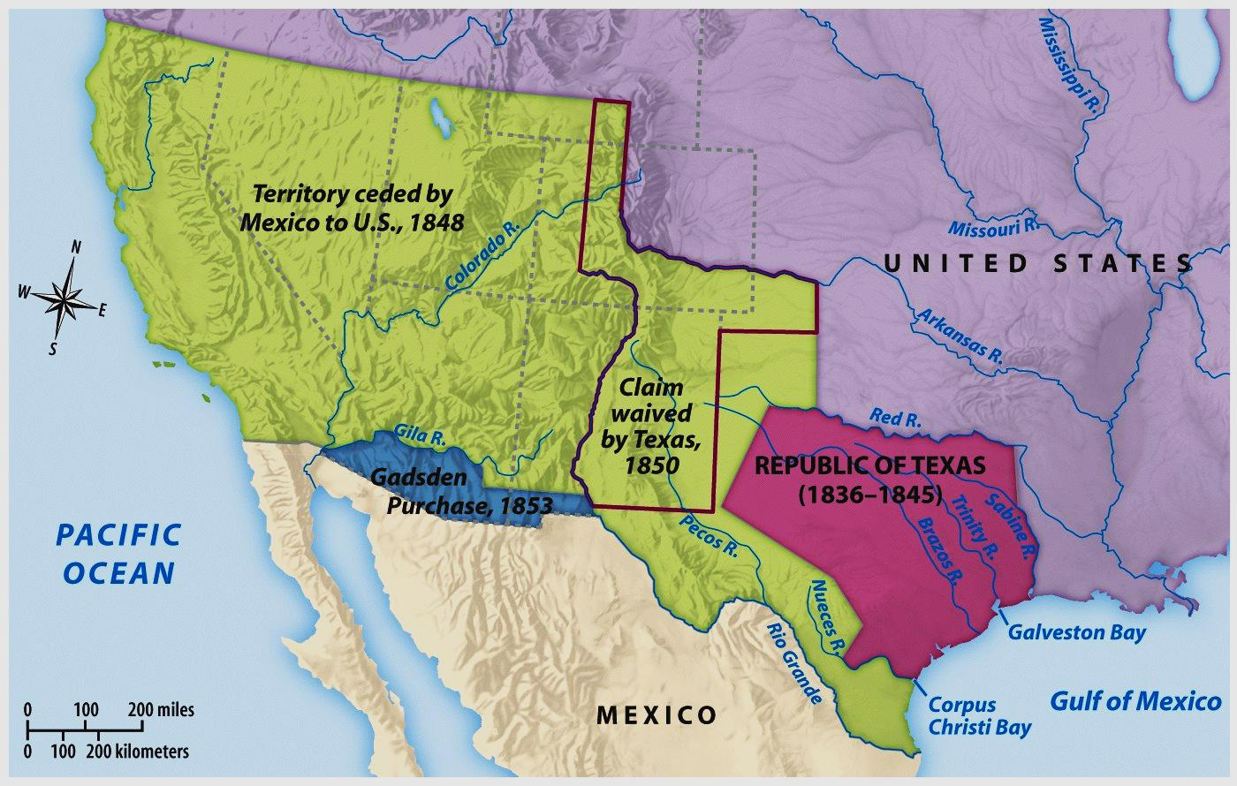
6. (1850) Congress faced a catastrophe with CA demanding admission as a free state

Slide 28
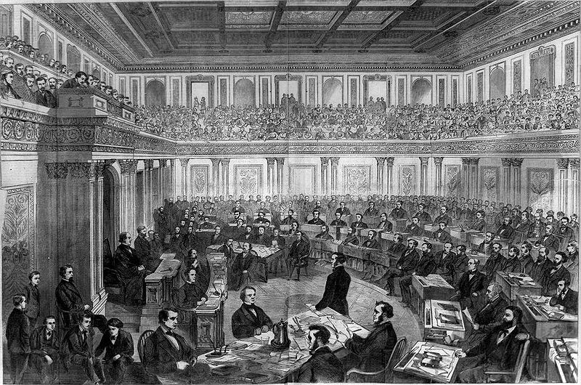
7. Four aging giants of the Senate met to engineer a compromise

Slide 29
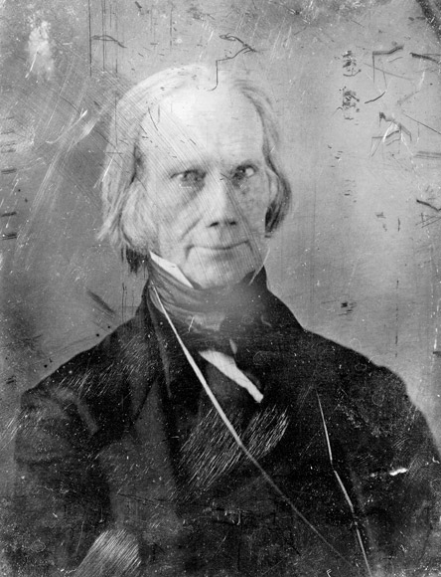
8. Henry Clay had urged the North to adopt fugitive slave laws

Slide 30
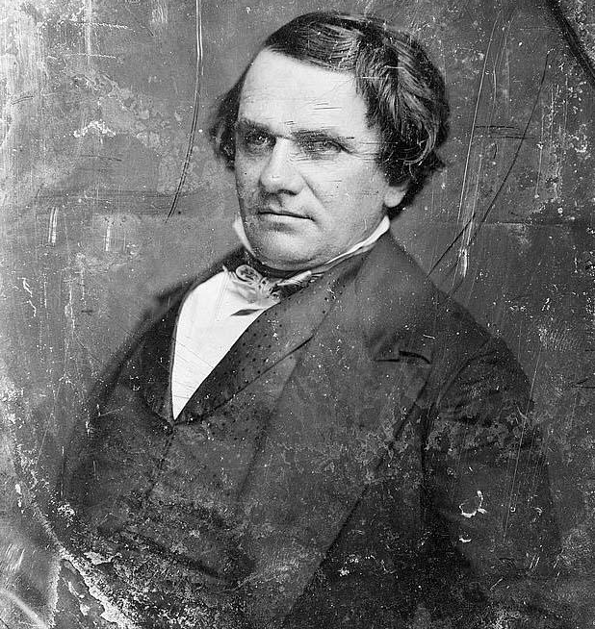
9. Clay was supported by Stephen Douglas (the “Little Giant”)

Slide 31
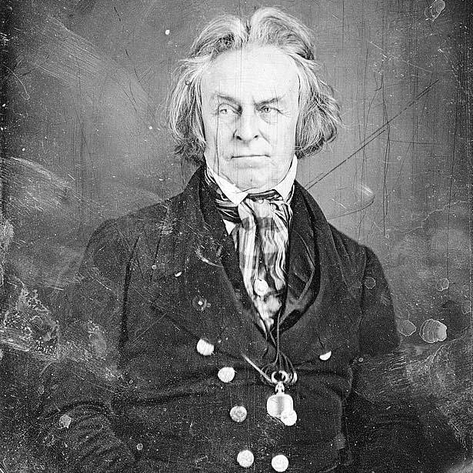
10. John C. Calhoun (dying of tuberculosis) wanted slavery left alone, runaway slaves returned, return of political balance

Slide 32
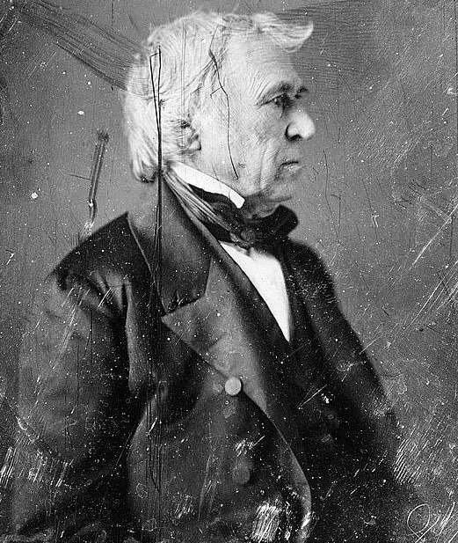
14. President Taylor morally opposed slavery and vetoed every compromise created by Congress

Slide 33
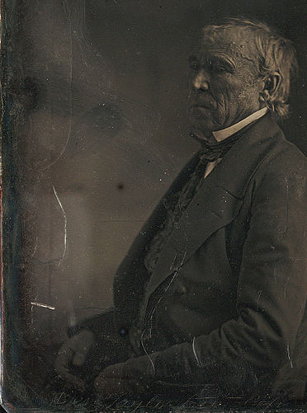
In the late 1980s, college professor Clara Rising hypothesized that Taylor was murdered… On June 17, 1991, Taylor's remains were exhumed and transported to the Office of the Kentucky Chief Medical Examiner, where radiological studies were conducted and samples of hair, fingernail and other tissues were removed. The Laboratory revealed no traces of poison. Rather, it was concluded that on a hot July day Taylor had attempted to cool himself with large amounts of cherries and iced milk. In the unhealthy climate of Washington, with its open sewers and flies, Taylor came down with cholera morbus, or acute gastroenteritis as it is now called. He might have recovered, but his doctors drugged him with ipecac, calomel, opium and quinine and bled and blistered him too.
15. (1850) Taylor suddenly died of an acute intestinal disorder

Slide 34
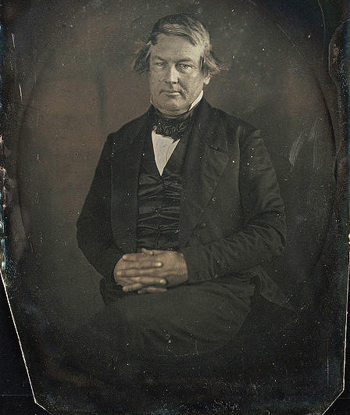
16. The weak Millard Fillmore became president

Slide 35
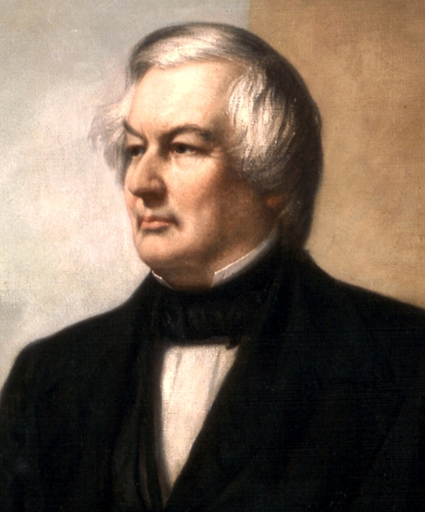
RANK—#37
Millard Fillmore
Presidency: 1850-1853
Birthplace: New York
Education: Elementary School
Party: Whig
Age Upon Taking Office: 50
Vice-President: N/A
Height: 5’9”
Nicknames: “His Accidency”
Fun Fact:
Queen Victoria of England once remarked that Fillmore was the most handsome man she had ever met.
Sound Bite: “It is a national disgrace that our presidents, after having occupied the highest position in the country, should be cast adrift, and, perhaps, be compelled to keep a corner grocery for subsistence.”

Slide 36
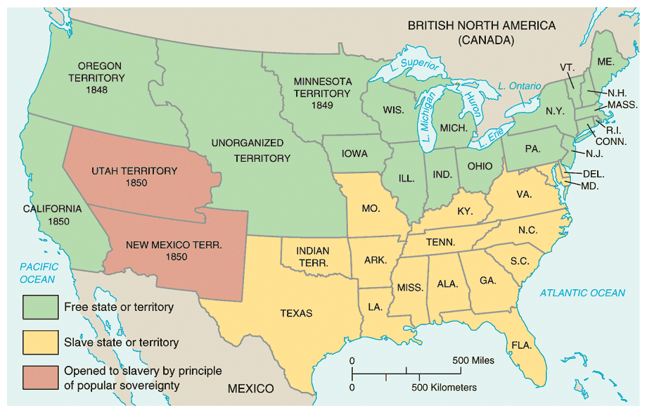
17. Fillmore signed a series of agreements eventually known as the Compromise of 1850

Slide 37
18. CA admitted as free state (permanently tipping the balance in the Senate)

Slide 38
19. Utah and New Mexico territories could decide (with popular sovereignty) about slavery

Slide 39
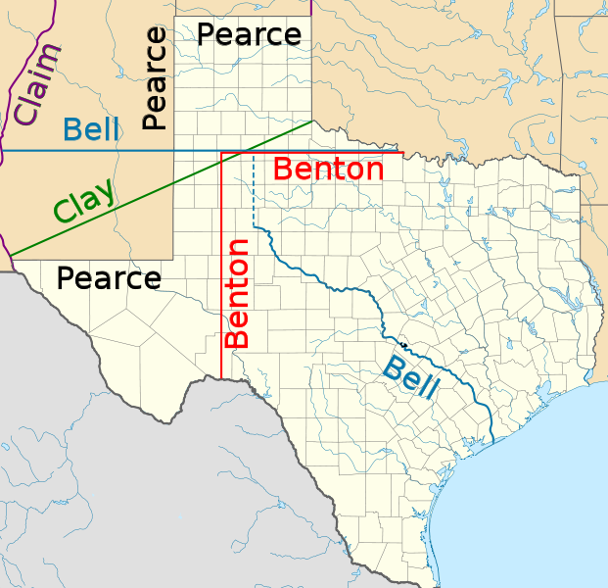
20. Texas lost its disputed territory to NM and OK but was paid $10 million

Slide 40
21. The slave trade (but not slavery) was banned in Washington D.C.

Slide 41
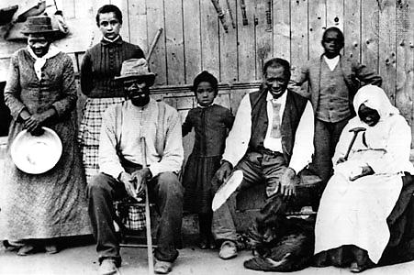
fleeing slaves couldn’t testify on own behalf
the federal commissioner who handled the case got $5 if the slave was free and $10 if not
people who were ordered to help catch the slave had to do so — even if they didn’t want to
22. Fugitive Slave Law passed (North had to help South capture and return escaped slaves)

Slide 42
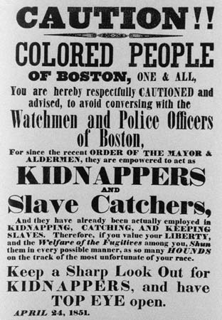
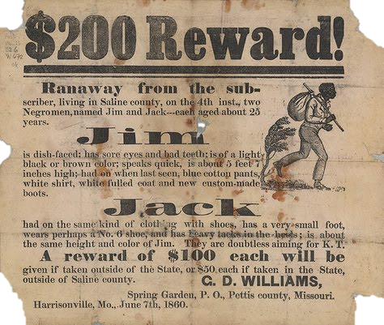
The Fugitive Slave Law

Slide 43
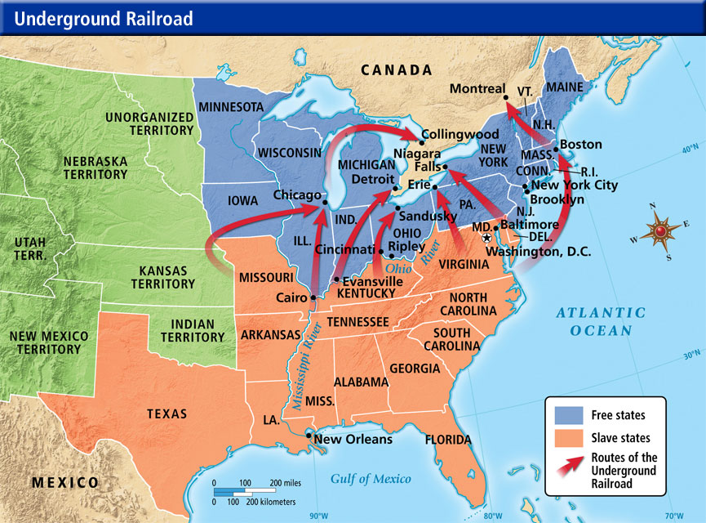
23. angry Northerners didn’t follow Fugitive Slave Law (the Underground Railroad became more active)

Slide 44
24. North got the better of the deal and the Compromise of 1850 postponed the Civil War

Slide 45
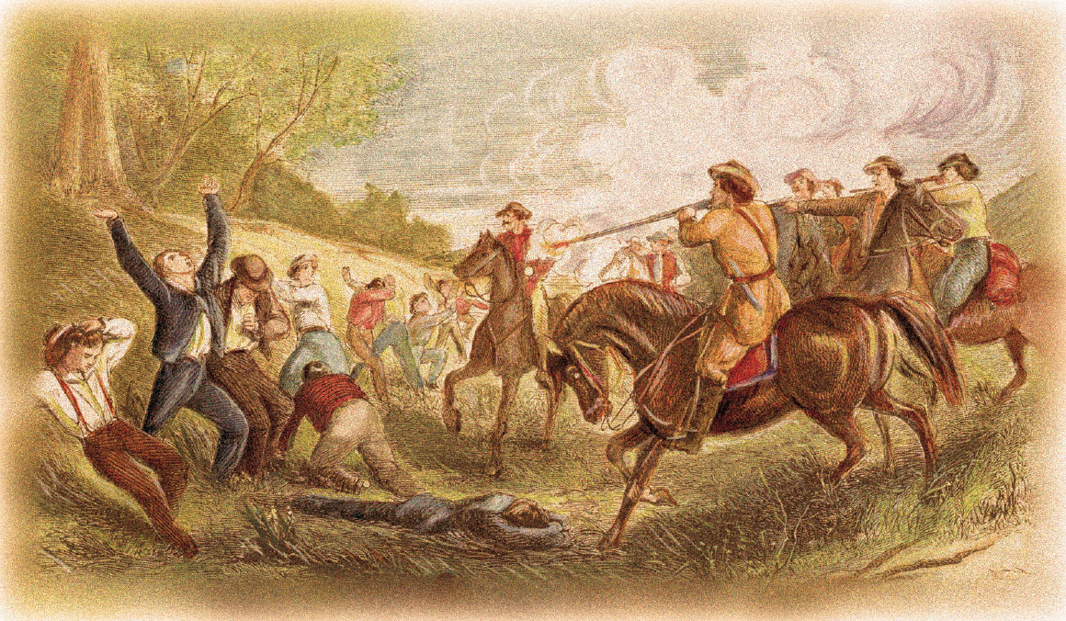
Uncle Tom’s Cabin, an antislavery novel by Harriet Beecher Stowe, increased opposition to slavery.
In 1854, the Kansas-Nebraska Act allowed popular sovereignty in Kansas and Nebraska, causing proslavery and antislavery settlers to flock to Kansas.
Notes:
45

Slide 46
By 1856, Kansas had two governments, one proslavery, the other antislavery.
Violence between the two sides earned the territory the nickname “Bleeding Kansas.”
In 1861, Kansas entered the Union as a free state.
Notes:
46

Slide 47
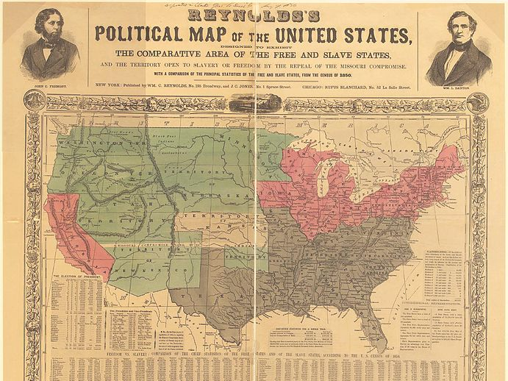
The Big Picture
The Kansas-Nebraska act hoped to leave the decision of slavery up to the people of these two territories, rather than the federal government. The Act’s reliance on popular sovereignty was intended to ease tensions but that backfired significantly.
D. The Kansas-Nebraska Act

Slide 48
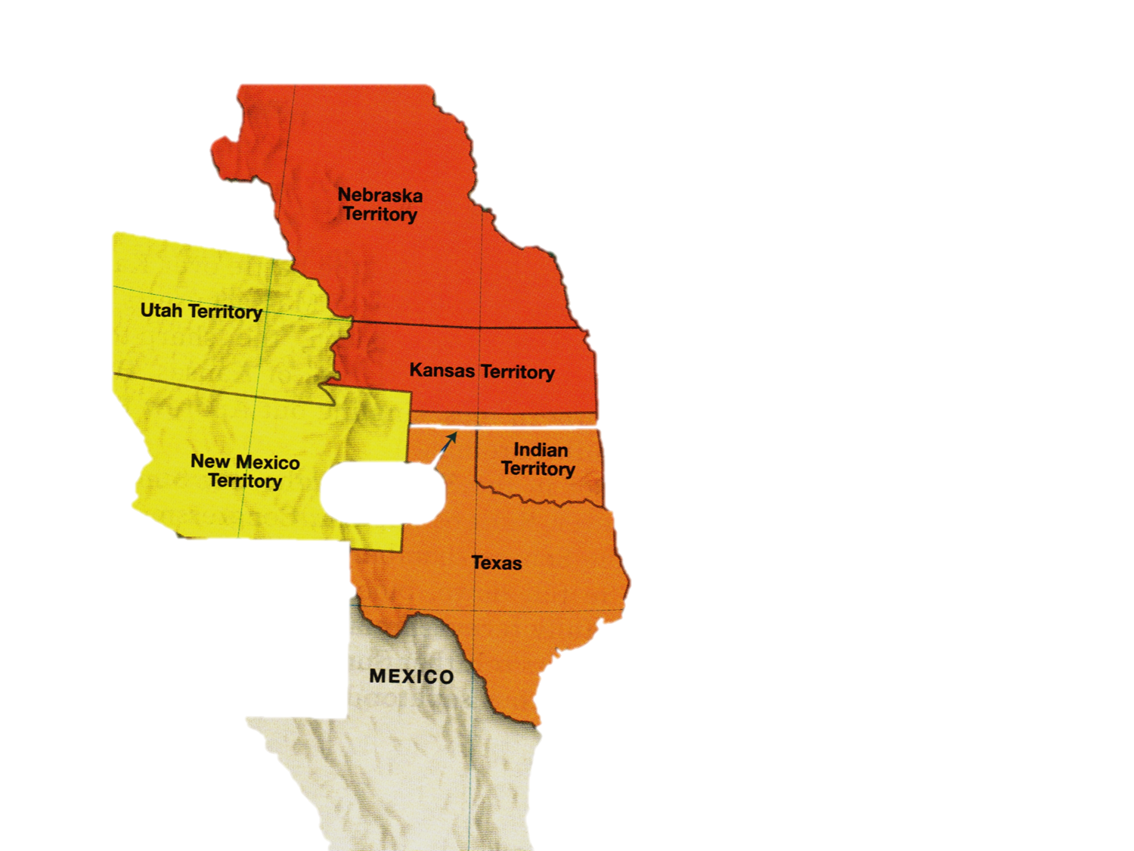
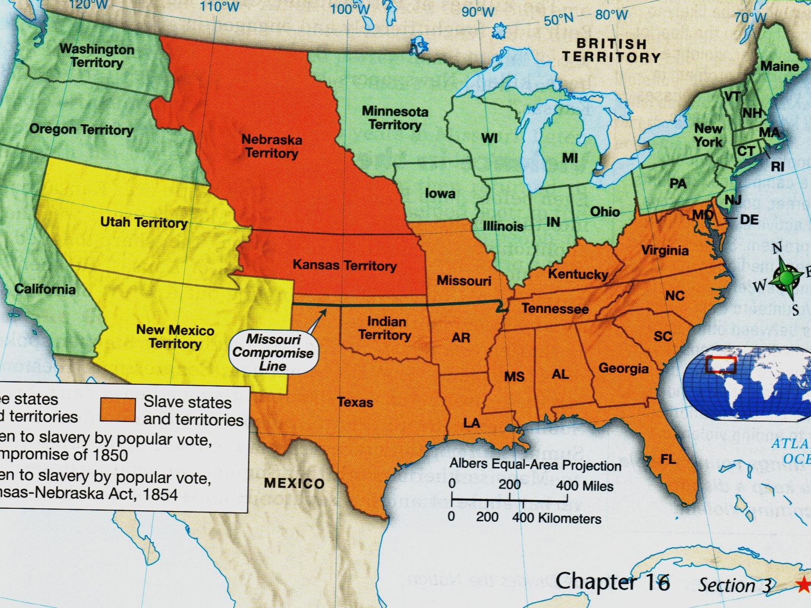
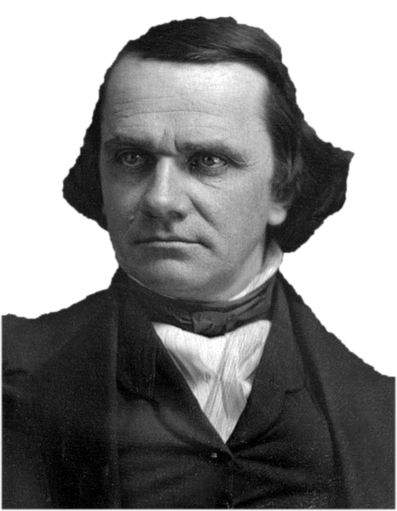
1. Sen. Stephen Douglas proposed the Kansas-Nebraska Act extending Popular Sovereignty to Kansas and Nebraska territories

Slide 49
2. this violated the Missouri Compromise (both KS & NE north of 36˚30)

Slide 50
Compromise of 1850
Kansas Nebraska Act
3. Southerners never considered Kansas a potential slave state so loved the bill (Northerners hated it)

Slide 51
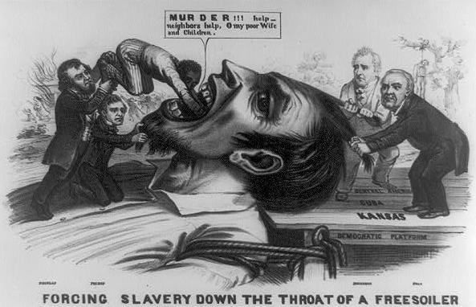
4. (1854) Douglas got the Kansas-Nebraska Act through Congress

Slide 52
5. the Kansas-Nebraska Act killed the Missouri Compromise and indirectly killed the Compromise of 1850

Slide 53
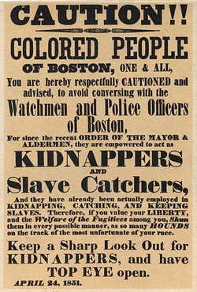
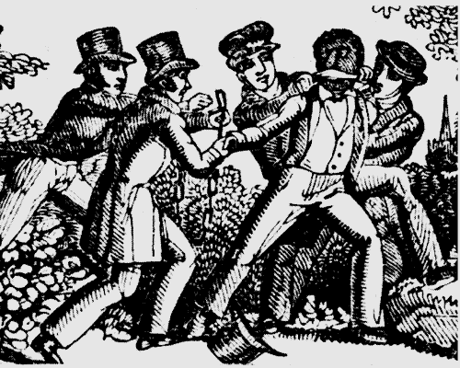
6. Angry Northerners stopped enforcing the Fugitive Slave Law (Southerners furious)

Slide 54
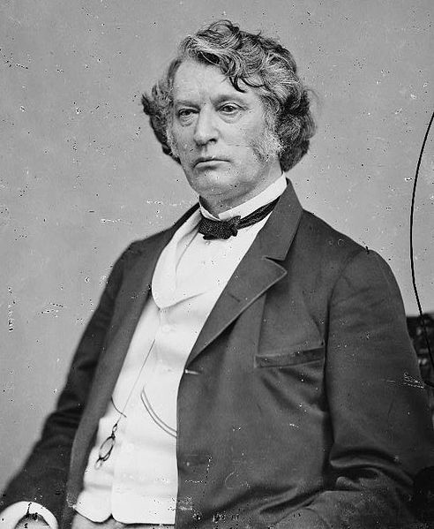
"Alas! too often those principles which give consistency, individuality, and form to the Northern character, which render it staunch, strong, and seaworthy, which bind it together as with iron, are drawn out, one by one, like the bolts of the ill-fitted vessel, and from the miserable, loosened fragments is formed that human anomaly -- a Northern man with Southern principles. Sir, no such man can speak for the North.”
-Charles Sumner, on Stephen Douglas
The Kansas-Nebraska Act

Slide 55
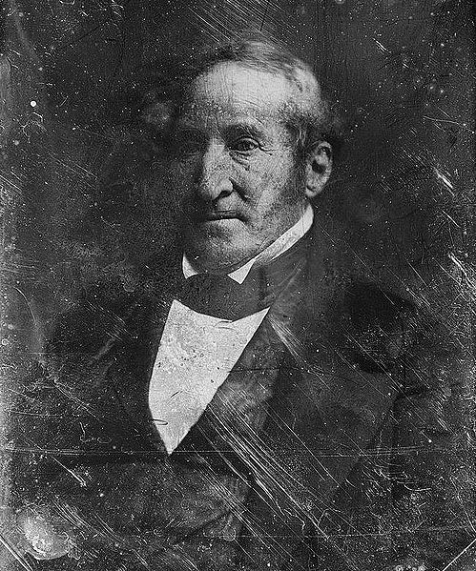
"What is the excuse for all this turmoil and mischief? We are told it is to keep the question of slavery out of Congress! Great God! It was out of Congress, completely, entirely, and forever out of Congress, unless Congress dragged it in by breaking down the sacred laws which settled it!"
-Thomas Hart Benton, MO
The Kansas-Nebraska Act

Slide 56
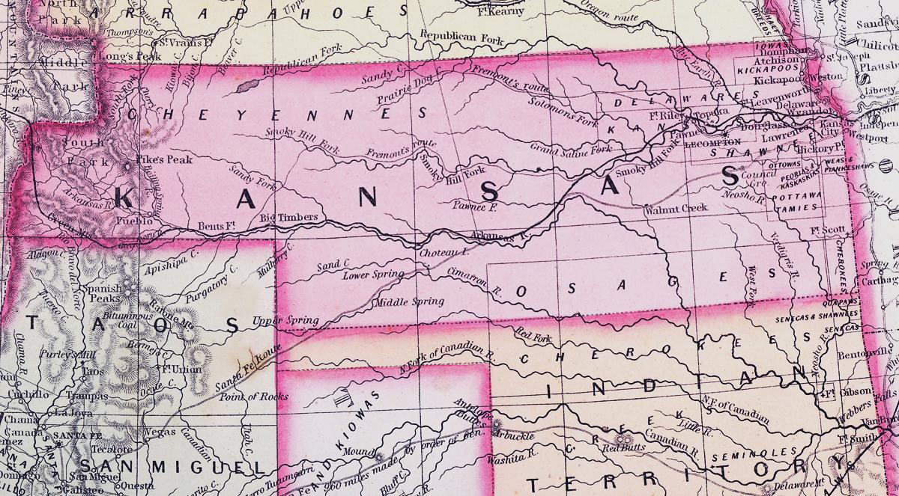
7. Northerners poured into Kansas (hoping to make it a free state) enraging the South

Slide 57
8. (1855) 1000s of Southerners from MO flooded election polls voting for slavery in Kansas

Slide 58
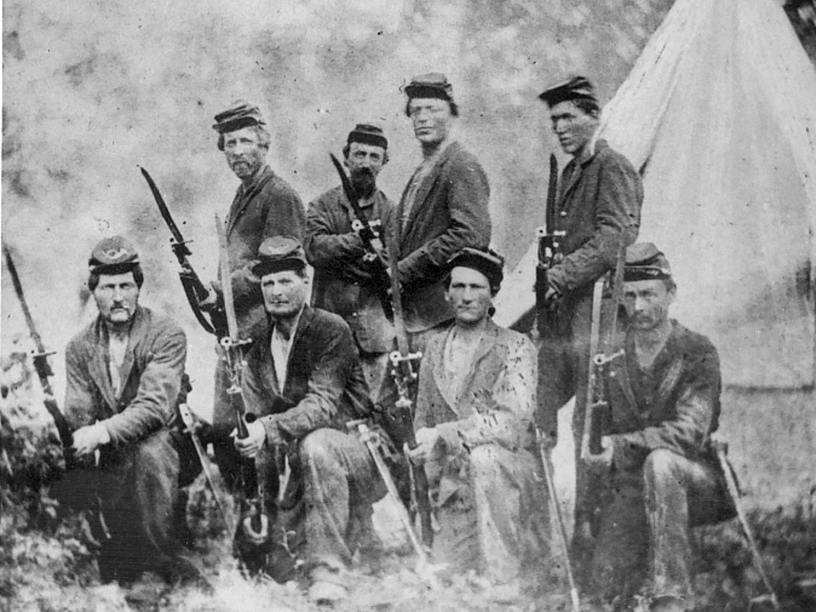
9. Angry Free Soil party members set up their own government in Topeka

Slide 59
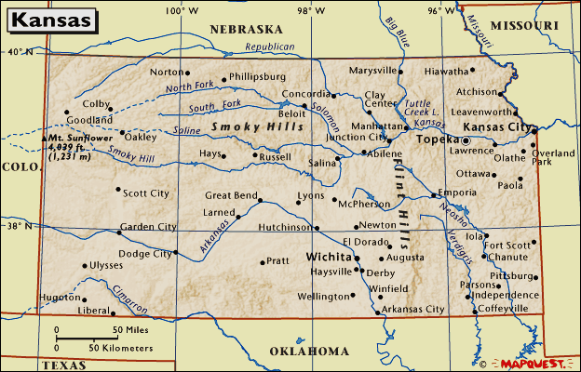
Shawnee
Topeka
10. Confused Kansans had to choose between 2 governments (one illegal in Topeka and one fraudulent in Shawnee)

Slide 60
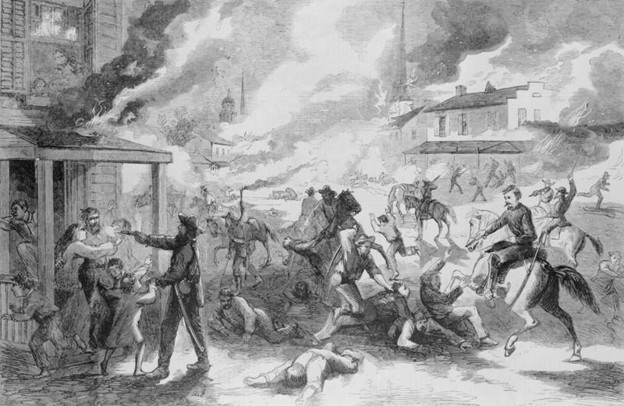
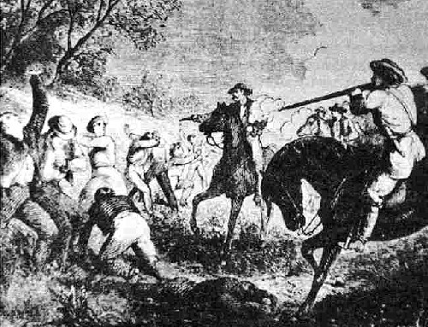
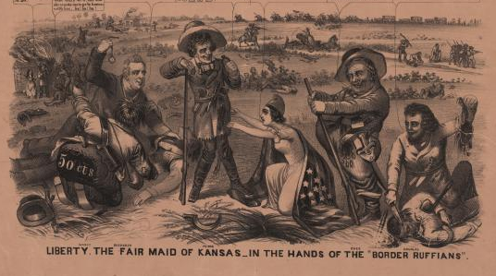
11. (1856) pro-slavery raiders attacked Lawrence, KS (“Bleeding Kansas” had begun)
Free-Soilers
(Anti-Slavery)
Border Ruffians
(Pro-Slavery)

Slide 61
Brown was arrested, tried, found guilty of treason, and executed.
Abolitionists saw him as a heroic martyr to the antislavery cause.
The sympathy he received in the North enraged southerners.
Hoping to inspire a slave revolt, radical white abolitionist John Brown in 1859 tried to seize a federal arsenal in Harper’s Ferry, Virginia.

Slide 62
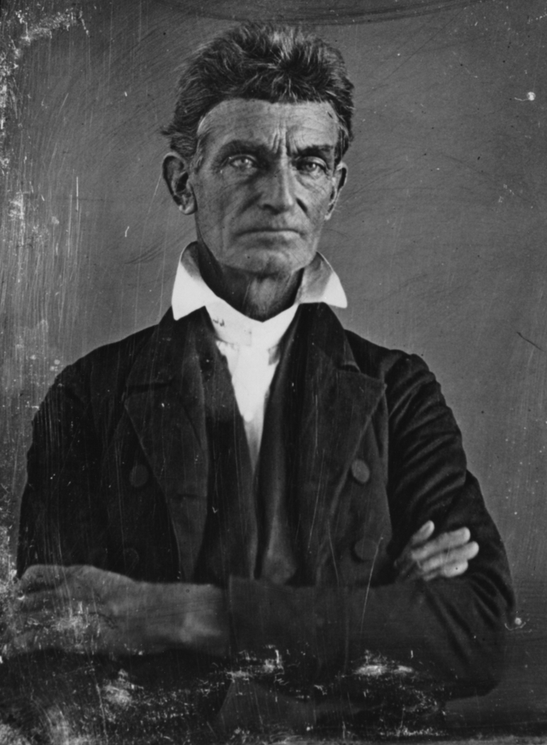
“Here, before God, in the presence of these witnesses, from this time, I consecrate my life to the destruction of slavery!”
—John Brown (1837)
Pottawatomie Creek Massacre
12. (May 1856) John Brown (crazy abolitionist) led his men to Pottawatomie Creek killing 5 pro-slavery people

Slide 63
Bleeding Kansas
“The fifth victim floated nearby as John Brown and his men washed blood from their swords in Pottawatomie Creek. Brown said that the killings had been committed in accordance to "God’s will," and that he wanted to "strike terror in the hearts of the proslavery people." His killings would provoke fear and reprisals -- pushing America one step closer to an all-out civil war.”
13. Brown’s violent act shocked even the most dedicated abolitionists bringing swift retaliation from pro-slavery people

Slide 64
14. (1857) Kansas was ready to apply for statehood (people allowed to vote for the state constitution “with slavery” or “without slavery”)

Slide 65
15. the Lecompton Constitution “with slavery” passed (Free-Soilers boycotted the vote)

Slide 66
Essay
Essential Question
Essay
Analyze the ways in which controversy over the extension of slavery into western territories contributed to the coming of the Civil War. Confine your answer to the
period 1845–1861.
Essential Question
Analyze how western expansion contributed to growing sectional tensions between the North and the South. Confine your answer to the period from 1800 to 1850.
Kansas
Essay
Essential Question
To what extent did the debates about the Mexican War and its aftermath reflect the sectional interests of New Englanders, westerners, and southerners in the period from 1845 to 1855?
16. Congress rejected Lecompton Constitution (in 1861 Kansas entered US a free state)

Slide 67
17. “Bleeding Kansas” was an issue that spilled into Congress

Slide 68
“The slave power dares anything, and it can be conquered only by the united masses of the people. From Congress to the people, I appeal.”
18. Sen. Charles Sumner was vocally anti-slavery and condemned all slavery supporters

Slide 69
"Mr. Sumner, I have read your speech twice over carefully. It is a libel on South Carolina…”
19. Rep. Preston Brooks (a Southerner) couldn’t legally challenge Sumner to a duel

Slide 70
20. Brooks beat Sumner with a cane (until the cane broke) as nearby Senators watched and Southern congressmen cheered

Slide 71
"Good job. We consider the act good in conception, better in execution, and best of all in consequences. These vulgar abolitionists in the Senate must be lashed into submission.“
-The Richmond Enquirer
21. incident further divided US (Sumner’s popular “The Crime Against Kansas” speech made Brooks and South look bad)

Slide 72
His opponent was John C. Frémont of the new Republican Party.
In 1856, Democrat James Buchanan ran for President.
Although Frémont lost, the Republican Party—which opposed the extension of slavery into the western territories— gained new popularity.

Slide 73
In 1857, the Dred Scott v. Sandford decision widened divisions between North and South.
The Supreme Court ruled against Scott, stating that slaves were property, not citizens.
The Court also said that the federal government could not ban slavery in any territory.
Notes:
73

Slide 74
The Big Picture
In 1857, the US Supreme Court had a rare opportunity to make a ruling regarding slavery and its outcome pushed the nation further towards disunion and civil war.
F. The Dred Scott Case

Slide 75
1. (1857) Supreme Court ruled on the Dred Scott case

Slide 76
Moved to Wisconsin (slavery banned by Missouri Compromise)
Moved to Illinois (slavery banned by Northwest Ordinance)
Born in Virginia
Moved to Missouri
2. Dred Scott a slave whose master took him north into free territory (lived there many years)

Slide 77
Moved to Missouri
3. When his master died Dred Scott sued for his freedom from new master (he lived in a free territory)

Slide 78
4. Missouri Supreme Court agreed and freed him but new master appealed to US Supreme Court which overruled the decision

Slide 79
They (Slaves) had for more than a century before been regarded as beings of an inferior order, and altogether unfit to associate with the white race, either in social or political relations, and so far unfit that they had no rights which the white man was bound to respect."
—Justice Roger Taney
5. Chief Justice Roger Taney argued slaves not citizens and had no right to sue (case dismissed)

Slide 80
6. The case angered millions of abolitionists against slavery and the movement grew

Slide 81
7. Taney ruled Missouri Compromise and Northwest Ordinance unconstitutional (Congress lacked right to ban slavery in territories)

Slide 82
8. Northerners complained about ruling, the South was angered by Northern defiance (tensions rose)

Slide 83
The Union in Crisis: to 1860
Slavery in West
Wilmot Proviso
Free-Soil Party
Compromise of 1850
Fugitive Slave Act
Kansas-Nebraska Act
Bleeding Kansas
John Brown
Harper’s Ferry
Republican Party
Election 1856
Dred Scott v Sandford

