Slide 1
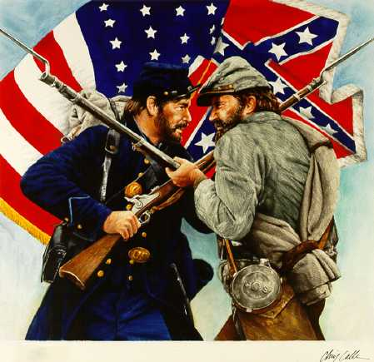
The Furnace of Civil War
YANKEES VS. REBELS
NORTH VS. SOUTH
UNION VS. CONFEDERACY
Essential Question: What factors and events led to the Union victory in the Civil War?

Slide 2
Objectives
Evaluate the advantages the North enjoyed in the Civil War.
Analyze the impact of the Civil War on the North and South, especially the impact of the Emancipation Proclamation.
Explore the outcome and aftermath of the Civil War.

Slide 3
Terms and People
Robert E. Lee – top Confederate general throughout the Civil War
Anaconda Plan – northern Civil War strategy to starve the South by blockading seaports and controlling the Mississippi River
Emancipation Proclamation – 1863 decree by President Lincoln that freed enslaved people living in Confederate states still in rebellion
habeas corpus – constitutional guarantee that no one can be held in prison without charges being filed

Slide 4
Terms and People (continued)
inflation – rising prices
Ulysses S. Grant – important Union general who led Union armies to victory in the Civil War
Battle of Gettysburg – battle in 1863 in which Confederate troops were checked after invading the North and which resulted in more than 50,000 casualties
Gettysburg Address – speech by President Lincoln in which he dedicated a national cemetery in Gettysburg and reaffirmed the ideas for which the Union was fighting
Notes:
4

Slide 5
Terms and People (continued)
William T. Sherman – Union general who in the fall of 1864 led Union troops on a 400-mile march of destruction through Georgia and South Carolina
total war – military strategy in which an army attacks not only enemy troops but the economic and civilian resources that support them
Notes:
5

Slide 6

What factors and events led to the Union victory in the Civil War?
The North had several advantages in the war, including its strong industries and transportation systems, a well-organized navy, and a large supply of immigrant labor.
The success of the Anaconda Plan and victories at Gettysburg and on Sherman’s March to the Sea also worked to the North’s advantage.

Slide 7
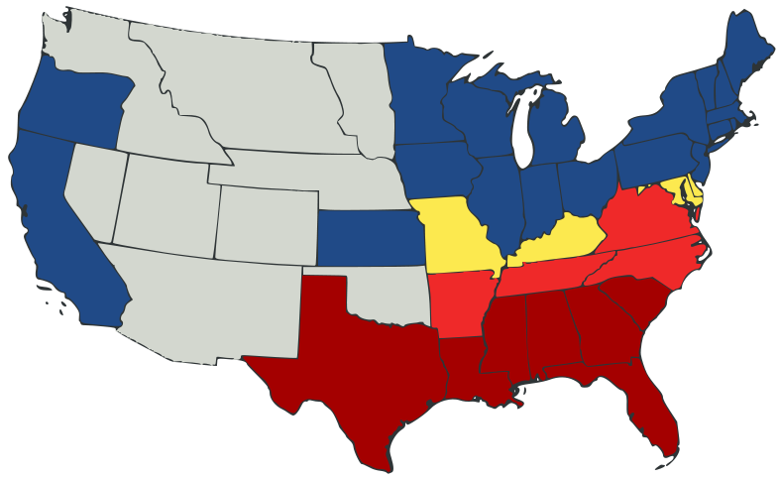

The Big Picture
Despite some Southern strengths, the North’s population advantage, industrial capacity, infrastructure and enjoyment of the moral high ground made victory for the Union likely.
North vs. South

Slide 8
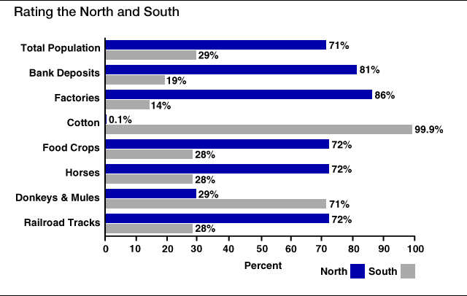
North and South

Slide 9

The North’s goal was to preserve the Union.
The North’s advantages
  A large immigrant work force kept its factories running.
  The North was able to produce more ammunition, arms, and other supplies.
  It had an extensive railway system and naval superiority.

Slide 10
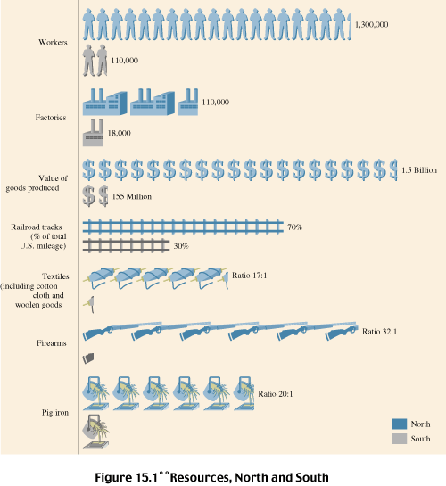
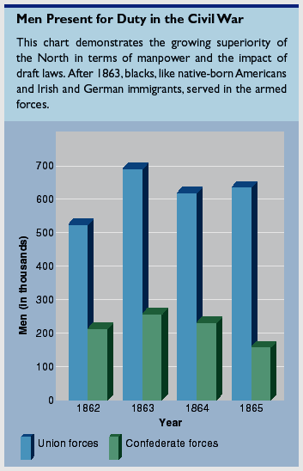
1. the North enjoyed greater manpower and industrial resources, stronger leadership, and the moral high ground (preserving the Union and eventually emancipating slaves)

Slide 11

The South’s goal was independence.
The South’s advantages
  Although the South had a smaller army, at the outset of the war its troops were more committed to their cause.
  The better military commanders, like Robert E. Lee, fought for the South.
  The Confederacy did not have to conquer the North—it just had to survive until the North quit fighting.
Notes:
11

Slide 12
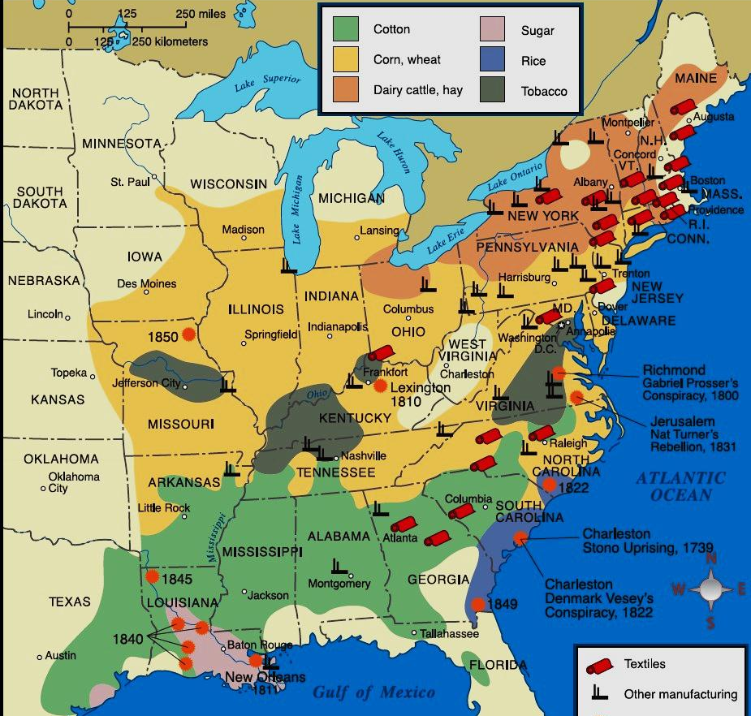
South had a shortage of factories (South lacked basic supplies as war dragged on)

Slide 13
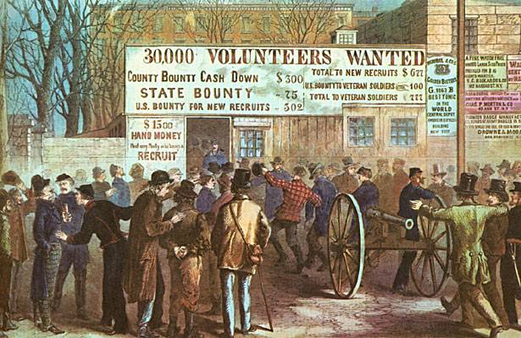
“I don’t think a young man ever went over all considerations more carefully than I did. It might mean sickness, wounds, loss of limb, and even life itself…But my country was in danger.”
-William Saxton, Cincinnatus, NY
6. both North and South hoped a volunteer army would be enough to win the war (90% of Union army in 1861 were volunteers)

Slide 14
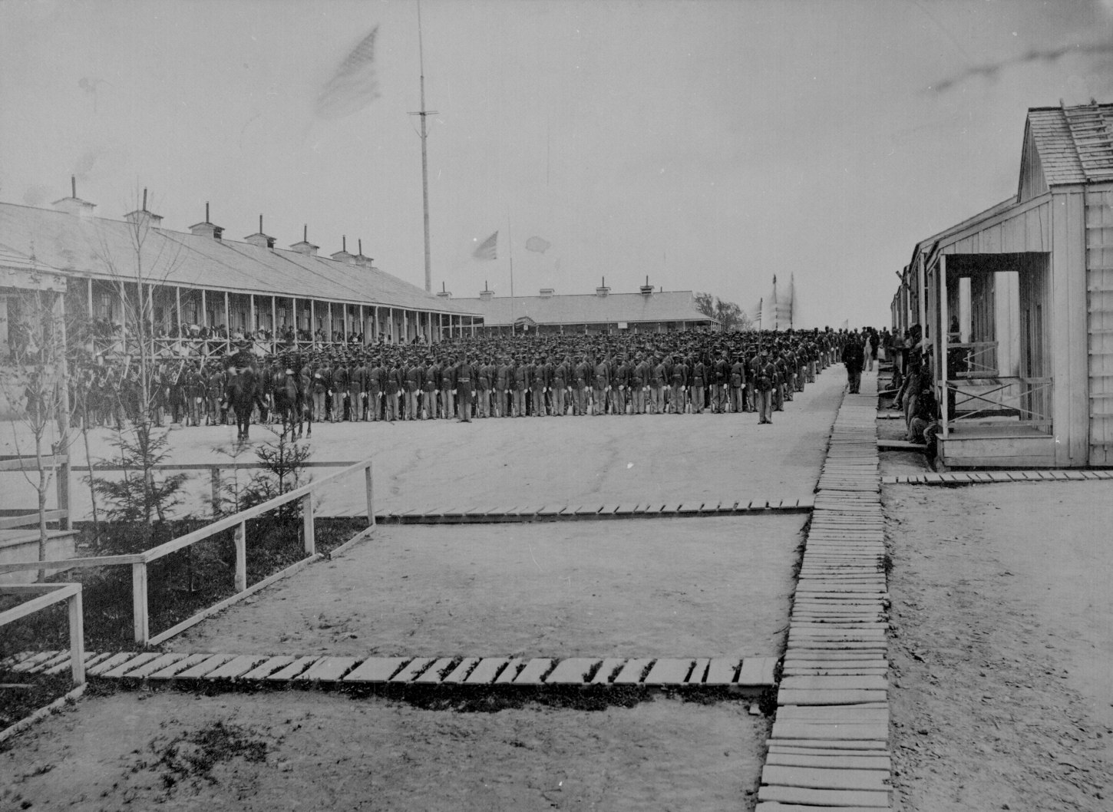
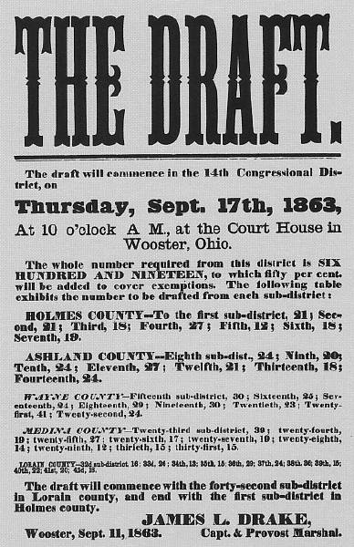
7. first the South but eventually even the North resorted to forced conscription

Slide 15
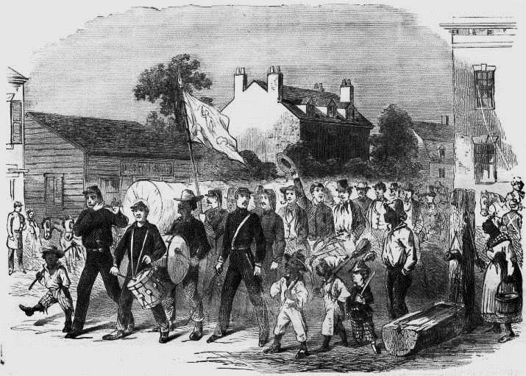
“Would you, My Darling, …be willing to leave your Children under such a (despotic Union) government? No-I know you would sacrifice every comfort on earth, rather than submit to it.”
-James B. Griffin, South Carolina, to his wife
This is “a rich man’s war and a poor man’s fight.”
-poor Southerner
8. in the South owners of 20+ slaves exempted from duty

Slide 16
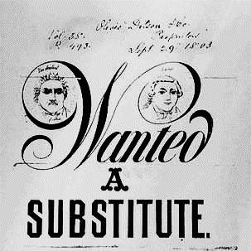
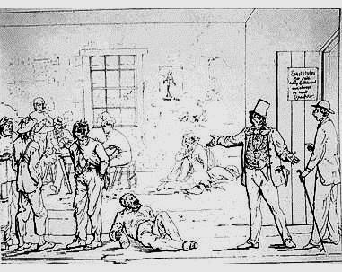
9. in the North the wealthy could hire a substitute for $300 to Congress (poor people angry and draft riots broke out in NYC)

Slide 17
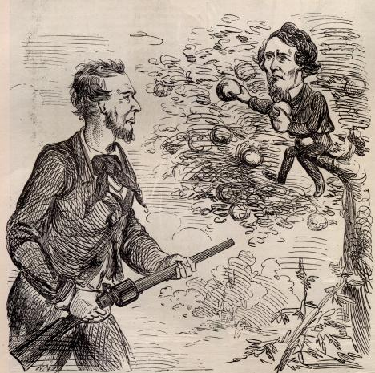
10. US government (led by Lincoln) was far more powerful and capable of waging war than the Confederacy (led by Davis)

Slide 18
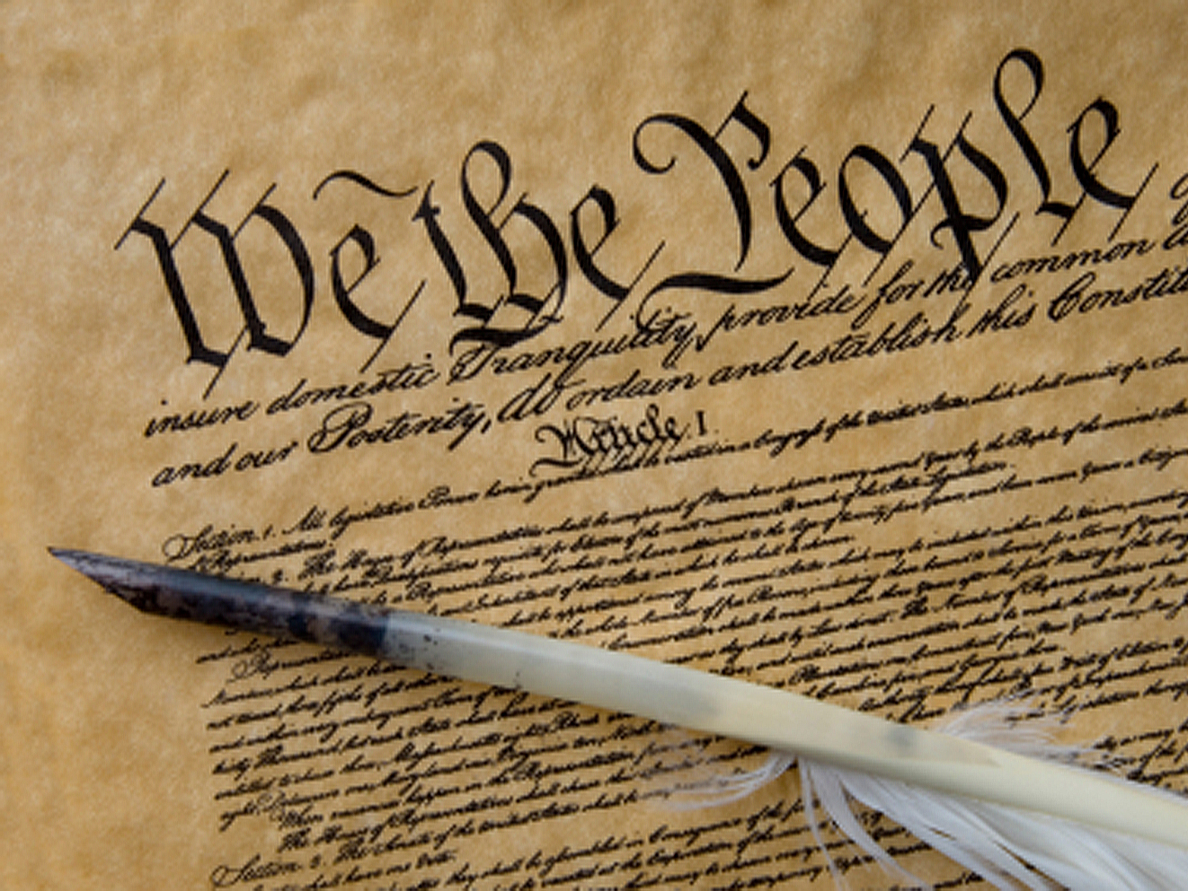
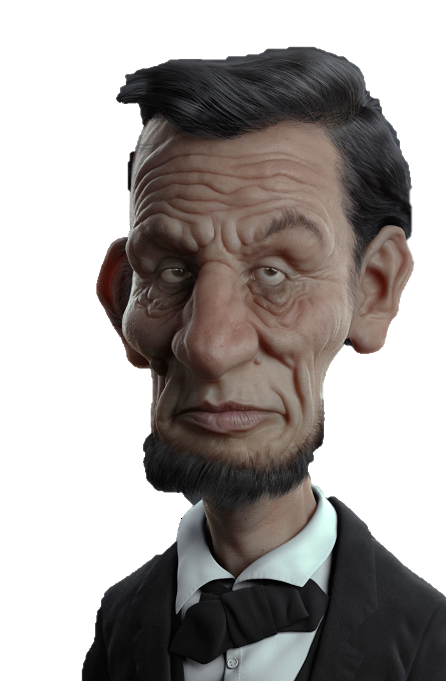
13. Lincoln led an established gov’t but assumed war-time presidential powers that stretched and perhaps went beyond constitutionality

Slide 19
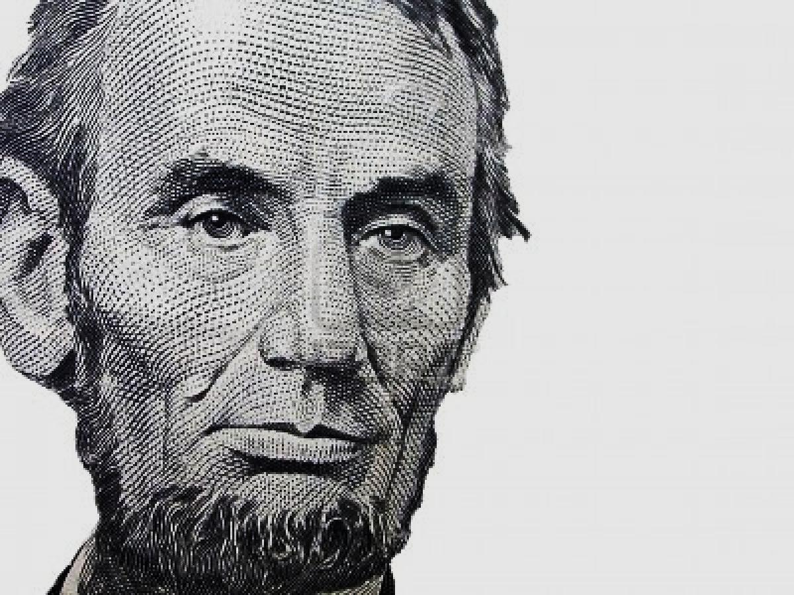
“We shall nobly save, or meanly lose, the last best hope of earth.”
-Abraham Lincoln
14. Lincoln used the preservation of the Union to justify these temporary acts of tyranny

Slide 20
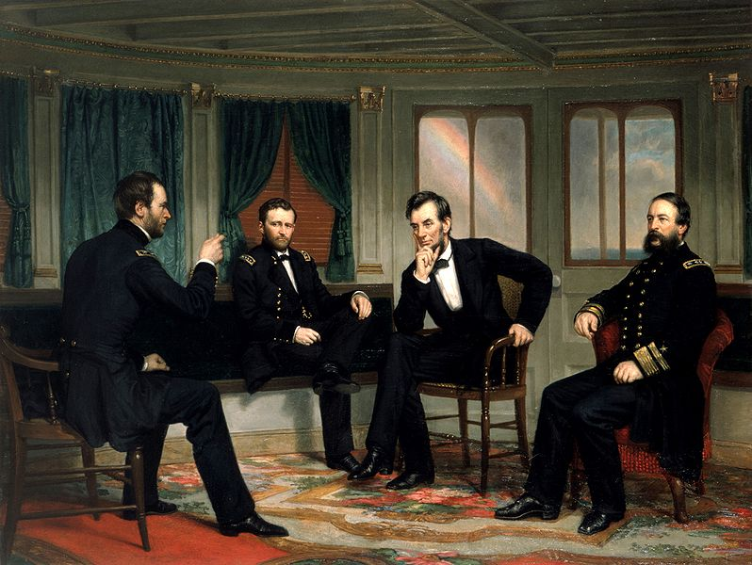
15. Lincoln set up illegal blockades, acted without consent of Congress, used troops to intimidate border states, gave $2 million to companies for war purposes

Slide 21
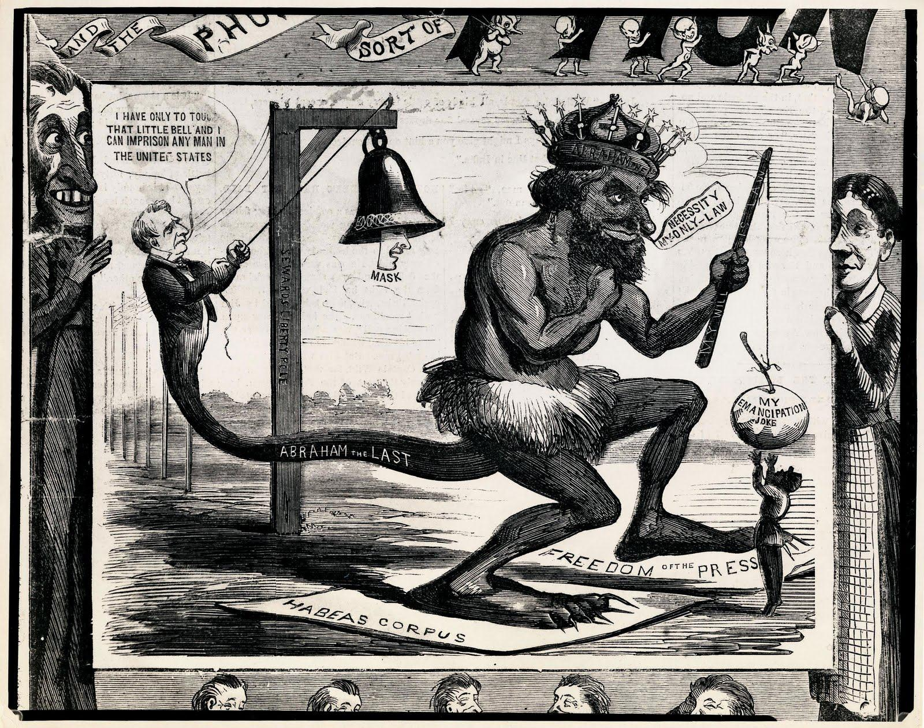
16. he suspended habeas corpus so he could arrest anti-Unionists

Slide 22
17. given the North’s many advantages the South’s chances hinged on foreign intervention (they almost got it)

Slide 23
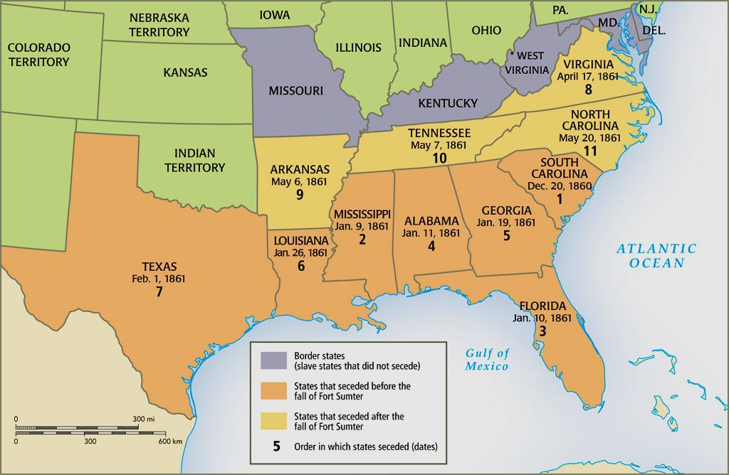
“Rest not your hopes in foreign nations, this war is ours; we must fight it ourselves.”
-Jefferson Davis
18. Lincoln used threats and moral persuasion (Britain had banned slavery) to successfully keep British from helping the South

Slide 24
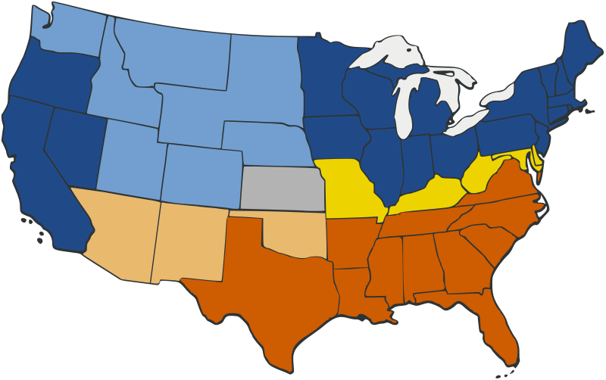
19. as war dragged on the Northern strengths beat Southern disadvantages

Slide 25
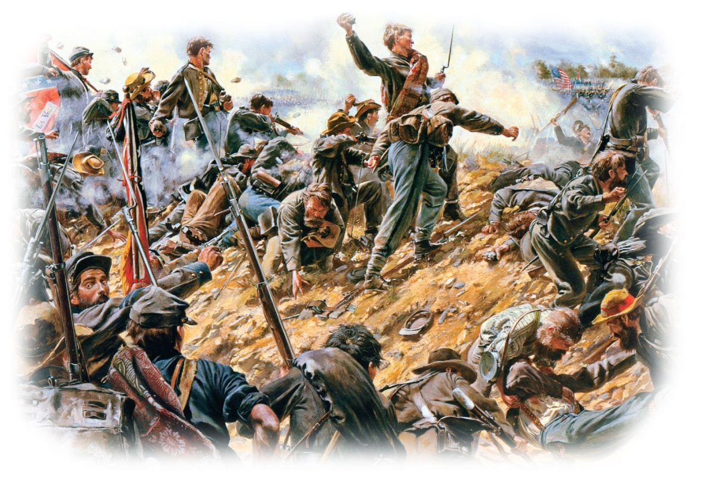
Though both sides won battles, neither could gain a clear and decisive victory in the early part of the war.
Efficient new weapons produced massive numbers of casualties, and limited medical care ensured that many of the wounded died of infection.

Slide 26
The North employed the Anaconda Plan
to starve the South into submission.
Union forces planned to seize the Mississippi River and the Gulf of Mexico so the South could not receive supplies.
By the middle of 1862, the North had captured most of the Mississippi Valley and a strategic railroad juncture in Tennessee.
Notes:
26

Slide 27
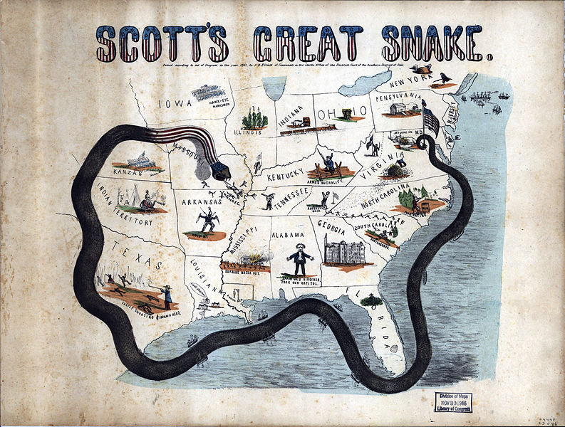
12. US navy would suffocate South through an oceanic blockade
“Anaconda”
Plan

Slide 28
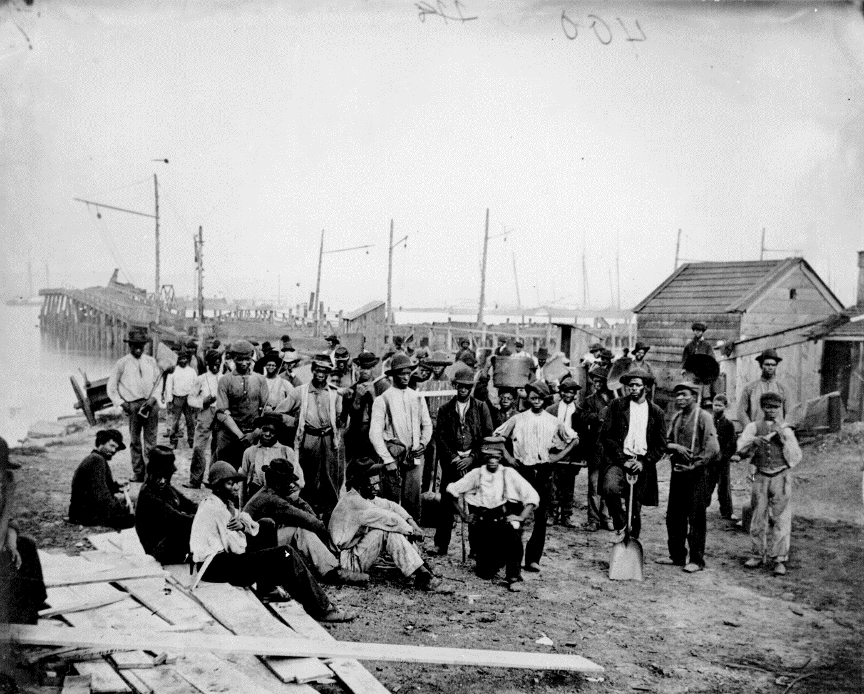
13. North wanted to free the slaves to undermine the South’s economic foundations

Slide 29
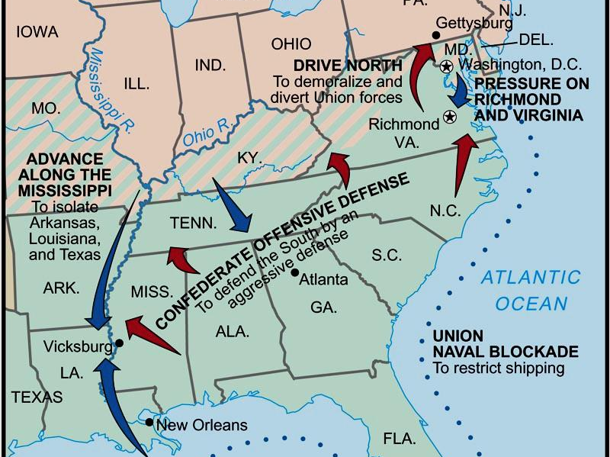
14. North hoped to cut the Confederacy in half by seizing control of the Mississippi River

Slide 30
15. North would chop Confederacy to pieces by marching through GA and the Carolinas

Slide 31
16. could win if captured the capital at Richmond, VA

Slide 32
Lincoln’s goal in the Civil War was to preserve the Union.
While personally opposed to slavery, in the early days of the war, he said that he lacked the authority to end the practice.
He feared alienating the slave-holding states that remained loyal to the Union: Maryland, Delaware, Kentucky and Missouri.
Notes:
32

Slide 33

  Slaves in states still in rebellion were freed.
  Southern slaves were now encouraged to run away and help the Union.
  Eventually, African Americans were recruited to fight in the Union Army and 180,000 served.
But in January 1863, Lincoln issued the Emancipation Proclamation.
Notes:
33

Slide 34
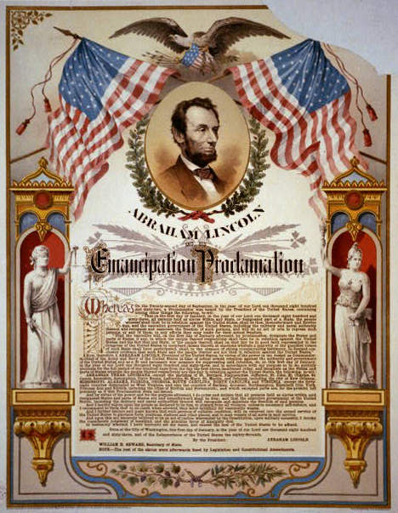
2. the war was now more than just saving the Union (it was also saving the slaves)

Slide 35
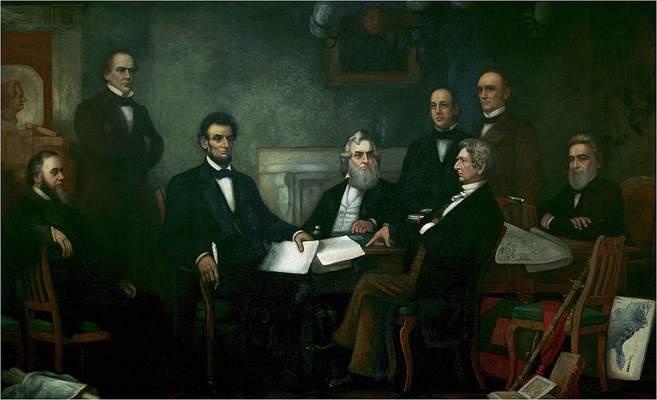
3. the Proclamation only freed the slaves in not-yet conquered Southern territories

Slide 36
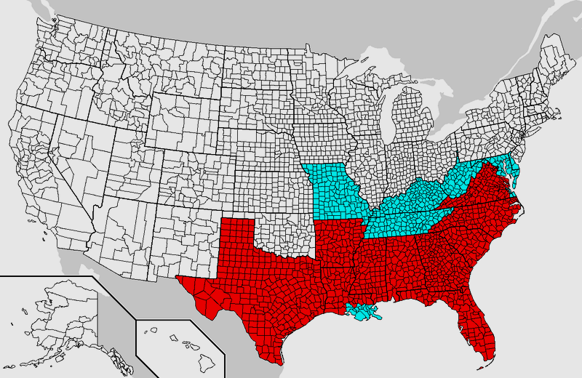
Lincoln freed the slaves where he couldn’t but wouldn’t where he could
“The principle is not that a human being cannot justly own another, but that he cannot own him unless he is loyal to the United States.”
-The London Spectator
4. slaves in Border States and conquered territories not freed

Slide 37
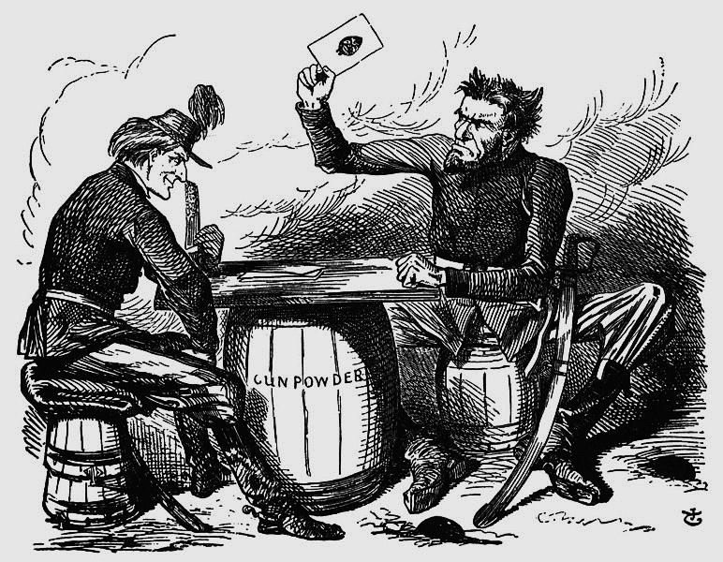
Slavery is nearly “dead, but the negro is not, there is the misfortune.”
-newspaper, Cincinnati, OH
Every freed slave should “shoulder an Irishman and leave the Continent.”
-New Yorker
5. the Proclamation very controversial (some soldiers refused to fight for abolition & deserted)

Slide 38
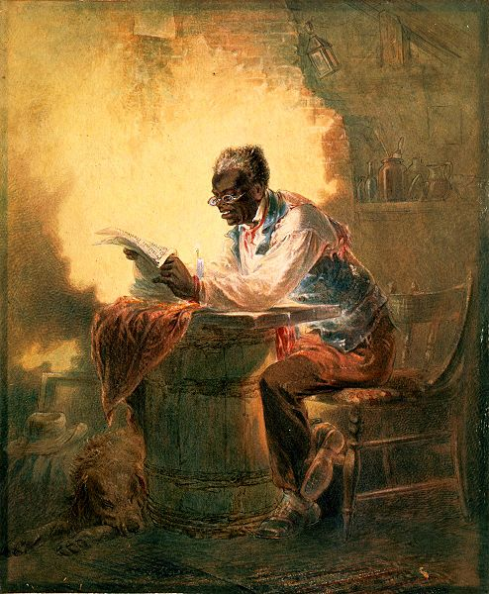
“Arrest that hoe on the hands of the Negro, and you smite the rebellion in the very seat of its life.”
-Frederick Douglass
*about 1 in 5 slaves ran away after the Proclamation
6. many slaves left their plantations upon hearing of Proclamation undermining the labor of South

Slide 39
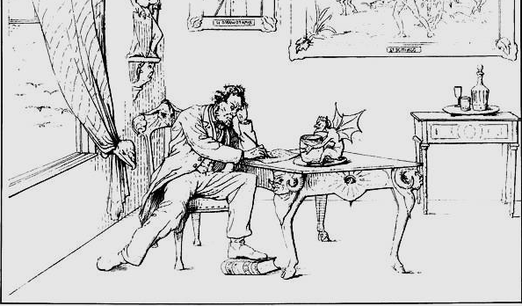
The Emancipation Proclamation is “the most execrable (horrible) measure recorded in the history of guilty man.”
-Jefferson Davis, President of CSA
7. angry Southerners claimed Lincoln was inciting a slave rebellion

Slide 40
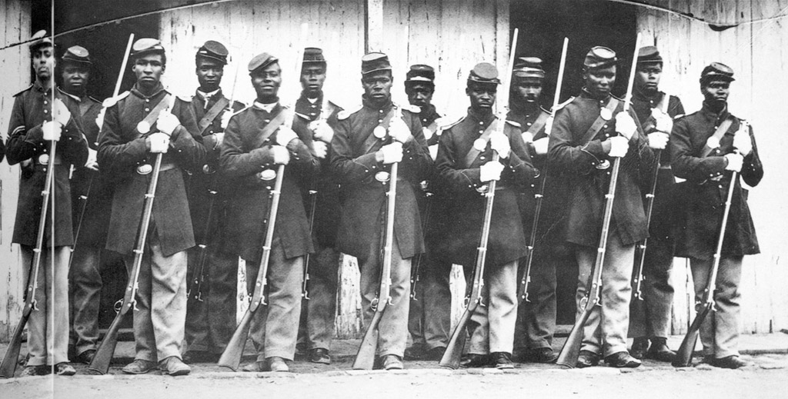
8. Lincoln’s decision to issue the Proclamation helped prevent Confederacy from gaining diplomatic support from European powers

Slide 41
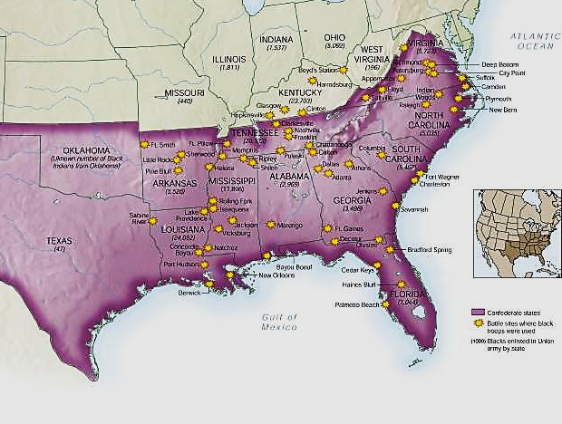
African-Americans
in Civil War Battles
“I am as much opposed to slavery as any of them but I am not willing to be put on a level with the negro and fight with him.”
-NY soldier
Without black soldiers “We would be compelled to abandon the war in three weeks.”
-Abraham Lincoln
9. Proclamation enabled many African-Americans to fight in the Union army (blacks = 10% of Union army at end)

Slide 42
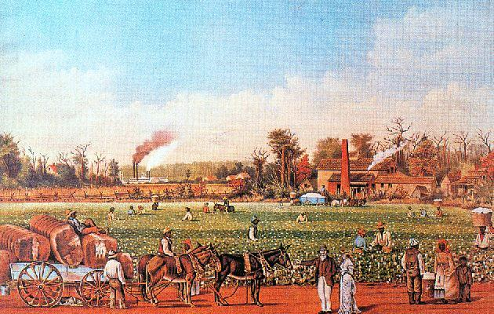
11. most slaves didn’t cast off their chains when heard of Proclamation (fear, loyalty, policing?)

Slide 43
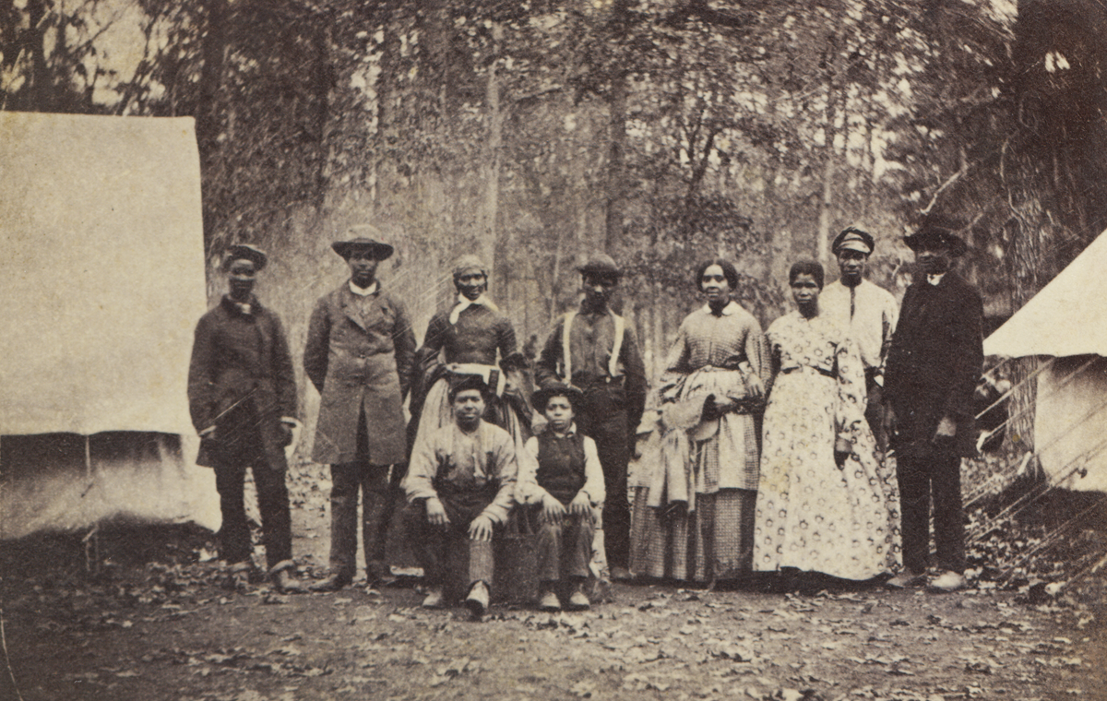
“I became free in 1863, in the summer, when the Yankees come by and said I could go work for myself.”
-Jackson Daniel, former slave in Alabama
12. many walked off plantation when Union armies came through

Slide 44
The war greatly affected life in the North.
Mines and factories stepped up production of war supplies.
For their service, Congress offered soldiers land in the west.
The federal government raised tariffs.
The federal government imposed an income tax.

Slide 45
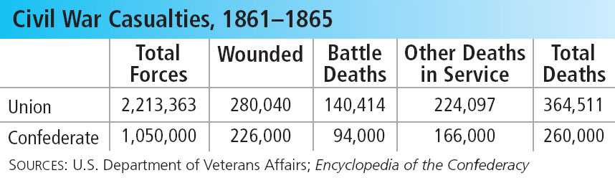
In July 1863, Congress imposed a draft on
men 20-45 years of age, and draft riots ensued.
As the death toll for the war rose, Northern critics demanded peace.

Slide 46
Lincoln suspended the right of habeas corpus, which guaranteed no one could be held in prison without specific charges.
Troops arrested many people suspected of disloyalty.
Lincoln felt this was a necessary action to help preserve the Union, but others criticized the move as unconstitutional.
Notes:
46

Slide 47
The South suffered damage and hardships.
Most battles took place in the South, which caused massive destruction.
The Confederacy printed worthless paper money, which caused severe inflation.
The combination of rising prices and food shortages sparked food riots in the South.
Notes:
47

Slide 48
In July 1863, Union troops defeated Lee at the Battle of Gettysburg. The battle was a turning point in the war.
In his 1863 Gettysburg Address, Lincoln reaffirmed the war’s purpose − to preserve the Union.
In 1864, General William T. Sherman marched across Georgia and South Carolina. Using a total war strategy, his troops destroyed buildings, crops, and railroad tracks.
Notes:
48

Slide 49
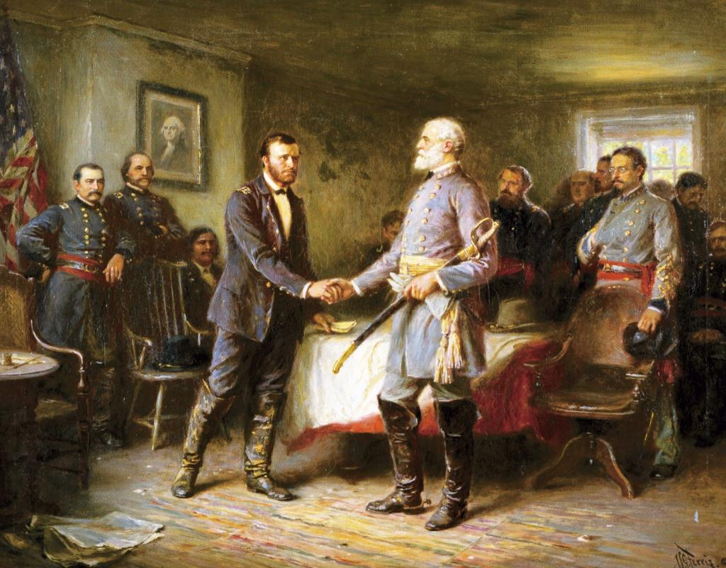
The Big Picture
Once the Union and General Ulysses S. Grant began utilizing a total war effort, northern population and industrial advantages soon forced the South into surrender.
The End of the War

Slide 50
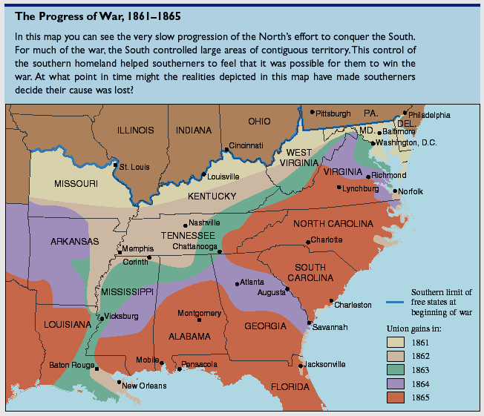
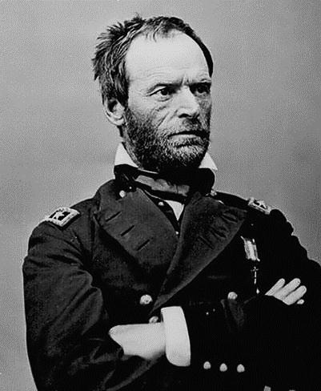
“All that has gone before is mere skirmish. The war now begins.”
-General Sherman
“The First Modern General”
1. after Grant cleared TN, Gen. William Tecumseh Sherman marched through GA

Slide 51
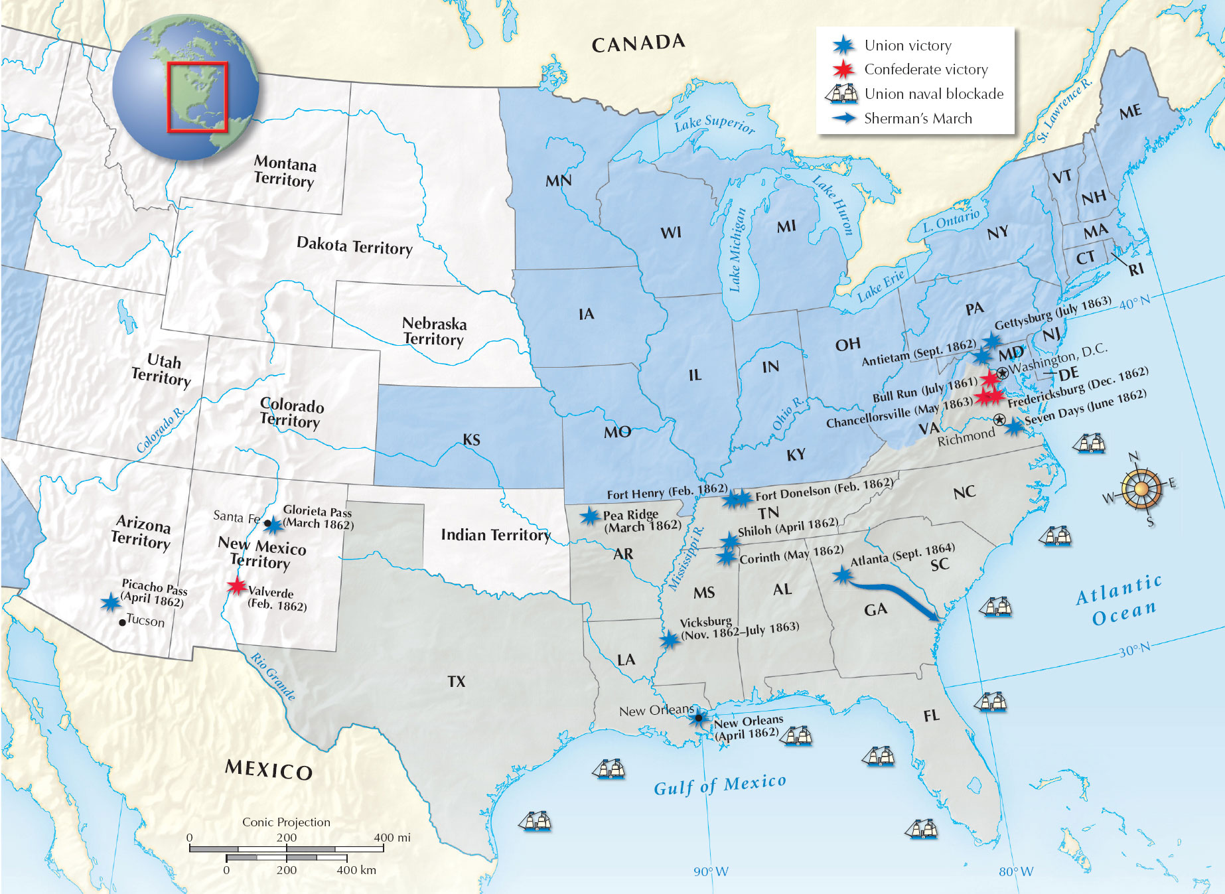
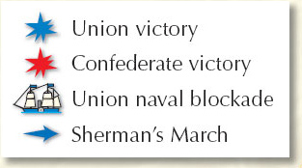

Slide 52
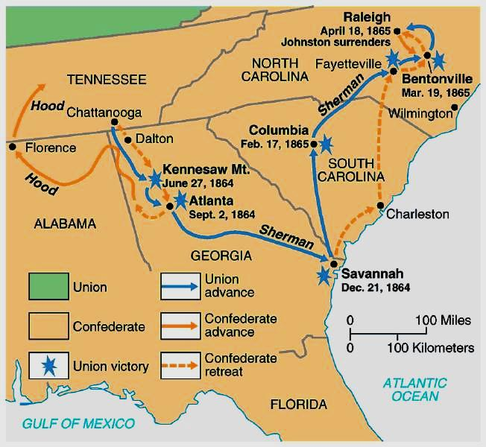
“When one nation is at war with another, all the people of one are enemies of the other. We are justified in treating all inhabitants as combatants. We are not only fighting hostile armies, but hostile people, and we must make old and young, rich and poor, feel the hard hand of war.”
-General Sherman
2. Sherman burned down Atlanta then completed “march to the sea” at Savannah

Slide 53
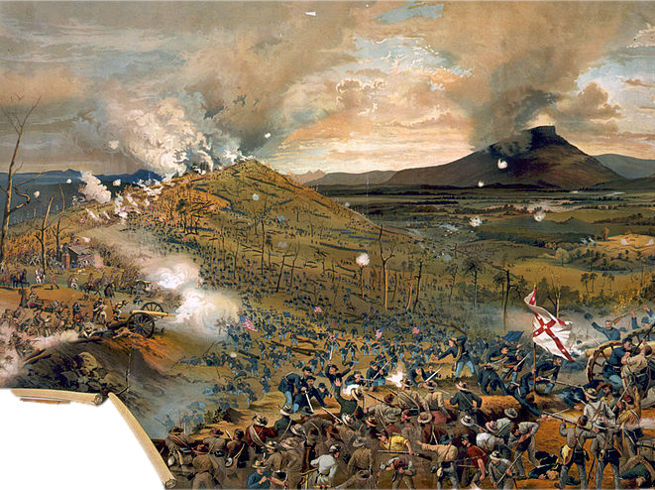
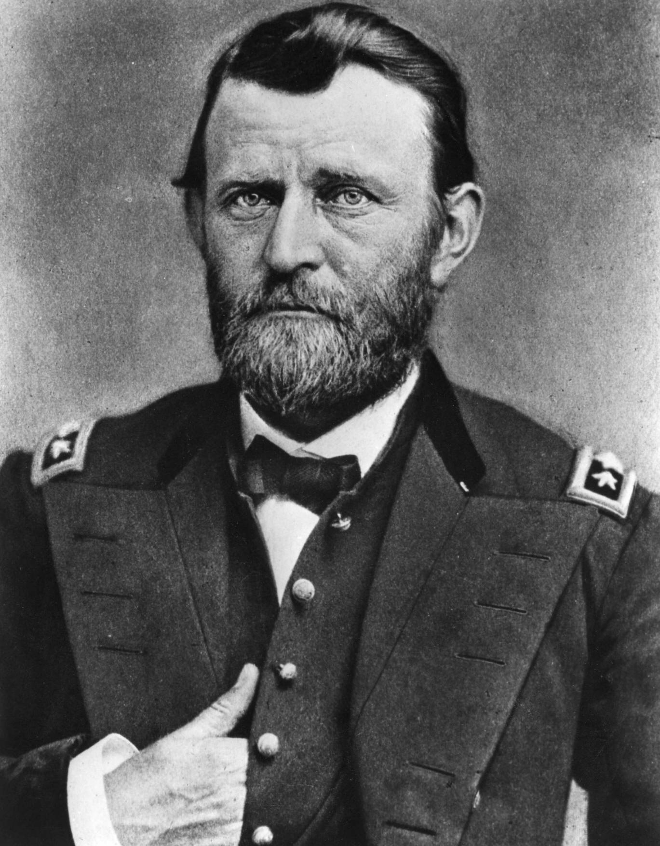
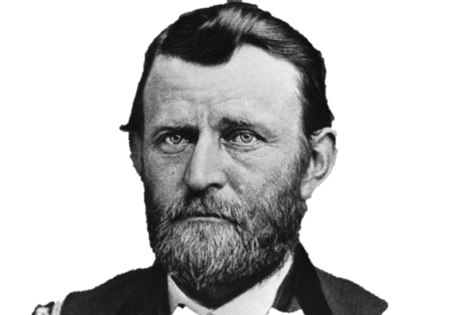
3. Sherman cut a trail of destruction one-mile wide (waging total war by cutting RR tracks, burning fields, destroying everything)

Slide 54
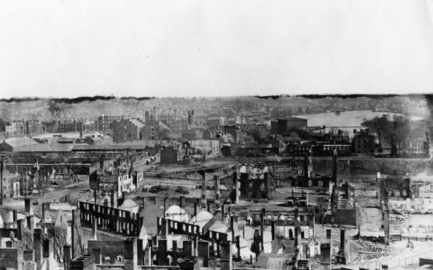
7. (1865) finally Grant captured and burned Richmond
“I felt as if all were dead within me, forever. We are going to be wiped off the earth.”
-Mary Chesnut, plantation mistress & general’s wife

Slide 55
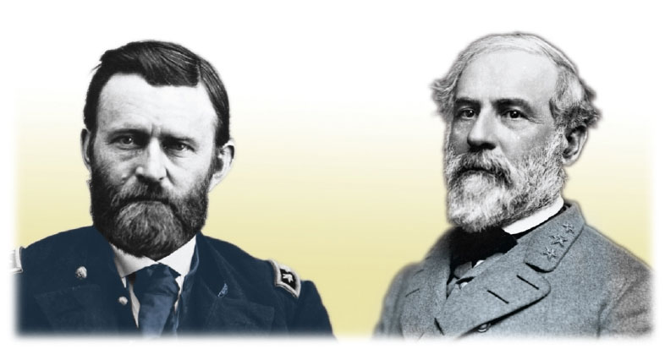
In the spring of 1865, Union troops
captured the Confederate capital.
On April 9, General Lee surrendered to General Ulysses S. Grant at Appomattox Court House, Virginia.
Notes:
55

Slide 56
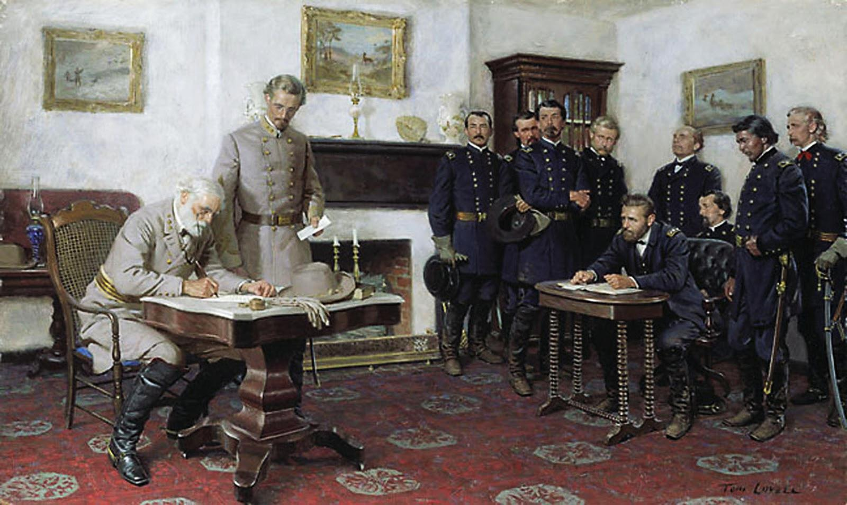
8. (April 1865) Lee was cornered at Appomattox Courthouse in VA and formally surrendered ending the war

Slide 57
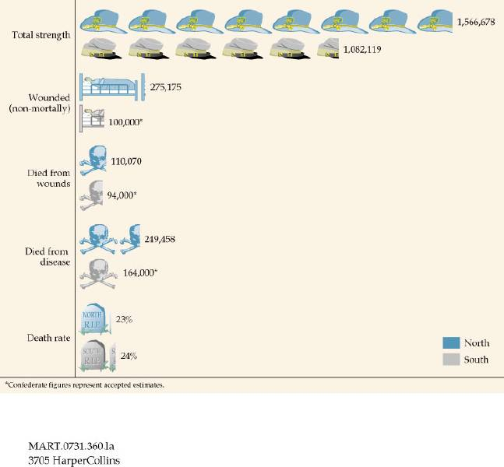
Casualties on Both Sides

Slide 58
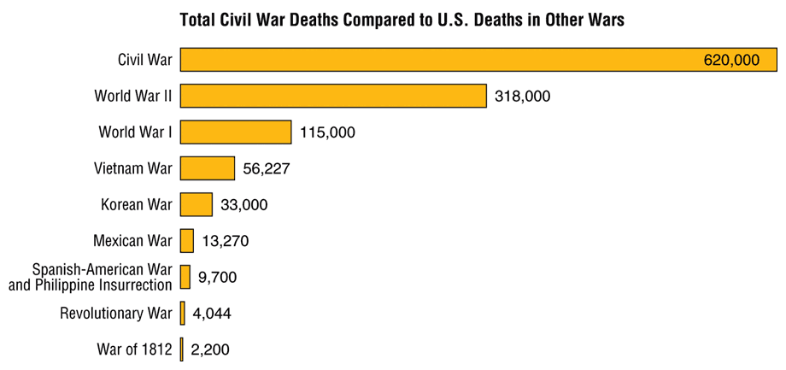
Civil War Casualties
in Comparison to Other Wars
War in Iraq deaths = 4,483
War in Afghanistan deaths = 1,699

Slide 59
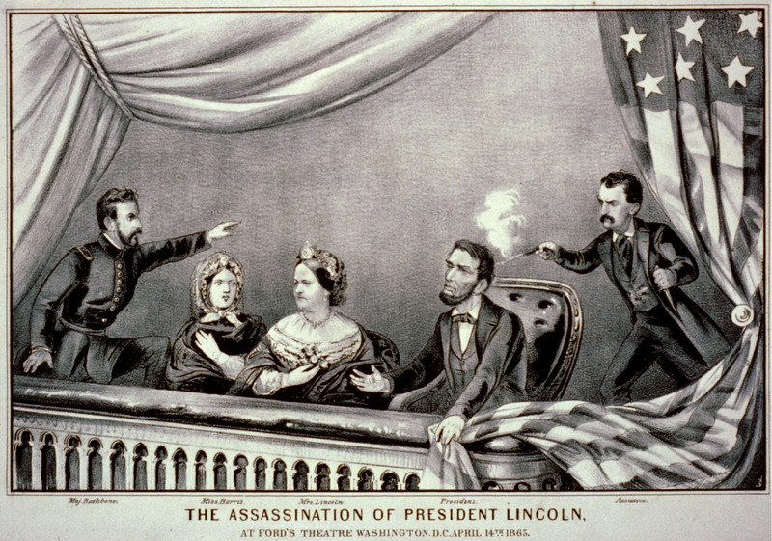
The Death of Lincoln

Slide 60



Thus Always to Tyrants!
Sic_semper_tyrannis
9. (4/14/65) Lincoln shot in the head by John Wilkes Booth (died soon after)

Slide 61

"Incontestably the greatest man I ever knew."
^{-Grant}
10. his death led people to realize his greatness and overlook his shortcomings

Slide 62


Essay
Essential Question
Evaluate the impact of the Civil War on political and economic developments in the following regions: the South, the North, the West.
11. South glad Lincoln died but he would likely have been kinder to the South during Reconstruction than Radical Republicans

Slide 63
  More than one-third of all soldiers were killed or disabled.
  The Southern landscape and economy were destroyed.
  African Americans saw the promise of freedom and opportunity.
The Civil War ushered in the harsh reality of modern warfare and had a lasting impact on the country.
Notes:
63

