Slide 1


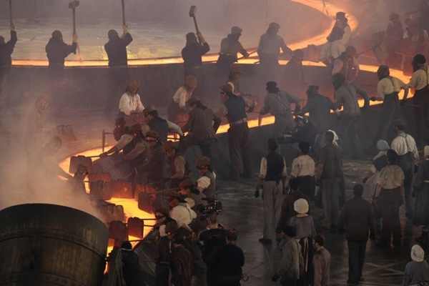
Emergence of Modern America
When you see the pencil appear, fill in the information in red on your info-graphic guided notes page.

Slide 2
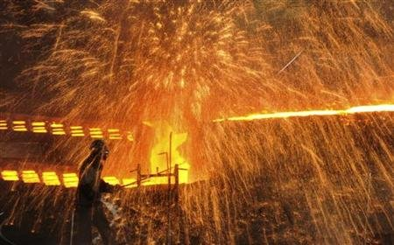

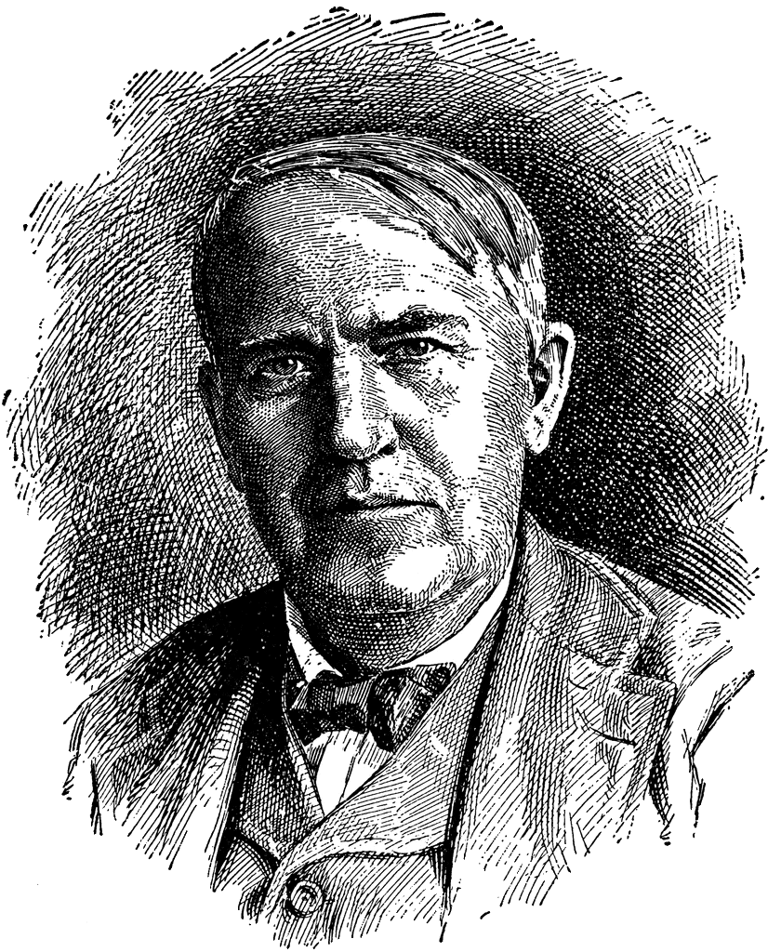
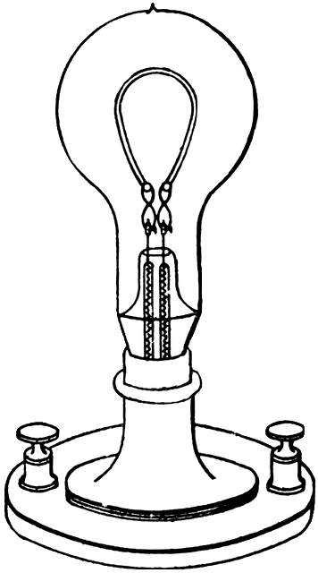
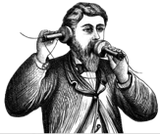
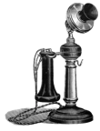
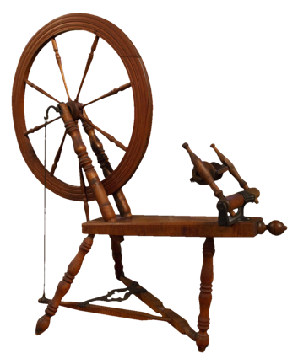
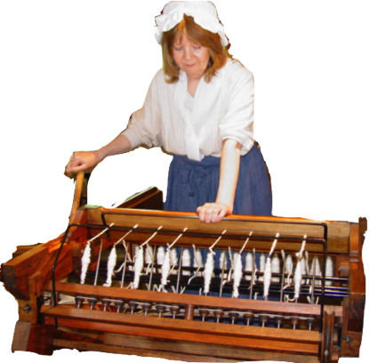
By the 1860’s machines had taken over much of the work once done by hand. Work had moved from homes and into factories.
After the Civil War, new inventions and improved technologies brought growth to businesses.
Many new inventions and manufacturing methods would change the future and impact how goods would be made.
Industrialization
The shift from making products by hand to using new innovations and machines for production.
Thomas Edison
Alexander Graham Bell

Slide 3
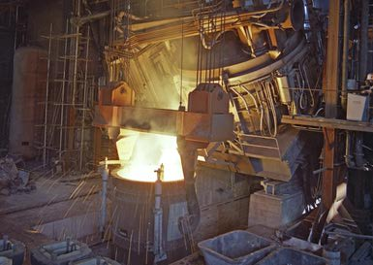
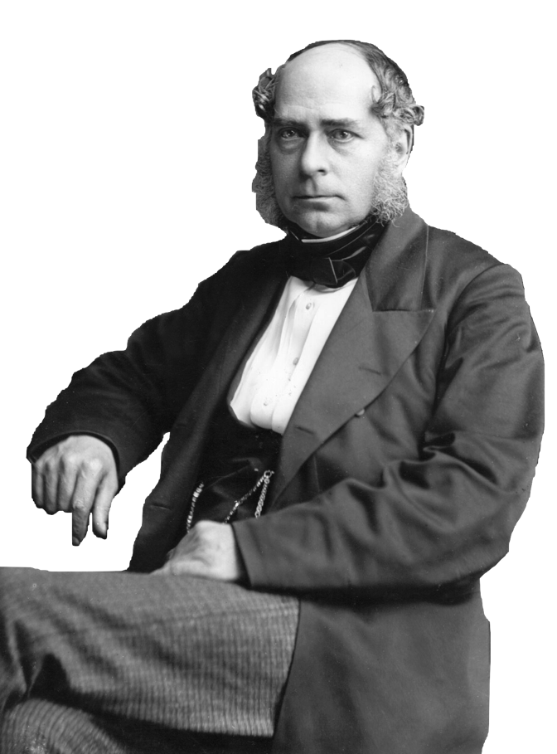

In the United States and England, inventers were working on improving the process to make steel. Steel is lighter weight but stronger than iron.
The result was the Bessemer Process that used less coal and increased the production of steel to 500 times what it had been.
This process ushers in the age of steel. Plows, railroad track, building beams, wire, nails, and even needles were being made out of steel.

Slide 4
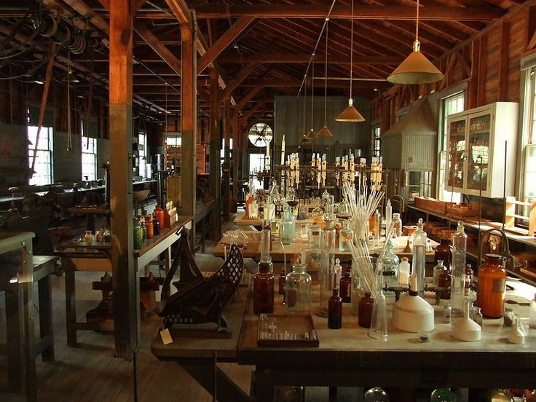

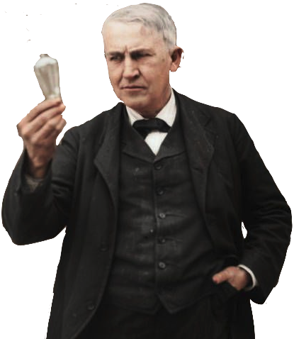

The electric power industry grew during the late 1800’s. Thomas Edison found the most ways to use electricity. He opened a laboratory in New Jersey and hired assistants to work in research teams. His laboratory invented so many things Edison received more than 1,000 U.S. patents.
His most famous invention was practical electric lighting. He figured out how to make a safe light bulb that burned steadily to work in homes and businesses. He also invented the electric grid to safely deliver electric currents to buildings and homes.
Thomas Edison
Made the practical light bulb and brought in the age of electricity

Slide 5
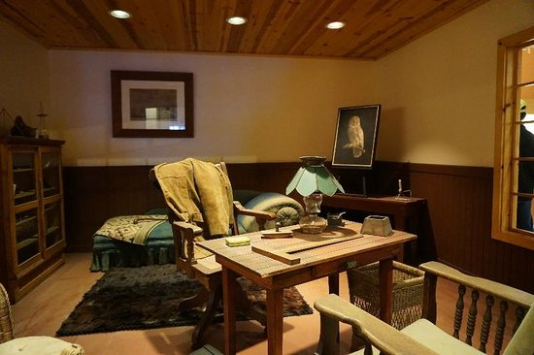
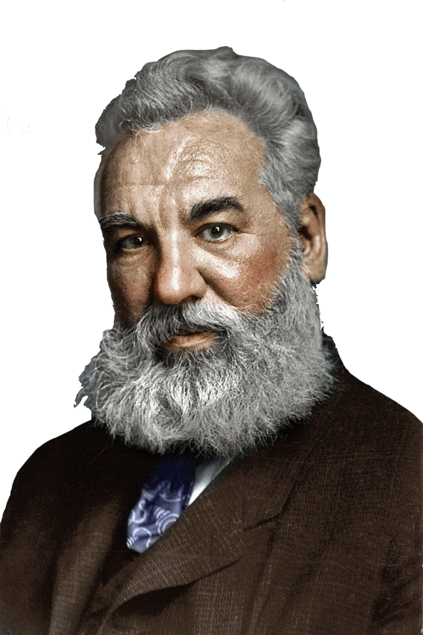
Communication was revolutionized with the telegraph in 1835 and in 1876, it would once again be made more efficient.
Scottish immigrant, Alexander Graham Bell, taught deaf students and wanted a device to transmit human speech using electricity.
One night, Bell was tinkering with the transmitter in his laboratory and he spilled acid on himself. He called for help from his assistant, Watson, who was in another room with the receiver. Watson heard Bell’s voice through the receiver and the telephone was born.
Alexander Graham Bell
Invented the telephone, making communication quick & easy.

Slide 6
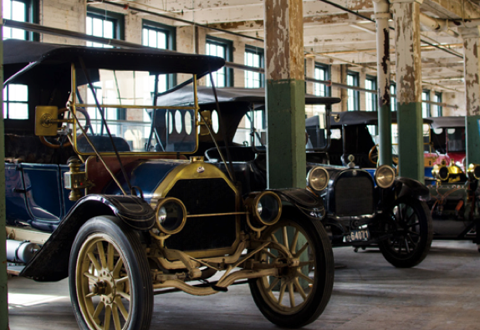
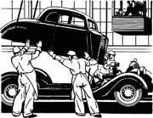
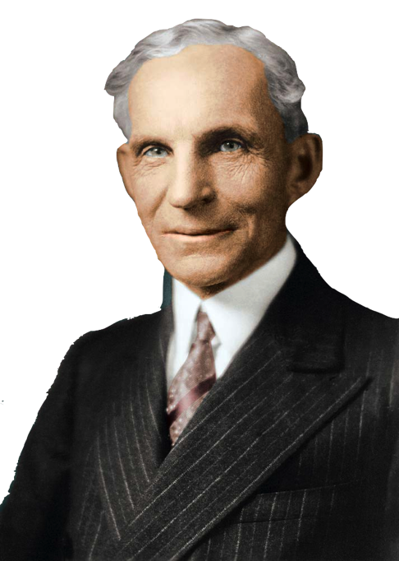

Henry Ford utilized the assembly line to mass produce his Model T cars. He created a moving assembly line using a conveyor to bring parts to workers.
Mass production methods like the assembly line made it possible for workers to make more goods in less time at lower costs.
Since it cost less for Ford to manufacture his Model T, his automobile attracted more customers. Mass production made goods more affordable and more people could buy manufactured products.
Mass Production & Assembly Line
Henry Ford increased production using the assembly line. This method produced more goods at lower costs.

Slide 7

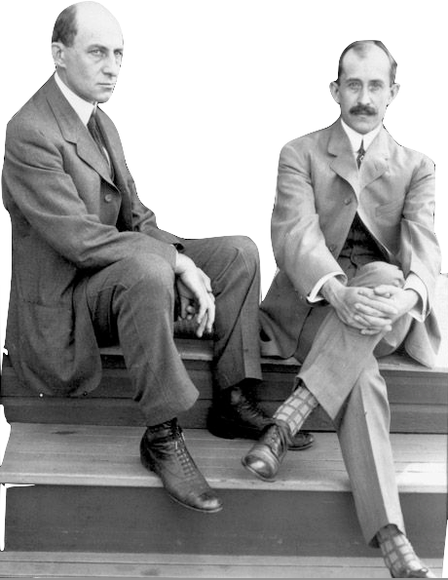
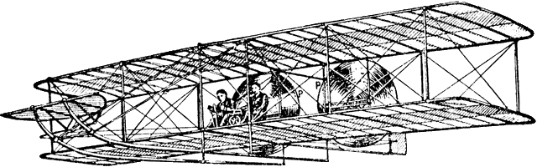
Air Transport
Orville & Wilbur Wright successfully piloted the first flying machine in 1903.
Brothers Orville and Wilber Wright were bicycle mechanics fascinated with the idea of building a flying machine.
In 1903 the brothers took their gasoline-powered airplane to Kitty Hawk, North Carolina and on December 17, Orville made the first successful flight of a powered aircraft.
By 1918, the U.S. Postal Service was using air transportation to make it faster and easier to get goods.

Slide 8
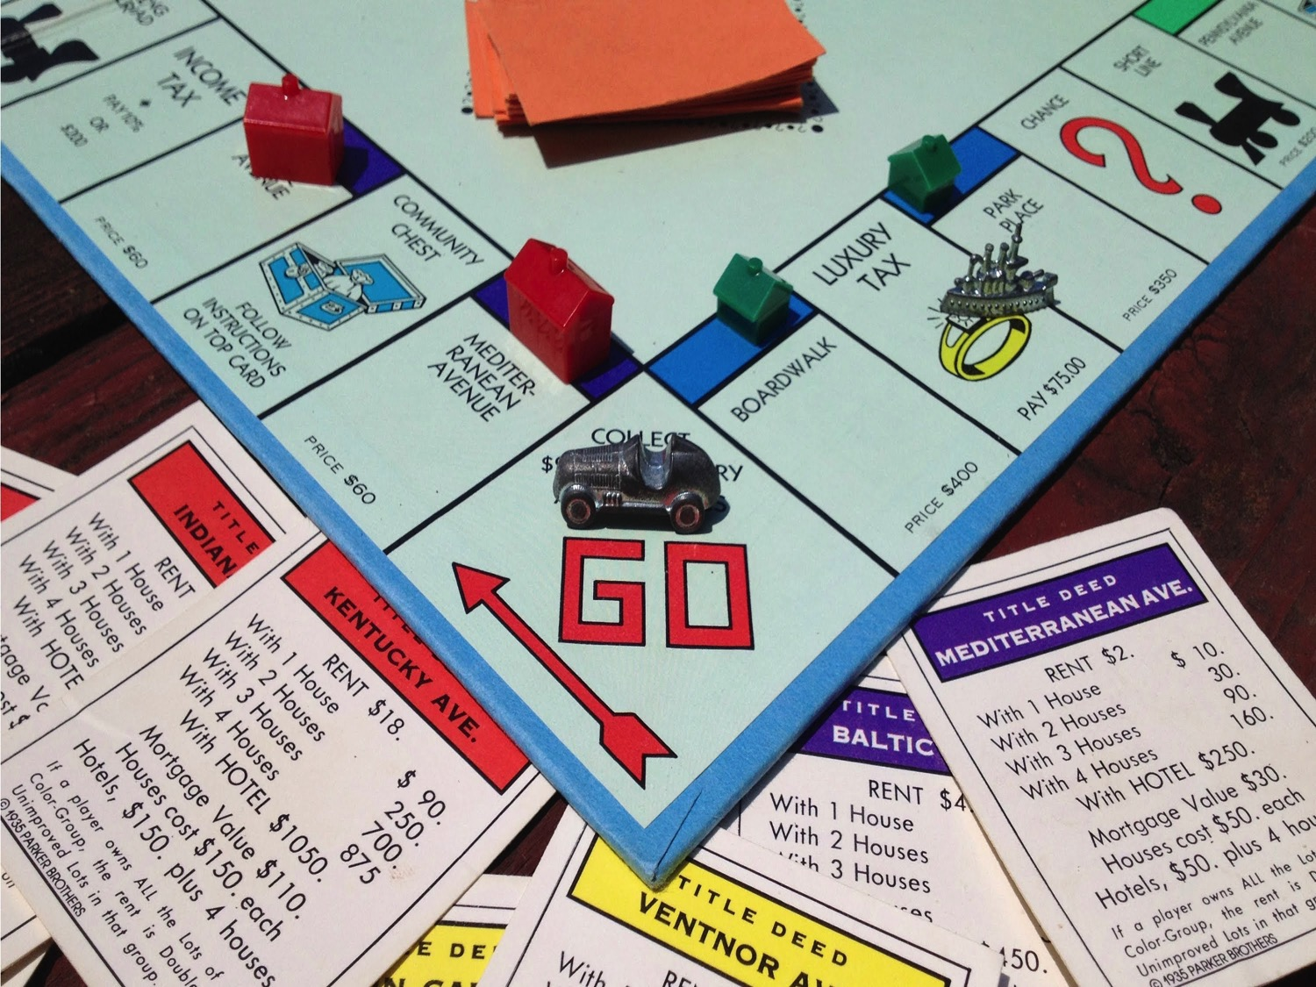

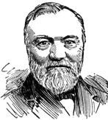

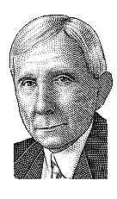


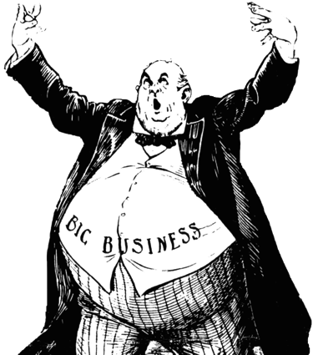
Monopoly
In the late 1800’s, there were very few government laws to regulate businesses and how companies were run. This led to the growth of a few giant corporations that would dominate American Industry.
Monopolies began to form in the industries such as steel, oil, and railroads. A company becomes a monopoly by wiping out all competing companies that make or sell the same product. They can set their prices higher because customers have no choice but to buy from them.
A company that controls all production and sales of a product by eliminating competition.
Andrew Carnegie
John D. Rockefeller

Slide 9
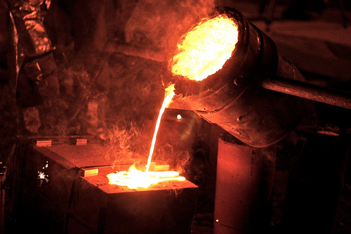
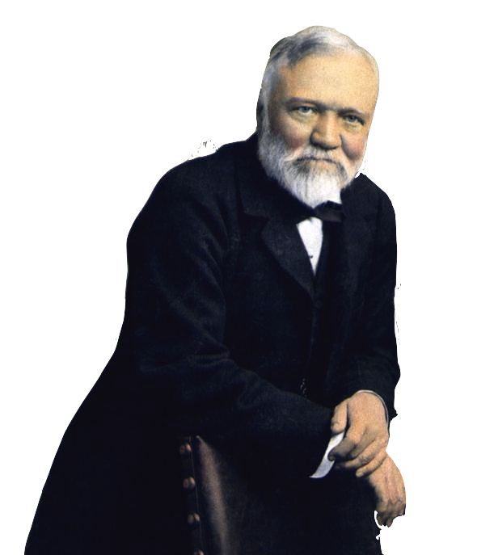





When Andrew Carnegie was 12, his family immigrated to the U.S. from Scotland. They settled in Pennsylvania. Andrew got his first job in a textile mill.
Carnegie learned about running a big business when he was working as an assistant to a railroad superintendent.
When Carnegie started his steel company, he sought to control every part of the process to make his product. He bought the iron ore mines, the ships and railroads, and the mills that produced his steel. He eventually created a monopoly in the steel industry.
Andrew Carnegie
Became the leader of the steel industry.

Slide 10
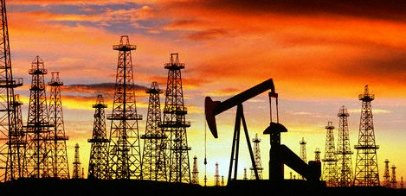
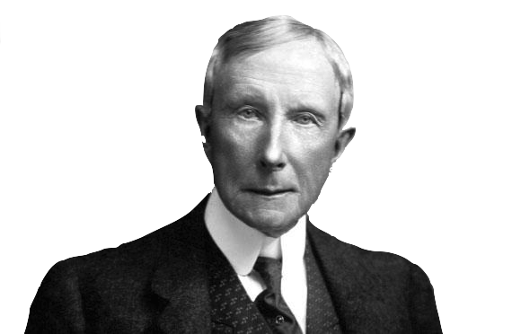
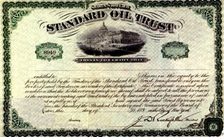


John D. Rockefeller learned to be frugal with money growing up in a poor family in upstate New York. He avoided unnecessary spending.
Rockefeller invested in his first oil refinery in 1862 when he was 23. At this time, oil was used to light homes and provided energy.
Like Carnegie, Rockefeller took control of every step of his business. He bought oil fields, railroads, ships, and pipelines.
To manage his businesses, he combined them into the Standard Oil Trust and was able to wipe out competitors.
John D. Rockefeller
Became the leader of the oil industry.

Slide 11
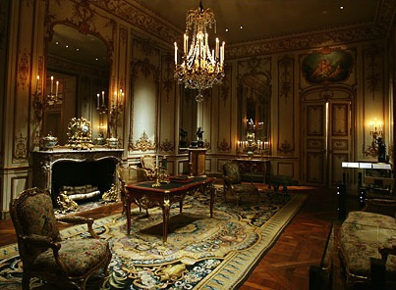
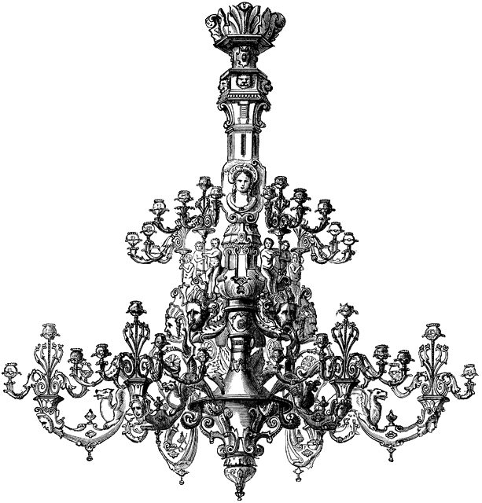
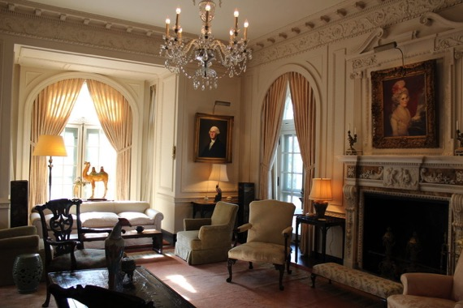
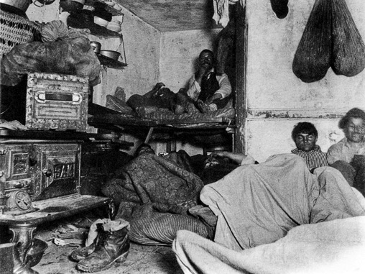
Rockefeller and Carnegie both had “Rags to Riches” stories. They went from poor beginnings to a life of magnificent wealth.
Their success inspired many to try and achieve the “American Dream” through hard work. However, these stories hid an important reality- most people who were millionaires in this era didn’t start out poor.
While the number of millionaires increased during this era, the reality was that most people who worked for their companies in the factories were living in extreme poverty.
The Gilded Age
Nickname for the age where the number of millionaires grew as businesses grew.
Gilded means overlaid in gold.
John D, Rockefeller’s Living Room
Poor immigrant living conditions

Slide 12
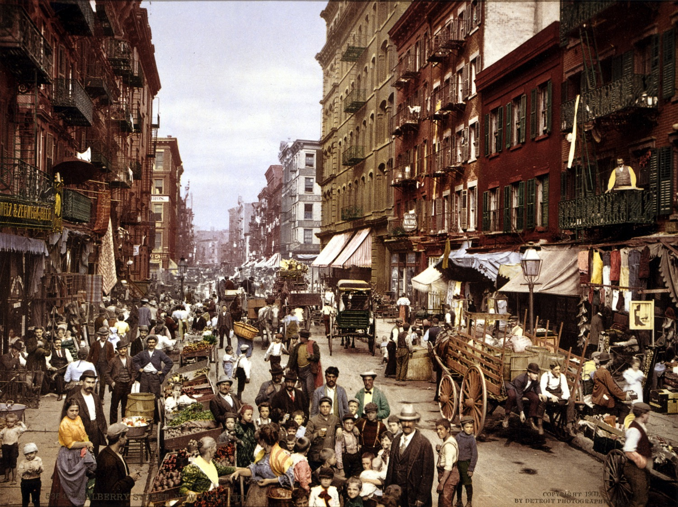
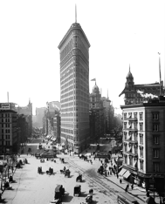
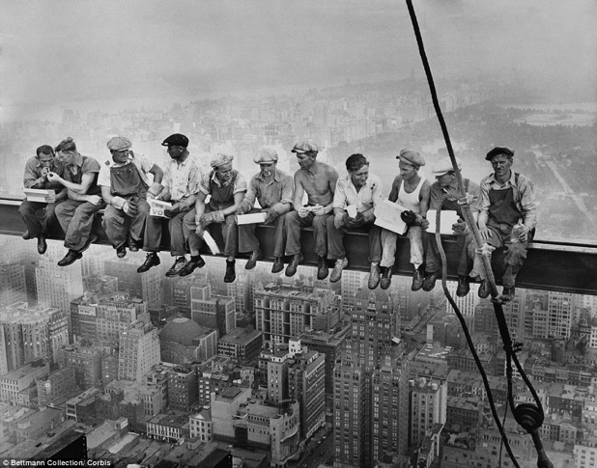
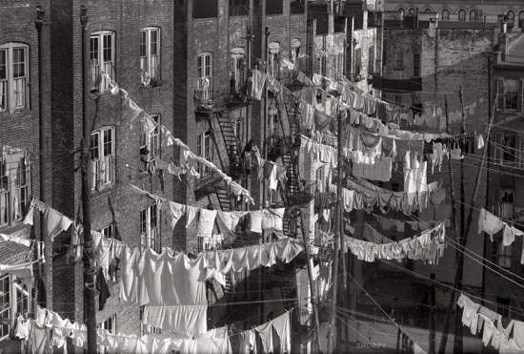
Urbanization
The growth of industries and increase in factories and manufacturing created millions of jobs in urban cities.
People flooded from rural areas and immigrants fleeing poverty flooded to America’s growing cities to look for jobs.
The new technologies were used to build cities. Electricity and steel changed the structure of cities. Elevators allowed for cities to grow upward into skyscrapers. Tenement buildings housed as many families as it could hold when housing became scarce.
Rural Americans flocked to urban cities looking for jobs. Skyscrapers helped cities grow upwards.

Slide 13
Optional Online Video Resources
America Story of Us: Cities
https://www.youtube.com/watch?v=DdmeyzzUesM
Men Who Built America: Traits of a Titan
https://www.youtube.com/watch?v=gR7oHh-fXUw
Men Who Built America: The Every Man
https://www.youtube.com/watch?v=ymEa24r0xXk
What is a Monopoly?
https://www.youtube.com/watch?v=nyt7uZ63vMU

