Slide 1

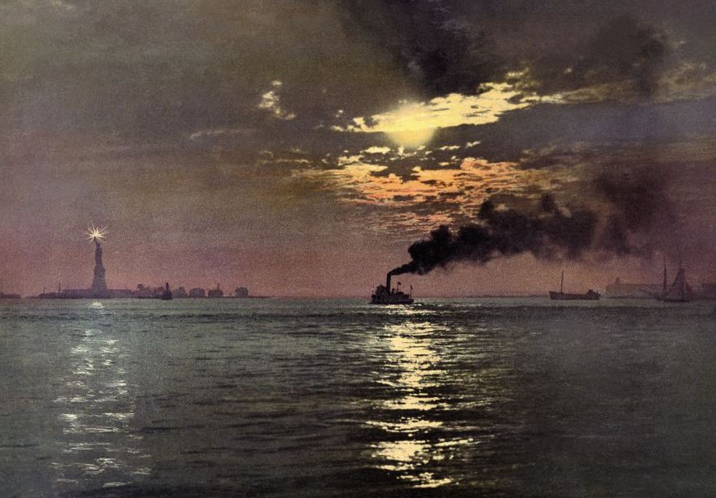
Emergence of Modern America
When you see the pencil appear, fill in the information in red on your info-graphic guided notes page.

Slide 2
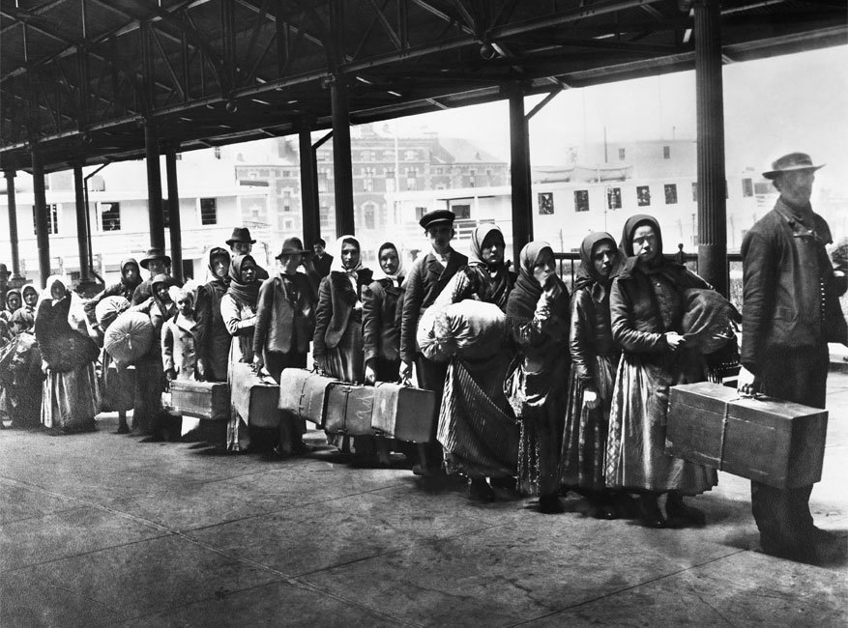

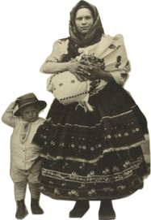
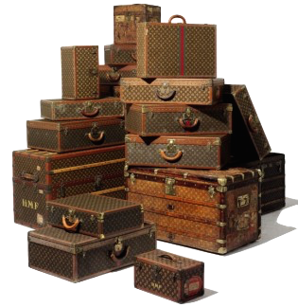
Between 1880 and 1920 more than 23 million immigrants arrived in America. They came from all over the world for a variety of reasons. Many came to escape poverty, political violence, and religious persecution. Others came seeking opportunities that their home countries could not provide.
Immigration impacted the growth of the United States in incredible ways. Not only did these immigrants become more “American”, America became more diverse with the contributions from new members of the population.

Slide 3
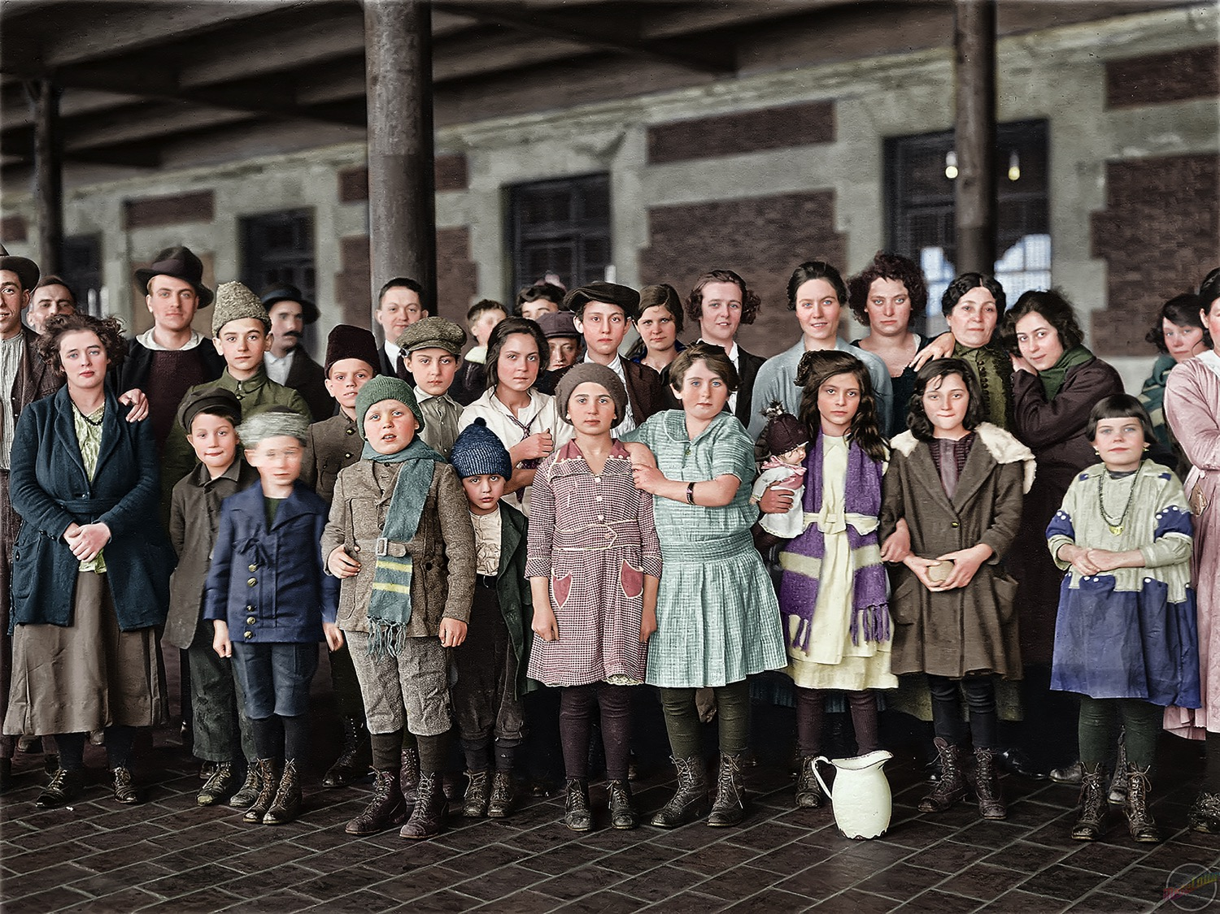


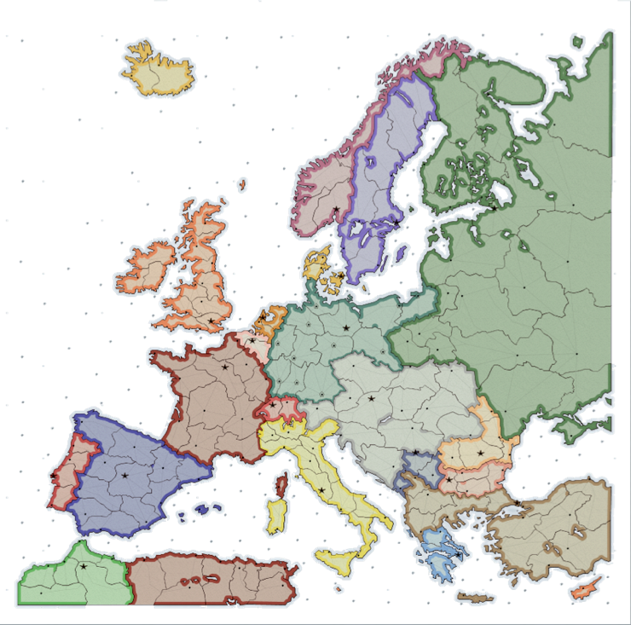

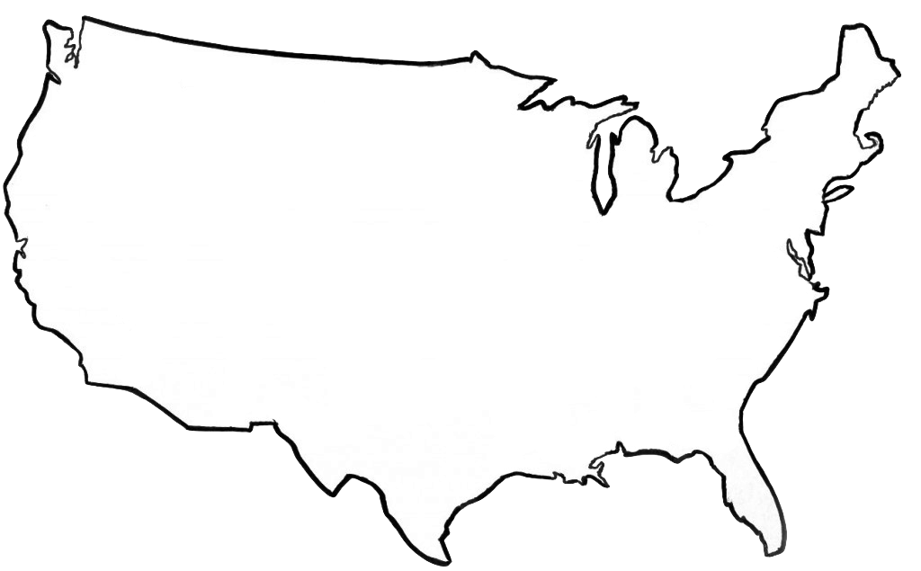

Before the 1890’s, most immigrants coming from Europe came from northern and western Europe from countries like England, Germany, and Norway. After 1900, more immigrants were coming from southern and eastern Europe. Italians, Poles, and Russians were among the great wave of new immigrants coming from Europe.
In 1892, the United States opened a new site for processing the growing number of immigrants coming from Europe. Ellis Island became the first stop for European immigrants where they were questioned and registered.
1892
Ellis Island opened
Ellis Island

Slide 4
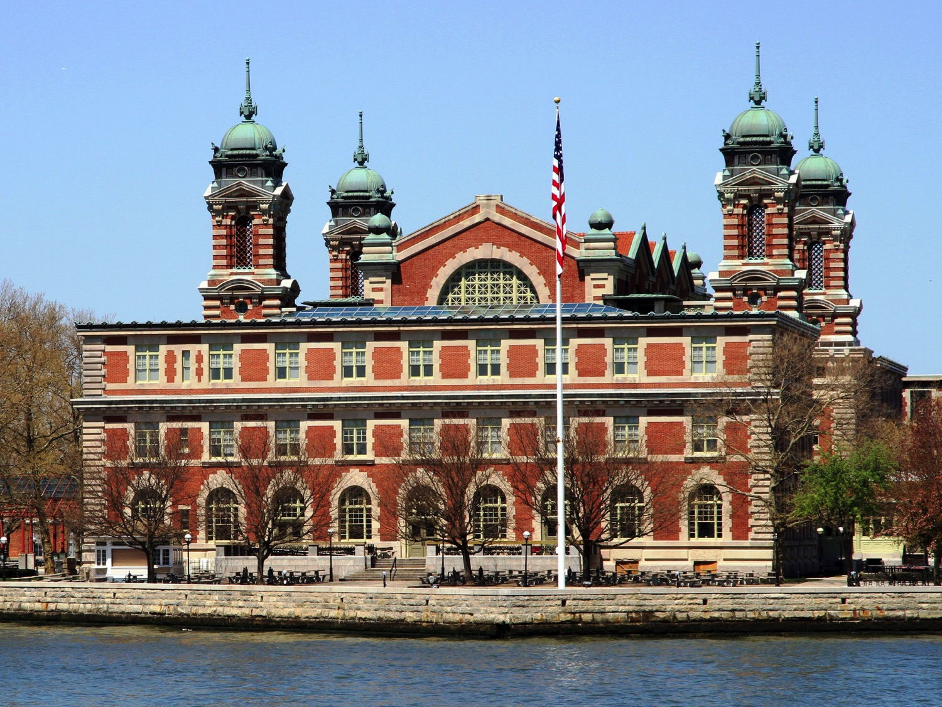
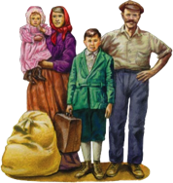
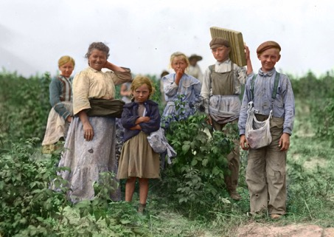
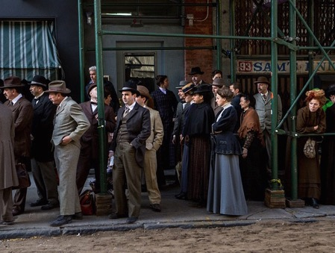
Some immigrants came as refugees from countries facing war. Others came during times of economic depressions when jobs, farmland, and food were scarce. Many came because the Homestead Act promised 160 acres of farmland to families willing to settle the frontier.
However, most European immigrants settled where factory jobs were abundant. Cities grew and faced the challenge of meeting the needs of so many new residents coming in so rapidly. Many immigrants settled in ethnic neighborhoods with others who had come from the same country.
European Immigrants
Millions came to escape poverty.
Most crossed the Atlantic Ocean and settled in cities along the East Coast.

Slide 5
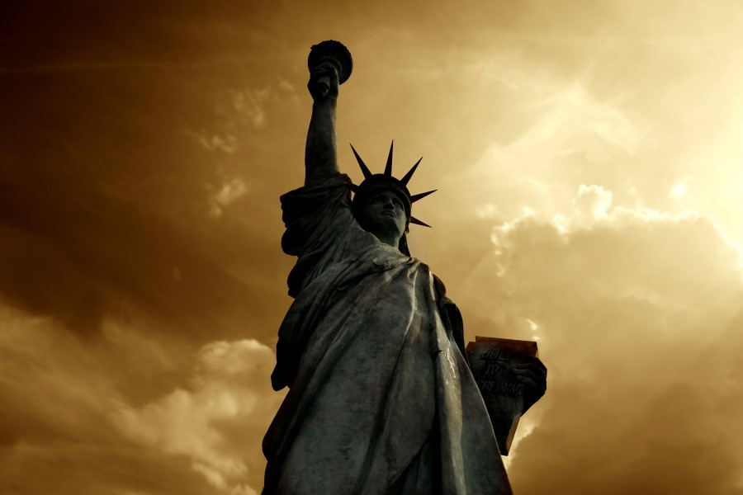
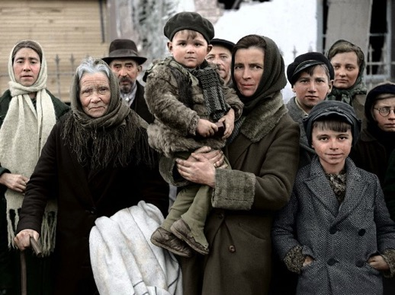
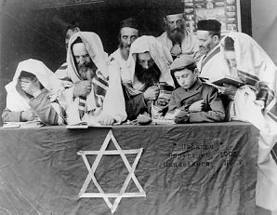
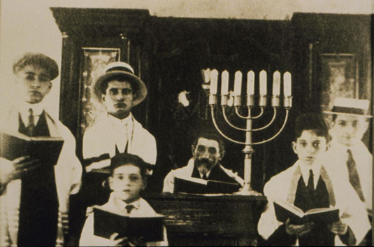
Between 1881 and 1924 around 2.5 million Jewish immigrants came to the U.S. from Russia and neighboring Eastern European countries. This was to escape religious persecution.
In the 1880’s Russians had passed many anti-Jewish laws and discriminated against Jews because their religious beliefs required them to worship, dress, and even eat differently. Laws prevented Jews from being allowed to own land or live in big cities. Their children were banned from schools. America promised free education and opportunities to live in communities and even own land and businesses.

Slide 6
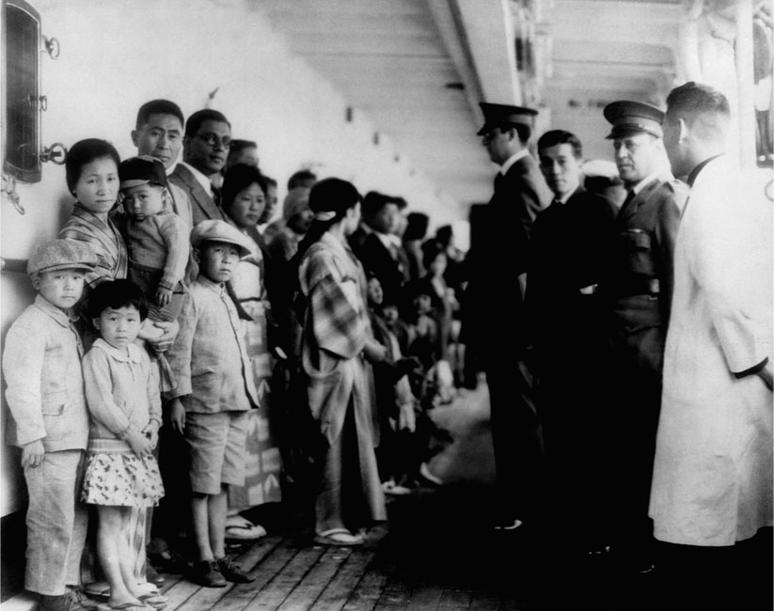

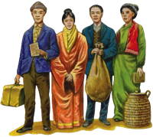
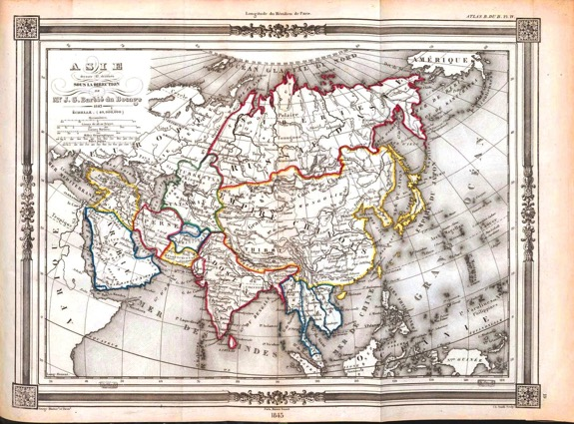
Asian Immigrants
On the other side of the country, outside of San Francisco, immigrants from Asia were coming to the United States to find jobs and a new life.
Some of the first Chinese immigrants had come during the Gold Rush to mine for their fortunes. Many Chinese laborers had been recruited to work for the Central Pacific Railroad.
Chinese immigrants were met with more overt racism as they tried to become established in the United States. Most chose to live in ethnic neighborhoods (Chinatown) where they started laundry businesses, restaurants and stores.
Crossed the Pacific Ocean to the West Coast. Many came to be miners, work on the railroad, or start their own businesses. Most came from China.

Slide 7
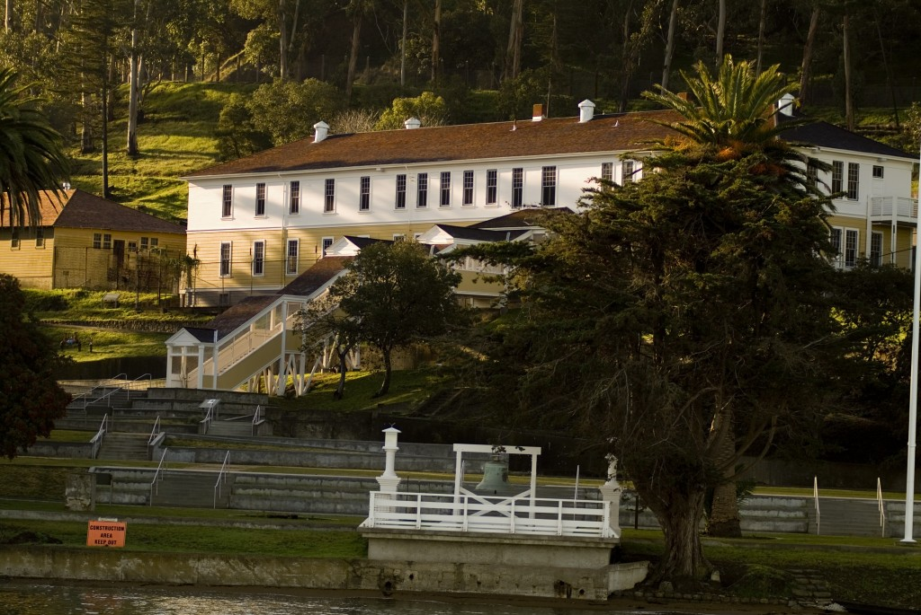
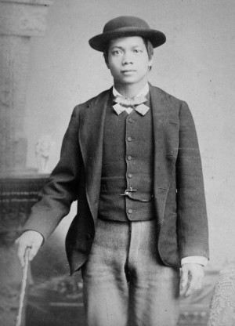
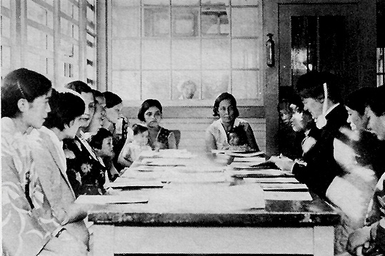
The first stop for Immigrants coming from Asia was Angel Island on the Pacific Coast of California.
In Angel Island’s filthy buildings, most Chinese immigrants were held for several weeks. They faced lengthy interviews and tests to determine if they were fit to stay in the U.S.
Asian immigrants often had to prove they were related to current citizens here in the U.S. before they would be released to start their new American lives. They were often nicknamed “paper relatives”. Nearly one in ten Chinese immigrants was refused entrance and sent back to China.
Angel Island

Slide 8
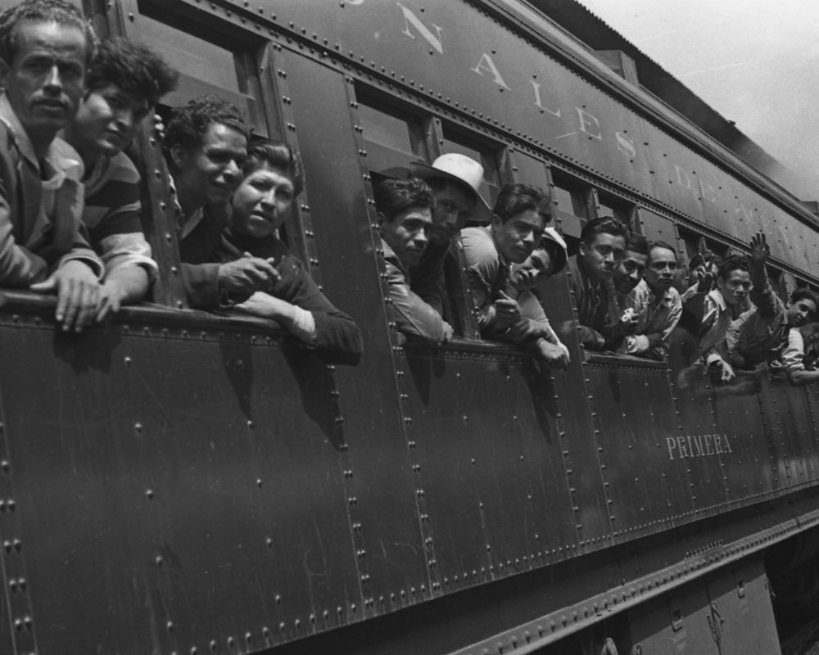

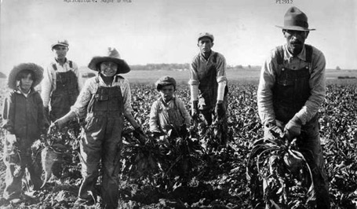

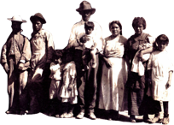
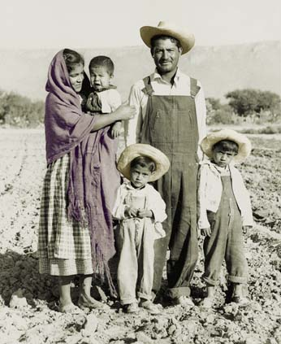
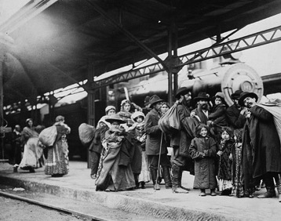
In 1910 Mexico was caught in the middle of a bloody civil war. Mexico’s president had allowed wealthy landowners to take over the lands of nearly 15 million farmers and Indians.
A rebellion took place when the landless farmers started an uprising and the violence lasted for a decade.
During this time, nearly half a million Mexicans entered the United States. They came freely with no required passports, many on trains and even more on foot.
Mexican immigrants found jobs as farmers, cattle ranchers, and as laborers for the railroad companies.
Mexican Immigrants
Many came to escape violence during the Mexican Revolution and found jobs in agriculture, ranching, and the railroad.

Slide 9
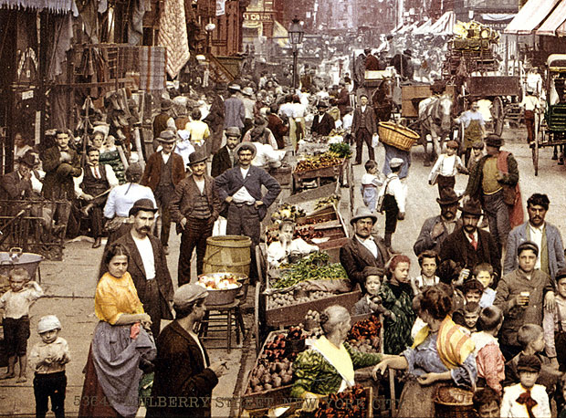

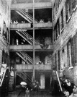
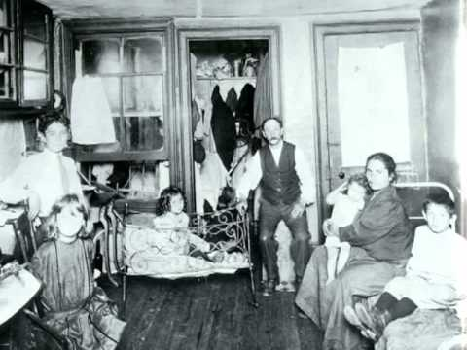
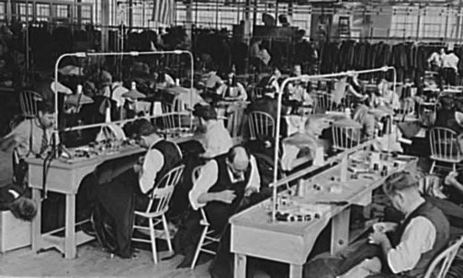
Cities struggled to absorb the rapid population growth that waves of immigrant ships brought them.
Many immigrants struggled to find resources like housing and jobs as they arrived. Ethnic neighborhoods like Little Italy and China Town made it easier for new immigrants to connect with others from their country of origin.
The demand for housing meant immigrant families crowded into run-down tenement buildings. The competition for jobs meant immigrants often were willing to work for lower wages in sweat shops and factories and could be easily replaced.
Tenements
Run-down buildings divided into tiny apartments to house as many immigrant families as possible.

Slide 10
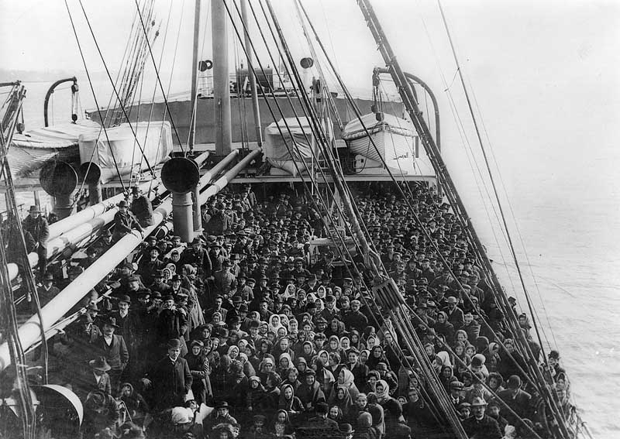
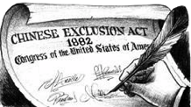
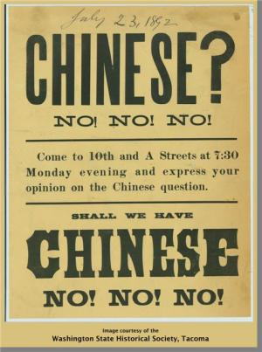
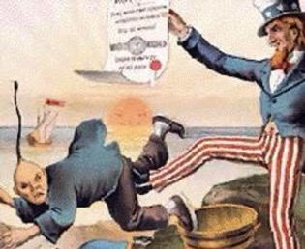
Immigrant groups were not always welcome in their new communities. To many U.S. citizens, the seemingly endless wave of newcomers meant competition for jobs.
Immigrants were usually eager to try and assimilate, or fit in, by adopting American culture, learning to speak English and sending their children to school when it was possible.
Still the differences in their cultures often made them targets of discrimination. Some employers advertised jobs for “Christians only”. In 1882 Congress passed the Chinese Exclusion Act to limit Asian immigrants.
Assimilation:
Becoming part of another culture.
Chinese Exclusion Act
1882-1943 Banned Chinese laborers from U.S. immigration.

Slide 11
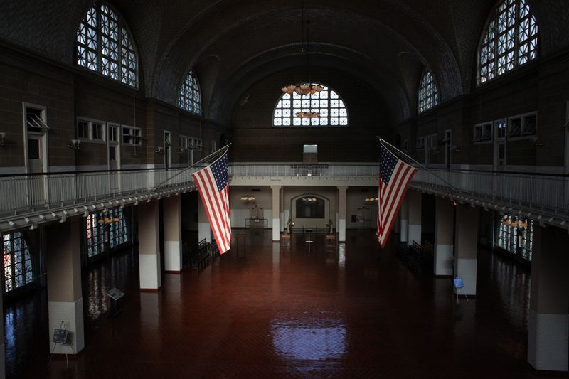

Positive Impact of Immigration | Negative Impact of Immigration
Added diversity
Helped grow the economy by providing workers
Overcrowded cities
Immigrants competed with Americans for jobs and were willing to work for lower wages
In the 1920’s there was a rise in “nativism” as Americans became less welcoming to the streams of immigrants. Congress limited immigration quotas and the great wave of immigration to the U.S. had ended.
But by then America had already been impacted by the diverse cultures brought here by the millions of newcomers. Even while assimilating, immigrants changed America with their foods, beliefs, languages, and music. The hard working men and women with strong values and new ideas started businesses and became important to the economic landscape of the nation.

Slide 12
Optional Online Video Resources
Ellis Island- A New Hope
https://www.youtube.com/watch?v=8X4CypTaOQs
Forgotten Ellis Island
https://www.youtube.com/watch?v=AuPZr68T_fg
Ellis Island- Endless Archive
https://www.youtube.com/watch?v=eH2hllmZdRg
Discovering Angel Island: The Story Behind the Poems
https://www.youtube.com/watch?v=f_EQY-0ThOM
Angel Island Immigration Station Tour
https://www.youtube.com/watch?v=ZnpgiUY5ip4
Paper Sons: Chinese Illegal Immigrants
https://www.youtube.com/watch?v=Hhc-om3SXKw

