Slide 1
Chapter 3 Introduction
This chapter covers the rise of industry and the problems of segregation, immigration, urban growth and westward expansion.
Section 1: The Triumph of Industry:
Section 2: Immigration and Urbanization
Section 3: The South and West Transformed
Section 4: Issues of the Gilded Age

Slide 2
Section 2: Immigration and Urbanization
Focus Question: Why did immigrants come to the United States, and how did they impact society?

Slide 3
Objectives
  Understand the reasons that immigrants came to America.
  Explain the immigrants’ experience upon arriving in the United States.
  Identify the changes that took place in cities of the nineteenth century.
  Describe the urban middle class.

Slide 4
Terms and People
Ellis Island – island in New York Harbor that served as an immigration station for millions of immigrants, especially those from Europe
Angel Island – island in San Francisco Bay that served as an immigration station for immigrants from Asia
suburb - residential area surrounding a city
tenement - multistory building divided into apartments to house as many families as possible

Slide 5

Why did immigrants come to the United States, and how did they impact society?
The turn of the century was a time of great change as industries boomed and cities grew.
It also was a time of change for the population, as immigrants from around the world poured into the United States.

Slide 6
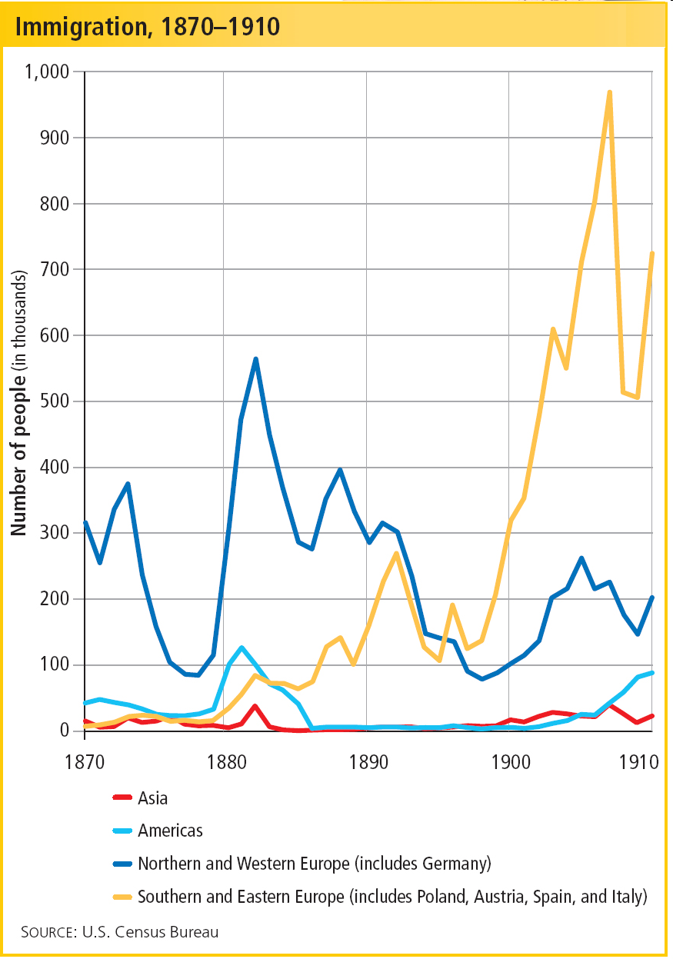
In the late 1800s, the number of immigrants entering the United States soared.
More than 18 million came from Europe, most from Southern and Eastern Europe.
Notes:
6

Slide 7
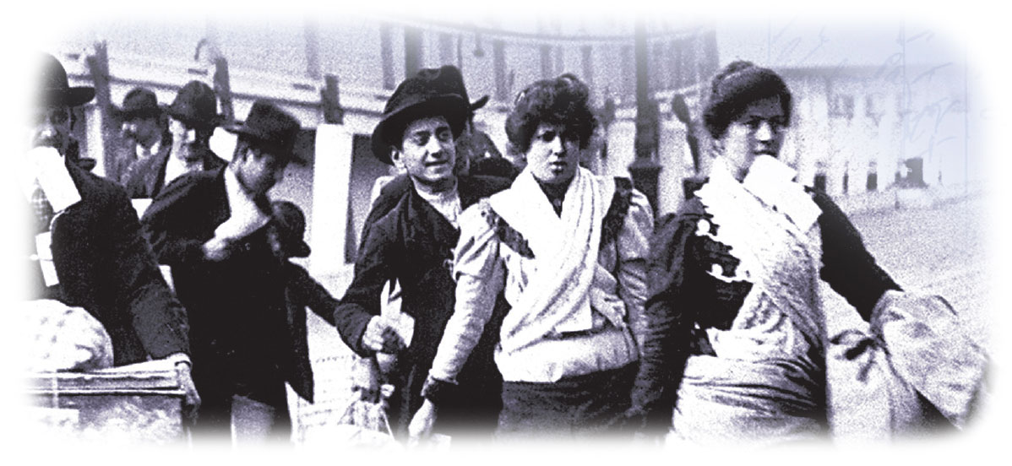
Unlike many of the earlier immigrants from Europe, most of the newcomers were Catholic or Jewish.
Few spoke English.
Notes:
7

Slide 8
Immigrants came to the United States for many different reasons.
Push Factors
Some factors seemed to push people from their homelands.
Religious persecution
Mandatory military service
Notes:
8

Slide 9
Pull Factors
Other factors seemed to pull people toward the United States.
Jobs
Political and religious freedom
Notes:
9

Slide 10
After a long and difficult journey, immigrants were taken to immigration stations for processing.
Most Europeans entered through Ellis Island in New York.
Most Asians came through Angel Island in San Francisco.

Slide 11
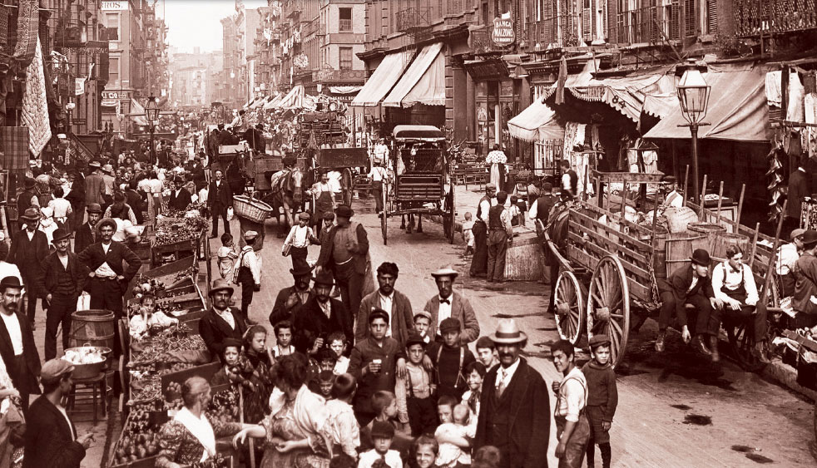
Once in the U.S., many immigrants found it difficult to adjust to urban industrial life.
They worked long hours and lived in crowded neighborhoods.
Many faced prejudice.
Notes:
11

Slide 12
Fraternal organizations helped many immigrants. So, too, did family members or others from the same homeland.
In time, immigrants made countless contributions to the growing nation.
With hard work, many immigrants built successful new lives.
Notes:
12

Slide 13
Rural and Urban Population
Cities grew rapidly as more and more people moved from farms to the sprawling urban areas.
Newcomers marveled at the skyscrapers above and the subways below.
Notes:
13

Slide 14
City planners used new technologies to help improve urban life.
Electric street lights and sewage treatment projects improved the infrastructure.
Electric trolleys and elevated trains allowed some people to move to the expanding suburbs.
Notes:
14

Slide 15
  Rapid growth led to a housing shortage.
  Unscrupulous landlords took advantage of desperate immigrants.
  Many families crowded together in tenements.
  The tenements were unhealthy and dangerous.
Despite such advances, however, urban dwellers still faced the problem of overcrowding.
Notes:
15

Slide 16

Urbanization resulted in many changes, including the growth of a middle class.
Growing industries created a demand for skilled, white-collar workers.
These middle class workers had enough money to spend on the variety of products now available.
Discretionary spending led to the success of another new business—department stores.

Slide 17
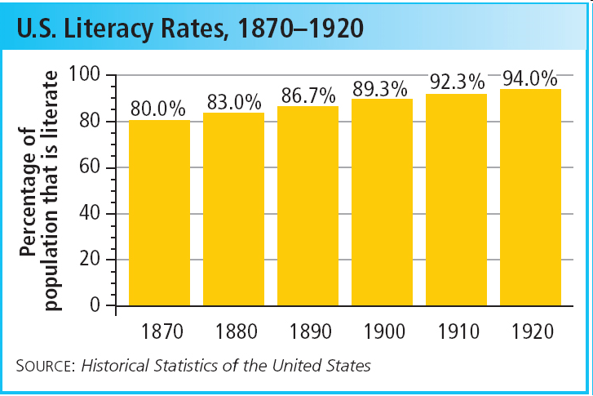
The new middle class also supported the expansion of education.
Literacy increased as more people graduated from high school and college.
Notes:
17

Slide 18
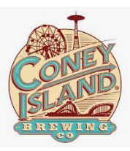
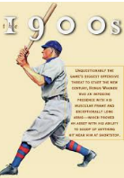
Arts and entertainment thrived as cities grew.
Mark Twain
Emily Dickinson
Henry James
Authors
Collegiate and professional sports
Amusement parks
Mass entertainment
Notes:
18

Slide 19

Interest in religion also surged,
as religious leaders appealed to the
growing number of city dwellers.
The Social Gospel movement promoted better wages and working conditions.
Evangelical Protestants traveled from city to city with religious revival meetings.

Slide 20
Review
Immigration & Urbanization
Immigration
South & East Europe
Catholics & Jews
Push Factors
Religious persecution
Military service
Pull Factors
Jobs
Freedom
Urbanization
Cities Grew
Technology
Street Lights
Sewage Treatment
Suburbs
Trolleys
Trains
Overcrowding
Housing Shortage
Tenements
Middle Class
Skilled Workers
Spare Cash
Dept. Stores
Education
Literacy
Entertainment
Authors
Mark Twain
Mass Entertainment
Sports
Baseball
Amusement Parks
Coney Island
Religion
Social Gospel
Revival Meetings
Notes:
20

