Slide 1
Objectives
  Explain the development of the New South.
  Understand the impact on Native Americans as settlers moved to the West.
  Identify who moved to the West and their reasons for doing so.

Slide 2
Terms and People
sharecropping – system in which a farmer tended a portion of a planter’s land in return for a share of the crop
Dawes Act – 1887 law that divided Indian reservations into privately owned plots of land
assimilate – to be absorbed into the main culture of a society
open range – vast area of grassland on which livestock roamed and grazed

Slide 3

What were the most important developments in the South and the West?
During the late 1800s, life changed dramatically in both the South and the West.
As southerners struggled with a lagging economy, westward migration led to a boom in mining, farming, and ranching.

Slide 4
After Reconstruction ended, southerners hoped to build a “New South.”
Textile, lumber, and steel industries emerged.
Business leaders worked to diversify the economy and support manufacturing.
Railroad construction boomed.
Notes:
4

Slide 5
Despite such progress, however, problems persisted.
The southern economy grew more slowly than economies in the North and Midwest.
A shortage of capital led to dependence on northern bankers.
High illiteracy rates and discrimination weighed down the region.
Notes:
5

Slide 6
For many southern farmers, it was a struggle to survive.
The price of cotton—their main crop— plummeted after the war.
Boll weevils wiped out entire crops.
Notes:
6

Slide 7
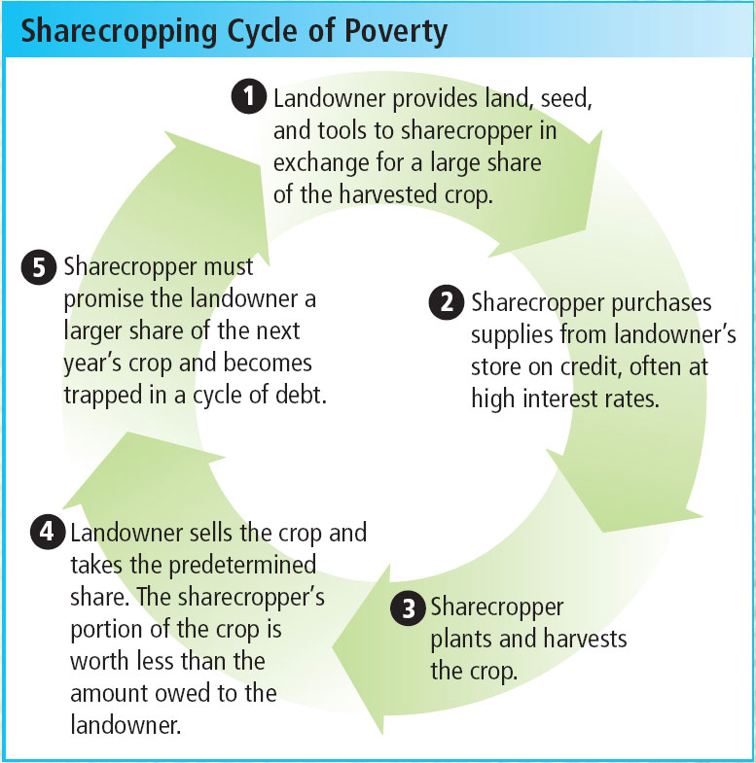
The sharecropping system added to the hardships as many farmers fell into a cycle of poverty.
Notes:
7

Slide 8
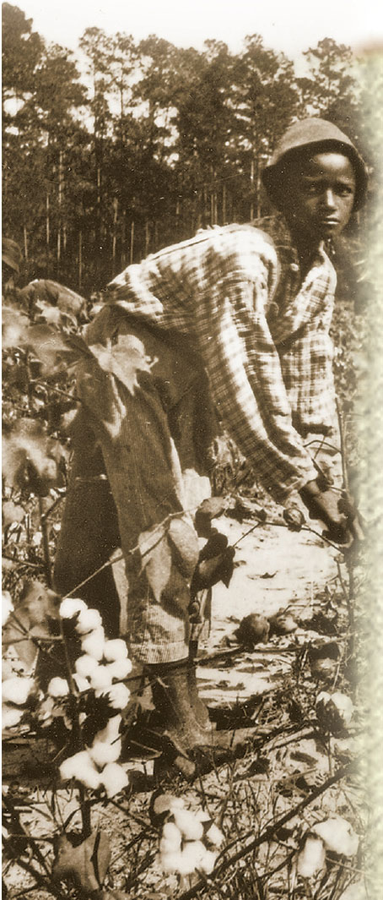
Life was especially hard for African Americans, who suffered bitter setbacks.
Newfound political and civil rights were stripped away.
Groups like the Ku Klux Klan terrorized African Americans.
Notes:
8

Slide 9
In the West, meanwhile, the threat to Native Americans grew even more urgent.
Settlers continued to push Native Americans from their lands.
The buffalo were being hunted nearly to extinction.
The government was forcing Native Americans to move onto reservations.
Notes:
9

Slide 10
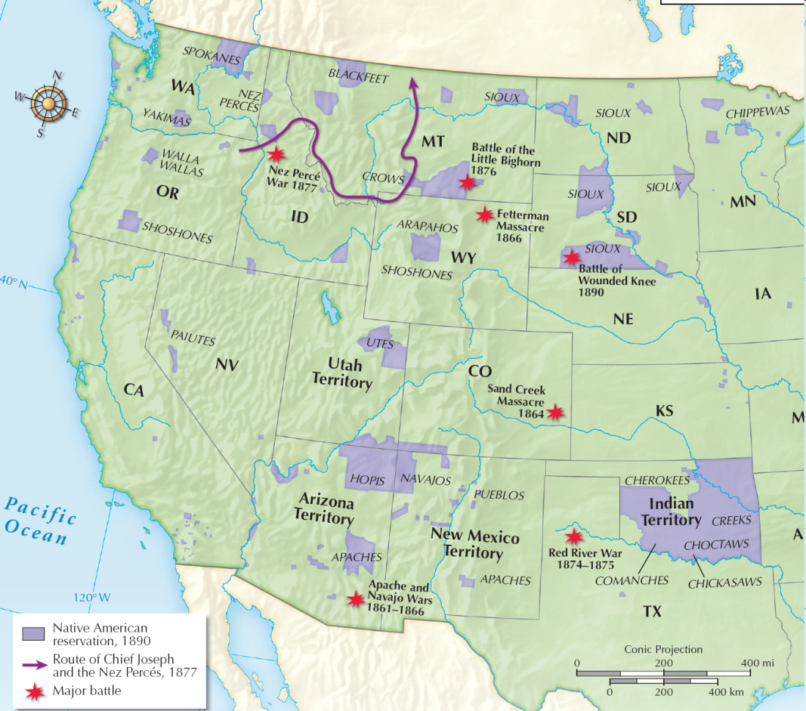
Some Native Americans fought to defend their lands.
The Sioux were victorious at Little Bighorn 1876.
Chief Joseph and the Nez Percé were defeated after attempting to retreat to Canada, 1877.
Notes:
10

Slide 11
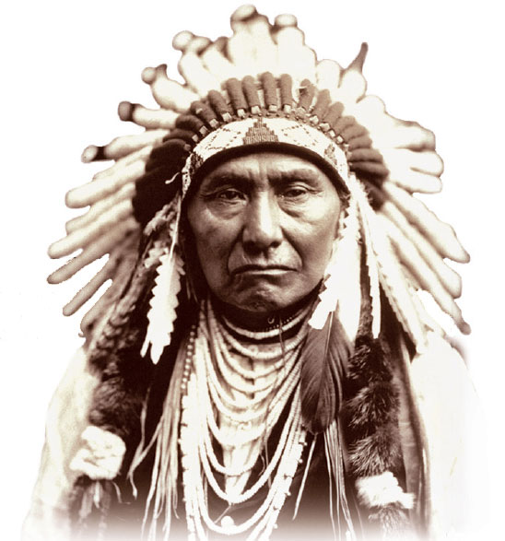
Indian resistance was eventually crushed, and Native Americans were moved onto reservations.
The Dawes Act (1887) gave the government the authority to divide reservations into privately owned plots and urged Native Americans to assimilate.
In time, however, many lost their land and fell into poverty.
Chief Joseph
Notes:
11

Slide 12
Some Indians looked to the ancient ritual of the Ghost Dance to help regain their spirit.
In 1890, tragedy struck when officials tried to stop a Ghost Dance.
Soldiers killed 250 Native Americans, mostly women and children, at Wounded Knee 1890.
Fearful of insurrection, authorities banned Ghost Dances.
Notes:
12

Slide 13
Among the first were prospectors, attracted by discoveries of gold and silver in the mid-1800s.
Mining towns boomed—until the gold and silver ran out.
As Native Americans were being forced onto reservations, millions of settlers continued to move west.

Slide 14
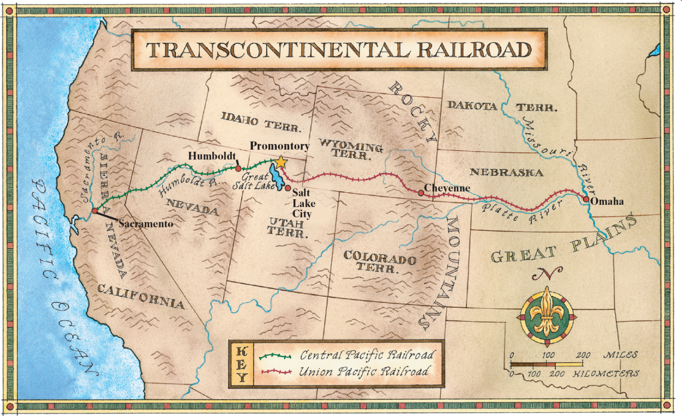
The transcontinental railroad helped open the West to long-term development.
Railroads were soon carrying people and products across the country.

Slide 15
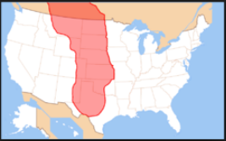
Frontier farmers realized their dream of owning their own land, but many found life on the Great Plains to be lonely and difficult.
  There were few trees, little rainfall, and plagues of grasshoppers.
Homes were built of sod and heated
by burning dried buffalo dung.
With no wood, barbed wire was used for fencing.

Slide 16
Other settlers turning to ranching.
At the end of the Civil War, some 5 million head of cattle roamed freely in Texas.
Ranchers began rounding up the cattle as the demand for beef grew.
Ranchers hired cowboys to herd the cattle north to railroad lines.

Slide 17
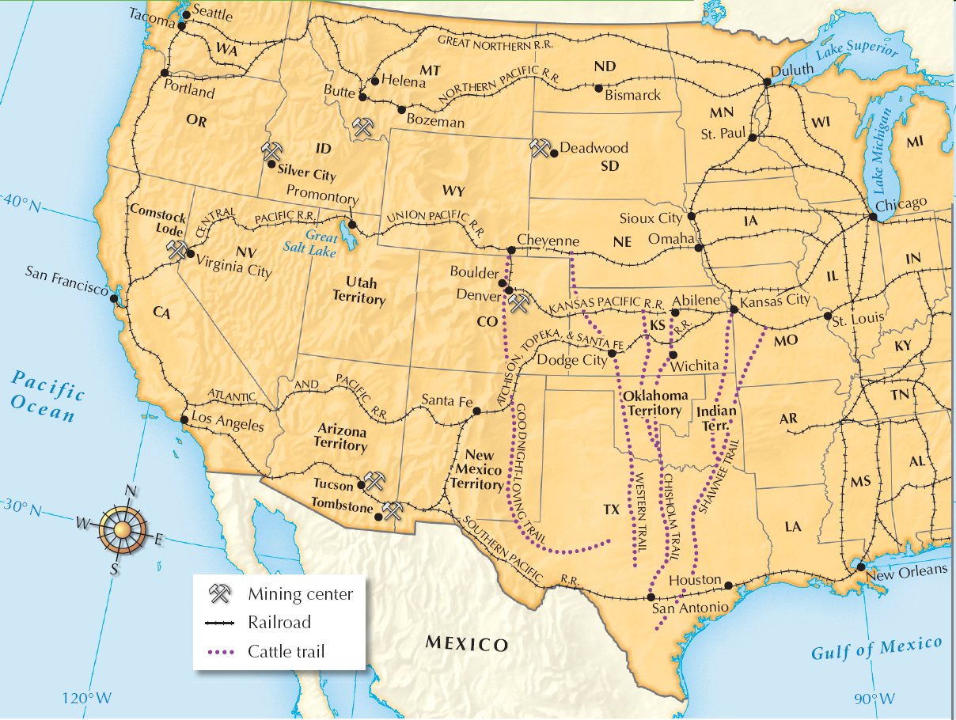
The long cattle drives ran along well-worn trails ending at railroad depots.
From there, the cattle was shipped east.

Slide 18
In time, ranchers began to raise steer on the open range, closer to the railroad lines.
A series of terrible winters ended open-range ranching.
No longer able to rely on open grazing lands, ranchers began to fence their land and raise feed for their herds.
Fin

Slide 19
South & West Transformed
The South
New South
Economy
Manufacturing
Textile
Lumber
Steel
Railroad
Slower economy than north
Shortage of capital
Illiteracy
Discrimination
Struggle to survive
Cotton $ down
Weevils wipe crops
Sharecropping
Cycle of poverty
African Americans
Civil rights stripped
KKK
The West
Native Americans
Settlers took land
Buffalo hunted
Defended land
Sioux
Little Bighorn
Nez Percé
Fight No More
Forced onto reservations
Dawes Act
Assimilate
Ghost Dances
Wounded Knee 1890
Settlers
Gold & silver
Transcontinental railroad
Great Plains farming hard
Ranching in Texas
Cattle roamed
Beef demand up
Cowboys
Cattle drives
Cattle to railroads
Ship to cities

