Slide 1
Objectives
  Understand the segregation and social tensions that troubled the nation during the late 1800s.
  Identify the political and economic challenges that existed during the Gilded Age.
  Analyze the effects of the Populists’ programs and activities.

Slide 2
Terms and People
Gilded Age – period during the late nineteenth century when a façade of prosperity covered underlying problems
Jim Crow laws – Reconstruction era laws passed in the southern states that separated blacks and whites
graft – bribery and corruption
Pendleton Act – law that created a civil service system for the federal government

Slide 3
Terms and People (continued)
gold standard – economic system in which money is backed by gold
Populist Party – People’s Party; political party that favored the coinage of silver and several political and economic reforms
William Jennings Bryan – Populist candidate for President in 1896
Notes:
3

Slide 4

What challenges arose for the nation during the Gilded Age?
With the rapid pace of industrialization and the boom in the West, it seemed the nation was experiencing a new golden age.
Beneath the glittery surface, however, lurked many serious problems.

Slide 5
The issue of racial inequality continued to trouble the nation.
Southern states passed Jim Crow laws to separate blacks and whites.
In Plessy v. Ferguson, the Supreme Court upheld segregation as long as states maintained “separate but equal” facilities.
Notes:
5

Slide 6
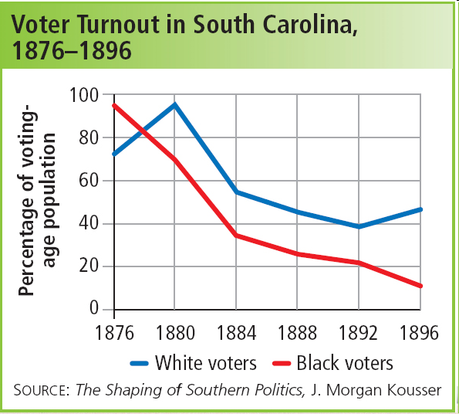
The separate facilities for African Americans, however, were rarely equal.
At the same time, southern states passed poll taxes and literacy tests that prevented blacks from voting.
Notes:
6

Slide 7
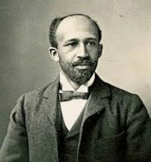
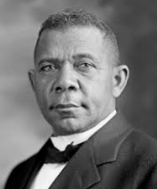
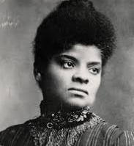
African American leaders responded to discrimination in different ways.
W.E.B. Du Bois became a vocal activist for civil rights.
Booker T. Washington built Tuskegee Institute
as a symbol of black self-help.
Ida B. Wells campaigned against lynching.
Notes:
7

Slide 8

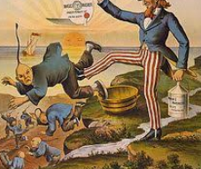
Members of other minority groups also
struggled against discrimination.
Mexican Americans fought to maintain their property rights.
Las Gorras Blancas resorted to warlike tactics to protect their lands.
Asian immigrants were terrorized for taking white workers’ jobs.
The Chinese Exclusion Act banned Chinese immigration.
Notes:
8

Slide 9
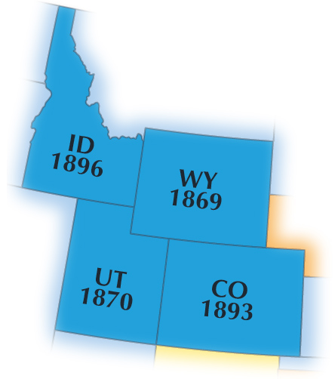
Though they made important gains in education, women still fought for the right to vote.
Several western states allowed women to vote, yet the fight for a national suffrage amendment stalled.
Inspired by Susan B. Anthony and Elizabeth Cady Stanton, women continued to campaign for equality.
Notes:
9

Slide 10
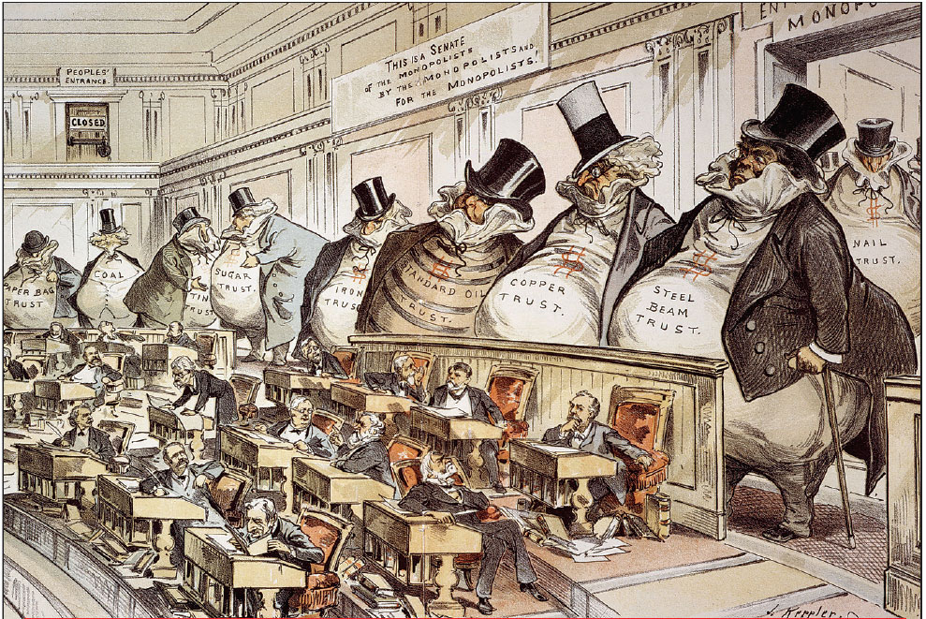
Adding to the nation’s problems was government corruption.
Dishonest politicians gained power by giving government jobs to those who promised political support.
Graft was rampant. (Political corruption - the unscrupulous use of a politician's authority for personal gain.)
Notes:
10

Slide 11
Created a federal civil service system
Awarded jobs to those scoring the highest on written exams
Congress passed the Pendleton Act to help control government corruption.
Notes:
11

Slide 12
Tariffs were a key political issue of the time.
Republicans
supported high protective tariffs
Democrats
favored lowering duties on imports
While the two parties argued over tariffs, however, other issues developed that would soon lead to the creation of a third party.
Notes:
12

Slide 13
Given the nation’s many problems, some Americans had become angry with the government.
Farmers were among those expressing this anger.
With crop prices falling and debts mounting, many feared they would lose their land.

Slide 14
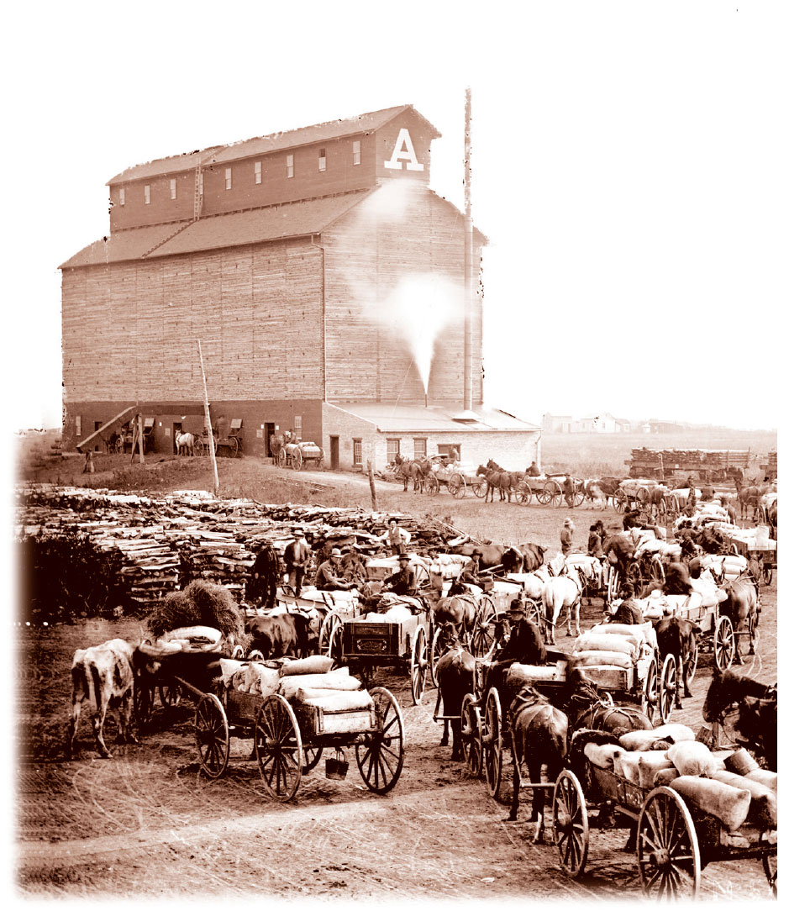
Farmers joined together to form organizations to push for reforms.
The Grange
The Farmers’ Alliance

Slide 15
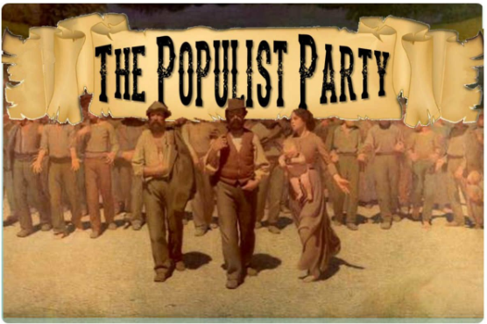
Members of the Farmers’ Alliance soon formed the Populist Party, or People’s Party.
  Sought government ownership of the railroads
  Called for the creation of subtreasury banks
  Favored the coinage of silver
  Supported reforms such as the secret ballot, the direct election of senators, and a graduated income tax

Slide 16
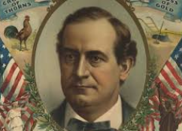
In 1896, the Populists supported Democrat William Jennings Bryan for President.
Championed the cause of the American farmer
In a hard-fought campaign, Bryan took his case directly to the American people.
Denounced the gold standard
Made “free silver” the centerpiece of his campaign

Slide 17
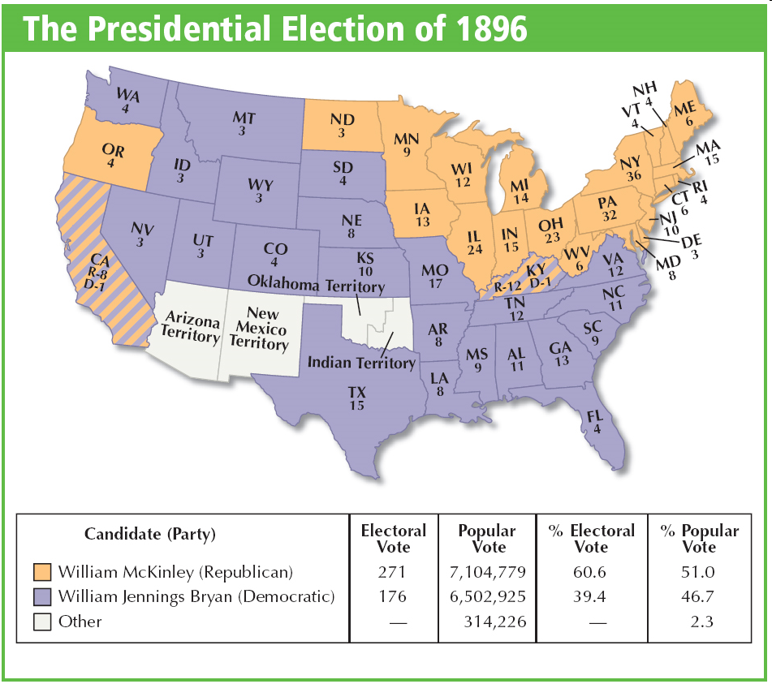
Despite his support in the South and the West, Bryan lost the election to Republican William McKinley.
Notes:
17

Slide 18

Though the Populist Party soon faded away, it had a lasting impact on the political system.
Several Populist proposals, such as the graduated income tax, eventually became law.
Bryan’s style of appealing directly to voters became the norm in American politics.

Slide 19
Gilded Age Challenges
Racial Inequality
Jim Crow
Plessy v Ferguson
Poll Taxes
Literacy Tests
Responses
WEB du Bois
Booker T Washington
Ida B Wells
Mexican Americans
Las Garras Blancas
Asians
Chinese Exclusion Act
Government Corruption
Graft
Pendleton Act
Tariffs
American Discontent
Farmers Unions
Populist Party
William Jennings Bryan
Notes:
19

