Slide 1
Chapter Introduction
This chapter will focus on how reformers sought to solve the problems caused by industrialization, urbanization and immigration in the early 1900s.
Section 1: The Drive for Reform
Section 2: Women Make Progress
Section 3: The Struggle Against Discrimination
Section 4: Roosevelt’s Square Deal
Section 5: Wilson’s New Freedom

Slide 2
Objectives
Identify the causes of Progressivism and compare it to Populism.
Analyze the role that journalists played in the Progressive Movement.
Evaluate some of the social reforms that Progressives tackled.
Explain what Progressives hoped to achieve through political reforms.

Slide 3
Terms and People
Progressivism – movement that believed honest and efficient government could bring about social justice
muckrakers – socially conscious journalists and writers who dramatized the need for reform
Lincoln Steffens – muckraking author of Shame of the Cities, exposed corruption in urban government
Jacob Riis – muckraking photographer and author of How The Other Half Lives, exposed the condition of the urban poor

Slide 4
Terms and People (continued)
Social Gospel – belief that following Christian principles could bring about social justice
settlement house – community center that provided services for the urban poor
Jane Addams – leader in the settlement house movement
direct primary – allowed voters to select candidates rather than having them selected by party leaders
Notes:
4

Slide 5
Terms and People (continued)
initiative – gave citizens the power to propose laws
referendum – allowed citizens to reject or accept laws passed by their legislature
recall – gave voters the power to remove legislators before their term is up
Notes:
5

Slide 6

What areas did Progressives think were in need of the greatest reform?
Progressivism was a movement that believed the social challenges caused by industrialization, urbanization, and immigration in the 1890s and 1900s could be addressed.
Progressives believed that honest and efficient government could bring about social justice.

Slide 7

believed industrialization and urbanization had created social and political problems.
were mainly from the emerging middle class.
wanted to reform by using logic and reason.
Progressives were reformers who:

Slide 8
Progressives believed honest and efficient government could bring about social justice.
They wanted to end corruption.
They tried to make government
more responsive to people’s needs.
They believed that educated leaders
should use modern ideas and scientific techniques
to improve society.
Notes:
8

Slide 9
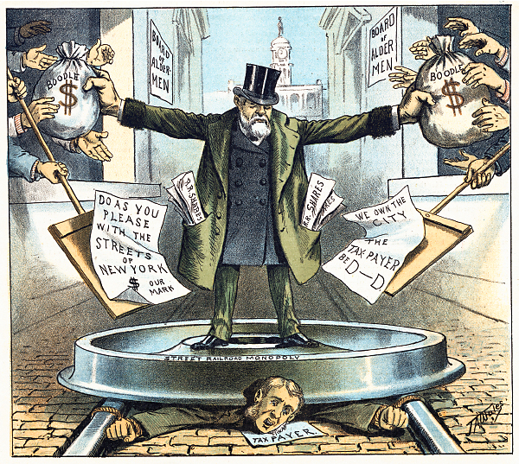
Progressives targeted a variety
of issues and problems.
corrupt political
machines
trusts and
monopolies
inequities
safety
city services
women’s suffrage

Slide 10

Muckrakers used investigative reporting to uncover and dramatize societal ills.
Lincoln Steffens
The Shame of the Cities
John Spargo
The Bitter Cry of the Children
Ida Tarbell
The History of Standard Oil
Notes:
10

Slide 11
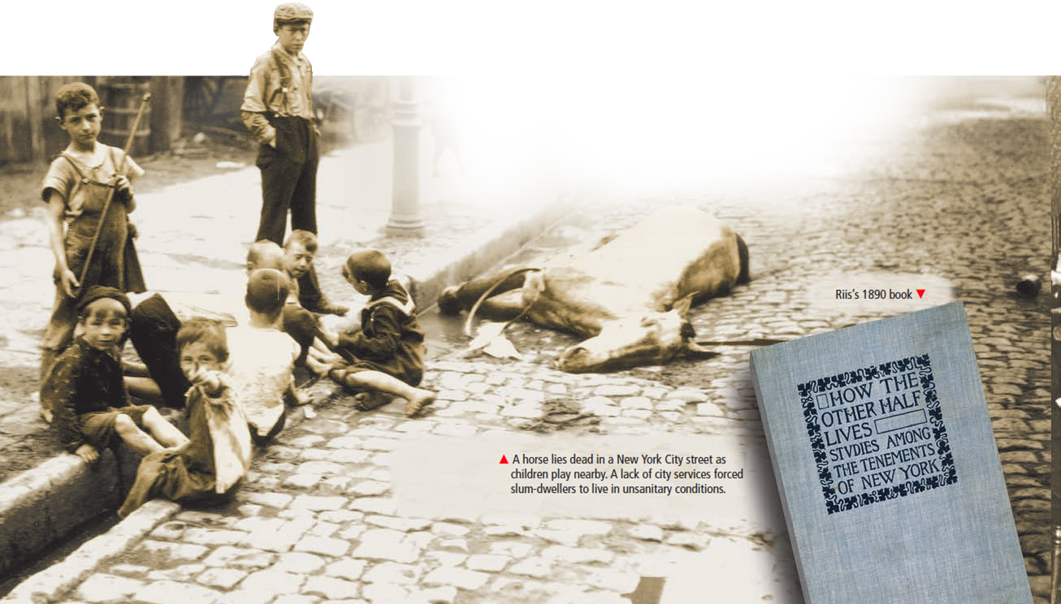
Jacob Riis exposed the deplorable conditions poor people were forced to live under in How the Other Half Lives.
Notes:
11

Slide 12

The naturalist novel portrayed the struggle of common people.
Upton Sinclair’s novel, The Jungle, provided a shocking look at
meatpacking in Chicago’s
stockyards.

Slide 13
Theodore Dreiser’s, Sister Carrie, discussed factory conditions for working women.
Francis Ellen Watkins’s, Iola Leroy, focused on racial issues.
Frank Norris’s, The Octopus, centered on the tensions between farmers and the railroads.
Progressive novelists covered a wide range of topics.
Notes:
13

Slide 14
Jane Addams led the settlement house movement.
Her urban community centers provided social services for immigrants and the poor.
Christian reformers’ Social Gospel demanded a shorter work day and the end of child labor.
Notes:
14

Slide 15
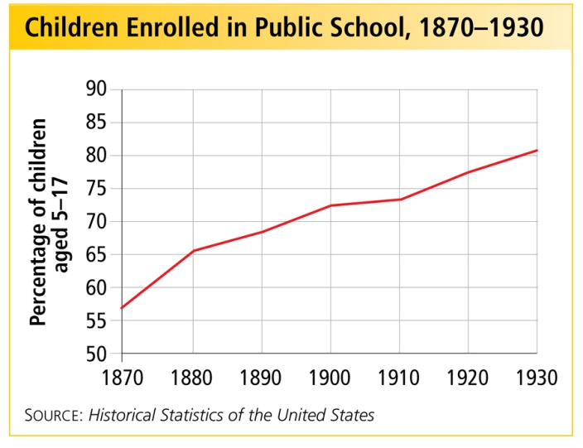
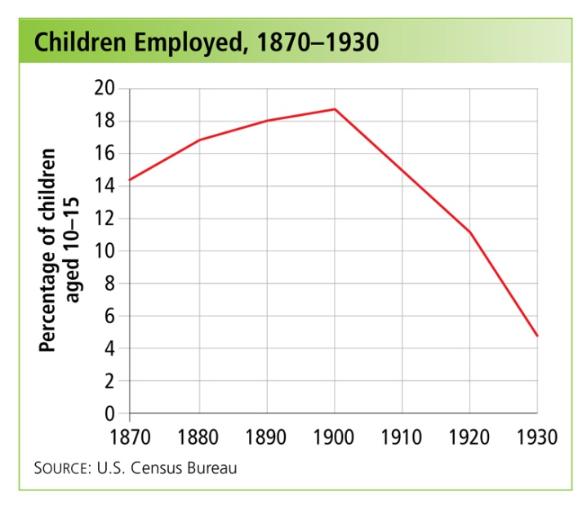

Progressives succeeded in reducing child labor and improving school enrollment.
The United States Children’s Bureau was created in 1912.
Notes:
15

Slide 16

In the 1900s, the U.S. had the world’s worst rate of industrial accidents.
In 1911, 156 workers died in the Triangle Shirtwaist Fire. Many young women
jumped to their deaths
or burned.
Worker safety was an important issue for Progressives.

Slide 17
Government could
not be controlled by political bosses and business interests.
Government needed to be more efficient and more accountable to the people.
To reform society, Progressives realized they must also reform government.

Slide 18
Cities and states experimented with new methods of governing.
In Wisconsin, Governor Robert M. La Follette and other Progressives reformed state government to restore political control to the people.
direct primaries initiatives referendums recalls

Slide 19
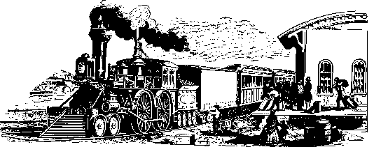
Progressive governors achieved state-level reforms of the railroads and taxes.
Two Progressive Governors, Theodore Roosevelt of New York and Woodrow Wilson of New Jersey, would become Progressive Presidents.
On the national level, in 1913, Progressives
helped pass the 17th Amendment, providing for the direct election of United States Senators.

