Slide 1
Chapter Introduction
This chapter will focus on how reformers sought to solve the problems caused by industrialization, urbanization and immigration in the early 1900s.
Section 1: The Drive for Reform
Section 2: Women Make Progress
Section 3: The Struggle Against Discrimination
Section 4: Roosevelt’s Square Deal
Section 5: Wilson’s New Freedom

Slide 2
Objectives
Analyze the impact of changes in women’s education on women’s roles in society.
Explain what women did to win workers’ rights and to improve family life.
Evaluate the tactics women used to win passage of the Nineteenth Amendment.

Slide 3
Terms and People
Florence Kelley – founded the National Consumer’s League known as the NCL
National Consumer’s League (NCL) – labeled and publicized “goods produced under fair, safe, and healthy working conditions”
temperance movement – campaign to end the production, sale, and use of alcohol
Margaret Sanger – opened the first birth control clinic
Ida B. Wells – helped to found the National Association of Colored Women

Slide 4
Terms and People (continued)
suffrage – the right to vote
Carrie Chapman Catt – president of the NAWSA, campaigned to pass women’s suffrage at both the state and national levels
NAWSA – National American Woman Suffrage Association
Alice Paul – social activist, led women to picket at the White House
Nineteenth Amendment – 1919, granted women the right to vote
Notes:
4

Slide 5

How did women of the Progressive Era make progress and win the right to vote?
In the early 1900s, many women were no longer content playing a limited role in society. Activists helped bring about Progressive reforms including women’s suffrage.
Women would continue the struggle to expand their roles and rights in the future.

Slide 6

By the early 1900s, a growing number of middle-class women wanted to do more than stay at home as wives and mothers.
Colleges like Pennsylvania’s Bryn Mawr and New York’s School of Social Work armed middle-class women with education and modern ideas.
However, most poor women continued to labor long hours, often under dangerous or dirty conditions.

Slide 7
  They worked long hours in factories and sweatshops, or as maids, laundresses or servants.
  They were paid less and often didn’t get to keep their wages.
  They were intimidated and bullied by employers.
Progressive reforms addressed working women’s conditions:
Notes:
7

Slide 8
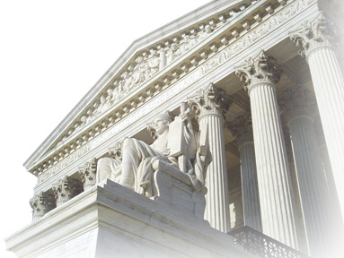
Reformers saw limiting the length of a woman’s work day as an important goal and succeeded in several states.
In Muller v. Oregon, the
Supreme Court ruled that states could legally limit a women’s
work day.
This ruling recognized the
unique role of women as
mothers.

Slide 9
In 1899, Florence Kelley founded the Women’s Trade Union League which worked for a federal minimum wage and a national eight-hour workday.
The WTUL also created the first workers’ strike fund, which helped support families who refused to work in unsafe or unfair conditions.

Slide 10

Progressives supported the temperance movement.
They felt that alcohol often led men to spend their earnings on liquor, neglect their families, and abuse their wives.
The Woman’s Christian Temperance Union grew steadily until the passage of the 18th Amendment which banned the sale and production of alcohol in 1919.

Slide 11
In 1916, Margaret Sanger opened the first birth control clinic. She believed that having fewer children would lead to healthier women.
In 1921, Sanger founded the American Birth Control League to make information available to women.
She was jailed. The courts eventually ruled that doctors could give out family planning information.
Notes:
11

Slide 12
African Americans also worked for women’s rights.
Ida B. Wells founded the National Association of Colored Women or NACW in 1896.
The NACW supported day care centers for the children of working parents.
Wells also worked for suffrage, to end lynchings, and to stop segregation in the Chicago schools.
Notes:
12

Slide 13
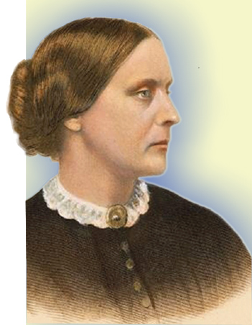
Ultimately suffrage was seen as the only way to ensure that government protected children, fostered education, and supported family life.
Since the 1860s, Susan B. Anthony
and Elizabeth Cady Stanton
worked relentlessly for
women’s suffrage.
Still, by the 1890s, only Wyoming
and Colorado allowed women to vote.
Susan B. Anthony

Slide 14
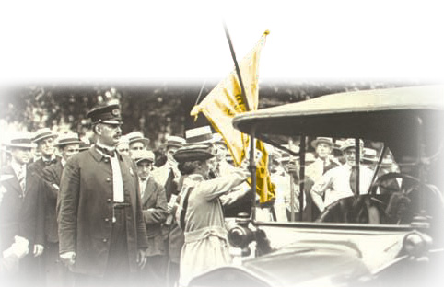
In 1917, social activists led by Alice Paul formed the National Woman’s Party. Their radical actions made the suffrage movement’s goals seem less
dramatic by comparison.
The NWP picketed the White House.
Hundreds of suffragettes were arrested and jailed.
Notes:
14

Slide 15
President of the National American Suffrage Association, Carrie Chapman Catt, promoted a two-part strategy to gain the vote for women.
  1
  NAWSA lobbied Congress for a constitutional amendment.
  Supporters, called suffragettes, used the referendum process to pass state laws.
  2
Notes:
15

Slide 16
The National Association Opposed to Woman’s Suffrage feared voting would distract women from their family roles.
Many men and women were offended by Paul’s protests in front of the White House. A mob shredded her signs and pickets.
Not all women supported suffrage.

Slide 17
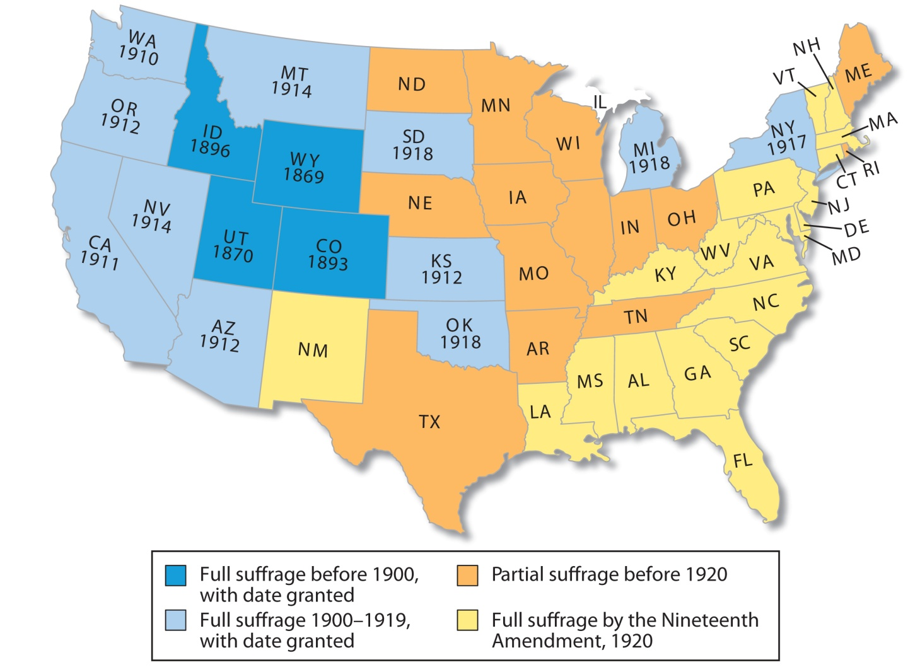
States gradually granted suffrage to women, starting in the western states.

Slide 18
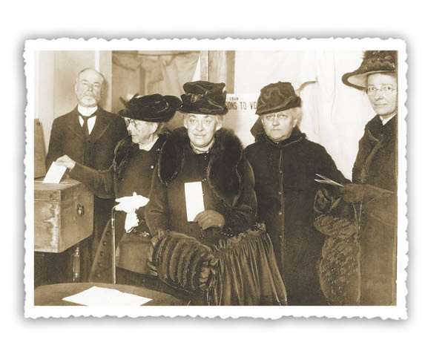
In June 1919, the Nineteenth Amendment was passed by Congress. The amendment stated that the vote “shall not be denied or abridged on account of sex.”
In November 1920, women nationwide voted in a presidential election for the first time.
Notes:
18

