Slide 1
Chapter Introduction
This chapter will focus on how reformers sought to solve the problems caused by industrialization, urbanization and immigration in the early 1900s.
Section 1: The Drive for Reform
Section 2: Women Make Progress
Section 3: The Struggle Against Discrimination
Section 4: Roosevelt’s Square Deal
Section 5: Wilson’s New Freedom

Slide 2
Objectives
Discuss Theodore Roosevelt’s ideas on the role of government.
Analyze how Roosevelt changed the government’s role in the economy.
Explain the impact of Roosevelt’s actions on natural resources.
Compare and contrast Taft’s policies with Roosevelt’s.

Slide 3
Terms and People
Theodore Roosevelt – energetic Progressive who became the youngest president in 1901
Square Deal – Roosevelt’s program to keep the wealthy and powerful from taking advantage of small business owners and the poor
Hepburn Act – gave the Interstate Commerce Committee power to limit railroad company prices
Meat Inspection Act – gave federal agents power to inspect and monitor the meatpacking industry

Slide 4
Terms and People (continued)
Pure Food and Drug Act – gave the federal government responsibility for insuring food and medicine are safe
John Muir – California naturalist who advocated for the creation of Yosemite National Park
Gifford Pinchot – forestry official who proposed managing the forests for later public use
Notes:
4

Slide 5
Terms and People (continued)
National Reclamation Act – gave the federal government power to decide where and how water would be distributed in arid western states
New Nationalism – Roosevelt’s 1912 plan to restore the government’s trustbusting power
Progressive Party – Roosevelt’s party in the 1912 election
Notes:
5

Slide 6

What did Roosevelt think government should do for citizens?
After a number of weak and ineffective Presidents, Theodore Roosevelt was a charismatic figure who ushered in a new era.
Roosevelt passed Progressive reforms, expanded the powers of the presidency, and changed how Americans viewed the roles of the President and the government.

Slide 7
In 1901, 43-year-old Theodore Roosevelt became the United States’ youngest president, rising quickly as a Progressive idealist.
Shortly after graduation from Harvard in 1880, he was elected to the New York State Assembly.
Following the death of his wife three years later, he headed west to become a rancher.
He had a reputation for being smart, opinionated, and extremely energetic.

Slide 8
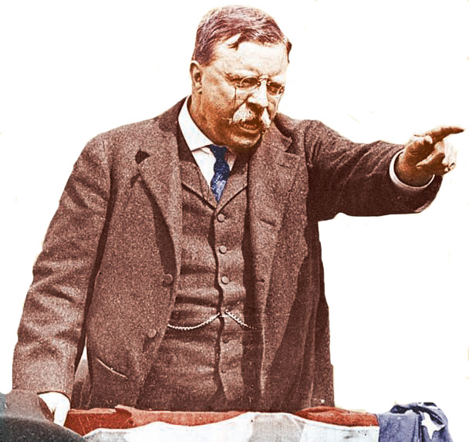
  In 1889 he returned, earning a reputation for fighting corruption on New York City’s Board of Police Commissioners.
  Chosen by President McKinley to be Assistant Secretary of the Navy, he resigned to organize the Rough Riders at the start of the Spanish American War.
  He returned a war hero and was elected Governor of New York in 1898.

Slide 9
But, in 1901, William McKinley was assassinated.
As Governor, his Progressive reforms upset Republican leaders. To get him out of New York, President McKinley agreed to make Roosevelt his running mate in 1900. They won easily.
As President, Roosevelt dominated Washington. He was so popular that even a toy, the
teddy bear,
was named
for him.

Slide 10
Roosevelt greatly expanded the power of the presidency and the role of government beyond that of helping big business.
His Square Deal program promised fairness and honesty from government.
He used the power of the federal government on behalf of workers and the people.

Slide 11
In 1902, Roosevelt threatened a federal
take-over of coal mines when owners
refused to compromise on hours.
This was the first time the federal government had stepped into a labor dispute on the side of workers.
The Department of Commerce and Labor was established to prevent capitalists from abusing their power.

Slide 12
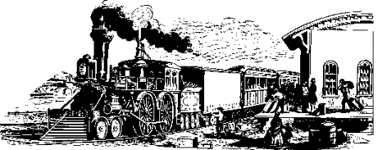
Roosevelt also took on the railroads after the courts stripped the Interstate Commerce Commission’s authority to oversee rail rates.
Elkins Act (1903)
Allowed the government to fine railroads that gave special rates to favored shippers, a practice that hurt farmers
Hepburn Act (1906)
Empowered the ICC to enforce limits on the prices charged by railroad companies for shipping, tolls, ferries, and pipelines

Slide 13
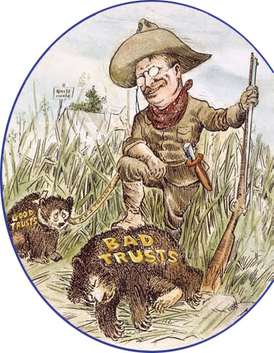
Roosevelt was known as a trustbuster.
He used the Sherman Antitrust Act to
file suits against
what he saw as
“bad” trusts, those that bullied small businesses or
cheated consumers.
Notes:
13

Slide 14
The Meat Inspection Act provided for federal inspections and monitoring of meat plants.
The Pure Food and Drug Act banned the interstate shipments of impure or mislabeled food or medicine.
Roosevelt backed Progressive goals to protect consumers by making the federal government responsible for food safety.
Today, the Food and Drug Administration (FDA) tests and monitors the safety of food and medicine.
Notes:
14

Slide 15
Roosevelt had a deep reverence for nature, which shaped his policies.
Pinchot felt that resources should be managed and preserved for public use.
Roosevelt also admired John Muir, who helped establish Yosemite National Park, and who advised him to set aside millions of acres of forestland.
As a Progressive, Roosevelt supported Gifford Pinchot’s philosophy on the preservation of resources.
Notes:
15

Slide 16
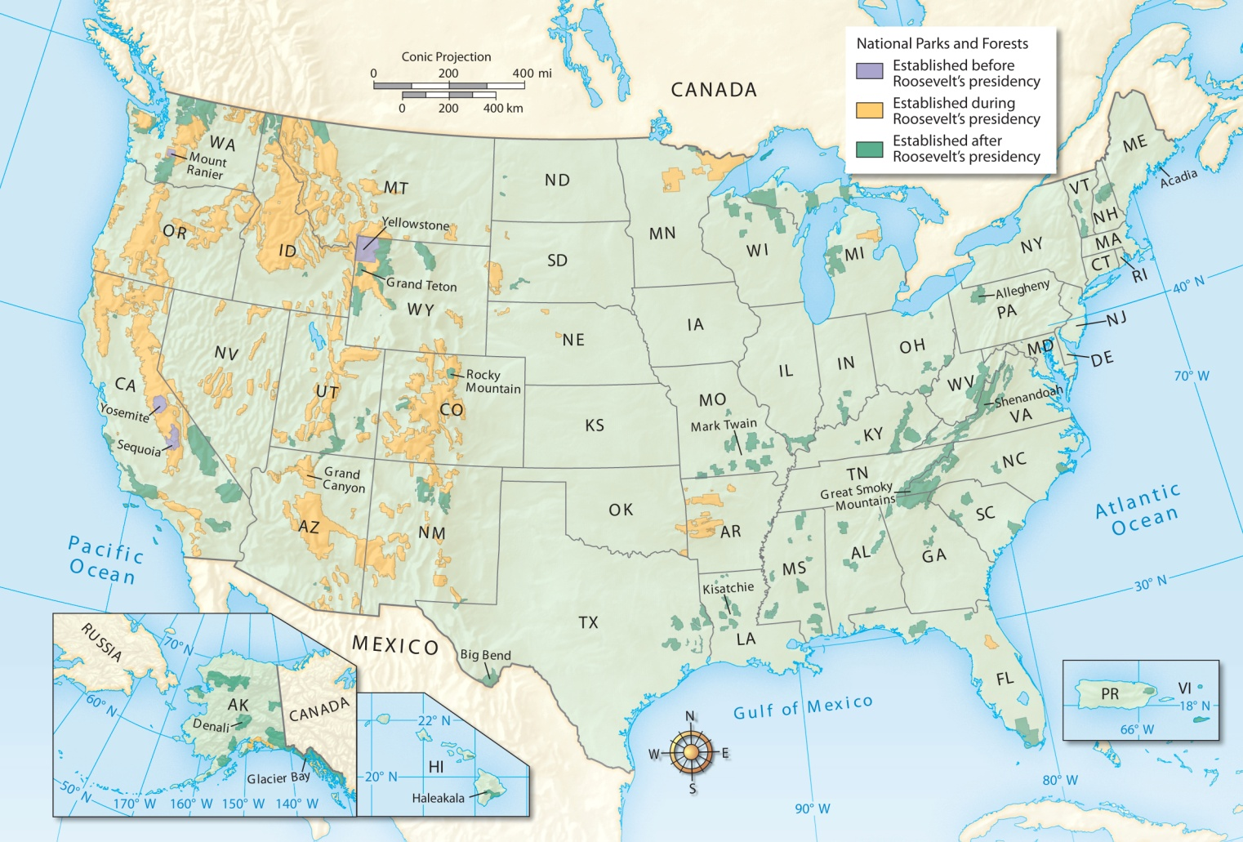
Roosevelt added 100 million acres to the National Park and Forest System.

Slide 17


This Act gave the federal government power to distribute water in the arid west, effectively giving government the power to decide where and how water would be dispensed.
In another example of the government’s authority, Congress passed the National Reclamation
Act of 1902.

Slide 18
In 1908, Roosevelt retired. But he soon disagreed with his successor William Howard Taft on several issues.
1909 | Taft approved the Aldrich Act which didn’t lower tariffs as much as Roosevelt wanted.
1910 | Taft signed the Mann-Elkins Act providing for federal control over telephone and telegraph rates.
1911 | Taft relaxed the hard line set by the Sherman Antitrust Act.
Notes:
18

Slide 19
Taft did not share Roosevelt’s views on trusts but this was not the only area in which they disagreed.
Taft believed that a monopoly was acceptable as long as it didn’t unreasonably squeeze out smaller companies.
When Taft fired Gifford Pinchot and overturned an earlier antitrust decision, Roosevelt angrily decided to oppose Taft and ran for president again.
Notes:
19

Slide 20
Roosevelt promised to restore government trust-busting in a program he called New Nationalism.
Roosevelt’s candidacy split the Republican Party, which nominated Taft.
Roosevelt then accepted the nomination of the Progressive Party setting up a three-way race for the presidency in 1912.
Notes:
20

