Slide 1
Chapter Introduction
This chapter will focus on the emergence of the United States as an imperial power around the turn of the 20th century. It will explore the causes and effects of the Spanish American War and analyze the policies and actions of several U.S. presidents in East Asia and Latin America.
Section 1: The Roots of Imperialism
Section 2: The Spanish-American War
Section 3: The United States and East Asia
Section 4: The United States and Latin America

Slide 2
Objectives
Identify the key factors that prodded America to expand.
Explain how the United States took its first steps toward increased global power.
Summarize the chain of events leading up to the U.S. annexation of Hawaii.

Slide 3
Terms and People
imperialism – policy by which stronger nations extend their political, economic, and military, control over weaker territories
extractive economy – colonial economies based on an imperialist nation extracting or removing raw materials
Alfred T. Mahan – naval historian who advocated for naval power as the basis for a great nation; urged the U.S. to build a modern fleet

Slide 4
Terms and People (continued)
Social Darwinism − belief that Darwin’s theory of the survival of the fittest should be applied to societies, justifying imperialism
Frederick J. Turner – historian who noted the closure of the American frontier; his ideas were used by others to urge U.S. overseas expansion
Matthew Perry – U.S. naval commander who sailed a fleet into Tokyo Bay and opened trade with Japan in 1853
Notes:
4

Slide 5
Terms and People (continued)
Queen Liliuokalani – Hawaiian monarch dethroned in 1893 by rebel American planters in an action backed by U.S. Marines
Notes:
5

Slide 6

How and why did the United States
take a more active role in world affairs?
For most of its early history, the United States played a small role in world affairs. But in the late 1800s, some began calling for the U.S. to join the ranks of the world’s major powers.
Eventually, the United States abandoned isolationism and began to acquire influence and territories outside its continental borders.

Slide 7
Powerful European nations extended their political, economic, and military influence by adding colonies in Africa and Asia.
Meanwhile, the United States and Japan considered the benefits and implemented similar imperialist policies.
The mid-1800s through the early 1900s was an “Age of Imperialism.”

Slide 8
Colonial extractive economies were based on removing raw materials. The imperialist nations built strong armies and navies to protect their interests.
There were strong economic incentives for the U.S. to also adopt a policy of imperialism to obtain raw materials like rubber, iron, and oil.
American entrepreneurs also sought new overseas markets for their manufactured and agricultural products.
Notes:
8

Slide 9
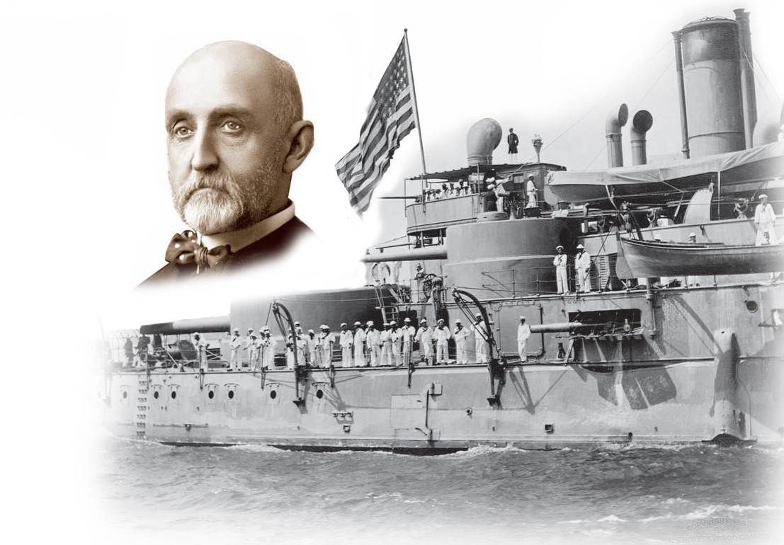
In The Influence of Sea Power Upon History, historian Alfred T. Mahan argued that all great nations owed their greatness to naval power.
He urged construction of a fleet of steel ships, acquisition of overseas bases, and construction of a canal across Central America.
The U.S. eventually followed all of his recommendations.
Notes:
9

Slide 10
Imperialists justified their actions based on beliefs about their own racial, national, and cultural superiority.
Social Darwinism applied Darwin’s theories of natural selection to societies. In a competitive world, only the fittest nations survive.
Americans extended their belief in Manifest Destiny overseas, justifying imperialism as God’s will.
Notes:
10

Slide 11
Historian Frederick J. Turner argued that the frontier served as a “safety valve,” siphoning off potential discontent in the U.S.
Turner’s followers urged overseas expansion as America’s next frontier to avert future discontent in the U.S.
Notes:
11

Slide 12
In 1867, Secretary of State William Seward purchased Alaska from Russia for $7.2 million.
  Critics mocked “Seward’s Icebox” and “Seward’s Folly” as a far off and useless frozen tundra.
  But, valuable resources including gold, timber, and oil were found.
  Alaska also doubled America’s territory.

Slide 13
  In the 1790s Americans planters established sugar cane plantations in Hawaii.
    In 1887, these planters gained control of the government from King Kalakaua.
    In 1891, Queen Liliuokalani, attempted to regain control of her island.
    In 1893, with the help of U.S. Marines, the Queen was dethroned. President McKinley backed annexation when he took office.
In 1898 Congress voted to annex Hawaii.

Slide 14
The United States expanded
overseas after 1850.
Commodore Matthew Perry’s fleet entered Tokyo Bay persuading Japan to trade with the U.S.
1853
1865
1867
1898
1898
Secretary of State William Seward purchased Alaska from Russia.
The U.S. obtained Midway Islands in the Pacific.
Congress approved the annexation of Hawaii.
The Spanish American War gave the U.S. control of the Philippines, Puerto Rico and Guam.

Slide 15
