Slide 1
Chapter Introduction
This chapter will focus on the emergence of the United States as an imperial power around the turn of the 20th century. It will explore the causes and effects of the Spanish American War and analyze the policies and actions of several U.S. presidents in East Asia and Latin America.
Section 1: The Roots of Imperialism
Section 2: The Spanish-American War
Section 3: The United States and East Asia
Section 4: The United States and Latin America

Slide 2
Objectives
Explain the causes of the Spanish-American War.
Identify the major battles of the war.
Describe the consequences of the war, including the debate over imperialism.

Slide 3
Terms and People
José Martí – Cuban patriot who launched a war for independence from Spain in 1895
William Randolph Hearst – owner of the New York Journal who, along with Joseph Pulitzer of the New York World, started the Yellow Press
Yellow Press – sensationalized and exaggerated reporting on Spanish atrocities in Cuba
jingoism – aggressive nationalism
George Dewey – commodore of the U.S. squadron that destroyed the Spanish fleet in Manila Bay

Slide 4
Terms and People (continued)
Emilio Aguinaldo – leader of Filipino nationalists who defeated the Spanish Army
Rough Riders – volunteer cavalry unit assembled by Theodore Roosevelt, famous for their 1898 charge at San Juan Hill
Treaty of Paris – ended the Spanish-American War and included U.S. acquisition of Puerto Rico and the purchase of the Philippines
Notes:
4

Slide 5

What were the causes and effects of the Spanish-American War?
American economic interests, the growth of a national imperialist spirit, and an aggressive Yellow Press brought the United States to the brink of war in 1898.
The United States acquired colonies and became a world power as a result of the Spanish-American War.

Slide 6
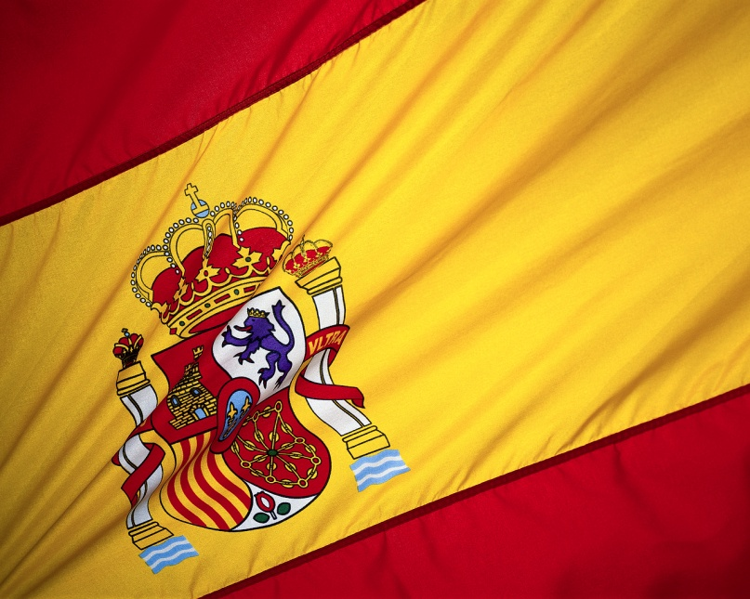
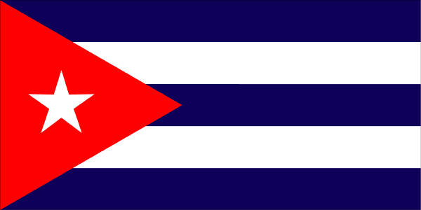
In 1897, Spain was in decline as an imperialist power.
Its remaining possessions included Puerto Rico and Cuba in the Caribbean Sea, and the Philippine Islands in the Pacific.
Spanish flag
Philippines
Cuban flag

Slide 7
In 1895, Cuban patriot José Martí launched a war for independence from Spain.
Spanish General Valeriano Weyler was brutal in his attempts to stop Martí’s guerrilla attacks.
Tens of thousands of rural farmers died of disease and starvation in concentration camps.
The sympathetic Yellow Press published emotional headlines in the U.S. about Spanish atrocities.
Notes:
7

Slide 8
American emotions were inflamed by Joseph Pulitzer’s New York World and William Randolph Hearst’s New York Journal.
In response, President McKinley warned Spain to make peace and sent the battleship Maine to Havana harbor to protect American citizens.
When Hearst published a letter stolen from the Spanish ambassador that insulted President McKinley, American jingoism rose to a fever pitch.
Notes:
8

Slide 9
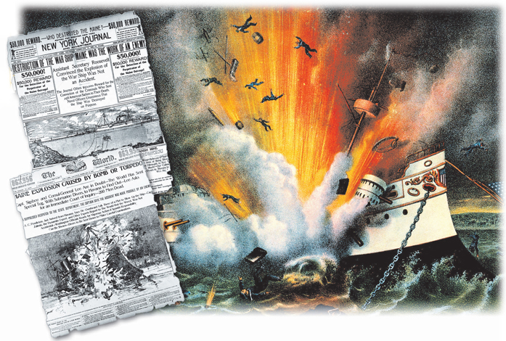
On February 15, 1898, the Maine exploded,
killing 266 Americans.
Notes:
9

Slide 10
The Yellow Press demanded war. Headlines screamed, “Remember the Maine!”
A naval board of inquiry blamed a mine for the explosion.
In response, Spain agreed to American demands, including
an end to the concentration camps.
Despite Spanish concessions, President McKinley sought permission to use force.

Slide 11
In April 1898, following a heated debate, Congress agreed to McKinley’s request.
  As a result, the Teller Amendment was added, stipulating that the U.S. would not annex Cuba.
Critics charged that the real goal was an American take-over of Cuba.
  The U.S. Navy was sent to blockade Cuban ports.
  President McKinley called for 100,000 volunteers.

Slide 12
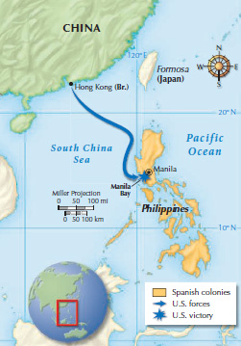
In response to the American actions, Spain declared war on the U.S. The war began with U.S. victories in the Philippines.
  Commodore George Dewey surprised and easily defeated a Spanish fleet at Manila Bay.
  Rather than surrender to the Filipino independence fighters led by Emilio Aguinaldo, Spanish troops surrendered to U.S. forces.
Notes:
12

Slide 13
  Guantanamo Bay was captured.
  Theodore Roosevelt’s Rough Riders, and two regiments of African American soldiers, stormed San Juan Hill.
  A Spanish fleet was destroyed at Santiago.
  Spanish troops surrendered in Cuba and on the island of Puerto Rico.
U.S. troops easily defeated the Spanish in Cuba.

Slide 14
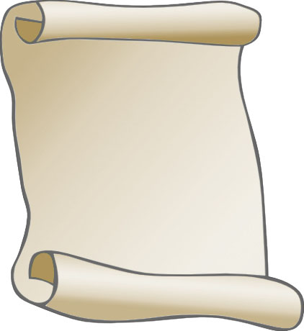
  Spain sold the Philippines to the U.S. for $20 million.
  Guam and Puerto Rico became American territories.
  Under the Teller Amendment, Cuba could not be annexed by the United States.
In the Treaty
of Paris, Spain gave up control of Cuba, Puerto Rico, and Guam.
Notes:
14

Slide 15
While Secretary of State John Hay called it a “splendid little war” debate soon arose over the Philippines and U.S. imperialism.
  Critics like William Jennings Bryan and Mark Twain attacked imperialism as against American principles.
  President McKinley argued that the U.S. had a responsibility to “uplift and civilize” the Filipino people. However, the U.S. brutally suppressed a Filipino rebellion.
Notes:
15

Slide 16
In February 1899, the U.S. Senate ratified the Treaty of Paris by just one vote.
In the election of 1900 McKinley faced Bryan
for the Presidency.
McKinley chose Theodore Roosevelt, “the hero of San Juan Hill” as his running mate.
McKinley and Roosevelt won easily.
The United States now had an empire and a new stature in world affairs.
Notes:
16

