Slide 1
Objectives
Examine what happened to Puerto Rico and Cuba after the Spanish-American War.
Analyze the effects of Roosevelt’s “big stick” diplomacy.
Compare Wilson’s “moral diplomacy” with the foreign policies of his predecessors.

Slide 2
Terms and People
Foraker Act – established civil government in Puerto Rico with an appointed governor
Platt Amendment – addendum to Cuba’s constitution restricting Cuba’s independence from the United States
“big stick” diplomacy – Theodore Roosevelt’s approach to international relations that depended on a strong military to achieve its aims
Panama Canal – waterway dug across Panama to shorten the trip between the Atlantic and the Pacific

Slide 3
Terms and People (continued)
Roosevelt Corollary – Roosevelt’s addition to the Monroe Doctrine, which stated that the U.S. would intervene in Latin America in order to prevent European intervention
“dollar diplomacy” – President Taft’s policy to encourage investment rather than use force in Latin America
“moral diplomacy” – President Wilson’s policy to encourage human rights and opportunity rather than act in our own self-interest in Latin America
Notes:
3

Slide 4
Terms and People (continued)
Francisco “Pancho” Villa – Mexican guerrilla and outlaw who eluded capture by General Pershing for 11 months in 1916-1917
Notes:
4

Slide 5

What actions did the United States take to achieve its goals in Latin America?
American entrepreneurs and political leaders called for an aggressive and exclusive role for the U.S. in Latin America.
While beneficial to the United States, this approach engendered anti-American sentiment and instability in area.

Slide 6
The status of Puerto Rico:
In 1900, the Foraker Act authorized a civil government for Puerto Rico.
A governor would be appointed by the U.S. President.
In the Insular Cases the Supreme Court ruled that Puerto Ricans did not have the same rights or tax status as other Americans.

Slide 7
Cuba became independent in 1902.
The Platt Amendment made it a protectorate of the United States which retained the rights to:
approve or reject any treaty signed by Cuba.
intervene to preserve order in Cuba.
lease military bases in Cuba.
Cubans disliked the Platt Amendment but accepted their status since they were protected by the U.S.
Notes:
7

Slide 8
Roosevelt saw it as America’s responsibility to “civilize” or uplift weaker nations.
The U.S. would act as an “International Policeman” in the Western Hemisphere to prevent European intervention.
He saw international leadership as a moral challenge the U.S.
had to accept.
In 1904, President Roosevelt added his Roosevelt Corollary to the Monroe Doctrine.
Notes:
8

Slide 9
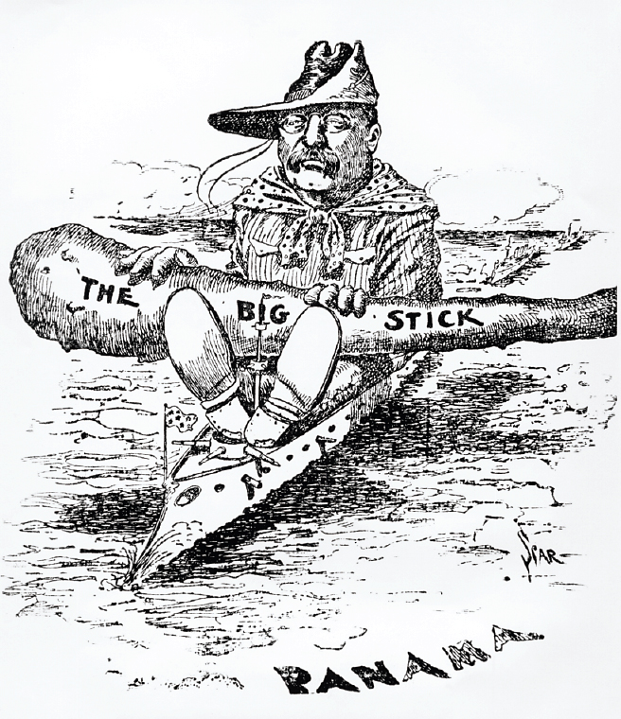
Roosevelt’s
policy was called
“big stick” diplomacy
from his motto, “Speak softly but carry a big stick.”
Cartoonists saw Roosevelt as a policeman in
Latin America.

Slide 10
The Panama Canal was constructed between 1904–1913
The U.S. needed permission from Colombia
which owned the Isthmus of Panama.
Colombia wanted more money than the United States was willing to pay.
Roosevelt encouraged Panamanian rebels to declare independence.
The United States recognized the Panamanian government in 1904.
Roosevelt negotiated to lease the “Canal Zone” from the new Panamanian government for $10 million plus an annual rent.
Notes:
10

Slide 11
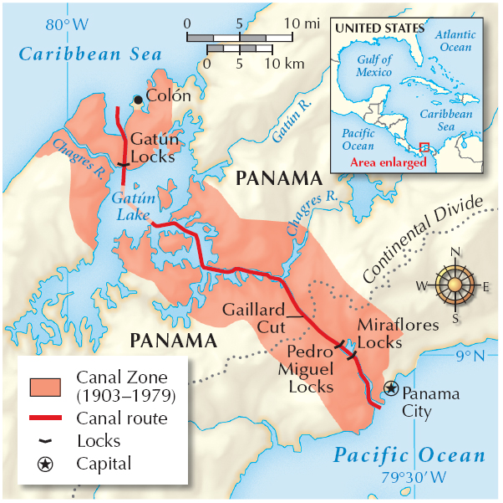
Construction of
the canal was a tremendous engineering feat
that involved tens
of thousands of workers.

Slide 12
In 1909 William Howard Taft became President. He replaced the “big stick,” which was unpopular among Latin Americans, with “dollar diplomacy.”
Rather than emphasizing military force, Taft looked to increase American investments in plantations, mines, and railroads.
Taft did not dismiss the use of force, because he sent troops into Nicaragua in 1909 and 1912.
Notes:
12

Slide 13
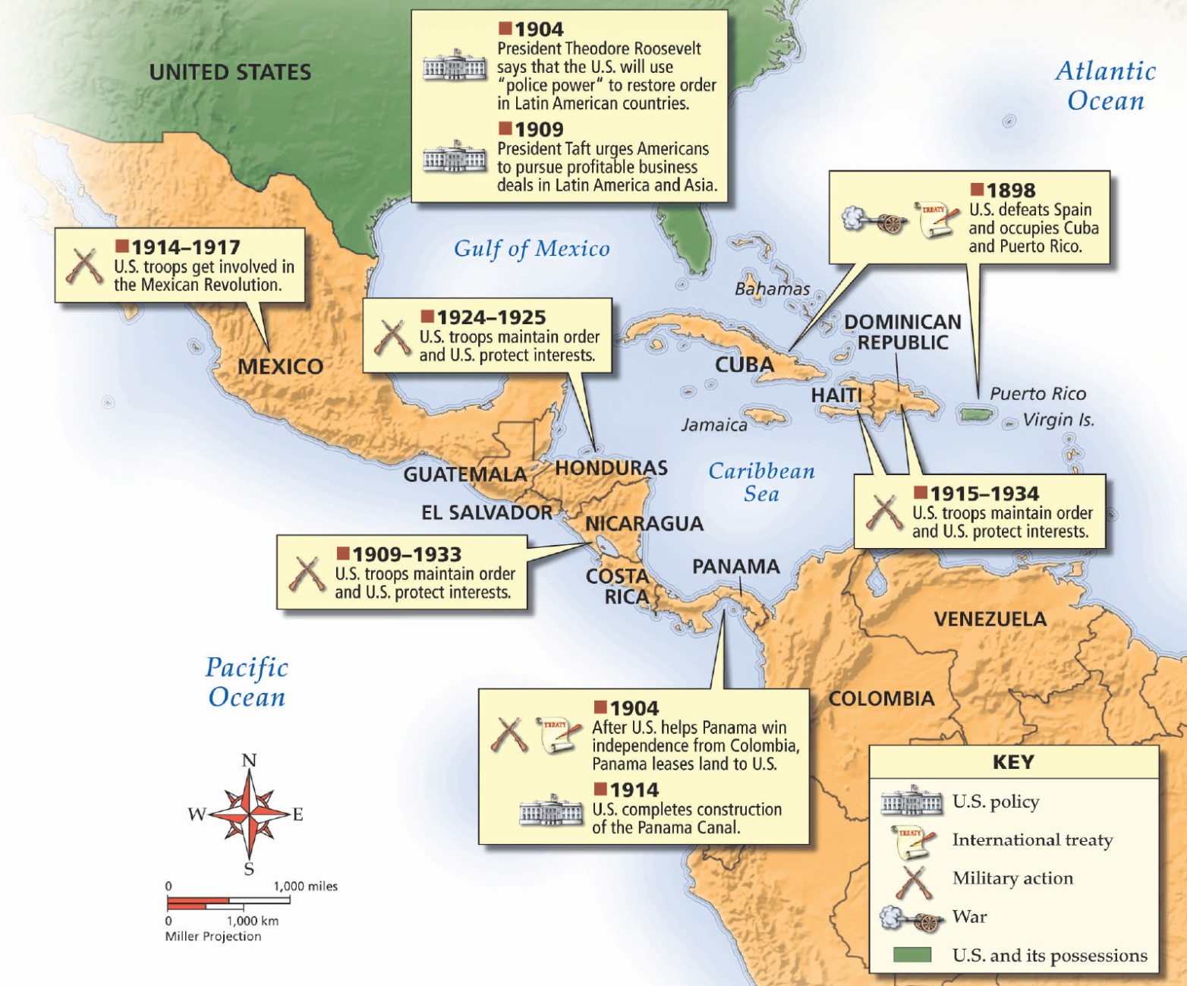

Slide 14
  supported human rights and national integrity rather than U.S. self-interest
  stated that the U.S. needed to be a friend even when it was not in our best interests
  promised the U.S. would “never again seek one additional foot of territory by conquest”
President, Woodrow Wilson proclaimed a new policy of “moral diplomacy” in 1913.

Slide 15
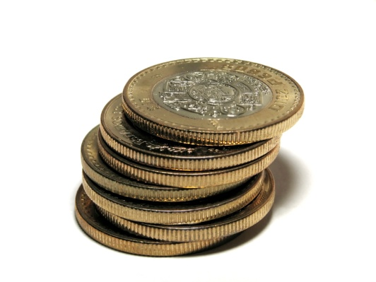
Despite his intentions, Wilson wound up intervening in Haiti, the Dominican Republic and especially in Mexico.
Mexican dictator Porfirio Díaz promoted American investment in Mexico, benefiting a small wealthy upper class of landowners, clerics and military men.
Meanwhile, poor Mexican farmers were struggling in extreme poverty.
Notes:
15

Slide 16
In 1911, a revolt by Francisco Madero toppled Díaz. Two years later, General Victoriano Huerta
seized control and executed Madero.
Wilson refused to recognize a “government of butchers.” When American sailors were arrested, he sent U.S. Marines into Mexico
Huerta’s government collapsed and he was in turn replaced by Venustiano Carrenza.
The famous outlaw Francisco “Pancho” Villa threatened to start a new rebellion.
Notes:
16

Slide 17
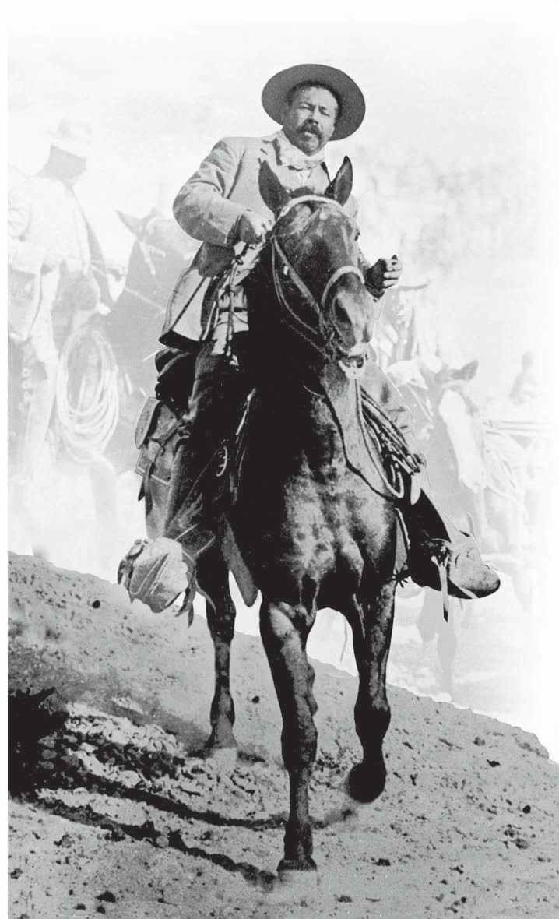
In 1916, Villa participated in raids across the U.S. border, leaving 18 dead.
Wilson sent General John J. Pershing and 10,000 troops into Mexico to catch Villa but failed.
Notes:
17

