Slide 1
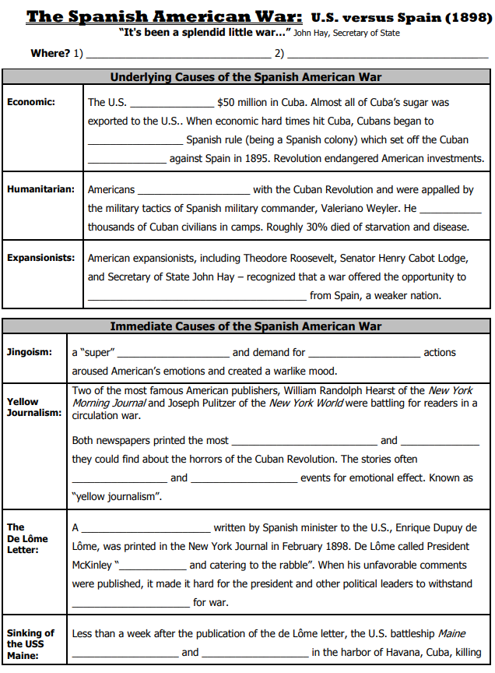
Ch 5 Review Activities: The Spanish-American War & The Causes of US Imperialism
Replace the word “text” with your own words. Make sure that you delete “text”
text
text
text
text
text
text
text
text
text
text
text
text
text
text
text
text
text
text
text

Slide 2
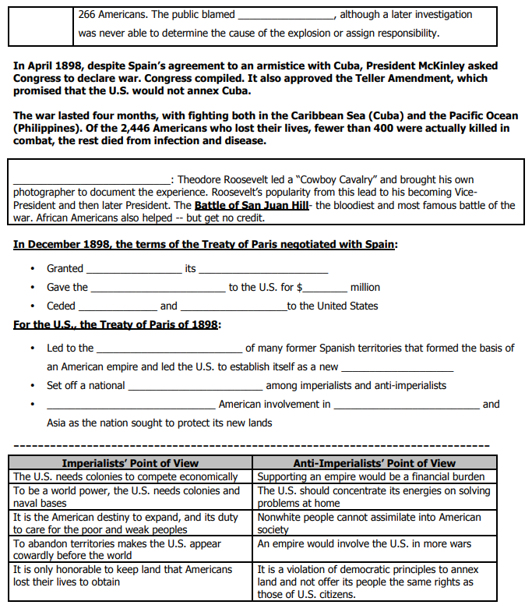
text
text
text
text
text
text
text
text
text
text
text

Slide 3
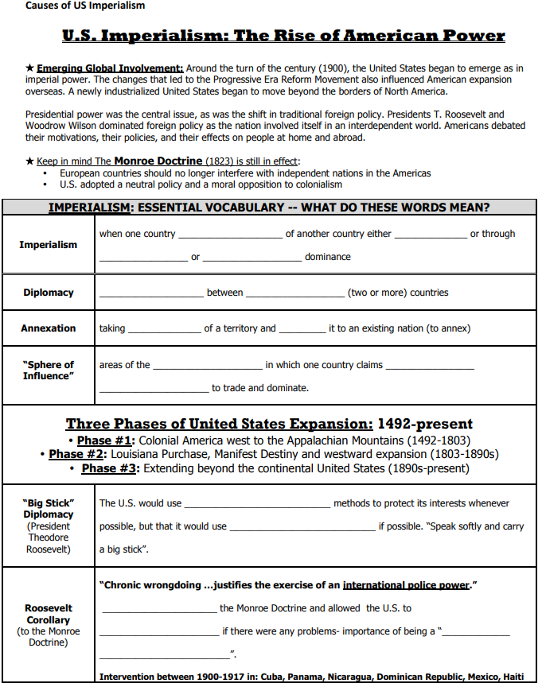
text
text
text
text
text
text
text
text
text
text
text
text
text
text
text
text
text

Slide 4
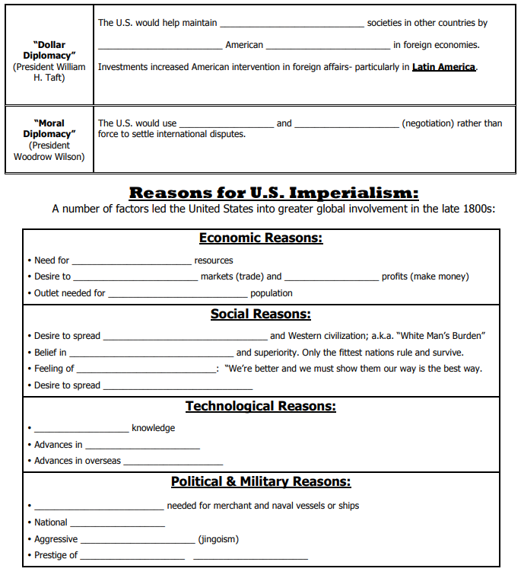
text
text
text
text
text
text
text
text
text
text
text
text
text
text
text
text
text
text
text
text

