Slide 1
Chapter Introduction
This chapter will focus on what caused the United States to become involved in World War I and how the United States changed as a result of this involvement.
Section 1: From Neutrality to War
Section 2: The Home Front
Section 3: Wilson, War, and Peace
Section 4: Effects of the War

Slide 2
Objectives
Identify the causes of World War I.
Describe the course and character of the war.
Explain why the United States entered the conflict on the side of the Allies.

Slide 3
Terms and People
Alsace-Lorraine – French region lost to German states in 1871
militarism – a glorification of the military
Francis Ferdinand – archduke of Austria-Hungary who was assassinated in 1914
William II – the German emperor
Western Front − trenches that stretched from the Belgian coast to the Swiss border with France, forming the battlefield between the Allies and the Central Powers in Western Europe

Slide 4
Terms and People (continued)
casualty – killed, wounded, or missing soldier
contraband – weapons and other war supplies
U-boat – a German submarine
Lusitania – English passenger ship sunk by a German U-boat, killing American civilians
Zimmermann note – a telegram in which the German foreign minister proposed an alliance with Mexico against the U.S.
Notes:
4

Slide 5
What caused World War I, and why did the United States enter the war?
In 1914, nationalism, militarism, imperialism, and entangling alliances combined to drag Europe into a world war.
The United States attempted to remain neutral but abandoned its long tradition of staying out of European conflicts.

Slide 6
In 1914, five factors made Europe a powder keg ready to explode.
Nationalism
Militarism
Economic rivalries
Imperial ambitions
Regional tensions
Notes:
6

Slide 7
Nationalism, or devotion to one’s country, caused tensions to rise.
Among the powers of Europe, nationalism caused a desire to avenge perceived insults and past losses.
Some felt national identity centered around a single ethnic group and questioned the loyalty of ethnic minorities.
Social Darwinists applied the idea of “survival of the fittest” to nations.
Notes:
7

Slide 8
Economic competition for trade and colonies increased nationalistic feelings.
Economic competition caused a demand for colonies and military bases in Africa, the Pacific islands, and China.
Alliances provided a promise of assistance that made some leaders reckless or overly aggressive.
Notes:
8

Slide 9
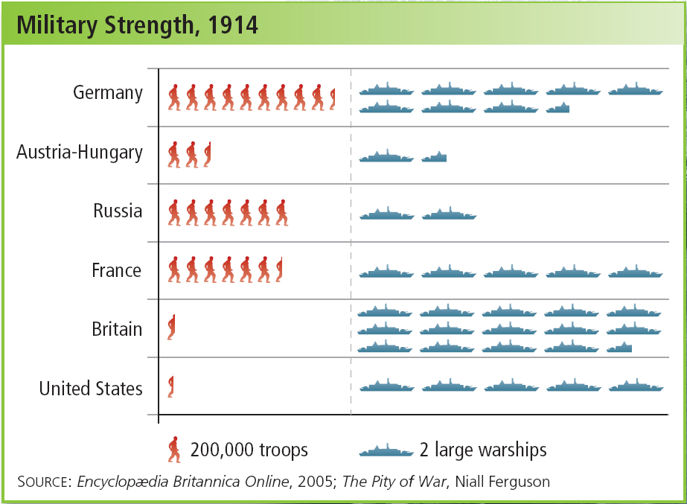
Nations stockpiled new technology,
including machine guns, mobile artillery,
tanks, submarines, and airplanes.
Militarism,
combined with nationalism, led to
an arms race.
Notes:
9

Slide 10
On June 28, 1914, Serb nationalists assassinated the heir to the throne of Austria-Hungary, Archduke, Francis Ferdinand.
The assassination triggered a chain of events that drew two sets of allies into a bloody conflict.
Notes:
10

Slide 11
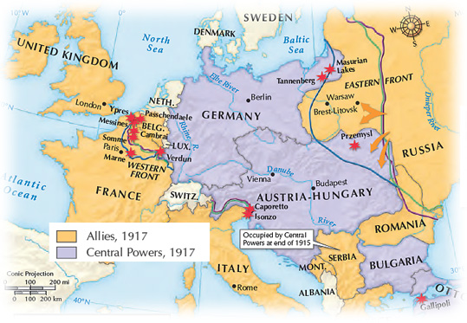
Europe’s alliance system caused the conflict to spread quickly, creating two main combatants.
Allied Powers included Britain, France, Russia, and Serbia.
Central Powers included Germany and Austria-Hungary.
Notes:
11

Slide 12
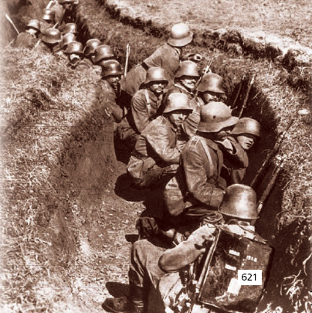
Germany invaded Belgium, a neutral country, to attack France.
The German advance was stopped about 30 miles from Paris.
The war bogged down as both sides dug a long series of trenches, creating the Western Front.

Slide 13
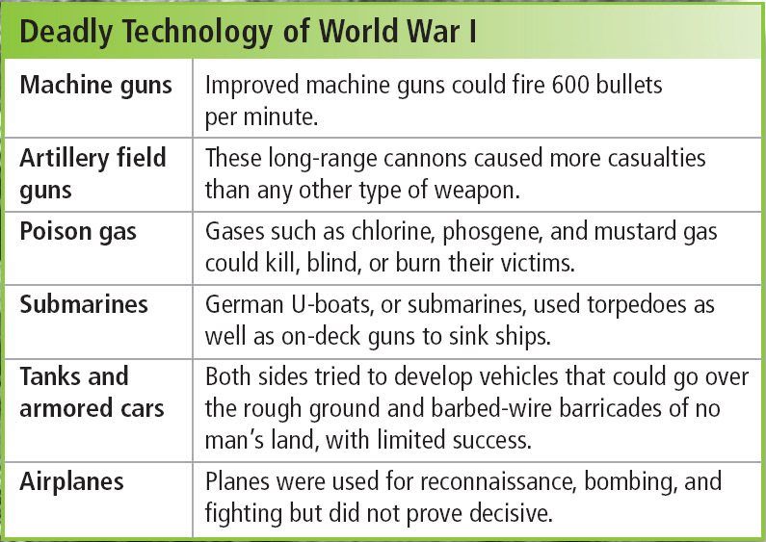
The era’s deadly defensive weapons made attacks difficult and dangerous.
Neither side could overcome the other’s defenses, and a stalemate quickly developed.
Notes:
13

Slide 14
The United States had a long tradition of staying out of European conflicts.
Yet one-third of Americans had been born in a foreign country and still identified with their homelands.
As the war dragged on in Europe, President Wilson urged Americans to remain neutral.
Many Americans favored one side or the other.
Notes:
14

Slide 15
U.S. public opinion fell into three main groups.
Isolationists | Favored staying out of the war
Interventionists | Favored fighting on the Allies’ side
Internationalists | Wanted the U.S. to play a role for peace but not fight
Notes:
15

Slide 16
Britain’s goal was to intercept contraband goods.
In defiance of international law, Britain also prevented non-contraband goods, such as food and gasoline, from reaching Germany.
Early in the war, the British navy had set up a blockade of Germany.
Germany responded by trying to blockade Britain.
Notes:
16

Slide 17
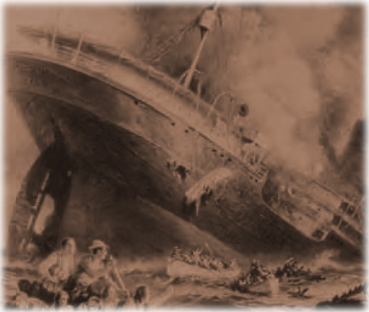
German U-boats torpedoed ships bound for Britain.
On May 7, 1915, a U-boat sank the British passenger ship Lusitania off the coast of Ireland, killing many Americans.

Slide 18
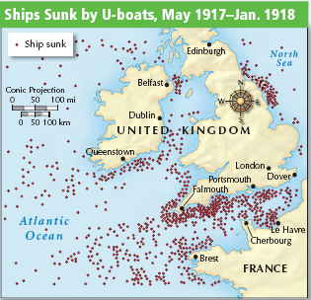
Americans were angry about the Lusitania. Germany failed to keep its promise to not sink any more passenger ships.
President Wilson still wanted peace, but he began to prepare for the possibility of war.
In 1916, Congress expanded the army and authorized more warships.
Notes:
18

Slide 19
Two events in 1917 led President Wilson o ask Congress to declare war on the Central Powers.
The Zimmermann Note was intercepted. In this telegram, Germany tried to forge an alliance with Mexico against the United States.
Germany returned to a policy of unrestricted submarine warfare, sinking any ship headed for Britain.
Notes:
19

Slide 20
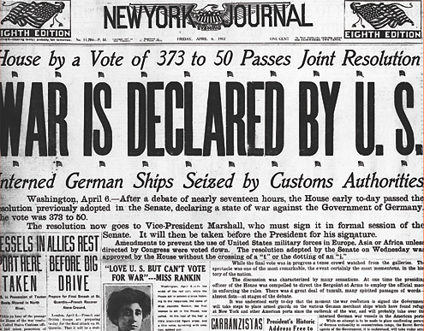
On April 2, 1917, Wilson asked Congress to declare war against Germany, saying “The world must be made safe for democracy.”
Congress responded with a declaration of war on April 6, and the United States entered World War I.
Notes:
20

