Slide 1
Chapter Introduction
This chapter will focus on what caused the United States to become involved in World War I and how the United States changed as a result of this involvement.
Section 1: From Neutrality to War
Section 2: The Home Front
Section 3: Wilson, War, and Peace
Section 4: Effects of the War

Slide 2
Objectives
Understand how the United States military contributed to the Allied victory in the war.
Describe the aims of the Fourteen Points.
Analyze the decisions made at the Paris Peace Conference.
Explain why the United States Senate refused to ratify the treaty ending World War I.

Slide 3
Terms and People
convoy – group of ships that traveled together for protection against German U-boats
Vladimir Lenin – radical communist leader who took over Russia in March 1917
John J. Pershing – General who led American forces in Europe
Fourteen Points – Wilson’s plan for lasting peace through international openness and cooperation
self-determination – the right of people to choose their own form of government

Slide 4
Terms and People (continued)
League of Nations – world organization to promote peaceful cooperation between countries
Henry Cabot Lodge – Republican Senator who opposed ratification of the Treaty of Versailles
reparations – payments for war damages
“irreconcilables” – Senate isolationists who opposed any treaty that included a League of Nations
“reservationists” – Senators who opposed the Treaty of Versailles as written but were open to compromise
Notes:
4

Slide 5
How did Americans affect the end of World War I and its peace settlements?
When the United States entered World War I in the spring of 1917, the war was at a deadly, bloody stalemate along the Western Front.
The American entry into the war would play a key role in the Allied victory.

Slide 6
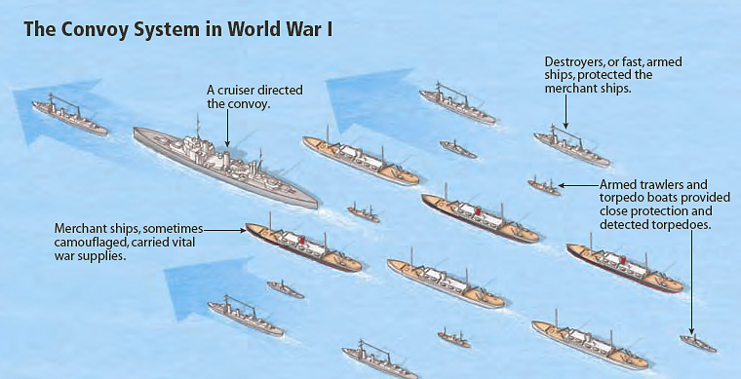
When the United States entered the war in 1917, Germany increased U-boat attacks, hoping to win the war before American troops could make a difference.
Convoys of British and American ships, protected by warships, provided better safety at sea.
Notes:
6

Slide 7
Several factors gave the Central Powers an advantage on land.
The Allies were exhausted from years of fighting.
Russia was torn apart by revolutions at home.
Communists gained control of Russia, and their leader Vladimir Lenin signed a treaty with Germany in 1918, ending Russian involvement in the war.
The closing of the Eastern Front allowed Germany to send more troops to the Western Front.
Notes:
7

Slide 8
In the spring of 1918, Germany began an all-out offensive on the Western Front.
The attacks threatened to break through Allied defenses and open
a path to Paris.
More American soldiers began to arrive, and U.S. troops carried more of the burden of fighting.
Notes:
8

Slide 9
General John J. Pershing turned millions of untrained American men into soldiers, then led them in France.
The arrival of American soldiers gave the Allies a military advantage.
They fought bravely in many battles.
By the end of the war, 1.3 million Americans had served at the front. More than 50,000 of them died.
Notes:
9

Slide 10
By the fall of 1918, the German front was collapsing.
Many German and Austro-Hungarian soldiers deserted, mutinied, or refused to fight.
On November 11, 1918, Germany surrendered to the Allies in Compiegne, France.
Notes:
10

Slide 11
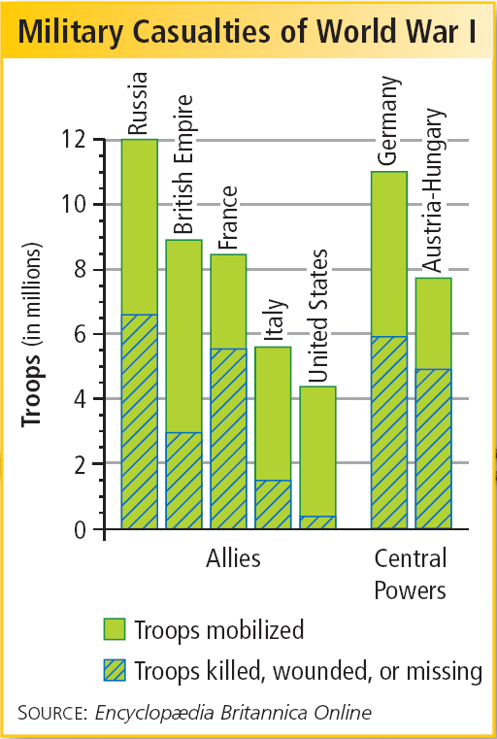
The war took a huge toll on those involved.
Nearly 5 million Allied soldiers and 8 million Central Powers soldiers were killed in the fighting.
In addition, 6.5 million civilians died during the conflict.

Slide 12
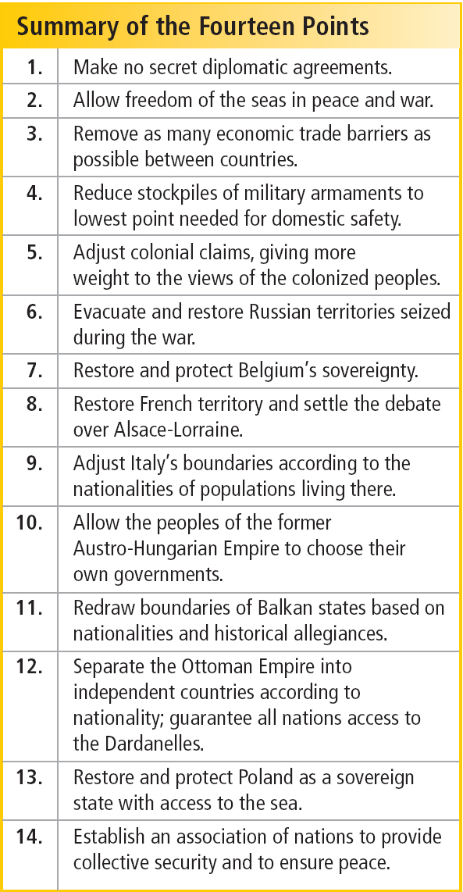
In early 1919, President Wilson traveled to Versailles, France for a peace conference.
He met with European leaders and presented a plan for peace based on his Fourteen Points.
Wilson’s vision of a postwar world was grounded in the idea of “peace without victory.”

Slide 13
Wilson’s Fourteen Points made specific proposals to promote future peace.
Practice open diplomacy.
Allow freedom of the seas.
Encourage free trade.
Reduce arms stockpiles.
Scale back colonialism.
Encourage self-determination of nations.
Establish a League of Nations.

Slide 14
Allied leaders at Versailles wanted reparations.
European leaders did not share Wilson’s vision of peace without victory.
They wanted Germany to pay for war damages.
They also wanted to protect European colonialism and expand their countries’ territories.
Notes:
14

Slide 15
One by one, Wilson’s Fourteen Points were rejected, leaving only the League of Nations.
The League of Nations was an organization where countries could come together to resolve disputes peacefully.
Wilson’s proposal to create a League of Nations was added to the Treaty of Versailles.

Slide 16
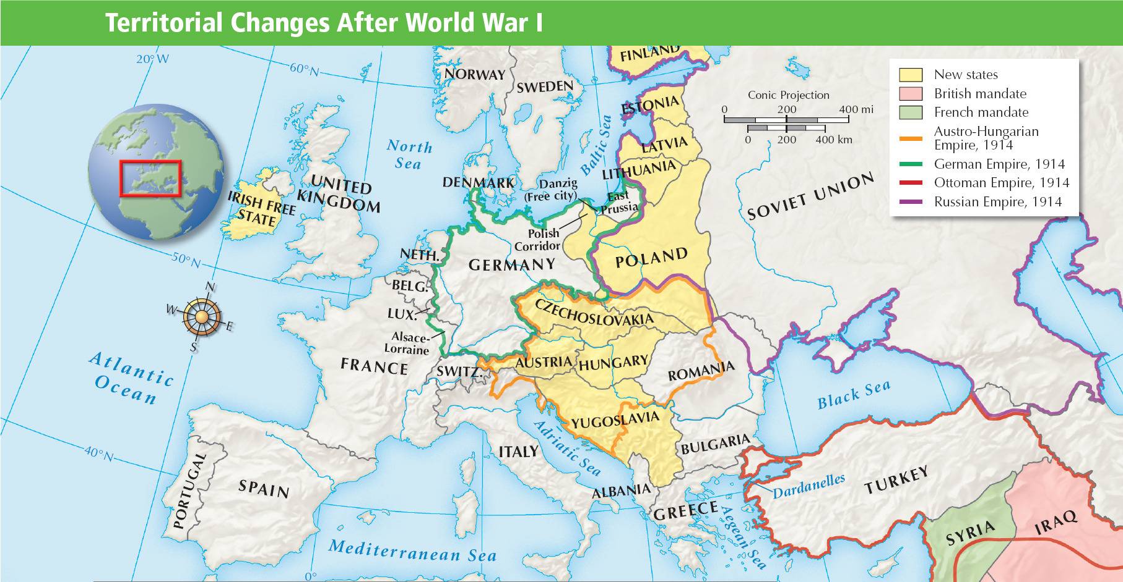
The Treaty of Versailles redrew the map of Europe and broke up the Ottoman Empire.

Slide 17
Wilson returned to face a hostile Senate, where two groups opposed the treaty.
The “reservationists,” led by Henry Cabot Lodge, opposed the treaty as written but were willing to negotiate changes.
The “irreconcilables” were isolationists who opposed the League of Nations.
Notes:
17

Slide 18
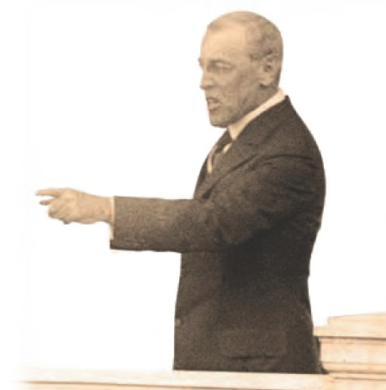
Wilson was unwilling to compromise on the treaty.
On a speaking tour to promote the League of Nations in September 1919, Wilson became ill and suffered a stroke.
As he lay near death, the Senate voted, refusing to ratify the Treaty of Versailles.
Notes:
18

