Slide 1
Objectives
Explain the impact of Henry Ford and the automobile.
Analyze the consumer revolution and the bull market of the 1920s.
Compare the different effects of the economic boom on urban and rural America.

Slide 2
Terms and People
Henry Ford – applied mass production techniques to manufacture automobiles; initiated changes that had a major impact on wages, working conditions, and daily life
mass production – the rapid, large-scale manufacture of identical products
Model T – automobile manufactured by Henry Ford to be affordable on the mass market
scientific management – analysis of a manufacturing process to improve speed and efficiency

Slide 3
Terms and People (continued)
assembly line – manufacturing technique in which products move past workers, each of whom adds one small component
consumer revolution – a flood of new, affordable goods
installment buying – buying on credit by making an initial down payment and then paying the balance over time
Notes:
3

Slide 4
Terms and People (continued)
bull market – a period of rising prices in the stock market
buying on margin – buying stock on credit by paying a percentage up front and borrowing the rest of its cost
Notes:
4

Slide 5
How did the booming economy of the 1920s lead to changes in American life?
During the 1920s, the American economy experienced tremendous growth. Using mass production techniques, workers produced more goods in less time than ever before.
The boom changed how Americans lived and helped create the modern consumer economy.

Slide 6
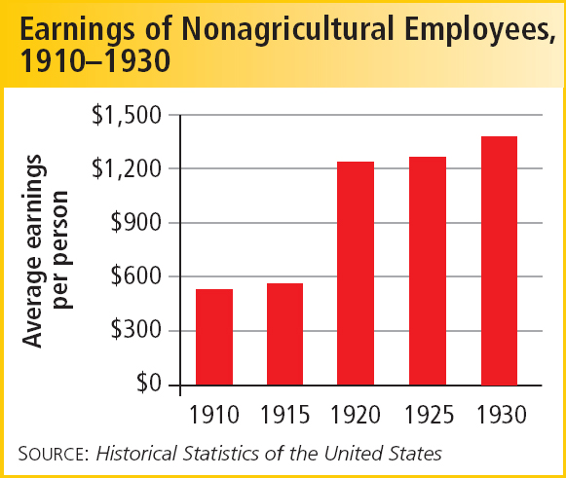
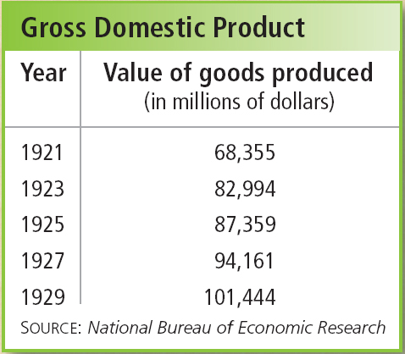
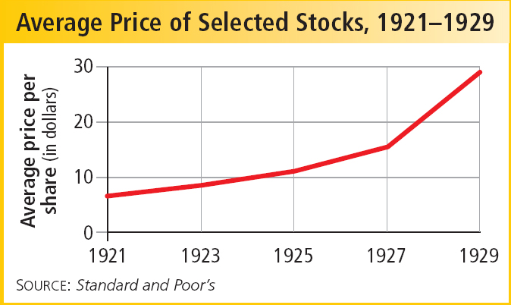
The 1920s were a time of rapid economic growth in the United States.
Much of this boom can be traced to the automobile.

Slide 7
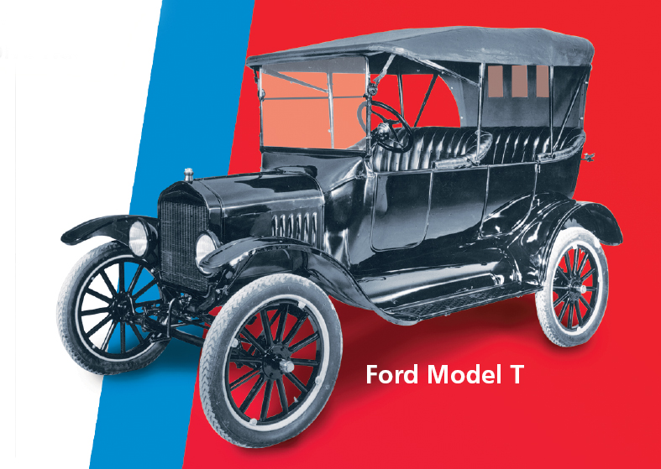
Before 1920, only wealthy people could afford cars.
By applying innovative manufacturing techniques, Henry Ford changed that.
His affordable Model T became a car for the people.
Notes:
7

Slide 8
Ford made the Model T affordable by applying mass production techniques to making cars.
A moving assembly line brought cars to workers, who each added one part.
Ford consulted scientific management experts to make his manufacturing process more efficient.
The time to assemble a Model T dropped from 12 hours to just 90 minutes.
Notes:
8

Slide 9
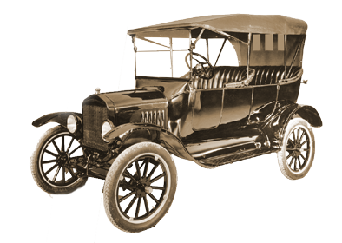
Ford also raised his workers’ pay and shortened their hours.
With more money and more leisure time, his employees would be potential customers.
By 1927, 56% of American families owned a car.
Notes:
9

Slide 10
How the Automobile Changed America
Road construction boomed, and new businesses opened along the routes.
Other car-related industries included steel, glass, rubber, asphalt, gasoline, and insurance.
Workers could live farther away from their jobs.
Families used cars for leisure trips and vacations.
Fewer people traveled on trolleys or trains.

Slide 11
The 1920s saw a consumer revolution.
Using installment
buying, people could buy more.
New products
flooded the market.
Advertising
created
demand.
Notes:
11

Slide 12
Rising stock market prices also contributed to economic growth.
Throughout the 1920s, a bull market meant stock prices kept going up.
Investors bought on margin (purchasing stocks on credit).
By 1929, around four million Americans owned stocks.

Slide 13
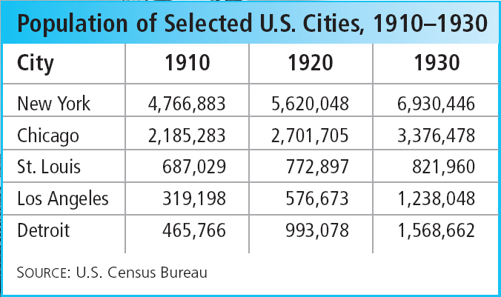
During the 1920s, cities grew rapidly.
Immigrants, farmers, African Americans, and Mexican Americans were among those who settled in urban areas.

Slide 14
Cities expanded outward, thanks to automobiles and mass transit systems.
More and more people who worked in cities moved to the suburbs.
Suburbs grew faster than inner cities.

Slide 15
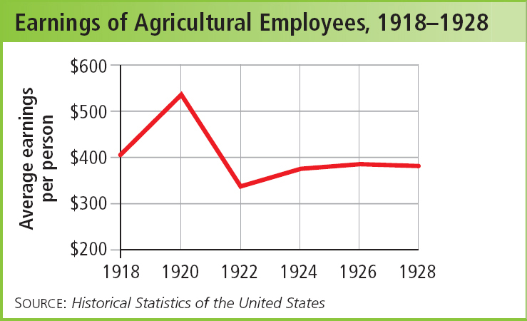
While cities and suburbs benefited from the economic boom, rural America struggled.
Farm incomes declined or remained flat through most of the 1920s.

Slide 16
Review
Booming Economy
Growth in Automobile industry
New Technology
Mass Production
Assembly line
Laissez-Faire Gov
Income tax cuts
Consumerism
Growth in debt
Spending through credit
Boom in Stock Market
Easy way to make money
More speculators enter.
Recession in Agriculture
Farmers bankrupt
Rural to urban shift

Slide 17
Review
Booming Economy
Reasons for booming Economy:
Growth in Automobile industry
Consumerism.
Technology,
Labor productivity
Management techs
Scientific Management
Taylorism
Mass Production
Assembly line
Laissez-Faire
Income tax cuts
Weak Anti trust laws
Monopoly power
Trade Unions declined
Growth in Debt
Spending through credit
Boom in Stock Market
Easy way to make money
More speculators to enter.
Recession in Agriculture
Farmers bankrupt
Rural to urban shift
Fragmented banking

