Slide 1
Objectives
Analyze how the policies of Presidents Harding and Coolidge favored business growth.
Discuss the most significant scandals during Harding’s presidency.
Explain the role that the United States played in the world during the 1920s.

Slide 2
Terms and People
Andrew Mellon – Secretary of the Treasury under President Harding; favored low taxes, a balanced budget, and less business regulation
Herbert Hoover – Secretary of Commerce; favored voluntary cooperation between businesses and workers
Teapot Dome scandal – Secretary of the Interior Albert Fall took bribes in return for leasing federal oil reserves to private companies.

Slide 3
Terms and People (continued)
Calvin Coolidge – quiet, frugal, and honest president who took office when Harding died
Washington Naval Disarmament Conference –meeting in which nations agreed to limit construction of large warships
Kellogg-Briand Pact – agreement to outlaw war as an instrument of national policy
Dawes Plan – loan program to help Germany make reparations to England and France so that those countries could repay wartime loans to U.S.
Notes:
3

Slide 4
How did domestic and foreign policy change direction under Harding and Coolidge?
Rather than pursue Progressive reform, Presidents Warren G. Harding and Calvin Coolidge favored conservative policies that aided business growth.
Foreign policy during this time was largely a response to the devastation of World War I.

Slide 5
In 1920 Warren G. Harding was elected President, promising a “return to normalcy.”
Unlike Progressives, Harding favored business interests and reduced federal regulations.
His Secretary of the Treasury Andrew Mellon was for low taxes and efficiency in government.
Mellon cut the federal budget from a wartime high of $18 billion to $3 billion.

Slide 6
Secretary of Commerce Herbert Hoover sought voluntary cooperation between labor and business.
Instead of relying on legislation to improve labor relations, Hoover got business and labor leaders to work together.
Notes:
6

Slide 7
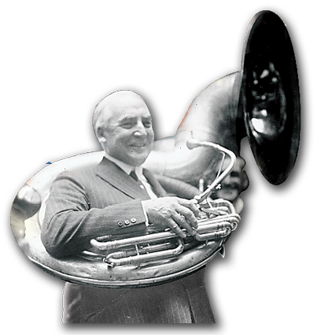
Harding was a popular, fun-loving president who trusted others to make decisions for him.
Some advisors, such as Mellon and Hoover, were honest, capable, and trustworthy.
Others, including a group known as the “Ohio Gang,” were not so civic-minded.
Notes:
7

Slide 8
Some Scandals of Harding’s Administration
Charles Forbes, head of the Veterans’ Administration, wasted millions of dollars on overpriced, unneeded supplies. Attorney General Harry Daugherty accepted money from criminals. Secretary of the Interior Albert Fall took bribes in return for federal oil reserve leases.
Notes:
8

Slide 9
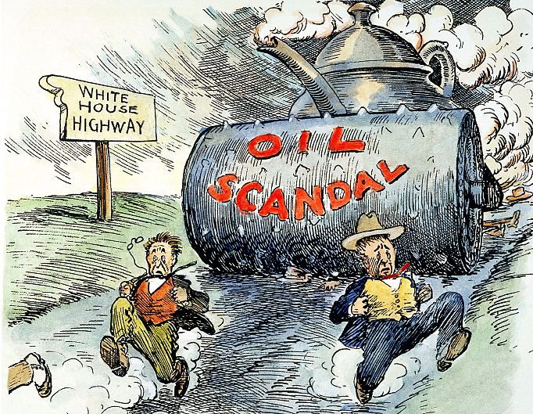
The Teapot Dome scandal became public.
In 1921, Fall took control of federal oil reserves intended for the navy.
He then leased those reserves to private oil companies.
Fall was sent to prison.
President Harding did not live to hear all of the scandal’s details. He died in 1923.
Notes:
9

Slide 10
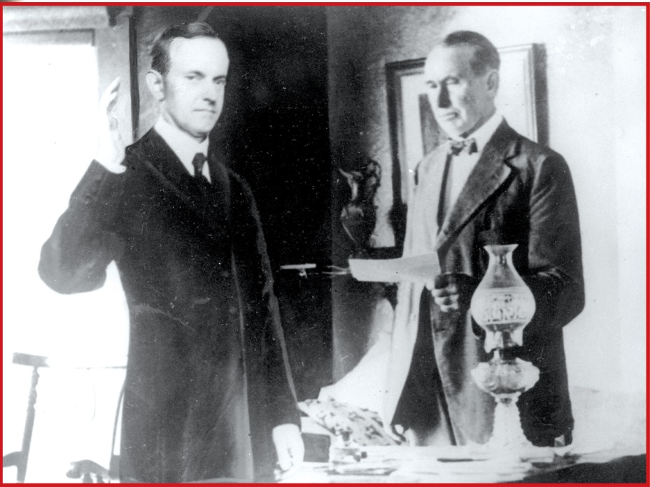
In August 1923, Vice President Calvin Coolidge became President.
Coolidge was a quiet, honest, frugal Vermonter.
As President, he admired productive business leaders.
Notes:
10

Slide 11
Coolidge believed that “the chief business of the American people is business.”
Coolidge continued Mellon’s policies to reduce the national debt, trim the budget, and lower taxes.
The country saw huge industrial profits and spectacular growth in the stock market.
The middle and upper classes prospered, especially in cities.
Notes:
11

Slide 12
Not everyone shared in the era’s prosperity.
Farmers struggled as agricultural prices fell.
Labor unions fought for higher pay and better working conditions.
African Americans and Mexican Americans faced severe discrimination.
Coolidge ignored such issues, believing it was not the federal government’s job to legislate social change.
Notes:
12

Slide 13
Under Harding and Coolidge, the United States assumed a new role as a world leader.
The Washington Naval Disarmament Conference limited construction of large warships.
The Kellogg-Briand Pact, signed by 62 countries, outlawed war.
Much of U.S. foreign policy was a response to World War I’s devastation.
But the U.S. refused to join the World Court.

Slide 14
During this period the United States also became a world economic leader.
To protect American businesses, Harding raised tariffs on imported goods by 25%.
European nations retaliated, creating a tariff war.
The Dawes Plan loaned money to Germany so that Germany could pay reparations to Britain and France; in turn, those countries could repay the U.S. for wartime loans.

