Slide 1
Objectives
Compare economic and cultural life in rural America to that in urban America.
Discuss changes in U.S. immigration policy in the 1920s.
Analyze the goals and motives of the Ku Klux Klan in the 1920s.
Discuss the successes and failures of the Eighteenth Amendment.

Slide 2
Terms and People
modernism – trend that emphasized science and secular values over traditional religious ideas
fundamentalism – belief that emphasizes the Bible as literal truth
Scopes Trial – 1925 “Monkey Trial,” which challenged a law against teaching Darwin’s theory of evolution in Tennessee public schools
Clarence Darrow – defense attorney in the Scopes Trial

Slide 3
Terms and People (continued)
quota system – a formula to determine how many immigrants could enter the U.S. annually from a given country
Ku Klux Klan – a group violently opposed to immigrants, Catholics, Jews, and African Americans
Prohibition – a ban on alcohol
Eighteenth Amendment – a 1919 Constitutional amendment that established Prohibition
Notes:
3

Slide 4
Terms and People (continued)
Volstead Act – a law that gave the government power to enforce the Eighteenth Amendment
bootlegger – someone who illegally sold alcohol during Prohibition
Notes:
4

Slide 5

How did Americans differ on major social and cultural issues?
In the 1920s, many city dwellers enjoyed a rising standard of living, while most farmers suffered through hard times.
Conflicting visions for the nation’s future heightened tensions between cities and rural areas.

Slide 6
In 1920, for the first time, more Americans lived in cities than in rural areas.
In cities, many people enjoyed prosperity and were open to social change and new ideas.
Times were harder in rural areas. Rural people generally preferred traditional views of science, religion, and culture.

Slide 7

An example of this clash of values was
the tension between modernism and Christian fundamentalism in the 1920s.
Modernism emphasized science
and secular values.
Fundamentalism emphasized religious values and taught the literal truth of the Christian Bible.

Slide 8
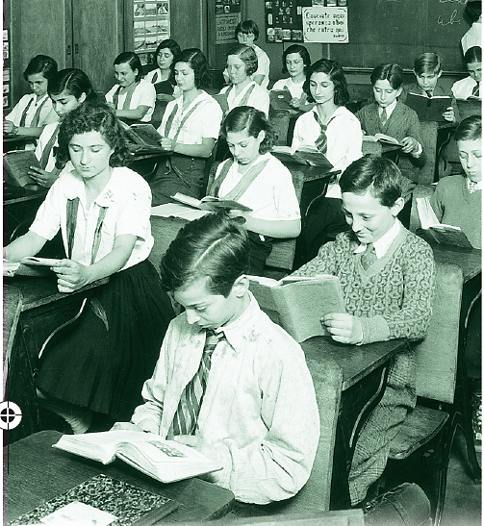
Attitudes toward education illustrate another difference between urban and rural perspectives.
Urban people saw formal education as essential to getting a good job.
In rural areas, “book learning” interfered with farm work and was less highly valued.

Slide 9
Education became a battleground for fundamentalist and modernist values
in the 1925 Scopes Trial.
Tennessee made it illegal to teach evolution in public schools.
Biology teacher John Scopes challenged the law.
Defense attorney Clarence Darrow tried to use science to cast doubt on religious beliefs.

Slide 10
The Scopes Trial illustrated a major cultural and religious division, but it did not resolve the issue.
Scopes was found guilty of teaching evolution
and fined.
The conflict over teaching evolution in public schools continues today.

Slide 11
Immigrants were at the center of another cultural clash.
Many Americans recognized the importance of immigration to
U.S. history.
Many Mexicans
settled in the
sparsely populated
areas of the
southwest.
Nativists feared that immigrants took
jobs away from native-born workers and threatened American traditions.
After World War I, the Red Scare increased distrust
of immigrants.

Slide 12
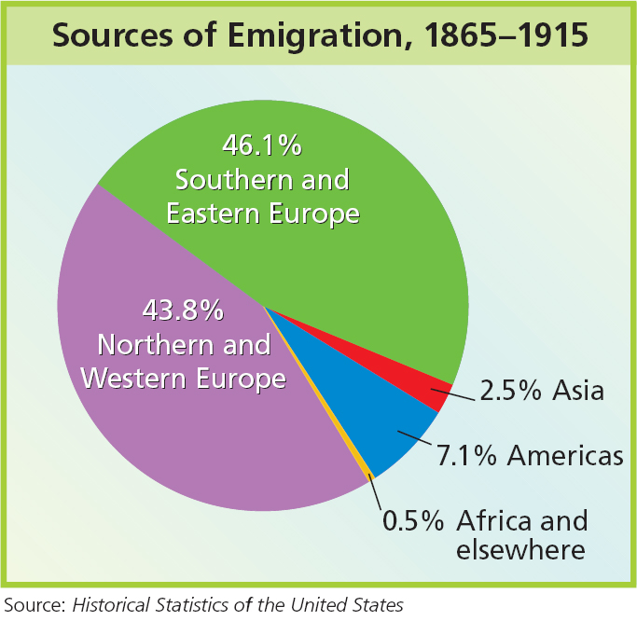
In 1924, the National Origins Act set up a quota system for immigrants.
For each nationality, the quota allowed
up to 2% of 1890’s total population
of that nationality living in the U.S.

Slide 13
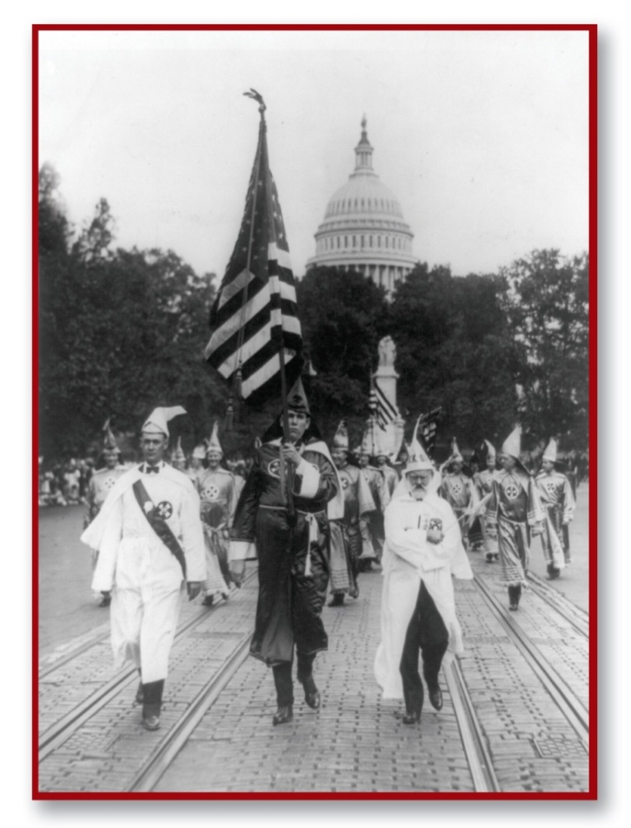
Trends such as urbanization, modernism, and increasing diversity made some people lash out against change.
Beginning in 1915, there was a resurgence of the Ku Klux Klan.
The Klan promoted hatred of African Americans, Jews, Catholics, and immigrants.
By 1925, the Klan had between
4 and 5 million members.
Notes:
13

Slide 14
Others embraced the idea of racial, ethnic,
and religious diversity.
Many valued the idea of the United States as a “melting pot.”
Groups such as the NAACP ( National Association for the Advancement of Colored People) and the Jewish Anti-Defamation League worked to counter the Klan and its values.
By the late 1920s, many Klan leaders had been
exposed as corrupt.

Slide 15
Alcoholic beverages were another divisive issue.
In 1919, the Eighteenth Amendment, which banned the making, distributing, or selling of
alcohol, became part of the Constitution.
The Volstead Act enabled the government to enforce the amendment.
Prohibition became law in the United States.

Slide 16
“Drys” favored Prohibition, hailing the law
as a “noble experiment.”
Drys believed that Prohibition was good for society.
“Wets” opposed Prohibition, claiming that it did not stop drinking.
Wets argued
that Prohibition encouraged hypocrisy and illegal activity.

Slide 17
A large illegal network created, smuggled, distributed, and sold alcohol, benefiting gangsters such as Al Capone.
People bought alcohol illegally from bootleggers and at speakeasies.
Prohibition
did not stop people from drinking alcoholic beverages.
Prohibition contributed to the rise of organized crime.
Notes:
17

