Slide 1
Objectives
Trace the reasons that leisure time increased during the 1920s.
Analyze how the development of popular culture united Americans and created new activities and heroes.
Discuss the advancements of women in the 1920s.
Analyze the concept of modernism and its impact on writers and painters in the 1920s.

Slide 2
Terms and People
Charlie Chaplin – popular silent film star
The Jazz Singer – the first talking motion picture
Babe Ruth – baseball star known as the “Sultan
of Swat” and the “Bambino”
Charles Lindbergh – the first person to fly solo and non-stop across the Atlantic Ocean
flapper – a young woman of the 1920s who rejected traditional values and dress

Slide 3
Terms and People (continued)
Sigmund Freud – psychologist who suggested that people are driven by subconscious desires
“Lost Generation” – writers who rejected Victorian values after World War I and searched for new truths
F. Scott Fitzgerald – author of The Great Gatsby and other novels that questioned the idea of the American dream
Ernest Hemingway – author of a Farewell to Arms who developed a new writing style
Notes:
3

Slide 4

How did the new mass culture reflect technological and social changes?
The automobile made it easier for people to travel. Other technological advances, such as radio and film, created a new mass culture. New styles also emerged in art and literature.
In many ways, the 1920s represented the
first decade of our own modern era.

Slide 5
In the 1920s, urban dwellers saw an increase in leisure time.
Farmers worked from dawn to dusk and had little time for recreation.
In cities and suburbs, people earned more money and had more time for fun. They looked for new kinds of entertainment.

Slide 6

One of the new kinds of entertainment was the
motion picture.
In the 1920s, 60 to 100 million people went to the movies each week.
Throughout most of the decade,
movies were silent, so people could watch them no matter what language they spoke.

Slide 7

Movies were affordable and available to everyone, everywhere.
Movies’ democratic, universal appeal created stars known the world over.
Charlie Chaplin became the most popular silent film star by playing “The Little Tramp.”
In 1927, Al Jolson appeared in The Jazz Singer, the first “talkie,” ending the era of silent films.

Slide 8
The radio and the phonograph were
powerful instruments of mass culture.
The first commercial radio station, KDKA, began in 1920.
Within three years, there were 600 radio stations.
People all over the country could hear the same music, news, and shows.
With phonographs, people could listen to music whenever they wanted.
Improvements in recording technology made records popular.
People listened to the same songs and learned the same dances.

Slide 9
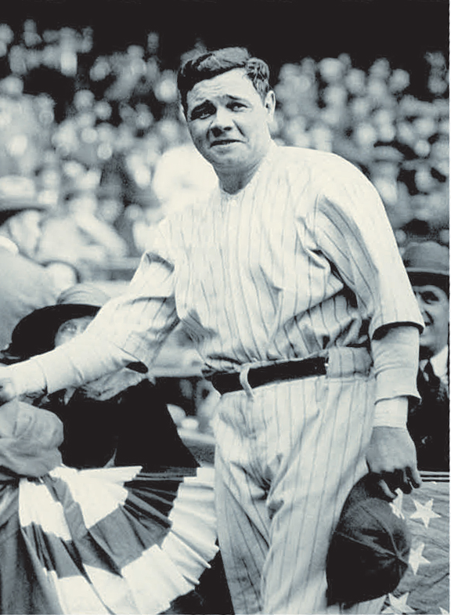
The world of sports produced some nationally famous heroes.
Thanks to newspapers and radio, millions of people could follow their favorite athletes.
Baseball player Babe Ruth, nicknamed “The Sultan of Swat,” thrilled people with his home runs.

Slide 10
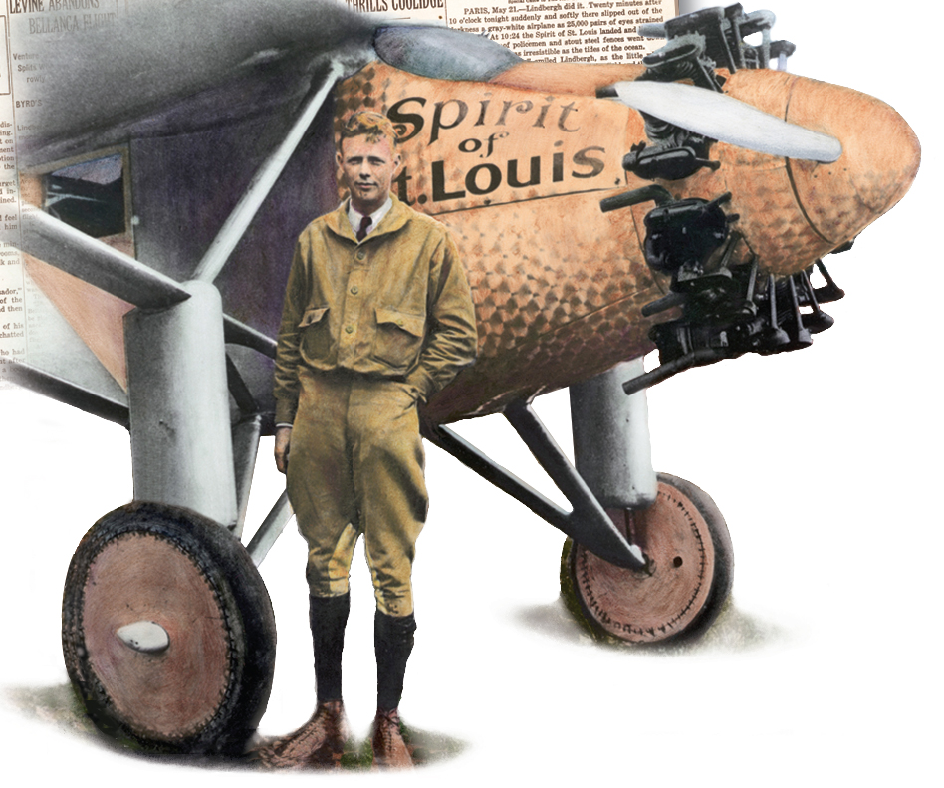
Aviator Charles Lindbergh became a national hero when he made the first solo flight across the Atlantic.
In May 1927, Lindbergh flew his single-engine plane, Spirit of St. Louis, non-stop from New York to Paris.
The flight took more than 33 hours.
Notes:
10

Slide 11
Women’s roles also changed in the 1920s.
Women married later, had fewer children, and generally lived longer, healthier lives.
Labor-saving appliances, such as electric irons and vacuum cleaners, allowed time for book clubs, charitable work, and new personal interests.
Such changes benefited urban women more than rural women.
Notes:
11

Slide 12
Flappers represented a “revolution in
manners and morals.”
These young women rejected Victorian morality and values.
They wore short skirts, cut their hair in a short style called the bob, and followed dance crazes such as the Charleston.
Notes:
12

Slide 13
The decade saw many “firsts” for women.
More women entered the workforce.
They moved into new fields such as banking, aviation, journalism, and medicine.
Nellie Tayloe Ross of Wyoming became the first female governor.
Other “firsts” included the first woman judge and the first woman elected to the U.S. Senate.
Notes:
13

Slide 14


World War I strongly affected the art and literature of the 1920s.
The war’s devastation left many questioning the optimistic Victorian attitude of progress.
Modernism expressed a skeptical, pessimistic view of the world.
Writers and artists explored the ideas of psychologist Sigmund Freud, who suggested that human behavior was driven by unconscious desires.
Notes:
14

Slide 15
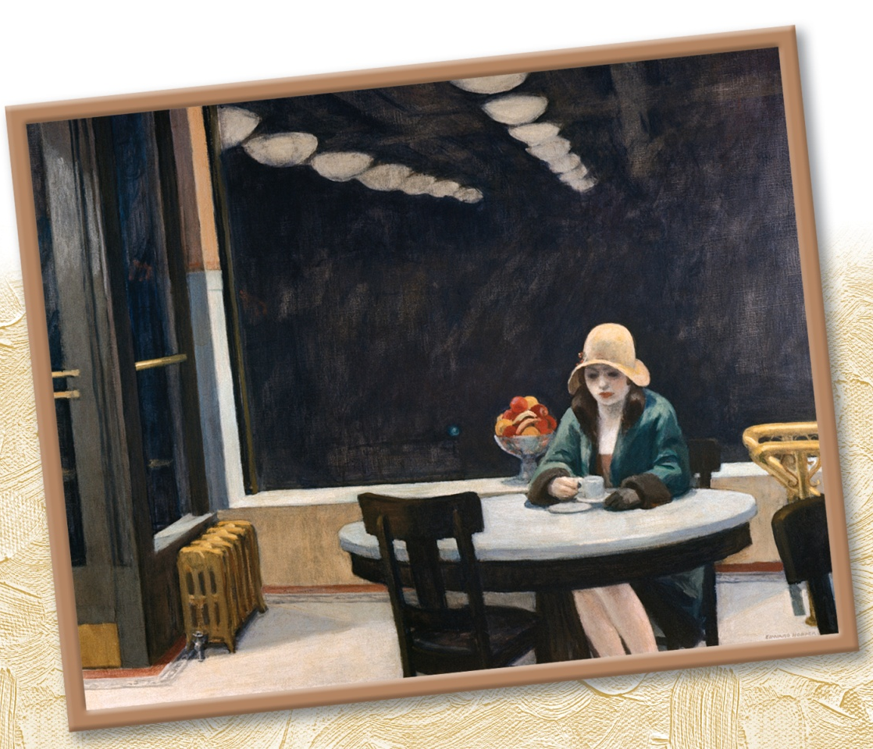
Artists such as Edward Hopper, Joseph Stella,
and Georgia O’Keefe challenged tradition and experimented with new subjects and abstract styles.
Notes:
15

Slide 16
Writers of the 1920s were called the Lost Generation because they’d lost faith in Victorian cultural values.
F. Scott Fitgerald explored the idea of the American dream, writing that his generation had found
“all faiths in man shaken.”
Ernest Hemingway questioned concepts of personal sacrifice, glory, honor, and war and created a new style of writing.
Playwright Eugene O’Neill explored the subconscious mind in his plays.

