Slide 1
Objectives
Analyze the racial and economic philosophies of Marcus Garvey.
Trace the development and impact of jazz.
Discuss the themes explored by writers of the Harlem Renaissance.

Slide 2
Terms and People
Marcus Garvey – founder of the Universal Negro Improvement Association and the “Back to Africa” movement who promoted black pride
jazz – American musical art form based on improvisation that came to represent the Roaring Twenties
Louis Armstrong – trumpet player who influenced the development of jazz
Bessie Smith – jazz singer known as the “Empress of the Blues”

Slide 3
Terms and People (continued)
Harlem Renaissance – the flowering of African American arts and literature in 1920s New York
Claude McKay – Harlem Renaissance writer who showed the struggles of ordinary African Americans
Langston Hughes – prolific writer who celebrated African American culture and life
Zora Neale Hurston – folklorist and author of Their Eyes Were Watching God
Notes:
3

Slide 4

How did African Americans express a new sense of hope and pride?
As a result of World War I and the Great Migration, millions of African Americans relocated from the rural South to the urban North. This migration contributed to a flowering of music and literature.
Jazz and the Harlem Renaissance had a lasting impact on American culture.

Slide 5
Many African Americans were attracted to northern cities by dreams of a better life.
They hoped to escape the poverty and racism of the South.
The North offered higher wages and a middle class of African American ministers, physicians, and teachers.
Discrimination did exist in the North, however, and African Americans faced low pay, poor housing, and the threat of race riots.

Slide 6
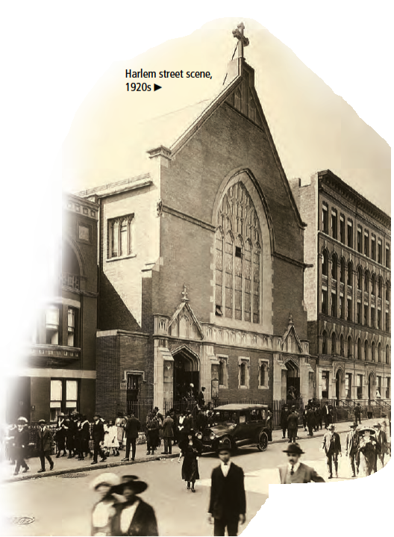
Harlem, in New York City, was the cultural focal point of the northern migration.
In Harlem, 200,000 African Americans mixed with immigrants from Caribbean islands such
as Jamaica.

Slide 7
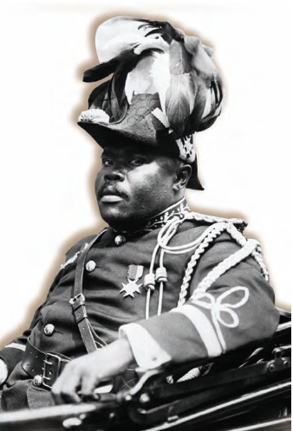
Jamaican immigrant Marcus Garvey
encouraged black pride.
Garvey promoted universal black nationalism and support of black-owned businesses.
He founded a “Back to Africa” movement and the Universal Negro Improvement Association.
Eventually, Garvey was
convicted of mail fraud and deported.

Slide 8
The 1920s was known as the “Jazz Age.”
Jazz was a kind of music based on improvisation that grew out of African American blues and ragtime.
It began in southern and southwestern cities such as New Orleans.
Jazz crossed racial lines to become a uniquely American art form.

Slide 9
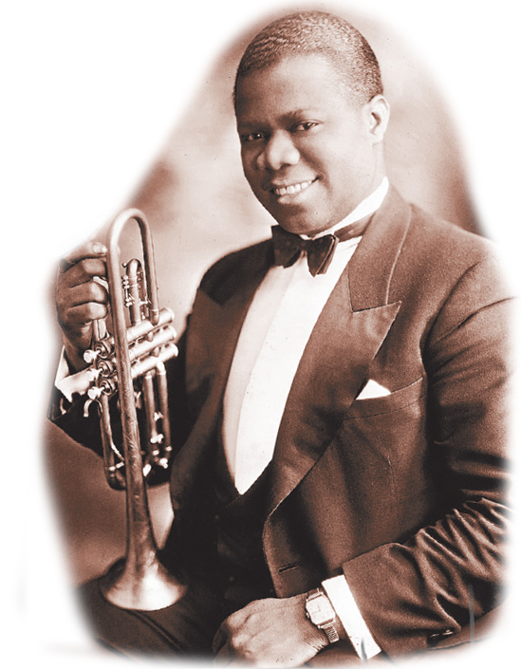
New Orleans trumpet player
Louis Armstrong was the unofficial
ambassador of jazz.
Armstrong played in New Orleans, Chicago, and New York.
His expert playing made him a legend and influenced the development of jazz.

Slide 10
Spread by radio and phonograph records,
jazz gained worldwide popularity.
Duke Ellington was a popular band leader who wrote or arranged more than 2,000 pieces of music and earned international honors.
Jazz bands featured solo vocalists such as Bessie Smith, the “Empress of the Blues.”
White composers such as Cole Porter, Irving Berlin, and George Gershwin found inspiration in jazz.

Slide 11
Jazz and the blues were part of the
Harlem Renaissance, a flowering of
African American arts and literature.
Novelists, poets, and artists celebrated their culture and explored questions of
race in America.
Jean Toomer’s Cane showed the richness of African American life and folk culture.
The writings of Claude McKay emphasized the dignity of African Americans and called for social and political change.

Slide 12

Langston Hughes, the most celebrated Harlem Renaissance writer, captured the diversity of everyday African American life in his poetry, journalism, and criticism.
Zora Neale Hurston published folk tales from her native Florida. Her novel Their Eyes Were Watching God speaks of women’s longing for independence.
Notes:
12

Slide 13
As the Great Depression began, the
Harlem Renaissance came to an end.
Yet this artistic movement had a lasting effect on the self-image of African Americans.
It created a sense of group identity and solidarity among African Americans. It later became
the cultural bedrock upon which the Civil Rights movement would be built.
Notes:
13

