Slide 1
Chapter Introduction
This chapter will cover the causes of the Great Depression, its impact on Americans, and Herbert Hoover’s unsuccessful attempts to deal with the crisis.
Section 1: Causes of the Depression
Section 2: Americans Face Hard Times
Section 3: Hoover’s Response Fails
Notes:
Comma after Americans

Slide 2
Objectives
Discuss the weaknesses in the economy of the 1920s.
Explain how the stock market crash contributed to the coming of the Great Depression.
Describe how the Great Depression spread overseas.

Slide 3
Terms and People
Herbert Hoover – former Secretary of Commerce and Republican candidate for President in 1928
speculation – when investors gamble that stock prices will rise
Black Tuesday – October 24, 1929, the day the stock market crashed
business cycle – periodic expansion and contraction of the economy

Slide 4
Terms and People (continued)
Great Depression – The collapse of the United States and world economies beginning in 1929
Hawley-Smoot Tariff – high protective tariff passed in June 1930 that contributed to a worldwide depression
Notes:
4

Slide 5
How did the prosperity of the 1920s give way to the Great Depression?
During the 1920s, many Americans enjoyed what seemed like an endless era of prosperity. But in 1929, the stock market crashed. Production fell, unemployment rose, and the economy went into a period of dramatic decline.
Years after the Great Depression began, periodic contraction was seen as part of the business cycle.

Slide 6
The Republicans took credit for the strong economy.
Their presidential candidate was Herbert Hoover.
He believed in voluntary cooperation between business and labor.
In the 1928 presidential race, the Republican Party was confident.

Slide 7
Despite Hoover’s confidence, some saw signs of weakness in the economy.
The agricultural sector was in trouble. Rural farmers produced huge surpluses of food that depressed prices.
Farmers could not afford to buy goods or repay their loans.

Slide 8
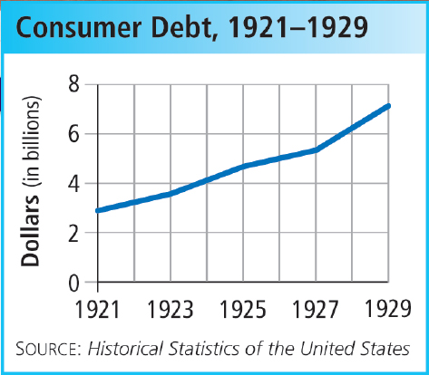
Easy credit and installment buying lead people to purchase goods they can’t pay for.
By 1929, Americans racked up more than $6 billion in personal debt — more than double the 1921 level.

Slide 9
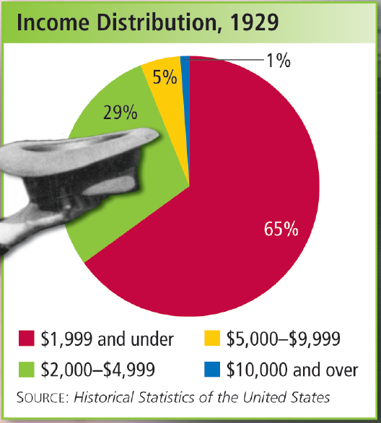
Rising wages masked an uneven distribution of wealth.
While factory workers’ wages rose 8%, factory output increased by 32%. As a result, worker incomes rose modestly, while rich investor incomes skyrocketed.

Slide 10
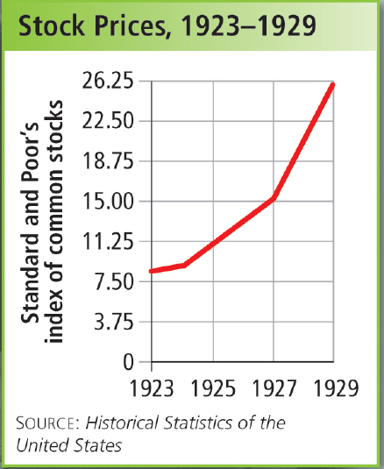
Until September 1929, the stock market continued to rise.
Many people borrowed money to buy stock, assuming prices would continue to go up.
Some economists feared that stocks were over-priced.

Slide 11
On October 29th, the stock market went into a free fall as investors tried to sell at any price.
16 million shares were sold on “Black Tuesday.”
Billions of dollars were lost in a few hours.
Many who bought stocks on margin were wiped out.
Notes:
11

Slide 12
In growth periods, workers are hired, wages rise, and demand for products increases.
In contraction periods, workers are fired, wages drop, and demand for products falls.
The Great Crash was a hallmark of the nation’s business cycle. The economy periodically grows and then
contracts.
Notes:
12

Slide 13
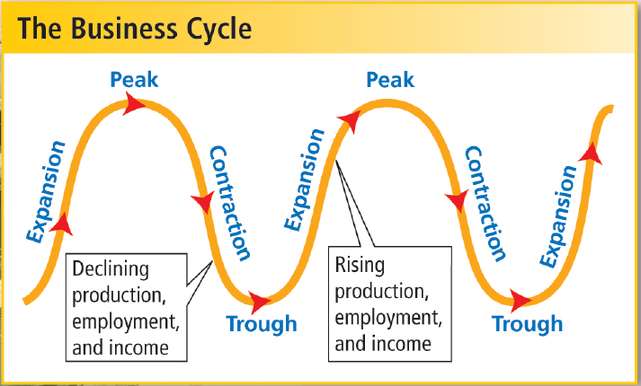
The stock market crash didn’t start the Great Depression by itself. Instead, it quickened the collapse of the U.S. economy.
Notes:
13

Slide 14
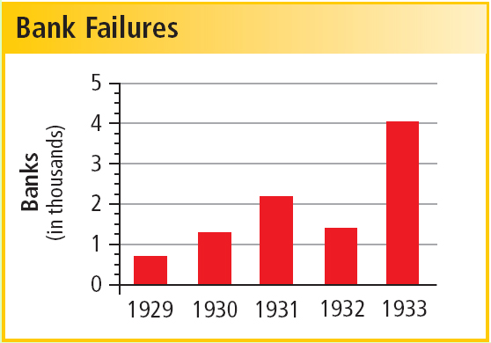
The banking system feels the effects of the crash first. People fear that their money will be lost so they run to the bank and attempt to withdraw their funds.
But banks don’t have enough of their money on hand as cash. These bank runs cause banks to fail.
Notes:
14

Slide 15
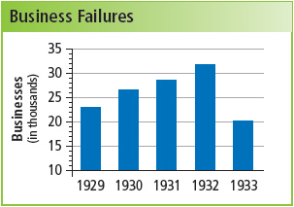
Factories closed, causing worker layoffs.
This lowered demand for goods.
By 1933, the unemployment rate reached 25%.

Slide 16
Congress passed the Hawley-Smoot Tariff to protect American manufacturers from foreign competition.
The strategy was a mistake. Other nations retaliated and raised tariffs as well.
The resulting drop in world trade only made the glut of American factory and farm products harder to sell.
Notes:
16

Slide 17
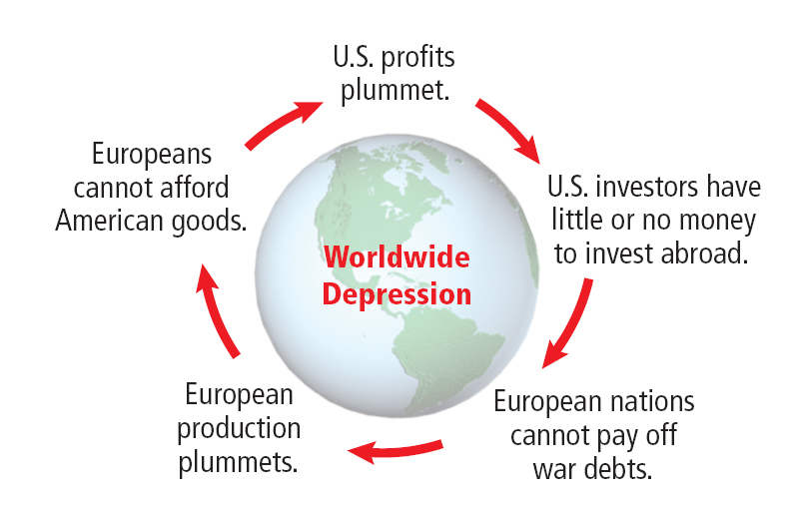
As international trade falls, a global drop in business leads to a worldwide depression.
Notes:
17

Slide 18
There were several causes of the Great Depression. There is still disagreement over which are most important.
Each of the following contributed to dangerous economic conditions:
hardships in Europe and rural America
uneven distribution of wealth
speculation in the stock market
increased personal debt
Notes:
18

