Slide 1
Chapter Introduction
This chapter will cover the causes of the Great Depression, its impact on Americans, and Herbert Hoover’s unsuccessful attempts to deal with the crisis.
Section 1: Causes of the Depression
Section 2: Americans Face Hard Times
Section 3: Hoover’s Response Fails
Notes:
Comma after Americans

Slide 2
Objectives
Examine the spread of unemployment in America’s cities.
Discuss the impact of the Great Depression on rural America.
Explain the human and geographical factors that created the Dust Bowl.

Slide 3
Terms and People
bread line – where charities or local agencies gave food to the poor
Hoovervilles – shantytowns set up on empty land in cities and named after the President
tenant farmers – rural farmers who lost their land but stayed on to work for larger landowners
Dust Bowl – millions of acres in the Great Plains that were destroyed when dust storms blew away the soil

Slide 4
Terms and People (continued)
Okies – Great Plains farmers forced off their land by the Dust Bowl
repatriation – policy whereby local, state, and federal governments encouraged or coerced Mexican immigrants – some of them U.S. citizens – to return to Mexico

Slide 5
How did the Great Depression affect the lives of urban and rural Americans?
The stock market crash signaled the end of boom times and the economy staggered into the Great Depression. Desperate poverty gripped the nation leaving a permanent impression on those who lived through it.
Tested by extreme hardship, this generation forged a strong character and will to restore prosperity.

Slide 6
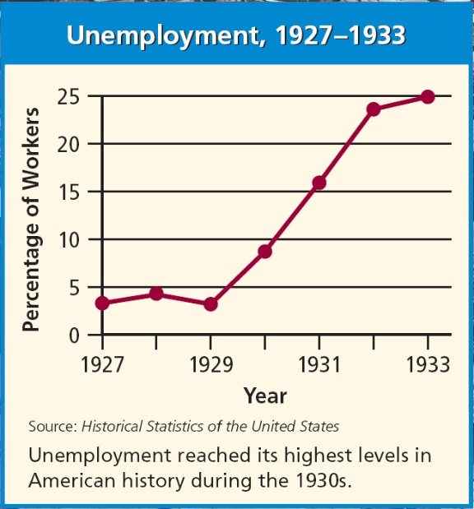
Few Americans understood the causes of the Great Depression, but everyone felt the impact.
Between 1921–1929, the unemployment rate never rose above 4%. By 1933, however, it was near 25%.
Those who managed to keep their jobs had their wages and hours cut.

Slide 7
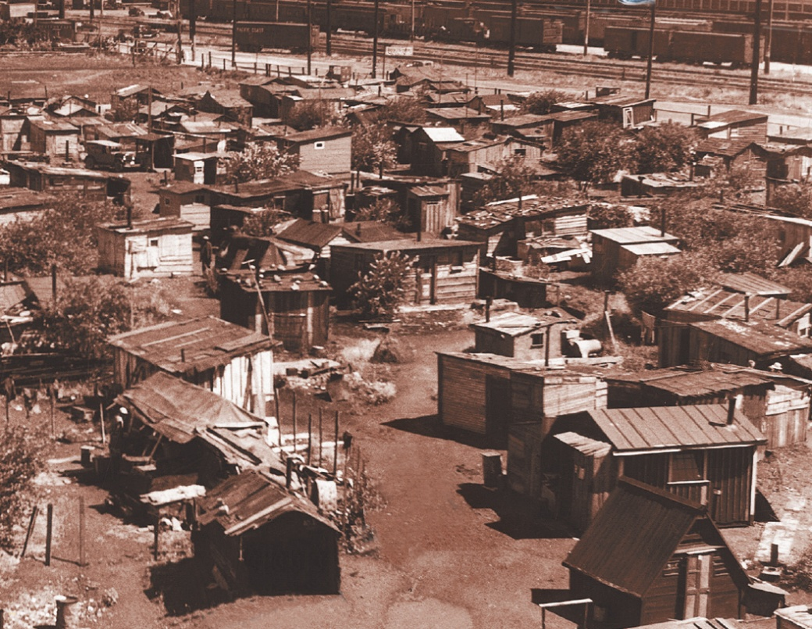
The homeless lived in empty railroad cars, in cardboard boxes, or in shacks built on public land or empty lots.
Hoovervilles appeared in major cities across the country.
Notes:
7

Slide 8
Between 1930 and 1934, nearly a million farmers lost their farms, homes, and farm equipment because they could not pay their mortgages.
Bankers sold the land and equipment at auction. Some farmers became tenant farmers, working for bigger landowners. Others decided to leave in search of work elsewhere in the U.S.
Notes:
8

Slide 9
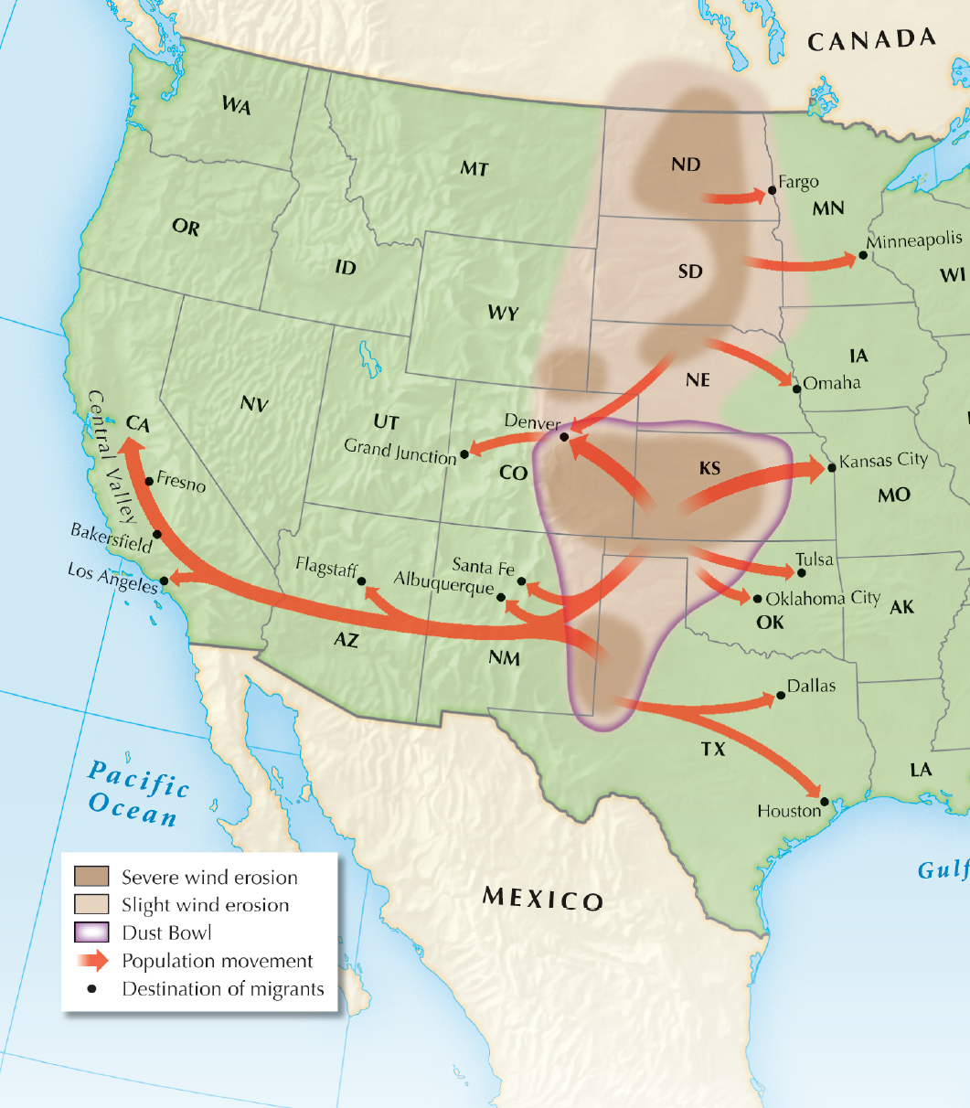
The remaining farmers on the Great Plains suffered a terrible drought, which led to the Dust Bowl.
Dust storms destroyed millions of acres of farmland.
Notes:
9

Slide 10
Millions of tons of topsoil were blown away in giant dust storms.
Farmers had dug up thick prairie grasses to plant wheat so there was nothing to hold the soil in place.
100 mile-per-hour winds blew dust clouds 8,000 feet tall in Oklahoma, Texas, New Mexico, and Colorado.
Wildlife and farm animals suffocated in the choking winds.

Slide 11
In old trucks, they moved west or to northern cities. 800,000 Okies left Texas, Oklahoma, Missouri, and Arkansas alone. Rural states lost population during the 1930s.
Those who could afford it bought distressed neighbors’ farms at low prices to build expanded commercial farms.
Farmers who had lost their land, called Okies regardless of where they were from, were forced to leave.

Slide 12
Family life was hurt by the Great Depression.
Those who still had jobs lived in fear that their next paycheck would be their last.
Those who were still working felt guilty because friends and relatives were unemployed.
America’s birthrate fell to its lowest level on record.
Some teens ran away and families broke up.

Slide 13
Minorities suffered even more during the depression.
As Okies moved west to find work, Mexicans and Mexican Americans faced fierce competition for jobs.
Local governments urged repatriation for Mexican Americans.
Even in good times, African Americans were “last hired and first fired.”
Many were thrown off southern farms where they were sharecroppers.

