Slide 1
Objectives
Discuss how Hoover’s initial conservative response to the depression failed.
Explain the changes in the President’s policies as the crisis continued.
Describe how Americans reacted to Hoover’s relief programs.

Slide 2
Terms and People
localism – policy whereby problems are best solved at the state and local level and not by the federal government
Reconstruction Finance Corporation – created in 1932 to lend cash to investors to stimulate the economy
trickle-down economics – economic theory that held that money lent to large banks and corporations would in turn be invested in small businesses which would hire more workers

Slide 3
Terms and People (Continued)
Hoover Dam – huge public works project on the Colorado River that provided jobs, water for irrigation, and power
Bonus Army – a march on Washington in 1932 in which World War I veterans seek bonus payment early
Douglas MacArthur – supervised the forced removal of the Bonus Army, which angered many Americans
Notes:
3

Slide 4
Why did Herbert Hoover’s policies fail to solve the country’s economic crisis?
As the Great Depression spread misery across America, Herbert Hoover struggled unsuccessfully to respond to the nation’s problems.
As a result of Hoover’s failed response, in 1932 Americans would turn to a new leader and increased government intervention to stop the depression.

Slide 5
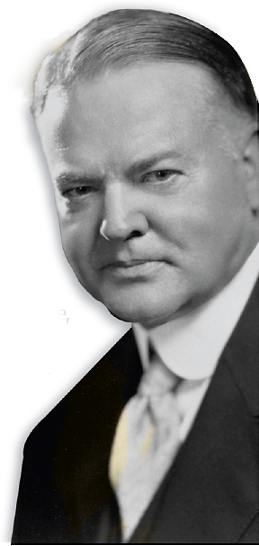
Herbert Hoover did not cause the Great Depression, but Americans looked to him to solve the crisis.
He tried a number of different approaches, but in the end he failed to discover the right formula for stopping the crisis.

Slide 6
Like most economists of the day, he believed that up and down swings in the economy were a natural part of the business cycle.
It was thought that strong businesses would weather storms without the support of the government.
At the start of the economic downturn, Hoover took a hands-off approach.
Notes:
6

Slide 7
Hoover saw that he must do something:
Asked businesses to keep wages, employment, and prices at current levels
Called for tax cuts, lower interest rates, and public works
Asked wealthy to donate more money to charity
Notes:
7

Slide 8
But volunteerism failed:
Towns and states didn’t have the necessary resources to deal with the depression.
Hoover did not support direct federal aid to individuals.
Hoover put his faith in localism, a policy whereby problems are best solved at the local and state levels.
Notes:
8

Slide 9
The RFC gave billions of dollars to banks and large businesses.
The idea was that they would lend to, and invest in, struggling businesses who would hire workers and thus end the depression.
The RFC failed when businesses did not hire more workers.
In 1932, Hoover urged Congress to create the Reconstruction Finance Corporation (RFC). The RFC employed a policy known as trickle down economics.
Notes:
9

Slide 10
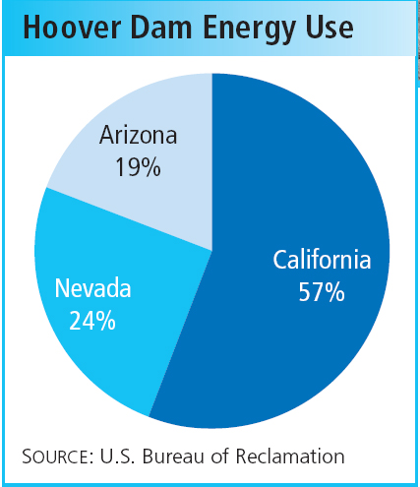
One policy that did succeed was the construction of Boulder Dam (later renamed Hoover Dam) across the Colorado River.
Started in 1930, the huge dam provided power for millions and irrigation for farm land, and put thousands to work.

Slide 11
Many grew disillusioned during the Great Depression.
Some blamed Hoover and some blamed capitalism.
Some were World War I veterans who wanted a bonus that was promised to them.
In 1932, those veterans formed the Bonus Army and marched on Washington.

Slide 12
Hoover ordered General Douglas MacArthur to remove the veterans. He used tear gas, cavalry, tanks, and troops with fixed bayonets.
Press photos of troops using excessive force angered the American public.
20,000 veterans set up camps and occupied vacant buildings. In July, police tried to evict them and riots erupted.

Slide 13
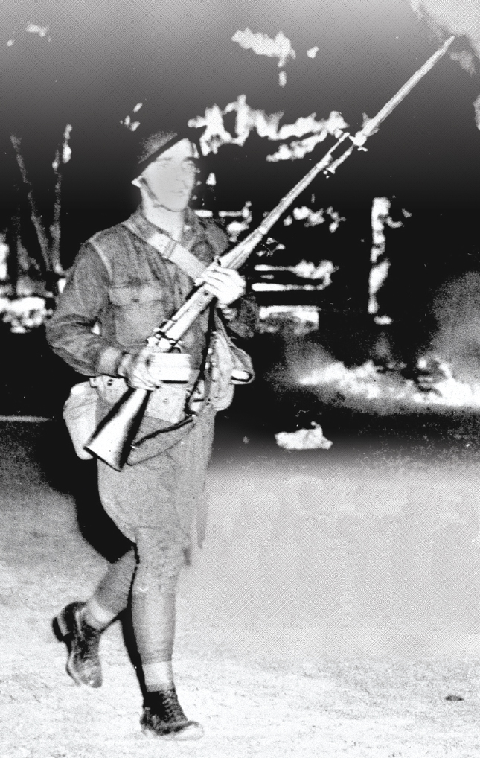
The eviction of the Bonus Army doomed Hoover’s bid for re-election.
Americans were ready for new leadership and a greater role for the government in solving problems.

