Slide 1
Objectives
Analyze the impact Franklin D. Roosevelt had on the American people after becoming President.
Describe the programs that were part of the first New Deal and their immediate impact.
Identify critical responses to the New Deal.

Slide 2
Terms and People
Franklin D. Roosevelt – American President elected at the height of the Great Depression
Eleanor Roosevelt – FDR’s wife and First Lady; known for her active role in the administration
New Deal – programs and legislation enacted by FDR during the Great Depression to promote economic recovery
fireside chat – informal radio broadcast in which FDR communicated with the American people
FDIC – Federal Deposit Insurance Corporation; government agency that insures bank deposits

Slide 3
Terms and People (continued)
TVA – Tennessee Valley Authority; government agency that built dams in the Tennessee River valley to control floods and generate electric power
CCC – Civilian Conservation Corps; government program that provided young men with jobs on environmental conservation projects
NRA – National Recovery Administration; government agency that developed codes of fair competition in industry, including minimum wages and prices
Notes:
3

Slide 4
Terms and People (continued)
PWA – Public Works Administration; government agency that improved the nation’s infrastructure and created millions of jobs
Charles Coughlin – Roman Catholic priest who accused FDR of not doing enough to end the depression
Huey Long – Louisiana Senator and New Deal critic

Slide 5
How did the New Deal attempt to address the problems of the depression?
As poverty and homelessness gripped the country, many Americans wondered if the nation could survive the crisis.
They hoped a new leader could bring back prosperity—and their faith in democracy.

Slide 6
In 1932, President Hoover ran for reelection. But he had little chance of winning.
Unemployment stood at 25%.
Bank failures had wiped out savings.
The hungry waited for food at soup kitchens.
Americans were ready for a change.

Slide 7
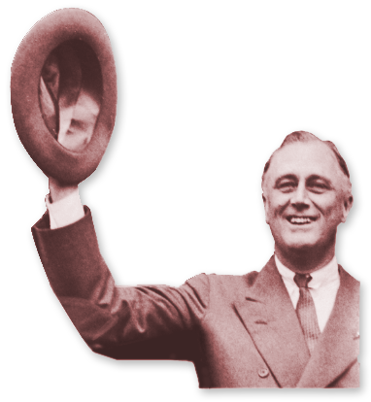
Hoover’s opponent in the election was Democrat Franklin D. Roosevelt.
Harvard graduate
New York State senator
Assistant Secretary of the Navy
1920 Nominee for Vice President
Polio survivor
Governor of New York
Notes:
7

Slide 8
The two candidates offered very different approaches to the problems of the Great Depression.
Hoover
Roosevelt
State and local governments and private agencies should provide relief.
Leadership should come from the federal government.
Roosevelt won in a landslide.
Notes:
8

Slide 9
Together with his “Brain Trust,” Roosevelt moved quickly to carry out his promise of giving Americans a New Deal.
During his first 100 days in office, 15 bills were passed.
First New Deal
The legislation had three goals: relief, recovery, and reform.

Slide 10
Roosevelt began with the bank crisis.
FDR declared a four-day bank holiday, closing the banks so they could get their accounts in order.
In the first of many fireside chats, FDR explained that his actions were to halt bank failures.
When the banks reopened, there were no more runs on the banks.
Notes:
10

Slide 11
FDR took other steps to reform the financial system.
Federal Deposit Insurance Corporation (FDIC)
Insured bank deposits
Securities and Exchange Commission (SEC)
Regulated the stock market
Such measures helped restore confidence in the economy.

Slide 12
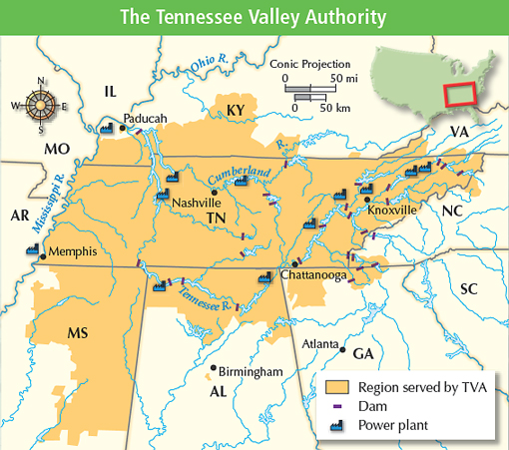
Roosevelt then turned to a series of New Deal programs to bring relief to the country.
Some programs helped farmers and those in the rural South.
The AAA sought to end overproduction and raise crop prices.
The TVA built dams to control floods and generate electricity.

Slide 13
Many programs focused on job relief.
Civilian Conservation Corps (CCC) | Put young men to work improving national parks, forests, and wilderness areas
Federal Emergency Relief Agency (FERA) | Granted funds to state and local agencies to helped the unemployed
Civil Works Administration (CWA) | Gave people jobs on public-works projects

Slide 14
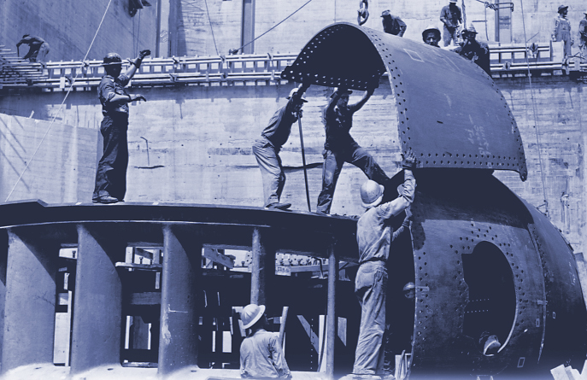
The Public Works Administration (PWA) created millions of jobs.
Workers built bridges, dams, power plants, and government buildings.
These projects improved the nation’s infrastructure.
Notes:
14

Slide 15
Roosevelt also took steps to speed economic recovery.
Established codes of fair competition
Set minimum wages for workers and minimum prices for goods
National Recovery Administration
(NRA)

Slide 16
Not everyone, however, supported the New Deal.
Conservatives charged that it was making the government too powerful.
Such critics formed the American Liberty League.
Destroying free enterprise
Undermining individualism

Slide 17
Some argued that the New Deal did not do enough to end the depression.
While conservatives thought the New Deal did too much, others took the opposite position.
Socialist Party
American Communist Party

Slide 18
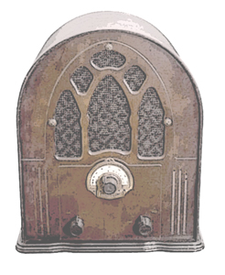
The opponents who gained the largest audience were Populist critics.
Dr. Francis Townsend | Proposed giving each person 60 or older $200 a month to spend
Father Charles Coughlin | Used his radio show to attack the New Deal, calling it communist
Senator Huey Long | Proposed a “Share Our Wealth” program that taxed the rich and gave money to the poor

Slide 19
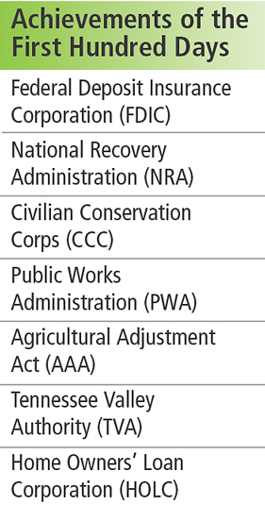
Despite the critics, the New Deal was popular with most Americans.
In his inaugural address, Roosevelt told Americans, “the only thing we have to fear is fear itself.”
FDR succeeded in reducing people’s fear, but the depression was far from over.

