Slide 1
Chapter Introduction
This chapter will cover the economic boom and government policies of the 1920s. It will discuss changes to American culture that arose from the consumer revolution, new technology, and the Harlem Renaissance.
Section 1: A Booming Economy
Section 2: The Business of Government
Section 3: Social and Cultural Tensions
Section 4: A New Mass Culture
Section 5: The Harlem Renaissance

Slide 2
Objectives
Discuss the programs of social and economic reforms in the second New Deal.
Explain how New Deal legislation affected the growth of organized labor.
Describe the impact of Roosevelt’s court-packing plan on the course of the New Deal.

Slide 3
Terms and People
second New Deal – legislative activity begun by FDR in 1935 to solve problems created by the Great Depression
WPA – Works Progress Administration; agency that provided job relief through public-works projects
John Maynard Keynes – British economist who supported the policy of deficit spending to help end the depression
pump priming – economic theory that favored public-works projects because they put money in the hands of consumers who would buy more goods, stimulating the economy

Slide 4
Terms and People (continued)
Social Security Act – 1935 law that created a pension system for retirees, established unemployment insurance, created insurance for victims of work-related accidents, and provided aid for poverty-stricken mothers and children, the blind, and the disabled
Wagner Act – law that recognized the right of employees to join labor unions and gave workers the right to collective bargaining
collective bargaining – process in which employers negotiate with labor unions about hours, wages, and other working conditions
Notes:
4

Slide 5
Terms and People (continued)
Fair Labor Standards Act – law that set a minimum wage and a maximum workweek and outlawed child labor
CIO – Congress of Industrial Organizations; labor organization founded in the 1930s that represented industrial workers
sit-down strike – labor protest in which workers stop working and occupy the workplace until their demands are met
court packing – FDR plan to add more justices to the Supreme Court after the Court ruled some New Deal legislation unconstitutional

Slide 6

What major issues did the second New Deal address?
As depression continued to grip the nation, Roosevelt continued to search for solutions.
Many of the New Deal programs created by FDR continue to impact Americans today.

Slide 7
Though progress had been made toward easing the problems of the Great Depression, Roosevelt knew that much work still needed to be done.
In 1935, FDR launched a new campaign to help meet the goals of relief, recovery, and reform.
The second New Deal
Relief – this means to ease the suffering of the poor and unemployed
Recovery – this means to get the economy working again; to get better
Reform – the means to make sure that a “great” depression never happens again

Slide 8
As FDR planned a new round of spending, critics charged that New Deal programs, and their high price tags, were wasteful.
The government was spending money it did not have.
The federal deficit had soared to $4.4 billion.
Notes:
8

Slide 9
Public-works projects put money in the hands of consumers.
Consumer spending would stimulate the economy.
Deficit spending was needed to end the depression.
Economists such as John Maynard Keynes disagreed.
Deficit spending continued under the second New Deal.
Notes:
9

Slide 10
The Works Progress Administration (WPA) created millions of jobs on public-works projects.
Workers built highways and public buildings, dredged rivers and harbors, and promoted soil and water conservation.
Artists were hired to enhance public spaces.
Notes:
10

Slide 11
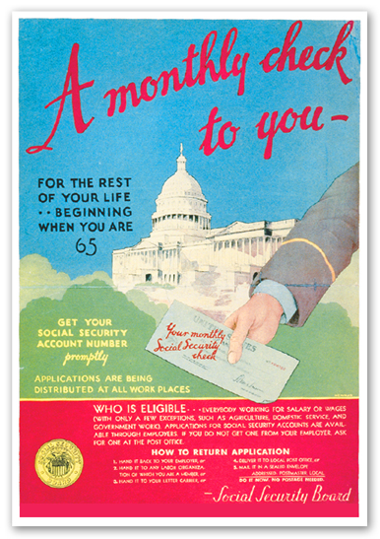
The Social Security Act created a pension system for retirees.
It also provided:
unemployment insurance
insurance for victims of work-related accidents
aid for poverty-stricken mothers and children, the blind, and the disabled
Notes:
11

Slide 12
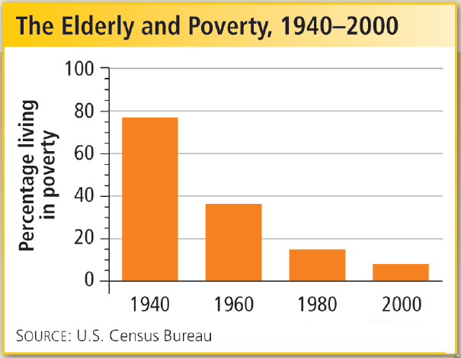
Such benefits helped reduce poverty among the nation’s elderly.
Notes:
12

Slide 13
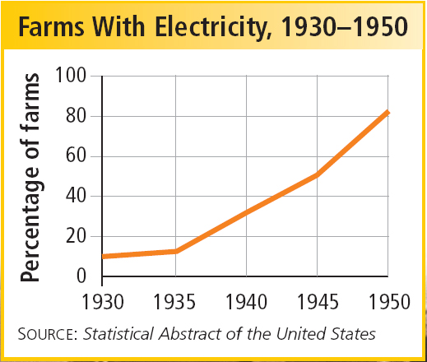
The Rural Electrification Administration helped bring power to isolated rural areas.
The government provided price supports for agriculture.
The government continued to give aid to farmers.
Notes:
13

Slide 14
The government also funded irrigation systems, dams, and other water projects in the West.
Construction of a Dam, a mural by WPA artist William Gropper, was a tribute to workers on western dams.
Notes:
14

Slide 15
Roosevelt believed that improving the standard of living for industrial workers would benefit the entire economy.
Recognized the right of workers to join labor unions
Gave workers the right to collective bargaining
Wagner Act
Set a minimum wage and maximum workweek
Outlawed child labor
Fair Labor Standards Act
Notes:
15

Slide 16
As union activity rose, a split emerged in the American Federation of Labor.
John L. Lewis formed the Congress of Industrial Organizations (CIO) to unionize industrial workers.
The AFL represented skilled workers who joined craft or trade unions.
The union made little effort to organize workers in the major industries.

Slide 17
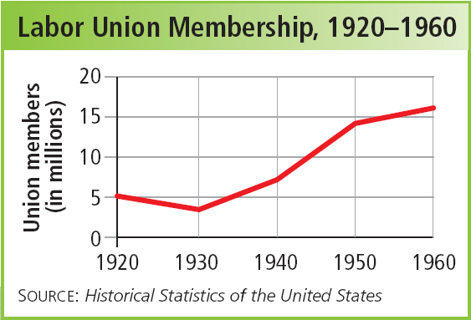
In 1936, the CIO’s United Auto Workers Union staged a sit-down strike at General Motors.
After 44 days, GM recognized the new union.
This success led to others, and union membership soared.

Slide 18
After an overwhelming reelection victory, FDR decided to fight back against the Supreme Court, which had struck down many of his programs.
In 1937, FDR proposed adding up to six new Justices to the Court.
Critics attacked his court-packing plan as an attempt to expand presidential power.
The failed plan weakened Roosevelt politically.

Slide 19
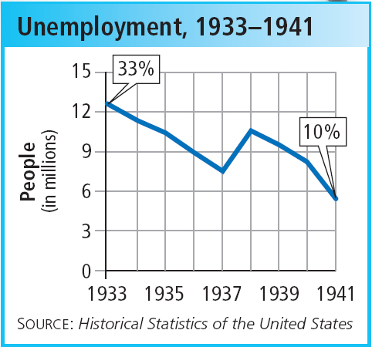
After the economy had begun to improve in 1935 and 1936, FDR cut back on government spending to reduce the deficit. At the same time, interest rates rose.
The combination caused the economy to sink again, and unemployment soared.
With his support wavering, FDR did not try to push further reforms through Congress.

