Slide 1





Chapter 25 Section 1
Chapter 22 Section 3
Objectives
Describe how the New Deal affected different groups in American society.
Analyze how the New Deal changed the shape of American party politics.
Discuss the impact of Franklin D. Roosevelt on the presidency.
Effects of the New Deal
The Cold War Begins

Slide 2
Terms and People
Black Cabinet – African American leaders who served as unofficial advisers to FDR
Mary McLeod Bethune – educator and member of FDR’s Black Cabinet
Indian New Deal – program that gave Native Americans economic assistance and greater control over their own affairs
New Deal coalition – diverse group of southern whites, northern blue-collar workers, midwestern farmers, and African Americans that united behind FDR and the New Deal

Slide 3
Terms and People (continued)
welfare state – government that assumes responsibility for providing for the welfare of children and the poor, elderly, sick, disabled, and unemployed

Slide 4

How did the New Deal change the social, economic, and political landscape of the United States for future generations?
The New Deal affected people of many different backgrounds and ways of life.
It also brought fundamental changes to the role of the federal government.

Slide 5
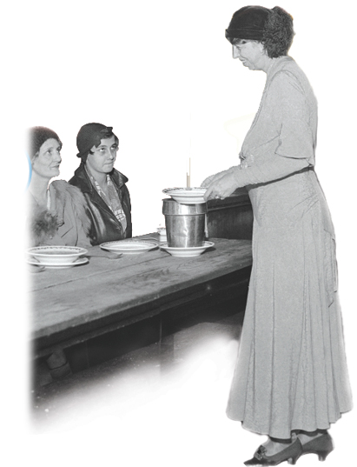
Eleanor Roosevelt inspired many women in her leadership role during the New Deal.
Transformed the role of First Lady from ceremonial to political activist
Traveled widely
Campaigned for FDR
Offered policy advice
Wrote a newspaper column

Slide 6
Other women also played important roles in the administration, such as Secretary of Labor
Frances Perkins, the first female Cabinet member.
However, the New Deal did not fight to end gender discrimination in the workplace.
The WPA and other agencies made an effort to employ men first.
Women could not work for the CCC.

Slide 7
African Americans were hit especially hard by the depression.
The unemployment rate for African Americans was nearly 50%.
Many people urged FDR to help end racial discrimination.
Roosevelt asked advice of members of his Black Cabinet, such as Mary McLeod Bethune.

Slide 8
But he did not always listen. FDR refused to support an antilynching law, fearing political fallout.
Farm subsidies led landowners to evict sharecroppers.
African Americans often did not receive equal wages.
Domestic and farm workers were exempted from New Deal programs.
Some New Deal measures unintentionally hurt African Americans.

Slide 9
The New Deal’s Commissioner of Indian Affairs, John Collier, tried to improve
living conditions for Native Americans.
The Indian New Deal:
  The Bureau of Indian Affairs encouraged native religions, languages, and
  customs.
Provided funds to build schools and hospitals
Created an Indian Civilian Conservation Corps

Slide 10
The Indian Reorganization Act of 1934 was considered the centerpiece of the Indian New Deal.
This law restored tribal control over native lands.

Slide 11
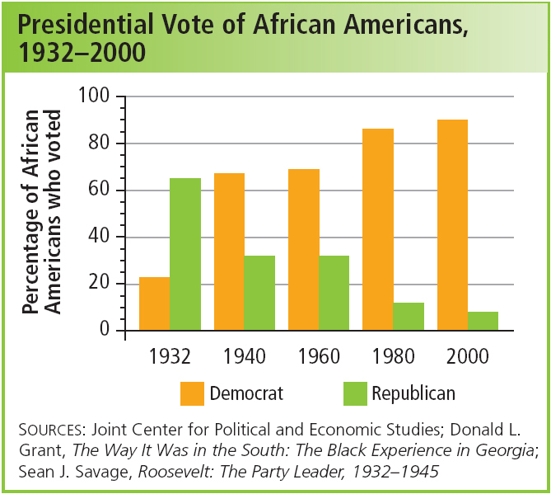
Roosevelt and the New Deal united diverse groups of Americans into a political powerhouse.
The New Deal coalition included southern whites, northern blue-collar workers, midwestern farmers, and African Americans.
Democrats were now in the majority.
Notes:
11

Slide 12
Roosevelt’s New Deal programs also helped unify a struggling nation.
Social and ethnic divisions diminished.
Immigrant communities gained a greater sense of belonging.
Programs such as the WPA and CCC allowed people of different backgrounds to get to know one another.
Notes:
12

Slide 13

With the New Deal, FDR broke from the tradition of laissez-faire and greatly expanded the role of government.
New Deal measures strengthened capitalism and encouraged the post-WWII economic boom.
Restored trust in the banks and the stock market
Increased homeownership
Protected workers
Helped modernize rural America
Notes:
13

Slide 14
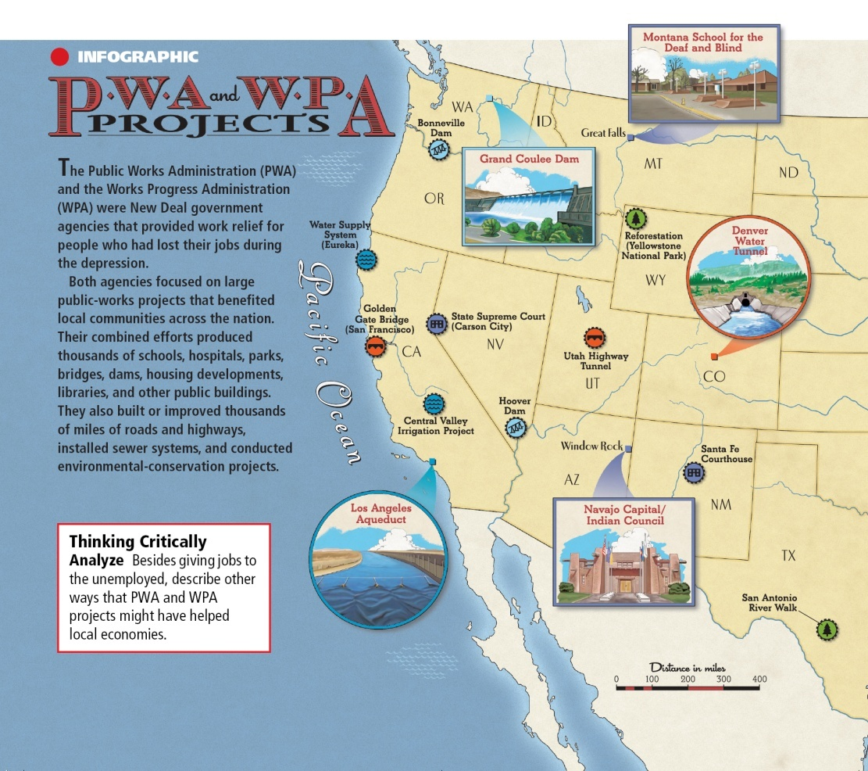
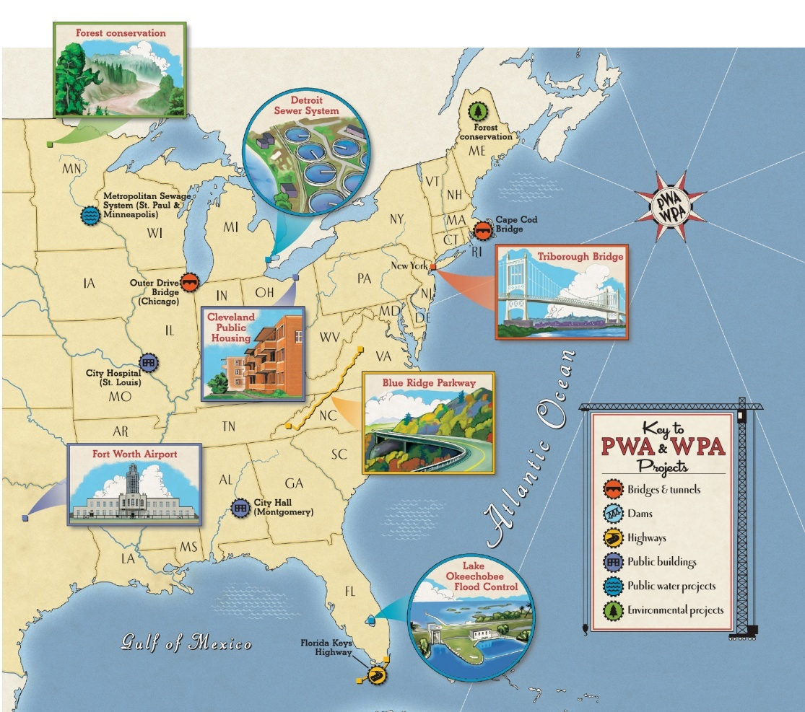
Thousands of WPA and PWA projects benefited communities—and local economies—across the country.
Notes:
14

Slide 15
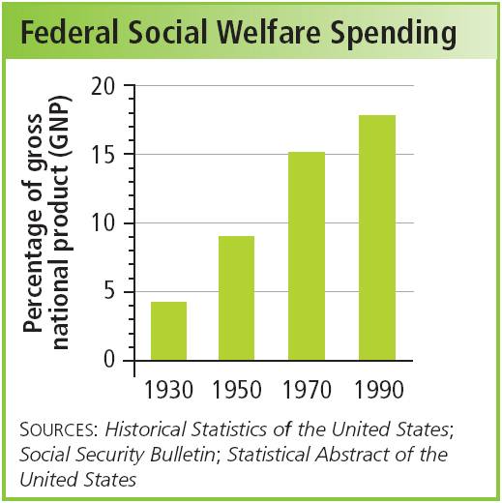
At the same time, the New Deal led to the rise of the welfare state.
In a major policy change, the New Deal established the principle that the federal government was responsible for the welfare of all Americans.
Notes:
15

Slide 16



FDR also favored federal action to protect the environment.
  The government established 12 million acres of new national parks.
  The CCC restored forests and preserved the environment.
  Despite its benefits, the TVA had a mixed environmental impact, disrupting natural habitats.
Notes:
16

Slide 17
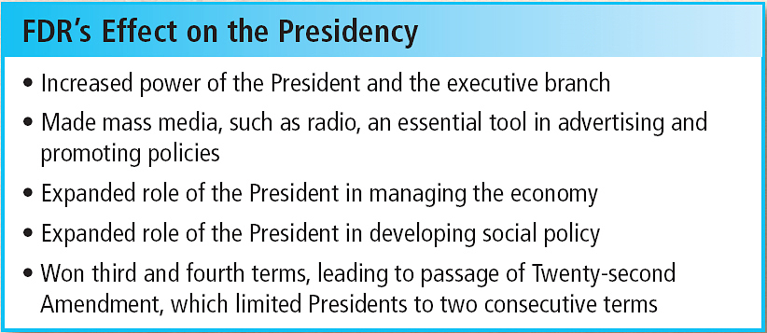
Finally, FDR and the New Deal changed the nature of the presidency itself.
Notes:
17

