Slide 1
Objectives
Trace the growth of radio and the movies in the 1930s and the changes in popular culture.
Describe the major themes of literature in the New Deal era.

Slide 2
Terms and People
The Wizard of Oz – popular depression-era film that promised dreams really can come true
Frank Capra – director whose films celebrated American idealism and the triumph of the common man over adversity
War of the Worlds – 1938 radio drama that was so realistic many people feared that Martians were actually invading
Federal Art Project – branch of the WPA that hired artists to create artworks for public buildings

Slide 3
Terms and People (Continued)
mural – large picture painted directly on a wall or ceiling
Dorothea Lange – FSA photographer who helped document the plight of America’s farmers
John Steinbeck – author whose depression-era classic The Grapes of Wrath tells the story of a family trying to escape the Dust Bowl
Lillian Hellman – playwright whose works featured strong roles for women and socially conscious subject matter
Notes:
3

Slide 4
How did the men and women of the depression find relief from their hardships in the popular culture?
Entertainment helped Americans struggling to survive the depression escape their worries—at least for a time.
Federal support for the arts added to the era’s rich cultural heritage.

Slide 5
Entertainment was big business during the 1930s.
Movies, radio, and music reflected the mood of the country.

Slide 6
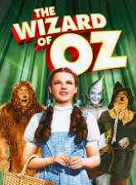
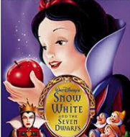
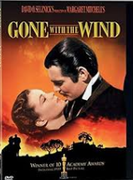
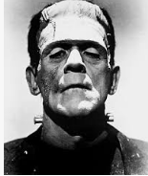
Most Americans went to the movies to escape their worries.
The Wizard of Oz
Snow White and the Seven Dwarfs
Frankenstein
Top Hat
Gone with the Wind

Slide 7
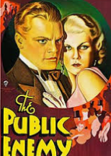
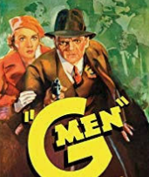
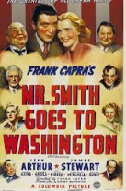
In the early 1930s, gangster films such as Public Enemy reflected the public’s distrust of government.
As the New Deal restored confidence, films such as
G-Men began portraying government officials as heroes.
Director Frank Capra focused on the triumph of the common man over adversity in such films as Mr. Smith Goes to Washington.

Slide 8
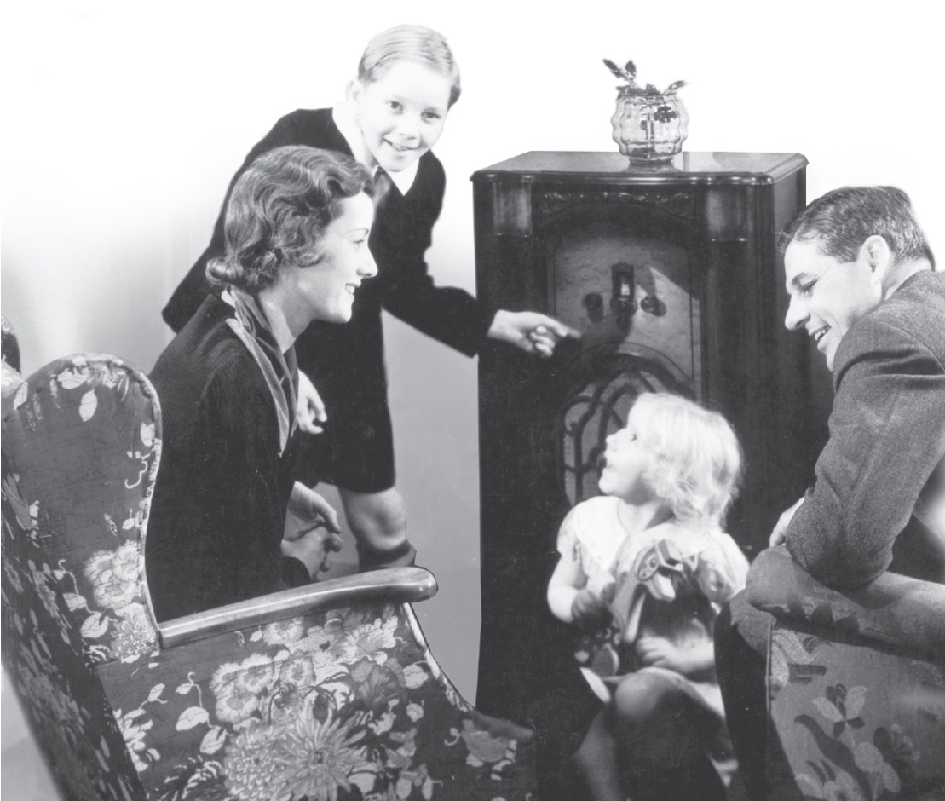
Radio was a vital part of everyday life.
Radio networks such as NBC and CBS entertained millions.
People listened to comedy, drama, news, and FDR’s fireside chats.

Slide 9
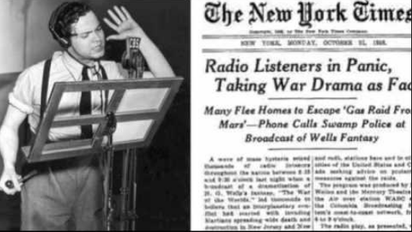
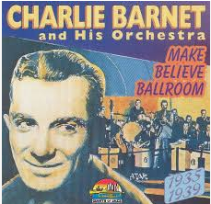
Radio disc jockeys played the latest tunes on shows like Your Hit Parade and Make Believe Ballroom.
Orson Welles’ 1938 radio drama War of the Worlds was so realistic that it caused a national panic when listeners thought that Martians were invading.

Slide 10
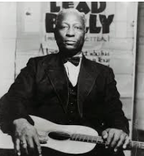
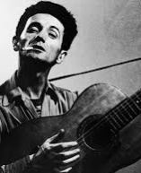
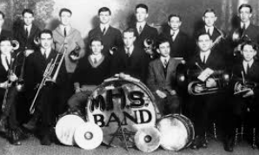
Music provided a happy diversion and a serious outlet for social concerns.
“Swing” music played by “big bands” topped the charts.
Latin music and dances like the rumba and the samba were popular.
The folk singer Leadbelly described the harsh lives of African Americans.
Woodie Guthrie wrote ballads about the Dust Bowl and the Okies.
Notes:
10

Slide 11
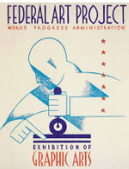
During the New Deal, the federal government provided funding for the arts for the first time in history.
The Federal Art Project, Federal Writers’ Project, and Federal Theater Project were all funded by the WPA.
WPA writers created a series of state guidebooks that
recorded the nation’s history
and folklore.
Notes:
11

Slide 12
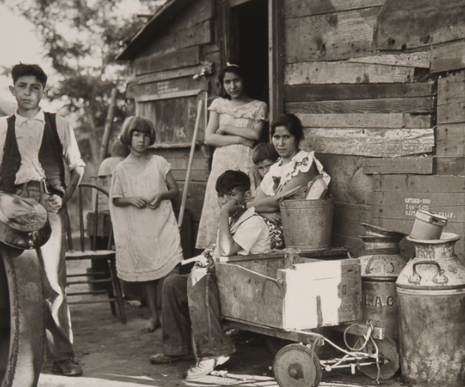
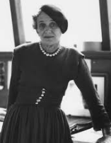
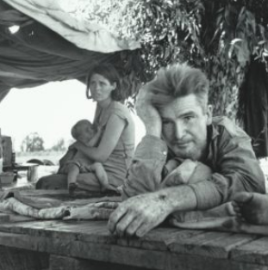
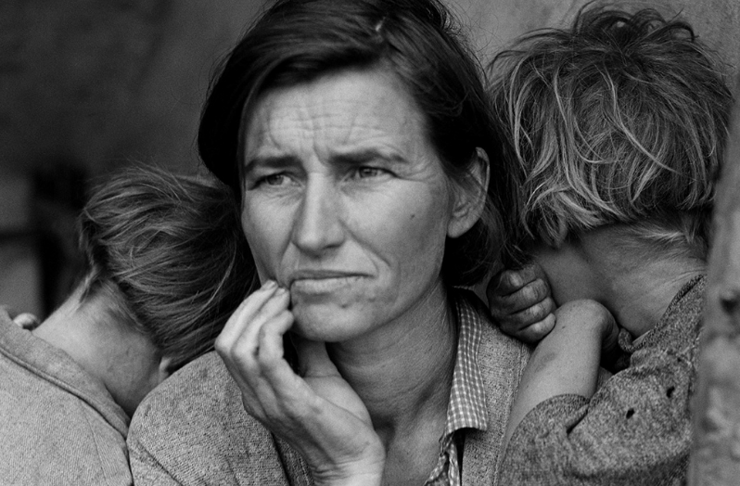
Artists painted giant murals in public buildings across the nation.
Photographers like Dorothea Lange created powerful images of impoverished farmers and migrant workers.
Notes:
12

Slide 13
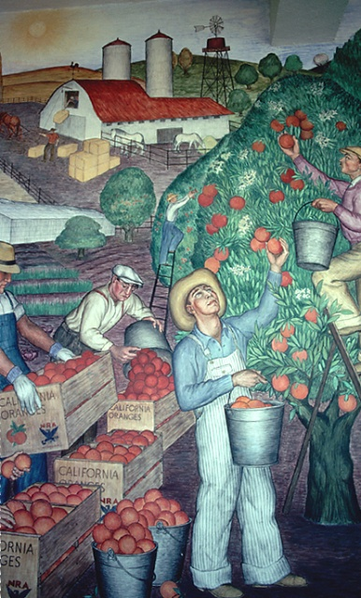
Critics charged that the Federal Art programs were promoting radical or communist views.
This led to a drop in congressional funding.
Though its funding was cut, the Federal Art programs set a precedent for future funding of the arts and humanities.

Slide 14
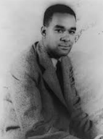
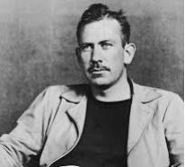
Depression-era writers reflected the concerns of Americans from all walks of life.
In The Grapes of Wrath, John Steinbeck told the story of an Okie family escaping the Dust Bowl.
Lillian Hellman
portrayed strong women in her plays.
In Native Son, Richard Wright explored racial prejudice.

Slide 15
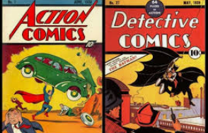
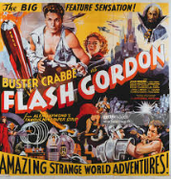
Comic strips and comic books also were very popular.
Flash Gordon
Dick Tracy
Superman
Science Fiction
Detective Story
The first great superhero comic
Fin

