Slide 1
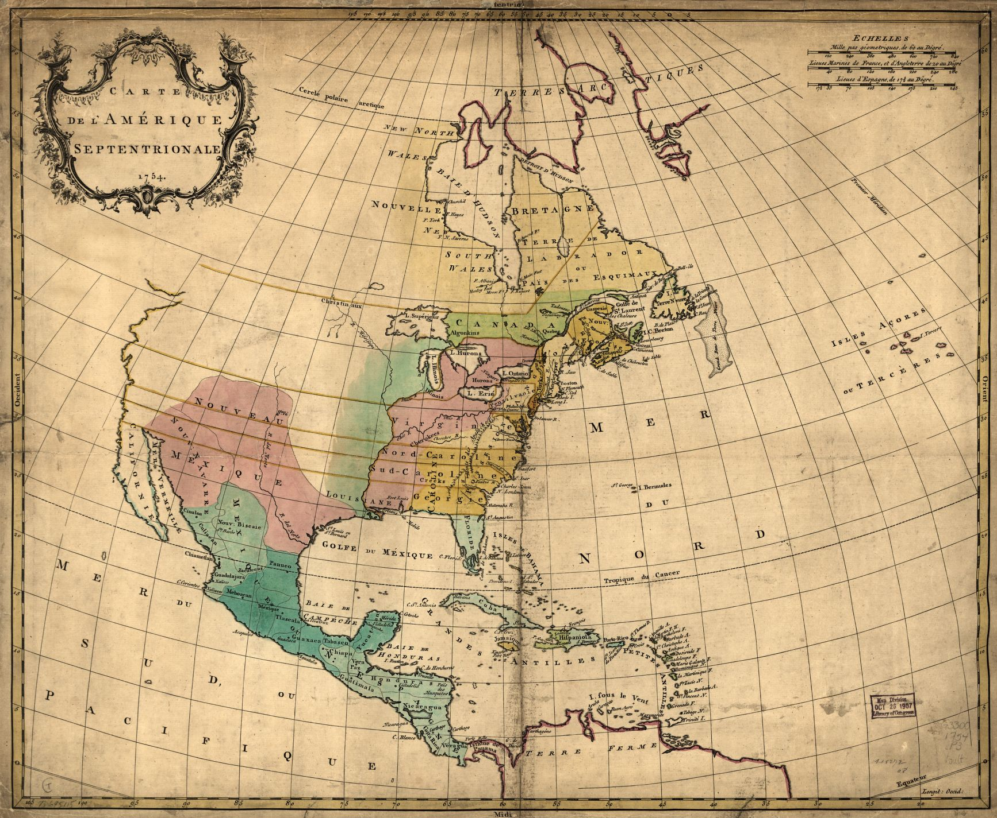
Colonial America
Growth, Diversity, and Conflict
Key Concept 2.1.II – In the 17th century, early British colonies developed along the Atlantic coast, with regional differences that reflected various environmental, economic, cultural, and demographic factors.
Key Concept 2.1.III – Competition over resources between European rivals and American Indians encouraged industry and trade and led to conflict in the Americas.
Key Concept 2.2.I – Transatlantic commercial, religious, philosophical, and political exchanges led residents of the British colonies to evolve in their political and cultural attitudes as they became increasingly tied to Britain and one another.

Slide 2
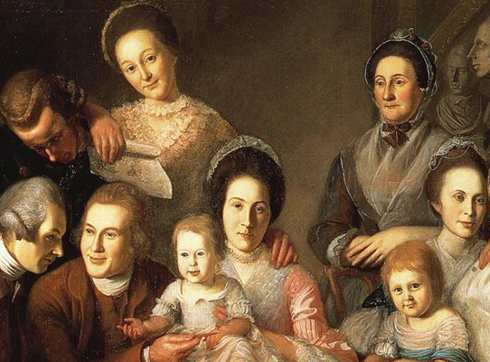
Colonial Society

Slide 3
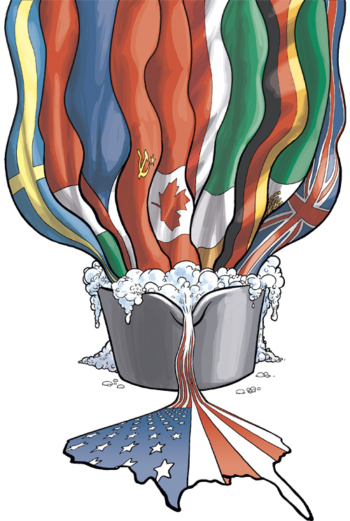
Characteristics of Colonial America
Enormous population growth
Largest colonies: VA, MA, PN, NC, MD
The American melting pot
66% English, 20% African
Remaining: Scots Irish, German, Dutch, Irish, French, Welsh, Jews
Anglicization
Religion, politics, culture
Growing more unique

Slide 4
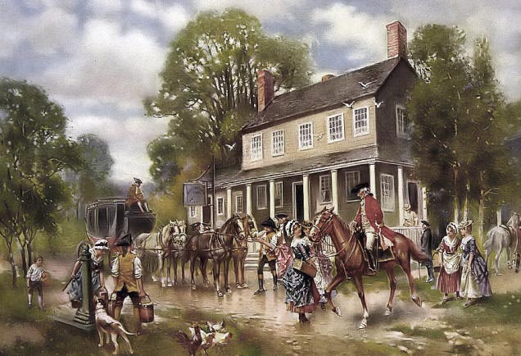
Colonial Social Structure
Small upper class
Majority of yeoman farmers
Small merchants, laborers
Indentured servants and prisoners
Slaves
Stratification mild compared to Europe – greater social mobility
Attempt to recreate European stratification failed
Emerging middle class
Democratic traditions protected against complete upper class control (John Smith: “He who does not work shall not eat”)
Notes:
Frontier
Few class distinctions (bears don’t care if you’re rich ☺ ); settled largely by Scots-Irish
Those with upper-class pretensions were resented
Stratification mild compared to Europe – greater social mobility
Attempt to recreate European stratification failed
Emerging middle class
Democratic traditions protected against complete upper class control (John Smith: “He who does not work shall not eat”)

Slide 5
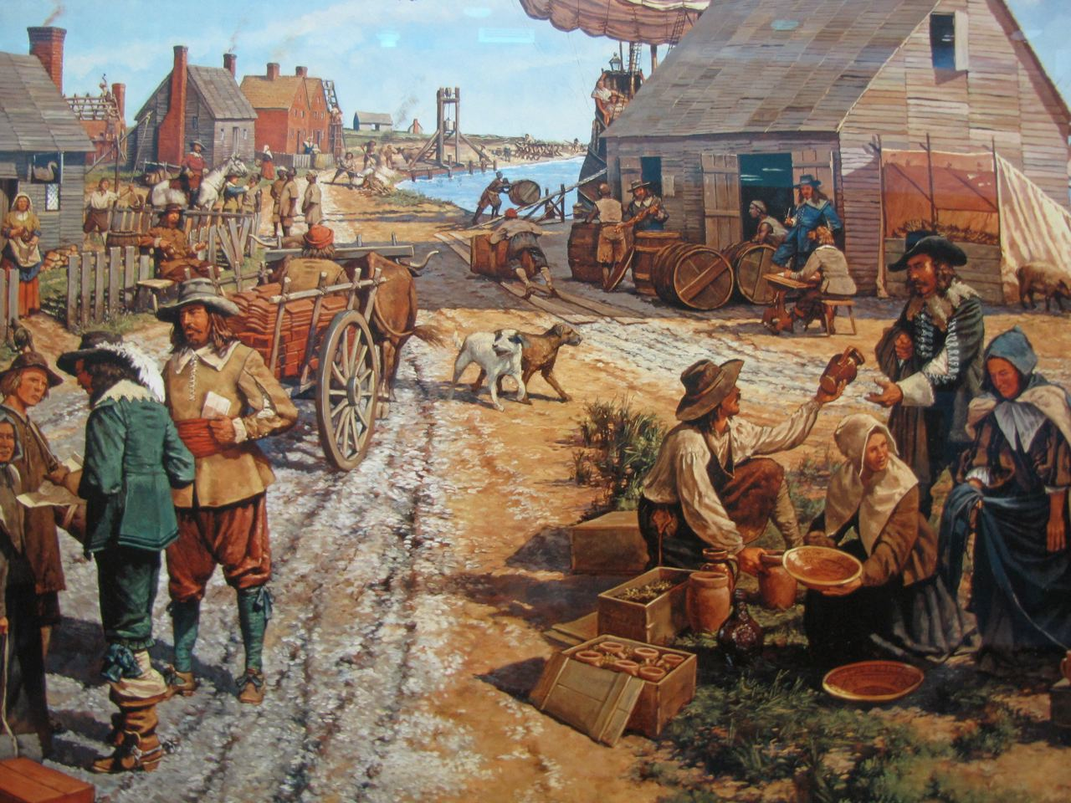
Colonial Lifestyle
Traditional family roles
Highest standard of living
Longer lifespan than Europe
Land generally cheaper than Europe
Wages 3x higher than Europe
Notes:
Traditional family roles
Highest standard of living
Generally lower mortality rates than Europe
Land was cheap, although less available in southern plantation system
Wages were about three times that of Europe

Slide 6
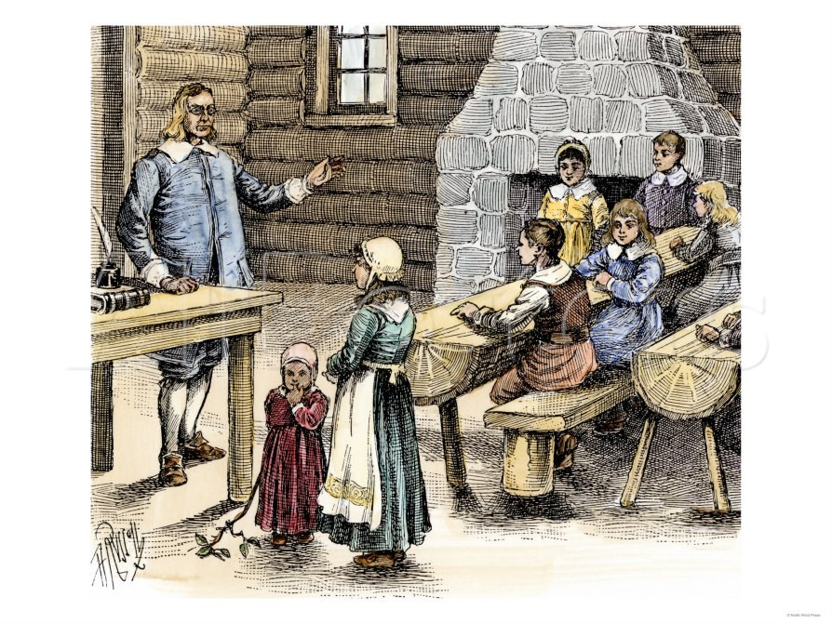
Education
New England
Strongest; for Bible Reading
Primary and secondary schools established early
Communities of 50 families or more required to build public schools
Middle Some public education
Many well-to-do families sent their sons to colleges in England
South Privileged; hired tutors to teach their children
Plantation living made cities, schools, and churches spread out
Colleges Primary focus on the training of new clergy, not academics
Eventually move towards secular subjects
Notes:
New England
Strongest; for Bible Reading
Primary and secondary schools established early
Communities of 50 families or more required to build public schools
Middle
Some public education
Many well-to-do families sent their sons to colleges in England
South
Privileged; hired tutors to teach their children
Plantation living made cities, schools, and churches spread out
College
Primary focus on the training of new clergy, not academics
Eventually move towards secular subjects
1st: Harvard (meant to train ministers); College of William and Mary created as a royal college (meant to train colonial leaders in the mindset of England; Washington, Jefferson, Patrick Henry all graduates)

Slide 7
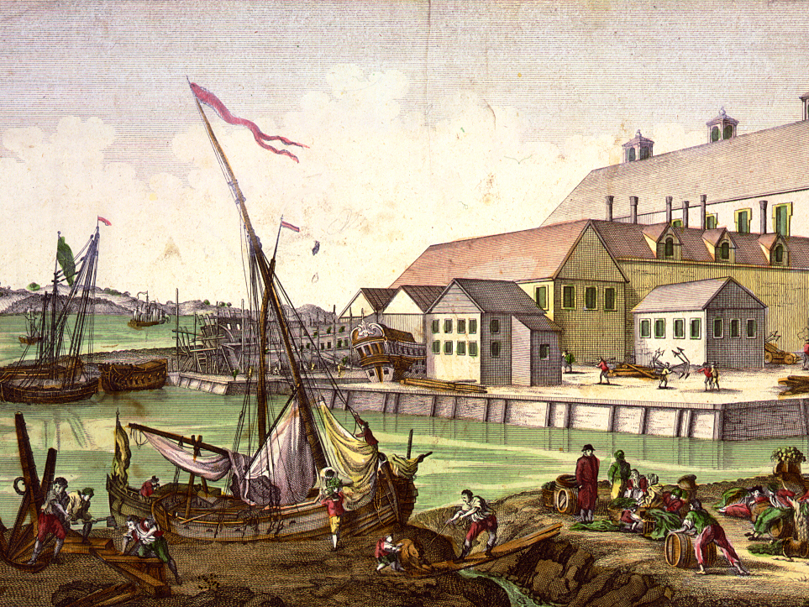
The Atlantic Economy

Slide 8
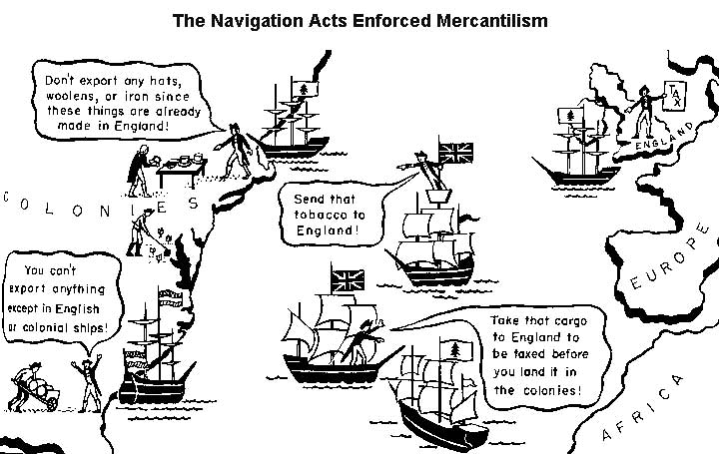
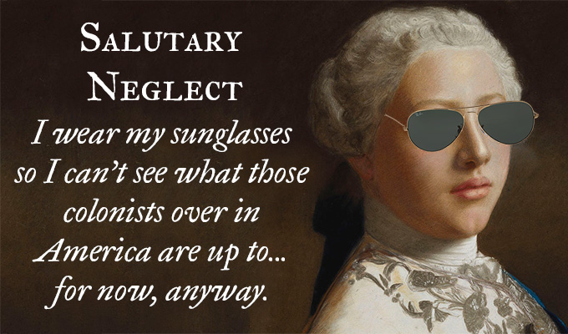
England’s Atlantic Colonies
Mercantilism: Colonies exist for the benefit of the mother country; act as both suppliers and consumers for the empire
Navigation Acts: Colonists could only trade using British ships
Salutary neglect: An unofficial British policy of avoiding enforcement of navigation laws to promote American business.

Slide 9
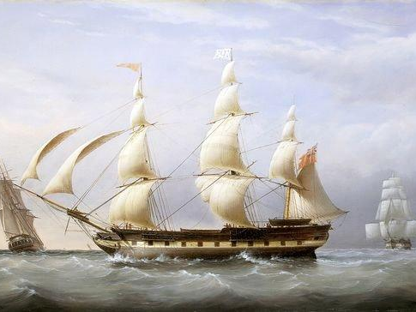
The Atlantic Economy
Notes:
Agriculture – Most common occupation, regardless of farm size. Most were yeoman farmers (small, independent farms)
Land Speculation – Made many investors wealthy (e.g. George Washington)
Manufacturing
Small industries (coopering, shipbuilding, etc. – industries that facilitated mercantilism)
Lumbering most important: shipbuilding
Cottage industry
Trade
High demand for British goods
Once British demand for American products peaked Americans sought other markets
Transportation
Inland transportation poor by road
Waterways most important: Population located near rivers
Other Colonial Occupations
Clergy most respected, but not as privileged as at home in Europe (many had secondary jobs)
Politics growing as an occupation (e.g. House of Burgesses) – wealthy and able ruled since only they could afford to take time away from their primary occupations

Slide 10
Agriculture – Most common occupation, regardless of farm size. Most were yeoman farmers (small, independent farms)
Land Speculation – Made many investors wealthy (e.g. George Washington)
Manufacturing
Small industries (coopering, shipbuilding, etc. – industries that facilitated mercantilism)
Lumbering most important: shipbuilding
Cottage industries
Notes:
Agriculture – Most common occupation, regardless of farm size. Most were yeoman farmers (small, independent farms)
Land Speculation – Made many investors wealthy (e.g. George Washington)
Manufacturing
Small industries (coopering, shipbuilding, etc. – industries that facilitated mercantilism)
Lumbering most important: shipbuilding
Cottage industry
Trade
High demand for British goods
Once British demand for American products peaked Americans sought other markets
Transportation
Inland transportation poor by road
Waterways most important: Population located near rivers
Other Colonial Occupations
Clergy most respected, but not as privileged as at home in Europe (many had secondary jobs)
Politics growing as an occupation (e.g. House of Burgesses) – wealthy and able ruled since only they could afford to take time away from their primary occupations

Slide 11
Trade
High demand for British goods
Once British demand for American products peaked Americans sought other markets
Transportation
Inland transportation poor by road
Waterways most important: Population located near rivers
Other Colonial Occupations
Clergy most respected, but not as privileged as at home in Europe (many had secondary jobs)
Politics growing as an occupation (e.g. House of Burgesses) – wealthy and able ruled since only they could afford to take time away from their primary occupations
Notes:
Agriculture – Most common occupation, regardless of farm size. Most were yeoman farmers (small, independent farms)
Land Speculation – Made many investors wealthy (e.g. George Washington)
Manufacturing
Small industries (coopering, shipbuilding, etc. – industries that facilitated mercantilism)
Lumbering most important: shipbuilding
Cottage industry
Trade
High demand for British goods
Once British demand for American products peaked Americans sought other markets
Transportation
Inland transportation poor by road
Waterways most important: Population located near rivers
Other Colonial Occupations
Clergy most respected, but not as privileged as at home in Europe (many had secondary jobs)
Politics growing as an occupation (e.g. House of Burgesses) – wealthy and able ruled since only they could afford to take time away from their primary occupations

Slide 12
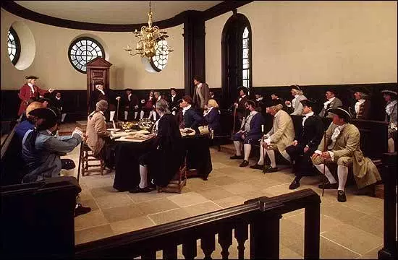
Politics and Power

Slide 13
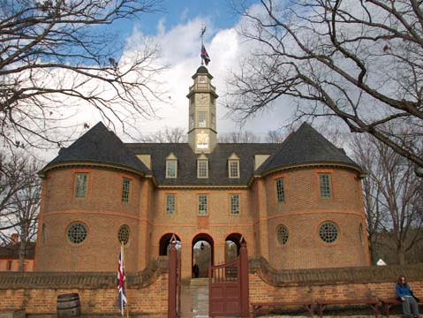
The House of Burgesses
First legislative body in the colonies
Half locally elected, half appointed by the King
Able to enact legislation by end of the 17thc.
Notes:
The House of Burgesses (1619): Assumed the role of the House of Commons in England
Control over finances, militia, etc.
Able to initiate legislation by end of 17th century
Governor’s Council appointed by royal governor
Mainly leading planters.
Functions like House of Lords.
High death rates ensured rapid turnover of members.

Slide 14
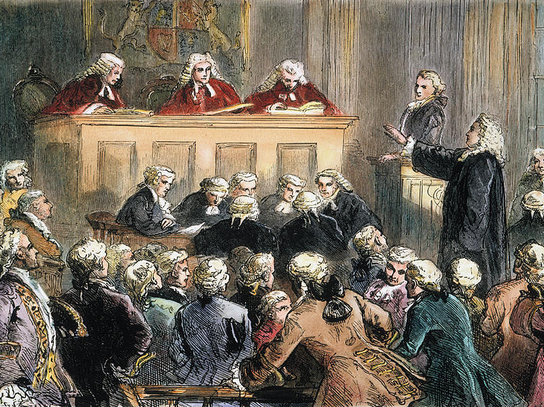
John Peter Zenger Trial
John Peter Zenger was a printer and journalist from New York
Accused of printing and publishing a “false, scandalous, and seditious libel” against Royal Governor William Cosby
Attorney argued that it wasn’t libel if it was true
Helped establish freedom of speech and press in the colonies

Slide 15
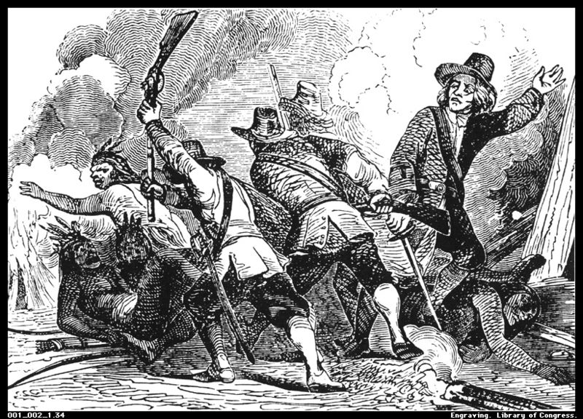
The Pequot War: 1636-1637
Puritans with Native American allies attacked Pequot village on Mystic River
Puritans set fire to homes & shot fleeing survivors!
Pequot tribe virtually annihilated→ 40 years of uneasy peace
Notes:
Pequots (NA from CT) vs. Puritans and Narragansett

Slide 16
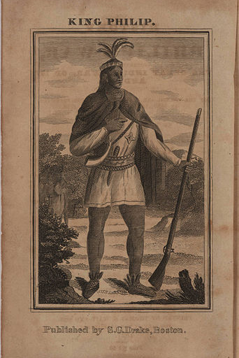
King Philip’s War: 1675-1676 AKA: Metacom’s Rebelllion
Metacom (known as King Philip by English) tried to unite local tribes to protect themselves against attacks
Attacked English settlements on the frontier – lasted two years
Eventually defeated; was drawn and quartered and his head displayed on a pike in Plymouth for years

Slide 17
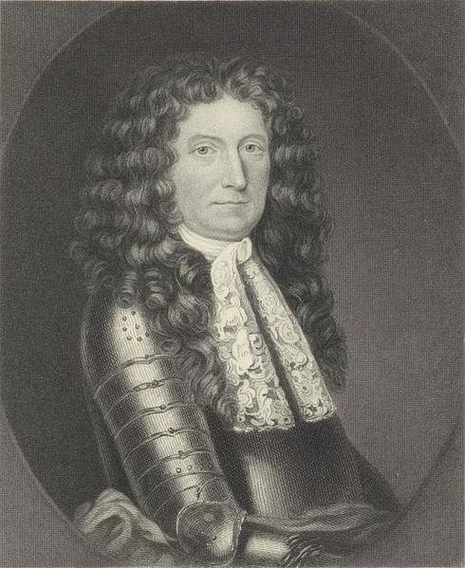
Seeds of Colonial Unity
New England Confederation
Consisted of 4 Puritan colonies (MA Bay, Plymouth, New Haven, Connecticut) for the purpose of defense against natives
Dominion of New England
Meant to regain English control over the colonies
New England ignoring the Navigation Acts
Didn’t like colonies defending themselves
Led by Sir Edmund Andros; despised by colonists
Epic failure

Slide 18
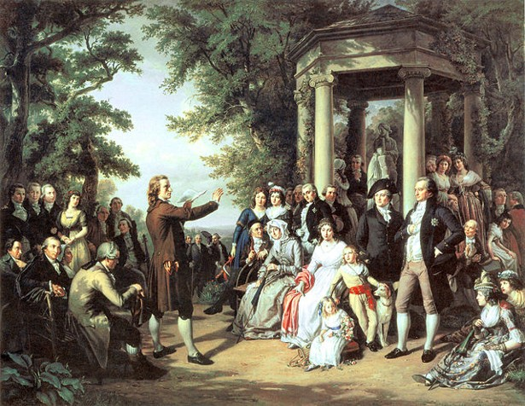
Changing Beliefs in Colonial America

Slide 19
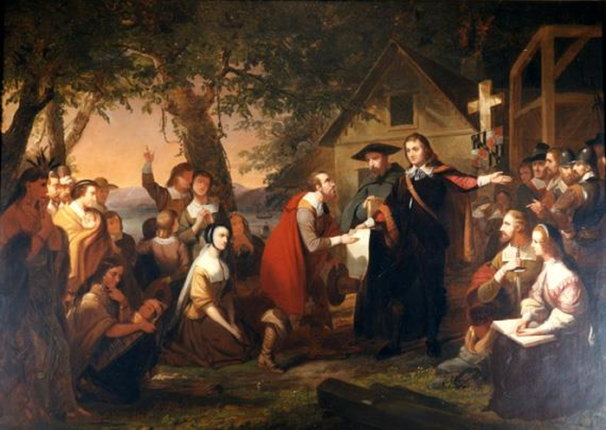
Colonial Religion
Most common religions
Anglican Church: Official faith in several colonies
Congregational Church
Presbyterian Church
Quakers
Catholics
Jews
Religious toleration
Toleration came about in large part due to non-church members.
Eventually led to separation of church and state (except for New England)

Slide 20
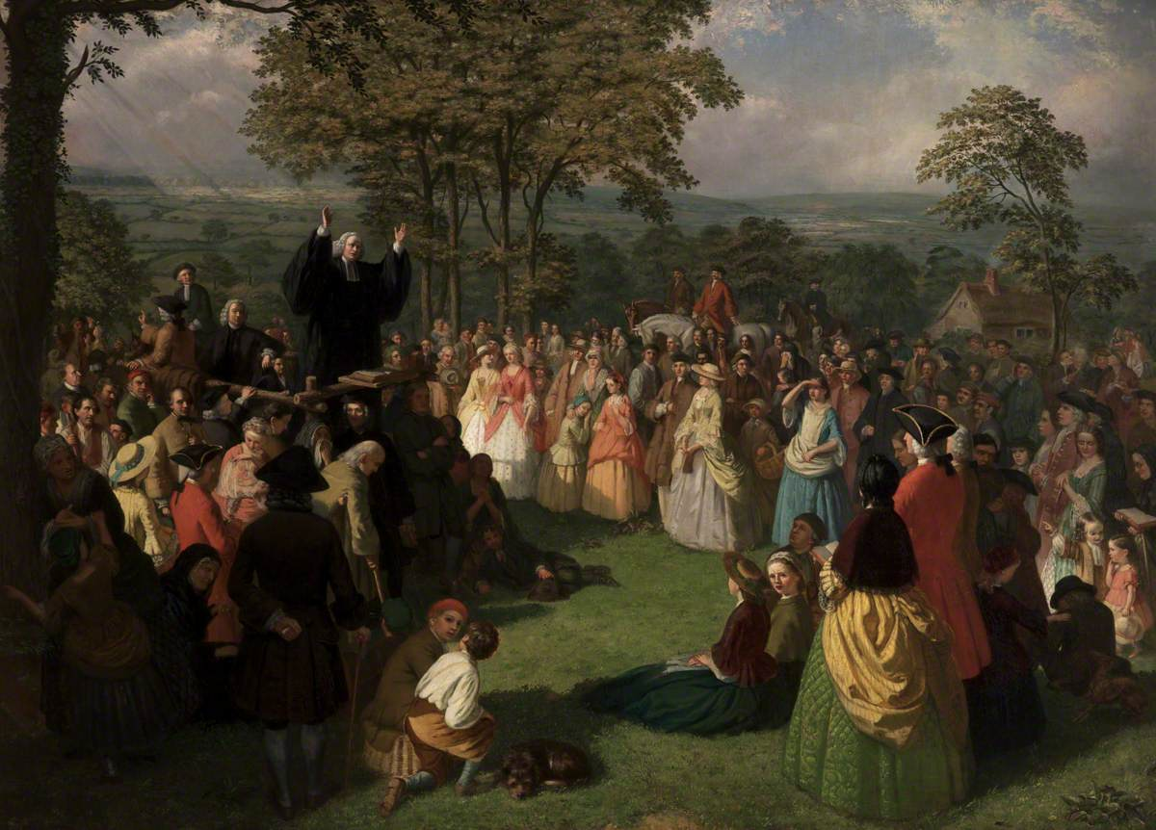
The Great Awakening
A widespread spiritual revival in the 1730s/1740s
Appealed to emotion, encouraged introspection, and commitment to personal morality
New vs. Old Light
Old Lights: Orthodox clergymen deeply skeptical of emotionalism and theatrical antics of the revivalists.
New Lights: Supported the Awakening for revitalizing American religion and used emotionalism to move followers.
Notes:
Appealed to emotion, encouraged introspection, and commitment to personal morality
New vs. Old Light
Old Lights: Orthodox clergymen deeply skeptical of emotionalism and theatrical antics of the revivalists.
New Lights: Supported the Awakening for revitalizing American religion and used emotionalism to move followers.
Picture linked to short CrashCourse video on the 1st Great Awakening

Slide 21
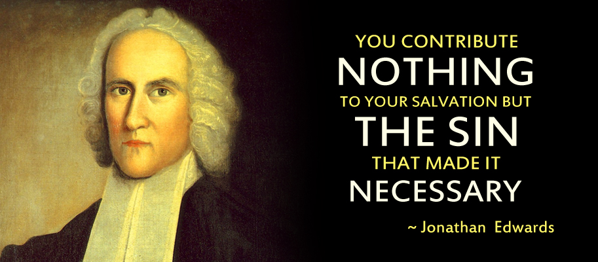
Jonathan Edwards
Most influential
Salvation through God’s grace alone
Emphasized eternal damnation (“fire and brimstone” sermons)
“Sinners In the Hands of an Angry God”
Notes:
Jonathan Edwards
Most influential of the movement
Blasted the idea of salvation through good works; dependence on God's grace is paramount
Emphasized eternal damnation (“fire and brimstone” sermons)
“Sinners In the Hands of an Angry God”

Slide 22
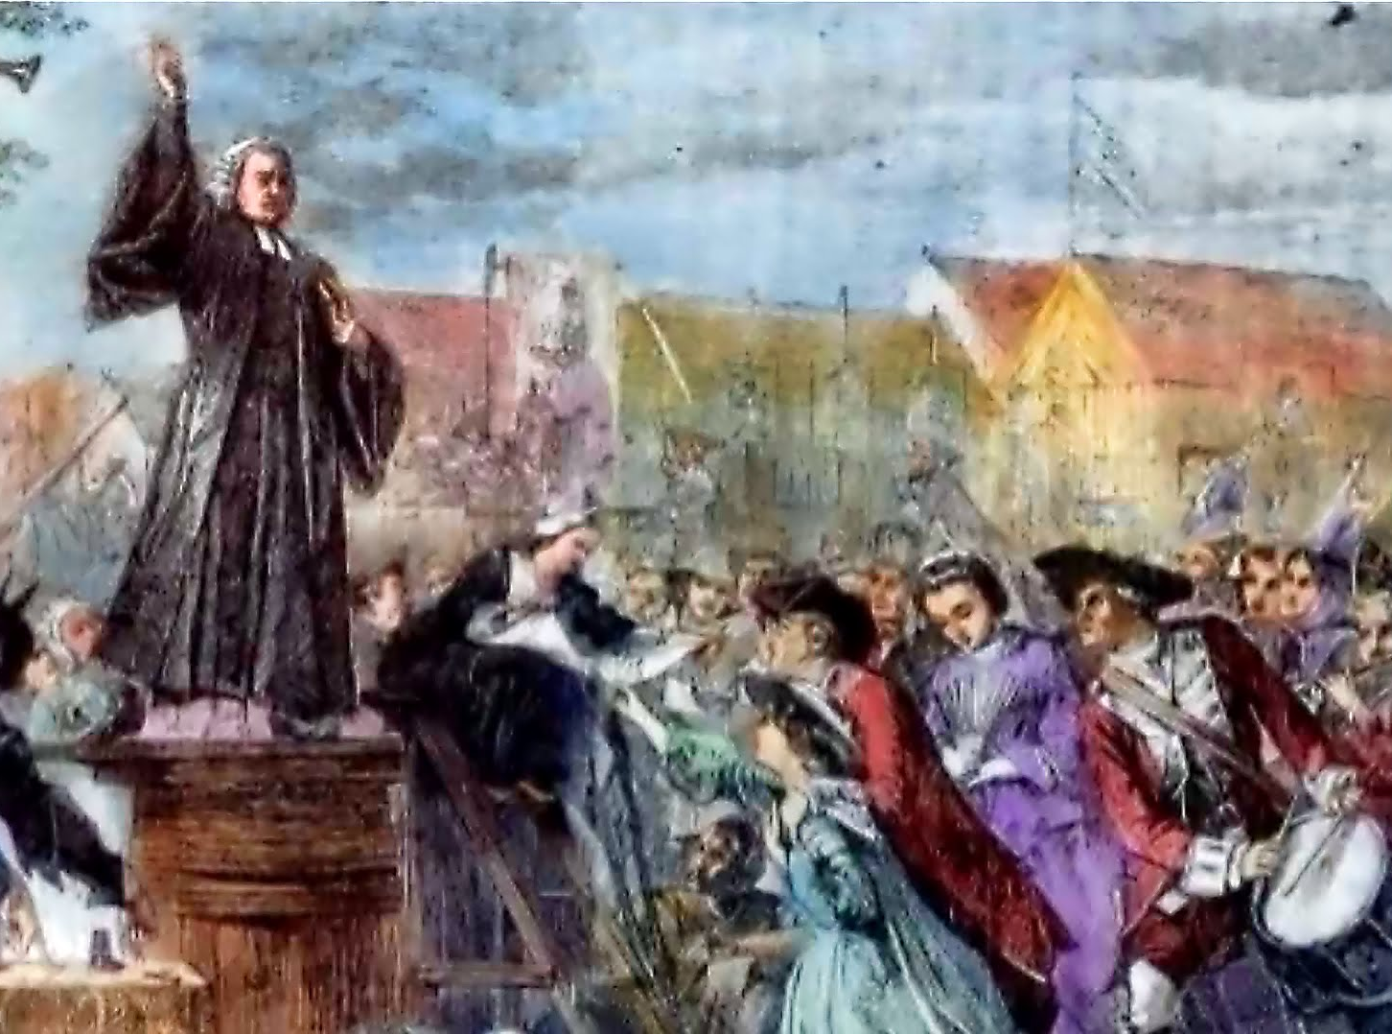
Created schisms and new denominations (e.g. Baptist, Methodist, Congregationalist, etc.)
Brought religion to many who had lost touch with it
Undermined the older clergy
Encouraged a new wave of missionary work among the Indians and slaves
Effects of
the Great Awakening

Slide 23
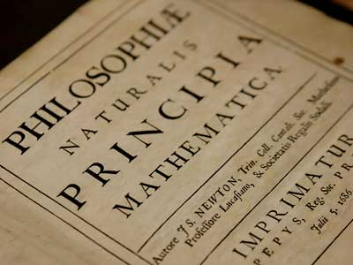
The Enlightenment
An 18thc. cultural movement of intellectuals
Use logic and reason to improve society and government
Challenges traditional authority
Notes:
A cultural movement of intellectuals in 18th century Europe and the United States, whose purpose was to reform government and society, and advance knowledge through reason and logic.

