Slide 2
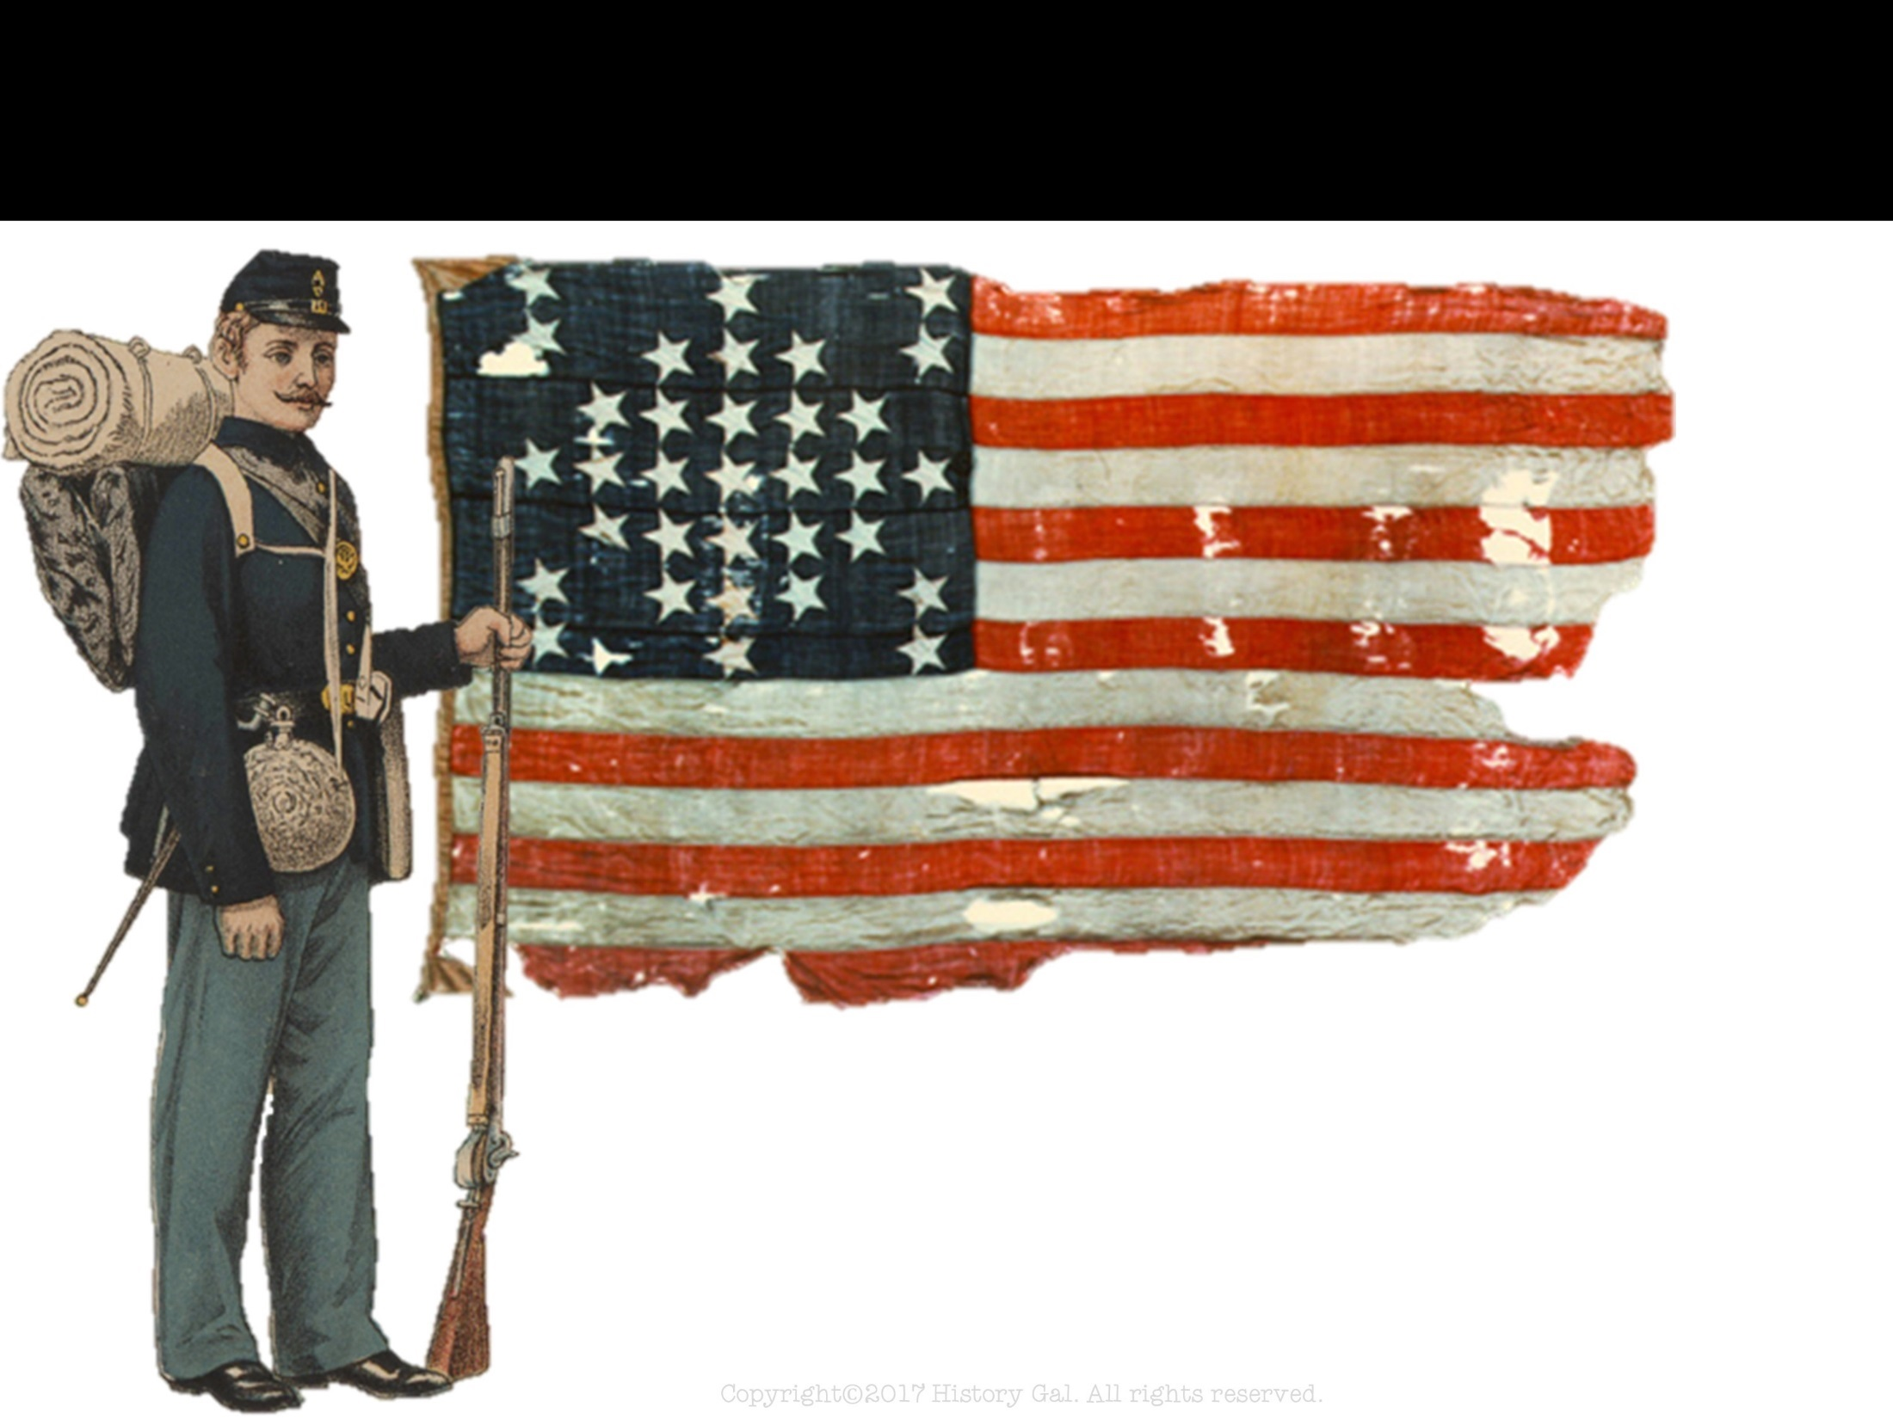
COMPARING NORTH & SOUTH
NORTH - also known as the North, Union, Federals, Yankees & Billy Yanks, soldiers wore BLUE

Slide 3
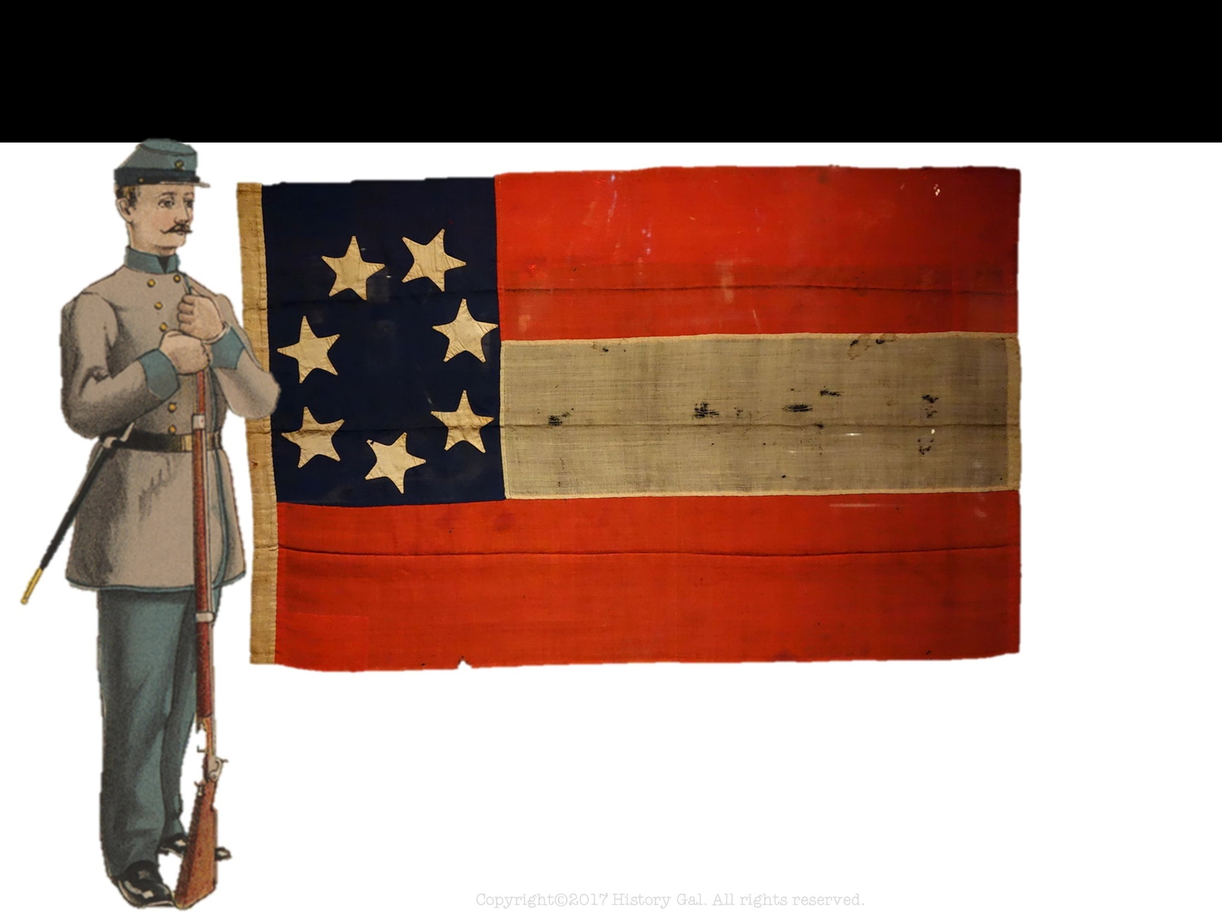
COMPARING NORTH & SOUTH
SOUTH - also known as the South, Confederacy, Rebels & Johnny Reb, soldiers wore GRAY

Slide 4
COMPARING NORTH & SOUTH
NUMBER OF STATES
NORTH: 23
(West Virginia & Nevada are not included in this number)
SOUTH: 11

Slide 5
COMPARING NORTH & SOUTH
GOVERNMENT
NORTH
Had a working and established government
Capital: Washington, D.C.

Slide 6
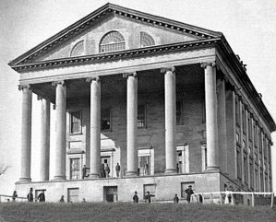
COMPARING NORTH & SOUTH
GOVERNMENT
SOUTH
New, untried government
States had more power than the central government which made collecting taxes and passing laws difficult
Capital: Richmond, Virginia
Constitution of Confederate States of America

Slide 7
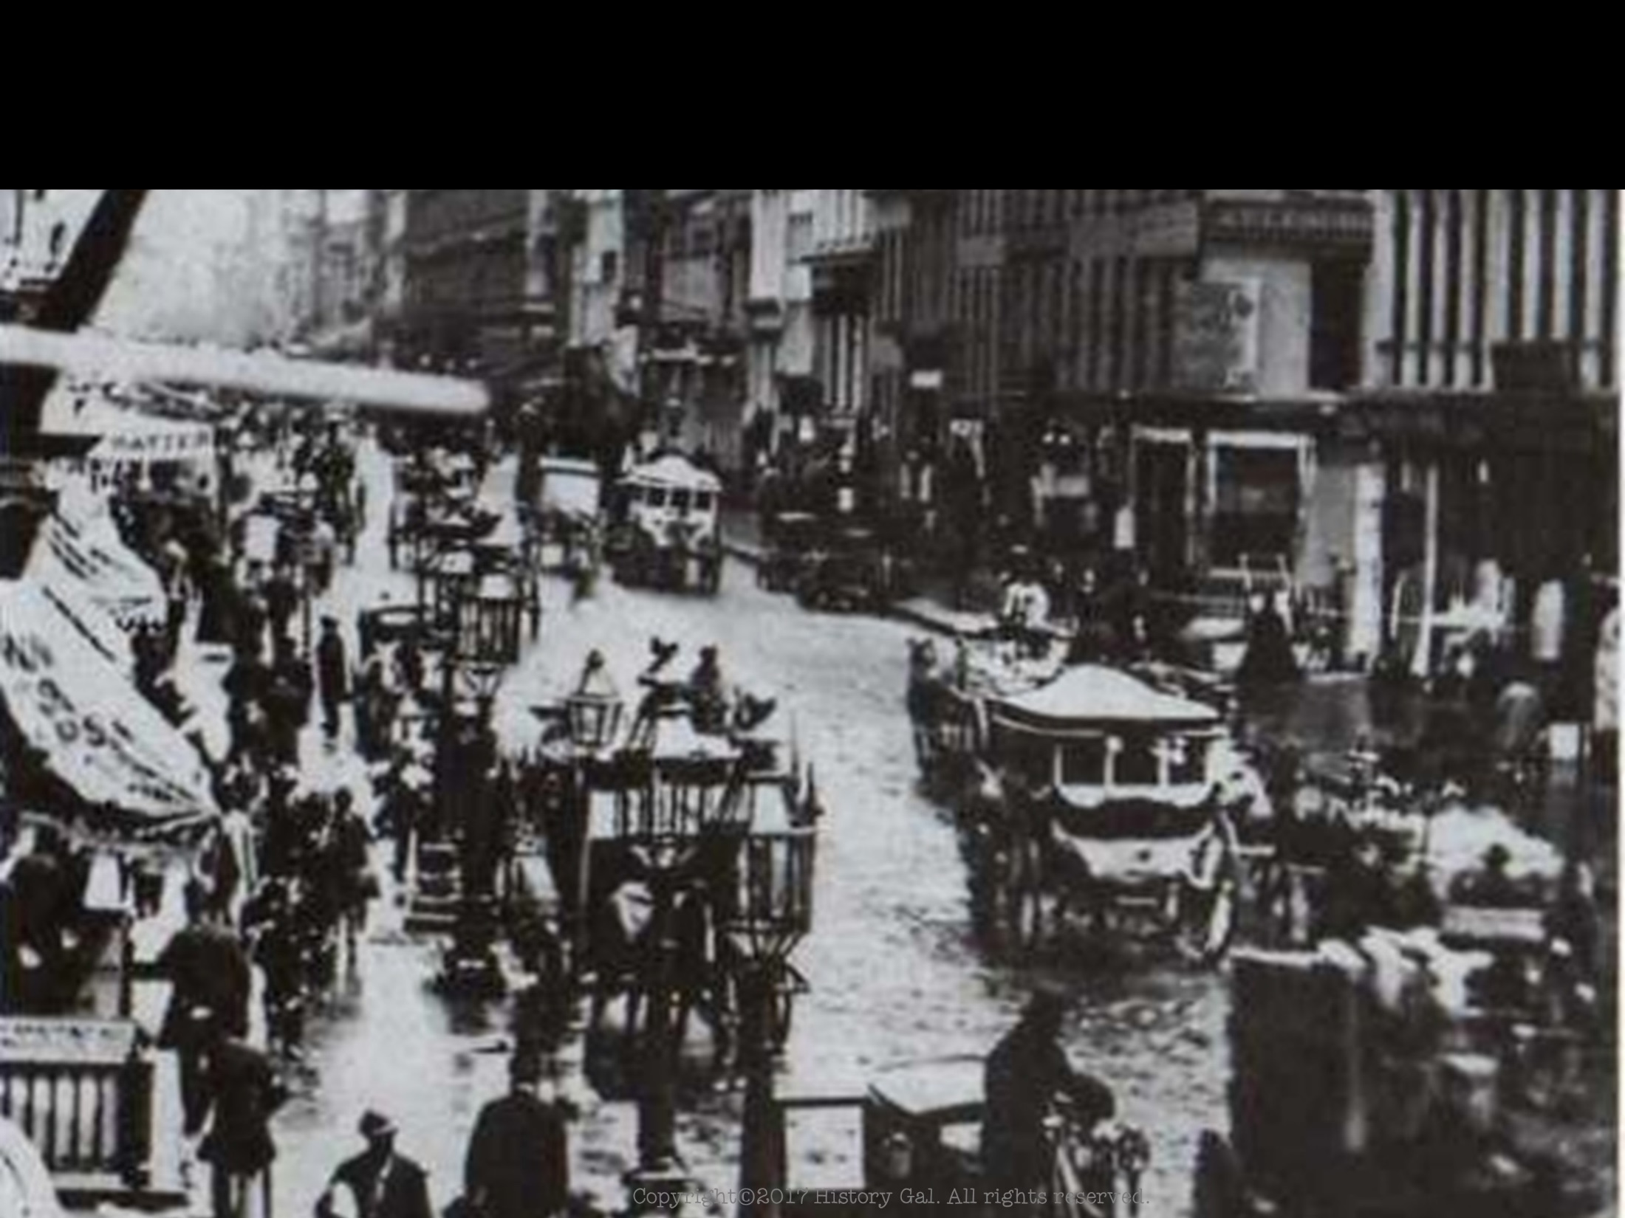
COMPARING NORTH & SOUTH
POPULATION
NORTH: 22 million and the number continued to increase as immigrants flowed in during the war years
SOUTH: 9 million, 3.5 million of which were slaves

Slide 8
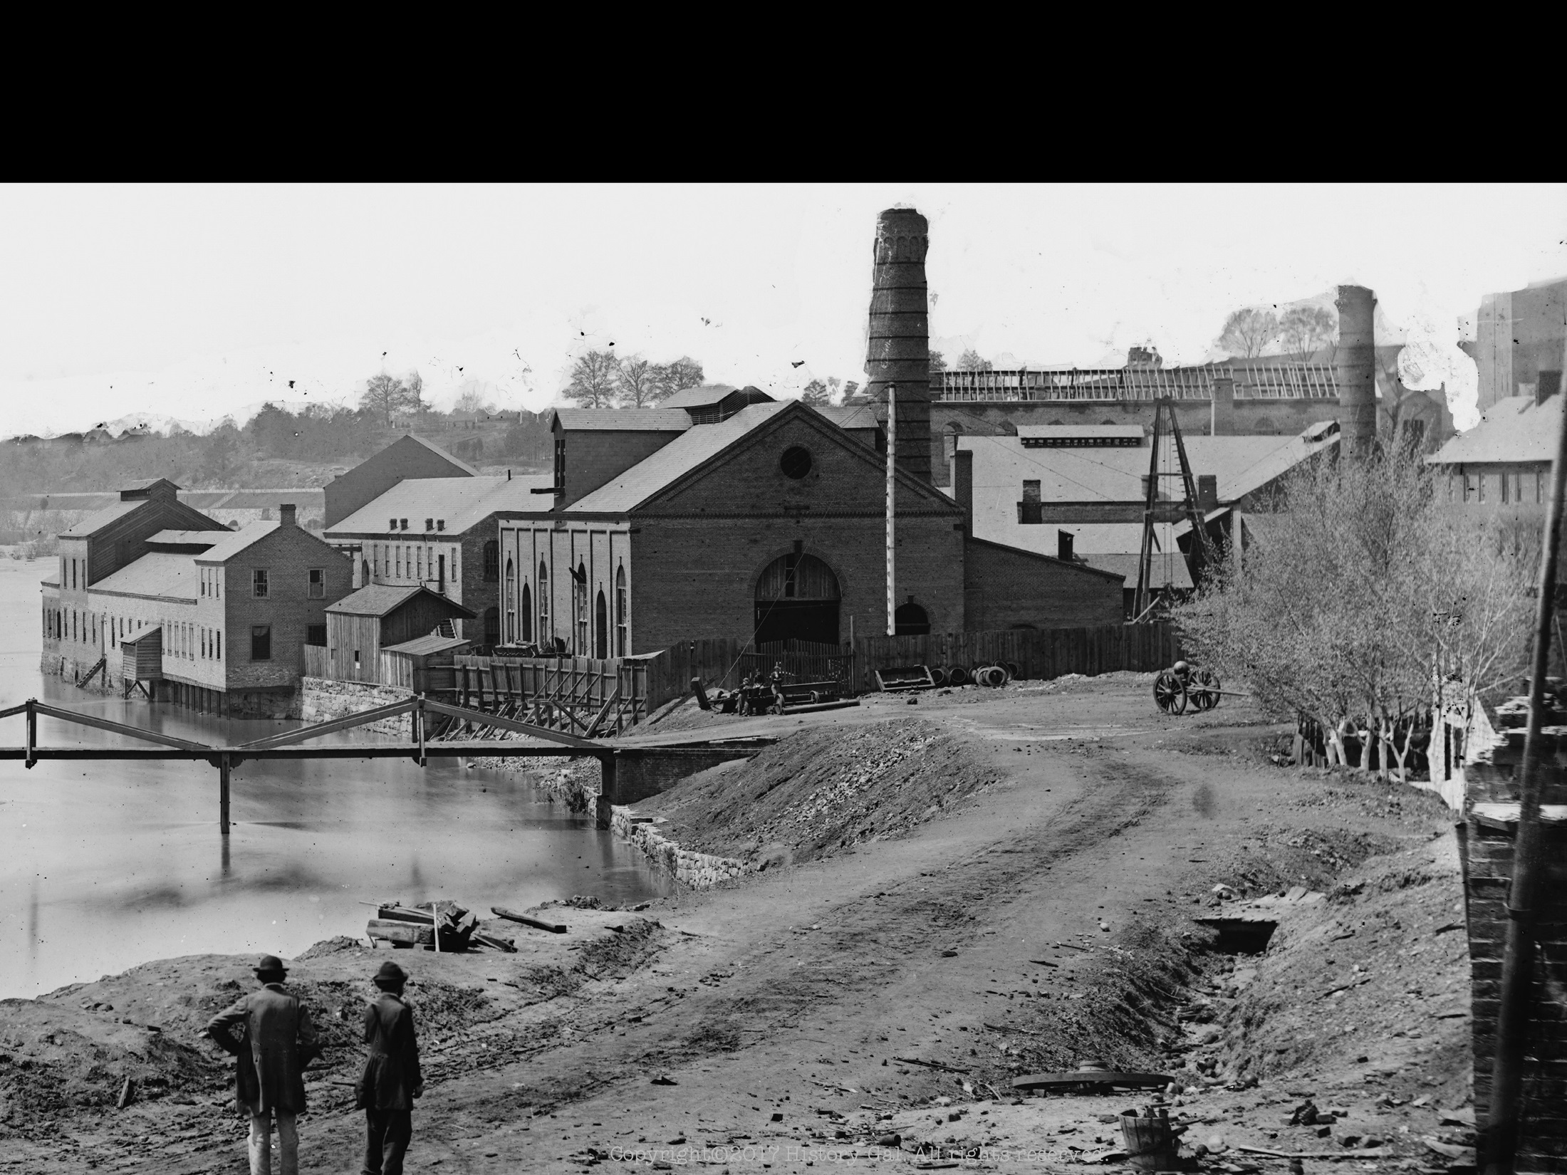
COMPARING NORTH & SOUTH
INDUSTRY
NORTH
contained 85% of the nation’s factories
contained 90% of skilled workers
able to produce all of the supplies and weapons needed for the war

Slide 9
COMPARING NORTH & SOUTH
INDUSTRY
SOUTH
limited industry
had to rely on imports for its war materials making it vulnerable to Northern blockades
Bread Riots

Slide 10
COMPARING NORTH & SOUTH
TRANSPORTATION
NORTH
extensive railroad system meant men and supplies could be moved quickly
large group of merchant marines (shipping vessels and the people that worked on them)
naval supremacy

Slide 11
COMPARING NORTH & SOUTH
TRANSPORTATION
SOUTH
inadequate railroad system (contained less than 30% of nation’s railroad mileage)
few merchant ships or naval vessels
Copyright©2017 History Gal. All rights reserved.

Slide 12
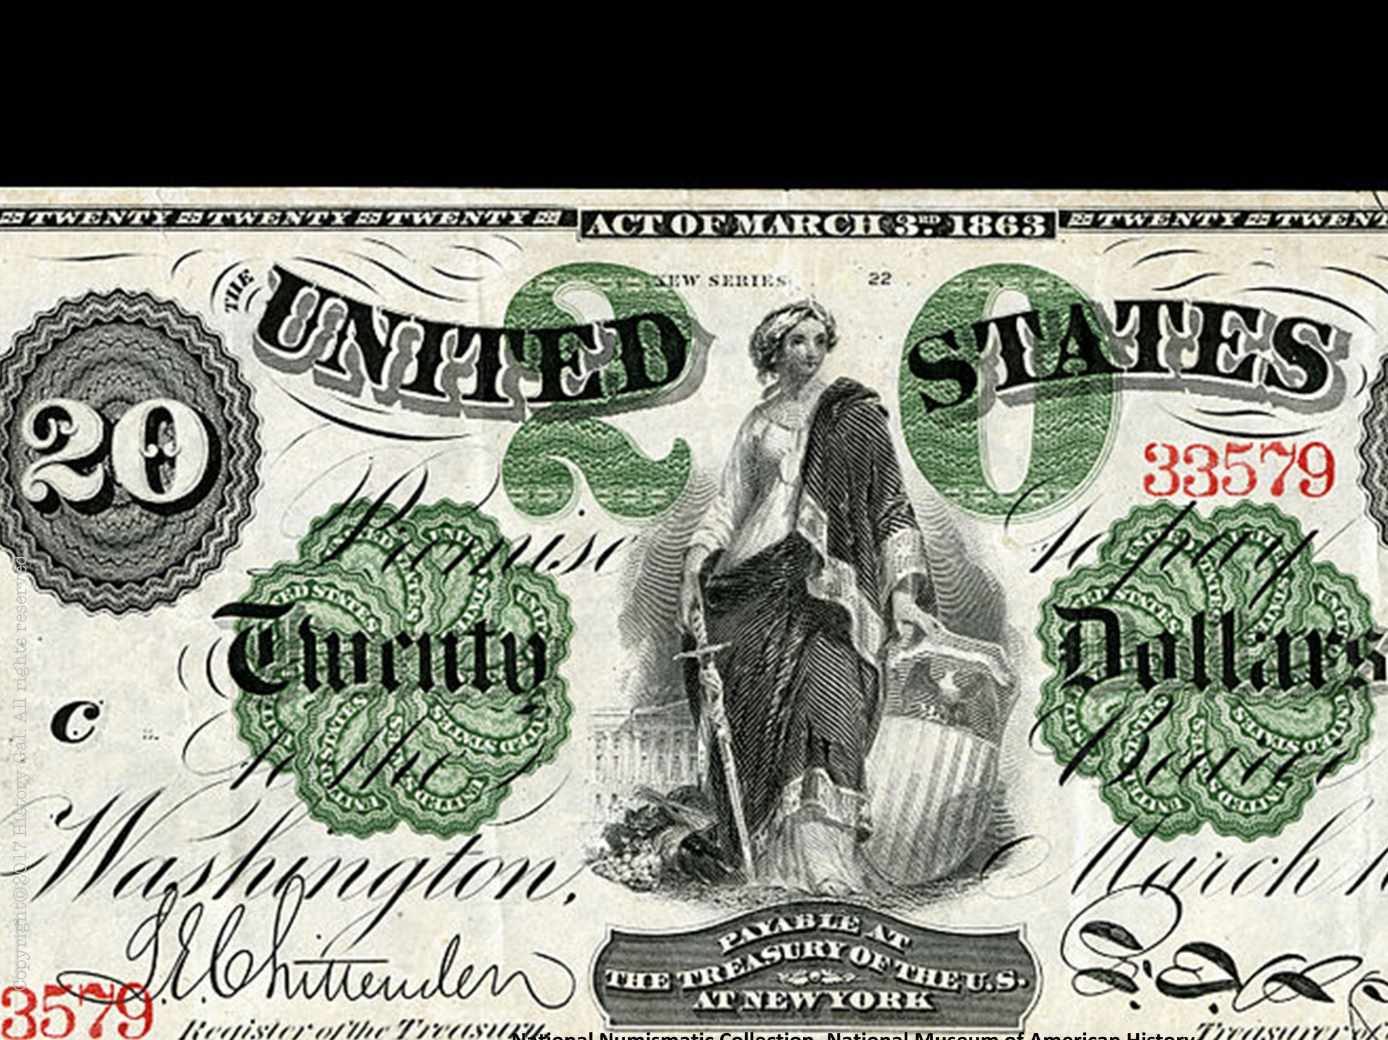
COMPARING NORTH & SOUTH
FINANCES
NORTH
controlled 70% of nation’s wealth

Slide 13
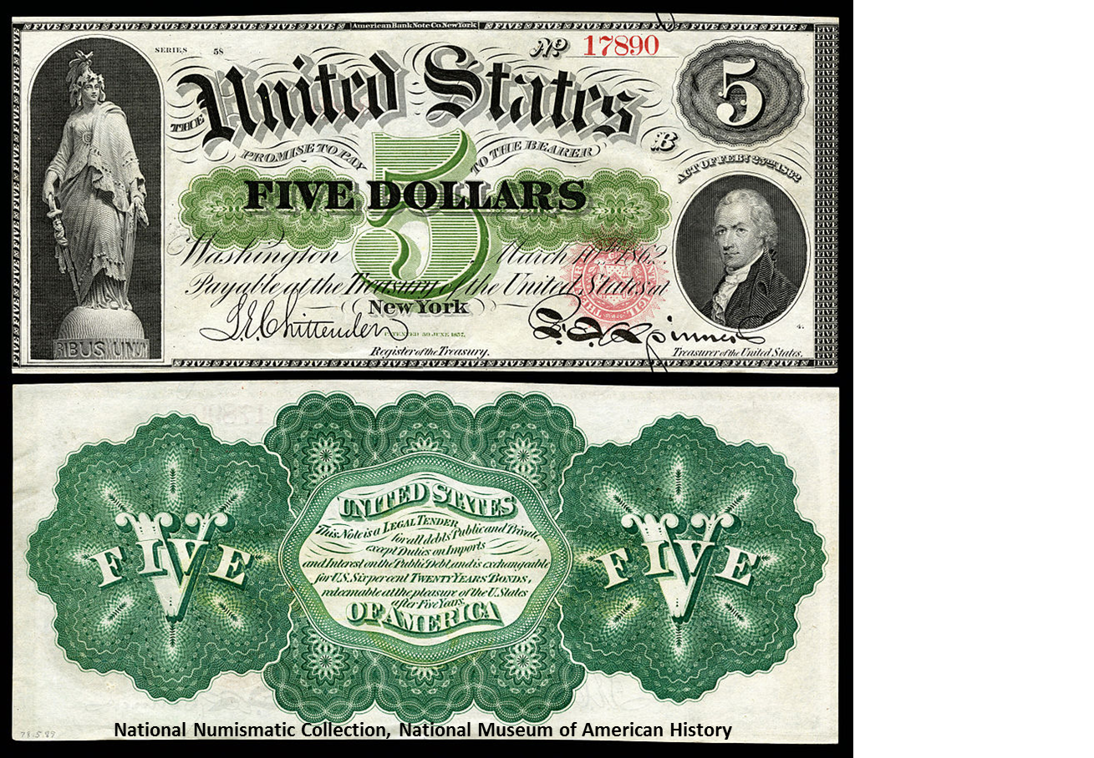
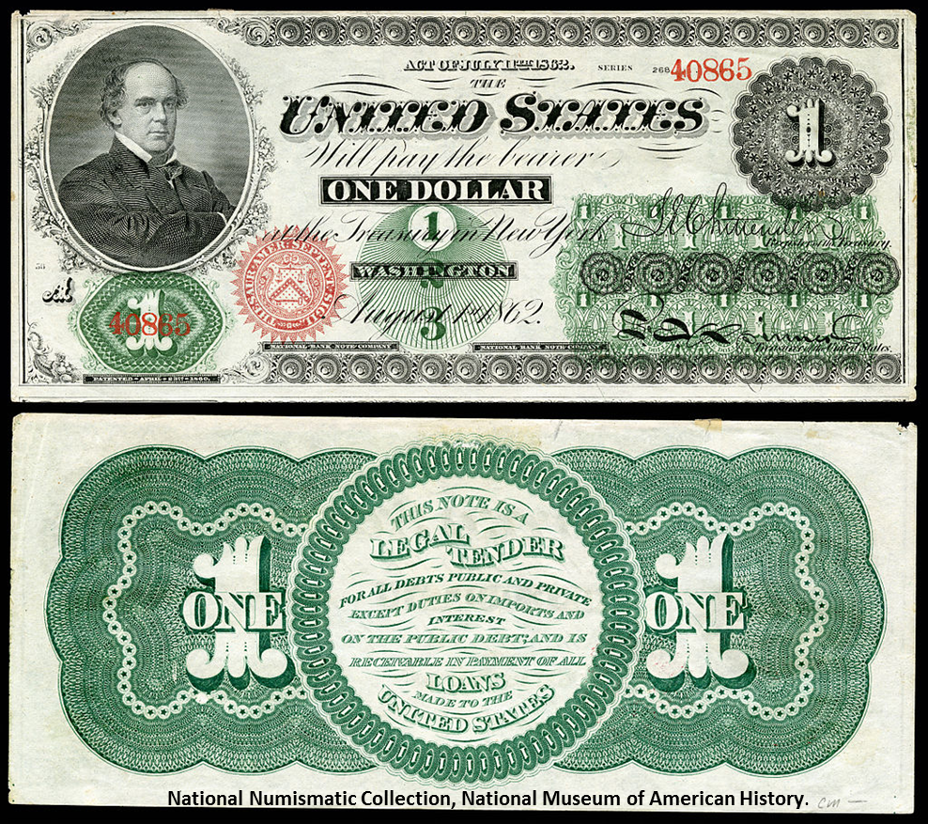
COMPARING NORTH & SOUTH
To fund the war, the North
levied high tariffs on imports
introduced an income tax
issued paper money called greenbacks that were not backed by gold, but by the government
sold government bonds to banks and individuals
National Numismatic Collection, National Museum of American History

Slide 14
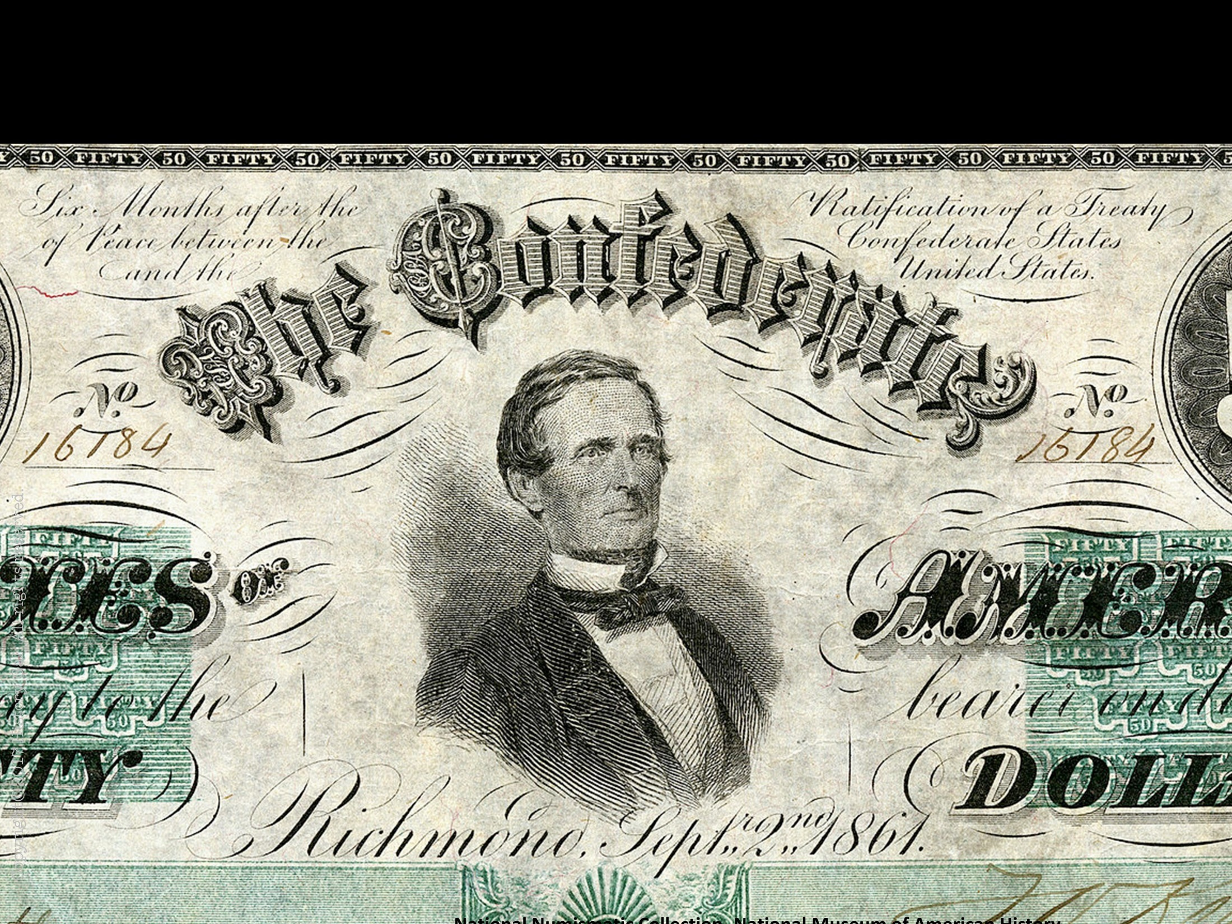
COMPARING NORTH & SOUTH
FINANCES
SOUTH
Was hurt by Northern blockades, unwillingness of foreign banks to provide large loans, and opposition to direct taxation by the Confederate government

Slide 15
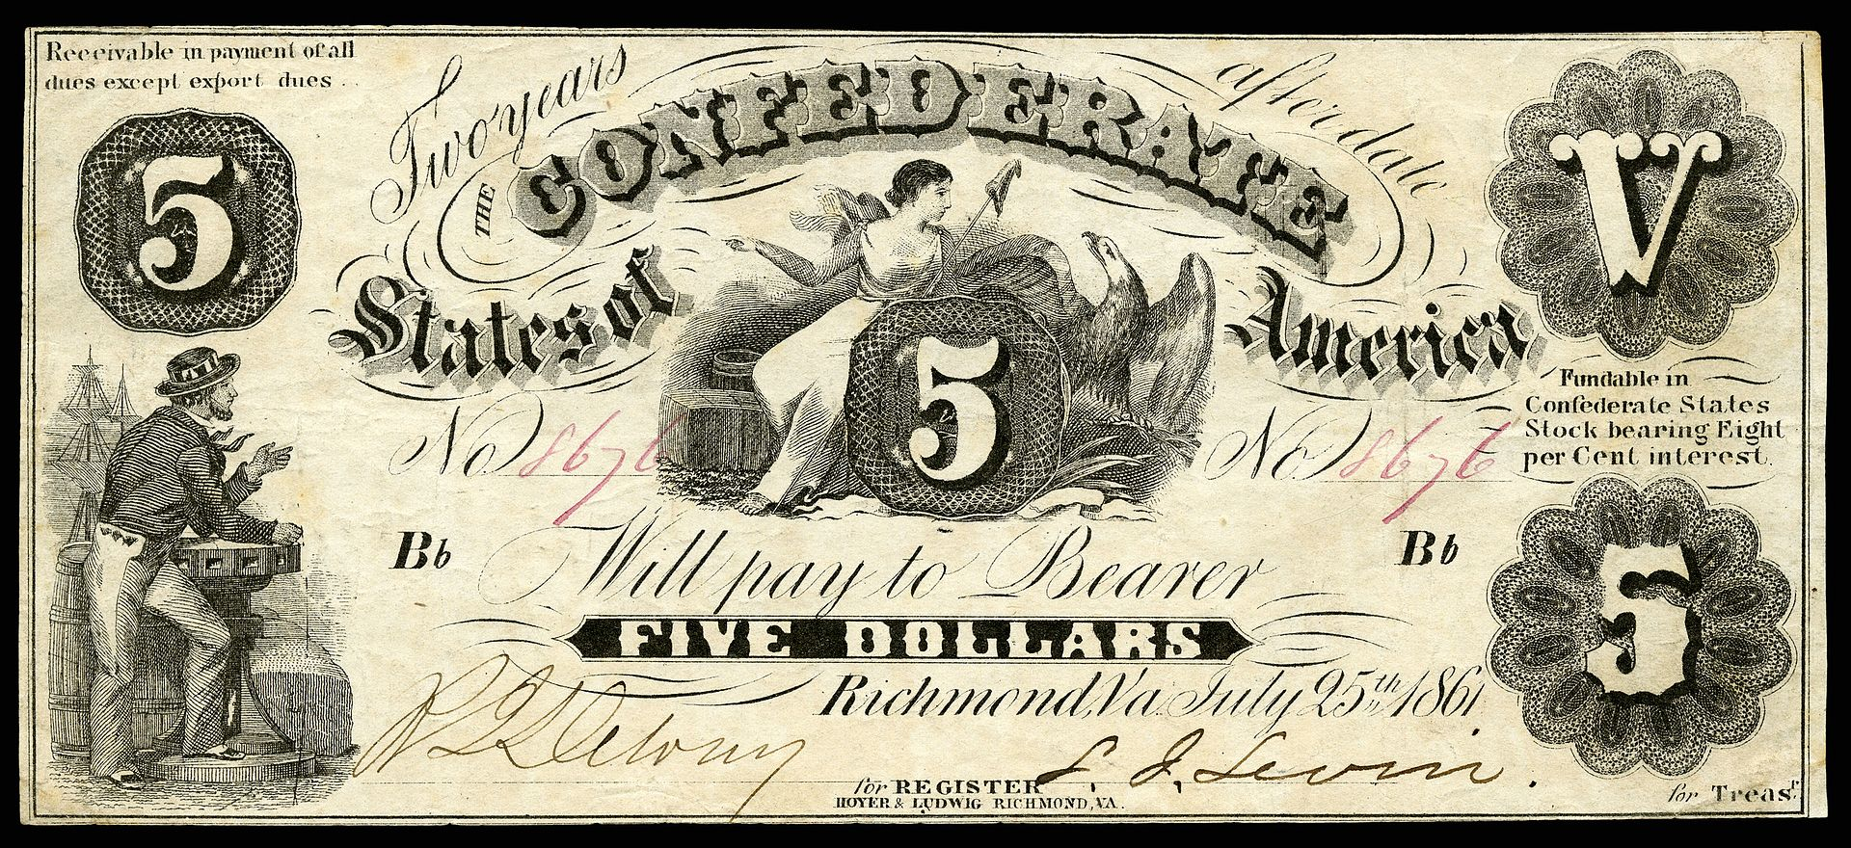
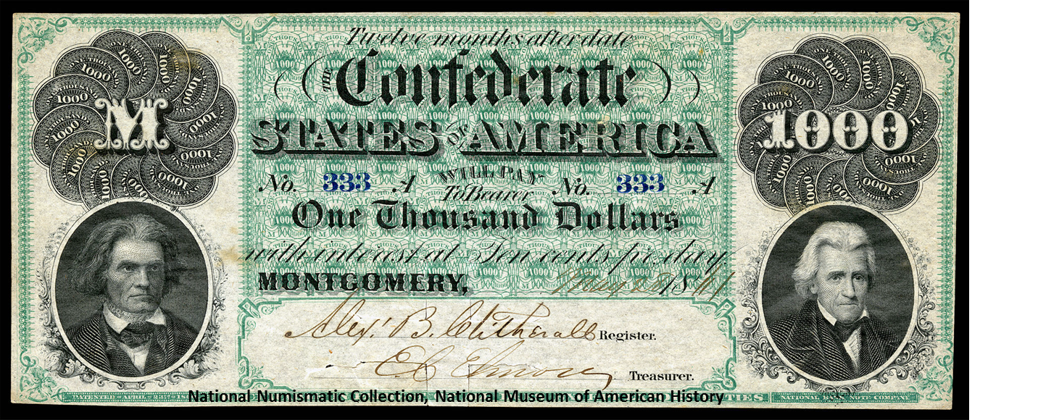
COMPARING NORTH & SOUTH
To fund the war, the South
raised excise taxes
sold government bonds
issued paper money

Slide 16
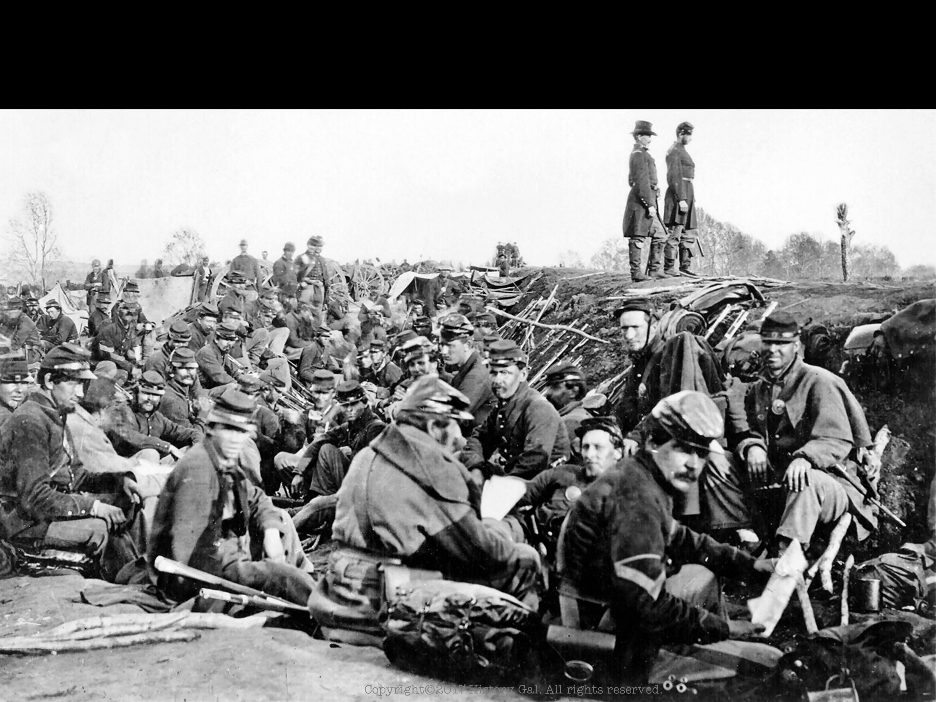
COMPARING NORTH & SOUTH
MILITARY FORCES
NORTH
very few experienced officers since most joined the Confederate army when their home state seceded
city dwellers and factory workers were not prepared for the life of a soldier and needed a lot of training
had to fight an offensive war

Slide 17
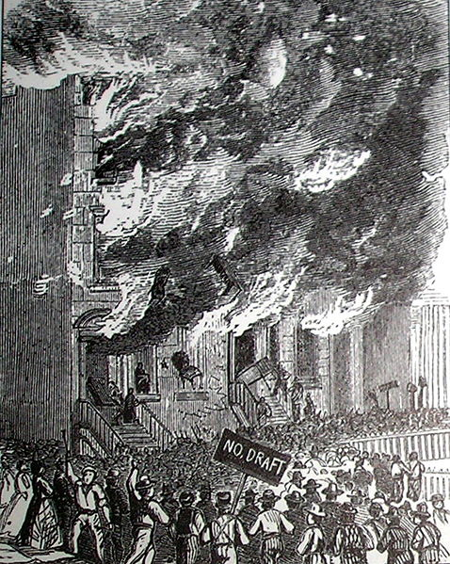
COMPARING NORTH & SOUTH
MILITARY FORCES
NORTH
drafted men between the ages of 20-45, but those who did not want to fight could find a substitute or pay $300
Draft Riots

Slide 18
COMPARING NORTH & SOUTH
MILITARY FORCES
SOUTH
superior military leadership
Southerners were accustomed to life in the outdoors, the use of weapons, and riding horses
had the advantage of fighting on their own soil
The Gray Ghost

Slide 19
COMPARING NORTH & SOUTH
MILITARY FORCES
SOUTH
drafted men between ages of 18-35 except those who owned 20 or more slaves (about 10% of slave owners owned more than 20 slaves)
Primary Source – Distribution of Land and Slaves in North Carolina

