Slide 1
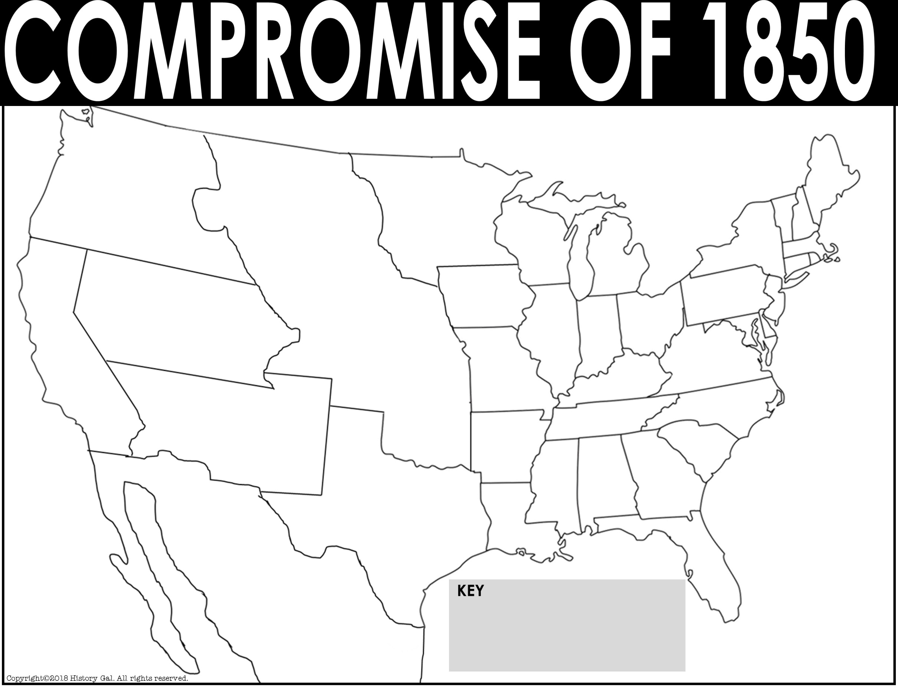
Canada
New Hampshire
Oregon Territory
Maine
Minnesota Territory
Vermont
Mass.
Wisconsin
Rhode
Island
Michigan
New York
Pennsylvania
Conn.
Utah
Territory
Unorganized Territory
Iowa
New Jersey
Ohio
Delaware
Illinois
Indiana
Maryland
California
Virginia
Missouri
Kentucky
North Carolina
New Mexico
Territory
Missouri Compromise Line
Tennessee
Arkansas
South Carolina
Alabama
Georgia
Mississippi
Texas
Louisiana
Atlantic Ocean
Mexico
Florida
Pacific
Ocean

Slide 2
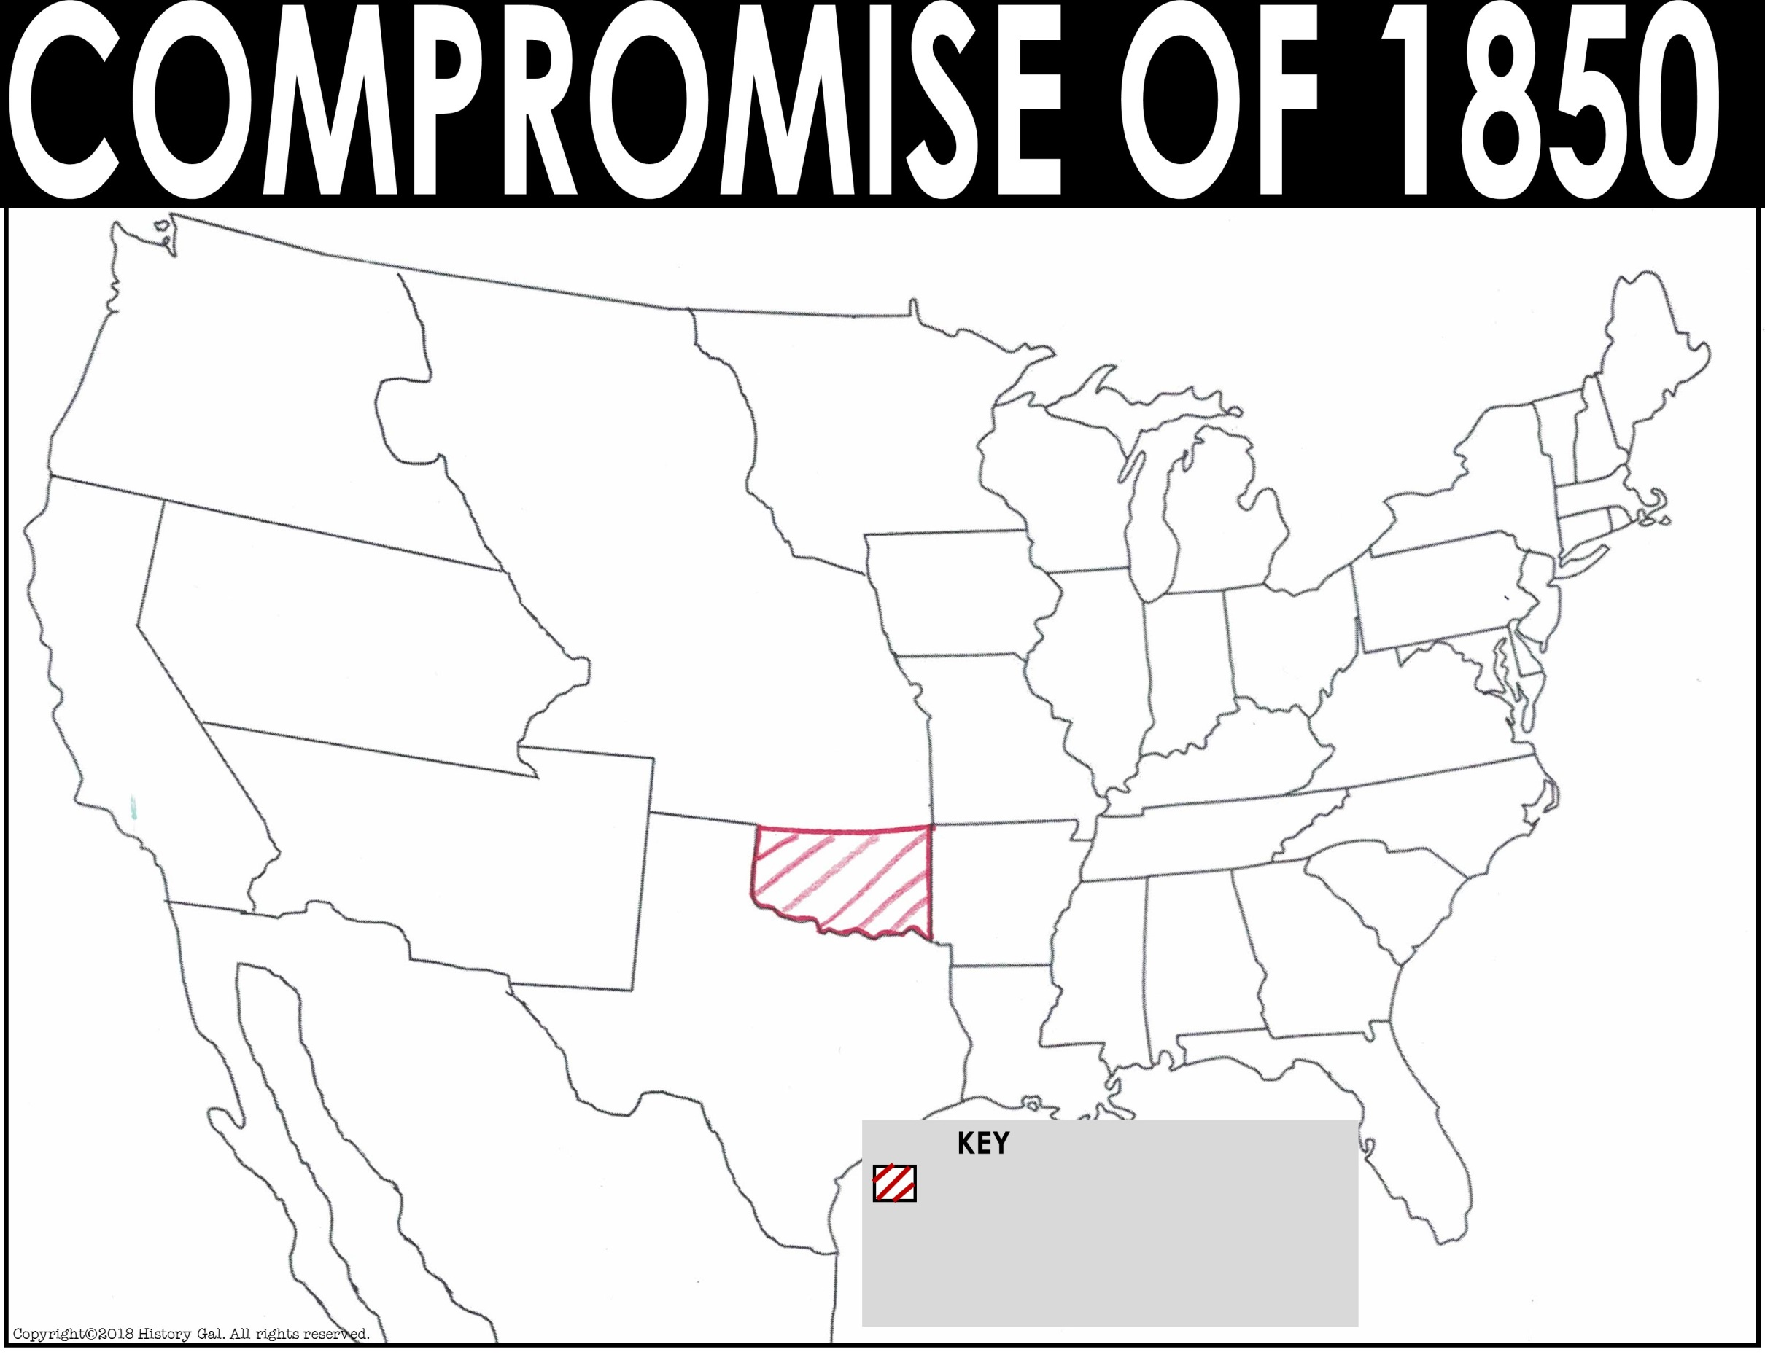
Canada
Oregon Territory
New Hampshire
Maine
Minnesota Territory
Vermont
Mass.
Wisconsin
New York
Rhode
Island
Michigan
Utah
Territory
Unorganized Territory
Iowa
Pennsylvania
Conn.
Ohio
New Jersey
Indiana
Delaware
Illinois
California
Maryland
Virginia
Missouri
Kentucky
North Carolina
New Mexico
Territory
Missouri Compromise Line
Tennessee
Atlantic Ocean
Arkansas
South Carolina
Mississippi
Georgia
Alabama
Texas
Louisiana
Mexico
Florida
Pacific
Ocean
Territory allowed to have slavery by the Missouri Compromise

Slide 3
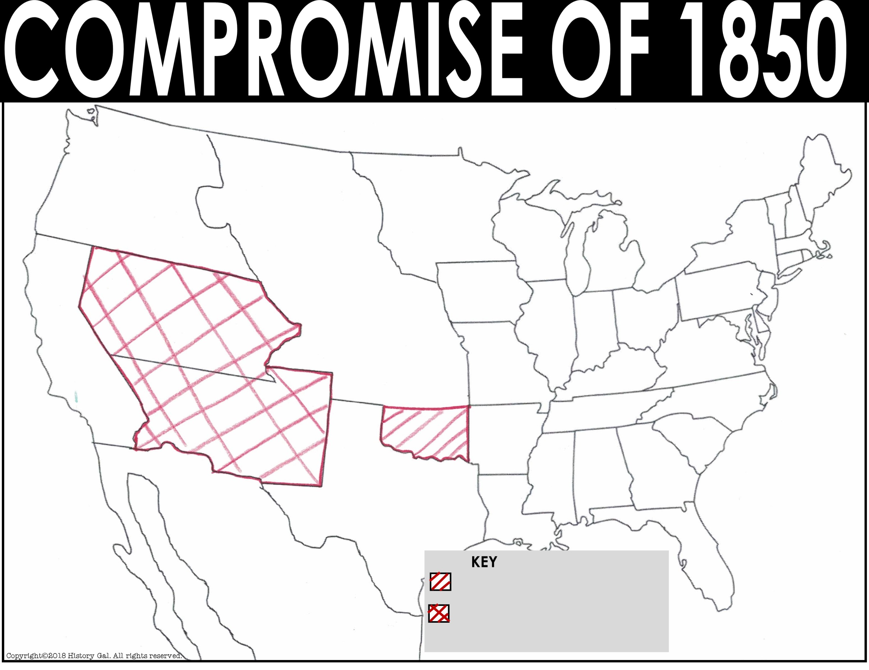
Canada
New Hampshire
Maine
Oregon Territory
Minnesota Territory
Vermont
Mass.
Wisconsin
New York
Michigan
RI
Utah
Territory
Iowa
Pennsylvania
Conn.
Unorganized Territory
Illinois
NJ
Ohio
Delaware
Indiana
California
Virginia
Maryland
Missouri
Kentucky
North Carolina
New Mexico
Territory
Missouri Compromise Line
Tennessee
Atlantic Ocean
Arkansas
South Carolina
Alabama
Georgia
Mississippi
Texas
Louisiana
Mexico
Florida
Pacific
Ocean
Territory allowed to have slavery by the Missouri Compromise
Territory OPENED to slavery by the Compromise of 1850

Slide 4
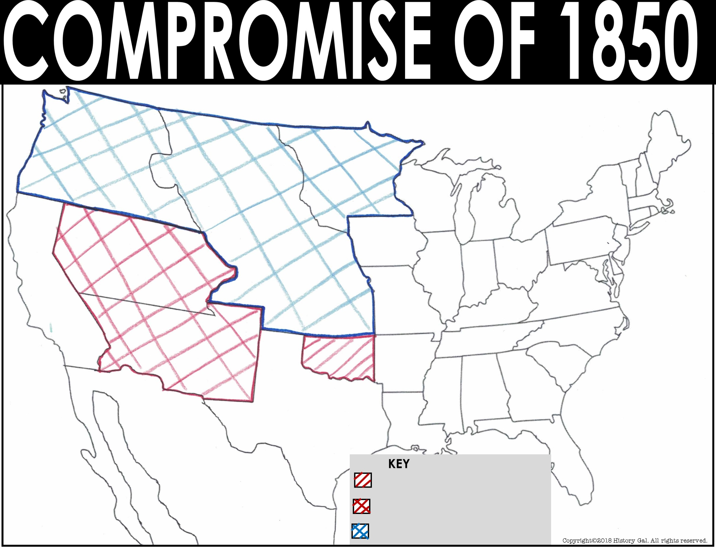
Canada
New Hampshire
Oregon Territory
Maine
Minnesota Territory
Vermont
Mass.
Wisconsin
New York
Rhode
Island
Michigan
Utah
Territory
Iowa
Pennsylvania
Conn.
Unorganized Territory
New Jersey
Illinois
Ohio
Delaware
Indiana
Maryland
California
Virginia
Missouri
Kentucky
North Carolina
New Mexico
Territory
Missouri Compromise Line
Tennessee
Atlantic Ocean
Arkansas
South Carolina
Mississippi
Georgia
Alabama
Texas
Louisiana
Mexico
Florida
Pacific
Ocean
Territory allowed to have slavery by the Missouri Compromise
Territory OPENED to slavery by the Compromise of 1850
Territory CLOSED to slavery

Slide 5
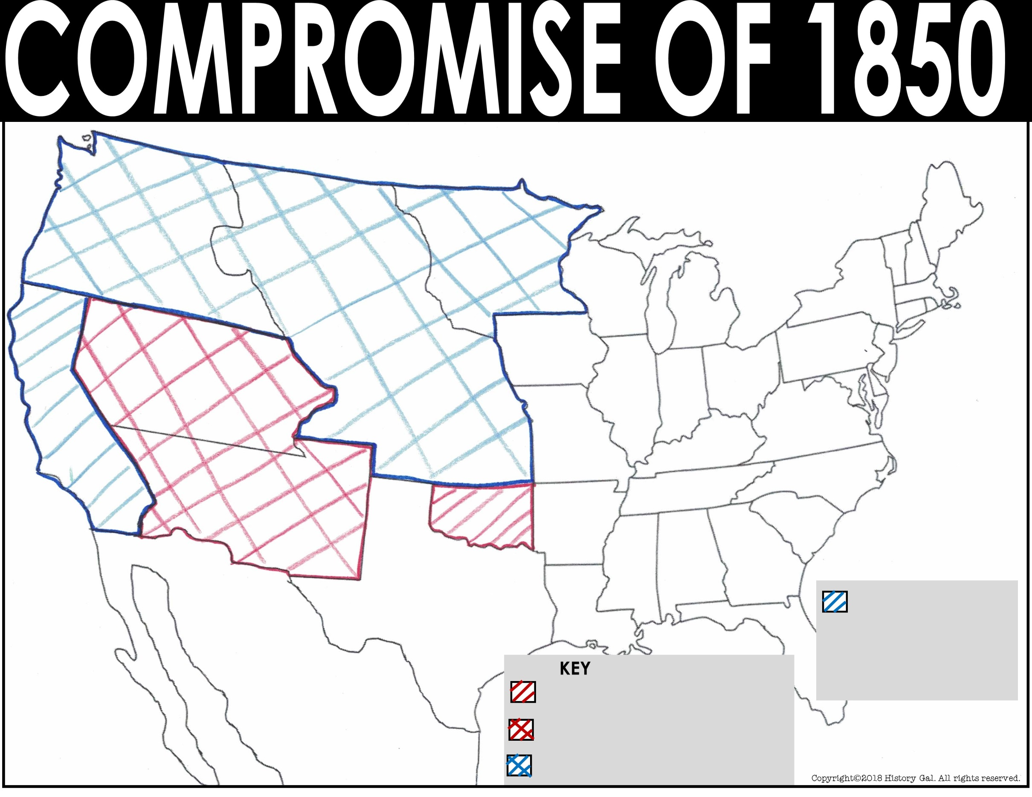
Canada
Oregon Territory
New Hampshire
Maine
Minnesota Territory
Vermont
Mass.
Wisconsin
New York
Rhode
Island
Michigan
Utah
Territory
Iowa
Conn.
Unorganized Territory
Pennsylvania
New Jersey
Illinois
Ohio
Delaware
Indiana
Maryland
California
Virginia
New Mexico
Territory
Missouri
Kentucky
North Carolina
Missouri Compromise Line
Tennessee
Atlantic Ocean
Arkansas
South Carolina
Alabama
Georgia
Mississippi
Texas
Louisiana
New state admitted as a FREE state
Mexico
Florida
Pacific
Ocean
Territory allowed to have slavery by the Missouri Compromise
Territory OPENED to slavery by the Compromise of 1850
Territory CLOSED to slavery

Slide 6
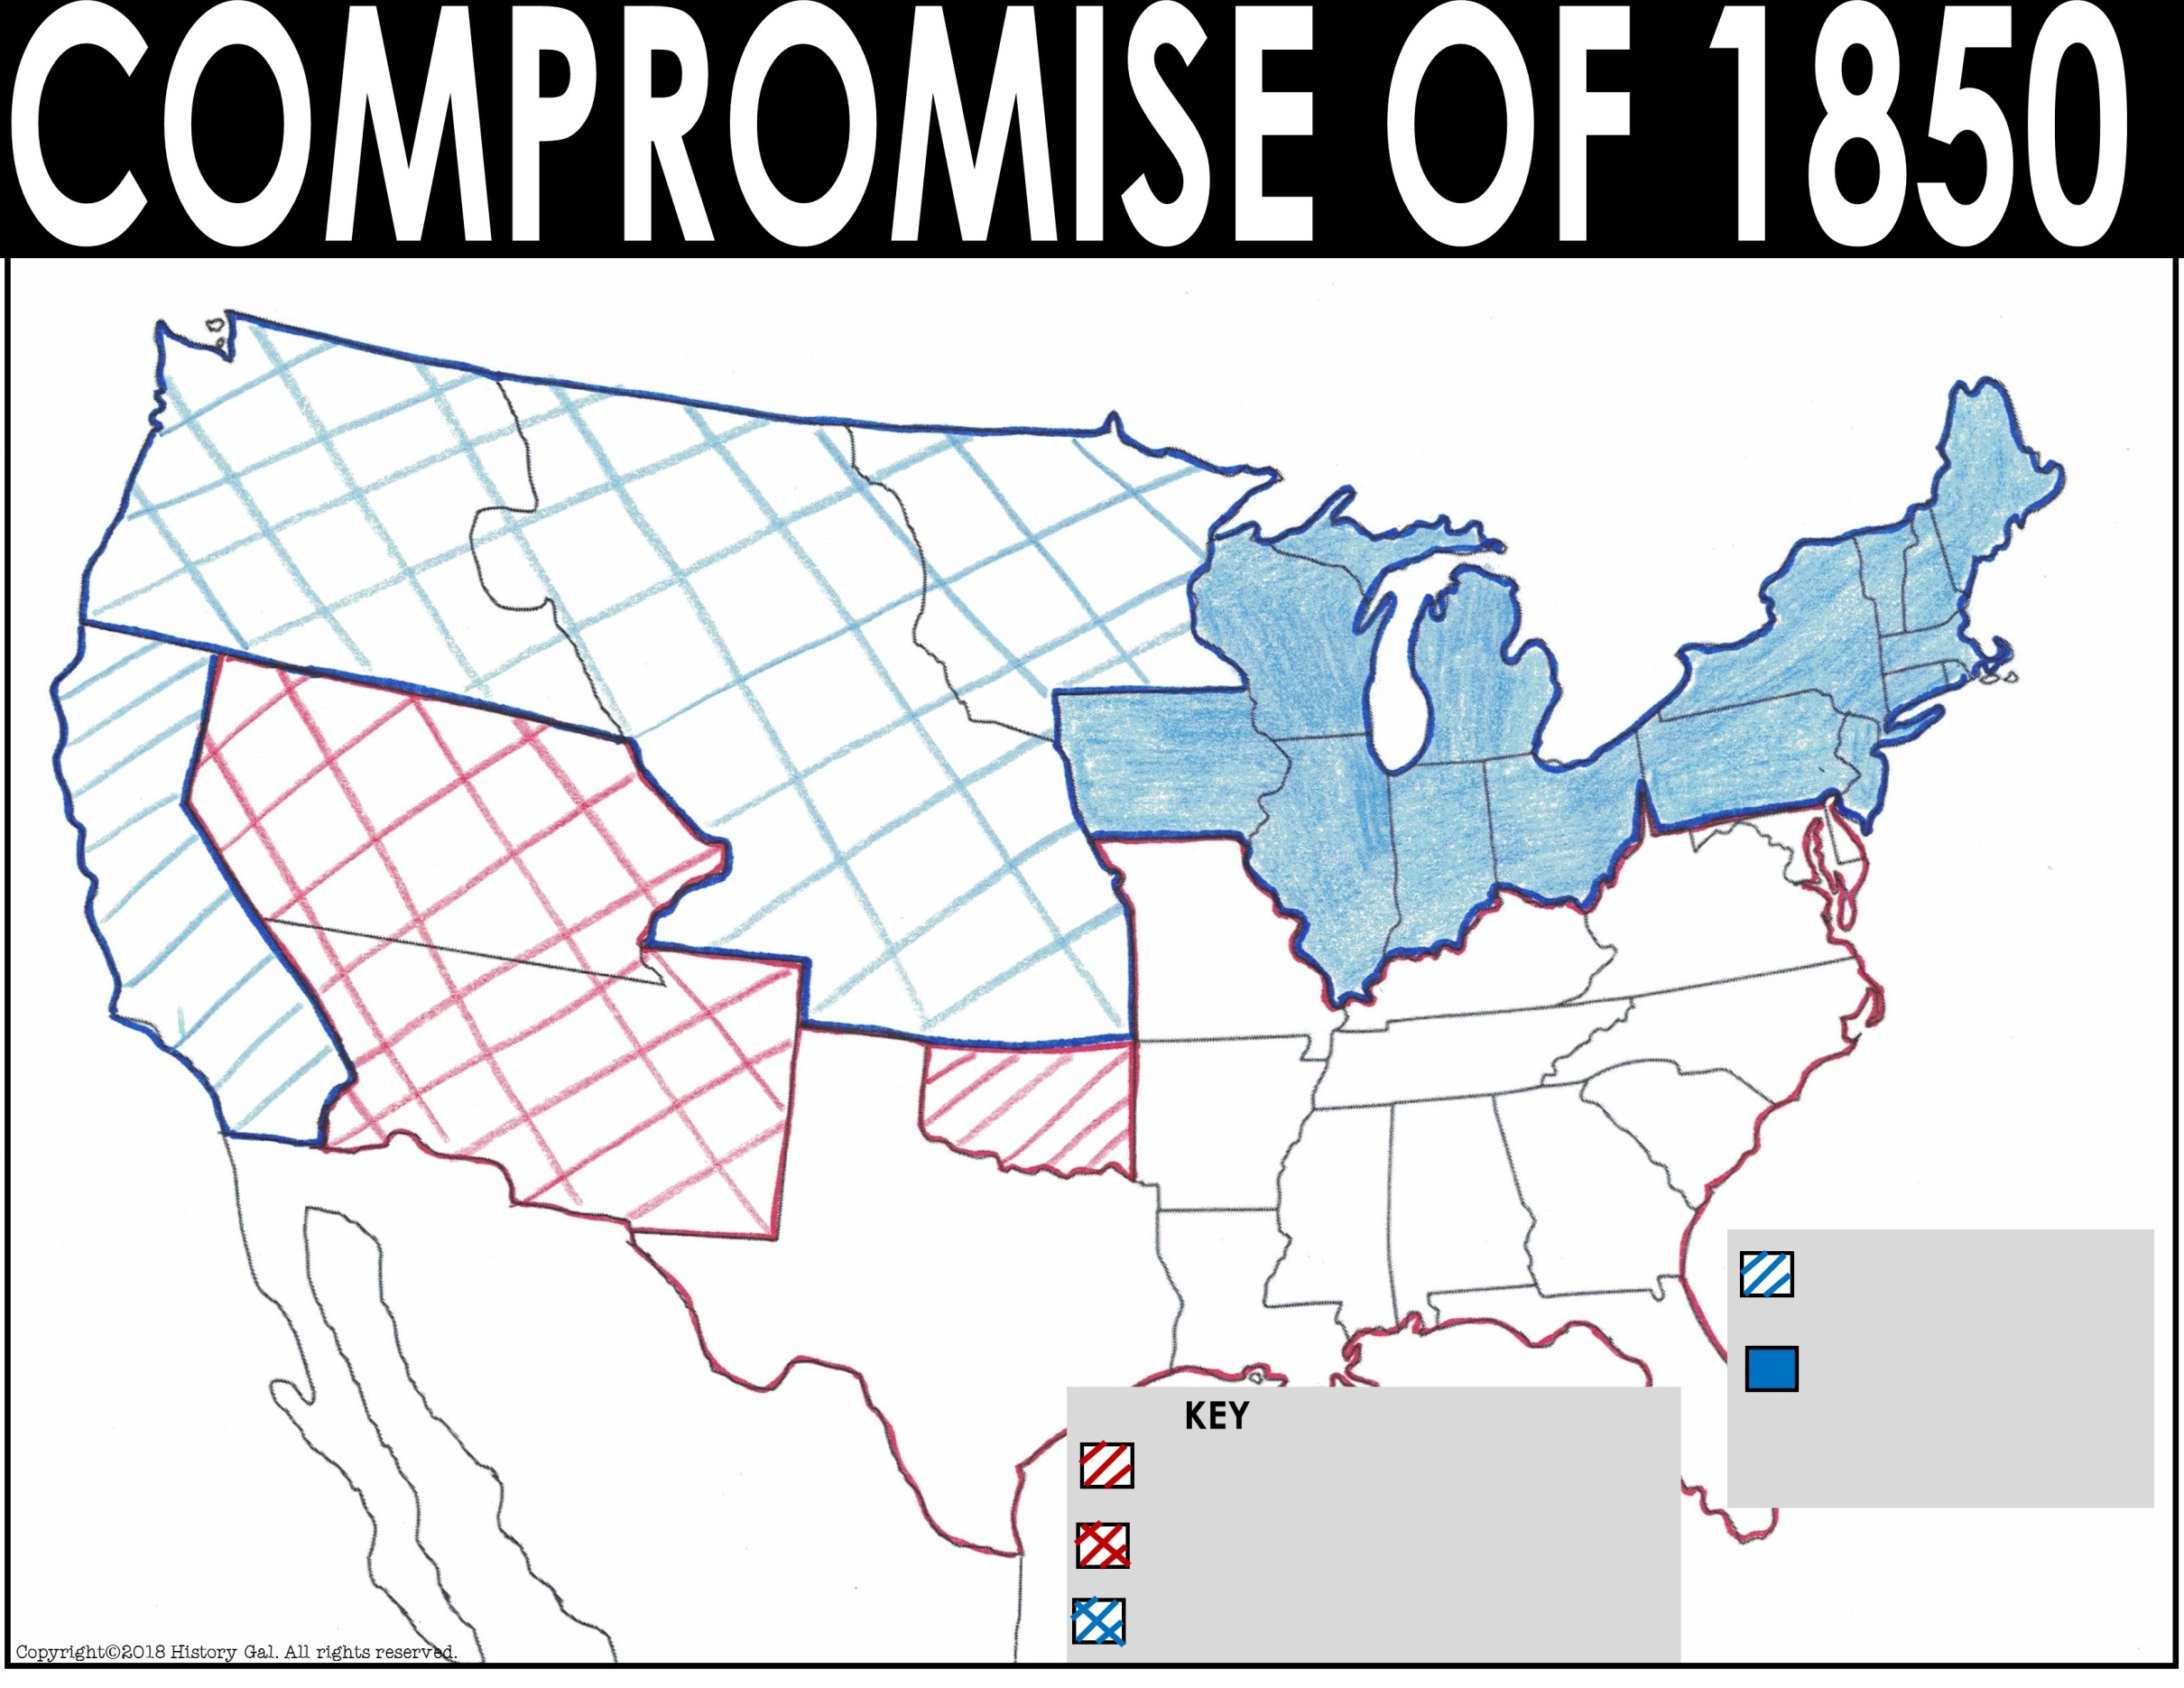
Canada
Oregon Territory
New Hampshire
Maine
Minnesota Territory
Vermont
Mass.
Wisconsin
New York
Rhode
Island
Michigan
Utah
Territory
Unorganized Territory
Iowa
Pennsylvania
Conn.
Illinois
Ohio
New Jersey
Indiana
Delaware
California
Virginia
Maryland
New Mexico
Territory
Missouri
Kentucky
North Carolina
Missouri Compromise Line
Tennessee
Atlantic Ocean
Arkansas
South Carolina
Alabama
Georgia
Mississippi
Texas
New state admitted as a FREE state
Louisiana
Mexico
Florida
FREE states
Pacific
Ocean
Territory allowed to have slavery by the Missouri Compromise
Territory OPENED to slavery by the Compromise of 1850
Territory CLOSED to slavery

Slide 7
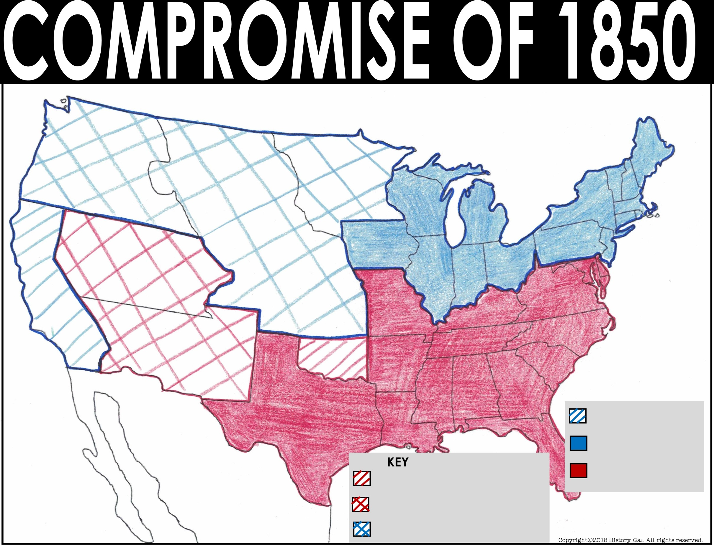
Canada
Oregon Territory
New Hampshire
Maine
Minnesota Territory
Vermont
Mass.
Wisconsin
New York
Rhode
Island
Michigan
Utah
Territory
Unorganized Territory
Iowa
Pennsylvania
Conn.
Ohio
New Jersey
Indiana
Delaware
Illinois
California
Virginia
Maryland
New Mexico
Territory
Missouri
Kentucky
North Carolina
Missouri Compromise Line
Tennessee
Atlantic Ocean
Arkansas
South Carolina
Alabama
Georgia
Mississippi
Texas
New state admitted as a FREE state
Louisiana
Mexico
Florida
FREE states
Pacific
Ocean
Territory allowed to have slavery by the Missouri Compromise
SLAVE states
Territory OPENED to slavery by the Compromise of 1850
Territory CLOSED to slavery

