Slide 1
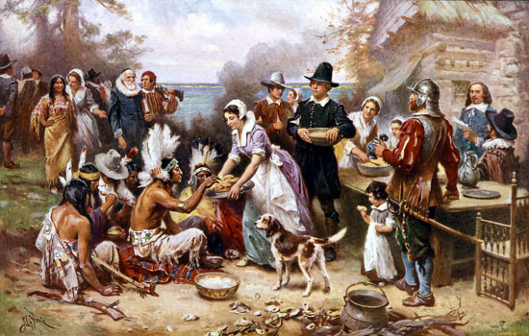

Bell Ringer
Why might someone want to immigrate to the United States of America today?

Slide 2
Converging Cultures

Slide 3
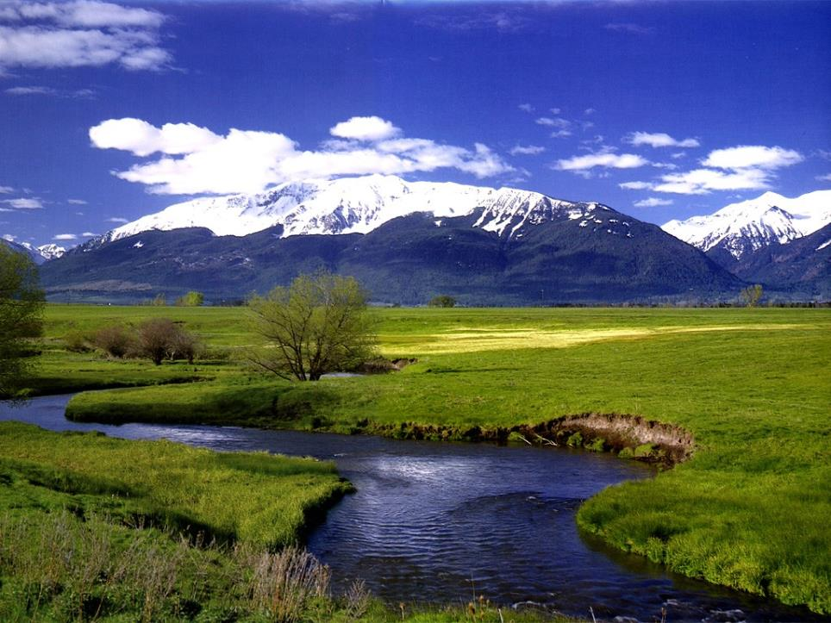
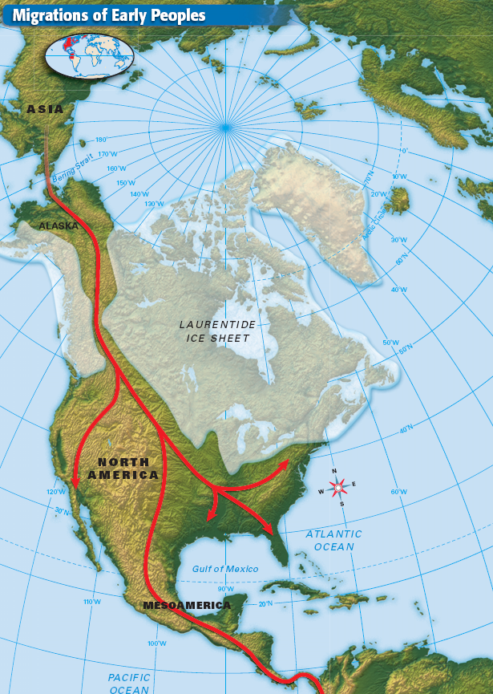
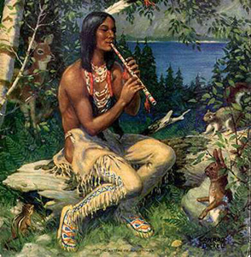
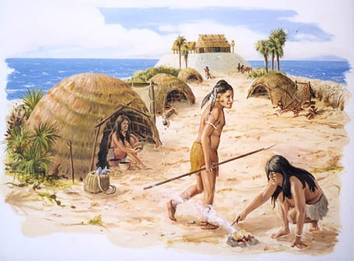
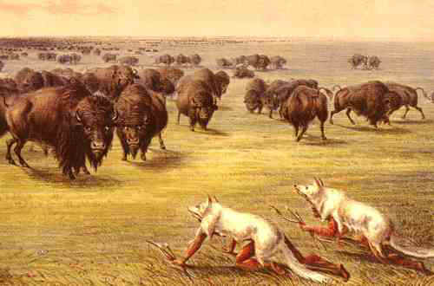
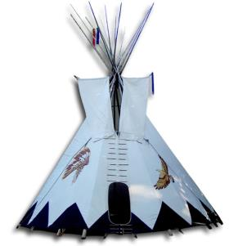
Earliest Americans
Native Americans were living in America between 15,000-30,000 years ago
Nomadic until they learned how to plant and raise crops.
Agriculture→ Civilizations
Diverse and Unique Cultures
a) Language
b) Housing
c) Economics
d) Food
e) Beliefs
Notes:
The first Americans arrived on the continent during the Pleistocene Ice Age (about 1.65 million until 10,000 years ago)
Northern and southernmost parts of the Americas covered by ice
Sea level was about 300 feet lower that it is today
The now-submerged land that connected the Asian and American continent is known as "Beringia."
The Paleo-Indians pursued migratory animals across the "land bridge" about 30,000 years ago
The Paleo-Indians dispersed southward

Slide 4
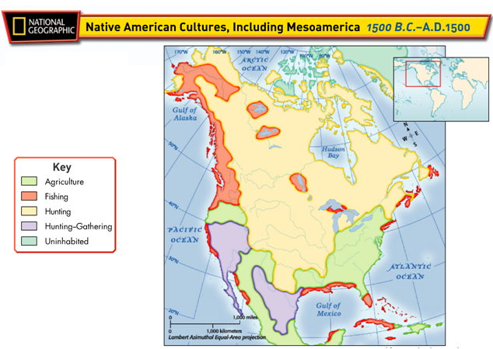
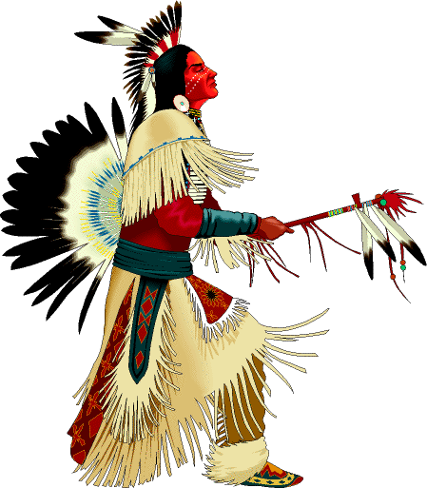
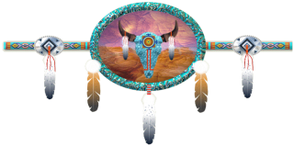

Slide 5
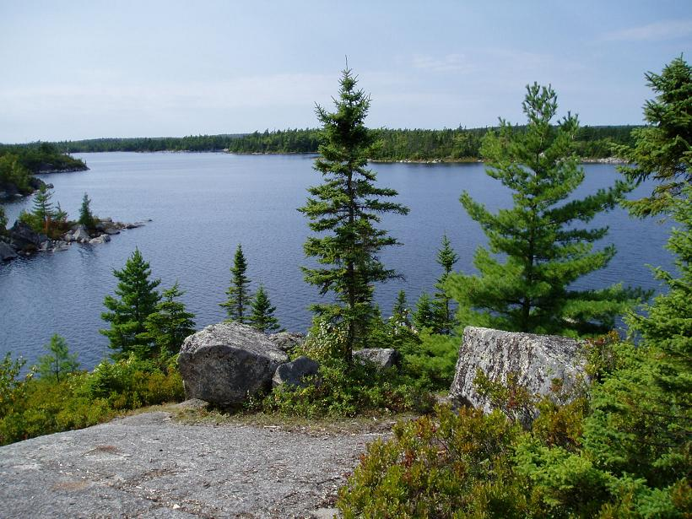
In what ways were Native American tribes different region to region?
Checking for Understanding
housing, language, economy, food, beliefs

Slide 6
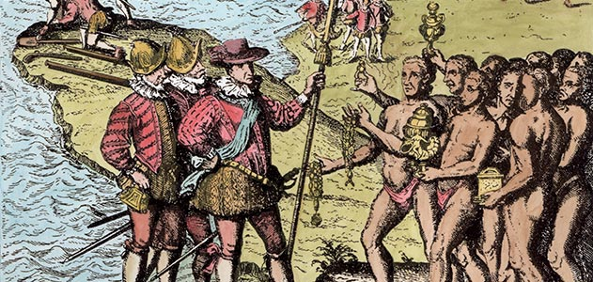
Native American: Way of Life | European: Way of Life
GIVING A respected person is one who gives. A person who hoards is watched with distrust. | SAVING A respected person is someone who saves. Even education is an investment in the future.
COOPERATION Cooperation is healthy and essential. Anyone who tries to stand out is showing off. They believe in team effort for the most part. | COMPETITION Competition is healthy and essential. You do not have to win but you must try to achieve first place. There was some cooperation.
HARMONY WITH NATURE Accepts nature. They do not try to change it. If a log falls across a creek, no one moves it. The creek path might change, but that is harmony. Farmers did plant seed and irrigate their crops, but these are exceptions. | CONQUEST OVER NATURE Controls nature by building dams and power plants. There are preserves set aside where land, plant, and animal life are in their natural state, but these are exceptions.
Based on the information provided how might European explorers and American Indians perceive one another?

Slide 7
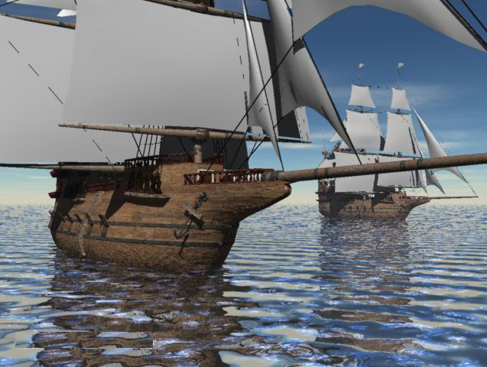
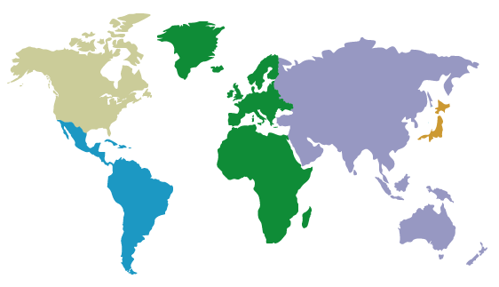
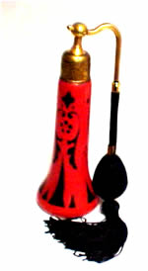
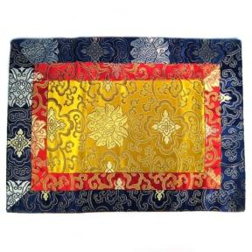

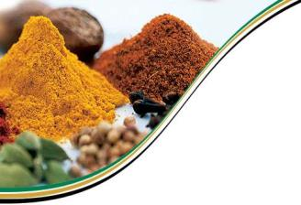


Age of Exploration
1400s Europe was interested in Asia for spices, perfumes, fine silks, and jewels
Hoped to find a sailing route through that would bypass Italy and the Middle East
Gems
Spices
Tea
Perfume
Silk

Slide 8
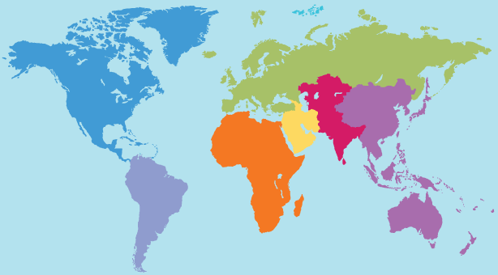
World Map

Slide 9
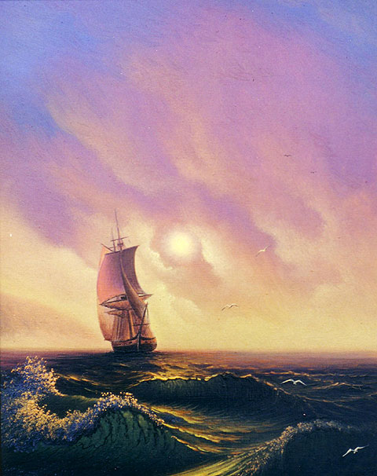
What do you already know about Christopher Columbus?
Notes:
http://www.danielnpaul.com/ChristopherColumbus.html
http://www.history.com/topics/exploration/columbus-controversy#

Slide 10
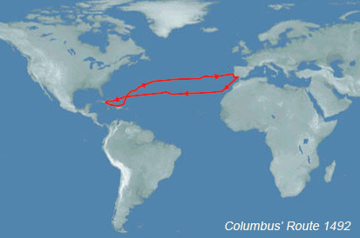
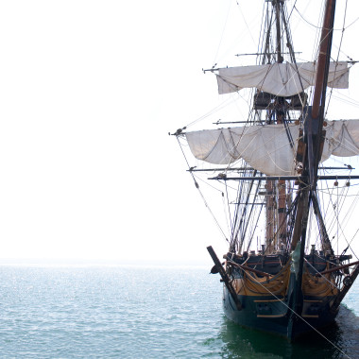
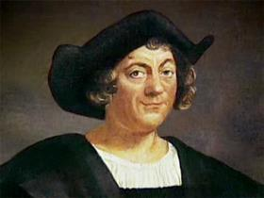

Christopher Columbus
Christopher Columbus, was convinced that he could reach Asia by sailing west.
In 1492 Columbus, set sail with three ships and landed on present-day San Salvador Island.
Notes:
http://www.danielnpaul.com/ChristopherColumbus.html
http://www.history.com/topics/exploration/columbus-controversy#

Slide 11
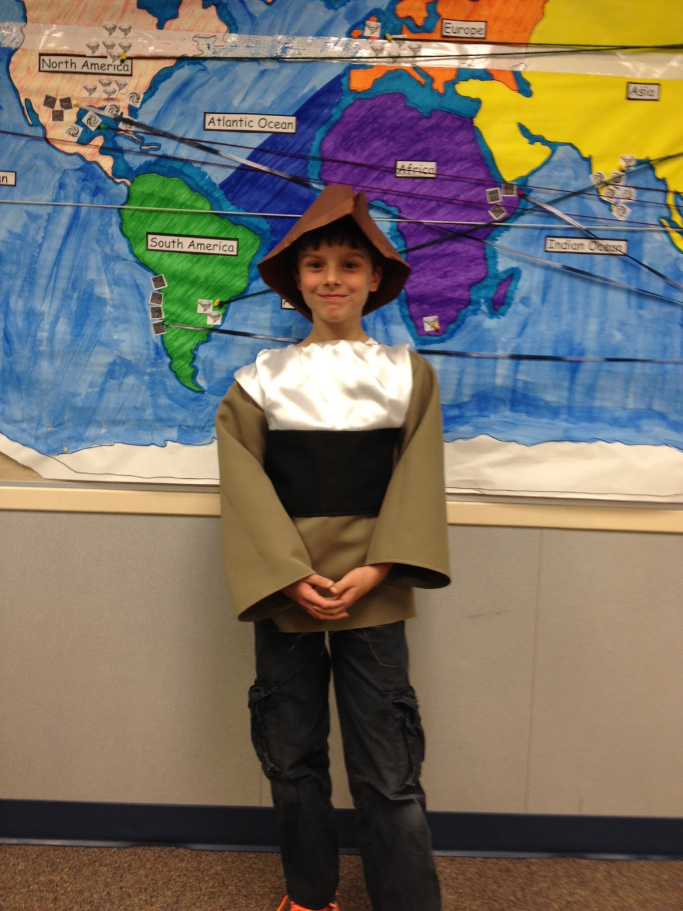
A CLOSER LOOK AT COLUMBUS
Columbus kidnapped Taíno Indians and enslaved them. Columbus wrote the following, “Let us in the name of the Holy Trinity go on sending all the slaves that can be sold,”—and “punished.” Columbus ordered that their hands be cut off or that they be chased down by vicious attack dogs, if they failed to deliver the quota of gold that he had demanded.
In 1500, Columbus wrote to a friend:
"A hundred castellanoes (a Spanish coin) are as easily obtained for a woman as for a farm, and it is very general and there are plenty of dealers who go about looking for girls; those from nine to ten (years old) are now in demand."
A priests first person account ”they thought nothing of knifing Indians by tens and twenties and of cutting slices off them to test the sharpness of their blades. They forced their way into native settlements, slaughtering everyone they found there, including small children, old men, pregnant women, and even women who had just given birth. They hacked them to pieces, slicing open their bellies with their swords…They grabbed suckling infants by the feet and, ripping them from their mothers' breasts, dashed them headlong against the rocks… they slaughtered anyone on their path ...”
Source: A Peoples History, Howard Zinn
After reading the provided excerpts do you think this changes your opinion on providing a holiday to celebrate Christopher Columbus? Explain your answer

Slide 12
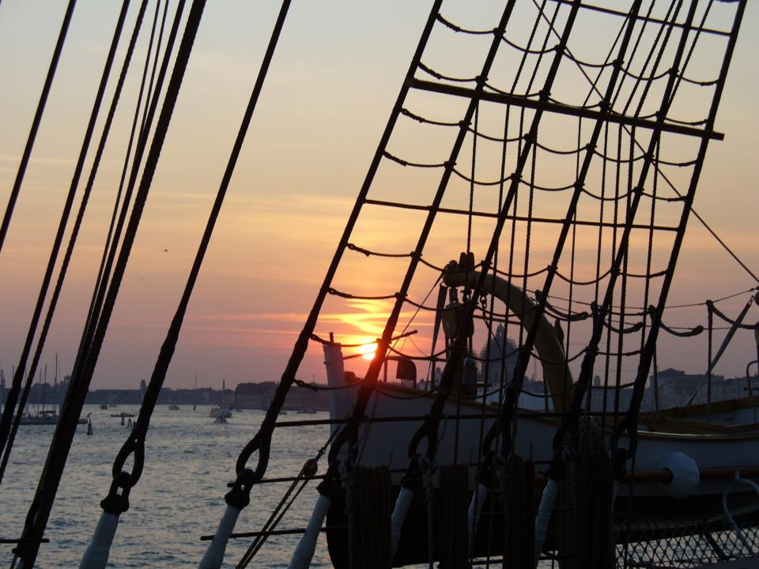
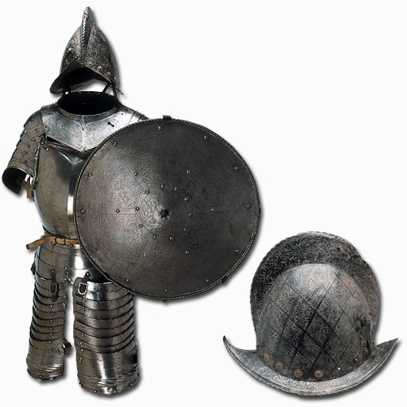
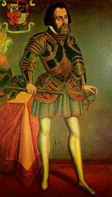
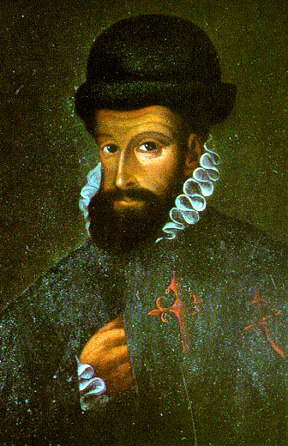
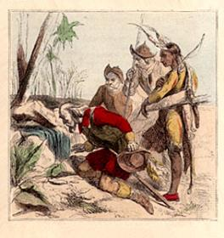
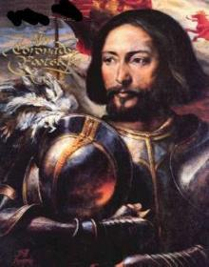
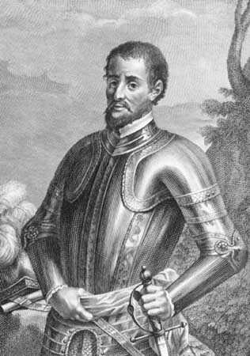
Columbus launched a wave of European exploration and settlement
a) Cortez→ Mexico
b) Pizarro→ Peru
c) Ponce→ Florida
d) Vasquez→ Southwest
e) Hernando→ Southeast
Exploring the New World

Slide 13
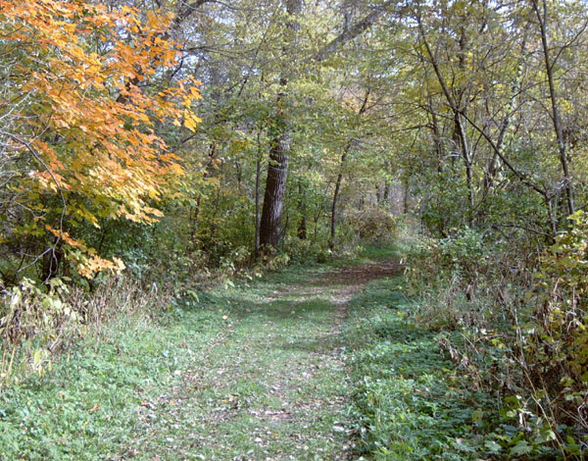
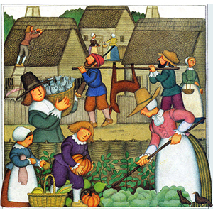

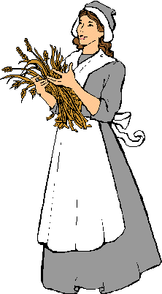

European Impact
Europeans in the Americas had both positive and negative consequences.
  Positives: the exchange of new foods, farming methods, inventions, and technology.
  Negative: Native American population was exposed to diseases that they had no immunity to

Slide 14

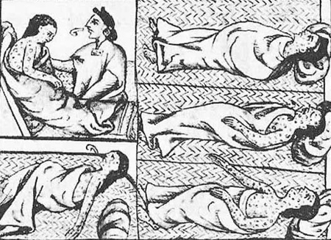
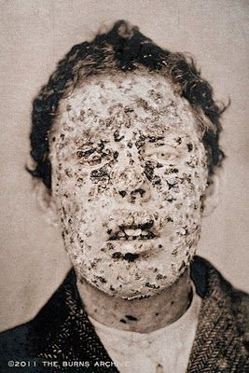
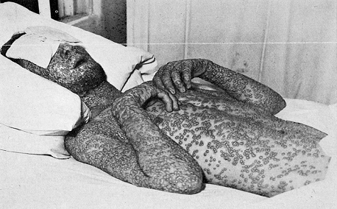
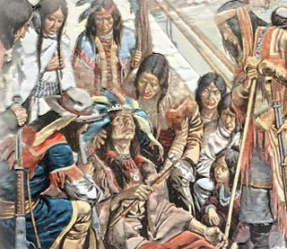

Disease
Disease would kill off 90% of the Native American population.
They had never be exposed to such diseases before and had no immunity to them

Slide 15


Columbian Exchange
Where did it originally come from?
  Americas or Europe

Slide 16

Columbian Exchange
Where did it originally come from?
  Americas or Europe

Slide 17
Columbian Exchange
Where did it originally come from?
  Americas or Europe

Slide 18
Columbian Exchange
Where did it originally come from?
  Americas or Europe

Slide 19
Columbian Exchange
Where did it originally come from?
  Americas or Europe

Slide 20
Columbian Exchange
Where did it originally come from?
  Americas or Europe

Slide 21
Columbian Exchange
Where did it originally come from?
  Americas or Europe

Slide 22
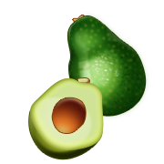
Columbian Exchange
Where did it originally come from?
  Americas or Europe

Slide 23
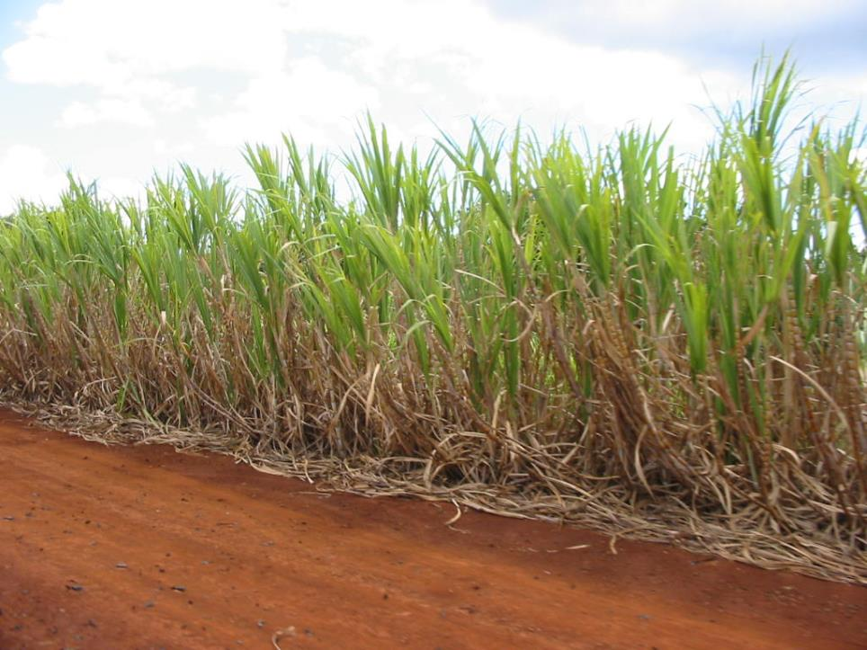
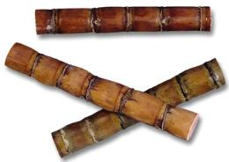

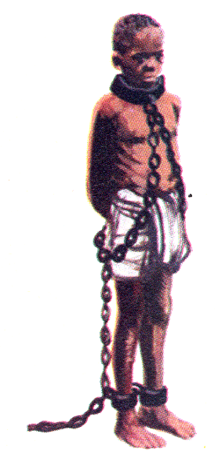
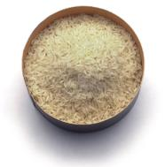
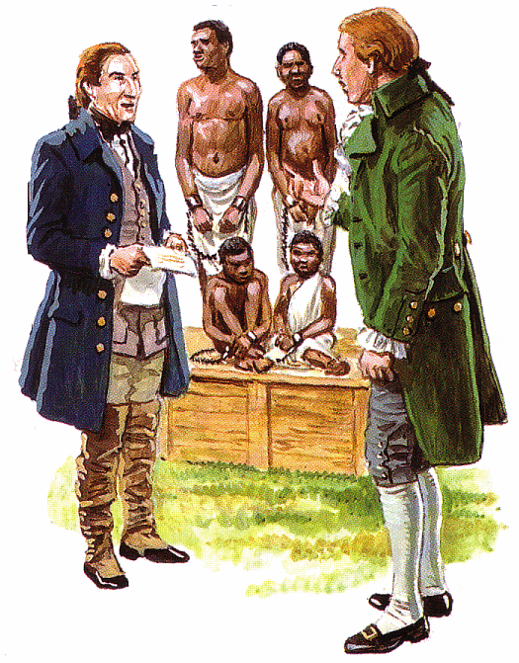
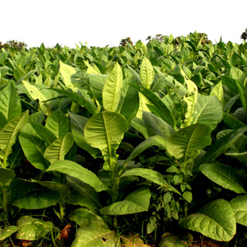
Establishing
Colonies
By the 1600s the French and English had established colonies in the eastern part of North America
They began importing enslaved Africans to grow sugar, rice, cotton, and tobacco.
CASH CROPS

Slide 24
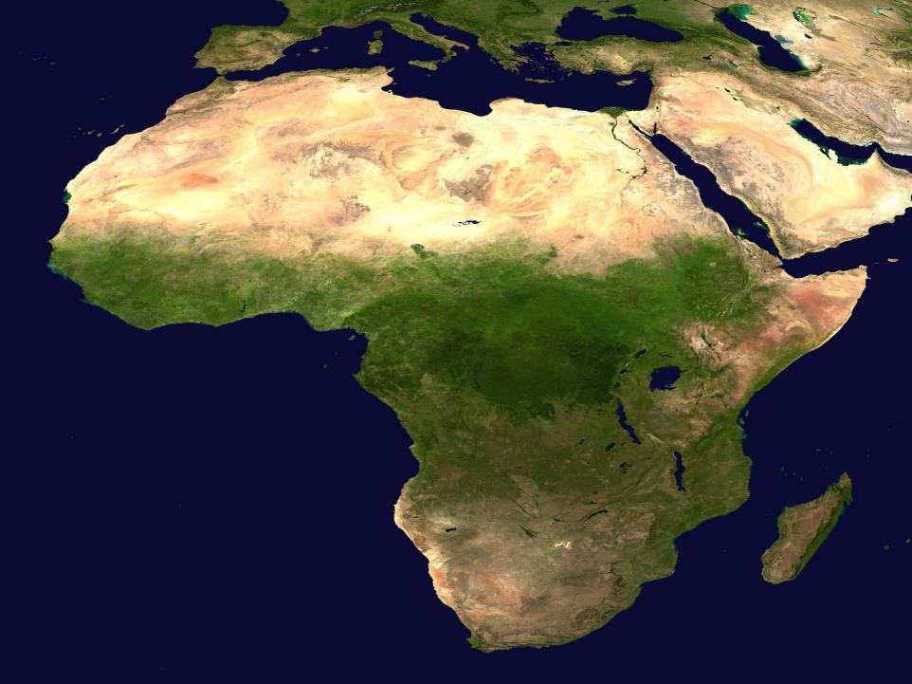
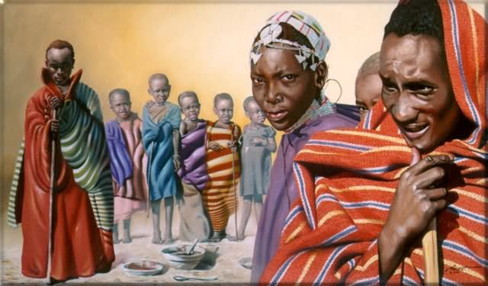
Why Africans for Slavery?
Africans had some immunity to European diseases
Had experience farming
Less likely to escape because they didn’t know the land
Their skin color made it easier to catch them if they escaped

Slide 25
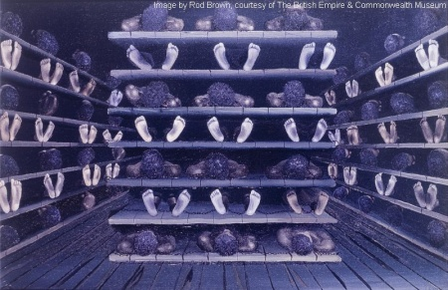
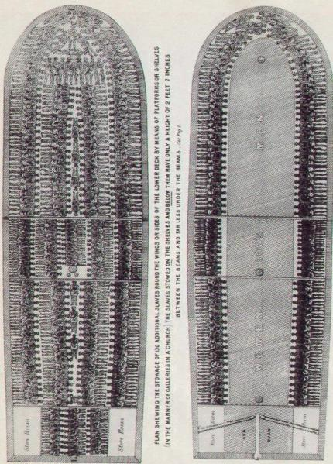
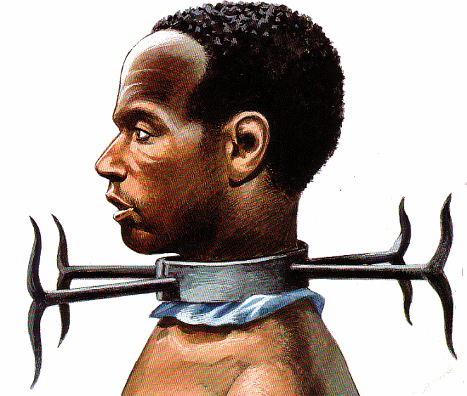
During the 15th century Africans were captured, enslaved and shipped to the New World.
20% of the Africans onboard would not survive the journey

Slide 26
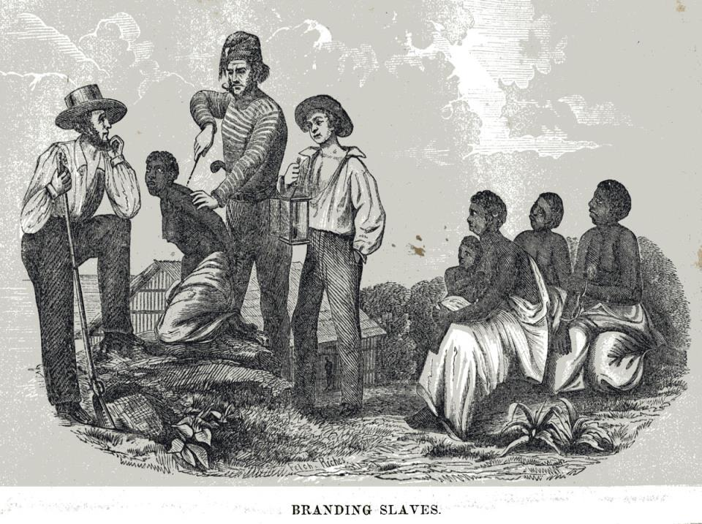




Slide 27
What were some of the positive and negative consequences of the arrival of Europeans in the New World?
Checking for Understanding
Positives- Columbian Exchange
Negatives- brought diseases that killed millions of Native Americans, use of slave labor

Slide 28
What are examples of cash crops?
Checking for Understanding
Tobacco, sugar, cotton, rice

Slide 29


First Settlements
Quebec
Jamestown
Louisiana

Slide 30

Jamestown- First lasting settlement, in Virginia
John Smith →
Fort
Captain John Smith and a painting of Jamestown.

Slide 31


Pilgrims
Some Puritans, called Separatists, were being persecuted by the King.
1620 Pilgrims, set sail for America on the Mayflower and settled off the coast of Cape Cod.

Slide 32


Mayflower Compact
A plan for self government known as the Mayflower Compact
The Mayflower Compact, signed by 41 English colonists on the ship Mayflower on November 11, 1620, was the first written framework of government established in what is now the United States.
The compact was drafted to prevent dissent amongst Puritans and non-separatist Pilgrims who had landed at Plymouth a few days earlier.

Slide 33

How can the Mayflower Compact be seen as a stepping stone to the creation of American Democracy?

Slide 34

13 Colonies
NEW ENGLAND COLONIES
Maine New Hampshire Massachusetts Rhode Island Connecticut
MIDDLE COLONIES
New York New Jersey Pennsylvania Delaware
SOUTHERN COLONIES
Maryland Virginia North Carolina South Carolina Georgia

Slide 35


New England
Colonies
Wanted to keep their family unit together and practice their own religion.
Puritans, who led very strict lives.
Not depending on other people for much.

Slide 36

Middle Colonies
Looking to practice their own religion (Pennsylvania mainly) or to make money.
Many of these people didn't bring their families with them from England and were the perfect workers for the hard work required in ironworks and shipyards.
Mixture of religions, including Quakers, Catholics, Lutherans, Jews, and others
William Penn

Slide 37

This picture of Bethlehem, Pennsylvania is typical of many towns in the Middle Colonies.

Slide 38




Maryland
Lord Baltimore, founded Maryland founded as a place of refuge for Catholics
In 1649, Maryland passed the Toleration Act, which granted religious toleration to all Christians.

Slide 39

Southern Colonies
Main motivation was to make money that was available in the new American market.
They brought their families to live on plantations.
Baptists and Anglicans

Slide 40
What colony was founded as a place for Catholic refugees?
Checking for Understanding
Maryland

Slide 41

Reasons People Moved to America
MAKE MONEY
America offered an abundance of raw and natural materials
Colonists could make good money by growing cash crops such as tobacco , sugar, and cotton
RELIGIOUS FREEDOM
Were not allowed to practice their beliefs in their old country
America is less discriminatory on religious beliefs
* example: Colony of Maryland was founded as a place for Catholic Refugees
Own Land
In Europe only the wealthy could own land
In America it did not matter your background or where you came from. Anyone could own land

Slide 42



Triangular Trade
Colonial merchants developed a triangular trade, exchanging goods between the colonies, England, Caribbean sugar planters, and Africa.
This trade led to increased colonial wealth, business investment, and the growth of cities.

Slide 43
What 3 factors influenced Europeans to move to America?
Checking for Understanding
Religious Freedom
Make Money
Own Land

Slide 44
How did the triangular trade benefit the colonies?
Checking for Understanding
The triangular trade allowed the colonies to exchange goods between several continents. It led to increased wealth, business investment, and the growth of cities.

Slide 45


Enslaved People
Enslaved Africans arrived in the colonies as early as 1619.
1775 slaves made up 20 percent of the population.
Slave codes denied slaves rights
  Cannot own property
  No education
  Cannot assemble
  Restricted movement

Slide 46


Slide 47




Not Everyone is Equal
Women and Jews did not have equal citizenship rights in the colonies.
  could not vote or hold public office.
Native Americans & Africans forced into slavery were abused

Slide 48
Which groups in the colonies did not have equal rights?
Checking for Understanding
Women, Jews, Native Americans and Enslaved Africans

