Slide 1
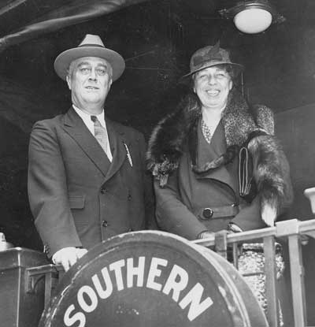
Culture in the 1930s
Notes:
Pictured above is FDR with his wife Eleanor.

Slide 2
D. Challenges at Home and Abroad (ca. 1914-1945) g. Evaluate the impact of the New Deal on various elements of American society (e.g., social, political, environmental, economic)

Slide 3
Eleanor Roosevelt
Eleanor was FDR’s wife. She took a major role in supporting various political goals while FDR was President.
She fought for the rights of minorities and women. Eleanor wanted the New Deal programs to help the poor living in the USA.
Eleanor supported Civil Rights for African Americans as well. She was upset that many New Deal programs seemed to discriminate against African Americans.
Notes:
Copyright, USHistoryTeachers.com All Rights Reserved.

Slide 4
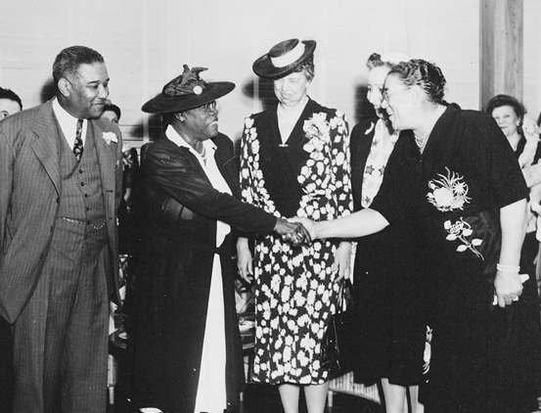
Eleanor Roosevelt standing with Mary Bethune. Bethune served with FDR to help African Americans.
Notes:
Copyright, USHistoryTeachers.com All Rights Reserved.

Slide 5
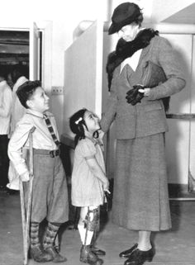
Eleanor Roosevelt visiting a children’s hospital.

Slide 6
African Americans in the 1930s
The struggle to give African Americans the rights they deserved grew in the 1930s.
FDR appointed many African Americans to serve in government positions. Mary Bethune, an African American, was hired to serve in the National Youth Administration to help African American Youth.
Bethune also helped create the “Black Cabinet.” This group assisted FDR on issues dealing with minorities.
Notes:
Copyright, USHistoryTeachers.com All Rights Reserved.

Slide 7
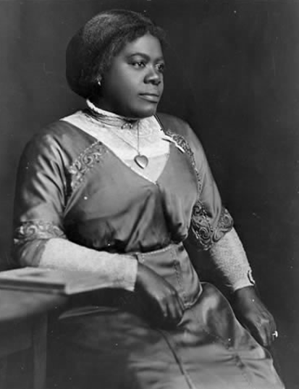
Mary Bethune served in FDR’s “Black Cabinet” to assist his administration to address the concerns of the African American community.

Slide 8
FDR and Civil Rights
While the Roosevelt administration saw some improvement with Civil Rights, many offered criticism as well.
For instance, FDR refused to sign a federal anti-lynching law, saying it was a “states matter.”
The New Deal Programs that created jobs also discriminated against African Americans and even paid some workers less than whites.
Notes:
Copyright, USHistoryTeachers.com All Rights Reserved.

Slide 9
Warning: Graphic Images

Slide 10
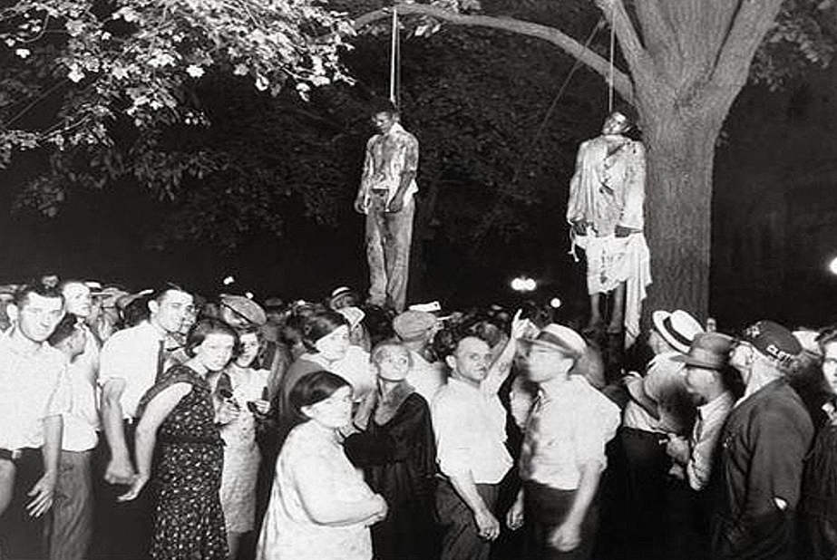
In the late 19th and early 20th Centuries, many African Americans became victims of mob lynching.
Notes:
Use this slide to help students to understand how the failure of Reconstruction impacted the following Civil Rights Movement in the 20th Century and how the KKK propagated murderous racism in the South. Also use this to address FDR refusing to sign a federal anti-lynching law.

Slide 11
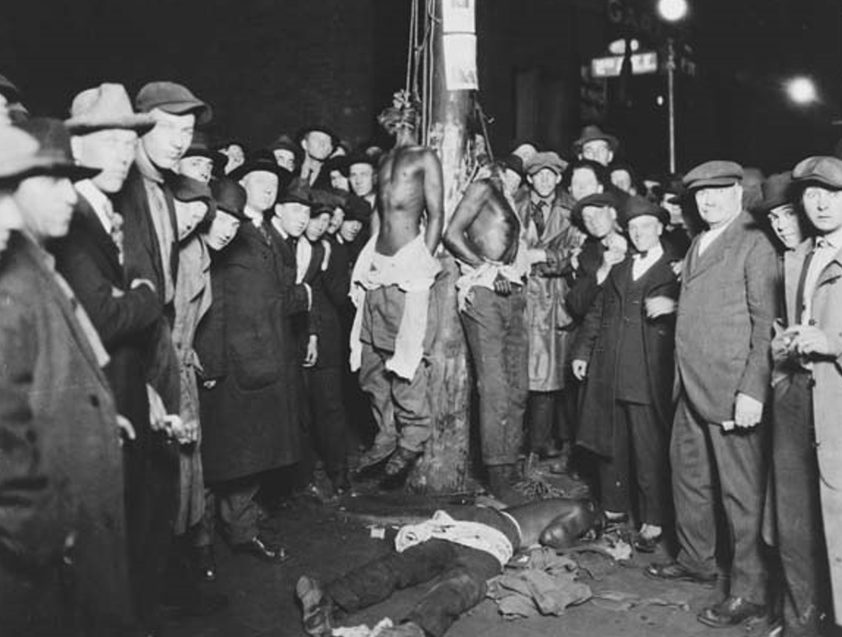
Notes:
Use this slide to help students to understand how the failure of Reconstruction impacted the following Civil Rights Movement in the 20th Century and how the KKK propagated murderous racism in the South. Also use this to address FDR refusing to sign a federal anti-lynching law.

Slide 12
The New Deal Coalition
While many argued FDR did not go far enough to help with Civil Rights, his modest advancement gained the support of many minorities.
The New Deal Coalition was a mixture of Southerners whites, African Americans, unions, and others that supported the New Deal programs.
The Wagner Act made unions and collective bargaining legal. Organized labor grew rapidly while FDR was President.
Notes:
Copyright, USHistoryTeachers.com All Rights Reserved.

Slide 13
Entertainment in the 1930s
Despite the poor economy, many flocked to the movies during the 1930s as an escape from the problems the nation was facing.
Famous films like Gone with the Wind, The Wizard of Oz, Snow White and the Seven Dwarfs, and others gained millions of dollars across the nation.
In his famous book, The Grapes of Wrath, John Steinbeck depicted the impact of the Great Depression on those living in Oklahoma.
Notes:
Copyright, USHistoryTeachers.com All Rights Reserved.

Slide 14
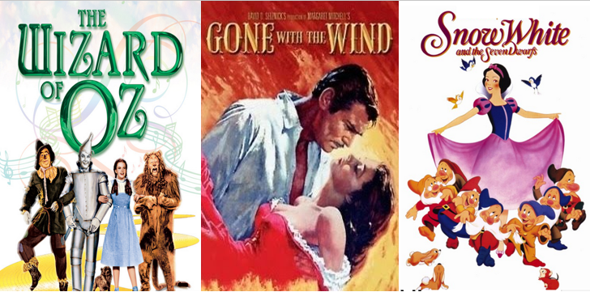
Despite the struggling economy, many Americans flocked to the movies
during the 1930s as an escape from
their difficult circumstances.

Slide 15
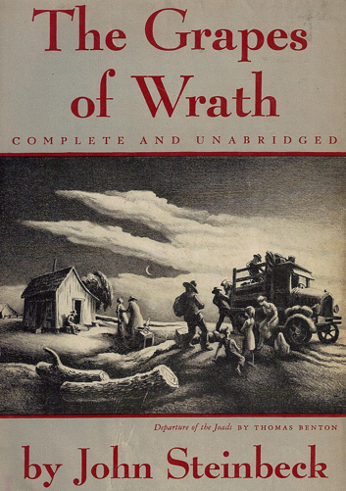
John Steinbeck’s famous novel depicted what life was like for those living in Oklahoma during the Great Depression and suffering from the impact of the Dustbowl.

Slide 16
THE
END

