Slide 1
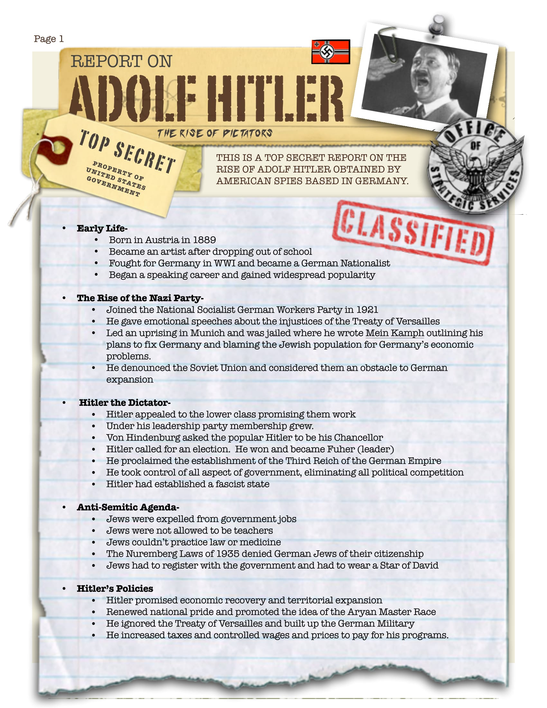
Dictators Come to Power

Slide 2
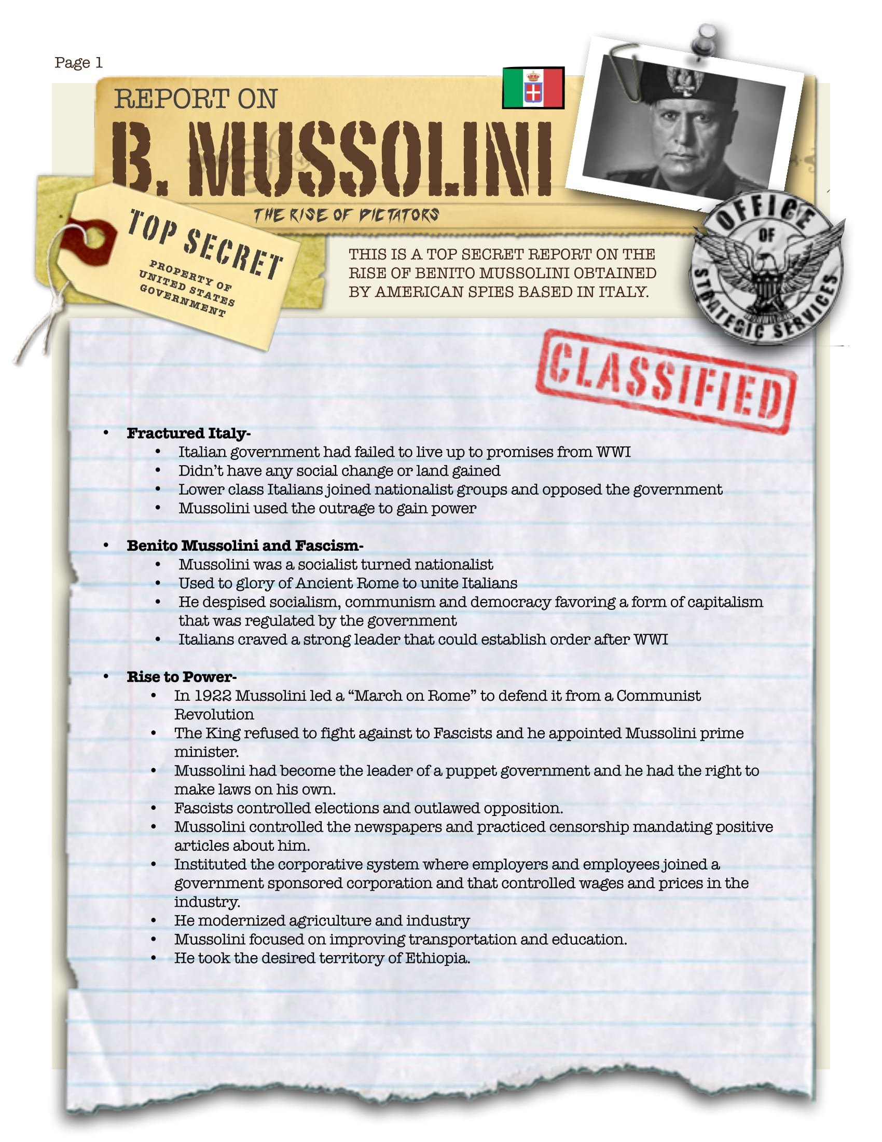
Dictators Come to Power

Slide 3
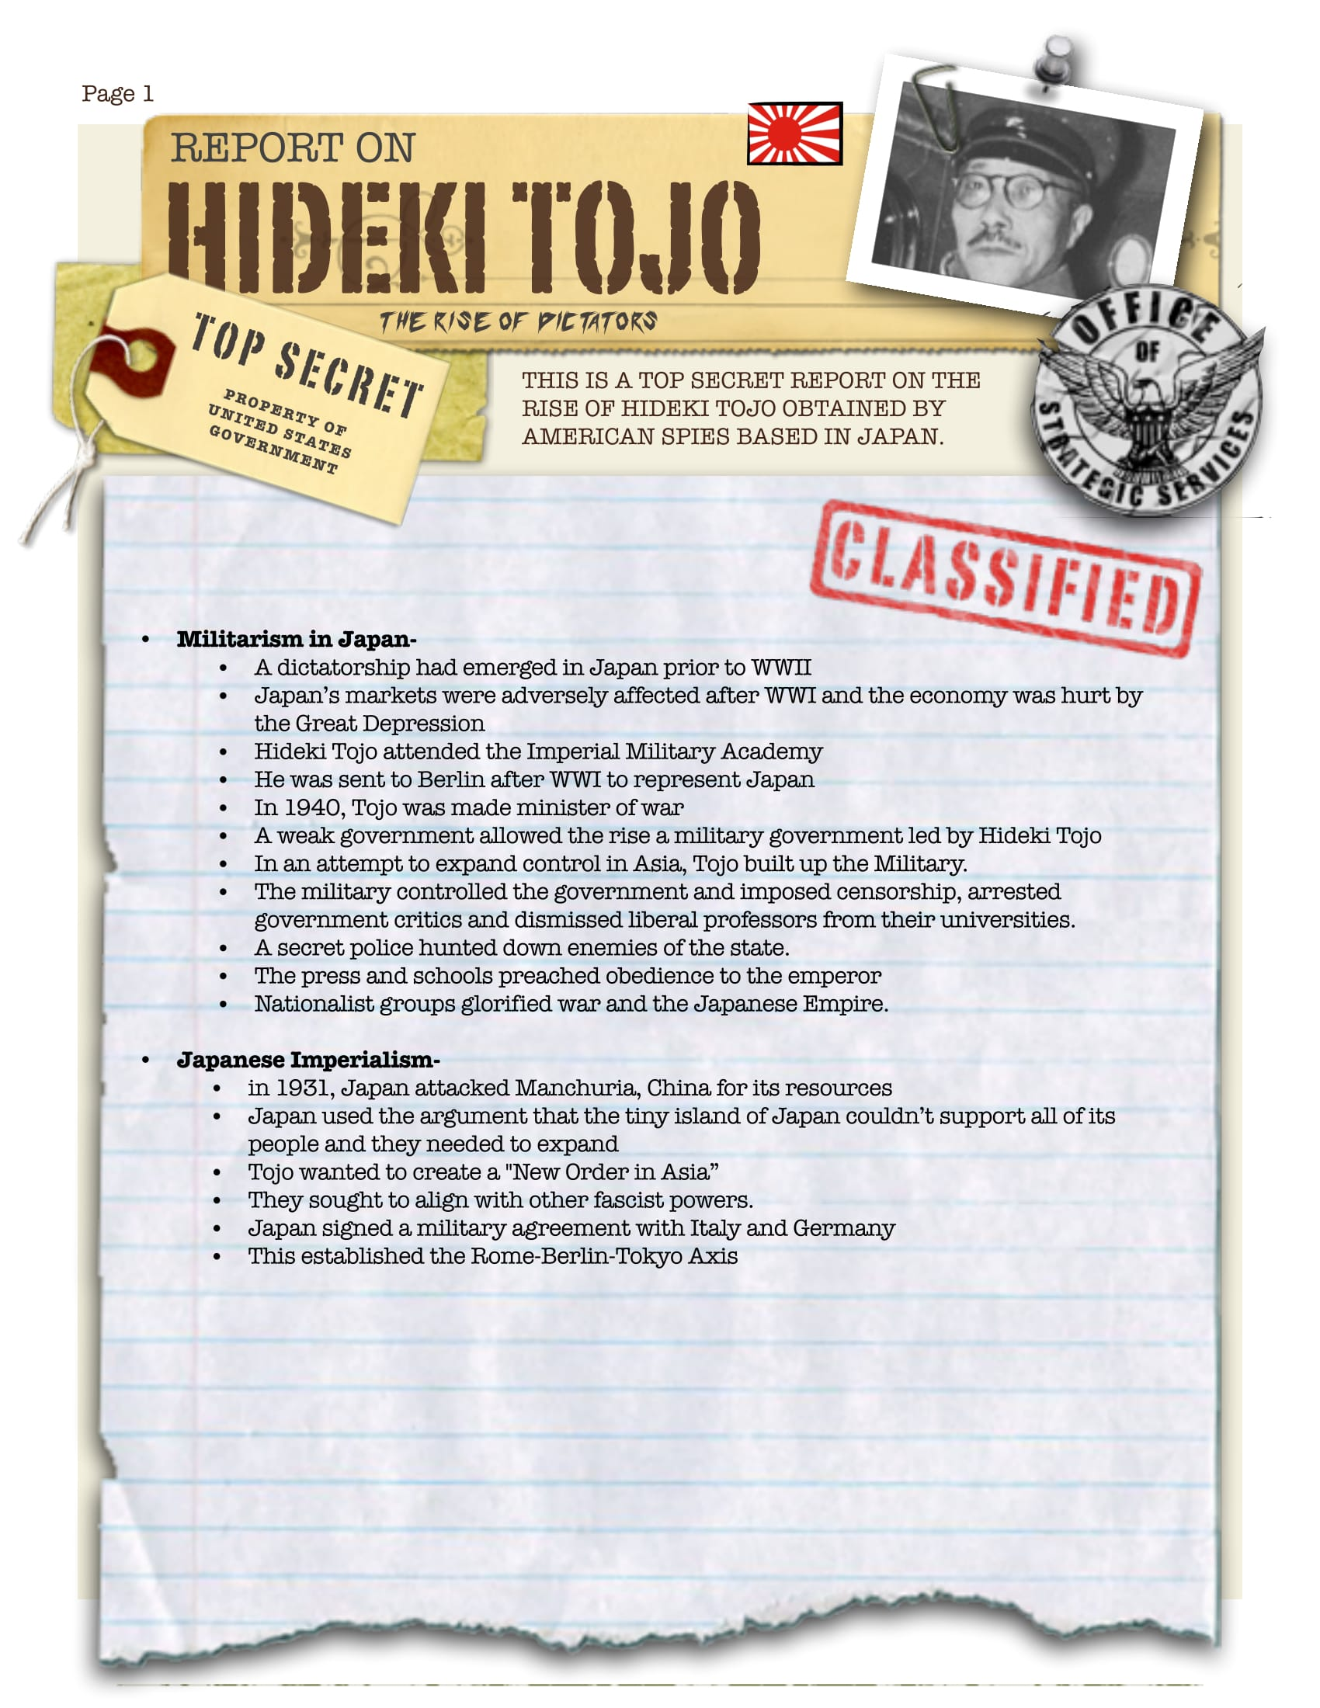
Dictators Come to Power

Slide 4
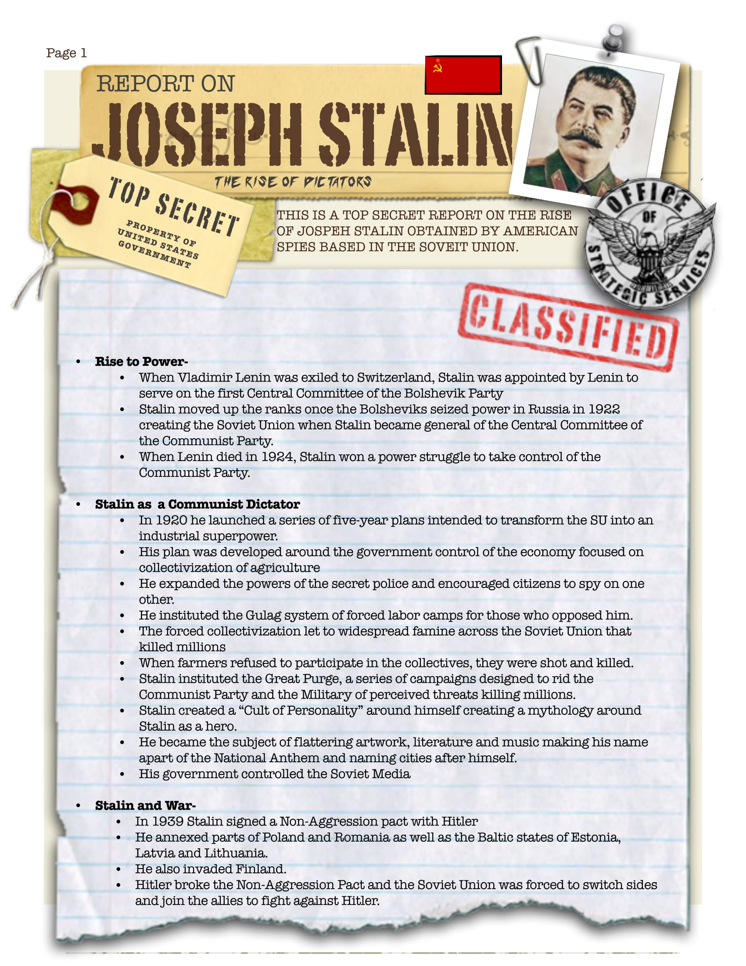
Dictators Come to Power

