Slide 1
Name:
Evaluating the Economy of the Twenties

Slide 2
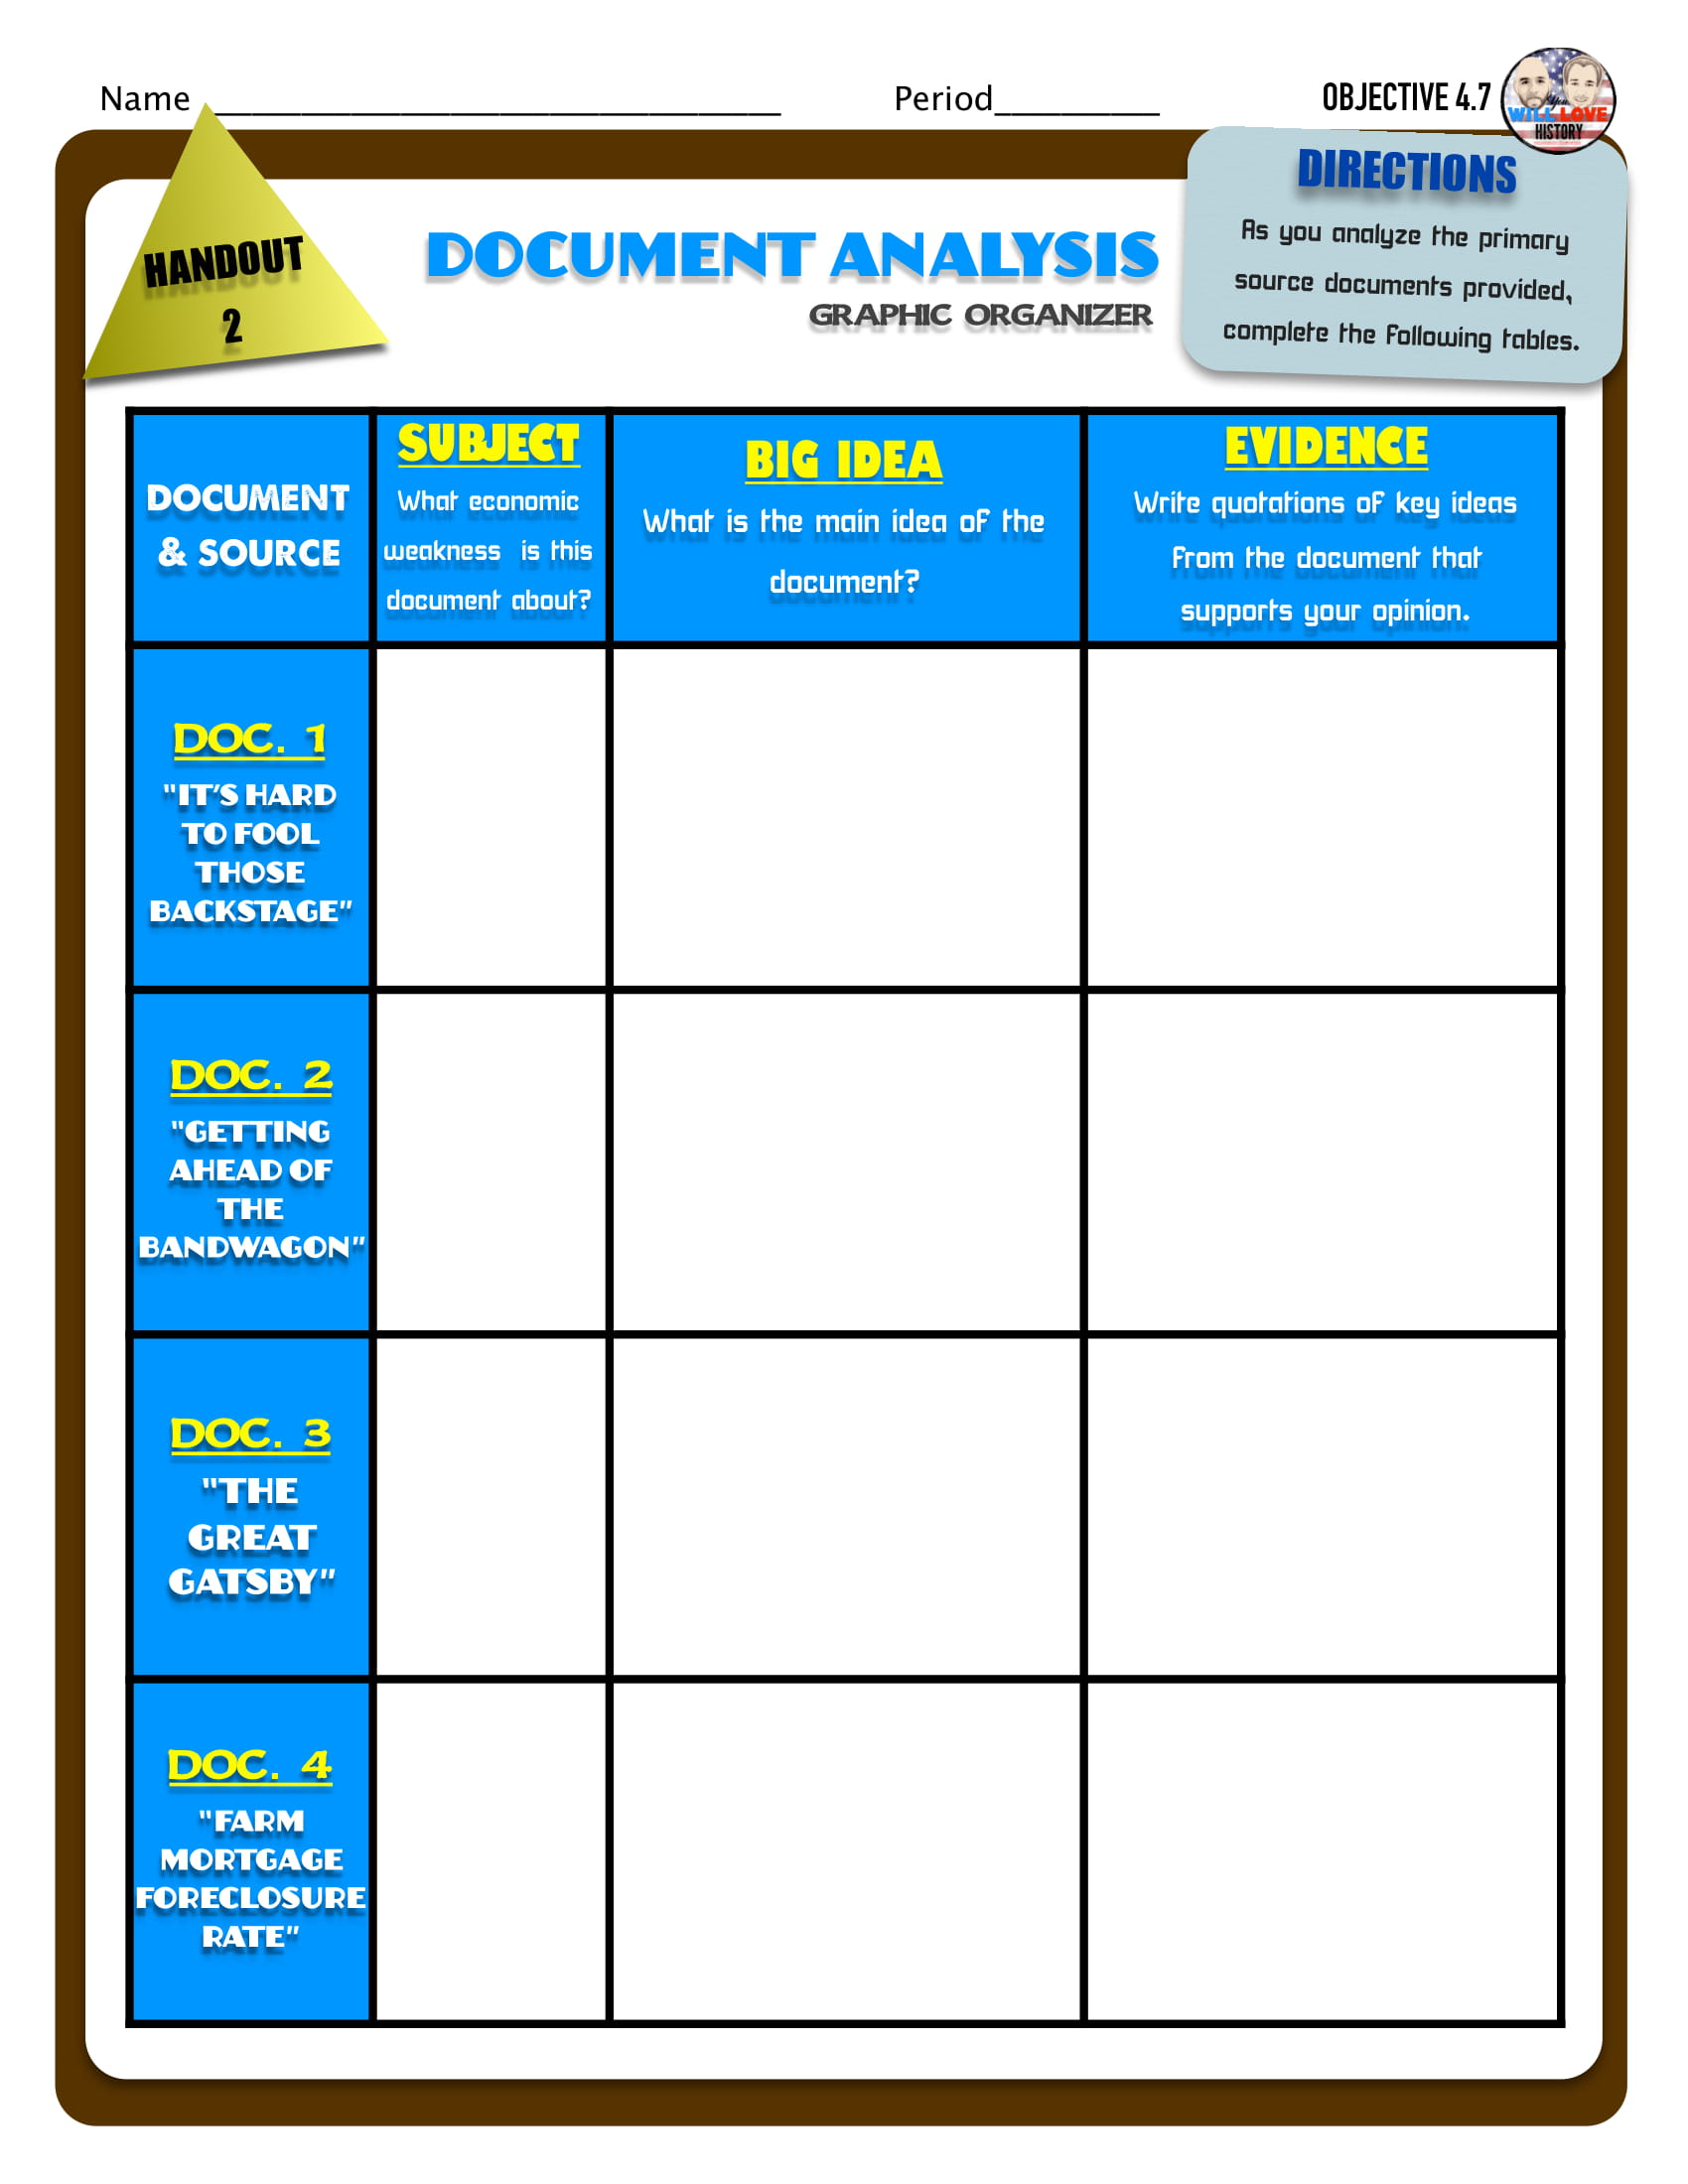
Evaluating the Economy of the Twenties

