Slide 1
American History
Review: Exploration to Constitution

Slide 2
Eras of US History Timeline
Put the following era of US history in order on the timeline above.
Exploration
Age of Jackson
Reconstruction
Civil War
Colonization
Westward Expansion/ Reform/ Sectionalism
Early Republic
Constitution
Revolution/ Declaration of Independence
Notes:
8.1(A): Identify the major eras and events in US history through 1877, including colonization, revolution, drafting the Declaration of Independence, creation and ratification of the Constitution, religious revivals such as the 2nd Great Awakening, early republic, the Age of Jackson, westward expansion, reform movements, sectionalism, Civil War, and Reconstruction, and describe their causes and effects

Slide 3
Eras of US History Timeline
Early Republic
Civil War
Colonization
Age of Jackson
Reconstruction
Exploration
West Exp, Reform, Sec.
Revolution/Dec. of Independence
Constitution
Exploration
Age of Jackson
Reconstruction
Civil War
Colonization
Westward Expansion/ Reform/ Sectionalism
Early Republic
Constitution
Revolution/ Declaration of Independence
Notes:
8.1(A): Identify the major eras and events in US history through 1877, including colonization, revolution, drafting the Declaration of Independence, creation and ratification of the Constitution, religious revivals such as the 2nd Great Awakening, early republic, the Age of Jackson, westward expansion, reform movements, sectionalism, Civil War, and Reconstruction, and describe their causes and effects

Slide 4
Exploration
Age of Exploration: Time period in which Europeans explored in search for Gold, Glory, and God
Northwest Passage: An East to West trade route to India
Reasons for Exploration | Explanation
Gold | European countries raced to expand European trade to increase wealth
Glory | European countries were competing for recognition and power among European countries
God | Desire for religious freedom and missionary work in the New World
Notes:
8.2(A): Identify reasons for European exploration and colonization in North America.

Slide 5
Colonization
Age of Colonization: Mass amounts of people from a specific country migrating to a new place to settle colonies with their own economies and societies
4 basic reasons for colonization: Political, Social, Religious, Economic
Economic
Push: Create colonies to support mercantilism
Pull: Desire own land, natural resources for profit
Religious
Push: King made everyone practice same religion
Pull: Escape religious persecution, freedom of religion
Social
Push: Rid society of excessive population
Pull: Start a new life, climb social ladder
Political
Push: Extend King’s power and domain
Pull: Self-government, more political freedom
Push and Pull Factors?
Push and Pull Factors?
Push and Pull Factors?
Push and Pull Factors?
Notes:
8.2(A): Identify reasons for European exploration and colonization in North America.

Slide 6
13 Colonies Map
Label the 13 Colonies and color regions as followed
New England – Red
Middle – Green
Southern - Orange
Colony Bank
Delaware
New York
Massachusetts
New Hampshire
Connecticut
North Carolina
South Carolina
Georgia
Maryland
New Jersey
Rhode Island
Virginia
Maryland
Notes:
8.10(B): Compare places and regions of the United States in terms of physical and human characteristics

Slide 7
13 Colonies Map
New England Colonies
Connecticut
New Hampshire
Massachusetts
Rhode Island
New Hampshire
Massachusetts
Rhode Island
Connecticut
Notes:
8.10(B): Compare places and regions of the United States in terms of physical and human characteristics

Slide 8
13 Colonies Map
Middle Colonies
New York
New Jersey
Pennsylvania
Delaware
New York
New Jersey
Pennsylvania
Delaware
Notes:
8.10(B): Compare places and regions of the United States in terms of physical and human characteristics

Slide 9
13 Colonies Map
Southern Colonies
Virginia
Maryland
North Carolina
South Carolina
Georgia
Maryland
Virginia
North Carolina
South Carolina
Georgia
Notes:
8.10(B): Compare places and regions of the United States in terms of physical and human characteristics

Slide 10
New England Colonies
The geography of a colony effects the products it makes (economy)
Geography
Rocky, thin soil
Economy
Winters: long and cold
Lots of Forest
On a Coastline
Lumbering
Fishing
Shipbuilding
Trade
Subsistence Farming: only farming enough for your own family
Notes:
8.10(C): Analyze the effects of physical and human geographic factors on major historical and contemporary events in the US.

Slide 11
Middle Colonies
The geography of a colony effects the products it makes (economy)
Geography
Flat, open land, fertile soil
Economy
Made their living by farming wheat, barley, oats, rye
Coastline
Lots of iron ore
Mild climate, allowed for long growing season
“Breadbasket Colonies”
Craftsmen & Manufacturing
Harbors for fishing and trade
New York & Philadelphia - large trading centers
Notes:
8.10(C): Analyze the effects of physical and human geographic factors on major historical and contemporary events in the US.

Slide 12
Southern Colonies
The geography of a colony effects the products it makes (economy)
Geography
Lots of rich, fertile soil
Economy
Swampy coasts allowed for tobacco and rice to be grown
Areas of swampy coastlines
Climate: Mild with short winters and long springs and summers
Plantations: large scale farms that need vast amount of labor and grew cash crops for large profits
Relied on slave trade to get more slaves to work on plantations
Notes:
8.10(C): Analyze the effects of physical and human geographic factors on major historical and contemporary events in the US.

Slide 13
Jamestown and Plymouth
Colony | Importance | Who settled and year | Government
Jamestown | First permanent English colony | Virginia Company, 1607 | Virginia House of Burgesses – 1st Rep. Gov. in colonies
Plymouth | First colony founded for religious freedom | Pilgrims, 1620 | Mayflower Compact – Social contract creating self-government
Notes:
8.1(C): Explain the significance of the following dates: 1607, founding of Jamestown; 1620, arrival of Pilgrims and signing of the Mayflower Compact (supporting standard)

Slide 14
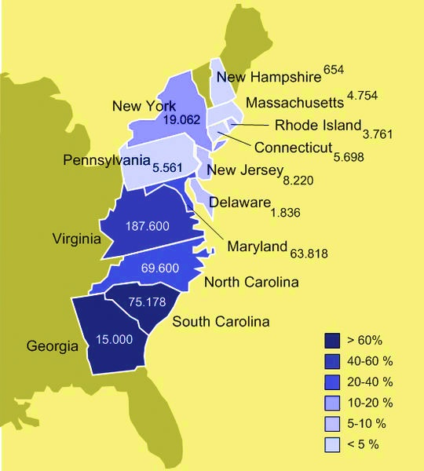
Impact of Slavery
Map Analysis Questions:
Which section of the colonies had the most slavery?
Why did this section of the colonies feel that slavery was so important?
Southern Colonies
Plantation systems used free slave labor to make more money off growing cash crops
Notes:
8.7C: Analyze the impact of slavery on different sections of the US

Slide 15
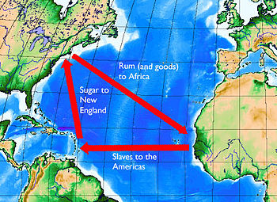
Triangular Trade and the Middle Passage
Triangular Trade and the Middle Passage
Map Analysis Questions:
Explain Triangular Trade using the map.
Circle the Middle Passage
Process by which slaves, goods, and natural resources were traded between W. Africa, W. Indies, and 13 Colonies
Notes:
8.12(B): Explain reasons for the development of the plantation system, the transatlantic slave trade, and the spread of slavery

Slide 16
French and Indian War
The French and Indian War was a war between ________and ____________. They both wanted control over the profitable _________________fur trade. The ________ would win the war, and the war would be ended by the _____________1763
France
Great Britain
Ohio River Valley
British
Treaty of Paris
Effects of the French and Indian War
British Problem | Giant War debt that needs to be repaid | Problems with Native Americans West of the Appalachians
British Solution | British impose high taxes on colonists to help pay debt | Proclamation of 1763: forbade colonists from going past the Appalachians
Colonists Reaction | Colonists angry about paying higher taxes | Colonists angry they cannot go into land they helped fight for
Notes:
8.4(A): analyze causes of the American Revolution, including the Proclamation of 1763, the Intolerable Acts, the Stamp Act, mercantilism, lack of representation in Parliament, and British economic policies following the French and Indian War

Slide 17
Causes of the American Revolution
Fill out the timeline below using the descriptions of the events.
1. _______
First tax on sugar and molasses
2. _______
Tax on paper goods
3. _______
Tax on tea
Sugar Act
Stamp Act
Tea Act
4. _______
Civil disobedience
5. _______
Punishment for Boston Tea Party
6. _______
Creates colonial militias
Dumped tea into harbor
Boston Tea Party
Intolerable Acts
1st Cont. Congress
Word Bank
1st Continental Congress Stamp Act Intolerable Acts
Sugar Act Boston Tea Party Tea Act
Notes:
8.4(A): analyze causes of the American Revolution, including the Proclamation of 1763, the Intolerable Acts, the Stamp Act, mercantilism, lack of representation in Parliament, and British economic policies following the French and Indian War

Slide 18
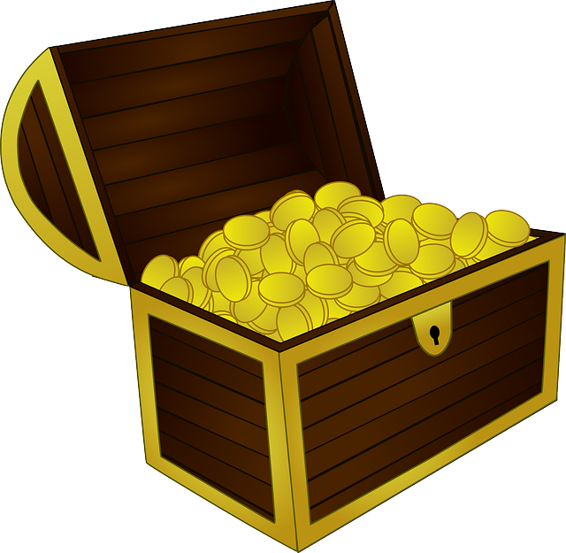
Causes of the American Revolution
Complete the cloze reading:
_________________is the theory that a nations wealth is dependent on the amount of _____________in its treasury. Therefore, England colonized North America to use it for its _______________________ to increase its exports to make a ________________.
Because ____________________ did not want the colonists trading their natural resources with other countries, they created the _____________. These laws ________colonists from trading with any other nation expect the mother country, Great Britain.
Mercantilism
Gold
Natural Resources
Profit
Great Britain
Navigation Acts
Forbid
Word Bank
Navigation Acts Mercantilism Great Britain
Gold Natural Resources Profit Forbid
Notes:
8.4(A): analyze causes of the American Revolution, including the Proclamation of 1763, the Intolerable Acts, the Stamp Act, mercantilism, lack of representation in Parliament, and British economic policies following the French and Indian War

Slide 19
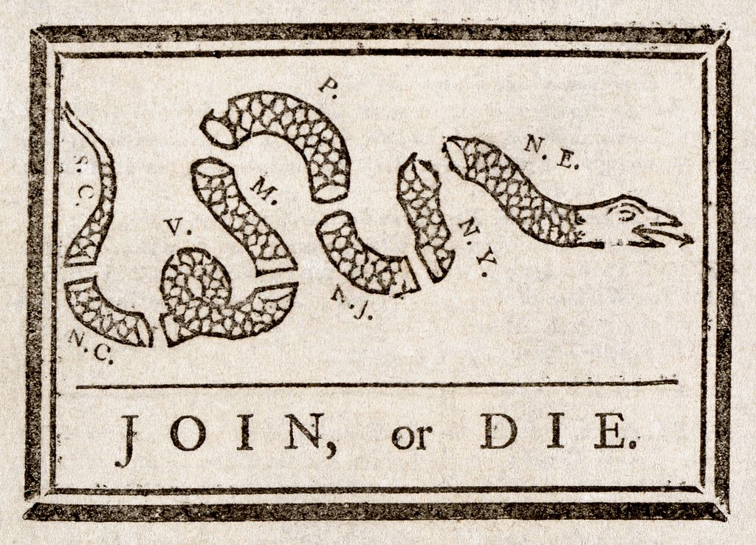
Causes of the American Revolution
American colonists began to split into 2 differing views, patriots and loyalists. Patriots wanted revolution with Great Britain and complete separation; where as Loyalists wanted to stay loyal to the king.
Use the diagram below to answer the questions:
What is the image trying to tell its viewers?
Would this image have been drawn by a patriot or a loyalists? Why?
13 colonies must unite together to stay alive
Patriot, because they wanted to colonies to unite to fight for independence from Britain
Notes:
8.4(A): analyze causes of the American Revolution, including the Proclamation of 1763, the Intolerable Acts, the Stamp Act, mercantilism, lack of representation in Parliament, and British economic policies following the French and Indian War

Slide 20
The American Revolution
Match and sequence the following events into the table on the right.
 | 1775: Fought because British were trying to take arms colonists were storing
 | 1777: Turning point, because of this victory, French joined colonists
 | Winter 1778-1779: Washington and troops endure a grueling, freezing winter here
 | 1781: Cornwallis (British commander) surrenders to Washington
 | 1783: Ended the Revolutionary War, extended borders from Atlantic to Mississippi River
Lexington/ Concord
Lexington/ Concord
Yorktown
Saratoga
Treaty of Paris, 1783
Valley Forge
Valley Forge
Saratoga
Yorktown
Treaty of Paris, 1783
Notes:
8.4(C): Explain the issues surrounding important events of the American Revolution, including; writing the Articles of Confederation; fighting the battles of Lexington, Concord, Saratoga, and Yorktown; enduring the winter at Valley Forge; and signing the Treaty of Paris 1783

Slide 21
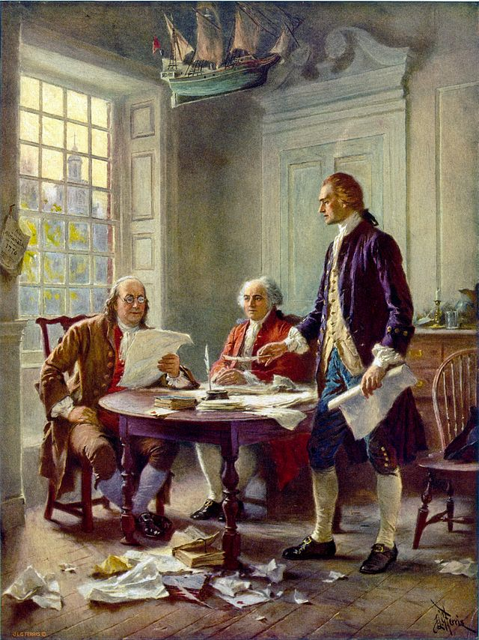
Declaration of Independence
Where and when was the Declaration of Independence written?
Who wrote the Declaration of Independence?
What did it say?
Philadelphia during the Second Continental Congress
July 4, 1776
Thomas Jefferson
Listed grievances (complaints) the colonists had with Great Britain.
Explained government should protect the rights of its citizens, Great Britain had taken rights away.
Declared the 13 colonies as an independent country
Notes:
8.1(C): explain the significance of the following dates; 1776: adoption of the Declaration of Independence
8.4(B): explain the roles played by significant individuals during the American Revolution, including Thomas Jefferson (Supporting standard)

Slide 22
Declaration of Independence
Explain in your own words what the quotes from the Declaration of Independence mean.
“We hold these truths to be self-evident, that all men are created equal, that they are endowed by their Creator with certain unalienable Rights, that among these are Life, Liberty and the pursuit of Happiness.”
“That to secure these rights, Governments are instituted among Men, deriving their just powers from the consent of the governed.”
“That whenever any Form of Government becomes destructive of these ends, it is the Right of the People to alter or abolish it, and to institute new Government.”
“The history of the present King of Great Britain is a history of repeated injuries and usurpations, all having in direct object their establishment of an absolute Tyranny over these states.”
“We therefore…solemnly publish and declare, That these United Colonies are, and of Right ought to be Free and Independent States.”
Notes:
8.15(C): Identify colonial grievances listed in the Declaration of Independence and explain how those grievances were addressed in the US Constitution and Bill of Rights
Citation: Jefferson, T. (1776). The Declaration of Independence. Historic American Documents (Lit2Go Edition). Retrieved December 31, 2014, from http://etc.usf.edu/lit2go/133/historic-american-documents/4957/the-declaration-of-independence/

Slide 23
Declaration of Independence
Match the events from the bank to the grievance stated in the Declaration of Independence
“For quartering of large bodies of troops among us”
Quartering Act
Event Bank
Quartering Act
Stamp Act
Lexington/Concord
Intolerable Acts
Sugar Act
Navigation Acts Townshend Acts Declaratory Act
“For cutting off trade with all parts of the world”
Navigation Acts
“He has … Government here… declaring us out of his Protection and waging War against us”
Declaratory Act
“For imposing taxes on us without our consent”
Intolerable Acts
Notes:
8.15(C): Identify colonial grievances listed in the Declaration of Independence and explain how those grievances were addressed in the US Constitution and Bill of Rights
Citation: Jefferson, T. (1776). The Declaration of Independence. Historic American Documents (Lit2Go Edition). Retrieved December 31, 2014, from http://etc.usf.edu/lit2go/133/historic-american-documents/4957/the-declaration-of-independence/

Slide 24
Inalienable Rights
Give examples of inalienable rights in the boxes below.
Inalienable Rights
Liberty
Life
Pursuit of Happiness
Rights, or freedoms, given to us at birth that cannot be taken away by government.
Answer Bank
More than 1 may be used in each example above and used more than once.
Quartering Act Stamp Act Lexington/Concord
Intolerable Acts Boston Massacre Sugar Act
Navigation Acts Townshend Acts Declaratory Act
Answer Bank
More than 1 may be used in each example above and used more than once.
Quartering Act Stamp Act Lexington/Concord
Intolerable Acts Boston Massacre Sugar Act
Navigation Acts Townshend Acts Declaratory Act
Notes:
8.19(A): Define and give examples of unalienable rights: According to the Declaration of Independence, primarily written by Thomas Jefferson, three unalienable rights are life, liberty, and the pursuit of happiness. These largely echo the unalienable rights identified by John Locke in Two Treatises of Government, except the three Locke articulated were life, liberty, and property.

Slide 25
Articles of Confederation
Weaknesses of the Articles of Confederation | Strengths of the Articles of Confederation
National government could not… Collect taxes Have a federal court system Could barely handle Shay’s Rebellion | Ordinance of 1785: allowed for orderly expansion of the U.S. through new added states Northwest Ordinance: Created the Northwest Territory
The ________________________________met to revise the Articles of Confederation. However, they ended up throwing out the Articles of Confederation and totally re-writing a new plan of government, the ____________________.
Constitutional Convention of 1787
Constitution
Notes:
8.15(B) –Summarize the strengths and weaknesses of the AOC - supporting

Slide 26
Constitutional Convention
The New Jersey Plan
Equal Representation - Each state would have 1 representative in the legislature
The Great Compromise
Bicameral Legislature – 2 House Senate - equal representation (2 Rep each ) House of Representation – Proportional Representation
The Virginia Plan
Proportional Representation – Representation in 2 houses would be based on population
Analysis Questions:
Which plan appealed to the small states?
Which plan appealed to the large states?
Which size state, small or large, got more of what they wanted with the Compromise?
New Jersey
Virginia
Large states
Notes:
8.4(D): Analyze the issues of the Constitutional Convention of 1787, including the Great Compromise and the 3/5 Compromise.

Slide 27
Constitutional Convention
Northern States
Did not want slavery to count in the population total
3/5 Compromise
Each enslaved person would count as 3/5 of a free person
Southern States
Did want slavery to count in the population total so they could have more representatives
Analysis Questions:
Why did the Northern and Southern states have differing ideas about how to count slaves in the population total?
Because representation in the House of Representatives was based on total population.
Notes:
8.4(D): Analyze the issues of the Constitutional Convention of 1787, including the Great Compromise and the 3/5 Compromise.

Slide 28
Ratification
After the Constitutional Convention, the Constitution could not become law until 9 out of 13 states ___________, or approved, it. So the Constitution was sent to the states for approval. ____________were people who supported the Constitution, and _______________ did not.
ratified
Federalists
Anti-Federalists
Federalists Supporters of the Constitution
Wanted a strong national government Wanted to ratify the Constitution
Anti-Federalists Did not support the Constitution
Wanted stronger state governments (States’ rights) Would not ratify without a Bill of Rights
Notes:
8.4(E) Analyze the Arguments for and against ratification

Slide 29
Federalists vs. Anti Federalists
“IT HAS been already observed that the federal government ought to possess the power of providing for the support of the national forces; in which proposition was intended to be included the expense of raising troops, of building and equipping fleets, and all other expenses in any wise connected with military arrangements and operations.” | “The remaining power for peace and trade might perhaps be safely lodged with Congress under some limitations. Three restrictions appear to me to be essentially necessary to preserve that equality of rights to the states, which it is the object of the state governments to secure to each citizen.”
Excerpt from Federalist Paper #30 Alexander Hamilton, published Friday, December 28, 1787 | Excerpt from Anti Federalist Paper #11 Alexander Hamilton, published 1787
Does the quote above represent a Federalists or Anti-Federalists View Point??
Does the quote above represent a Federalists or Anti-Federalists View Point??
Notes:
8.4(E) Analyze the Arguments for and against ratification

Slide 30
Principles of Government
Limited Government
Constitution lists the power of the government, tells government what it can and cannot do.
Popular Sovereignty
People hold the final authority in government, and are the source of governments power. People do this by by voting
Representative Government
People elect their political representatives, and those representatives serve at the will of the people
Individual Rights
Basic liberties and unalienable rights listed in the Bill of Rights (1st 10 Amendments)
Notes:
8.15 (D): analyze how the US Constitution reflects the principles of limited government, republicanism, checks and balances, federalism, separation of powers, popular sovereignty, and individual rights

Slide 31
Principles of Government
SEPARATION OF POWERS
Government is divided up between 3 equal branches, Legislative, Executive, and Judicial, and they all have their own responsibilities
CHECKS AND BALANCES
Each branch of government holds some control over the other branches, to make sure one branch does not become too powerful
FEDERALISM
Dividing and sharing powers between the national and state governments
Notes:
8.15 (D): analyze how the US Constitution reflects the principles of limited government, republicanism, checks and balances, federalism, separation of powers, popular sovereignty, and individual rights

Slide 32
Bill of Rights
1. | Freedom of speech, religion, assembly, petition, and press
2. | Right to bear arms
3. | No quartering (housing) of soldiers in private houses
4. | No unreasonable searches and seizures
5. | Due process of law
6. | Right to a fair, speedy, and public trial
7. | Right to a trial by jury for civil cases
8. | No cruel and unusual punishment
9. | Rights of the people are not limited to the Constitution
10. | All powers not given to the National government are reserved to the state
Real World Examples!!!
Notes:
8.19(B): Summarize rights guaranteed in the Bill of Rights

Slide 33
Bill of Rights
The First Amendment guarantees 5 different freedoms. One of those being religious freedom.
How did life before the Constitution lead Americans to want to add Religious freedom to the Bill of Rights?
How does religious freedom impact our way on life in America today?
Many people migrated from Europe to the colonies to escape religious persecution. Most American colonies practiced religious tolerance because of their negative experience in Great Britain
America has influenced other nation’s around the world through their practice of religious tolerance, and today we get to practice our different religions without fear or persecution
Notes:
8.25(C): Analyze the impact of the First Amendment guarantees on religious freedom on the American way of life.

Slide 34
Checks and Balances
President can veto legislation
Executive Branch
Legislative Branch
May reject treaties
President appoints judges
Impeach justices
Declare acts of president unconstitutional
Declare acts of congress unconstitutional
Judicial Branch
Judicial Review:
Right of the Supreme Court (Judicial Branch) to declare acts of the president and laws the Congress makes unconstitutional.
Notes:
8.18(A): Identify the origin of judicial Review and analyze examples of congressional and presidential responses

Slide 35
Amending the Constitution
Changes
Amendments: _______________to the _________________
Constitution
Process for Amending the Constitution
Amendment created/changed in the Constitution
2/3 of each house must approve change
3/4 of states must approve the change
You must have both!
Notes:
8.16 (A): summarize the purposes for and process of amending the US Constitution

Slide 36
Origins of the Constitution
Historical Document
Principle of Government
Magna Carta:
King was subject to laws like everyone else
Limited Government
English Bill of Rights:
Took away power of the monarch and gave rights to the people
Individual Rights
Mayflower Compact:
First signed government contract in U.S. creating a self-government
Popular Sovereignty
Notes:
8.15(A): Identify the influence of ideas from historic documents, including the Magna Carta, the English Bill of Rights, the Mayflower Compact, the Federalists Papers, and selected Anti-Federalists writings, on the U.S. system of government

