Slide 1
Portugal
1418-1460

Slide 2
Despite being called Prince Henry the Navigator, Henry was not a sailor or a navigator. He sponsored Portuguese explorations that established Europe’s first colonies and discovered places new to the Europeans.

Slide 3
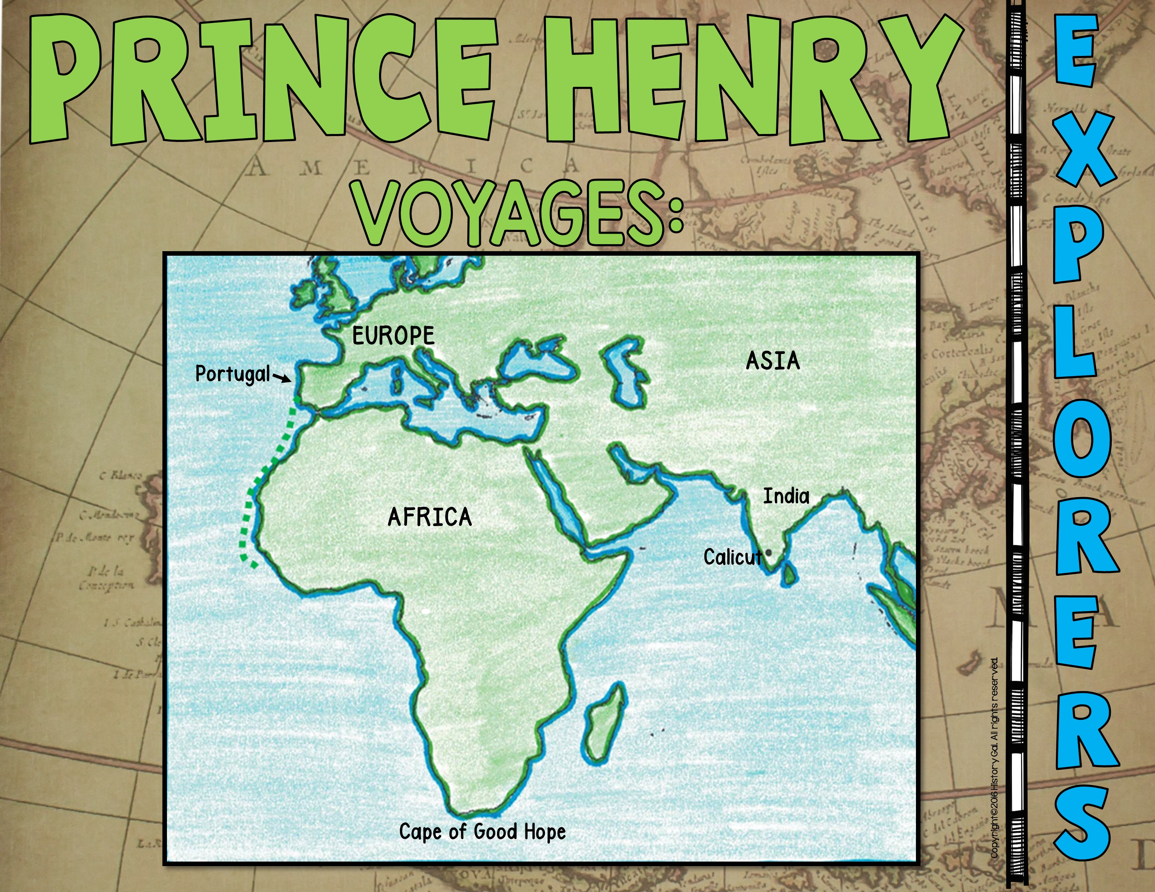
Prince Henry

Slide 4
Portugal
1487-1488

Slide 5
His expedition was the first to sail around the
southern cape of Africa, Cape of Good Hope.

Slide 6
5 Facts about Dias

Slide 7
Spain
1492-1502

Slide 8
He made a total of 4 voyages across the
Atlantic Ocean, “discovered” a New World,
America, and named the natives there, Indians.

Slide 9
Modern Ships
Columbus’ Quest for Gold

Slide 10
Portugal
1497-1499

Slide 11
He and his men traveled 24,000 miles to
discover the first sea route from Europe to Asia.

Slide 12
Fast Facts

Slide 13
England
1497-1498

Slide 14
His expedition was the first European expedition
to set foot on North America since the Vikings
and he claimed the land for England.

Slide 15
Mini-Bio

Slide 16
Spain & Portugal
1499-1504

Slide 17
He explored South America and declared it was a new continent and a New World, not the outskirts of Asia.

Slide 18
Fast Facts

Slide 19
Spain
1508-1513

Slide 20
His expedition explored Puerto Rico. Years later, he led an expedition into Florida (which he named) looking for the mythical Fountain of Youth.

Slide 21
Mini-Bio

Slide 22
Spain
1510-1519

Slide 23
His expedition crossed the Isthmus of Panama
reaching the South Sea (Pacific Ocean). He then claimed the
Pacific Ocean and its shores for Spain.

Slide 24
Balboa Finds the Pacific

Slide 25
Spain
1519-1524

Slide 26
He and his men conquered the Aztecs and made Spain very wealthy.

Slide 27
Mini-Bio

Slide 28
Spain
1519-1521

Slide 29
He led the first expedition to circumnavigate the world. In 1521, he was killed in a battle in the Philippines and in 1522, his crew finished the journey around the world.

Slide 30
Mini-Bio

Slide 31
France
1524-1528

Slide 32
He explored the Atlantic Coast. In 1528, he was
either killed and eaten by cannibals on a Caribbean
island or executed by the Spanish for piracy.

Slide 33
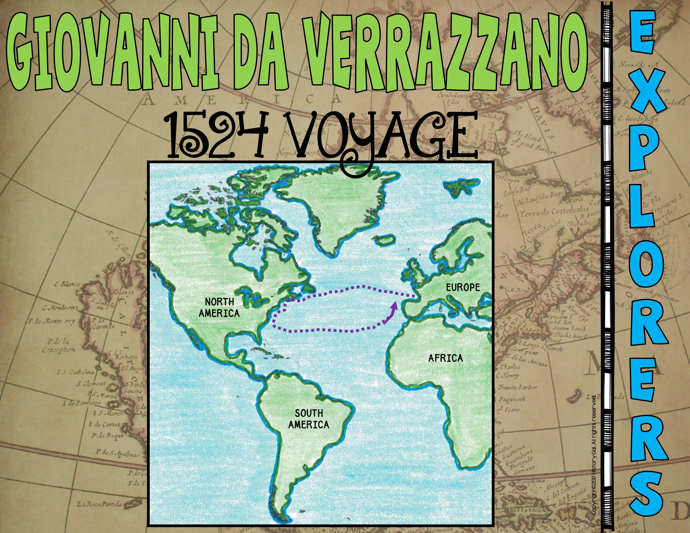
Biography

Slide 34
Spain
1532-1542

Slide 35
His expedition explored the Southeastern United States
and discovered the mouth of the Mississippi River.

Slide 36
Fast Facts

Slide 37
Spain
1532

Slide 38
He and his men conquered the Incas
and made Spain very wealthy.

Slide 39
Fast Facts

Slide 40
France
1534 -1542

Slide 41
In his 3 voyages, he claimed Canada for France
and mapped the St. Lawrence River.

Slide 42
Fast Facts

Slide 43
Spain
1540-1542

Slide 44
His expedition was one of the first to explore the American West. He made contact with the Pueblo Indians and discovered the Grand Canyon.

Slide 45
Mini-Bio

Slide 46
England
1578-1580

Slide 47
He led the first English expedition to circumnavigate the world for Queen Elizabeth I.

Slide 48
Discovery of Drake’s Fleet

Slide 49
France
1603-1616

Slide 50
He mapped the Atlantic coast and the
Great Lakes and founded Quebec.

Slide 51
Mini-Bio

Slide 52
England and Netherlands
1607-1611

Slide 53
His expedition explored the Hudson River and Hudson Bay while looking for the Northwest Passage for England and the East Coast for the Netherlands.

Slide 54
Fast Facts

Slide 55
France
1679-1687

Slide 56
He claimed the regions watered by the Mississippi River
and its tributaries for France. He also named the land Louisiana after King Louis XIV.

Slide 57
Biography

Slide 58
England
1768-1779

Slide 59
During his 3 voyages, he mapped in great detail lands from New Zealand to Hawaii, even searching for the fabled Northwest Passage. In 1779, he died in a fight with native Hawaiians.

Slide 60
The Endeavor

