Slide 1
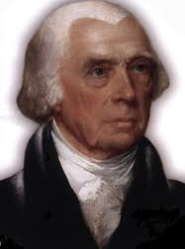
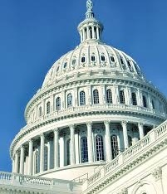
Federalism

Slide 2
Federalism
10th Amendment
“The powers not delegated to the United States by the Constitution, nor prohibited by it to the States, are reserved to the States respectively, or to the people”

Slide 3
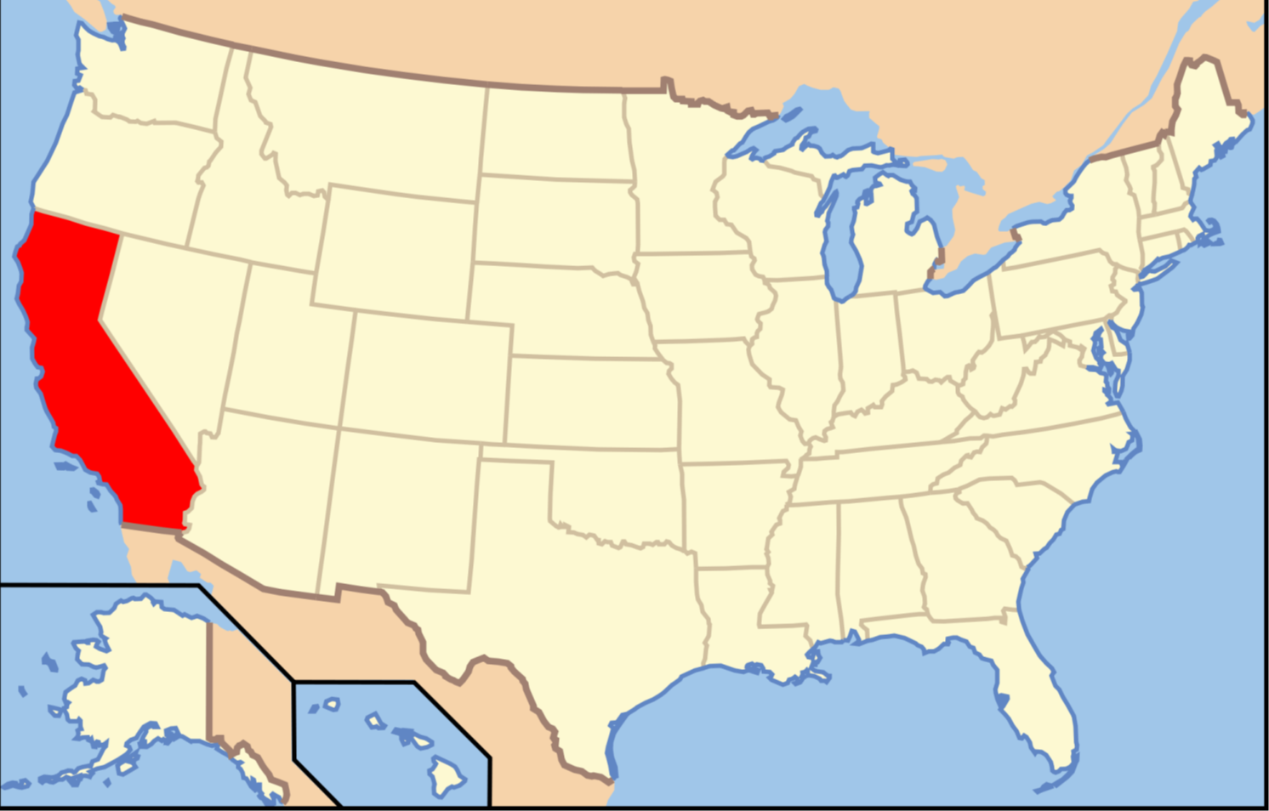
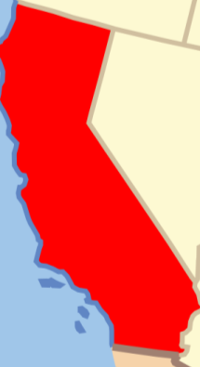
Division of Power
Separation of Power

Slide 4
Division of Power
Separation of Power

Slide 5
Supremacy Clause
This Constitution, and the Laws of the United States which shall be made in Pursuance thereof; and all Treaties made, or which shall be made, under the Authority of the United States, shall be the supreme Law of the Land; and the Judges in every State shall be bound thereby, any Thing [sic] in the Constitution or Laws of any State to the Contrary notwithstanding.
Article VI Section II
supreme Law of the Land;

Slide 6
Supremacy Clause
This Constitution, and the Laws of the United States which shall be made in Pursuance thereof; and all Treaties made, or which shall be made, under the Authority of the United States, shall be the supreme Law of the Land; and the Judges in every State shall be bound thereby, any Thing [sic] in the Constitution or Laws of any State to the Contrary notwithstanding.
Article VI Section II
supreme Law of the Land;

Slide 7
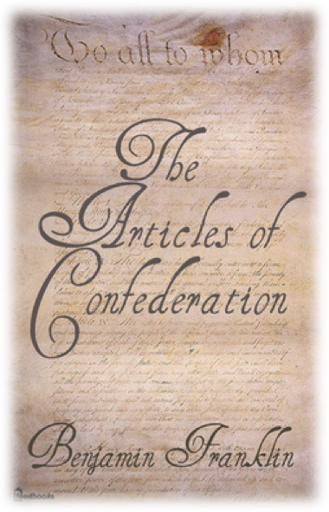
Articles of Confederation
“League of Friendship”
Limited
Government
Weak
Central
Government

Slide 8
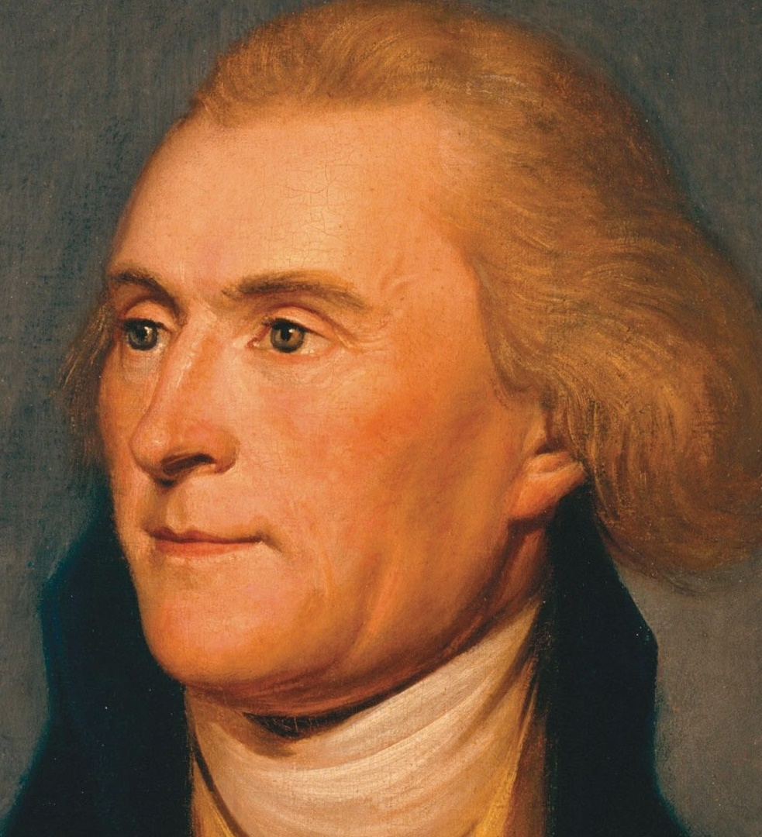
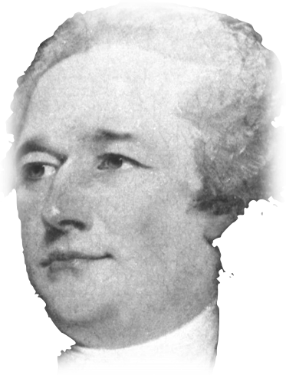
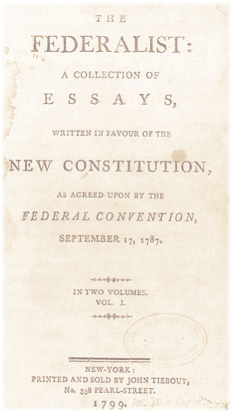
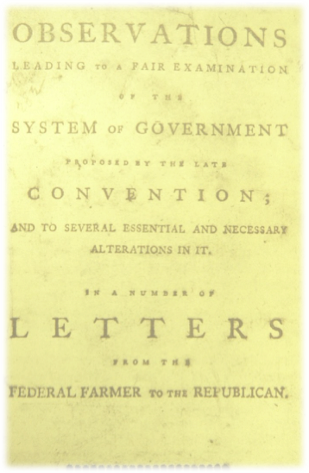
Federalists
Anti-Federalists
No Guarantee of Liberties
Flawed Constitution better than Articles
Letters from the Federal Farmer
Demand a Bill of Rights
Federalist Papers

Slide 9
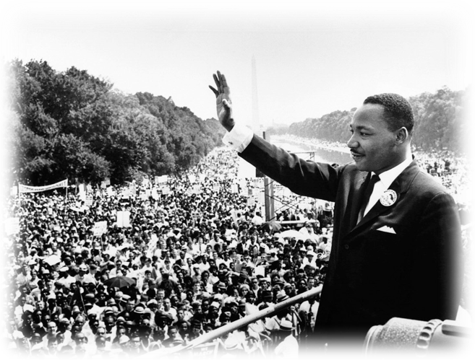
Why Does it Matter?

