Slide 1
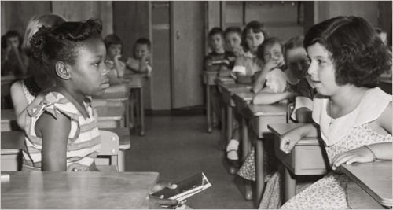
JIM CROW
SEPARATE
& UNEQUAL

Slide 2
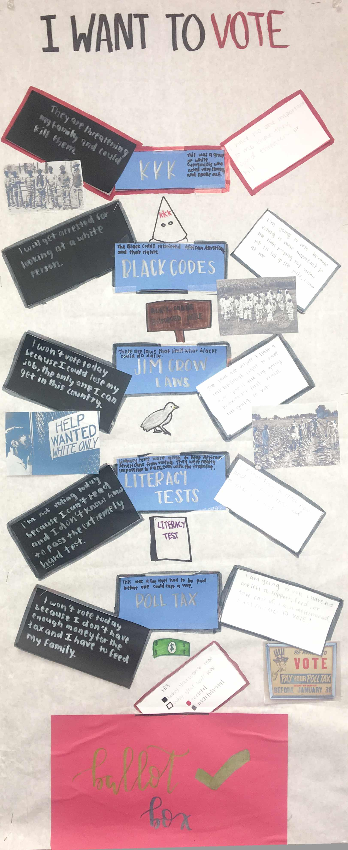
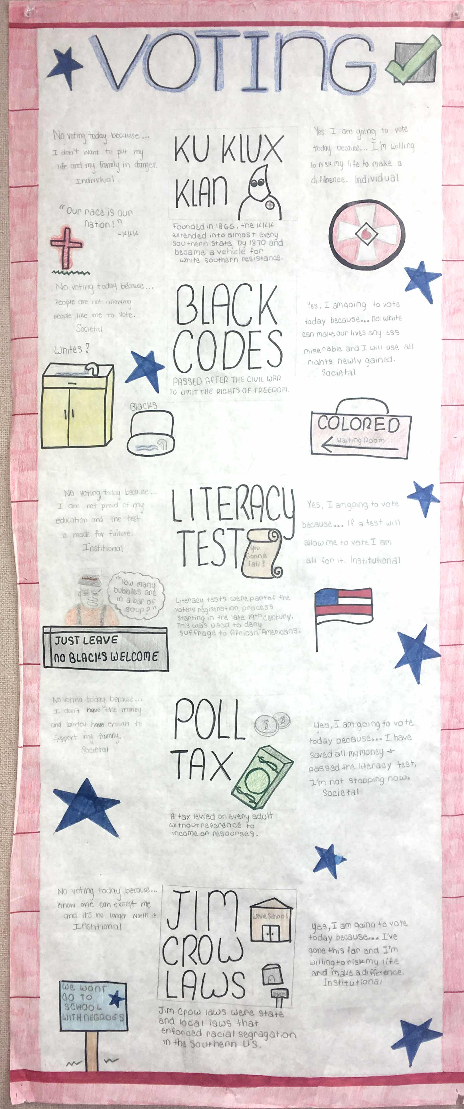
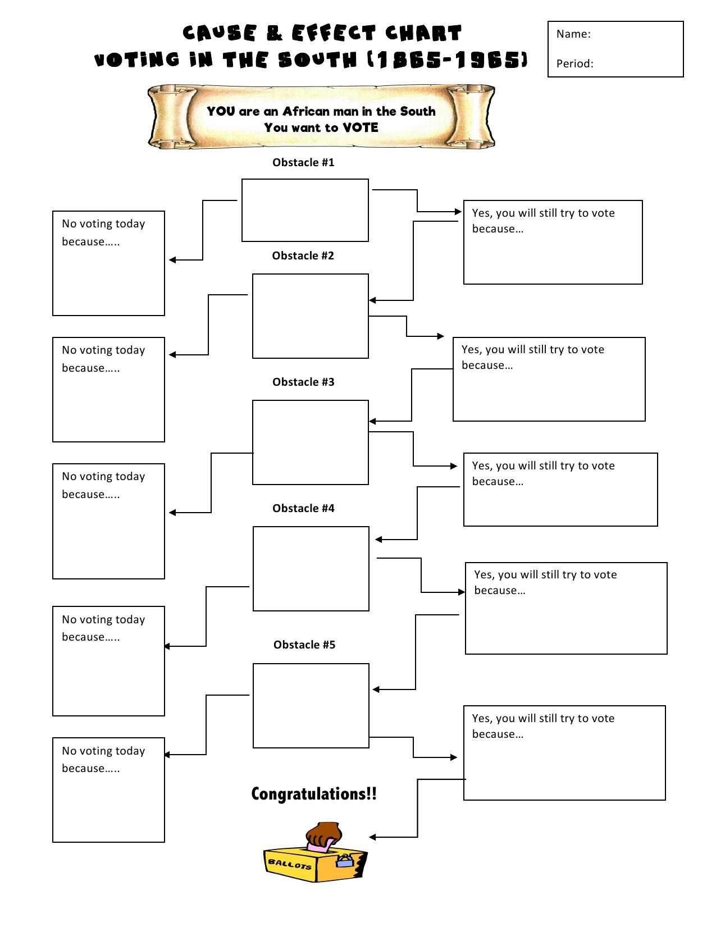
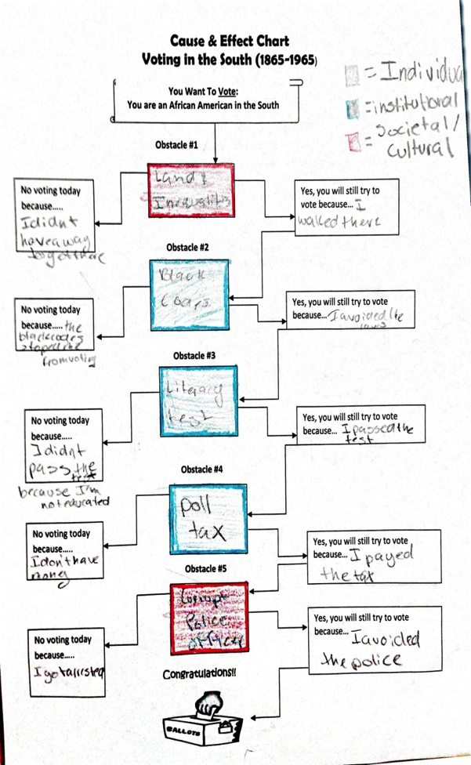
Conclusion of this lesson- You will create a ‘Cause And Effect Chart’
Directions:
Fill out the ‘Cause and Effect Chart’. Write in chronological order the obstacles that served to discourage or prevent African Americans from exercising their right to vote.
Choose FIVE obstacles from the word bank when filling out the chart.
Briefly explain in point form what each obstacle was, and how it may have been a barrier in the voting process. (Refer to your power-point notes, upcoming movie, and textbook if needed)
Identify at which of the three levels of ‘oppression’ the obstacle fits by shading/coloring each obstacle’s square. (Example: blue= Institutional, red=Cultural, yellow= Individual)
Institutional
Societal/Cultural
Individual
Final Draft:
On a larger piece of paper, recreate the chart and include illustrations.
Draw a picture/illustration beside each of the obstacles.
Note: *Leave additional space to add any forms of ‘resistance’ that you see in the film, ‘Freedom Song’.
Notes:
This lesson will begin with the teacher briefly going over the final unit project, and then re-visting the instructions for the project at the end of the power-point.

Slide 3
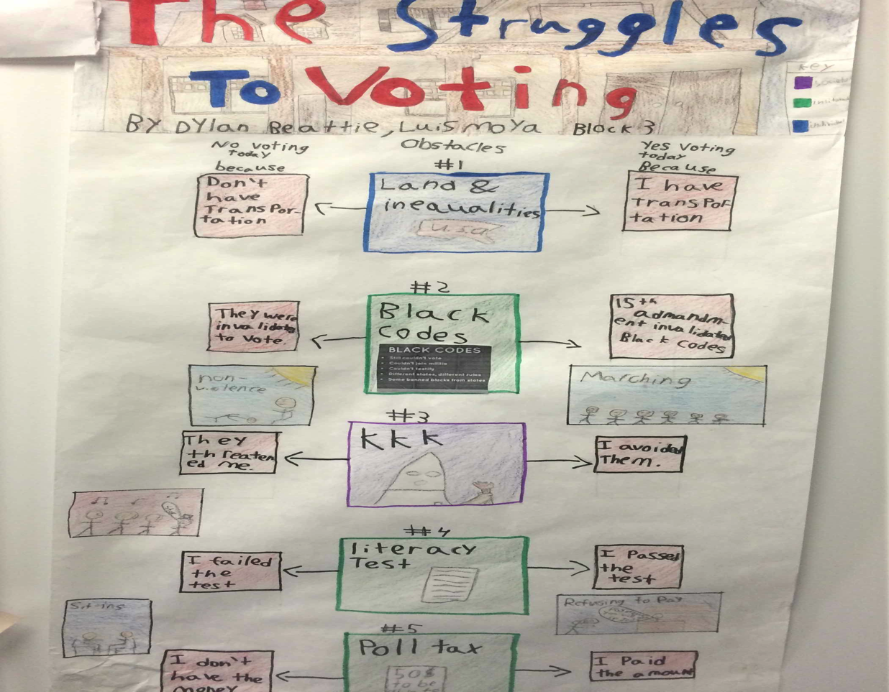
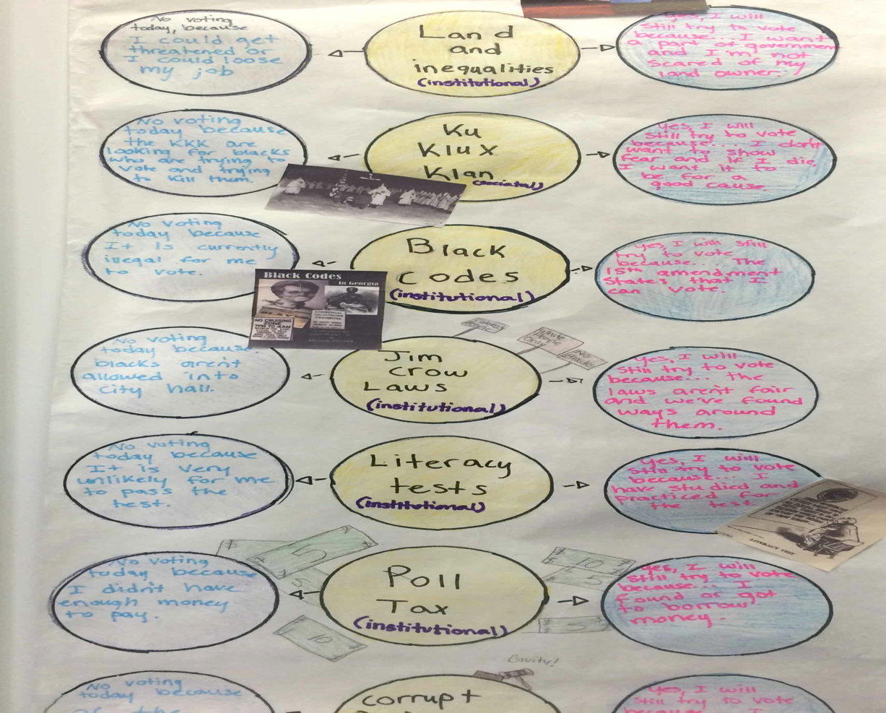
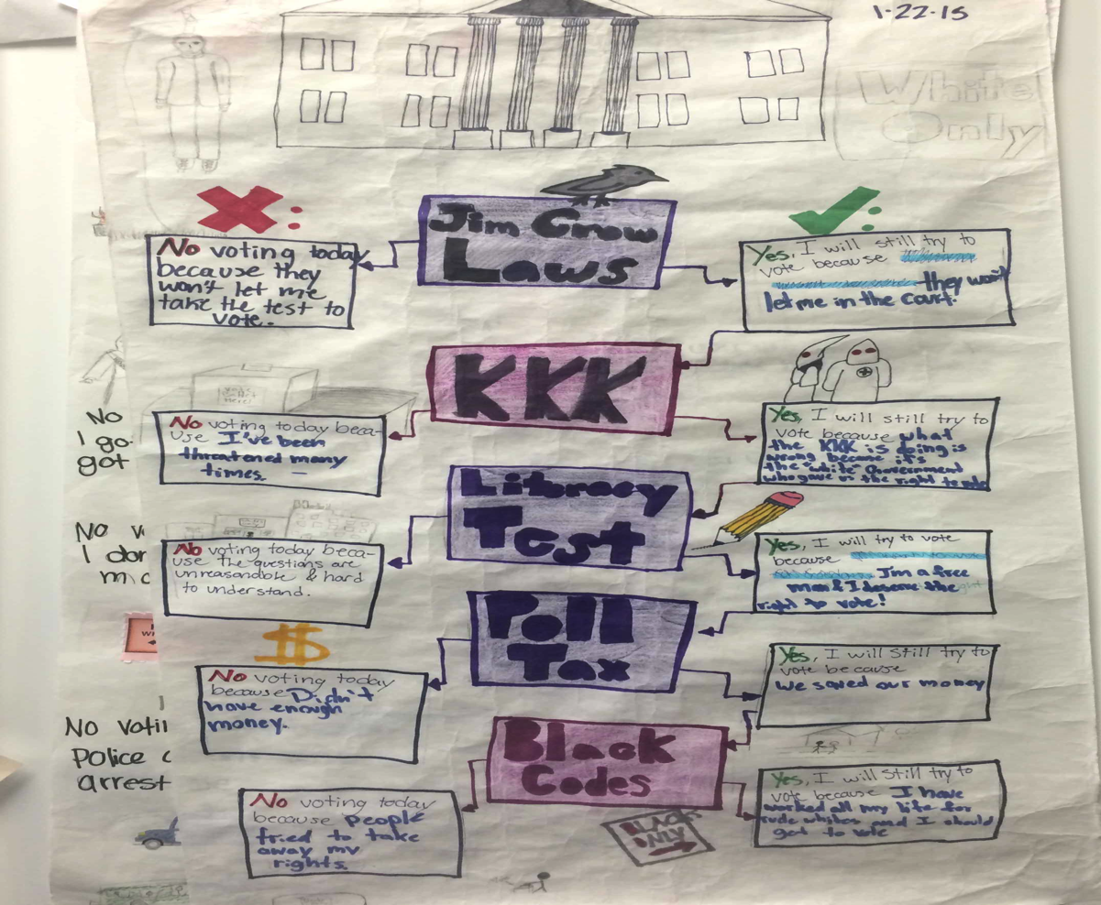
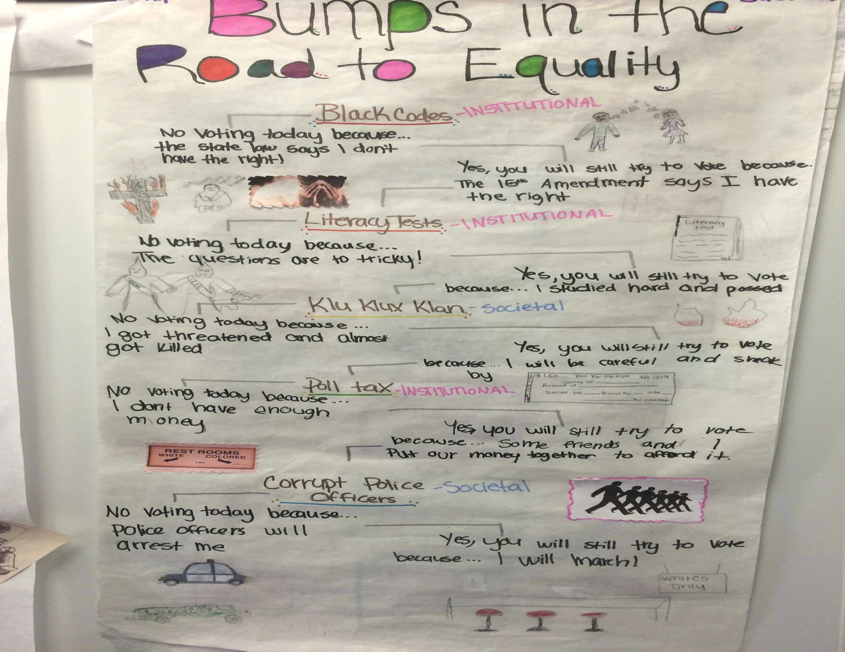
Final Draft: Student Examples

