Slide 1
Gilded Age Immigration
Political Cartoons

Slide 2
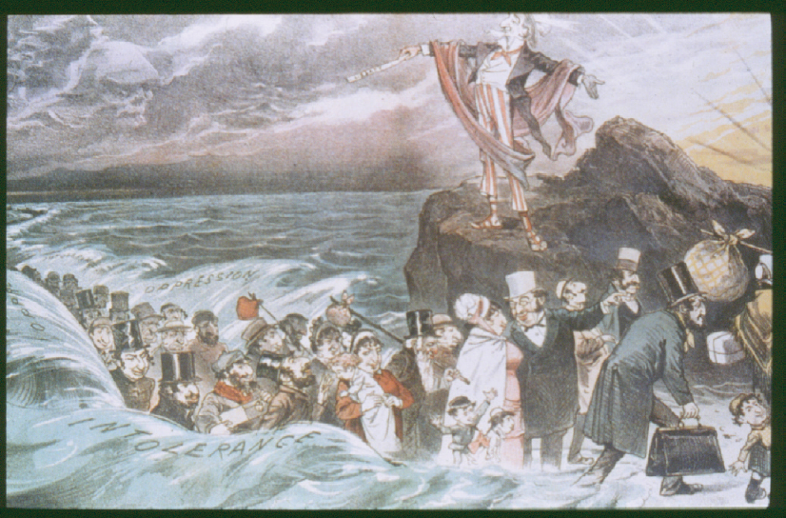
Cartoon 1
Who is parting the waters? What biblical figure does he represent?
Who do the people walking between the waves represent?
What is the artist’s attitude towards immigrants? Explain.

Slide 3
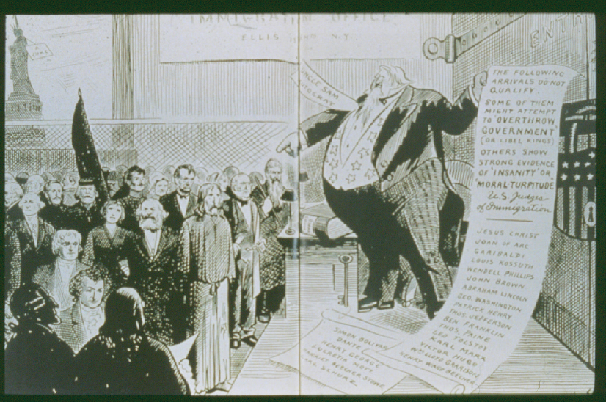
Cartoon 2
How is Uncle Sam portrayed?
What does Uncle Sam’s list say?
What is the artist’s attitude towards immigrants? Explain.

Slide 4
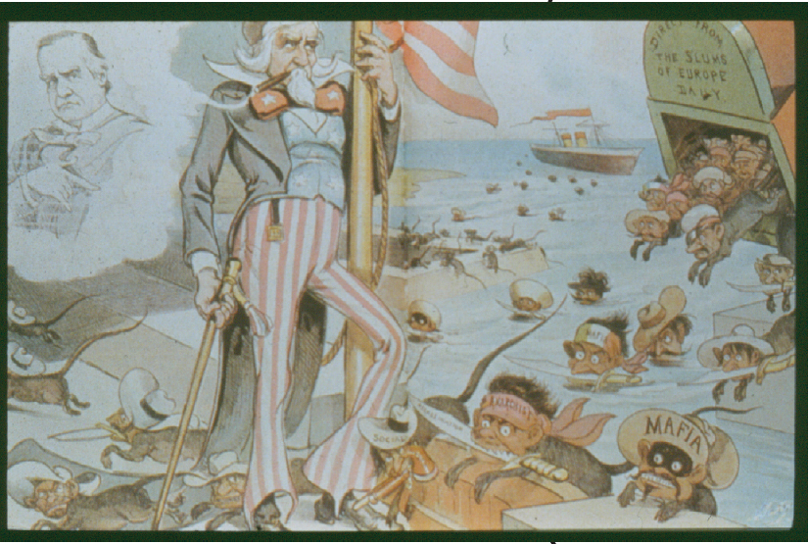
Cartoon 3
Whom do the bandits represent?
What is the artist’s attitude towards immigrants? Explain.

Slide 5
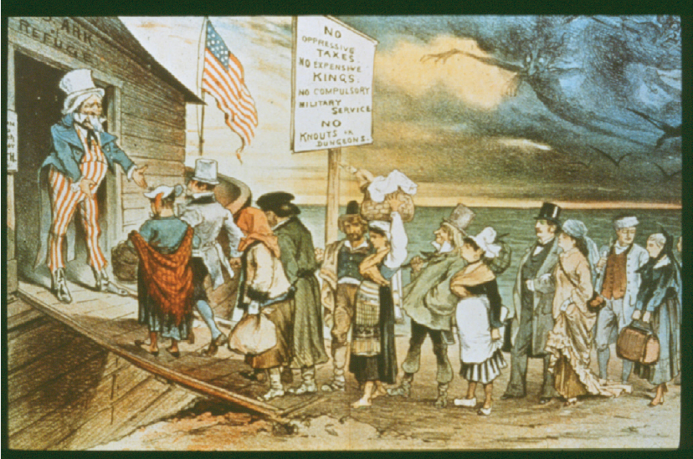
Cartoon 4
The sign above Uncle Sam reads “US Ark of Refuge”. What is Uncle Sam offering to the immigrants?
What might the figures in the upper right represent?
What is the artist’s attitude towards immigrants? Explain.

