Slide 1
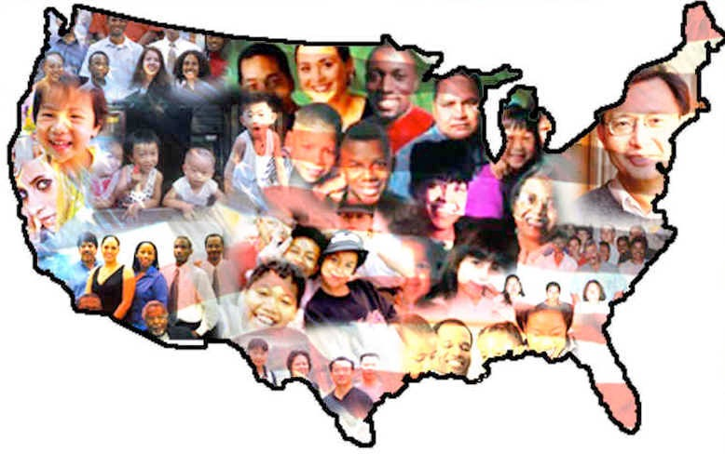
Immigration Policy in the United States 1865- 1910

Slide 2
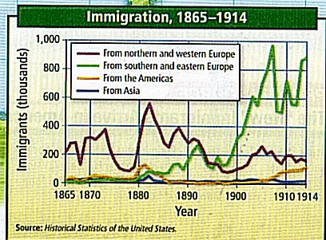

Slide 3
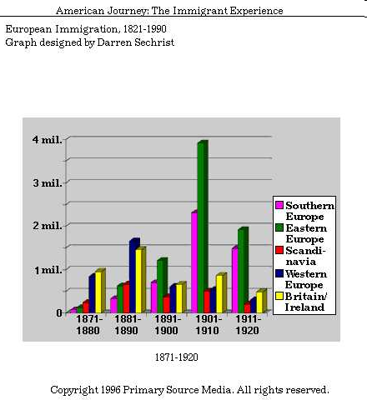

Slide 4
Immigration in the United States 1865- 1910
Between 1865-1900, approximately 13.5 million people arrived from overseas.
Most immigrants came from southern and eastern Europe – Italy, Poland, and Russia. Substantial numbers of Japanese and Chinese immigrants also arrived in the United States.
Immigrants faced many problems such as: prejudice, discrimination, hostility, “losing” their culture, and competed with Americans for jobs.

Slide 5
Immigration in the United States 1865- 1910
Nativism = the belief that native-born Americans and their ways of life are superior to immigrants and their ways of life. A general hostility toward foreigners.
Nativists believed immigrant languages, religions, and traditions had a negative impact on American society. They also believed that immigrant competition for jobs kept wages low.
As immigration increased, so did nativism and popular pressure to limit the flow of immigrants coming into the country.

Slide 6
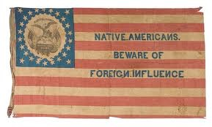
The “Know-Nothing” Party -- 1850s
Also known as the American party, the Know-Nothing party quickly died out and achieved none of its goals.
Members of the party worked hard to limit the voting strength of immigrants, keep Catholics out of public office, and require a lengthy residence before citizenship.
The party got its name from its members who kept the party secret and claimed to “know nothing” when asked about the party by others.

Slide 7
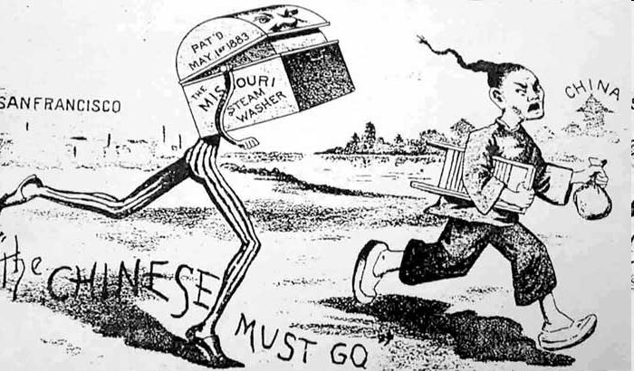
Chinese Exclusion Act (1882)
Barred Chinese immigration for 10 years and prevented Chinese already in the country from becoming citizens.
Chinese did not accept the law quietly. They protested that Americans did not oppose immigration of other groups like the Italians, Irish, and Germans.
Chinese organized letter-writing campaigns, petitioned the president, and filed a lawsuit in federal court.
California barred Chinese from owning property and working certain jobs – fearing the “yellow peril”.
Chinese immigration in 1890 = 105,000
Chinese immigration in 1900 = 74,000

Slide 8
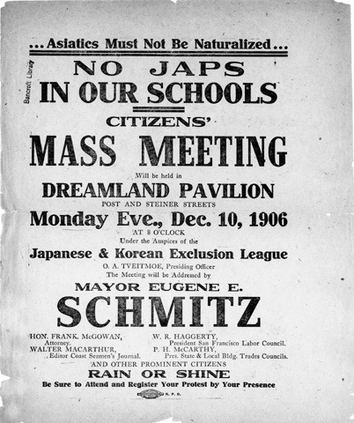
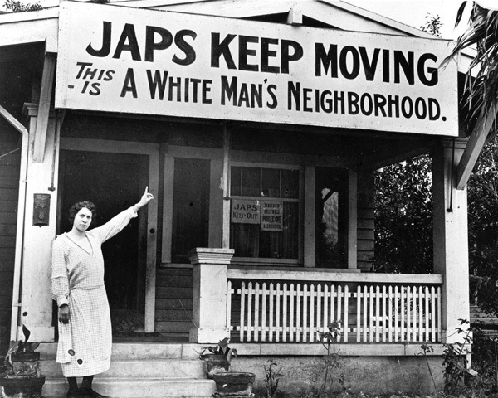
“Gentleman’s Agreement” (1907)
President Theodore Roosevelt reached an informal agreement with Japan under which that nation nearly halted the immigration of its people to the U.S.
In the wake of the "yellow peril" and the barring of Chinese immigration, the Japanese and American governments reached an agreement barring further Japanese immigration into the U.S.
While not a formal law, the agreement curbed Japanese immigration into the U.S., as much a desire of the Japanese government as the U.S. government

Slide 9
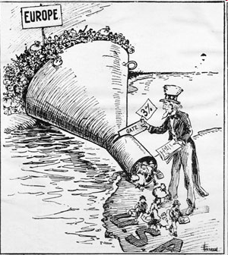
Emergency Quota Act (1921)
Established a temporary quota system, limiting immigration. Many looked to isolate the U.S. from involvement or association with foreign governments. Part of this was a call to limit immigration.
Only 3% of the total number of people in any ethnic group already living in the United States, according to the 1910 census, could be admitted in a single year.
Limited the number of immigrants to the United States each year to about 350,000.

Slide 10
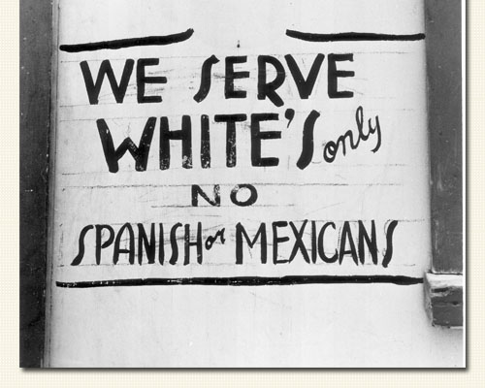
National Origins Act (1924)
Made immigrant restriction a permanent policy
Tightened the quota system, setting quotas at 2% of each national group residing in the country in 1890.
By pushing the year back to 1890, the effect was a severe bias toward northern and western European nations that had been the "traditional" areas of immigration.

