Slide 1
Type Your Name Here
Student Name
Instructions
This Digital Interactive Notebook is designed to help you review the Gilded Age in America. It includes pages on vocabulary terms, people, and key events of this period.
On each page you will see blue text boxes where you can type responses. Simply click in the box and begin typing to provide your response. You can also add your own text boxes by clicking on the text box icon ( ). You also will need to add images to various pages. You can do this by clicking on the “Image” icon ( ) or by going to “Insert > Image” in the menu.
Each text box can also be resized using the borders so that each fits on your pages.

Slide 2
Gilded Age Illustrated Vocabulary
Directions: Research each vocabulary term below and type your own definition in the 2nd column. Then look for an image that best symbolizes it and insert it in the 3rd column.
Vocabulary | Definition | Image
Promontory Point
Melting Pot
Nativism
Chinese Exclusion Act
Ellis Island
Tenements
Urbanization

Slide 3
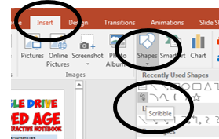
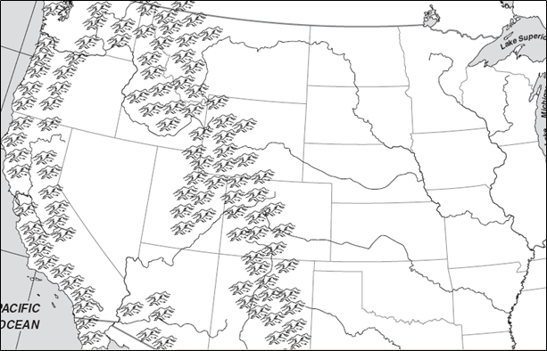
The Transcontinental Railroad
Directions:The First Transcontinental Railroad was a 1,907-mile line of track constructed between 1863 and 1869 that connected the Pacific coast with the existing Eastern U.S. rail network. Use the “Scribble” tool to draw in the route of the Transcontinental Railroad along with facts about the two companies who worked to complete it.
Union Pacific
Central Pacific
Golden Spike

Slide 4
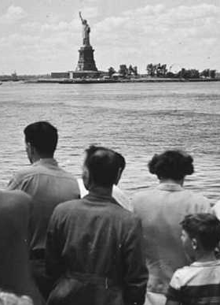
Immigration & Ellis Island
Directions: Most immigrants to the East Coast of the United States were processed at Ellis Island near the famous Statue of Liberty. Research about immigration at the time then watch this film then drag and drop the events to the correct place on the timeline.
1885
1890
1895
1900
1905
1910
1915
1920
1925
Drag & Drop
Fort Wood and the Statue of Liberty are declared a National Monument.
Emma Lazarus writes “The New Colossus” to raise funds for the Statue of Liberty's pedestal.
Ellis Island's new Main Building opened and received 2,251 immigrants.
A fire on Ellis Island burned the immigration station to the ground.
Annie Moore, a teenaged Irish girl, is the first immigrant processed at Ellis Island.
President Cleveland oversees the dedication of the Statue of Liberty.
The US enters WWI and immigration decreased dramatically.
Thousands of suspected “alien radicals” are interned at Ellis Island during the "Red Scare"
A record 1.25 million immigrants are processed at Ellis Island this year.

Slide 5
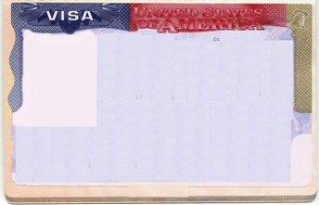
The American Melting Pot
Directions: After the Civil War came to an end and the Homestead Act opened up the west, immigration into the United States shot to an all-time high. Immigrants were expected to join the “Melting Pot” and become American. Research about the difference between “Old” and “New Immigrants along with the resistance they met. Then complete the “visas” for each and describe what it meant to join the “Melting Pot”.
What did it mean to join the American “Melting Pot”?
From:
Characteristics:
Nativitsts
From:
Characteristics:
Old Immigrants
From:
Characteristics:
The Melting Pot
New Immigrants

Slide 6
Tenements & Urbanization
Directions: As immigration surged and more people moved to America’s growing cities, the need for housing skyrocketed. To keep up with demand, cheap high-rise apartment buildings called “tenements” were built. Find pictures of both the inside and outside of a tenement building, then describe what they were like, where they were found, and what people lived in them.
Inside a Tenement
Outside a Tenement

Slide 7
Inventions of the Industrial Age
Directions: The Industrial Revolution was one of the greatest periods of development in science and industry. Improvements to the steam engine allowed for more inventions with motors and soon many other fields saw impressive new achievements. Research each invention to find a picture, who invented it, and the impact it had. Feel free to choose alternative inventions.
Improved Steam Engine
By:
Impact:
Light Bulb
By:
Impact:
Cotton Gin
By:
Impact:
Pasteur’s Vaccines
By:
Impact:
Telegraph
By:
Impact:
Airplane
By:
Impact:
Telephone
By:
Impact:
Model T Car
By:
Impact:

Slide 8
Robber Barons & Monopolies
Directions: During the Gilded Age, a small number of businessmen made vast sums of money by controlling entire industries. These men became known as “Robber Barons” because they sometimes exploited others to get ahead. Find a picture to represent each man’s industry then describe that person’s industry and background.
Andrew Carnegie
John D. Rockefeller
Type your response here.
Type your response here.
J.P. Morgan
Cornelius Vanderbilt
Type your response here.
Type your response here.

