Slide 1
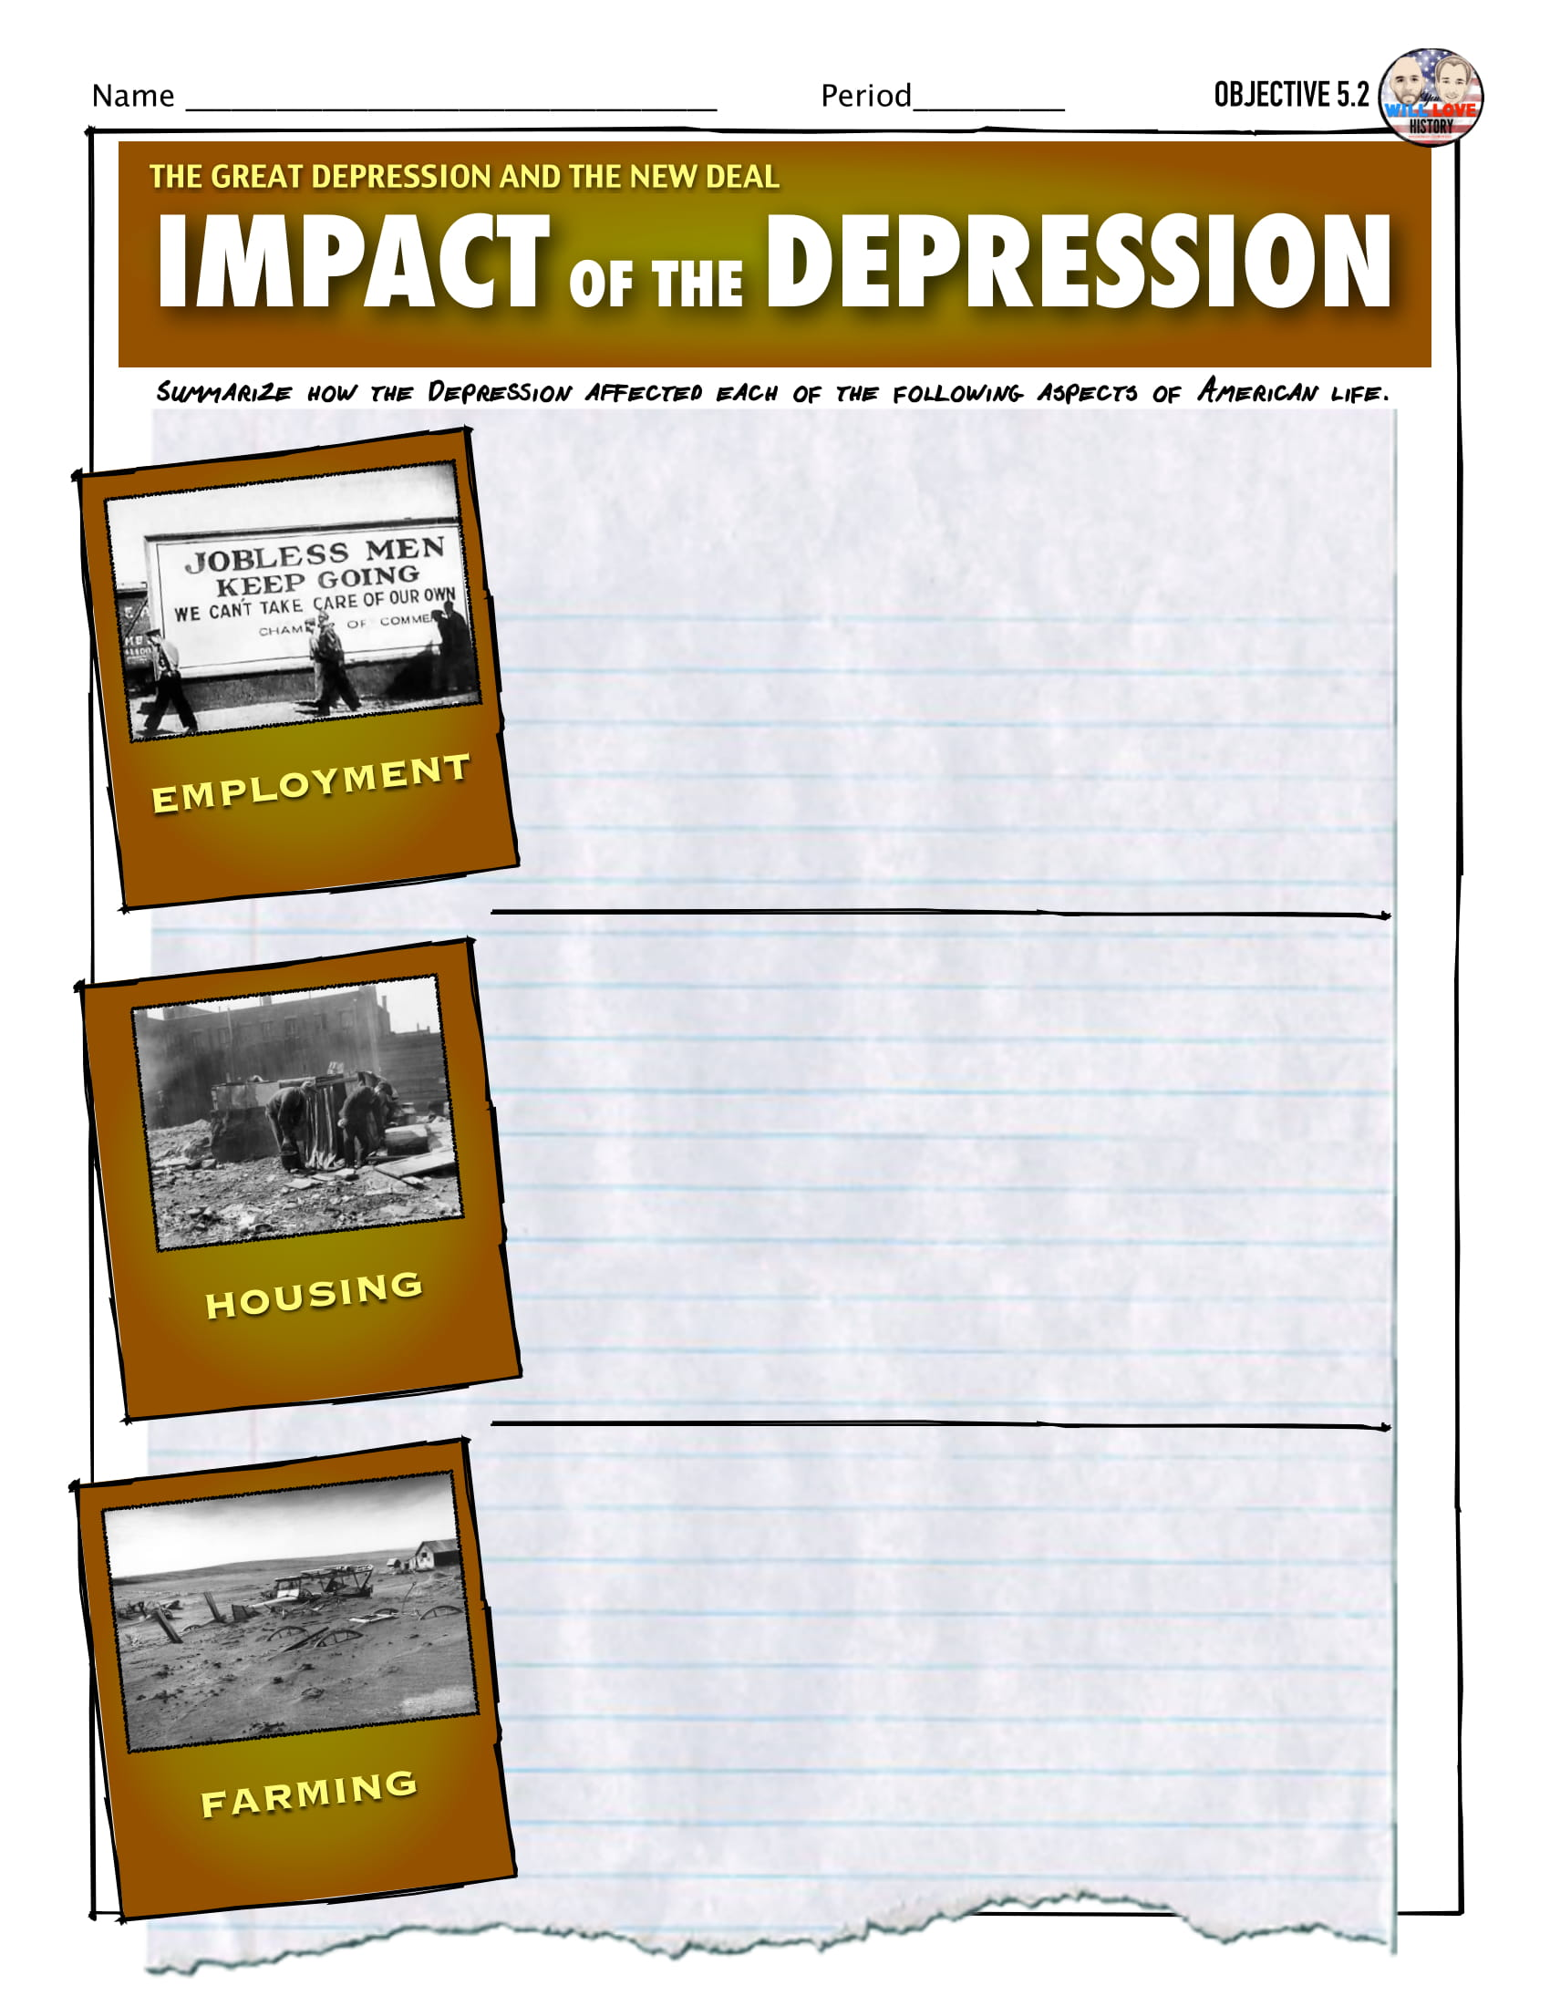
The Great Depression Grips America

Slide 2
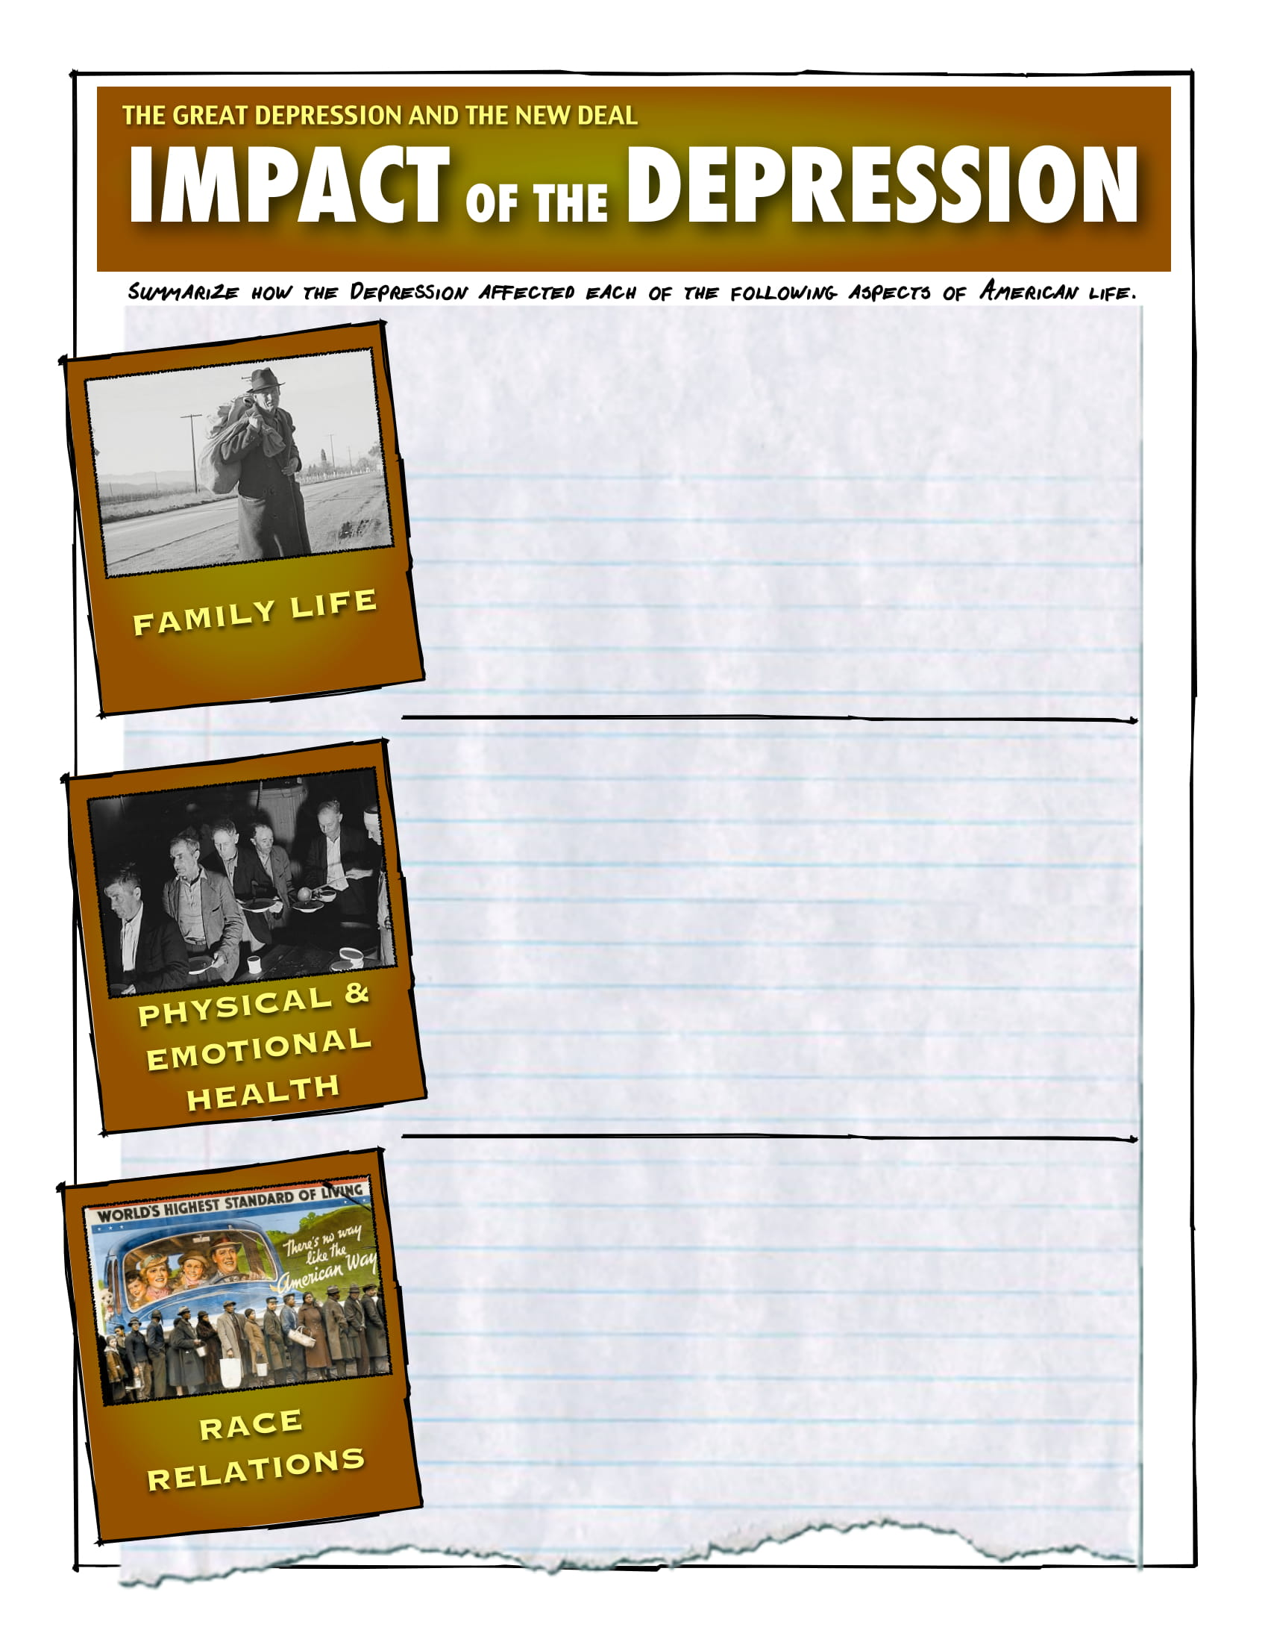
The Great Depression Grips America

Slide 3
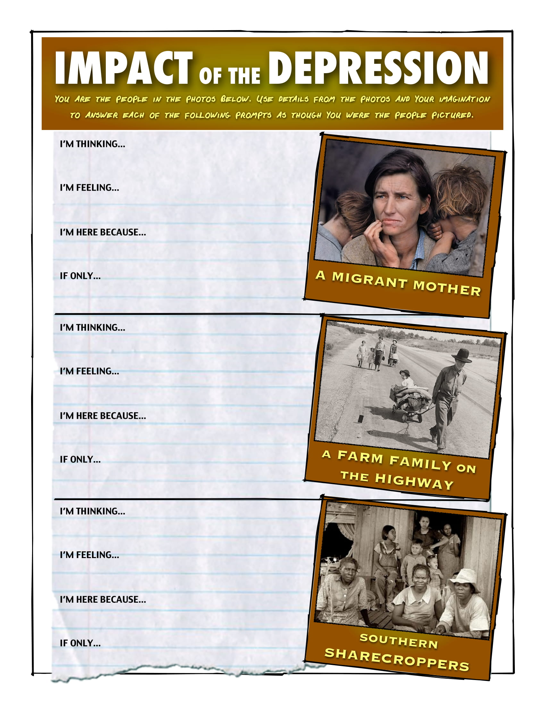
The Great Depression Grips America

Slide 4
