Slide 1
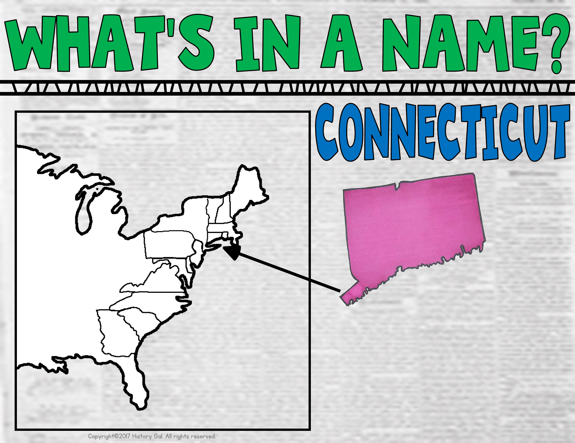
Named after the Indian word “Quinnehtukqut” which means “land on the long tidal river”

Slide 2
Named after the Delaware Bay and River which were named after Lord De La Warr, the governor of Virginia from 1610-1618

Slide 3
Named after King
George II

Slide 4
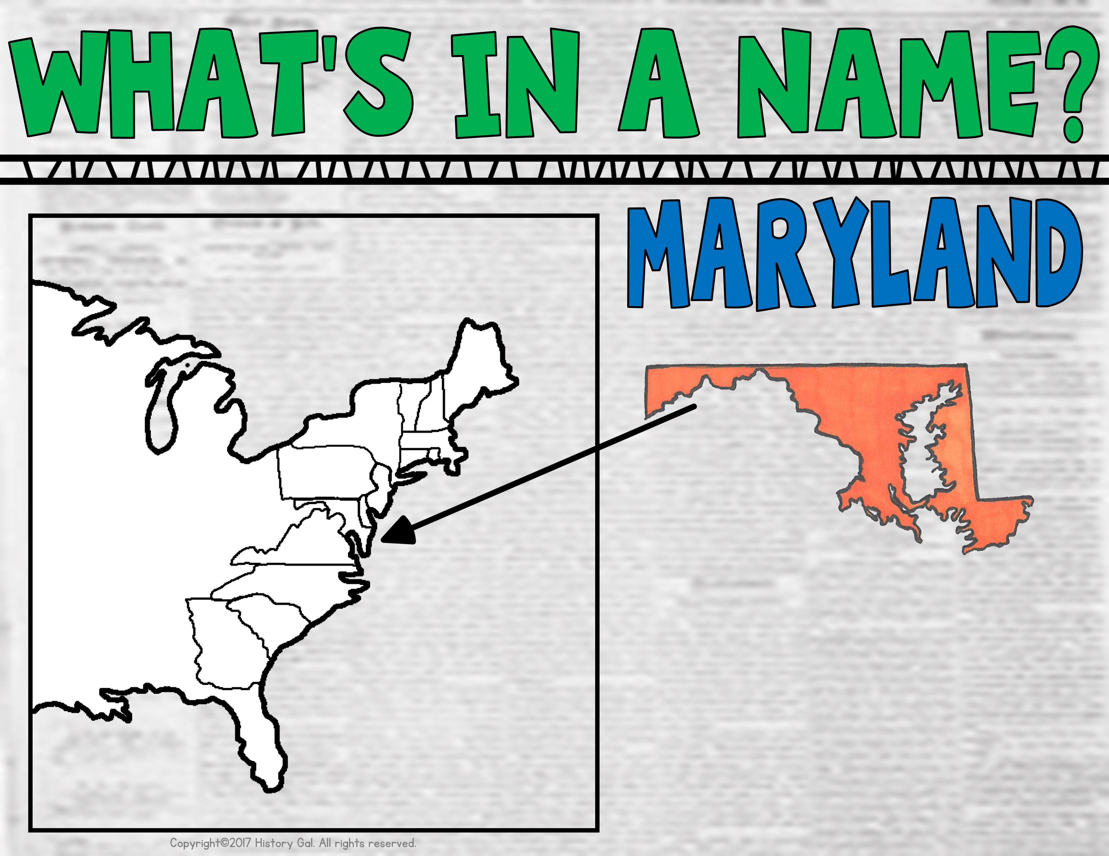
Named after the wife of King Charles I, Queen Henrietta Maria

Slide 5
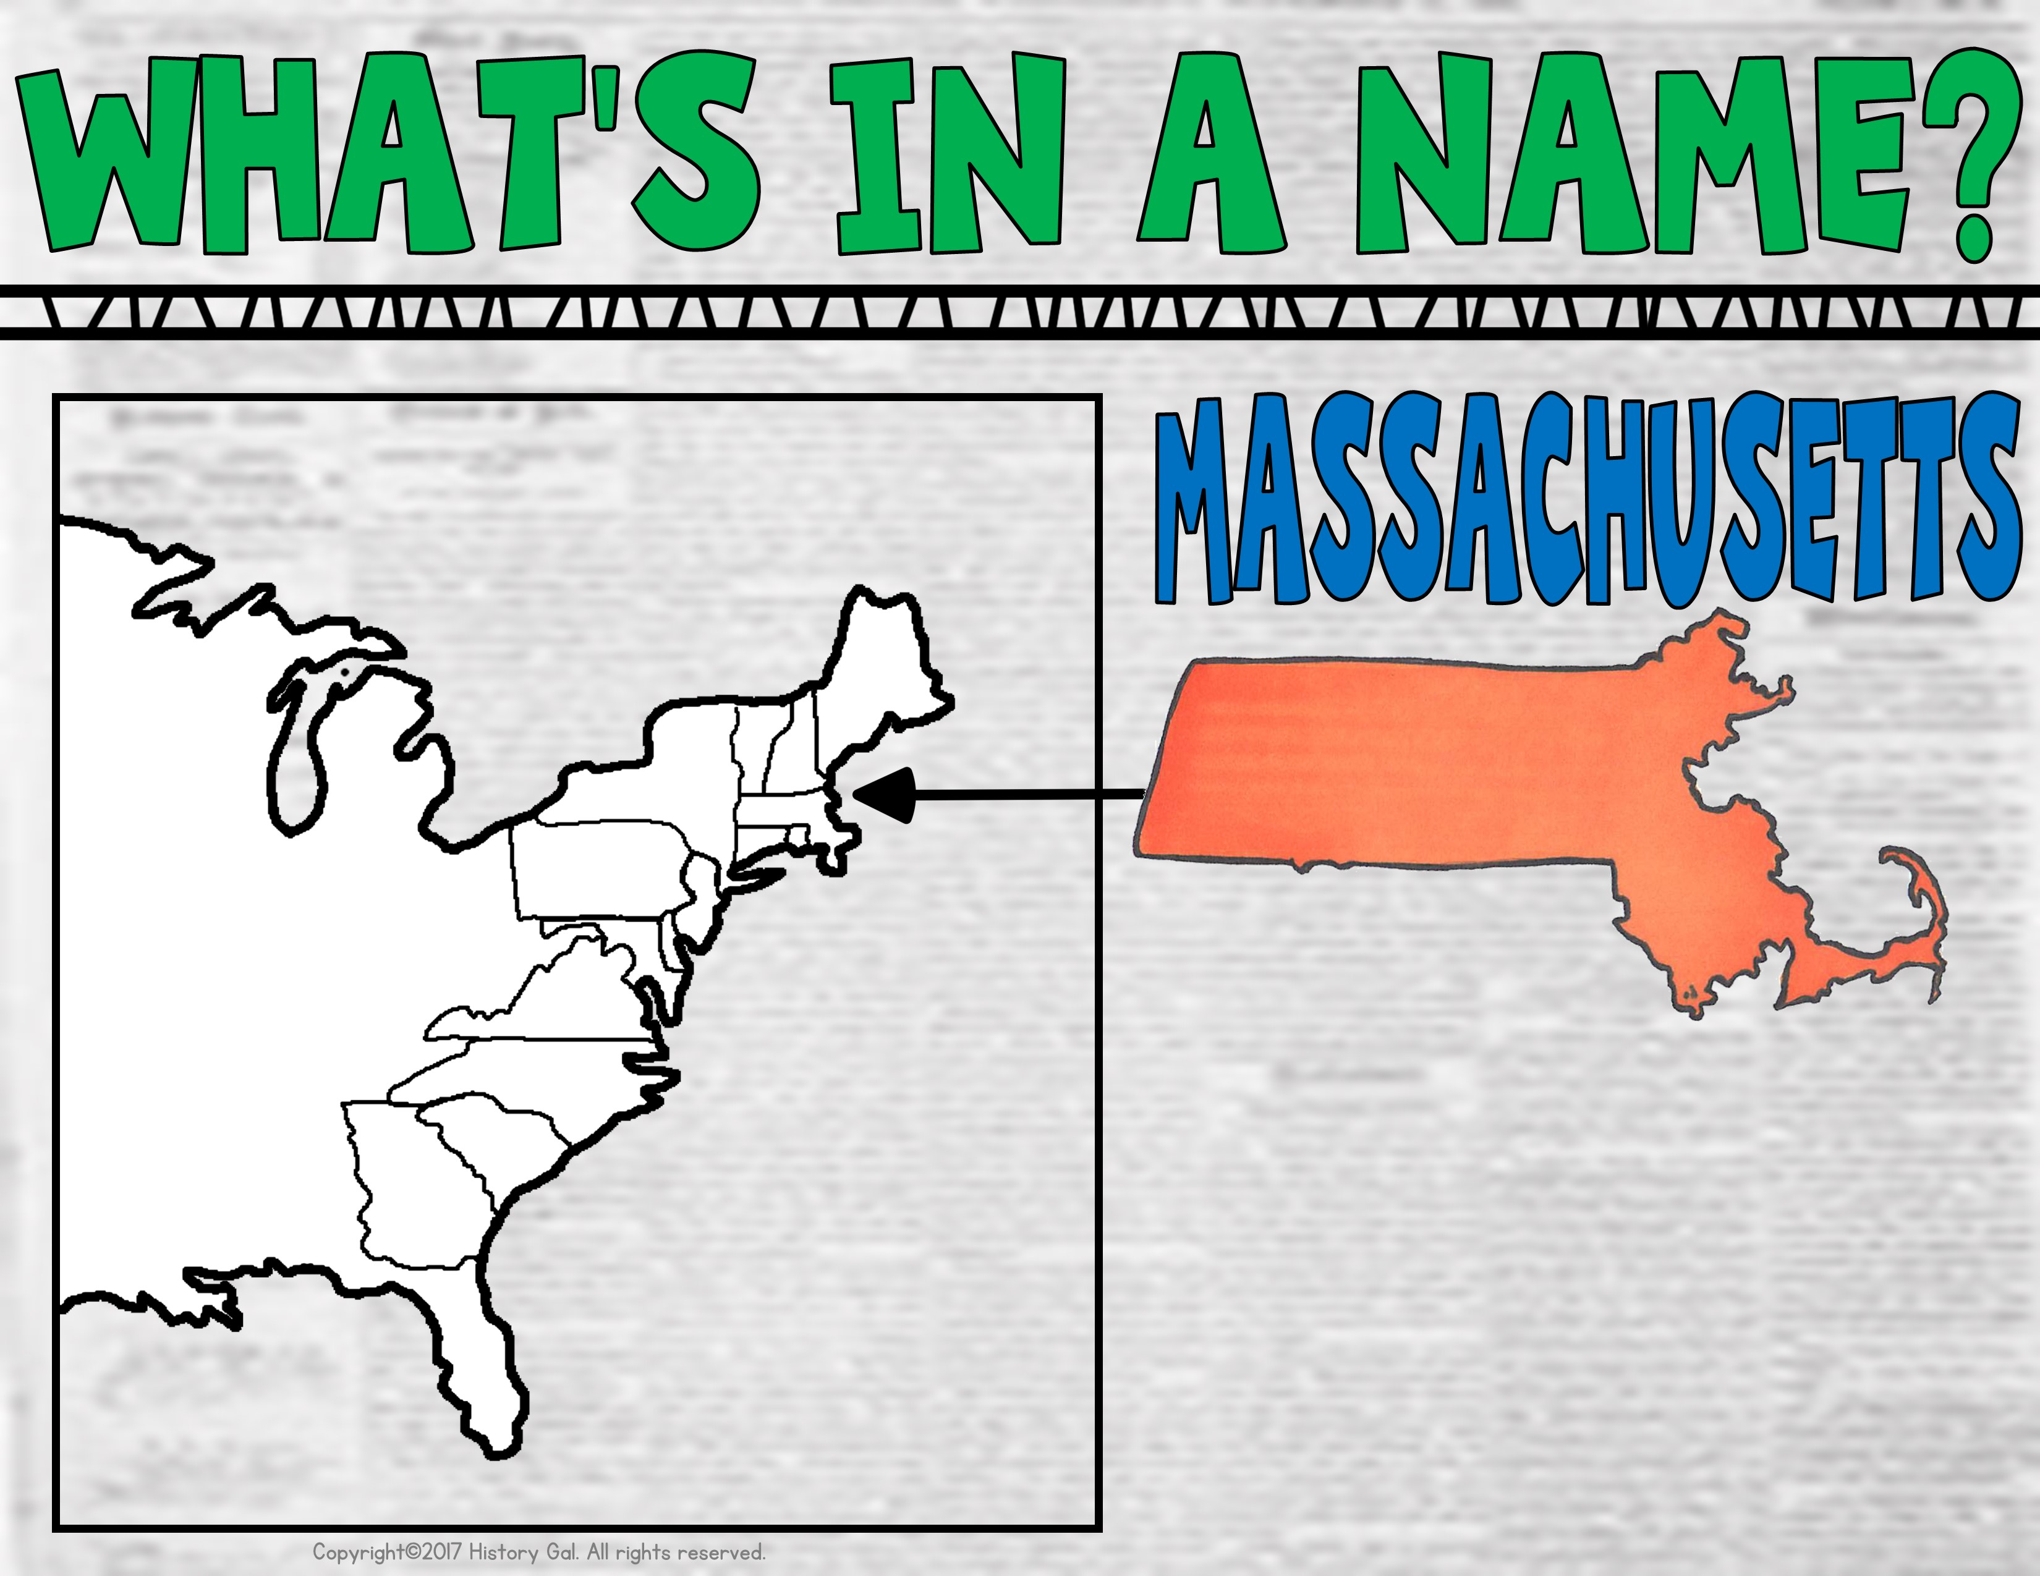
Named after the area’s indigenous people, the Massachusett

Slide 6
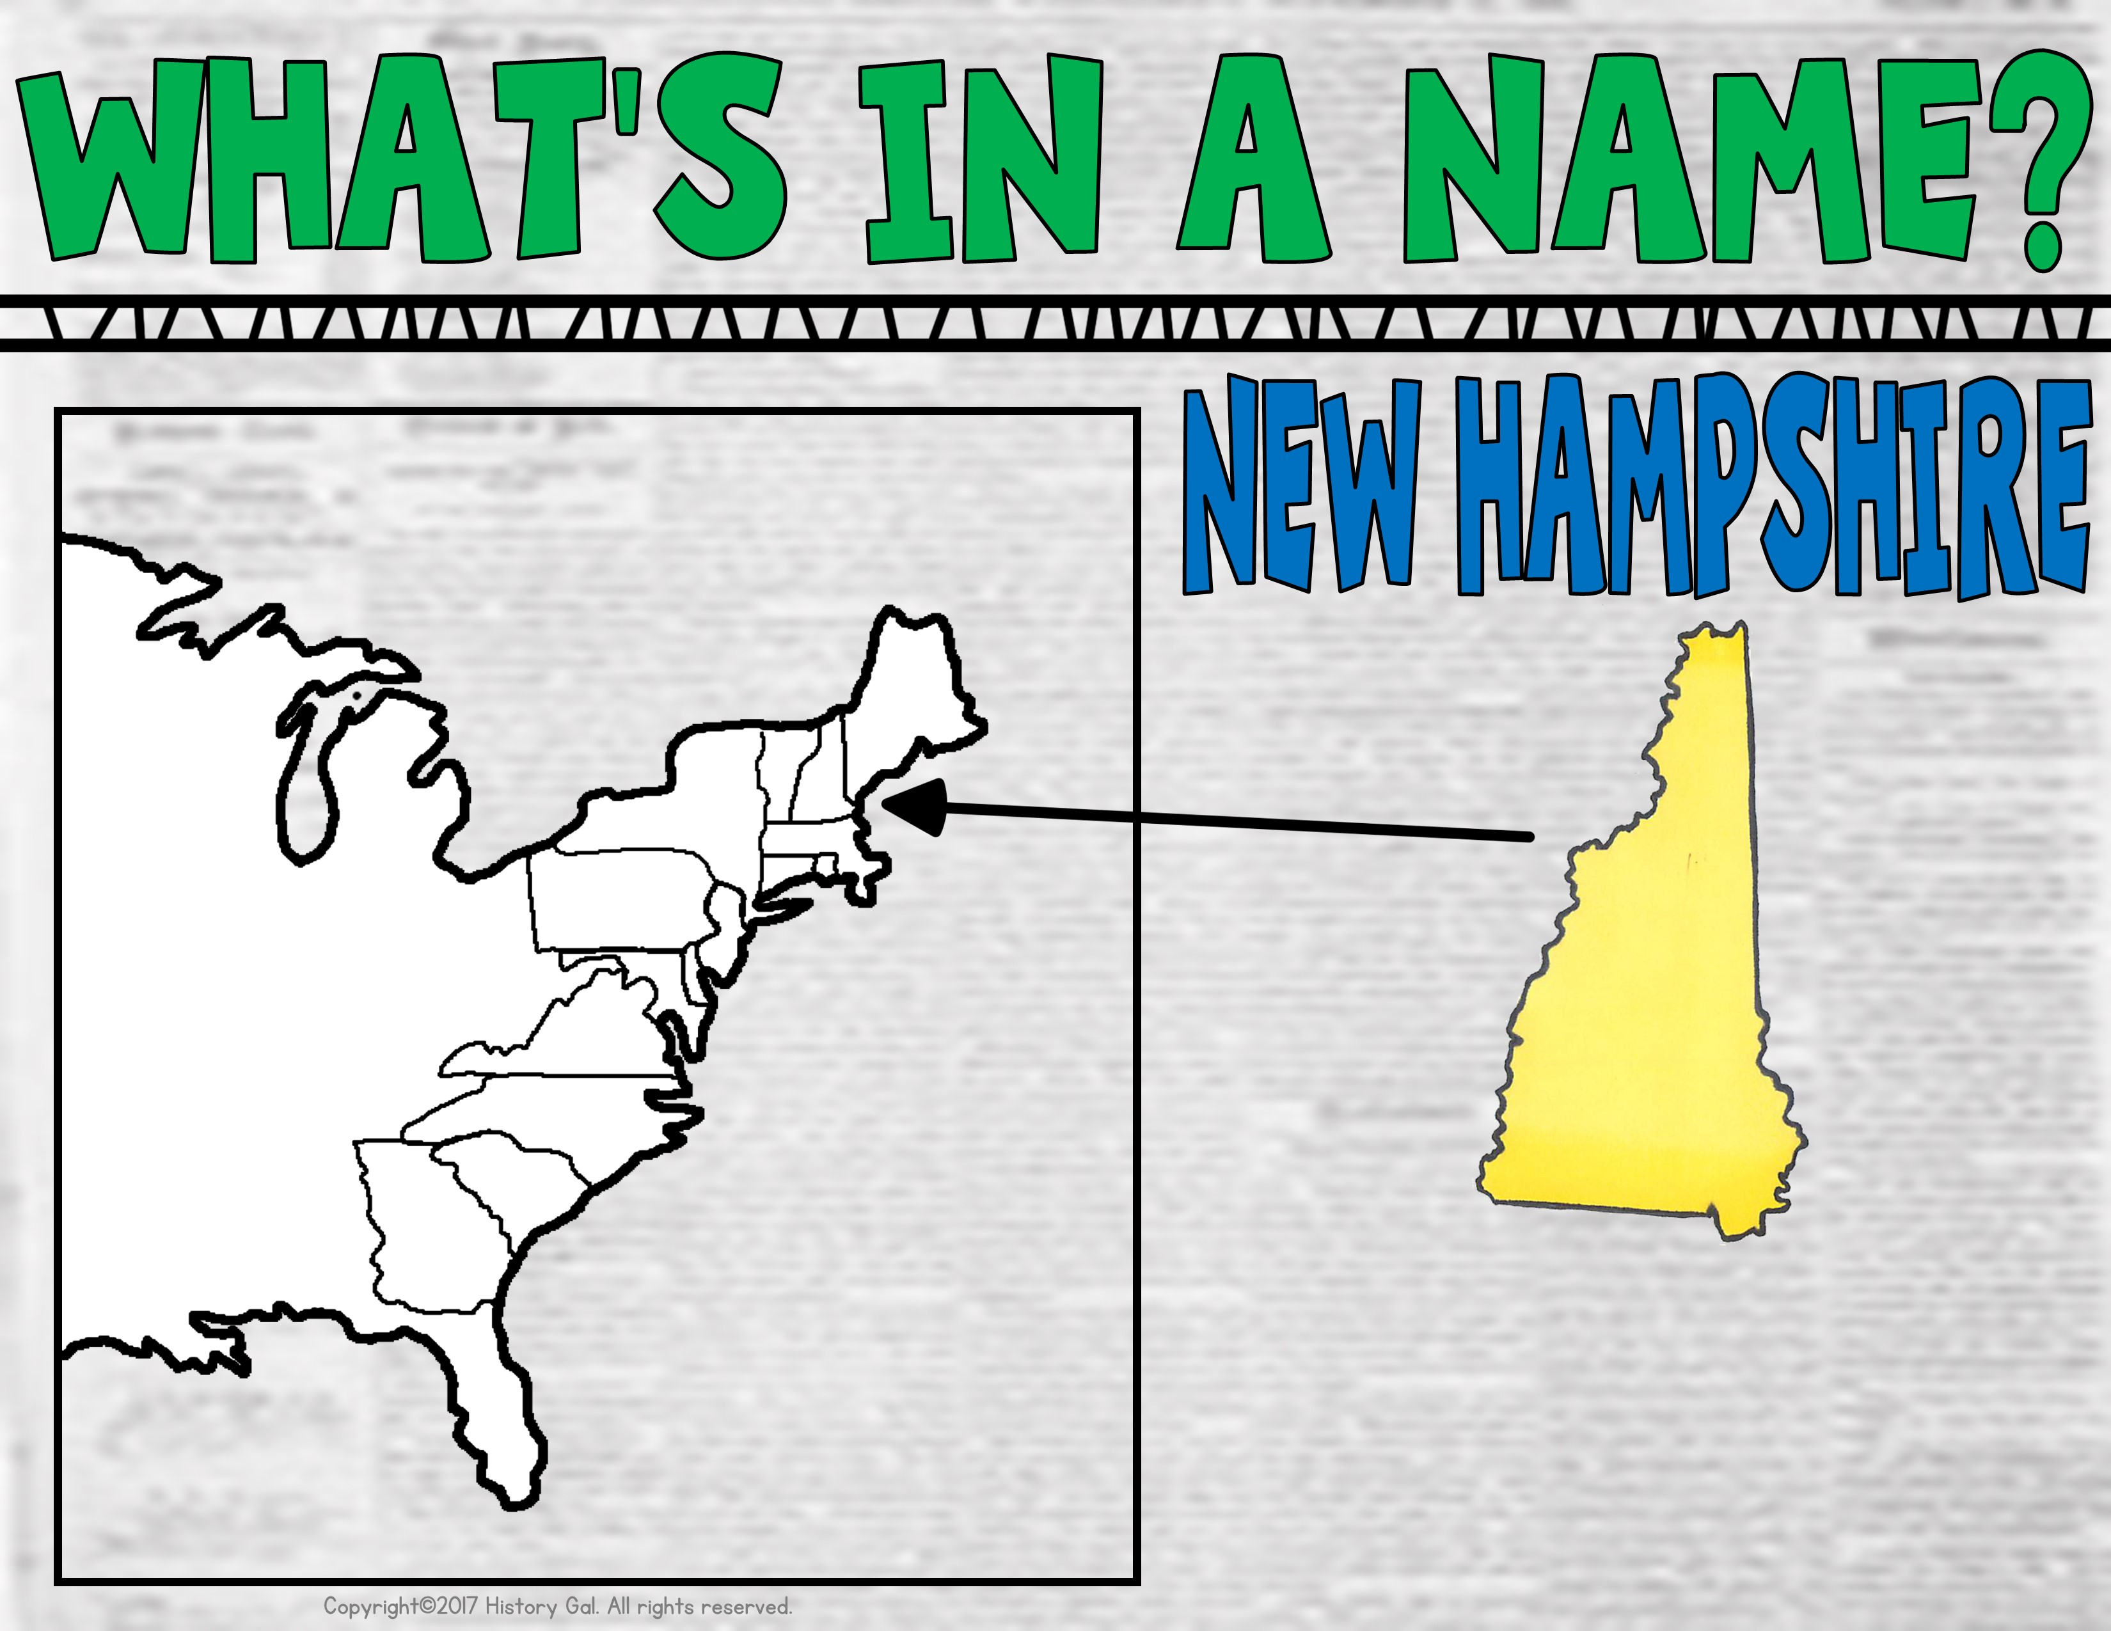
Named after the English county of Hampshire

Slide 7
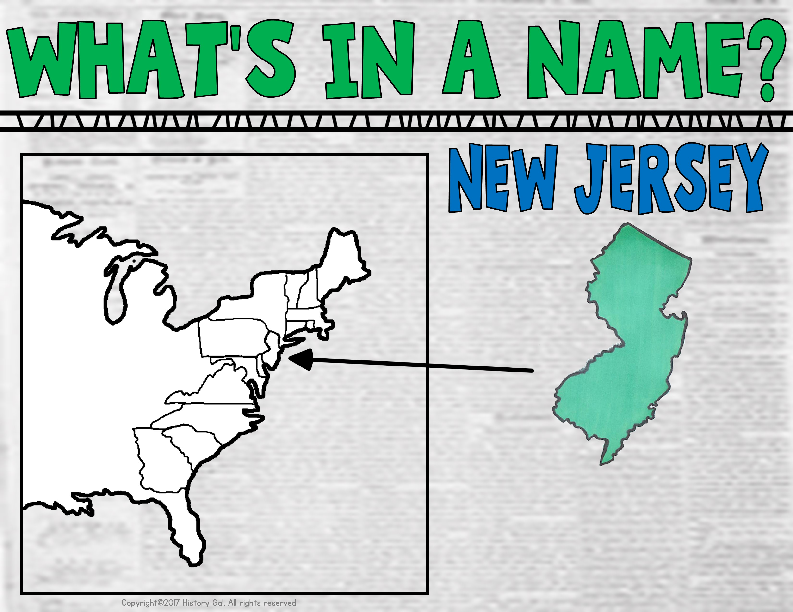
Named after
one of the islands in the English Channel

Slide 8
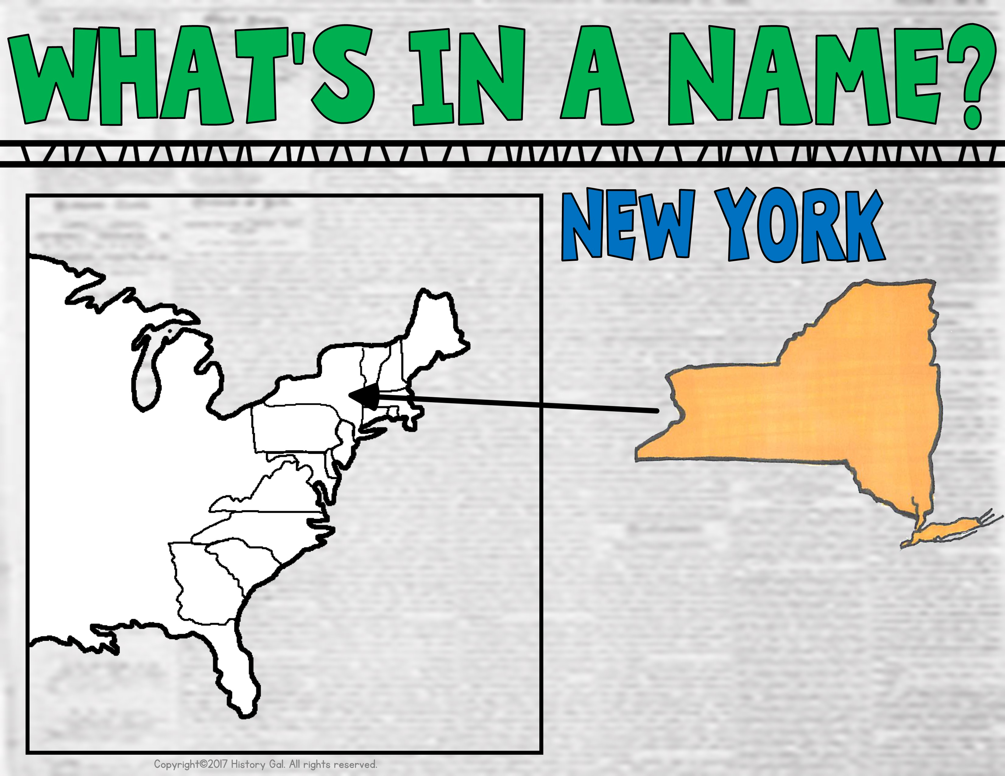
Named after the
Duke of York, James Stuart, who later became King James II

Slide 9
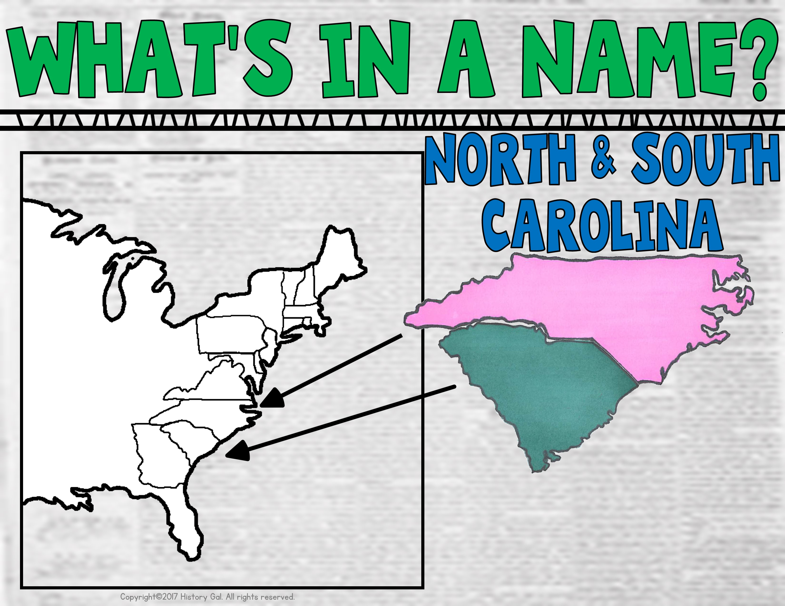
Named by King Charles II in honor of his father, King Charles I

Slide 10
Named in honor of William Penn’s father meaning “Penn’s Woodlands”

Slide 11
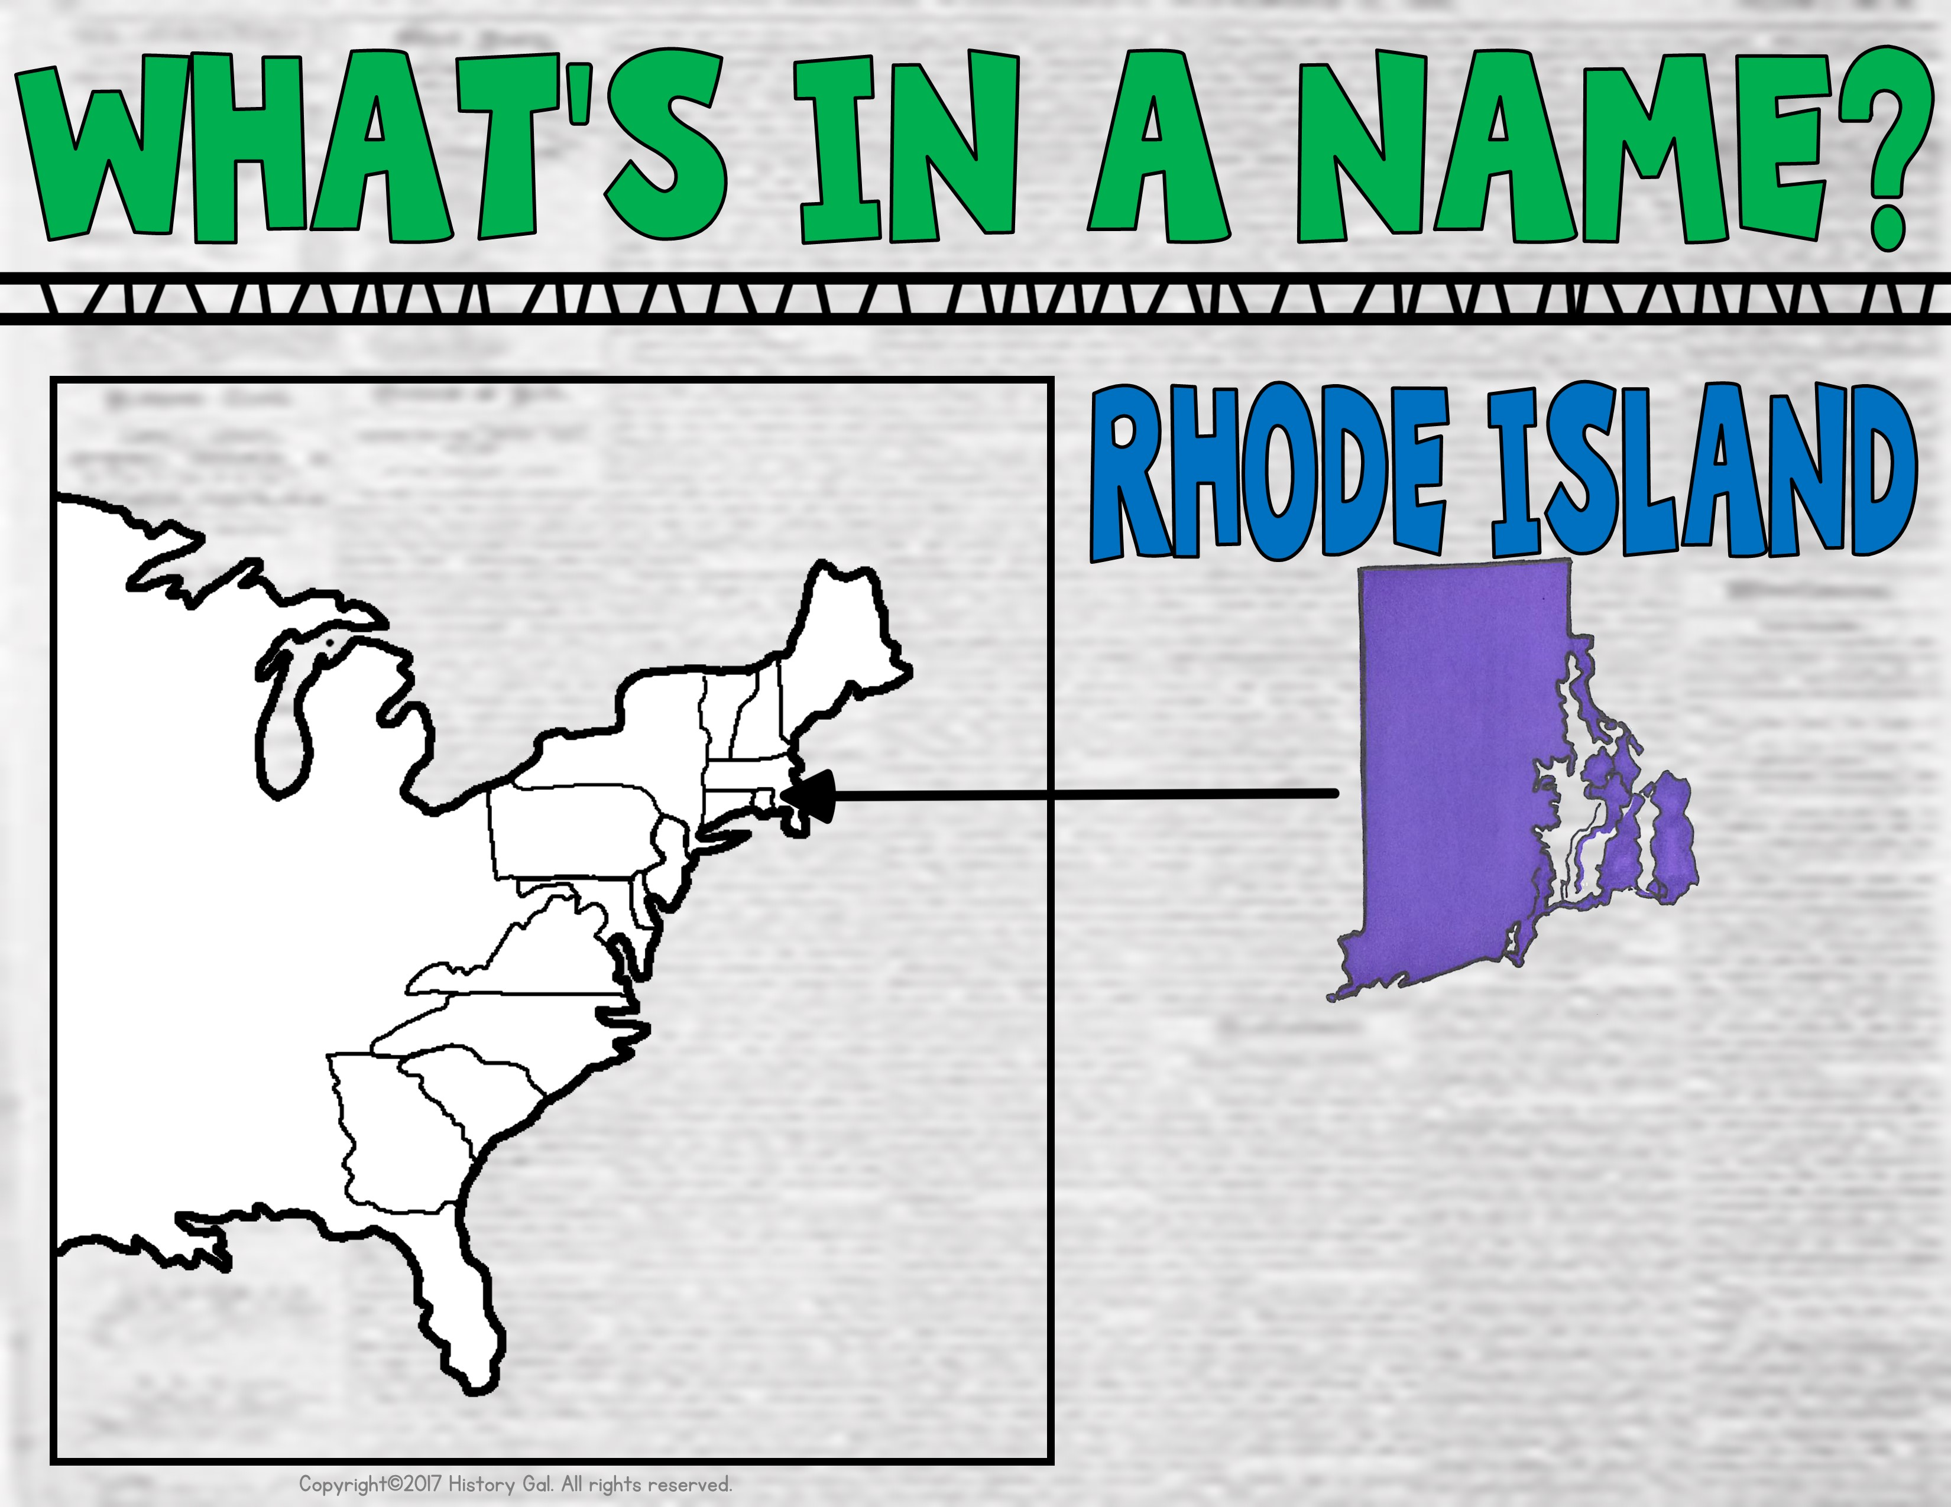
Named because its red clay reminded an explorer of the red clay on the Greek island of Rhodes

Slide 12
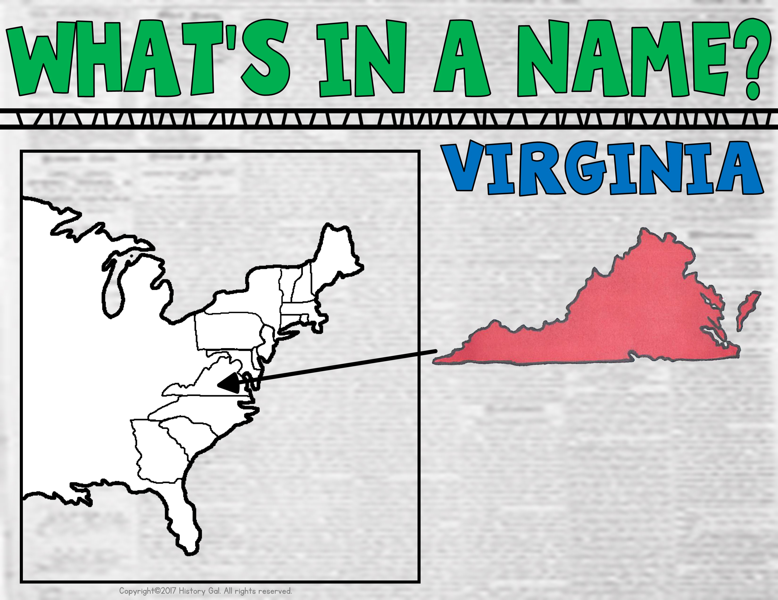
Named after Queen Elizabeth I who was often called the Virgin Queen since she never married

