Slide 1
In 1620, a ship called the Mayflower carried a group of people called Separatists, or Pilgrims, seeking religious freedom across the Atlantic Ocean to the New World.
Pilgrims Story of Us Video Clip

Slide 2
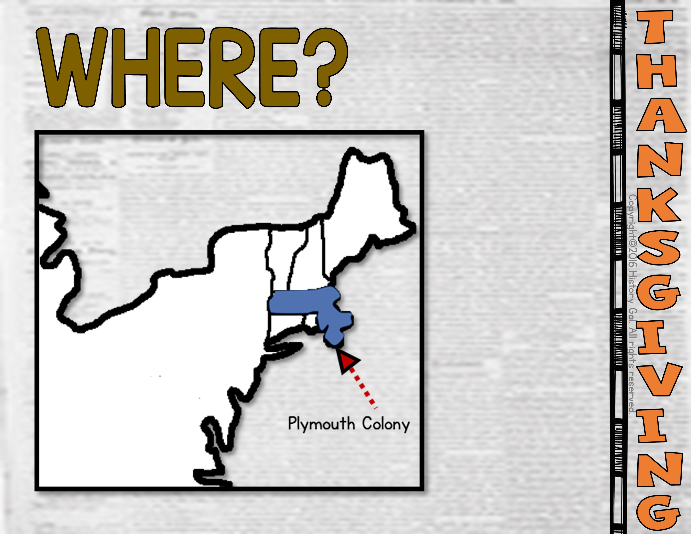

Slide 3
*Half of the settlers died during the first winter.
*Native Americans named Squanto and Samoset taught the Pilgrims how to hunt and fish and how to grow native crops.
*In the fall of 1621, the Pilgrims celebrated their first harvest with a 3 day feast and this became the basis for our
modern Thanksgiving.
Squanto Video

Slide 4
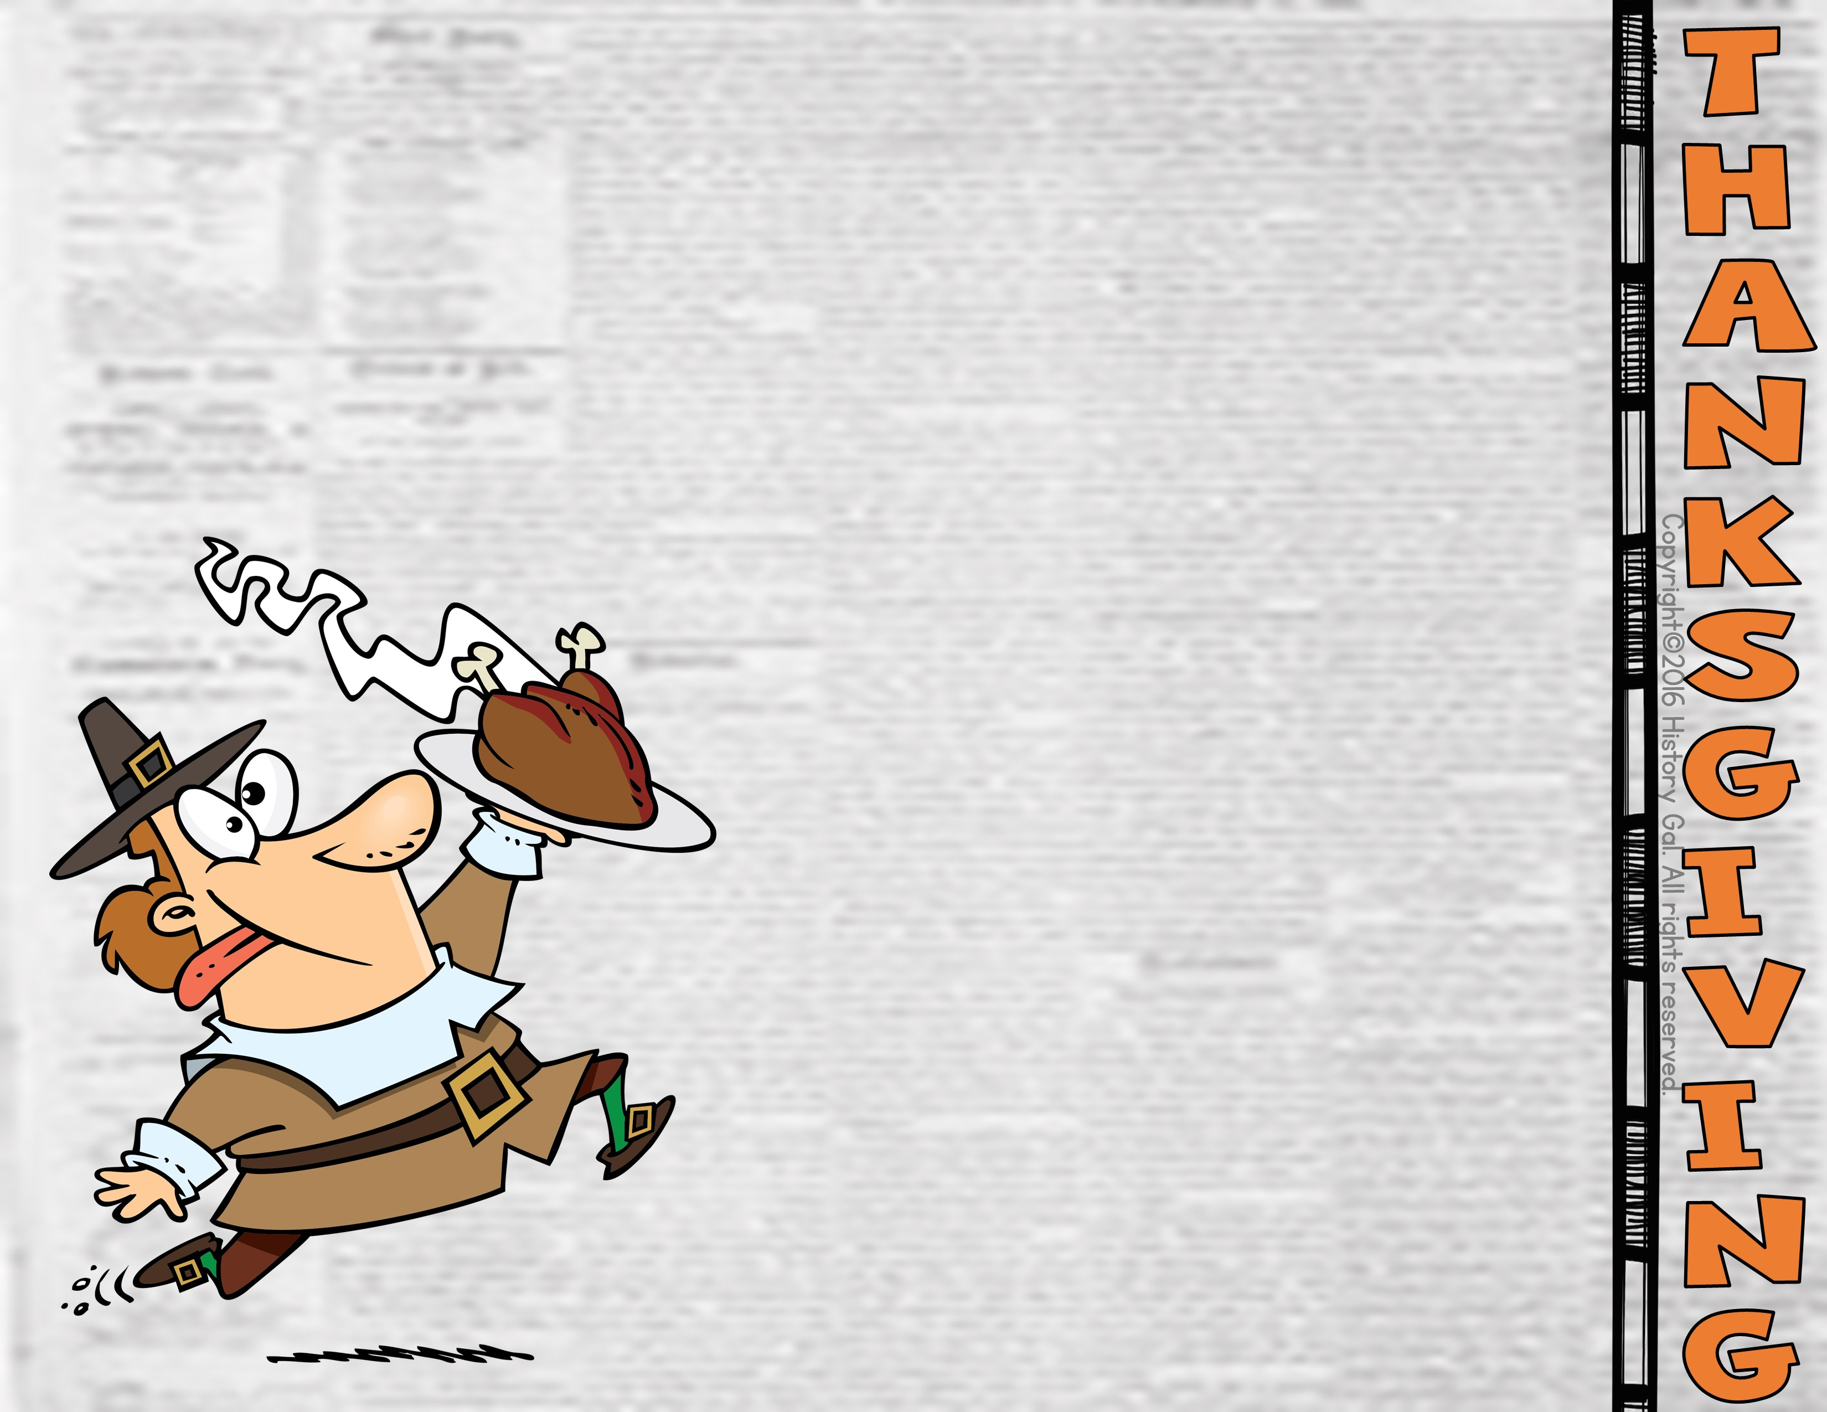
*Our modern-day Thanksgiving dinner looks very different from what the Pilgrims ate that first Thanksgiving.
*Historians aren’t sure if Pilgrims actually ate turkey during their feast. If they did, it likely shared the table with other wild birds like duck, geese, and even passenger pigeons.

Slide 5
Along with wild birds, the Pilgrims also likely ate deer, eel, fish, shellfish, cornbread, squash, greens, turnips, and pumpkins (although not in a pie!)at their feast. If there were cranberries, they weren’t served sweetened in a sauce.
Bet You Didn’t Know Thanksgiving

Slide 6
*As writer and editor of the influential 19th century’s Godey’s Ladies Journal, Sarah Josepha Hale lobbied for a national day of Thanksgiving.
*In 1863, she was finally successful when President Abraham Lincoln declared the last Thursday in November as Thanksgiving.
“Now, therefore, I, Abraham Lincoln, President of the United States, do hereby appoint and set apart the last Thursday in November next as a day which I desire to be observed by all my fellow-citizens, wherever they may then be, as a day of thanksgiving and praise to Almighty God, the beneficent Creator and Ruler of the Universe.”
-Oct. 20, 1863
The Mother of Thanksgiving Video

Slide 7
*As writer and editor of the influential 19th century’s Godey’s Ladies Journal, lobbied for a national day of Thanksgiving.
*In 1863, she was finally successful when President Abraham Lincoln declared the last Thursday in November as Thanksgiving.
“Now, therefore, I, Abraham Lincoln, President of the United States, do hereby appoint and set apart the last Thursday in November next as a day which I desire to be observed by all my fellow-citizens, wherever they may then be, as a day of thanksgiving and praise to Almighty God, the beneficent Creator and Ruler of the Universe.”
-Oct. 20, 1863
*In 1941, President Franklin Roosevelt signed a bill officially making the fourth Thursday in November the Thanksgiving holiday.
The Mother of Thanksgiving Video

