Slide 1
Hoover’s Response to the Great Depression: 1929-1933
President Herbert Hoover was the first president to deal with the deepening Depression.
Hoover’s Economic Plan:
Restore confidence in American economy with statements: “prosperity is just around the corner”.
Promoted programs to aid business, believing once businesses recovered, economic benefits would trickle down to workers and consumers.
Established the Reconstruction Finance Corporation to lend money to railroads, mortgage and insurance companies, and banks on the verge of bankruptcy.

Slide 2
Hoover’s Response to the Great Depression: 1929-1933
Used federal works projects to create jobs and stimulate the economy (this set a precedent for FDR’S New Deal programs).
Halted payment of war debts by European nations.
________________________________________________________________________________________________________________________________
Despite these efforts…
-- Hoover’s refusal to provide direct relief damaged his image as the nation’s leader.
-- Hoover continually insisted that the economy was actually improving (even the face of worsening conditions!)

Slide 3
What were “Hoovervilles”?
Families who lost their homes lived in unheated shacks built from cardboard, tin, or crates– these were called “Hoovervilles”.
People slept under old newspapers called “Hoover blankets.” Others slept in city parks. People selling apples and shoelaces on the street became common sight.
Cases of malnutrition, tuberculosis, and typhoid increased, also death from starvation and suicide. Parents often went hungry giving what food they had to their children.

Slide 4
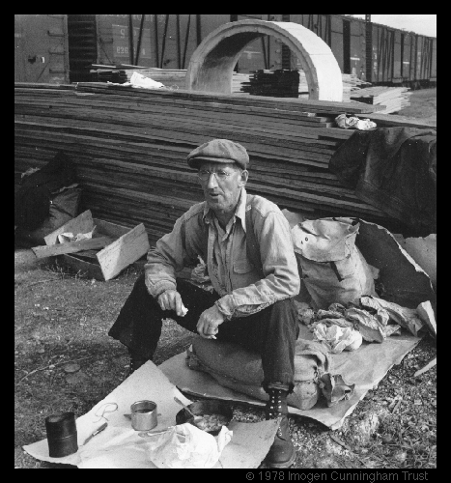
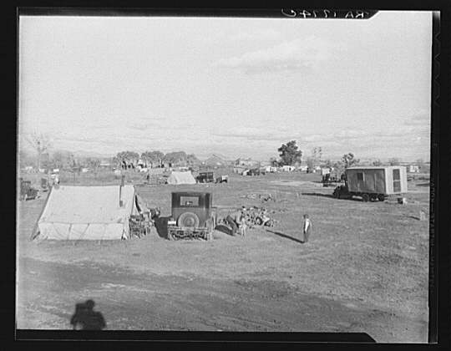
Growth of “Hoovervilles”
Hoovervilles in Bakersfield, California
Images: http://memory.loc.gov/learn/features/timeline/depwwii/depress/hoovers.html

Slide 5
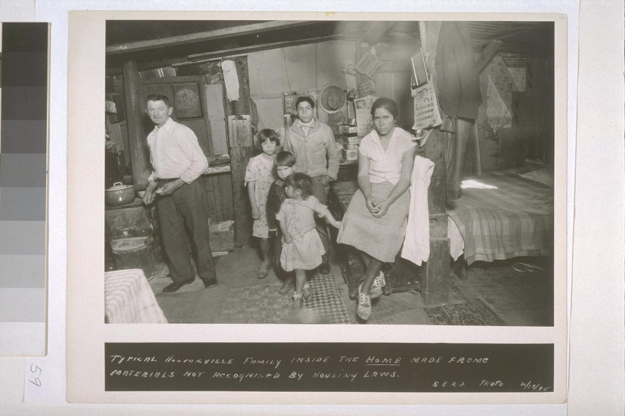
Growth of “Hoovervilles”
Family inside a Hooverville Home

Slide 6
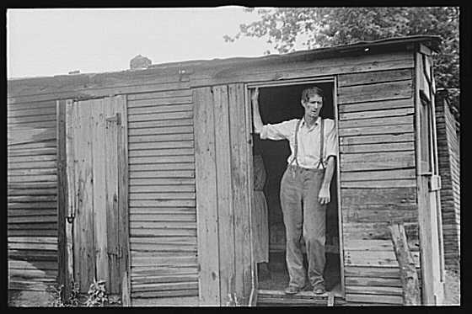
Growth of “Hoovervilles”
Fact: In 1932, 273,000 families were evicted from their homes. Here: A Hooverville in Portland, Oregon.

Slide 7
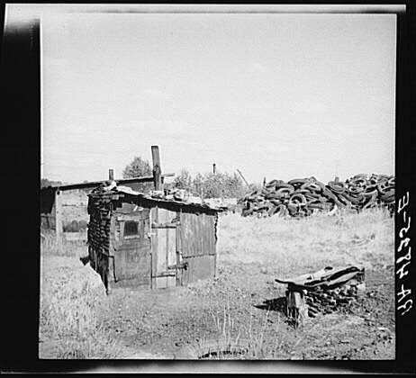
Growth of “Hoovervilles”
Dwellers in Local Hooverville (Circleville, Ohio)

Slide 8
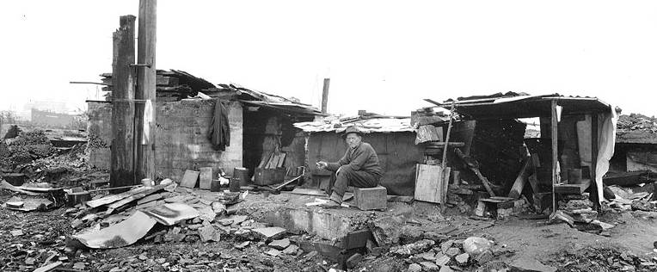
Growth of “Hoovervilles”
Former Skinner and Eddy Shipyard (Seatle)

Slide 9
The Bonus Army
The Bonus Army was made up of more than 15,000 World War I veterans, who demonstrated in Washington, D.C. seeking immediate payment of a "bonus" they believed they had been promised.
Hoover insisted the veterans were influenced by Communists and other agitators and called out the U.S. army to break up the Bonus Army’s camps and disperse the veterans.
News photographs showing tanks and tear gas being used against war veterans destroyed what little popularity Hoover had left.

Slide 10
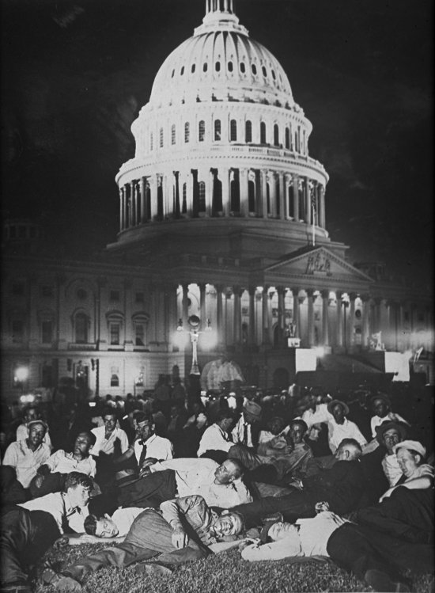
the Bonus Army
Members of the Bonus Army at the Capitol, 1932

Slide 11
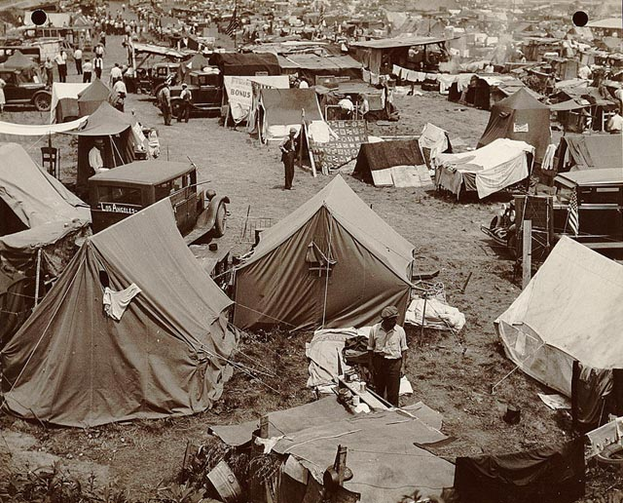
the Bonus Army
www.loc.gov/exhibits/treasures/trm203.html

Slide 12
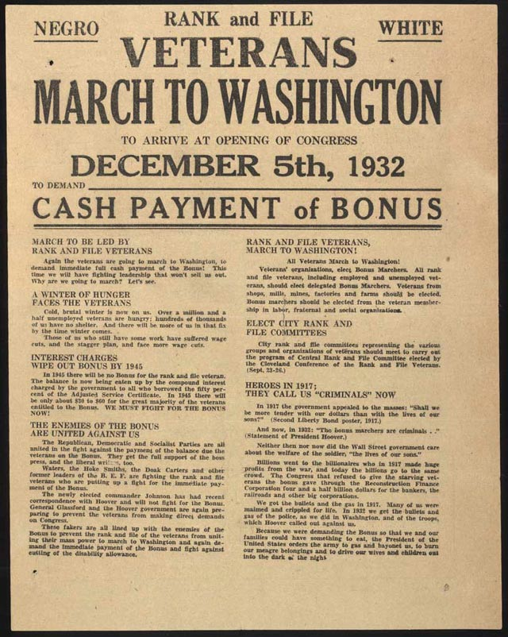
the Bonus Army
www.loc.gov/exhibits/treasures/trm203.html

Slide 13
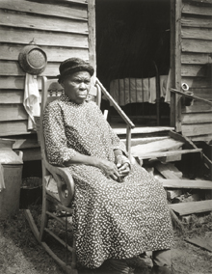
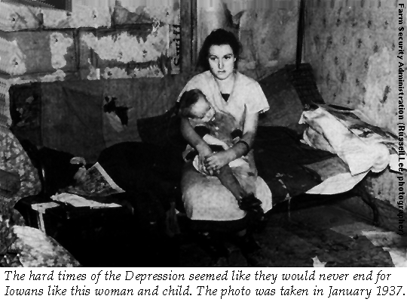
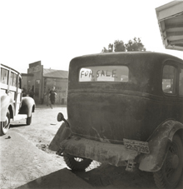
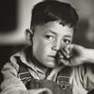
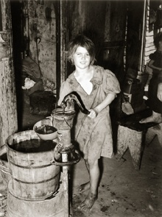
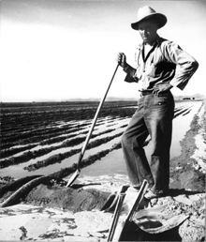

Slide 14
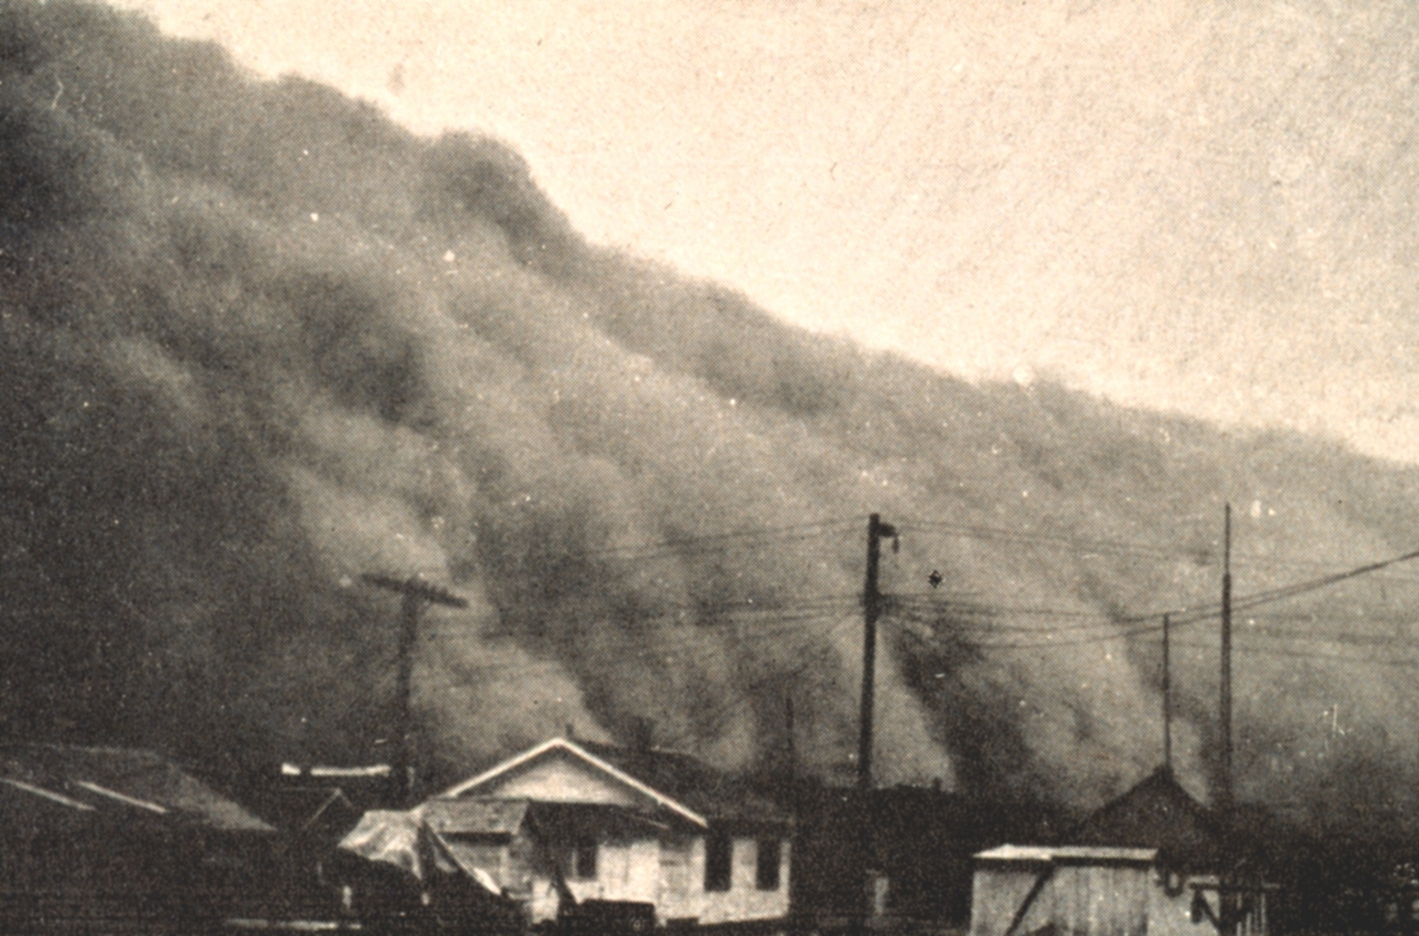
Surviving the Depression…

Slide 15
Surviving the Depression
Drought and Dust
During much of the 1930s, states from Texas to the Dakotas suffered a severe drought. Poor farming methods resulted in the loss of topsoil which was whipped around into giant dust storms that swept across the Great Plains. The Plains became known as the “Dust Bowl”.
The Dust storms, buried farm houses and made a dark clouds. Dust blew everywhere throughout the Midwest.

Slide 16
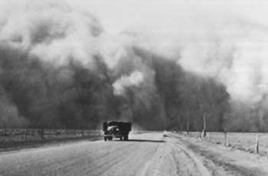
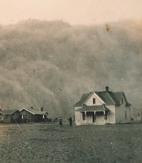

Slide 17
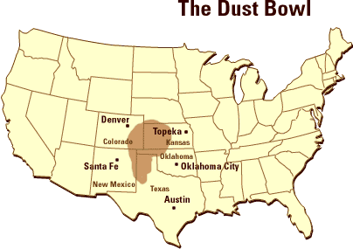

Slide 18
"The land just blew away; we had to go somewhere." -- Kansas preacher, June, 1936
Dust in the eyes of a child on a farm, 1936

Slide 19
Dust Bowl Days
On the fourteenth day of April of nineteen thirty five,
There struck the worst of dust storms that ever filled the sky:
You could see that dust storm coming,
the cloud looked deathlike black,
And through our mighty nation, it left a dreadful track...
This storm took place at sundown and lasted through the night,
When we looked out this morning we saw a terrible sight:
We saw outside our windows where wheat fields they had grown
Was now a rippling ocean of dust the wind had blown.
It covered up our fences, it covered up our barns,
It covered up our tractors in this wild and windy storm.
We loaded our jalopies and piled our families in,
We rattled down the highway to never come back again. — Woody Guthrie (1912-1967) From "Dust Storm Disaster"

Slide 20
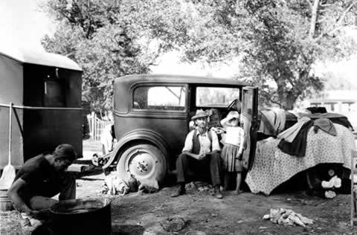
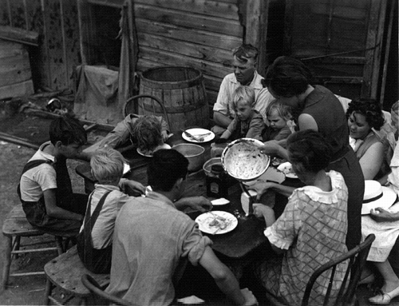
Escaping the Dust Bowl
Devastation in the Dust Bowl created a group of migrant farmers called “Okies” who moved to California and one region to another in search of work. They were also known as “migrant workers”.

Slide 21
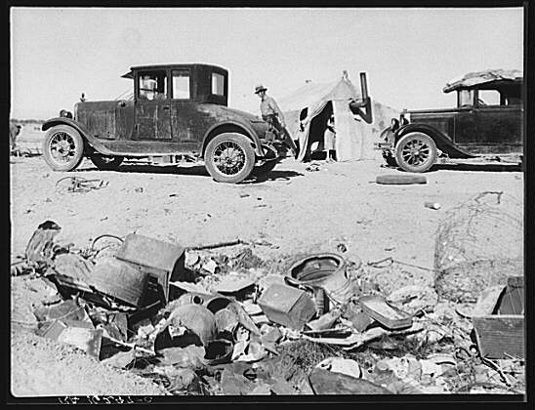
Migrant Workers
In 1932, there were two million homeless people moving around the country.
Mother and child from Oklahoma, now migrants in California 1937
Refugee families encamped
Near Holtville, California 1937

Slide 22
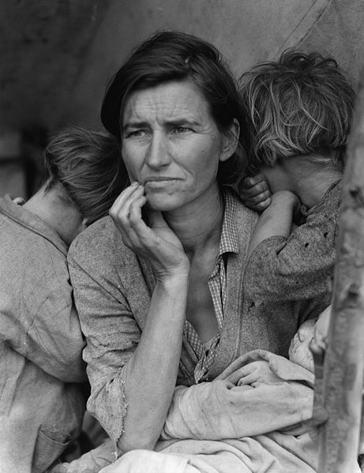
Documenting the Dustbowl Dorothea Lange never intended to be famous, and yet the picture she took of a worried and tired looking migrant mother and her children in 1936 became the image most associated with the decade.
Florence Owens Thompson huddled in a tent with seven children next to the car whose tires she had just sold to buy food. She told Lange the only thing they had to eat were small birds and frozen vegetables from the fields.
http://www.huntington.edu/news/0001/images/Migrant-Mother-1.jpg

