Slide 1
BECOMING AN INDUSTRIAL SOCIETY
Welcome To The Gilded Age

Slide 2
Immigration and Urbanization

Slide 3
Migration to the Cities & Immigration
In the mid 1800s, there was a DRAMATIC Increase in the number of Immigrants coming to the U.S.
Immigration: the action of coming to live permanently in a foreign country
Old Immigrants (1820-1860) | New Immigrants (1890-1900)
From Northern or Western Europe (German, English, Dutch) | From Eastern and Southern Europe (Italian, Polish, Russian, and Irish)
Mostly Protestant Christians | Mostly Catholics and Jews
Dominant English Culture | Brought Different Languages, Customs, Different Religious Beliefs, etc.
Literant and Skillful in many professions | Most were unskilled workers coming from poverty and illiterate
Came with families and had wealth | Came alone and with little money
Wanted to assimilate themselves into American Culture | Wanted to retain and embrace their own cultures

Slide 4
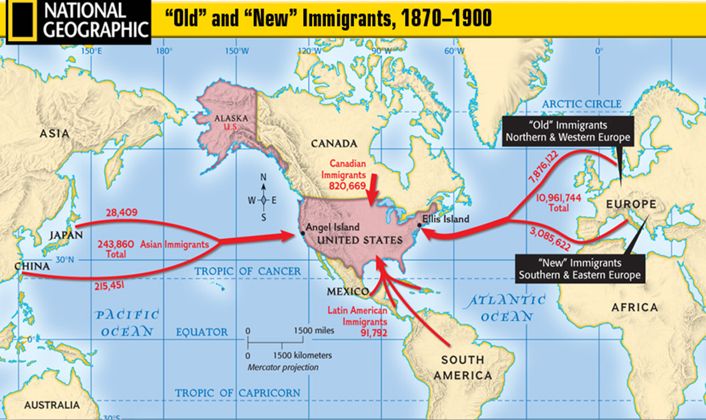
Immigration to the United States: Old vs. New Immigrants

Slide 5
Think About It:
Questions:
Who do you think spoke these words?
What does this tell you about life in the cities of America?
What does it tell you about the life of people like the person who spoke this quote?
“I came to America because I heard the streets were paved with gold. When I got here, I found out three things: First, the streets weren’t paved with gold. Second, they weren’t paved at all, and third, I was expected to pave them.”

Slide 6
Push & Pull Factors:
Why were immigrants coming to the US in such large numbers?
The Push-Pull Factor:
When people migrate, they don’t just leave one place and magically arrive somewhere else…usually, something pushes them away from their native country and pulls them toward a new place
Push Factors: circumstances that make a person want to leave
Pull Factors: advantages a country has that make a person want to come and live there
Push Factors | Pull Factors
Famine | The American Dream
Unemployment | Opportunity
War | Refuge
Religious Persecution | Freedom of Religion

Slide 7
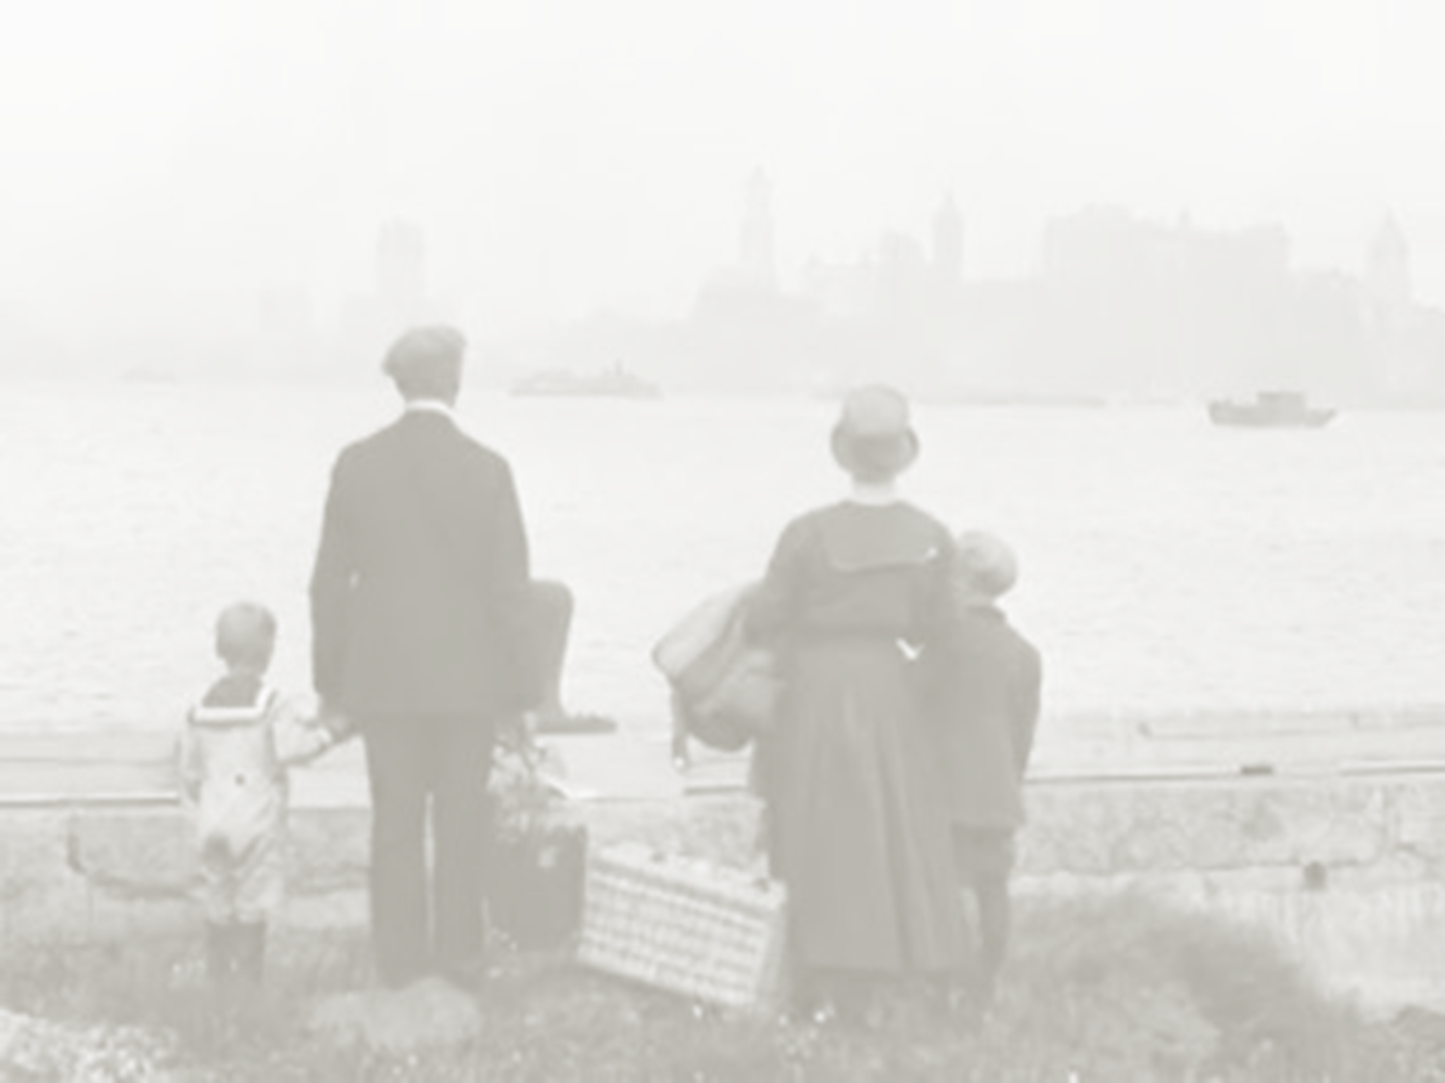
Immigration to the United States: Why were immigrants coming to the United States?
Based on this graph, identify two conditions in their native countries that caused immigrants to come to the United States.
______________________________________________
______________________________________________
Based on this graph, identify one situation in the United States that led to an
increase of immigrants coming into the nation.
______________________________________________

Slide 8
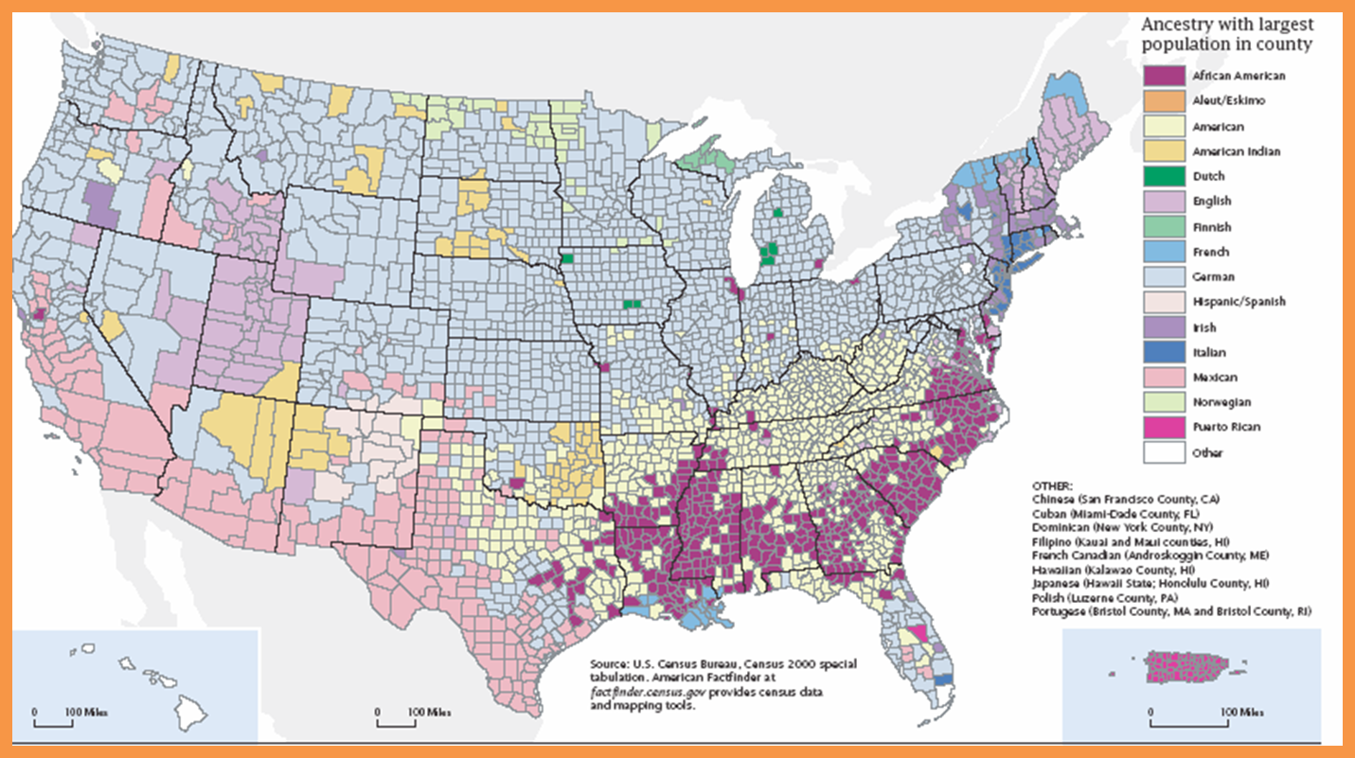
American Ancestry & Where Immigrants Settled

Slide 9
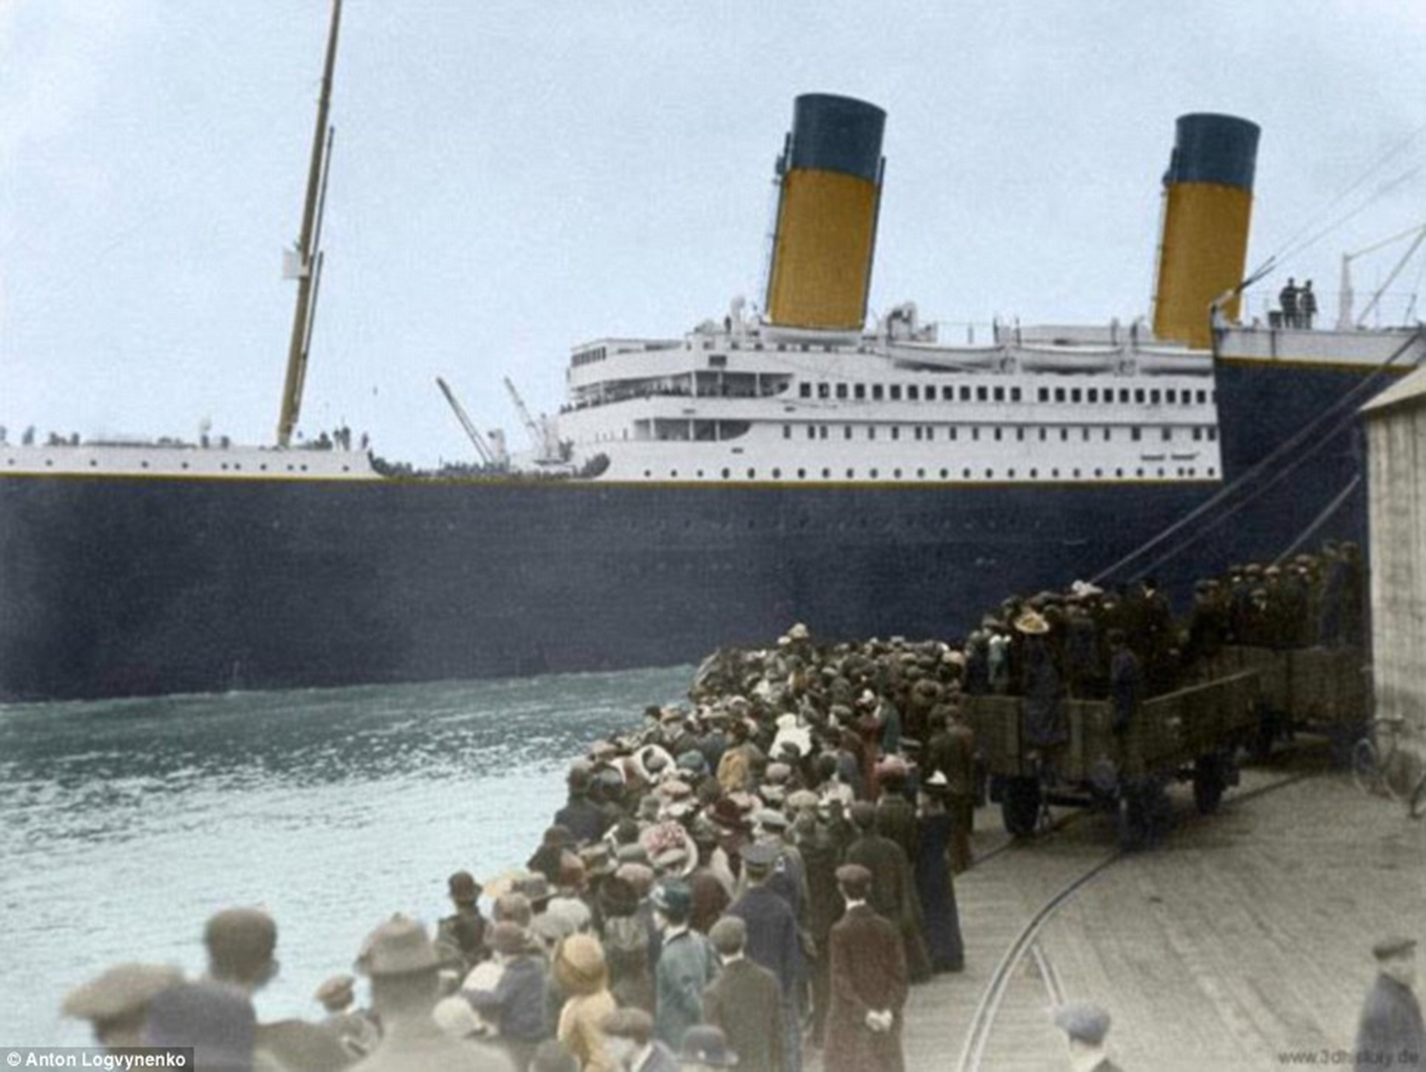
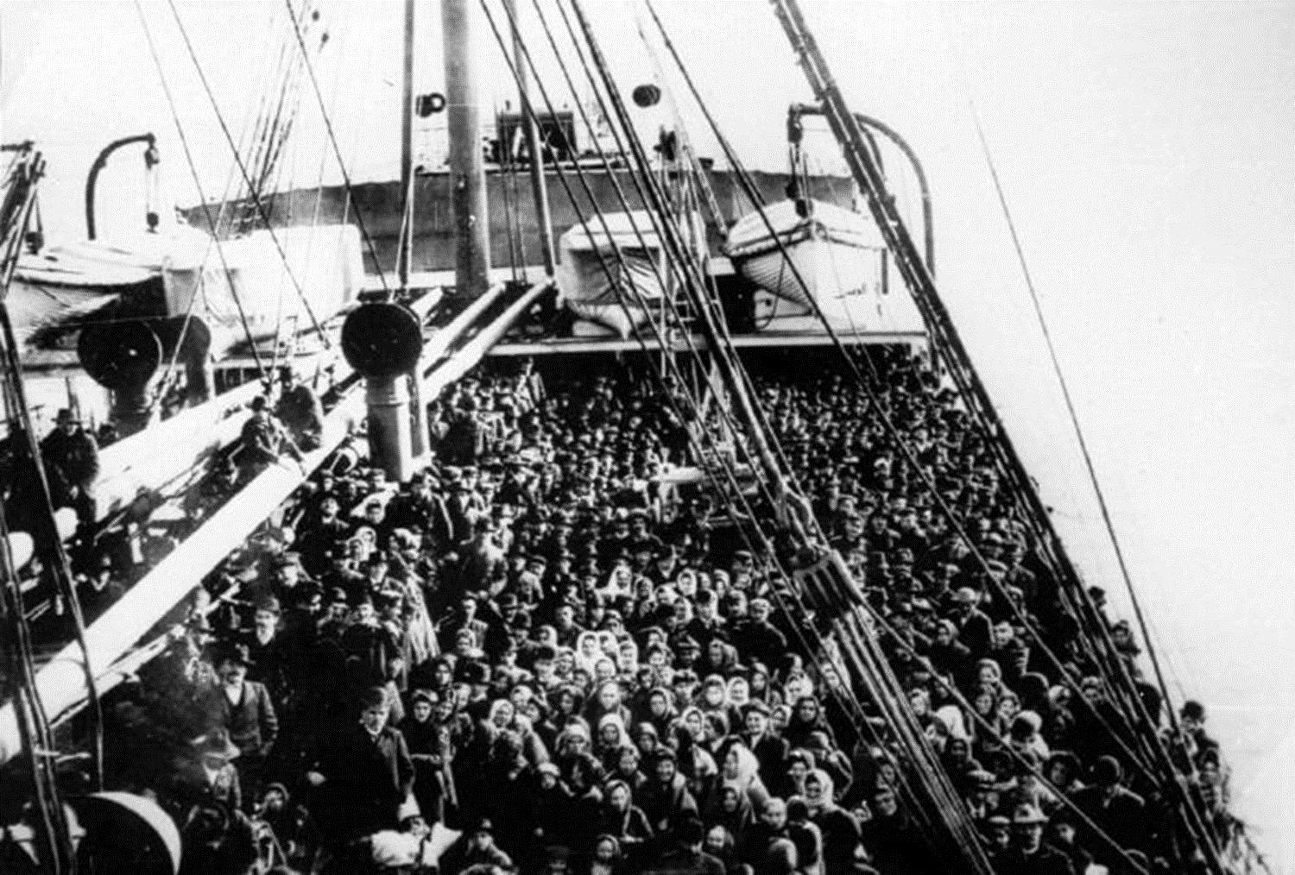
The Journey to the United States
Steamships were the means of transportation
1st and 2nd class passengers could go directly into New York City
Steerage Passengers (most common) had to be processed at Ellis Island
The Mortality rate was 10% for passengers in steerage
It is crowed, Dark, Unsanitary
Journey could last from two weeks to a month depending on the ship and weather

Slide 10
Where did Immigrants go once they arrived?
Ellis Island
Angel Island
To handle the large number of immigrants, in 1892, the federal government opened Ellis Island -- a reception center for European immigrants arriving by ship
Immigrants had to meet the following requirements in order to enter the country
Could not be a convicted felon
Must be able to work
Must have money ($25 in 1909)
Must be healthy
Immigration processing center located on the west coast in San Francisco Bay
Smaller than Ellis Island
Used primarily for Chinese immigrants
Followed a strict set of guidelines when allowing immigrants into the country (more so than Ellis Island)

Slide 11
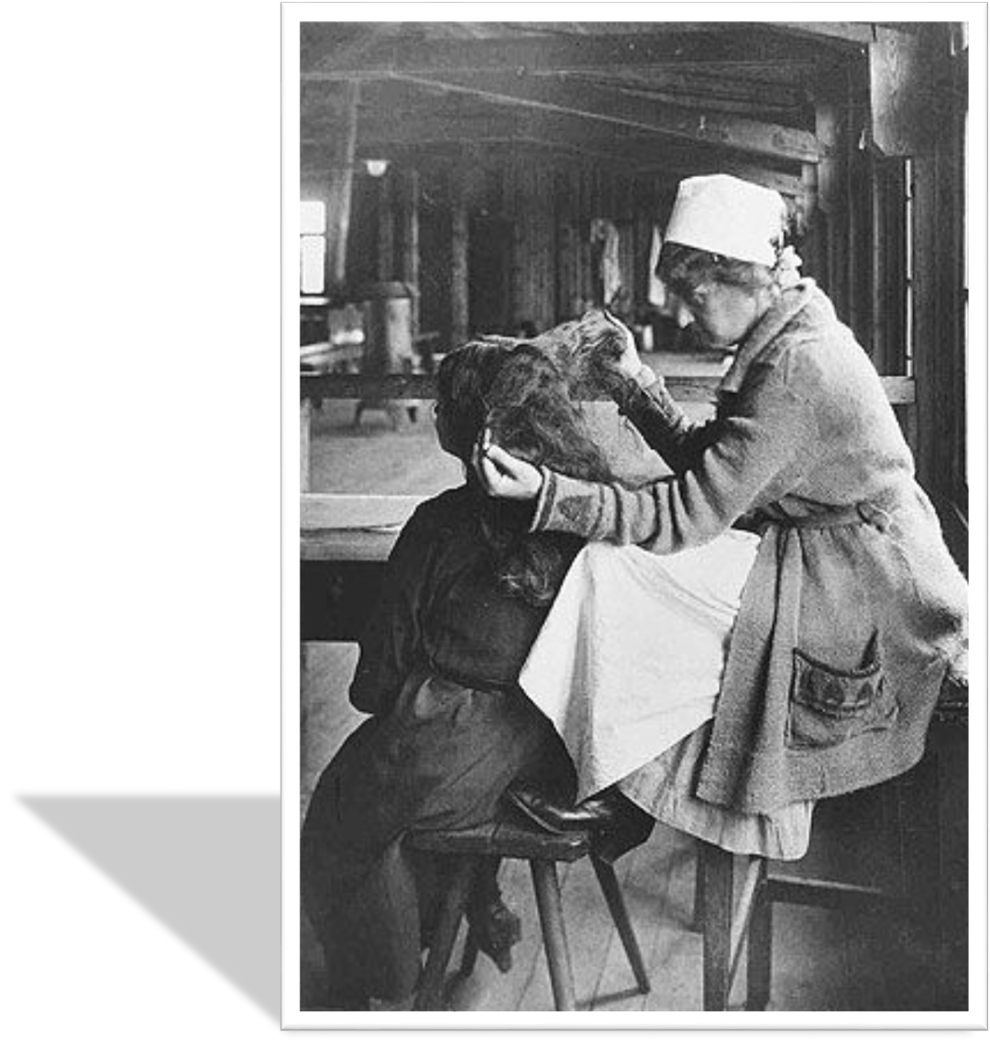
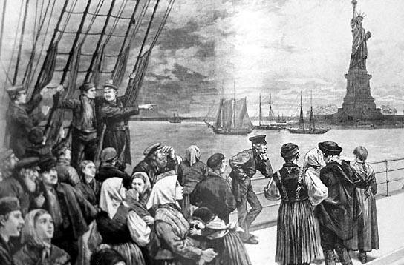
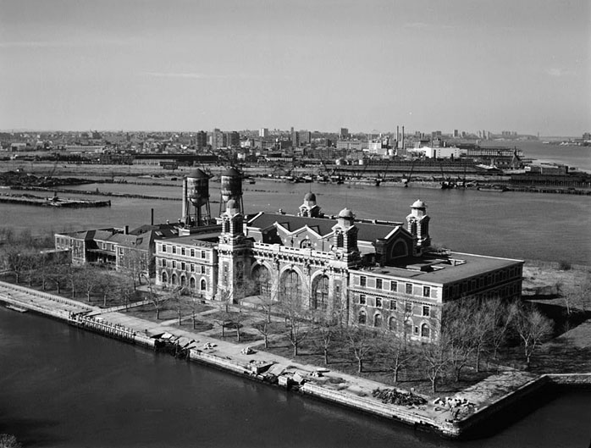
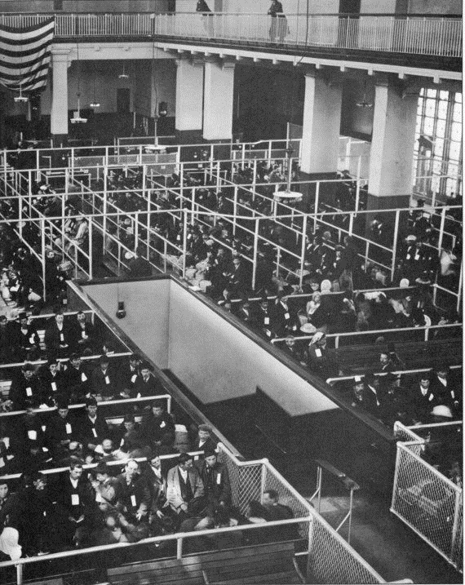
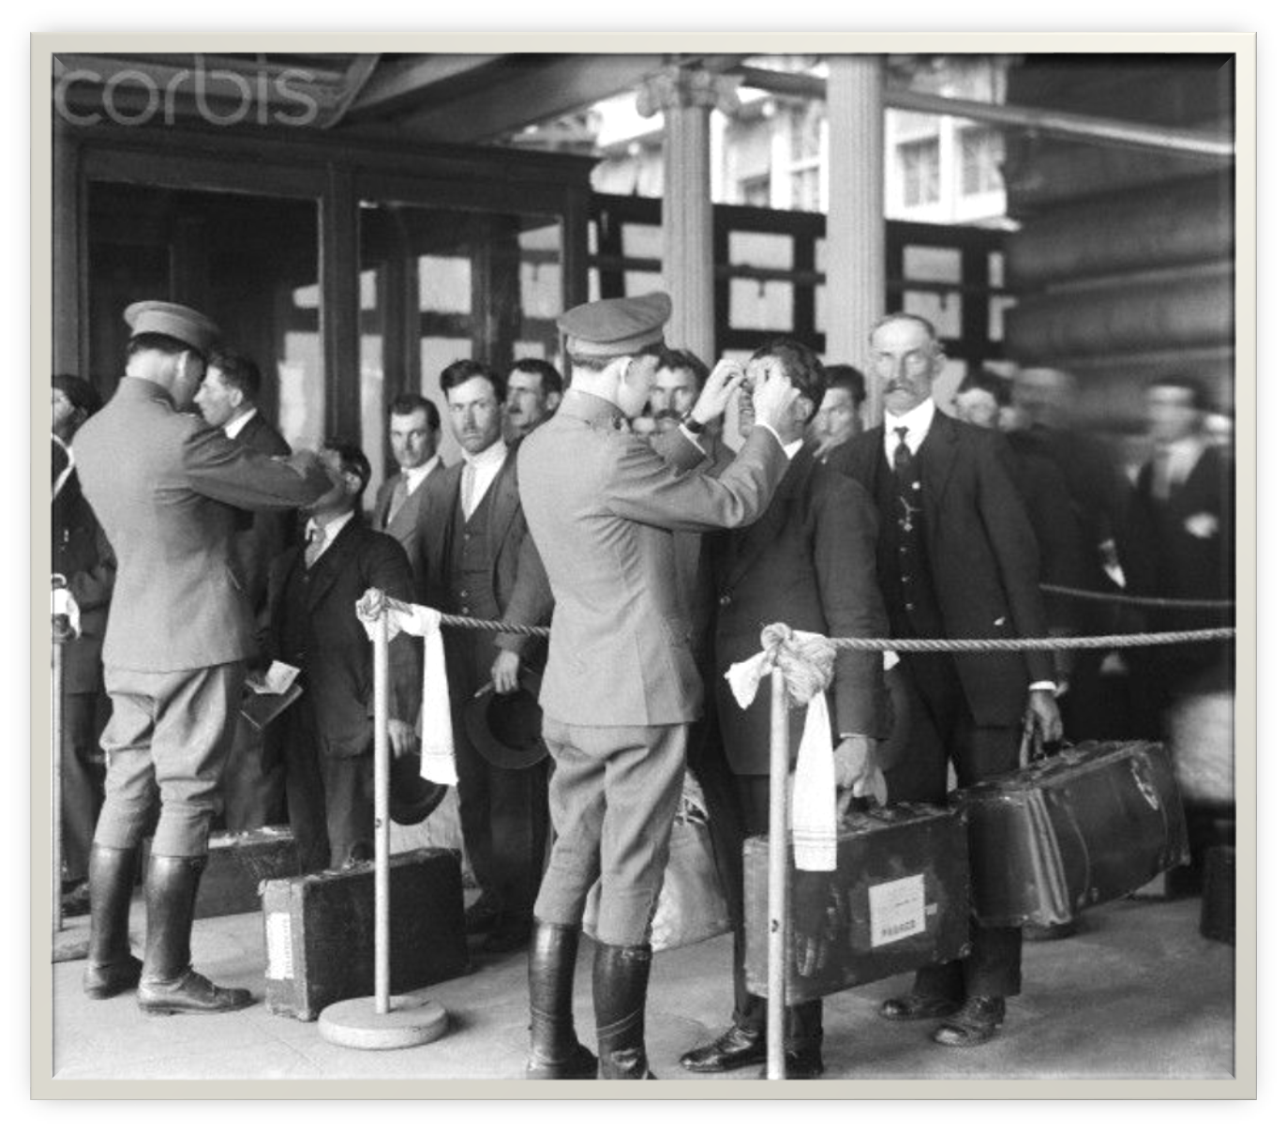
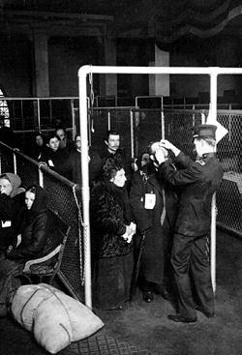
Ellis Island

Slide 12
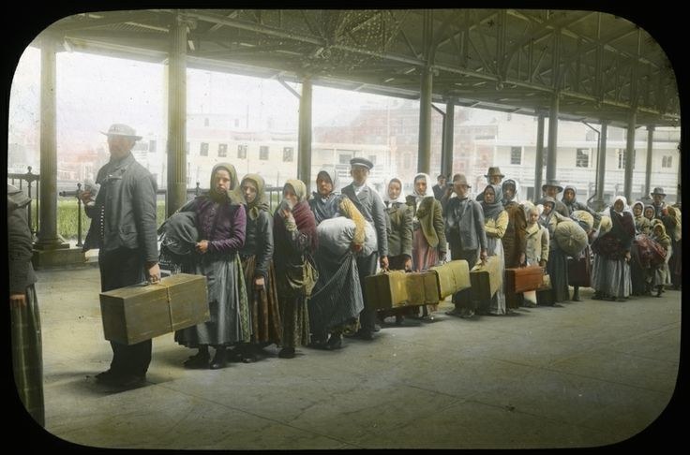
It is estimated that the ancestors of almost one-half of all the people living in the United States today passed through Ellis Island as immigrants. Today Ellis Island is open to the public. It contains the Ellis Island Immigration Museum.
Ellis Island

Slide 13
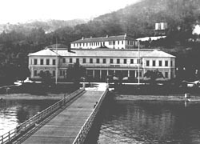
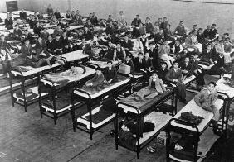
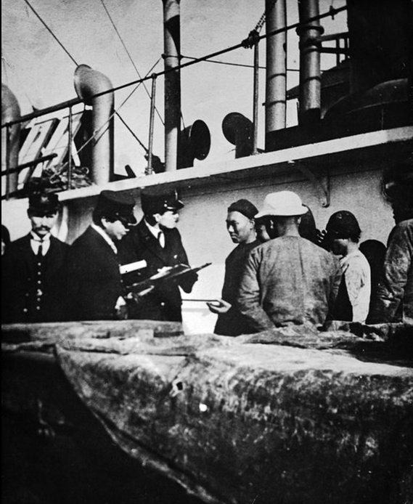
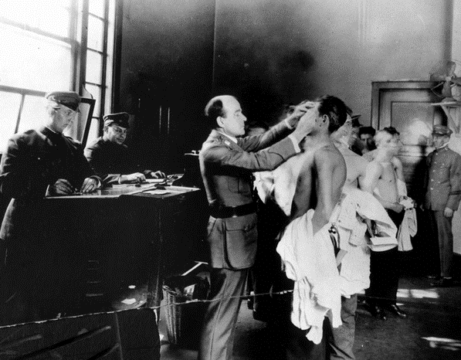
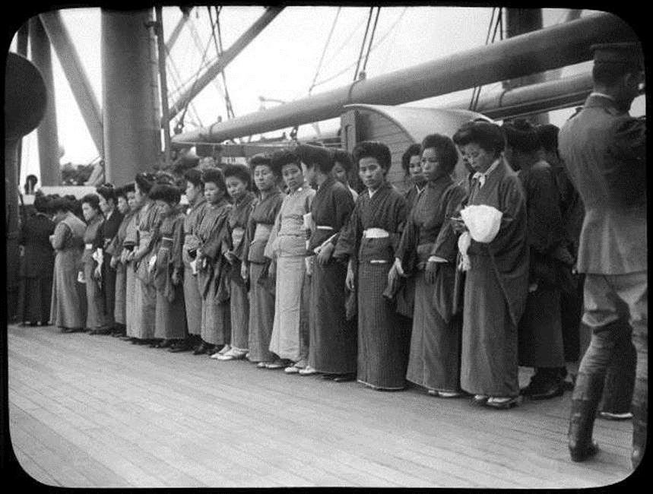
Angel Island

Slide 14
Discovering Angel Island: The Story Behind the Poems

