Slide 1
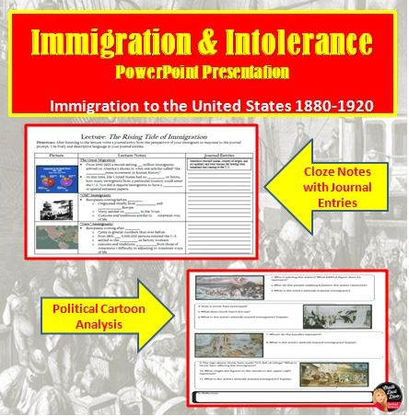
Lecture: Immigration & Intolerance
Immigration to the United States 1880-1920
(animate the slide SlideShow > From Current Slide)

Slide 2
Immigration Preview Activity
Pair Share: What is one principle or ideal that can be extracted from the following quotes?
Quote Set 1:
We hold these truths to be self-evident, that all men are created equal.
Thomas Jefferson, in the Declaration of Independence, 1776
Four score and seven years ago our fathers brought forth…a new nation conceived in liberty and dedicated to the proposition that all men are created equal.
Abraham Lincoln, in the Gettysburg Address, 1863

Slide 3
Quote Set 2
“America is a land of wonders, in which everything is in constant motion and every changes seem an improvement”
-Alexis de Tocqueville, 1835
“We are the pioneers of the world; the advance guard sent though the wilderness of the untried things to break a new path in the New World that is ours”
-Herman Melville, 1852
Pair Share: What is one principle or ideal that can be extracted from the quotes above?

Slide 4
Quote Set 3
“America is a land of unlimited possibilities.”
Ludwig Max Goldberger, 1903
“ What then is the American…here individuals of all nations are melted into a new race of men, whose labors and prosperity will one day cause great changes in the world”
-J. Hector St. John Crevecoeur, 1782
Pair Share: What is one principle or ideal that can be extracted from the quotes above?

Slide 5
Quote Set 4
“ The preservation of the sacred fire of liberty…[is] entrusted to the hands of the American people”
-George Washington, 1789
“ My country ‘tis of thee; Sweet land of liberty; Of thee I sing. Land where my Fathers died; Land of the pilgrims pride; from every mountain side, let freedom ring.”
Lyrics to “My Country ‘Tis of Thee” by Samuel Francis Smith, circa 1900
Pair Share: What is one principle or ideal that can be extracted from the quotes above?

Slide 6
Essential Question
Keep these principles in mind as you think about the mini-project question:
To what degree should we be proud or ashamed of American Society and government between 1890 and 1920?

Slide 7
Objective
Students will be able to analyze the “push” and “pull” factors for immigration at the turn of the century and the American reaction to it by completing diary entries.

Slide 8
Film Clip: Growth, Cities, and Immigration
Questions
Where did most “new immigrants” come from?
What cities did most new immigrants move to?
What were some reasons they came to America?
What were examples of intolerance against immigrants?
https://www.youtube.com/watch?v=RRhjqqe750A
Notes:
YouTube video clip: https://www.youtube.com/watch?v=RRhjqqe750A

Slide 9
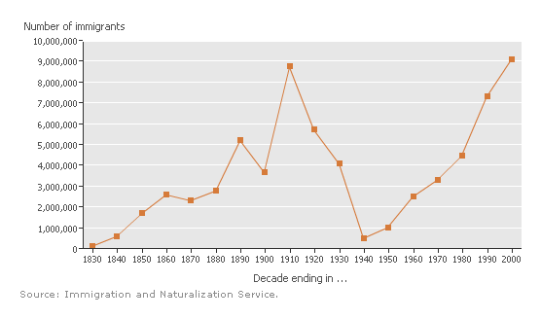
What does this
graph show?
2. What were the
Reasons for increased
immigration from
1830-1910?
3. What could be the
Reasons for the rapid
decline of immigration
between 1910-1940?
4. What could be the
reasons
for increased
immigration after 1940?

Slide 11
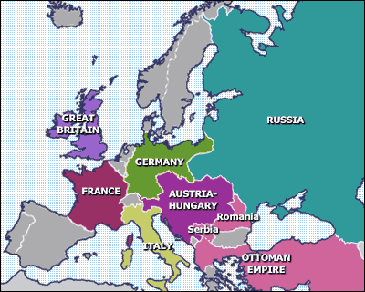
Europe: Late 1800’s

Slide 12
Directions
As you reads through the presentation, complete your CLOZE notes on the left-side of your worksheet

Slide 13
The Great Migration
From 1880-1921 a record setting 23 million immigrants arrived on America’s shores in what one scholar called “the largest mass movement in human history
At this time, the United States had no quotas, or limits, how many immigrants from a particular country could enter the U.S. Nor did it require immigrants to have a passport or special entrance papers.

Slide 14
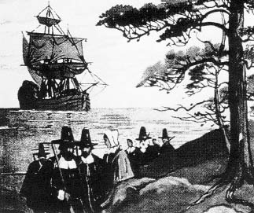
Old Immigrants

Slide 15
“Old” Immigrants’
Europeans coming before 1890
Originated chiefly from northern and western Europe
Many settled on farms in the West
customs and traditions similar to American way of life

Slide 16
Europe: Late 1800’s

Slide 17
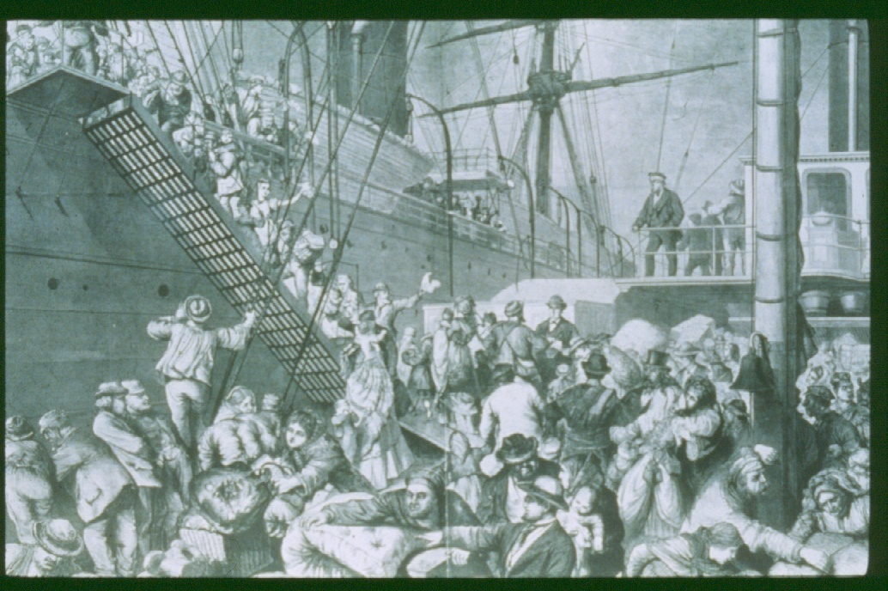
New Immigrants

Slide 18
“New” Immigrants
Europeans coming after 1890
Came in greater numbers than ever before
from 1901-1910 8,800,000 persons entered the U.S.
settled in the cities as factory workers
customs and traditions different from those of Americans = difficulty in adjusting to American ways of life

Slide 19
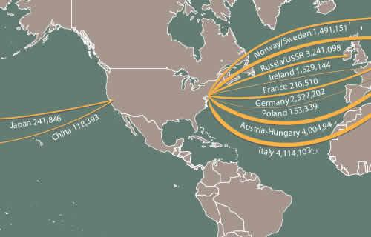
Immigration to the United States 1880-1920

Slide 20
Reasons for Immigration
Push Factors
Pull Factors
Economic
Agricultural based economies declined in Europe
Political
Political and religious persecution.
Social
Increased population = more people completed for few resources
Economic
America = land of opportunity
Political
America = Democracy
Social
America = land of equality

Slide 21
Journal Entry #1
Pretend you are immigrating to the United States at the turn of the century. Introduce yourself (name, country of origin, and occupation) and your reasons for leaving your homeland and coming to the U.S.

Slide 22
Film Clip: The Voyage
Notes:
https://www.youtube.com/watch?v=5rredHTyKaQ

Slide 23
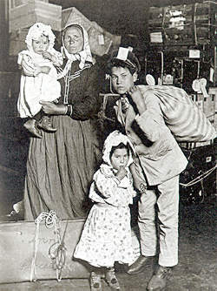
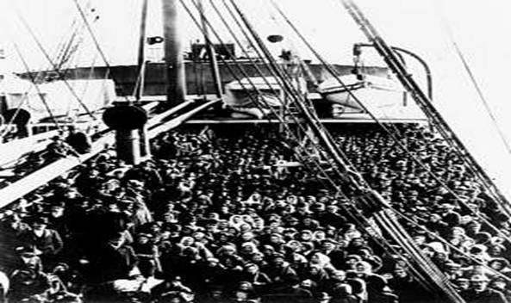
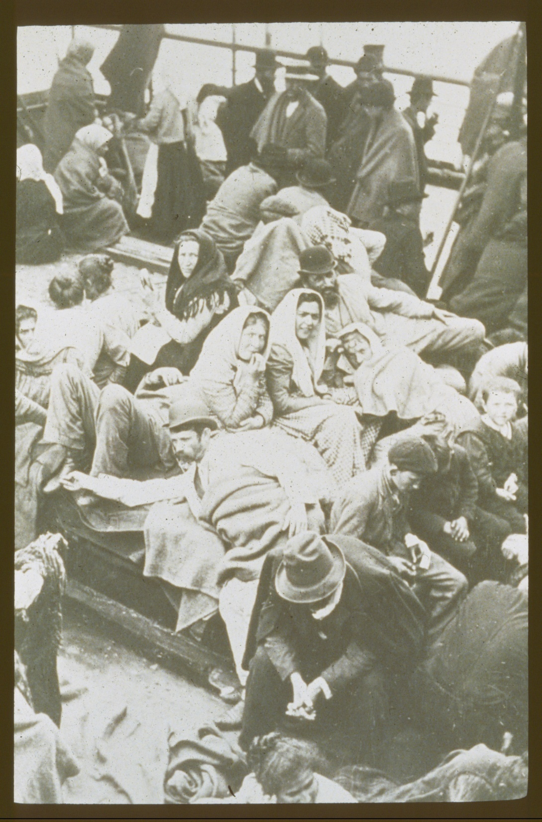
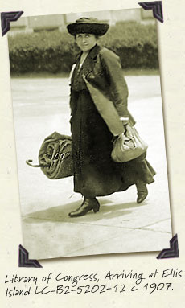
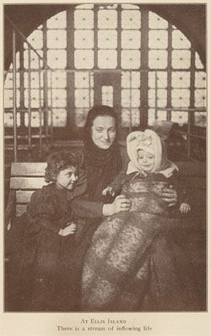

Slide 24
Arrival in America
Ellis Island
75% of immigrants entered at Ellis Island in New York Harbor
Angel Island
Asian immigrants entered at Angel Island in San Francisco

Slide 25
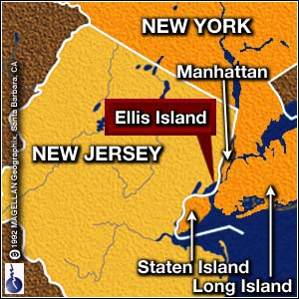
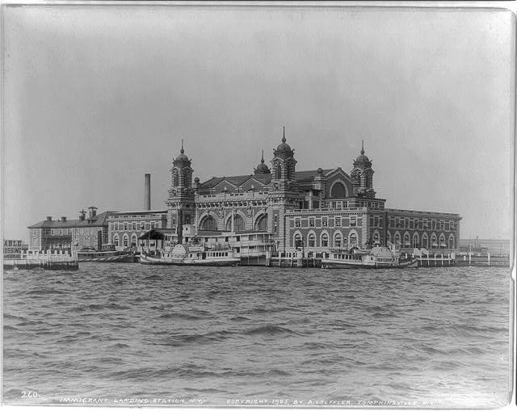
Listen to the interview with an immigrant describing her story about arriving at Ellis Island (animate the slide SlideShow > From Current Slide)
Notes:
Play sound clip: Ellis Island Voice 1 (double-click on icon)

Slide 26
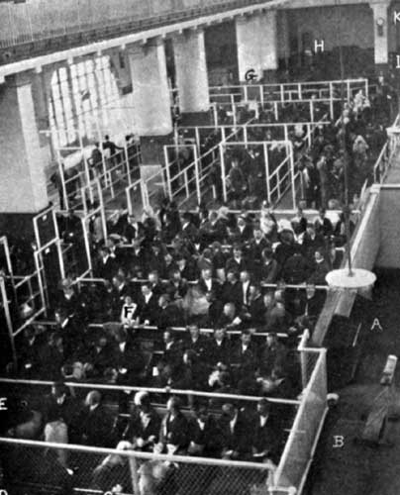
Legal Inspections Listen to an interview with an immigrant about the legal inspections.
(animate the slide SlideShow > From Current Slide)
Notes:
Double-click on sound icon to play interview

Slide 27
Journal Entry #2
Record your thoughts and feelings about the voyage to America and arriving at Ellis Island. Explain what it was like to be processed through Ellis Island.

Slide 28
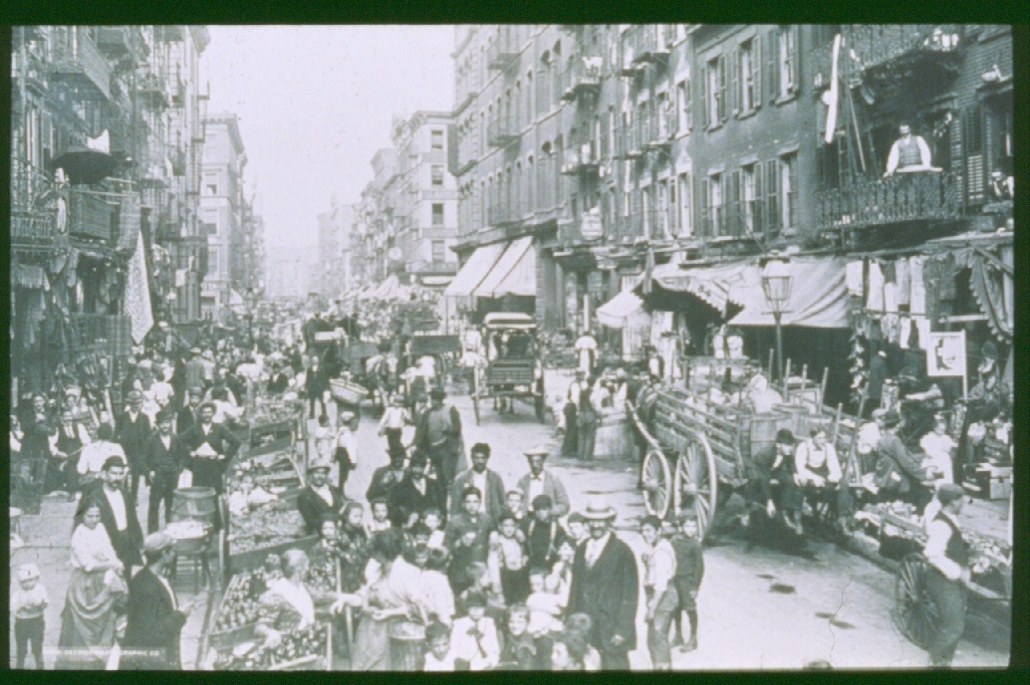
Ethnic Enclaves

Slide 29
Ethnic Enclaves
About 2/3 of immigrants settled in urban centers:
New York, Chicago, & Philadelphia.
By 1920 75% of foreign-born U.S. residents lived in cities.
These enclaves provided immigrants with a sense of community and security
Familiar language, food, religion, customs, etc.

Slide 30
Journal Entry #3
Record your thoughts and feelings about arriving in the place you intend to settle and describe your living conditions.

Slide 31
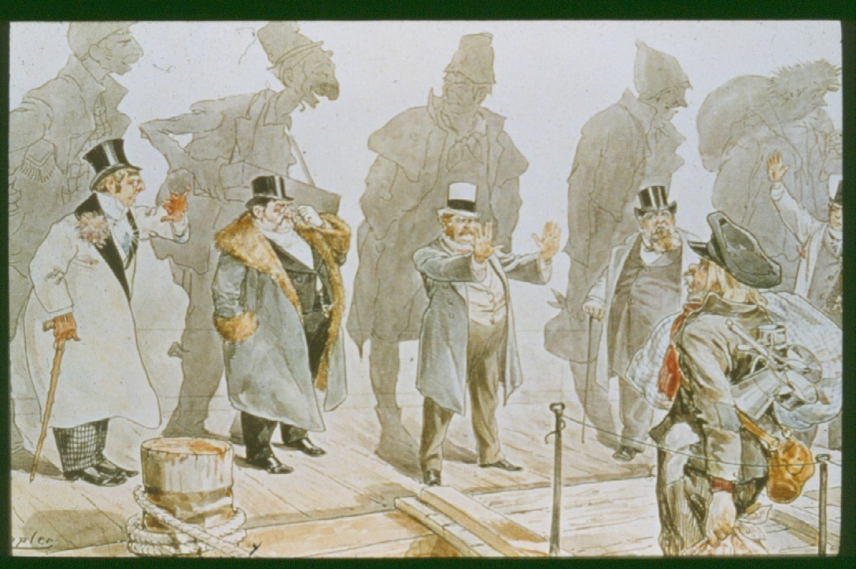
1. Describe what you see in this cartoon.
2. What is ironic about this cartoon?
3. What is the author’s opinion about people who oppose immigration?

Slide 32
American Treatment of Immigrants
American Nativism
Native born felt threatened by “new immigrant”
considered them inferior
Accused immigrants of taking jobs away from “real” Americans
Immigrants were difficult to Americanize
Americanization Movement
The belief that immigrants should adapt to American way of life as soon as possible.

Slide 33
Early Steps Restricting Immigration
The Chinese Exclusion Act (1882)
lasted until WWII
The Gentlemen’s Agreement (1907)
promise by Japanese government to deny passports to Japanese laborers seeking to migrate to the U.S.

Slide 34
Immigrants and Discrimination
Economically
last to be hired, kept in poorest jobs, first to be fired
Socially
confined to ghettos and slums; excluded from better hotels, restaurants, and clubs; and often refused admission to institutions of higher learning

Slide 35
Contributions of immigrant groups to America
Cultural
brought their different cultural heritages (Melting Pot vs. Salad Bowl)
Economic
Immigrants increased the demand of agriculture and industry, thereby further encouraged American economic growth
prevented a shortage of labor

Slide 36
Journal Entry #4
Describe the Native-born reaction to you and how it made you feel.

Slide 37
Discussion Question:
To what degree should we be proud or ashamed of American Society and government between 1890 and 1920?

Slide 38
In Reflection:
As you can see, there were varying attitudes towards immigrants.
In examining past attitudes towards immigrants in the United States, do you think that attitudes have changed towards immigrants? Why or why not?

