Slide 1
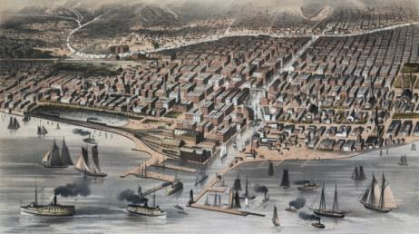
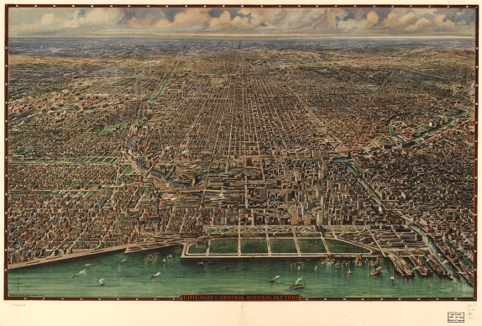
The Growth of Cities and American Culture
Immigration During the Gilded Age: 1865-1900
Chicago, 1870
Chicago, 1916
Notes:
Image, 1870: http://hd.housedivided.dickinson.edu/node/18438
Image, 1916: http://memory.loc.gov/cgi-bin/query/r?ammem/gmd:@filreq(@field(NUMBER+@band(g4104c+pm001550))+@field(COLLID+pmmap))

Slide 2
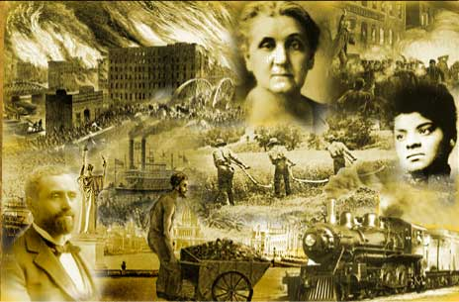
Essential Questions
Explain the impact of industrialization on the growth of cities and the shift in population, both in terms of immigration and urbanization.
In what ways and to what extent did industrialization and urbanization create a new American culture?
Notes:
http://dig.lib.niu.edu/gildedage/

Slide 3
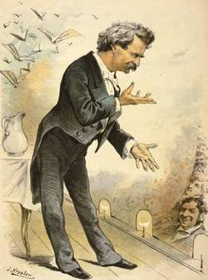
The Gilded Age
Coined by Mark Twain
gild:
To cover with or as if with a thin layer of gold
gilded:
1.covered or highlighted with gold or something of a golden color. 2.having a pleasing or showy appearance that conceals something of little worth

Slide 4
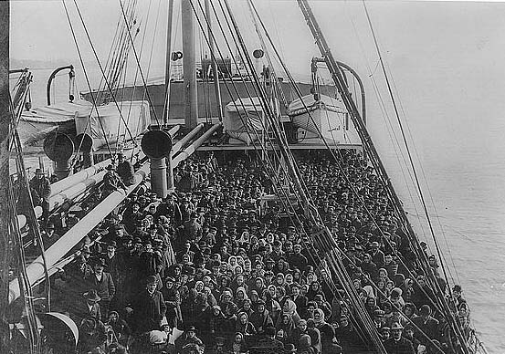
A Nation of Immigrants
Growth of Immigration
By end of 19th Century, US population had tripled
23.3 million (1850) → 76.2 million (1900)
16.2 million immigrants
Causes:
Push factors
Poverty, political turmoil, overcrowding, religious persecution
Pull factors
“land of opportunity”
Availability of industrial jobs
“Old” vs. “New” Immigrants
Southern & Eastern Europeans
Many poor and illiterate
Catholic, Greek Orthodox, Russian Orthodox, and Jewish
Non-WASP
“birds of passage”
Largely retained old world customs
Segregated
“Little Italy’s” and “Chinatowns”
Notes:
Image: http://grossmanproject.net/The%20Exodus.htm

Slide 5
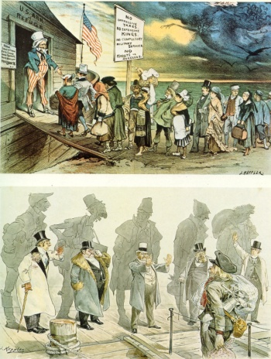
Reaction to Immigration
Statue of Liberty (1886)
Restricting Immigration
Chinese Exclusion Act (1882)
Restrictions on “undesirables” (1882)
Contract Labor Law (1885)
Gentleman’s Agreement (1907)
Immigration Centers
Ellis Island, NY
Angel Island, SF
Policies
Medical Exams & Quarantines (fear of TB)
Detention & Questioning
Preventing temporary workers and “paper brides”
Nativism
American Protective Association (1887)
Immigration Restriction League (1894)
Social Darwinists
Notes:
http://historyproject.ucdavis.edu/ic/image_details.php?id=9158

