Slide 1
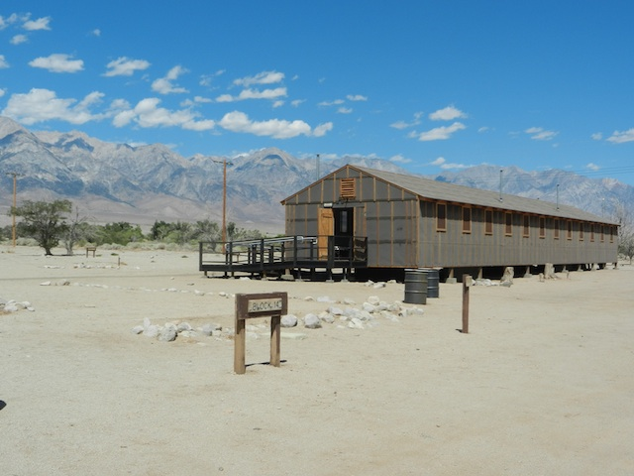
Japanese Internment
Simulation

Slide 2
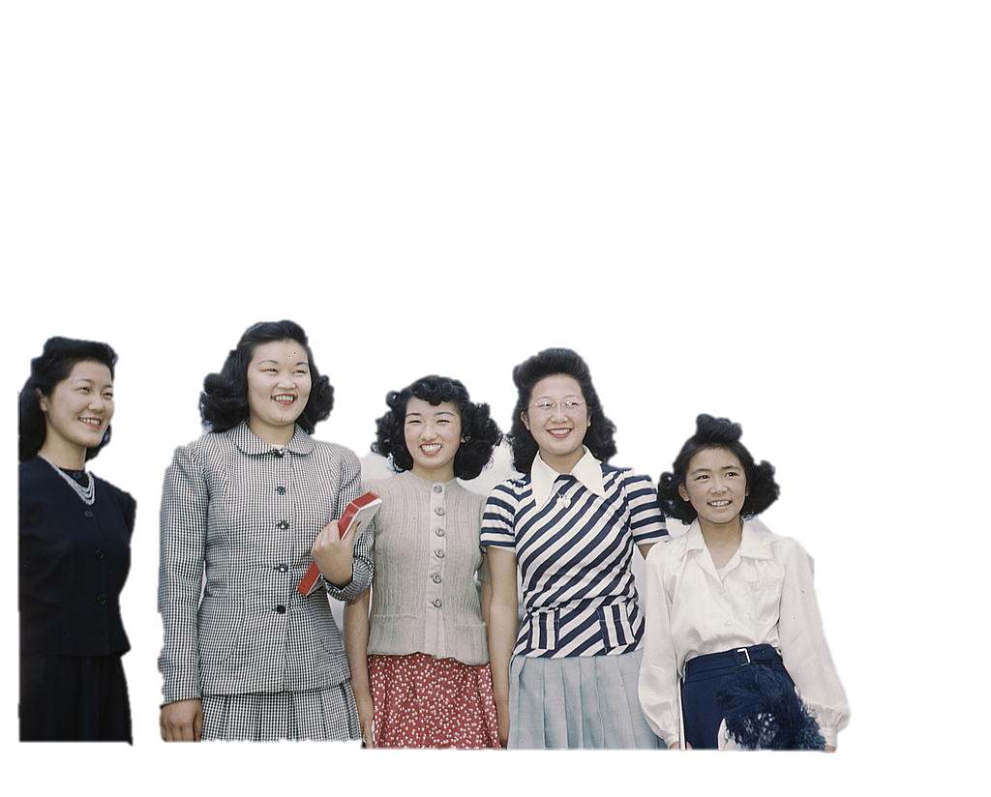
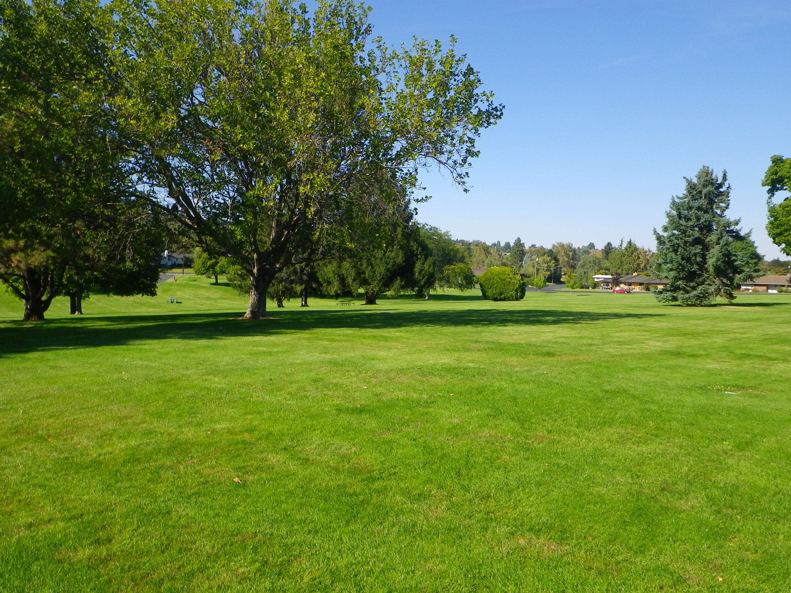
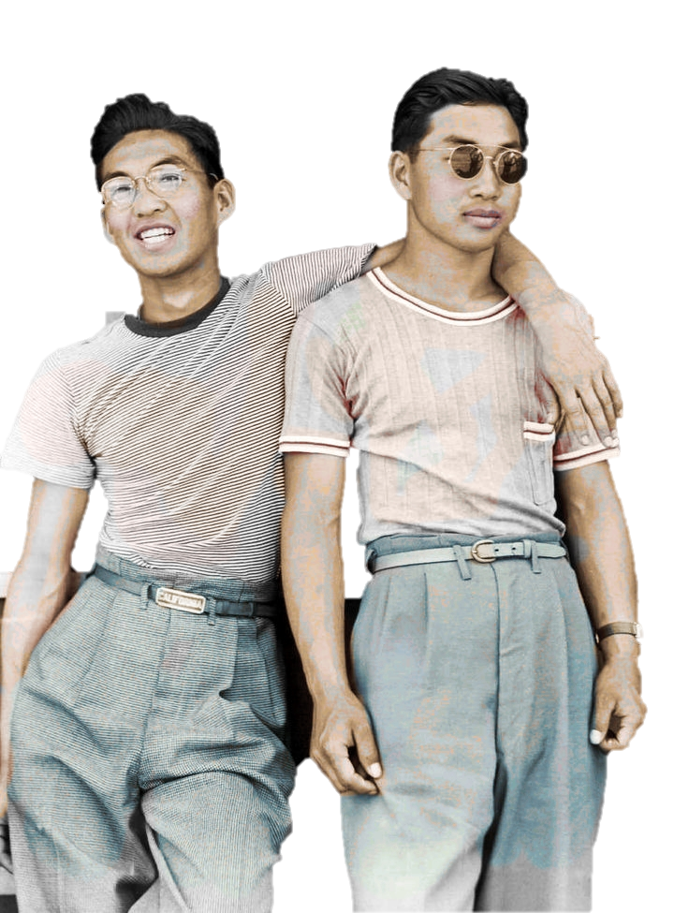
The year is 1941 and you are an 18 year high school student born and raised in California. You are excited about your senior year and all the activities coming up second semester.
c/o 1942

Slide 3
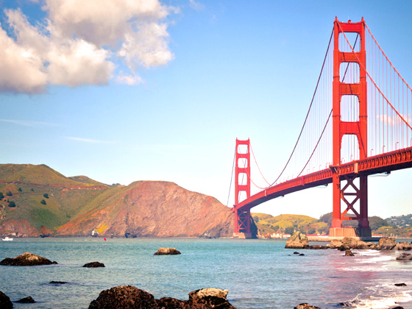
Teenage Fun
What type of activities did you do to have fun in the 1940’s as a teenager? Choose a number and record it in your Memory Book.
1
2
3
4

Slide 4
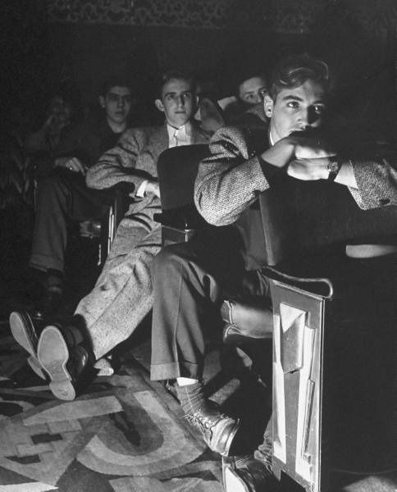
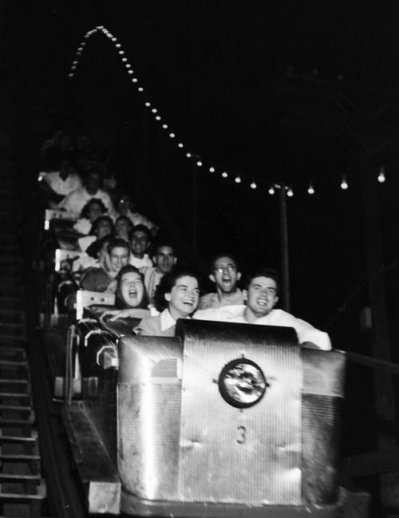
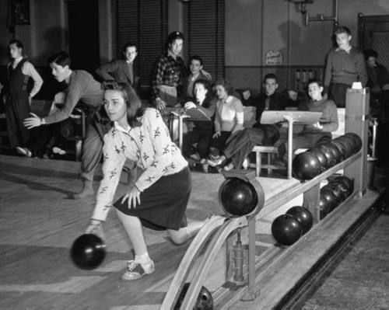
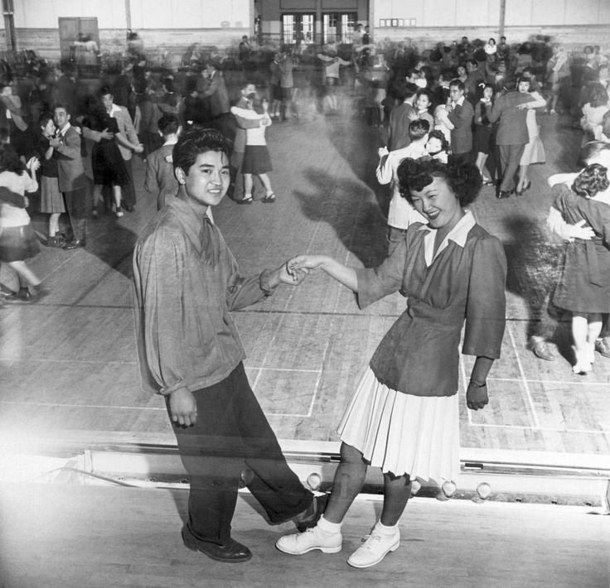
Teenage Fun
1- Movies
2- Arcade & Fun Zone
In your Memory Book record your activity
3- Bowling
4- Dancing the Jitter Bug & Swing

Slide 5
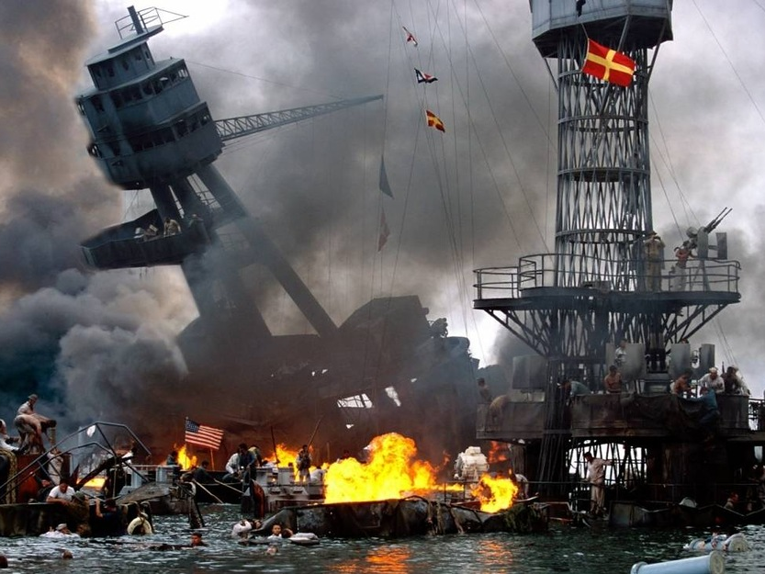
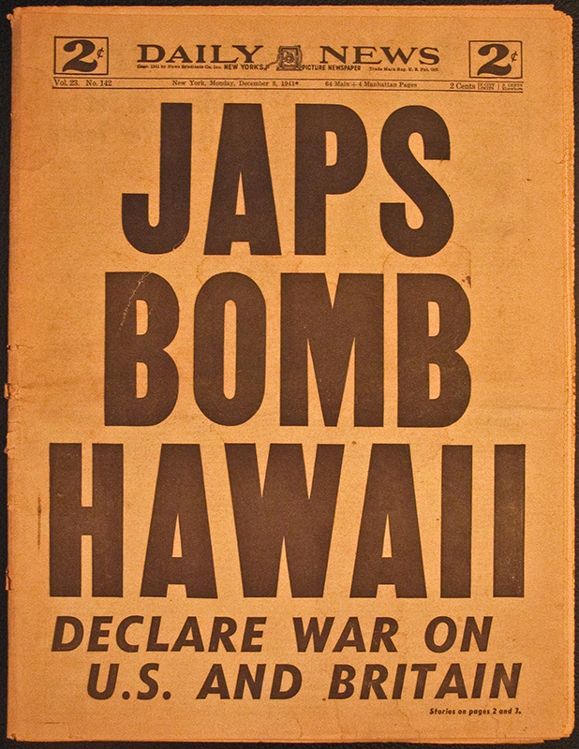
Your carefree Senior year is suddenly interrupted when on December 7th 1941 the Empire of Japan un-expectantly attacked the United States of America. As an American you were outraged that Pearl Harbor, Hawaii was bombed and your country’s security was threatened.

Slide 6
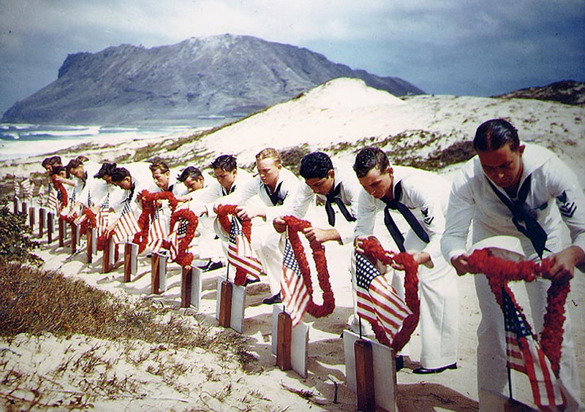
Rest in Peace!

Slide 7
Patriotism
How did you show your patriotism after the attack on America? Choose a number and record it in your Memory Book
1
2
3
4

Slide 8
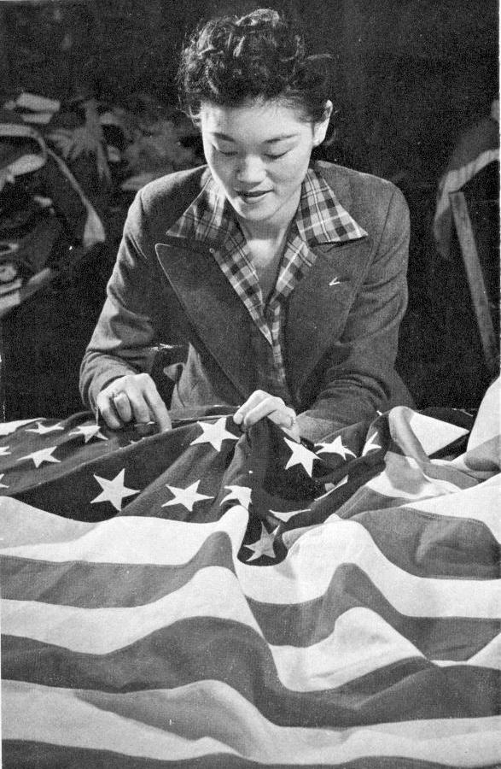
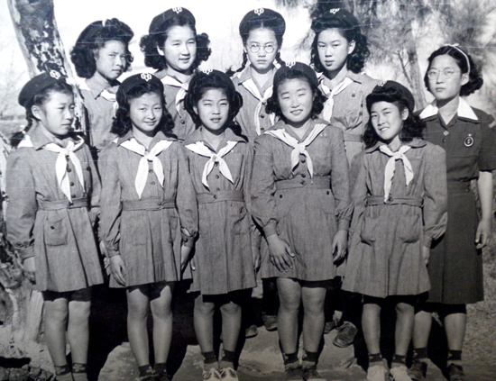
Patriotism
Record it in your Memory Book
1- You join the Girl Scouts or Boy Scouts of America
2- You get a patriotic tattoo
3- You create a community Victory Garden
4- Sew your own American flag to be flown at your home

Slide 9
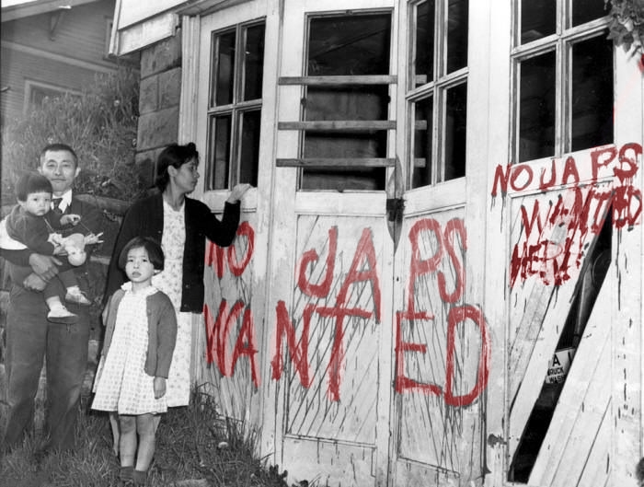
Despite your Patriotism you quickly realize that many of your fellow Americans are looking at you with hatred and racist sentiments because you are of Japanese ancestry

Slide 10
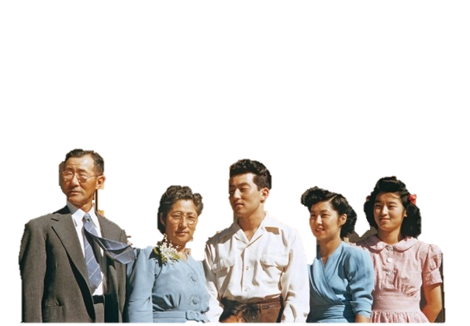
As a result of the Japanese attack on Pearl Harbor, Hawaii overnight, Japanese Americans found their lives changed
Despite the lack of any concrete evidence, Japanese Americans were suspected of remaining loyal to their ancestral land.
Anti-Japanese paranoia increased because of a large Japanese presence on the West Coast.
We are citizens!
We are Americans just like you!

Slide 11
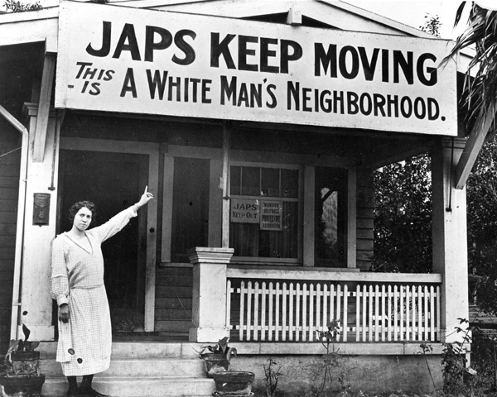
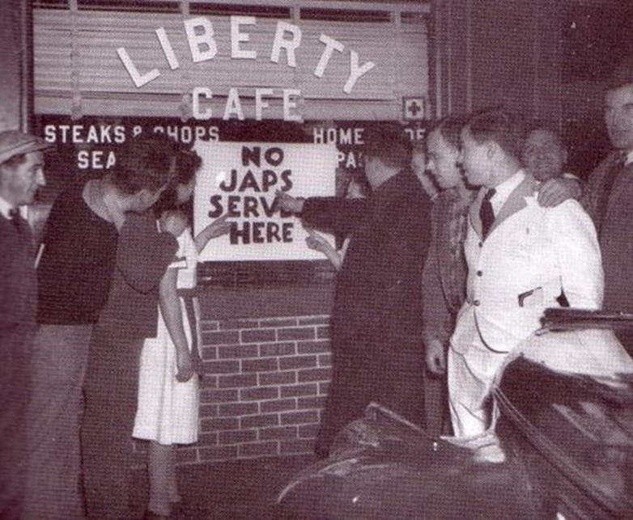
Anti-Immigrant racism was present even prior to America’s entrance into the war but it now intensified especially targeting people of Japanese Ancestry

Slide 12
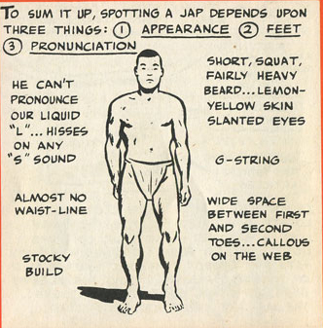
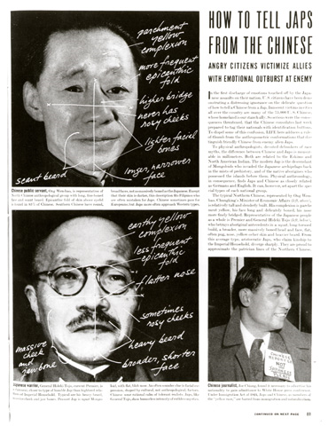
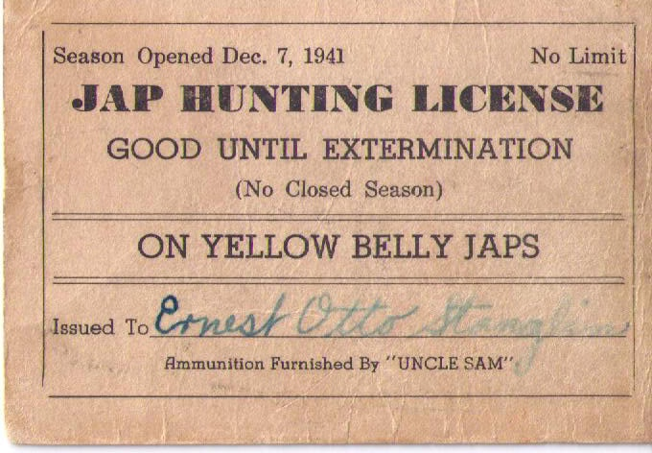
Notes:
LIFE Magazine article, "HOW TO TELL JAPS FROM THE CHINESE" December 22, 1941

Slide 13
Racism
How did you personally experience racism during this time? Choose 2 numbers and record it in your Memory Book .
1
4
2
5
3
6

Slide 14
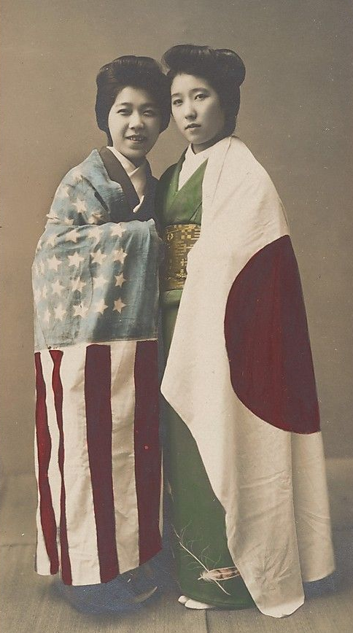
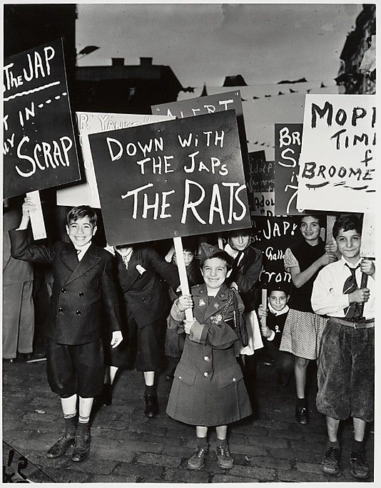
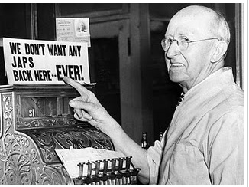
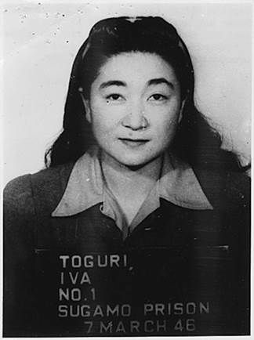
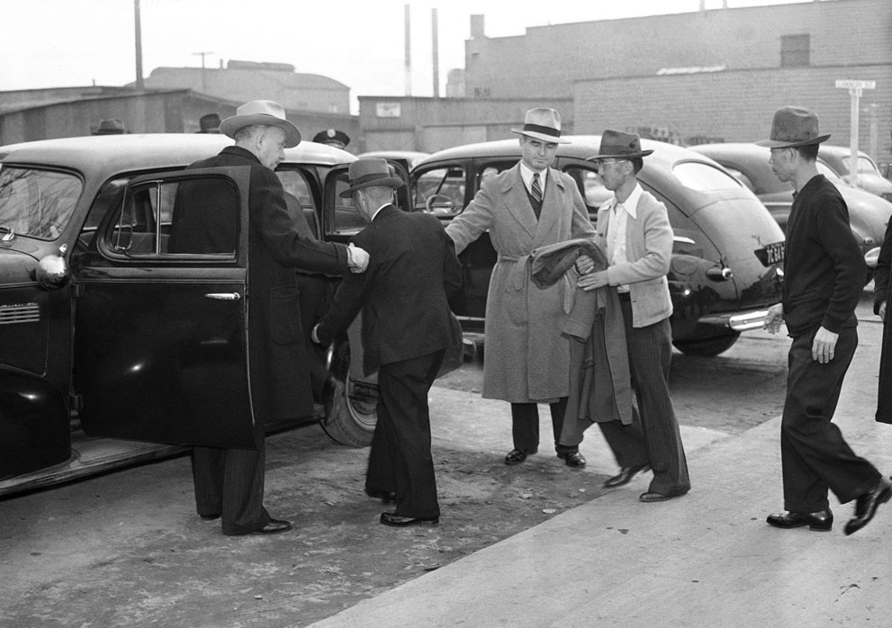
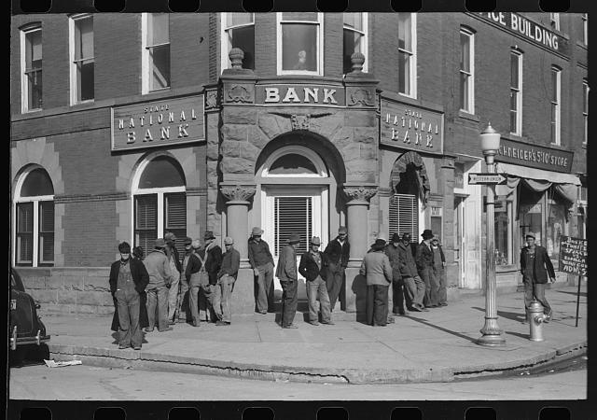
Racism
How did you personally experience racism during this time? Choose 2 numbers and record it in your Memory Book .
1. Your father was arrested because he was a Japanese American community leaders and was unfairly suspected of
having ties to Japan
4. Since your parent were both born in Japan the U.S. Treasury froze your family bank accounts causing numerous financial problems for your family
2. You were arrested for not abiding by the mandatory curfew now imposed on Japanese Americans
5. Your home was searched with out a warrant. The FBI confiscated your radios and family photos and letters dating back generations
3. Your house was vandalized, “Down with the Jap Rats”
6. The Grocery Store your family normally shops at now refuses to sell you anything

Slide 15
Happy New Year
New Years Eve arrives and you don’t feel in the partying mood. You are sad that America was attacked. You are mad that your own government & countrymen are treating you as the enemy. You are frustrated that unfair racist stereotypes are targeting you. Your carefree senior year has been ruined and you are unsure what the future holds for you and your family.

Slide 16
Another month passes and the anti-Japanese hysteria is not subsiding. You are still frustrated with the situation and it gets worse

Slide 17
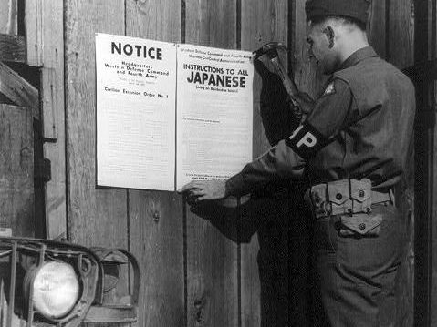
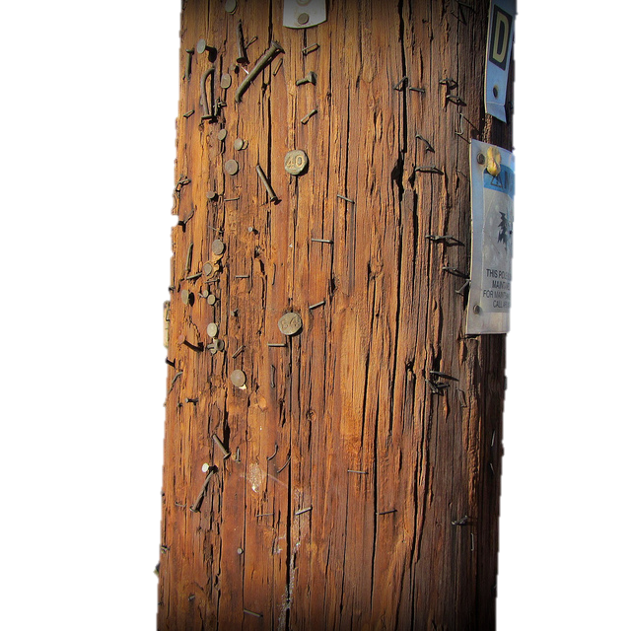
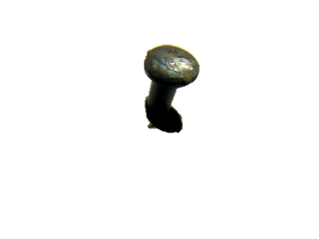
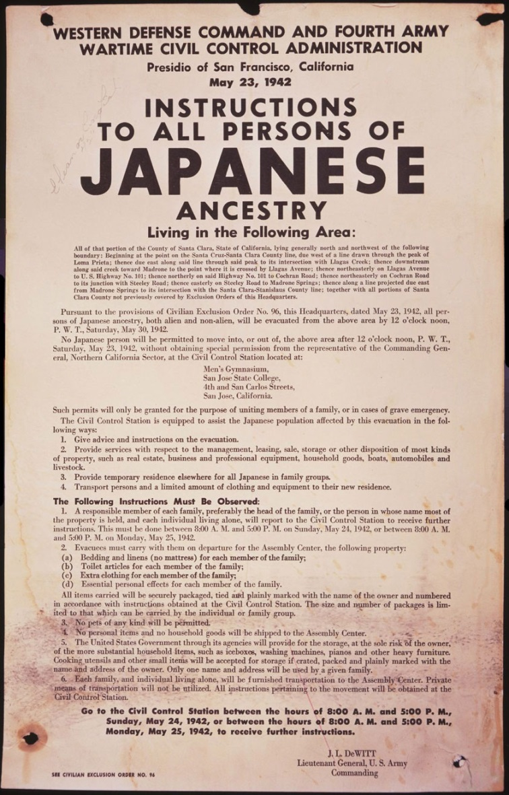
You see a flyer nailed to a telephone pole on one of the main roads. Your neighbors are all crowded around, and it appears to be causing quite a commotion. The flyer is a government document referred to as Executive Order 9066

Slide 18
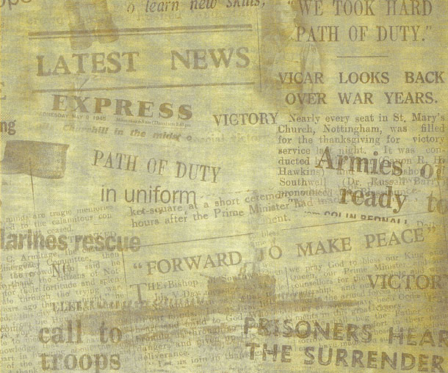
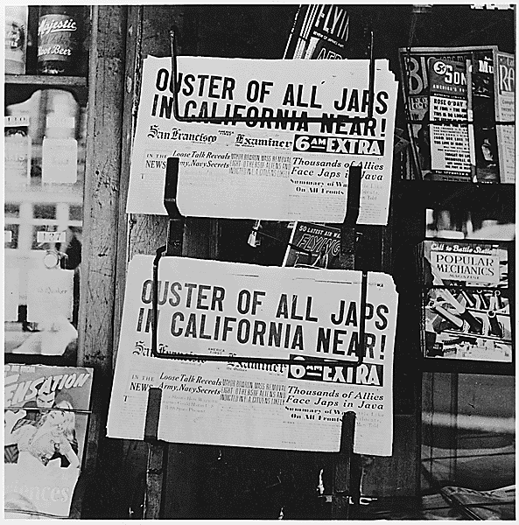
Executive Order 9066
Seventy-four days after Pearl Harbor, President Roosevelt issued an order (Executive Order No. 9066) that forced over 110,000 Japanese Americans to leave their homes in California, Washington, and Oregon and live in one of ten detention camps in desolate parts of the United States.
None of the Japanese Americans had been charged with a crime against the government. Two-thirds had been born in the United States, and more than 70 percent of the people forced into camps were American citizens.

Slide 19
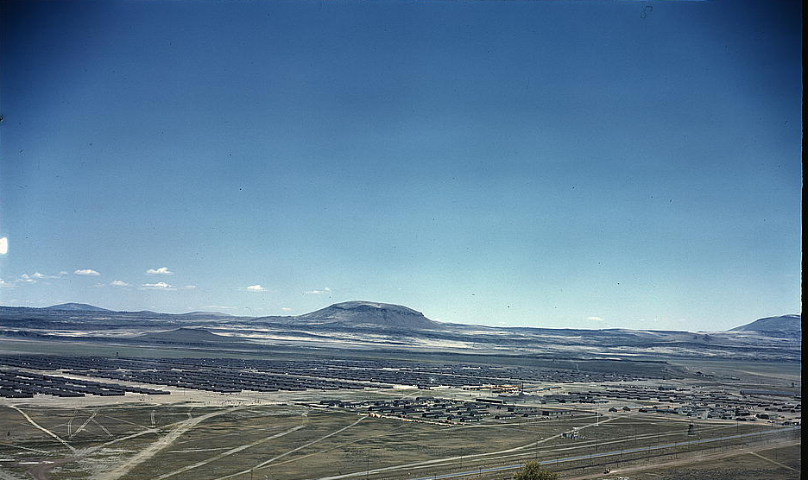
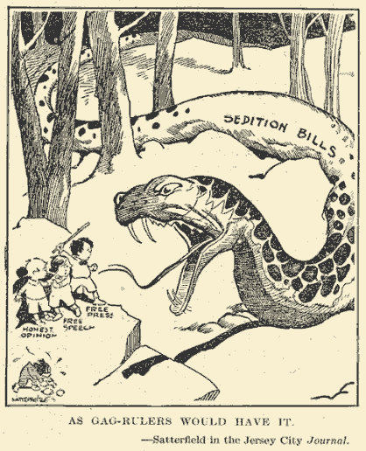
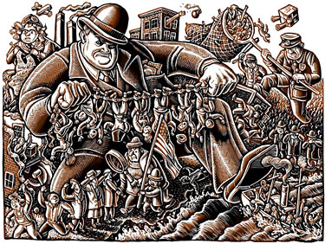
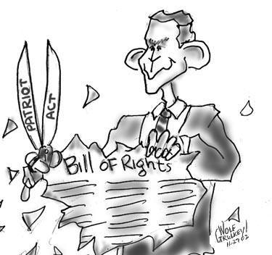
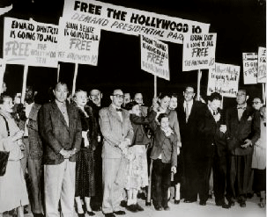
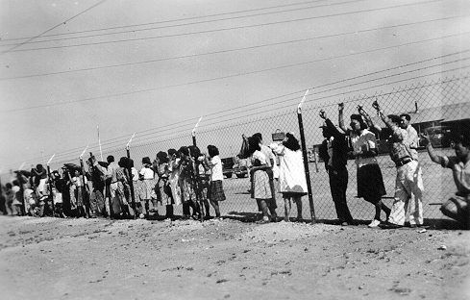
Executive Power
In times of crisis the government over steps its boundaries and takes away individual liberties
Palmer Raids- In fear of a Communist Uprising
Sedition/Espionage Acts-WWI
Japanese internment- WW2
Hollywood 10- Cold War- In fear of a Communist Spies
Patriot Act- September 11th

Slide 20
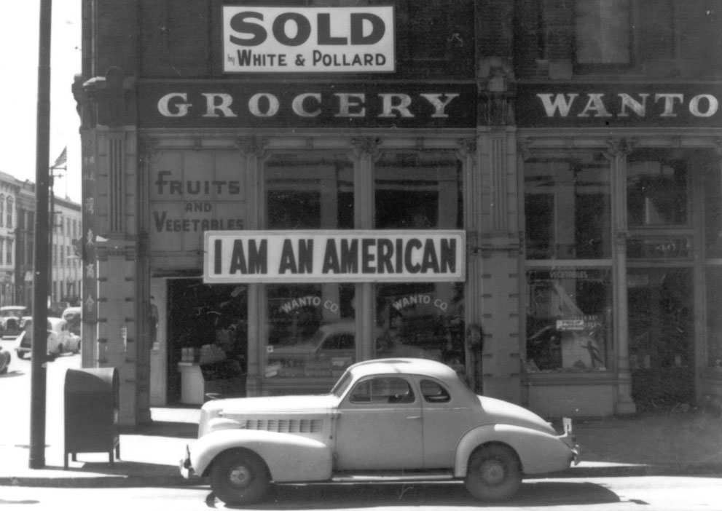
The clock is now ticking. You and your family have little time to pack and sell off what you can.

Slide 21
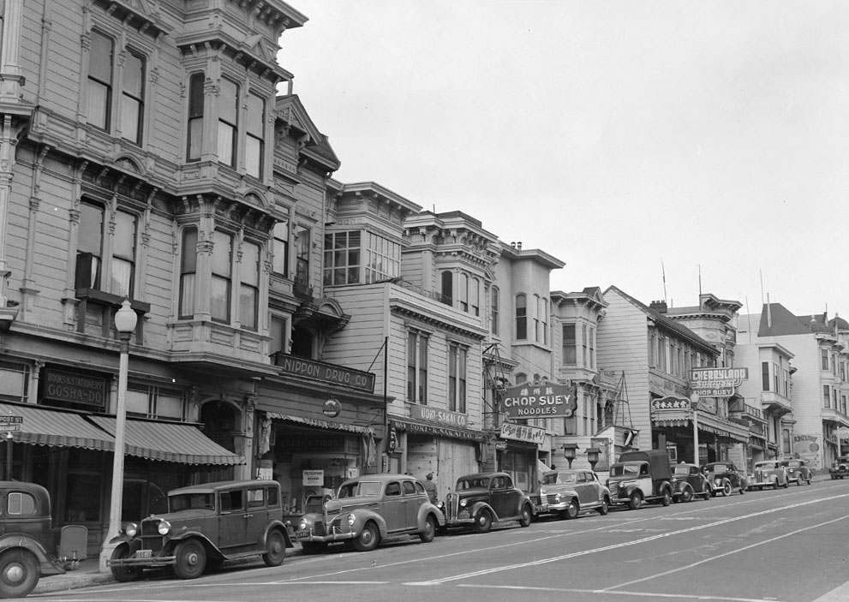
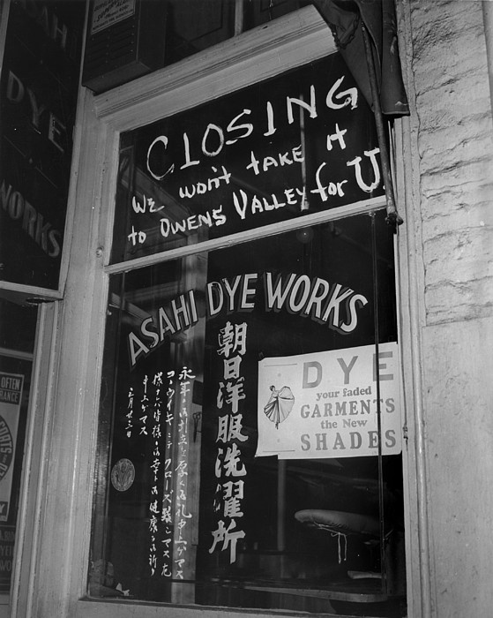
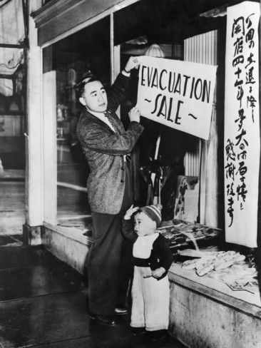
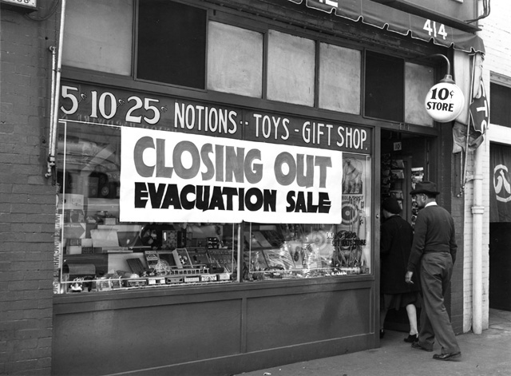
View of a business district on Post Street in a San Francisco neighborhood occupied by residents of Japanese ancestry, before evacuation, in 1942.
View this same intersection as it appears in the 2015 Future: Google Maps Street View.

Slide 22
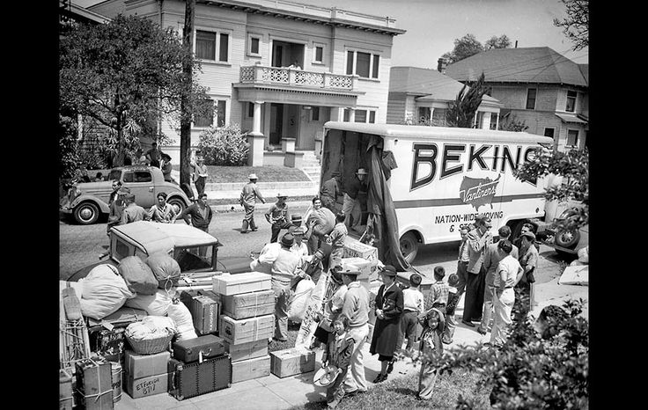
Life’s Possessions Gone
Many Japanese Americans were instructed to pack up only what they could carry and were forced to sell their homes, possessions, and businesses for an extremely small sum or just give them away because they had no other choice.
They had only a few weeks to pack, and dispose of al other possessions. The internees were only
allowed to carry bedding, clothing, and toiletries—whatever they could carry themselves.
However, some did not have a chance to sell their belongings and were forced to leave them.
The Japanese did not know where they were going or for how long they would be gone

Slide 23
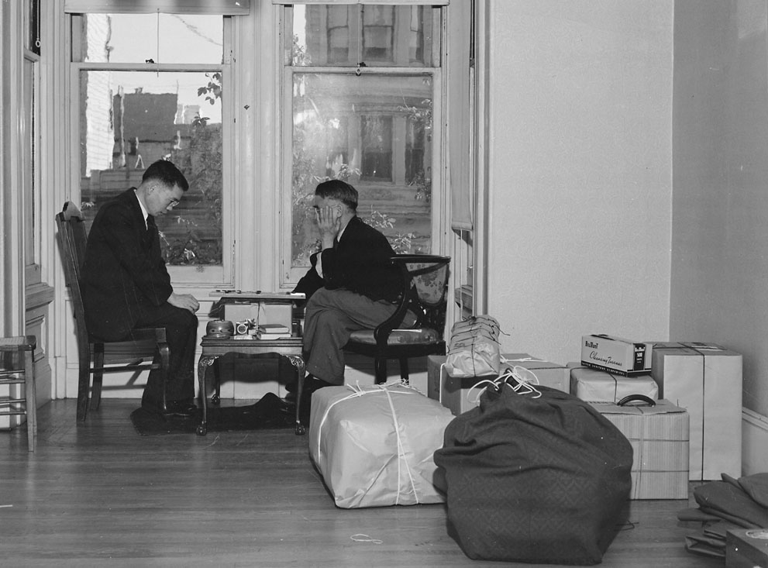
Packing Up
In your Memory Book note 4 belongings that mean the most to you

Slide 24
Packing Up
Circle the items in 2&4. You did not have enough space or you forgot to pack those items
4
2

Slide 25
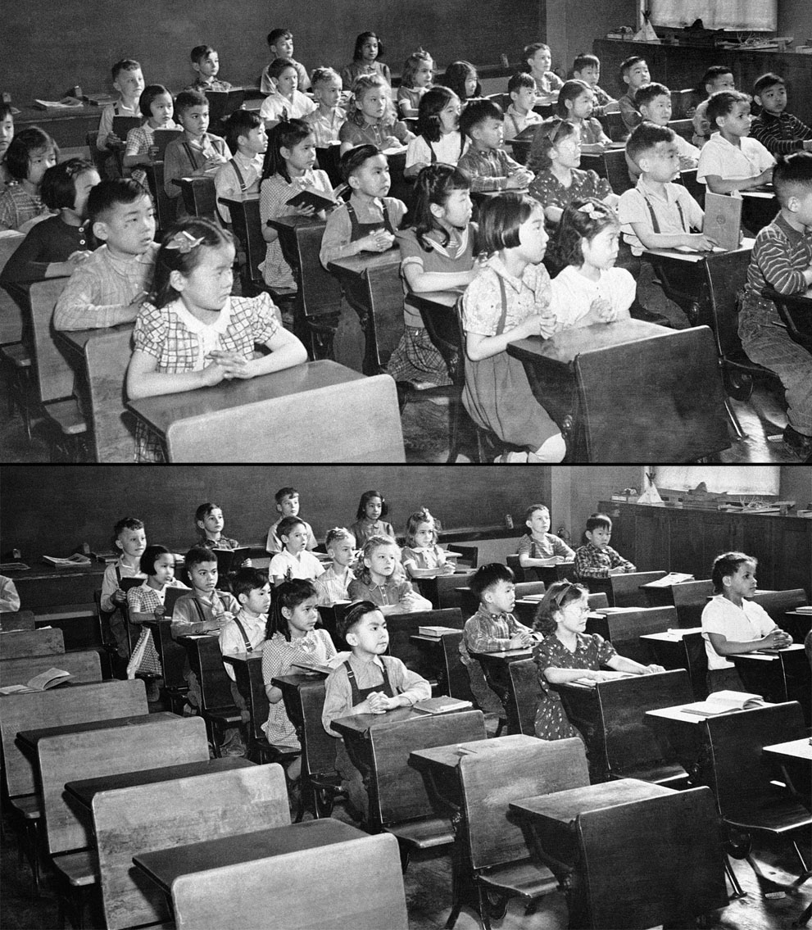
With Japanese-American Students
Your little sister’s 2nd grade class
Without Japanese-American Students
Notes:
Seattle Washington

Slide 26
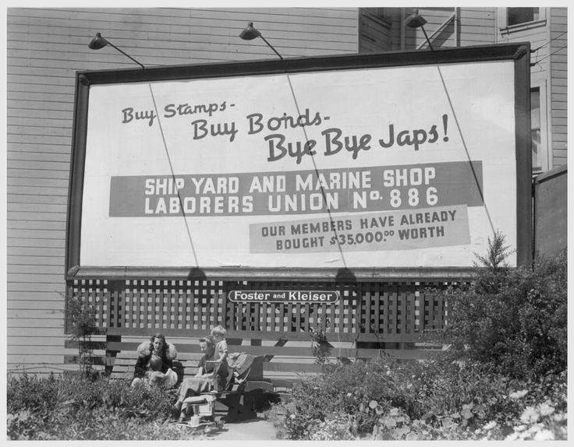

Slide 27
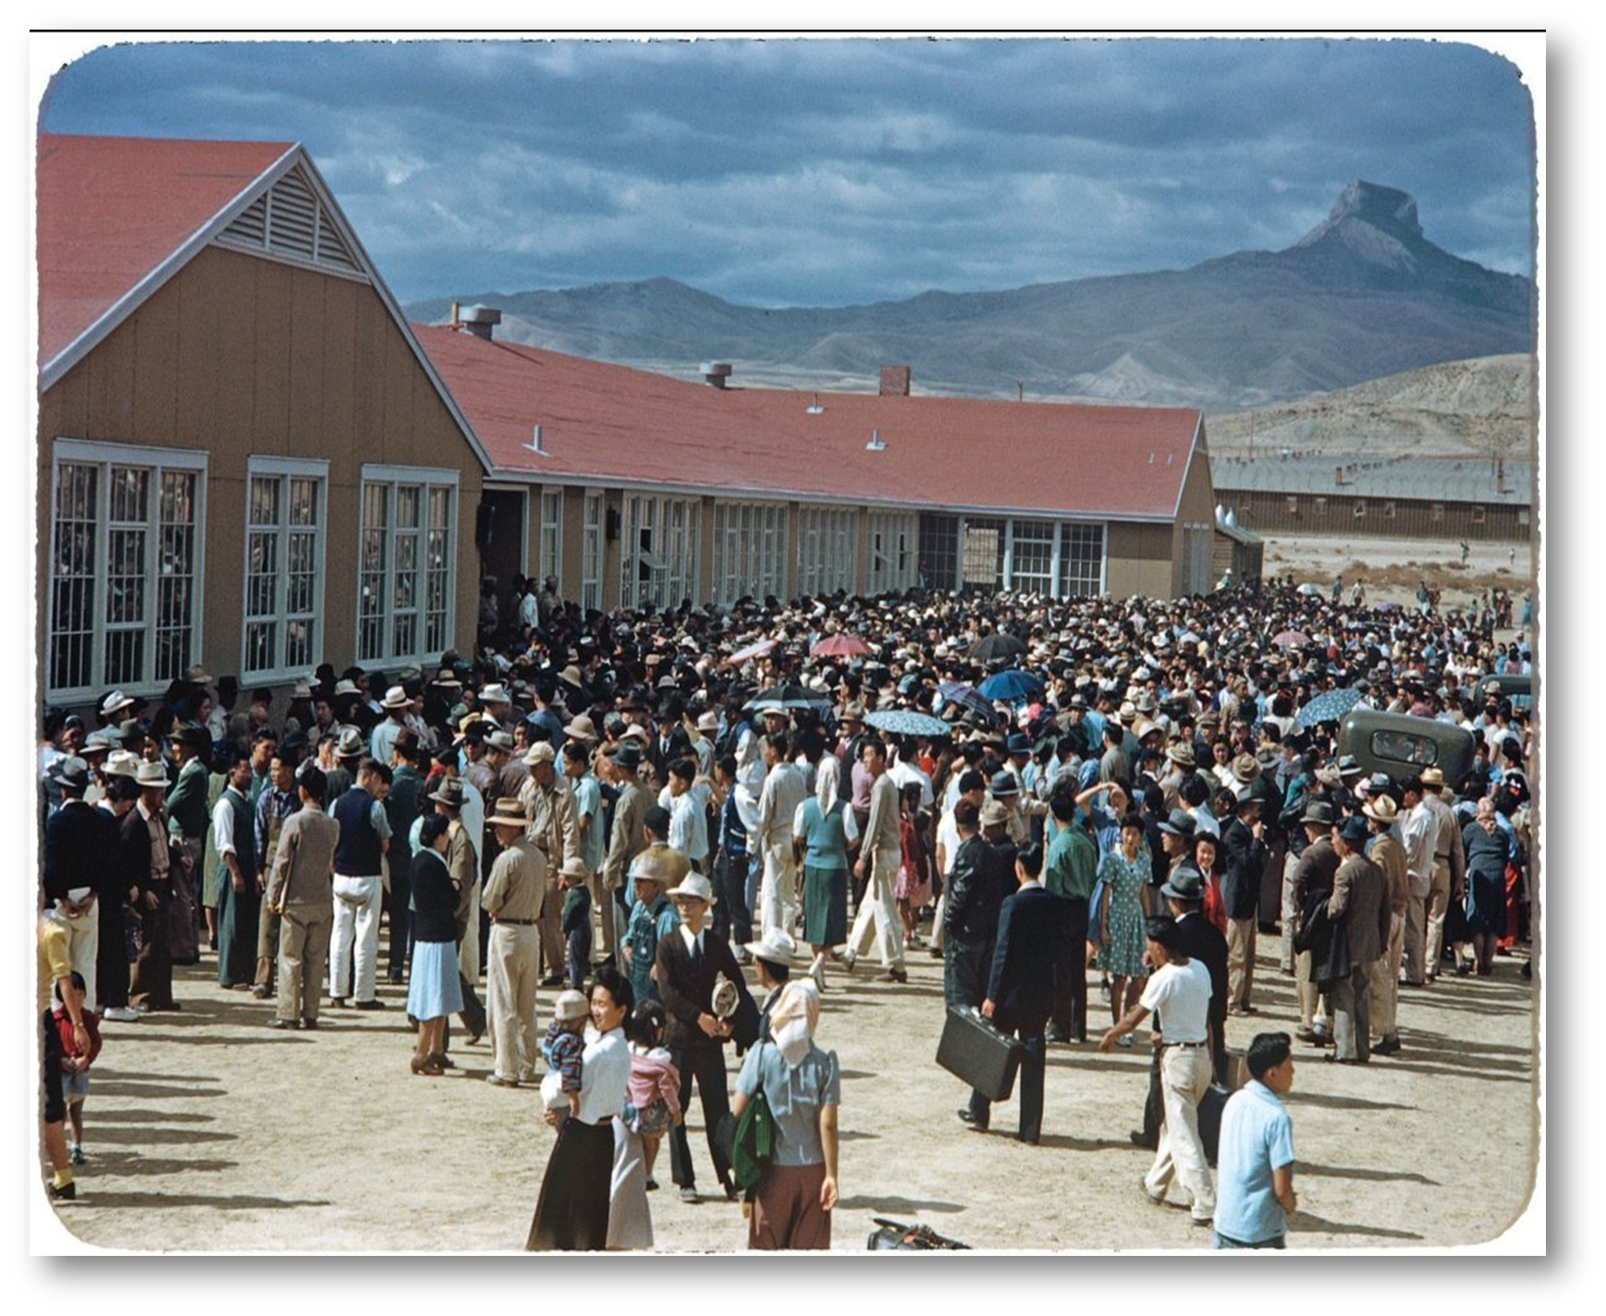
Assembly Center
You and your family were then loaded onto trains and busses and moved first into temporary assembly centers before they could be moved into the relocation centers, or internment camps. You were taken prisoner and placed in heavily guarded military camps in the middle of the desert.

Slide 28
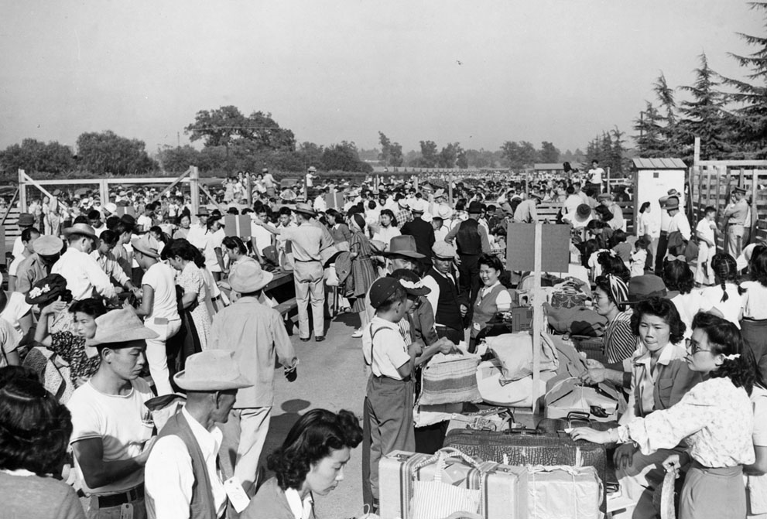
Japanese Americans are being vaccinated by fellow evacuees upon arrival at the Assembly center

Slide 29
Hopefully your luggage doesn’t get lost
Notes:
Salinas, California, 1942. Evacuees of Japanese ancestry identify their luggage at this Assembly center, prior to their transfer to a War Relocation Authority center.

Slide 30
Leaving on the Train

Slide 31
Assembly Centers: Evacuees were sent to hastily constructed temporary assembly centers at racetracks and athletic fields
War Relocation Centers: Evacuees were then sent to more permanent camps in the interior of the U.S. when they were finished being built.
Ten camps were built to hold the roughly 110,000 Japanese-Americans forced to leave their homes.

Slide 32
Relocation Camp
1
2
3
4
Choose a number to see where in the country you were sent for relocation. Write down the # in your MB
5
6
7
8
9
10

Slide 33
Relocation Camp
1- Amache, Colorado: In 1944, 36 draft resisters were sent to AZ Federal Prison.
2- Gila River, Arizona: Know to be the nicest of the 10 camps (show piece). Eleanor Roosevelt visited this camp in 1943
3- Heart Mountain, Wyoming: In July, 1944, 63 prisoners who had resisted the draft were convicted and sentenced to 3 years in prison.
4- Jerome, Arkansas: in June, 1944, Jerome was used to hold German POWs. After the Japanese Americans in Jerome were moved to Rohwer and other camps or relocated to the east
5- Manzanar, California: It was the first of the ten camps to open -- initially as a processing center.
6-Minidoka, Idaho: 73 Minidoka prisoners died in military service.
7- Colorado River Camp, Arizona: Hottest Camp & 2nd most populated after Tule.
In your Memory Book record which camp you were relocated to
8- Rohwer, Arkansas: Most of the internees were from Los Angeles and living in the racist segregated South was a huge culture shock
9- Topaz, Utah: 1943, elderly James Hatsuaki Wakas was shot walking toward the barbed-wire fence but was unable to hear or understand the guard’s warnings.
10- Tule Lake, California: One of the most turbulent camps -- prisoners held frequent protest demonstrations and strikes.

Slide 35
After Traveling for hours you finally see your new “home”

Slide 36
First Meal at Camp
Notes:
Japanese Americans removed from their Los Angeles homes line up at Manzanar Relocation Center, in California, on March 23, 1942, for their first meal after arrival at the camp. Rice, Beans, Prunes, and bread were included in the menu.

Slide 38
This place is horrible!

Slide 39
An oil stove, a single hanging light bulb, cots, blankets, and mattresses filled with straw were the only furnishings provided.
After eating you go to your barrack

Slide 40
Barracks
Inside the internment camps, Japanese Americans were faced with barracks type housing within isolated desert patches.
They were under military confinement, surrounded by barbed wire and armed
guards on all sides.

Slide 42
Barracks
1
2
What was the worst part of the barracks for you? Choose a number
3
4

Slide 43
Barracks
1- Your barrack had wide space in the wooden walls and sand blew through constantly
2- On a regular basis you would wake up to find snakes or large insects in your barrack
Record your frustration in your diary.
3- Your barrack was a converted horse stall and in the heat of the desert the stench of old horse manure was magnified which also brought horseflies
4- You hated the fact that you had no privacy. Sharing toilets & showers with no stalls or dividers

Slide 44
You Work in the Camp
Ultimately the government hoped for the camps to become self­-sustaining and did not want to put any significant amount of money into a situation viewed as temporary, especially not with skyrocketing defense costs abroad. Therefore,
there was a shortage of al kinds of supplies, workers, and aid to those in the internment camps.
Making camouflage nets for the military

Slide 45
Some of the Sights at Camp

Slide 46
Escape from Reality
Pick 2 numbers to see how you tried to have fun in the camps and normalize your life the best that you could
1
4
2
5
3
6

Slide 47
Escape from Reality
1- Go to camp dances
4- Play sports
Record your extracurricular activities in your Memory Book
2- Take up painting
5- Go to the camp theatre
3- Participate in Japanese cultural activities
6- Put on a Fashion Show
Wat Misaka will be the first person of “color” drafted to the NBA in 1947

Slide 48
1943- Eleanor Visits Camp

Slide 49
Eleanor’s Report of the Camp
1943: Eleanor Roosevelt visits Gila River Relocation Camp in Arizona
Her report emphasizes:
Lack of freedom
Breakdown of Family Structure
Low morale
Need to end the exclusion order and allow Japanese to return to their homes

Slide 50
FDR’s Response
FDR’s response to Eleanor’s report:
1. Find troublemakers in the camps and move them to a separate camp. This would clear the way to release the other evacuees
2. Issue work permits which allowed some evacuees to leave the camps
3. Allow Nisei to enlist in the army. 33,000 eventually served in the U.S. Army
“Normal life is hardly possible under any form of detention” FDR (1943)
1/3 of the evacuees were able to leave the camps through these 2 programs by the end of 1943.

Slide 51
Loyalty Oath
1943, Japanese Americans, would be allowed to volunteer for a racially segregated U.S. Army unit.
U.S. War Department and the War Relocation Authority (WRA) tested the loyalty of all people of Japanese ancestry who were incarcerated in the WRA camps.
They required all those 17 years of age and older to answer a questionnaire that became known as the "loyalty questionnaire."
Their answers would be used to decide whether they were loyal or disloyal to the United States.

Slide 52
Do WOMEN have to answer YES?
Question #27 asked: Are you willing to serve in the armed forces of the United States on combat duty, wherever ordered?
Question #28 asked: Will you swear unqualified allegiance to the United States of America and faithfully defend the United States from any and all attack by foreign or domestic forces, and forswear any form of allegiance to the Japanese Emperor or any other foreign government, power, or organization?
Do NON-CITIZENS have to answer YES?
Do ELDERLY have to answer YES?
Officials decided that a "yes" response to question #28 indicated loyalty and a "no" response indicated disloyalty to the United States.
U.S. law did not allow any Japanese immigrants to become naturalized U.S. citizens, answering "yes" would mean they were in danger of losing their Japanese citizenship, leaving them without legal status in any country.

Slide 53
#27- Overall in camps, only six percent of military-aged men who responded to a questionnaire said that they would volunteer for military service.
#28- In the end, many of the 1,327 who were expatriated to Japan were not accepted by the Japanese government

Slide 54
442nd
Many young Japanese American men signed up when the Army announced in 1943 that it would accept volunteers for the 442nd Regimental Combat Team, an all-Nisei combat unit created to serve in Europe.
About 3,000 volunteered and passed loyalty interrogations before acceptance on the team. The unit went on to be one of the most highly decorated in American history.

Slide 56
Draftees & Volunteers
8,000 Japanese American men, many draftees, served in the military during the war.
Japanese American women also volunteered from the camps to serve in the Women's Army Corps and the Red Cross.

Slide 57
The gov’t forced me to relocate for national security… but they want me to enlist?

Slide 58
Loyalty Questionnaire
1
2
Find out what happened to you after completing your Loyalty questionnaire. Pick a # and record it in your Memory Book
3
4

Slide 59
Loyalty Questionnaire
1- NO-NO Boy: You answered No & NO to ?s 27 & 28 and are seen as defiant so you are sent to Tule Lake Segregation Camp away from your friends and Family
2- You answered Yes to both questions and enlisted in the 442^{nd &} begin training in Shelby Mississippi
(If you are female you are deferred to #3’s response)
3- You volunteered for the Red Cross & the Women’s Army Corps (If you are male you are deferred to #4’s response)
4- You are drafted for the war and are sent to boot camp
(If you are female you are differed to #3’s response)
Record your experience in your Memory Book

Slide 60
As the War continues for the next few year individuals of Japanese ancestry are attempting to fight for their constitutional rights. One of the most notable Civil Rights activists is a man by the name of Fred Korematsu.

Slide 62
Fred Korematsu
Fred Korematsu was born to a Japanese-American family that owned a flower nursery. After World War II broke out, Japanese living in Pacific states were subject to curfews, and later sent to internment camps.
Korematsu refused to go to an internment camp. In 1942 he was arrested and sent to a camp.
Korematsu sued the United States. The U.S. Supreme Court upheld his conviction in 1944 on the grounds of military necessity.

Slide 63
Fred Korematsu v USA
1944- Supreme Court upheld the internment of Japanese Americans residing on the West Coast by ruling that the actions were necessary for national security

Slide 64
War is Over
1945 WWII finally comes to an end
The last camp did not close until 1946 and no substantial reparations were made to the Japanese American citizens who had been uprooted, robbed of their possessions and their civil rights.

Slide 65
War is Over
Add up all your numbers
Even
Odd

Slide 66
War is Over
Even- Luckily you had a friend that was able to keep your family’s belongings safe when you were away. You move back to California and thankfully find a job and start rebuilding your life
Add up all your numbers and Record in your Memory Book.
Note how the war ended for you depending on if your sum was EVEN or ODD
Odd- When you were forced to relocate your family lost everything. With no money, belongings or job you decide to stay nearby were your relocation camp is and try to help your family rebuild

Slide 67
Government Apology
In 1988 the government finally acknowledged that internment was unjust and the government issued $20,000 per internment survivor as an apology

Slide 68
Fred Korematsu with a letter of apology from the White House. 1998
Notes:
In one of the landmark Supreme Court cases, Fred Korematsu was convicted in 1944 for defying the order to intern Japanese-Americans. This Court decision was eventually reversed and in 1988 Korematsu received a medal of freedom. When in 2004 some detainees challenged government’s authority to hold them without trial in the Supreme Court, Fred Korematsu submitted a brief in support of detainees. He wrote: “When viewed in its historical context, the Government’s position is part of a pattern whereby the executive branch curtails civil liberties much more than necessary during wartime and seeks to insulate its actions from any judicial scrutiny… Only later errors are acknowledged and apologies made.”

